Slide 1
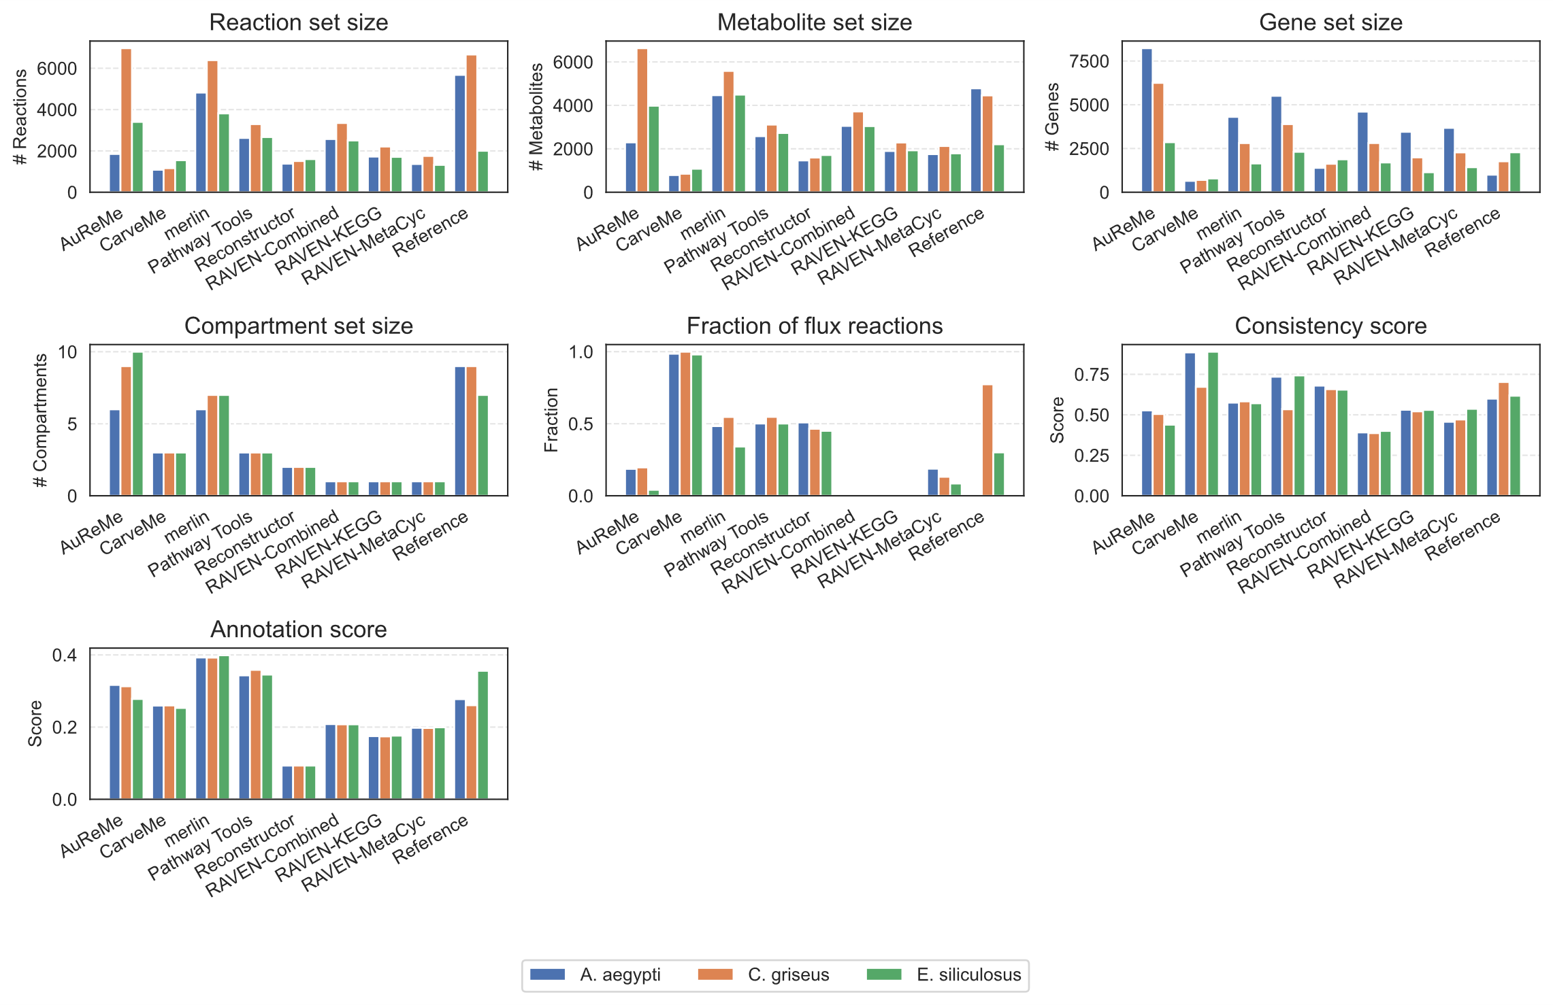
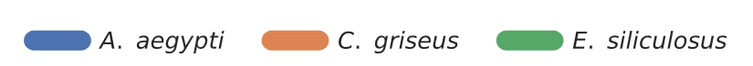
(a)
(b)
(c)
(d)
(e)
(f)
(g)
Organisms

Slide 2
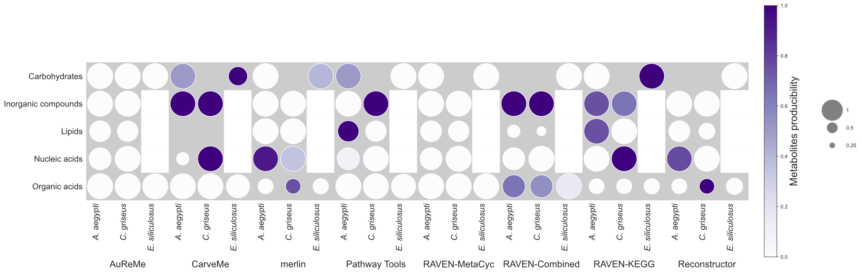
Metabolite
presence

Slide 3
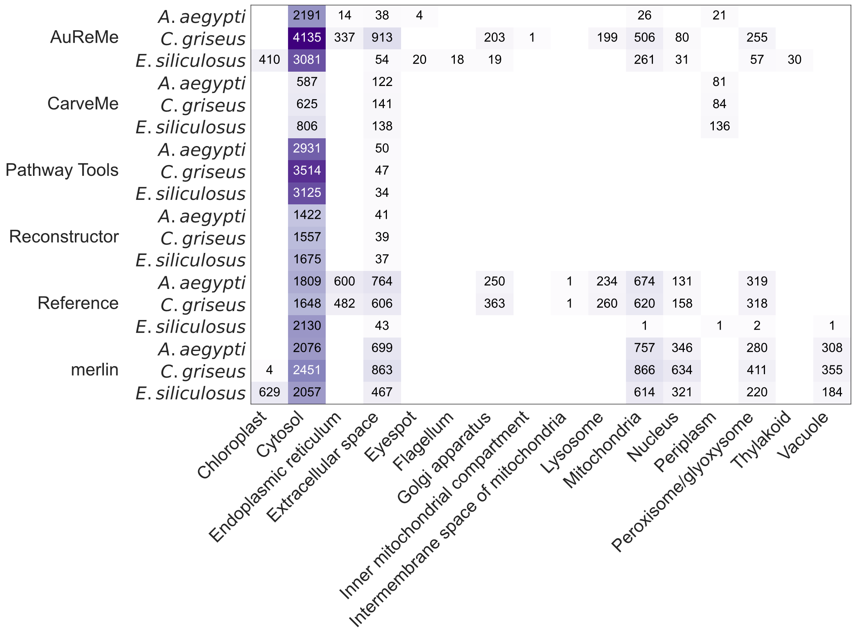
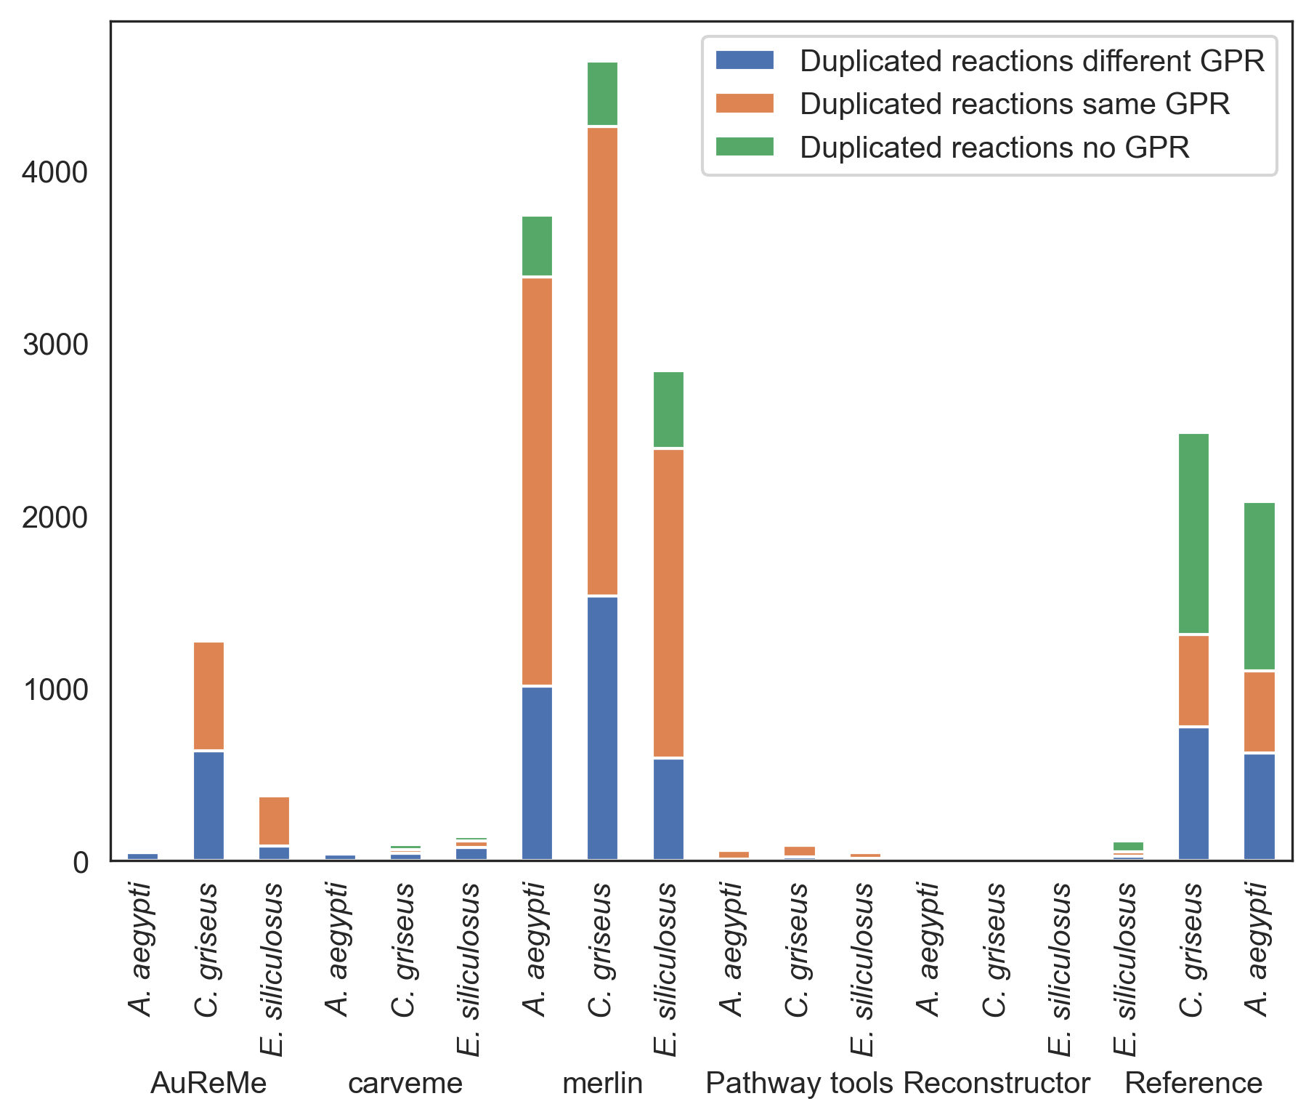
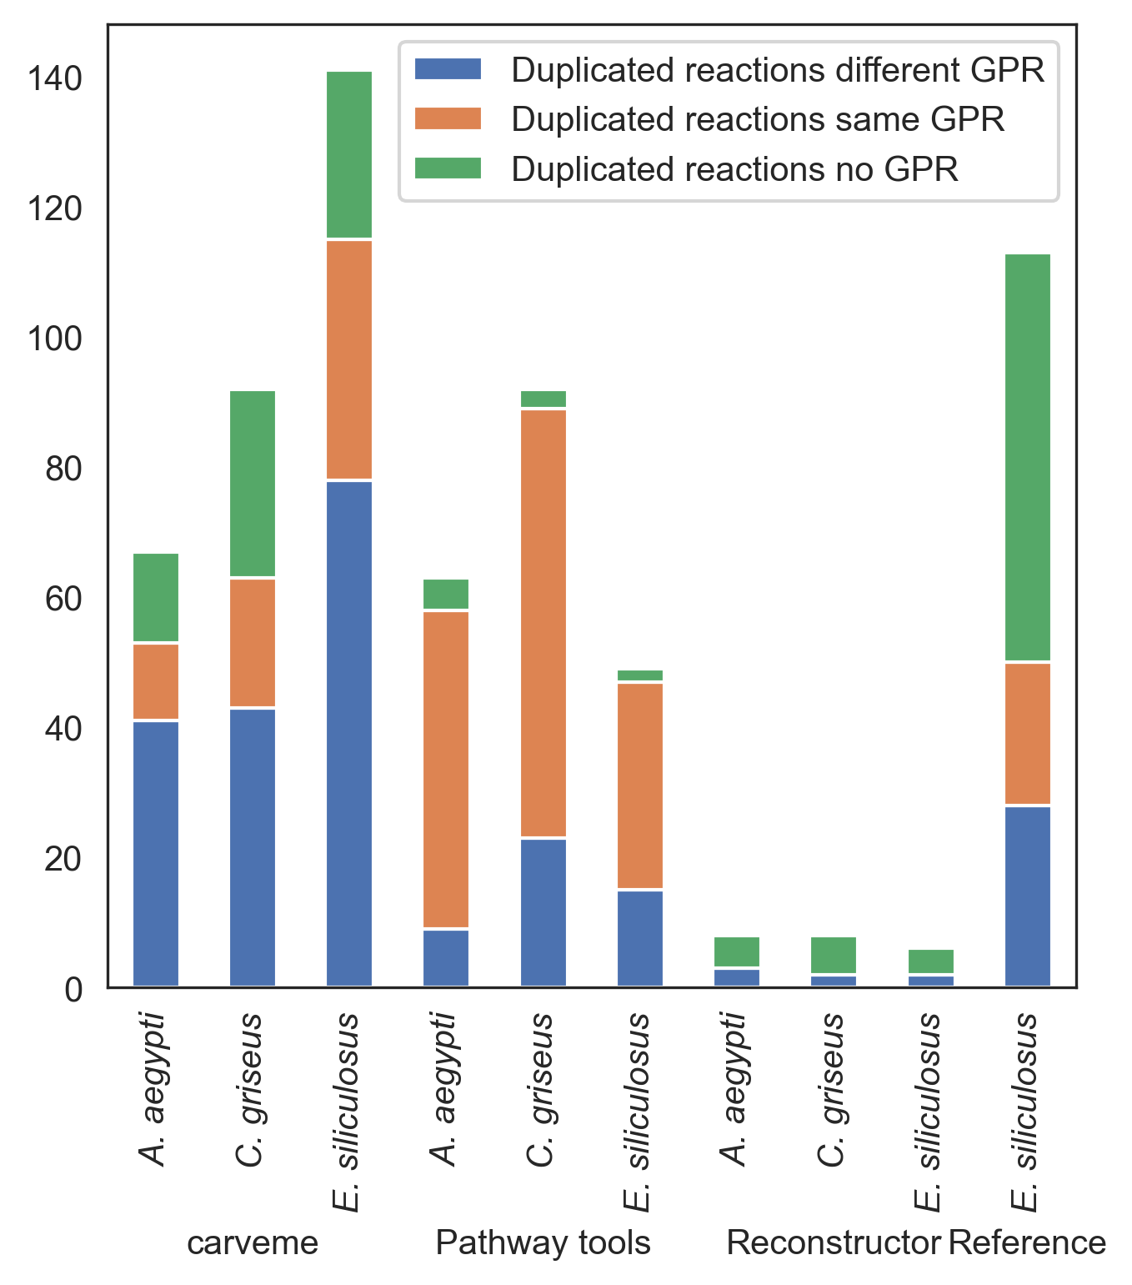
(a)
(b)
(c)
AuReMe
CarveMe
merlin
Pathway Tools
Reconstructor
Reference
CarveMe
Pathway Tools
Reconstructor
Reference

Slide 4
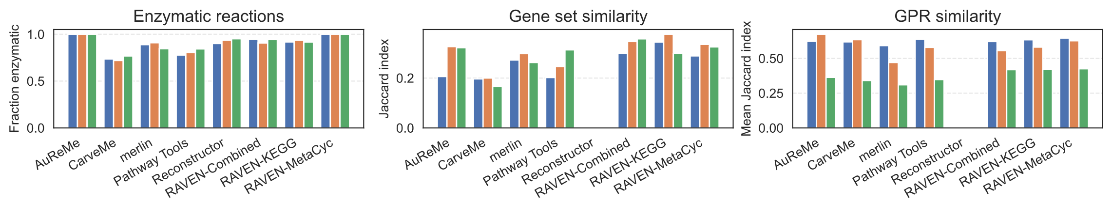
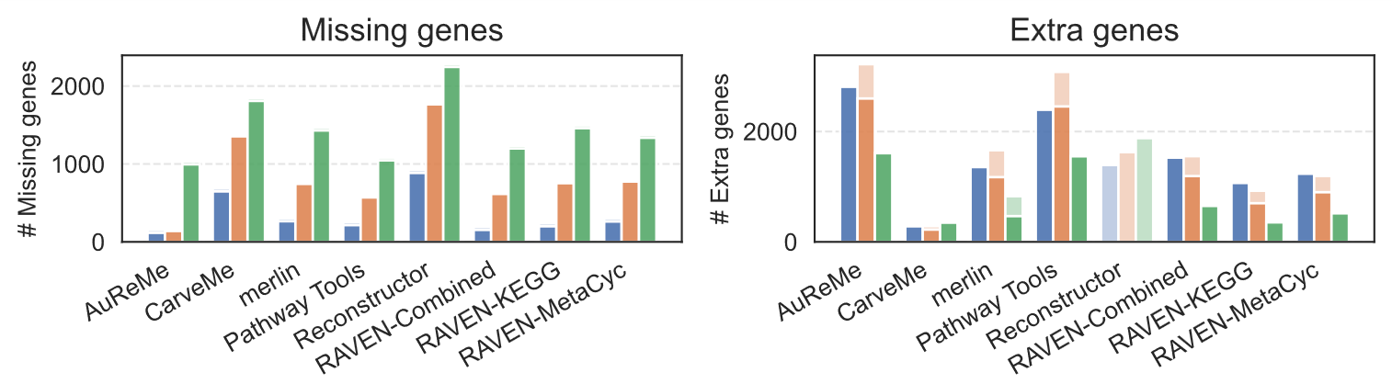
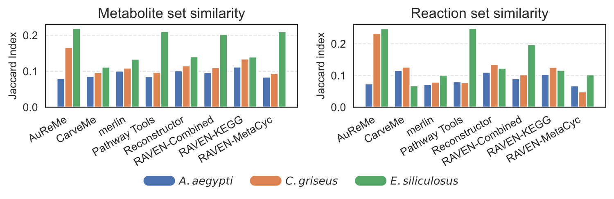
(a)
(b)
(c)
(d)
(e)
Organisms
Mapping status
Mapped
Non-mapped

Slide 5
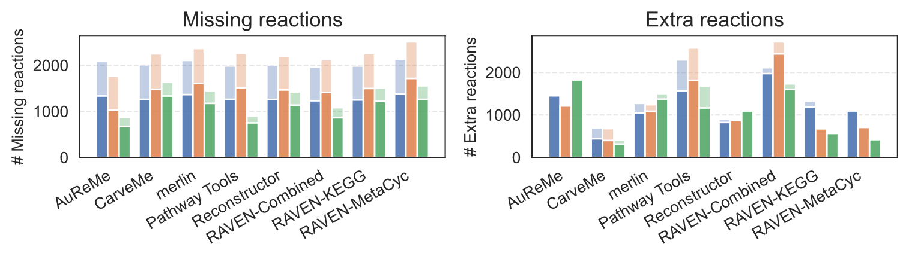
(a)
(b)
(c)
(d)
Organisms
GPR presence
With GPR
Without GPR

Slide 6
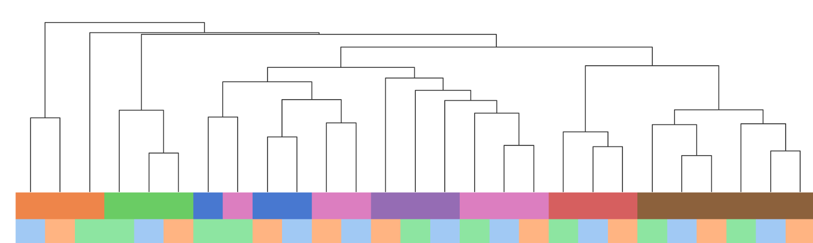
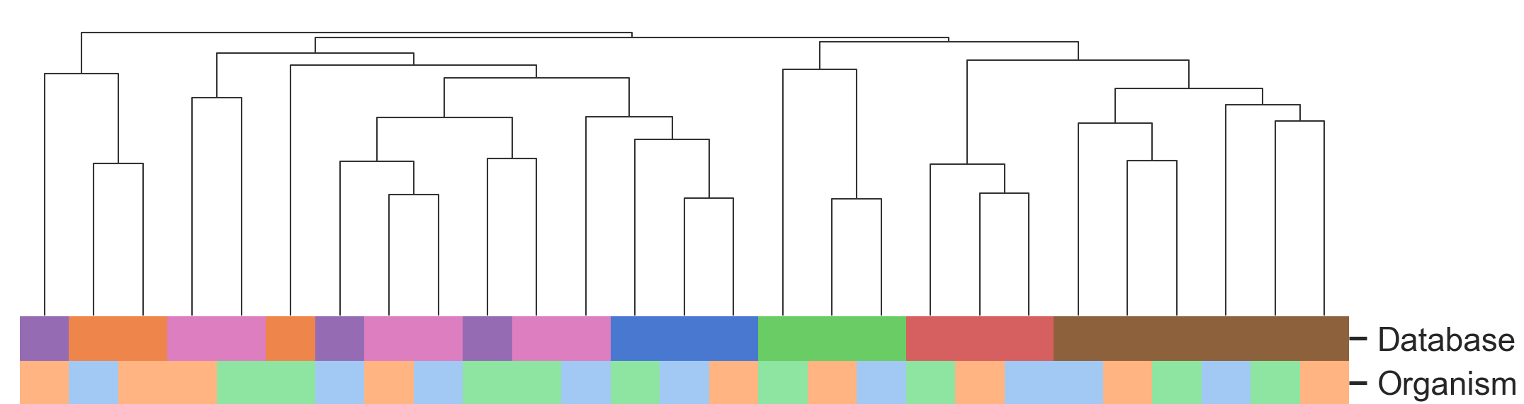
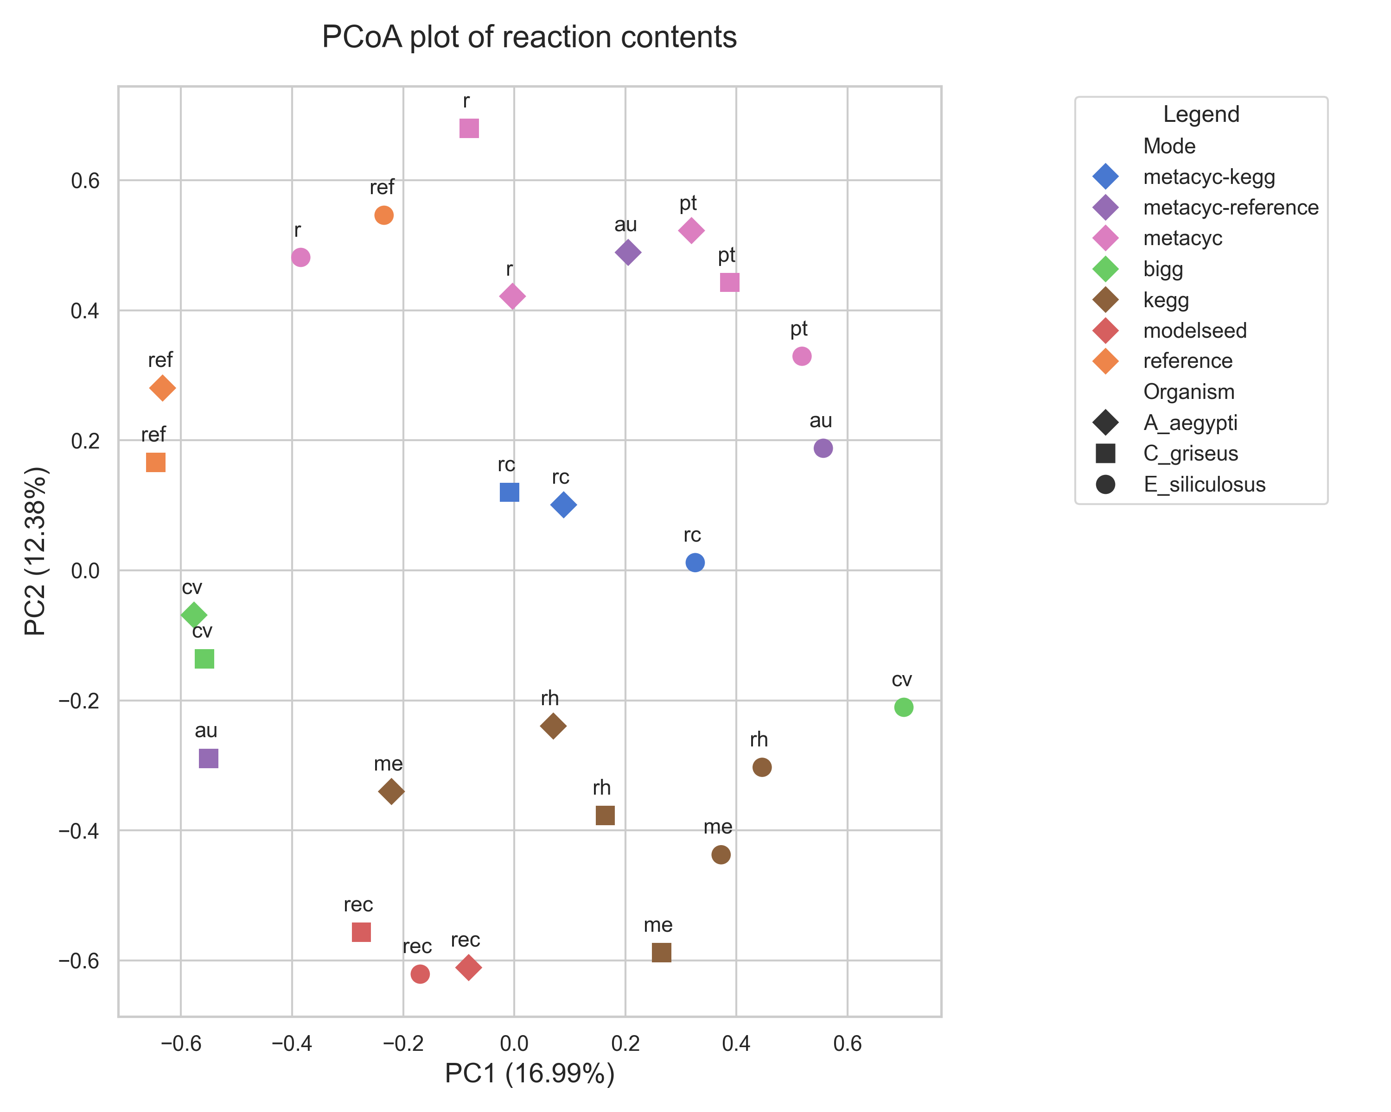
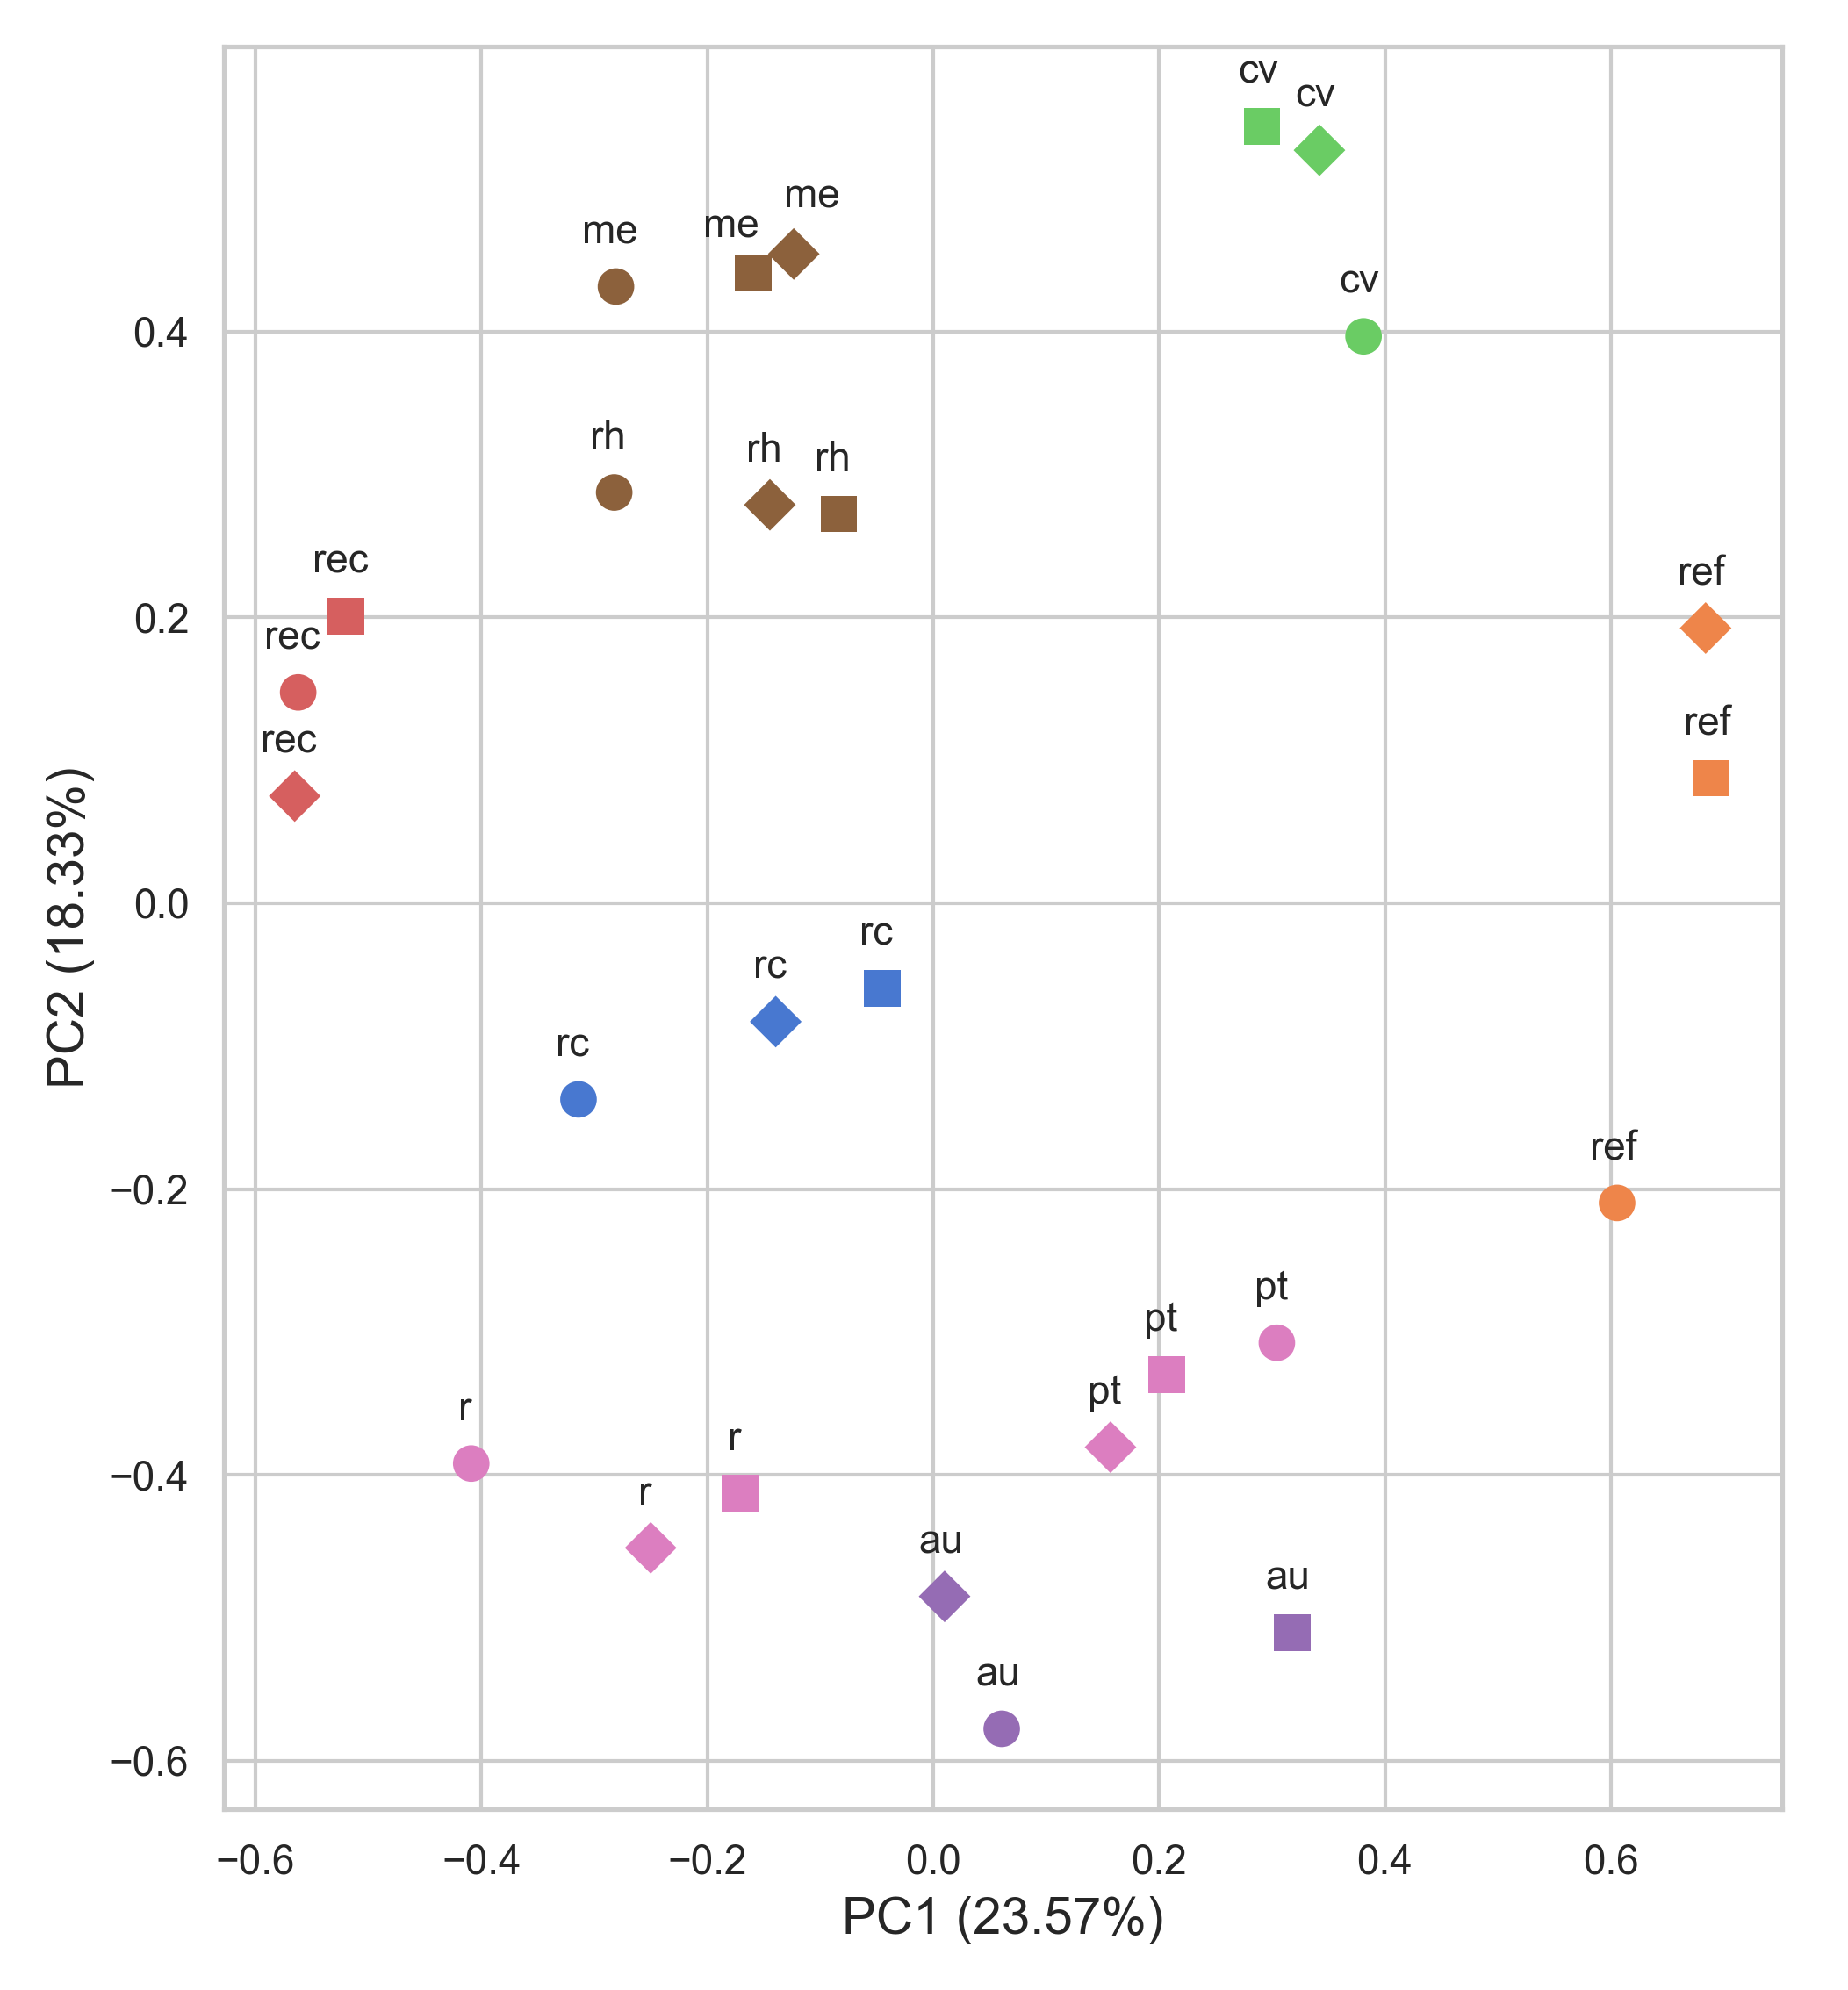
(a)
Metabolites
(b)
Reactions
r m
rc
r m
au
r m
r m
cv
rc
r m
au
pt
cv
cv
rc
au
au
pt
pt
rec
rk
rk
pt
pt
r m
ref
rec
rec
me
me
rk
ref
ref
ref
au
au
pt
rc
rc
rc
cv
cv
cv
rk
ref
ref
me
rec
rk
rk
rec
rec
me
me
me
r m
r m
Legend
r m
Database
r k
r k
MetaCyc + KEGG
MetaCyc + Template
MetaCyc
BiGG
KEGG
ModelSEED
Reference
r k
Organism
A. aegypti
C. griseus
E. siliculosus
rk
rk
r m
r m
rk
r m

Slide 7
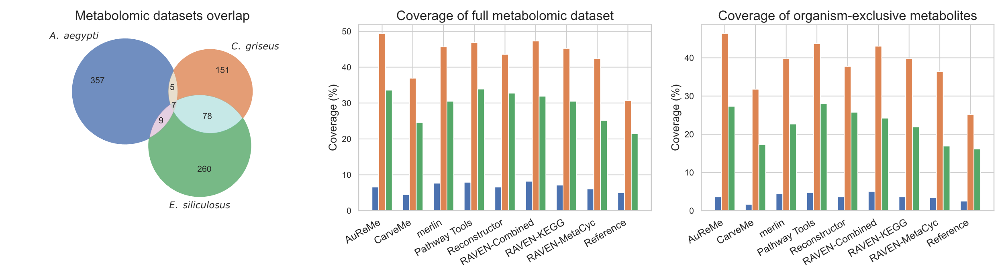
(a)
(b)
(c)

