Slide 1
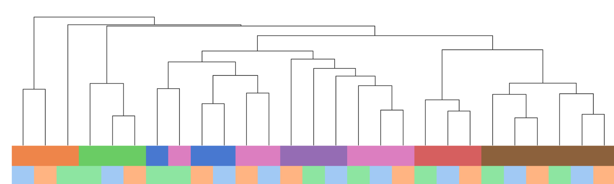
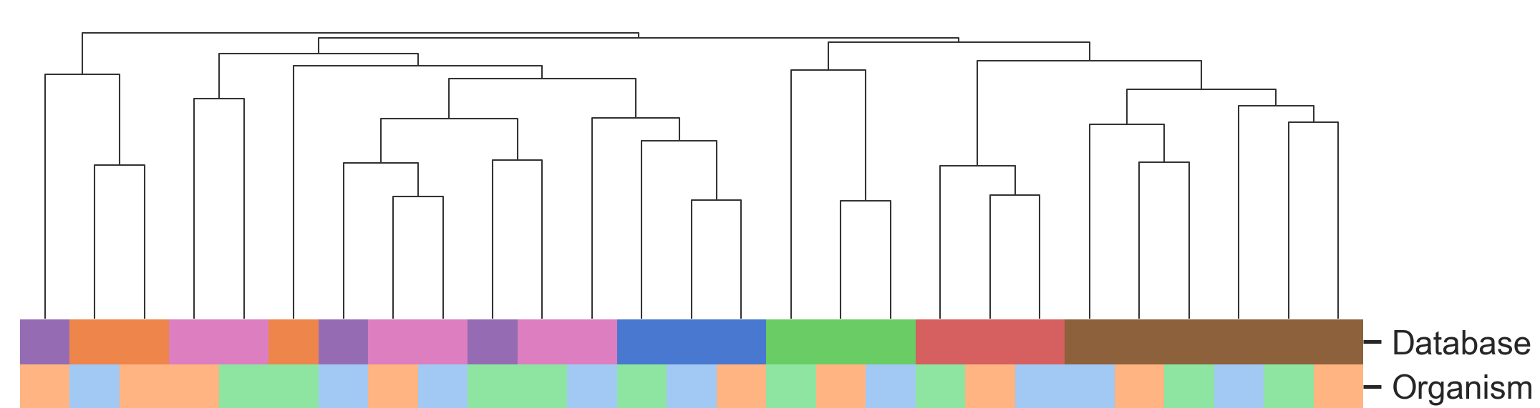
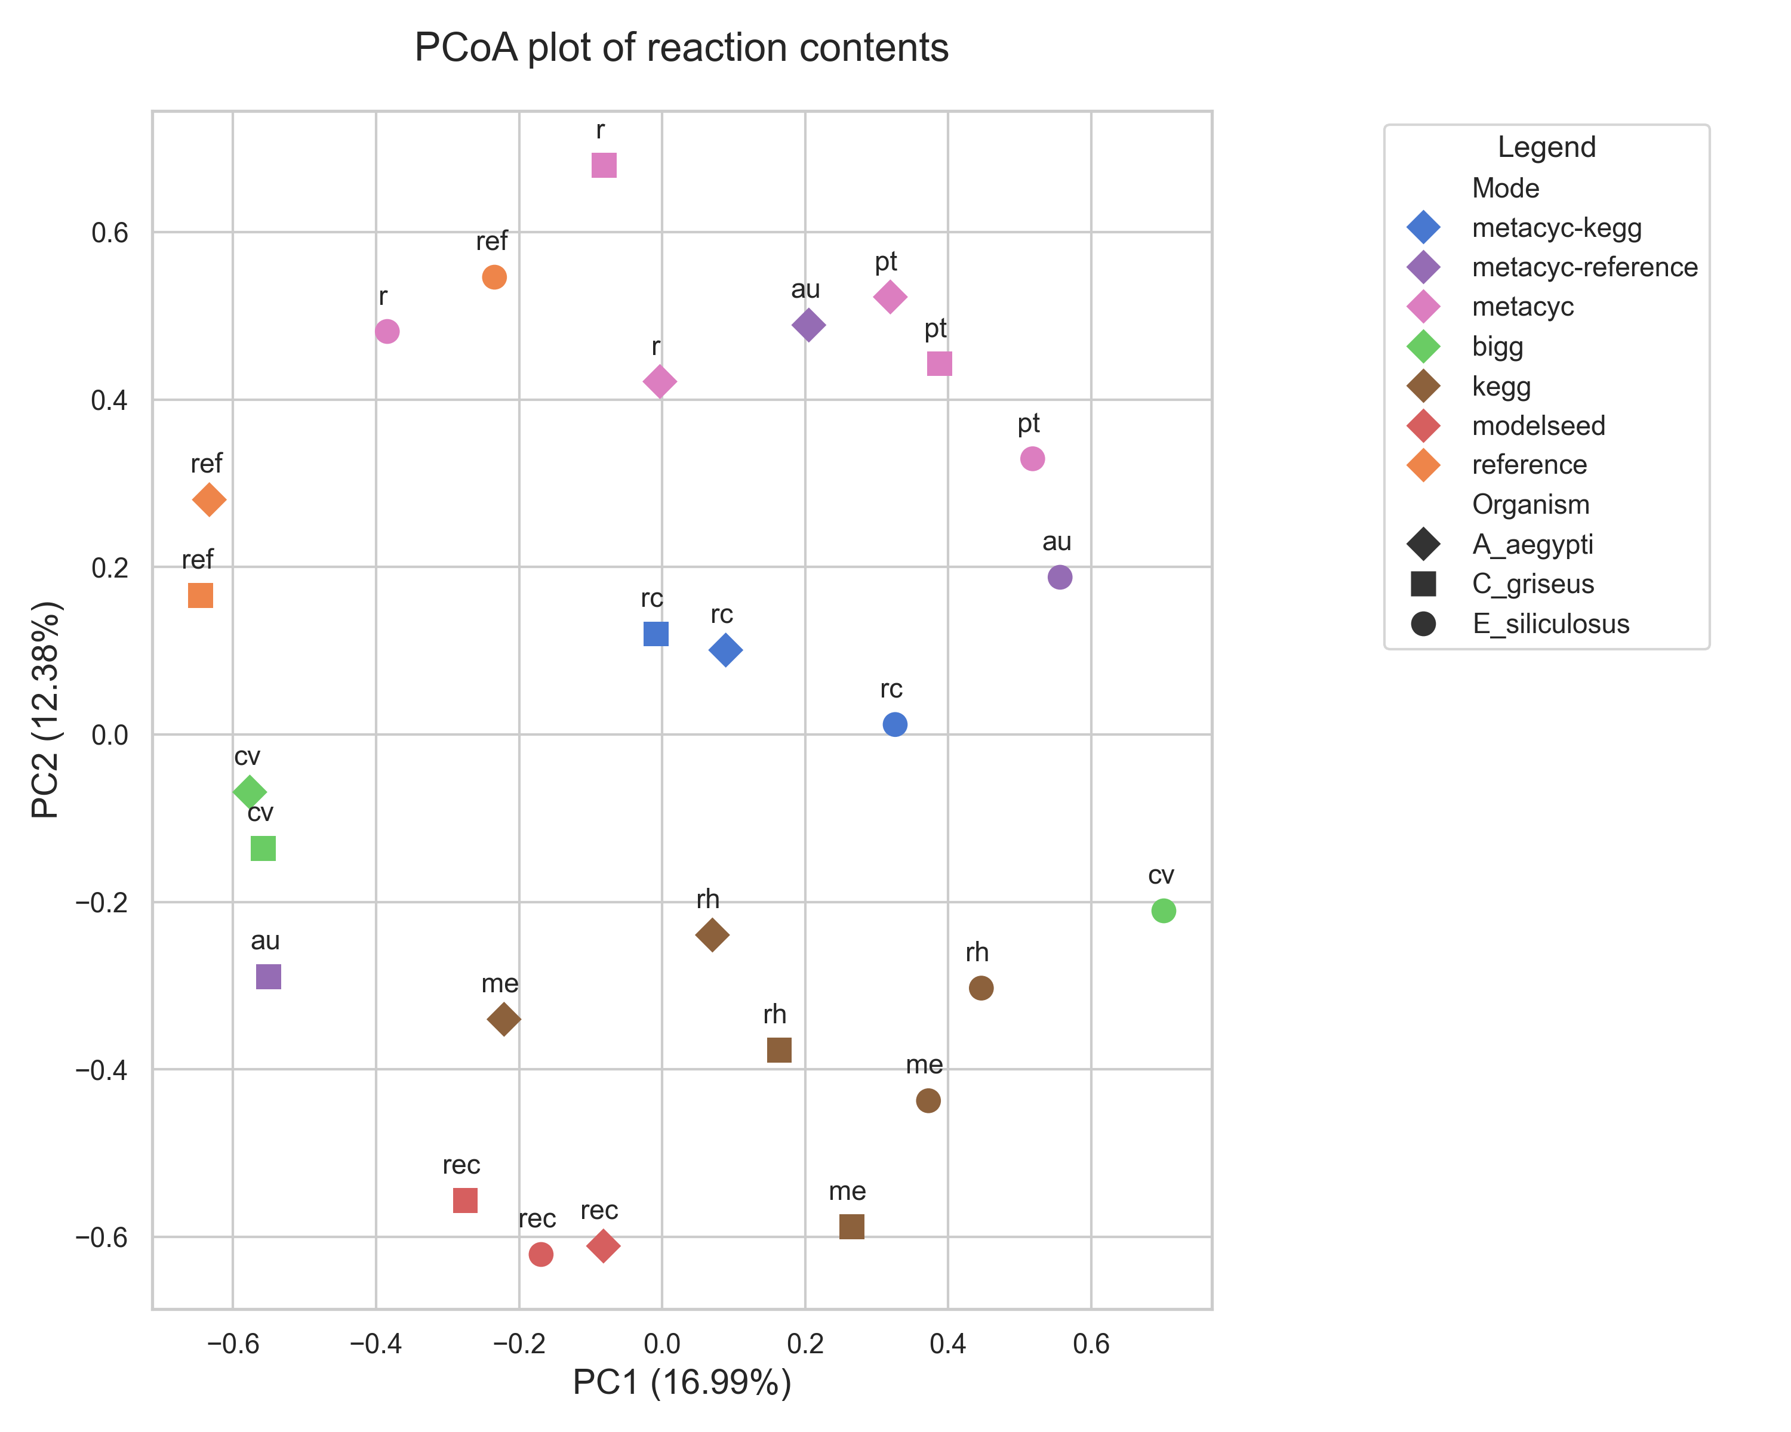
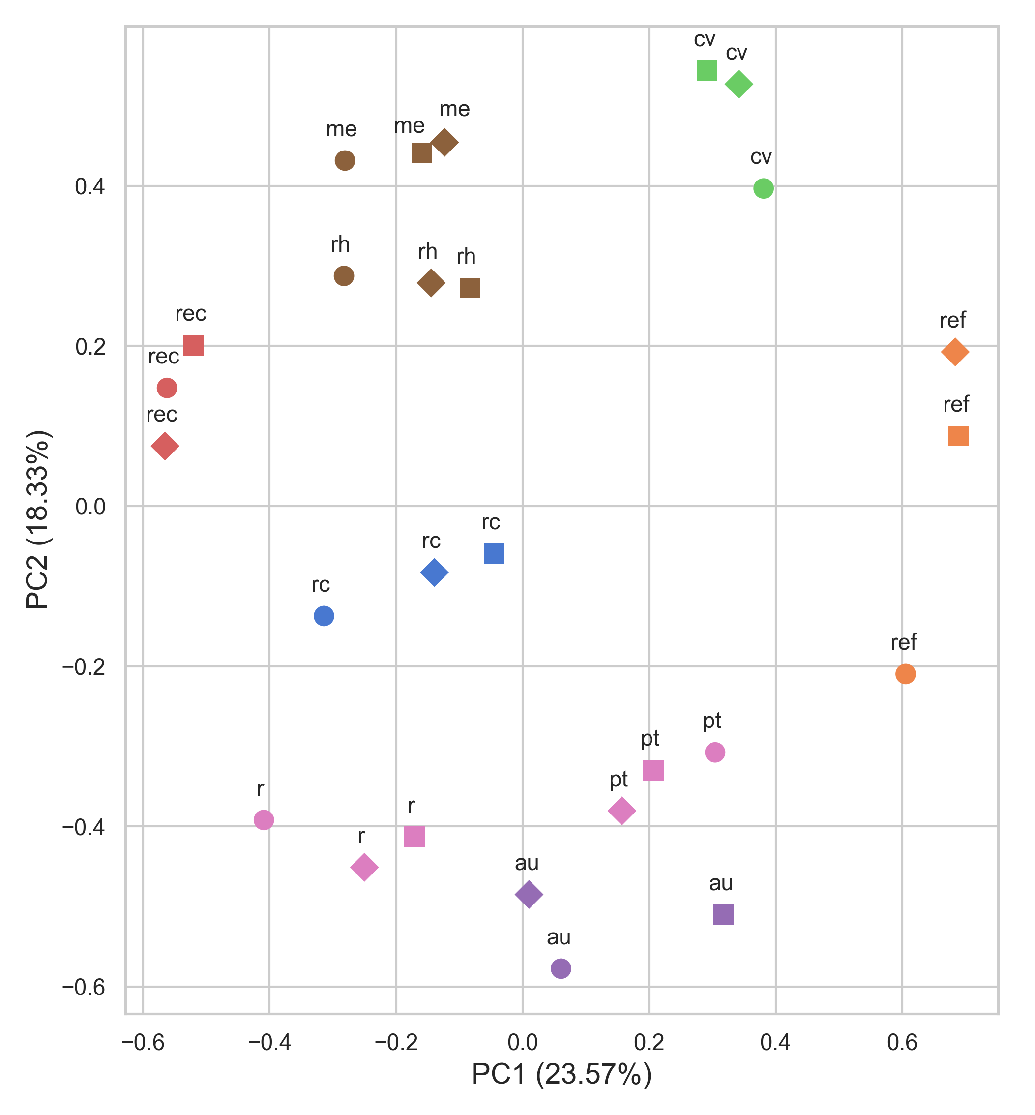
A.
Metabolites
B.
Reactions
r m
r m
au
r m
r m
cv
rc
rc
r m
au
pt
au
cv
cv
rc
au
pt
pt
rec
rk
rk
pt
pt
r m
rec
me
rk
ref
ref
pt
rc
rc
rc
cv
cv
cv
ref
rec
me
ref
au
au
rk
ref
ref
me
rec
rk
rk
rec
rec
me
me
me
r m
r m
Legend
r m
Database
r k
r k
metacyc-keg
metacyc-reference
metacyc
bigg
kegg
modelseed
reference
r k
Organism
A. aegypti
C. griseus
E. siliculosus
rk
rk
r m
r m
rk
r m

