Slide 1
Single Cell Sequencing

Slide 2
Filtering Cells and Genes
Many measurements
e.g. 30k genes x 1ks of cells
Some cells are uninformative, e.g.:
Very few reads, few genes detected
Two cells sequenced together (i.e. doublets)
Some genes are uninformative:
Low # reads, low variance across all cells
Too few cells express gene (e.g. < 10 of 10,000 cells nonzero)
Must filter genes and cells to reduce noise

Slide 3
Filtering the Counts Matrix
Cells might also be filtered:
Very few or zero counts (cell4)
Empty well?
Ambient expression?
Quiescent cell?
Very many counts (cell5)
Possible “doublet” of same cell type
Inconsistent expression pattern (cellM)
Possible “doublet” of different cell types
Doublet: two cells with same cell barcode
 | cell1 | cell2 | cell3 | cell4 | cell5 | cell6 | ... | cellM
gene1 | 93 | 25 | 0 | 0 | 3335 | 0 |  | 82
gene2 | 5 | 2 | 0 | 3 | 1252 | 0 |  | 12
gene3 | 0 | 0 | 0 | 0 | 0 | 0 |  | 0
gene4 | 98 | 21 | 1 | 1 | 5318 | 0 |  | 75
gene5 | 0 | 0 | 513 | 0 | 0 | 325 |  | 135
gene6 | 0 | 0 | 113 | 0 | 1 | 497 |  | 255
gene7 | 3 | 0 | 0 | 0 | 6 | 0 |  | 0
...
geneN | 68 | 52 | 0 | 2 | 4313 |  |  | 63

Slide 4
QC Summary
Do:
Start with permissive QC thresholds
Evaluate QC by visualizing distributions and re-visit after clustering
Adapt QC thresholds based on domain knowledge
Don’t:
Adjust QC thresholds to optimize p-values or obtain desired statistical metrics (akin to p-hacking)

Slide 5
Count Matrix Normalization
Normalization needed to make counts comparable between cells
Count depth scaling is a common strategy used by both Seurat and Scanpy
Seurat performs a lognormalizing strategy - counts for features are divided by library size and multiplied by a scaling factor (10k)
Scanpy normalizes each cell by total counts over all genes and by default all cells will have a total count equal to the median of unnormalized counts per cell
Single cell specific normalization methods are actively being developed and different normalization methods may be more appropriate for certain datasets

Slide 6
Log(x +1) transformation of normalized counts
Usually performed after normalization to reduce skewness of data
Allows for approximation of normality for downstream analyses that require this assumption
Single cell RNAseq data is not log-normally distributed
“Crude but useful”

Slide 7
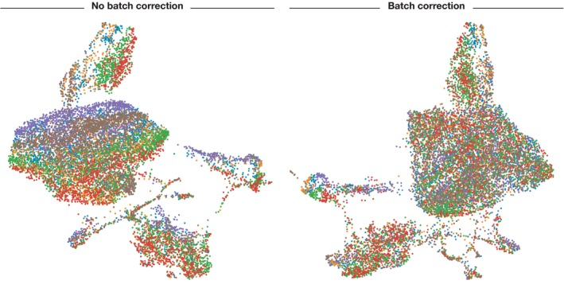
When do we perform batch correction?
Remember that batch correction (or any correction method) has a cost!
Determine if batch correction is necessary per experiment.

Slide 8
One way to determine if batch correction is necessary
Visualize a projection of your data (T-SNE, UMAP) and overlay the batches and conditions
Do you observe clustering based on batch?
Remember that if you’re plotting multiple conditions (stimulated/control), you might expect to see separation based on biological signal

Slide 9
Batch Correction Methods and Recommendations
ComBat is a general batch correction tool that has been found to work well with scRNA
Batch effects can often be mitigated by smart experimental design
Batch correction is different from integration (combining multiple experiments) - Use different tools!
Batch correction mitigates effects between cells and samples in the same experiment
Data integration attempts to combine separate experiments or datasets

Slide 10
What is integration?
Various methods designed to ensure that the same cell populations across different datasets group together (after integration)
This will allow for accurate comparisons across datasets by matching shared cell types
Integration is not always necessary if samples are expected to be highly similar
Integration forces a complicated tradeoff between batch correction and conservation of true biological variance
https://www.nature.com/articles/s41592-021-01336-8

Slide 11
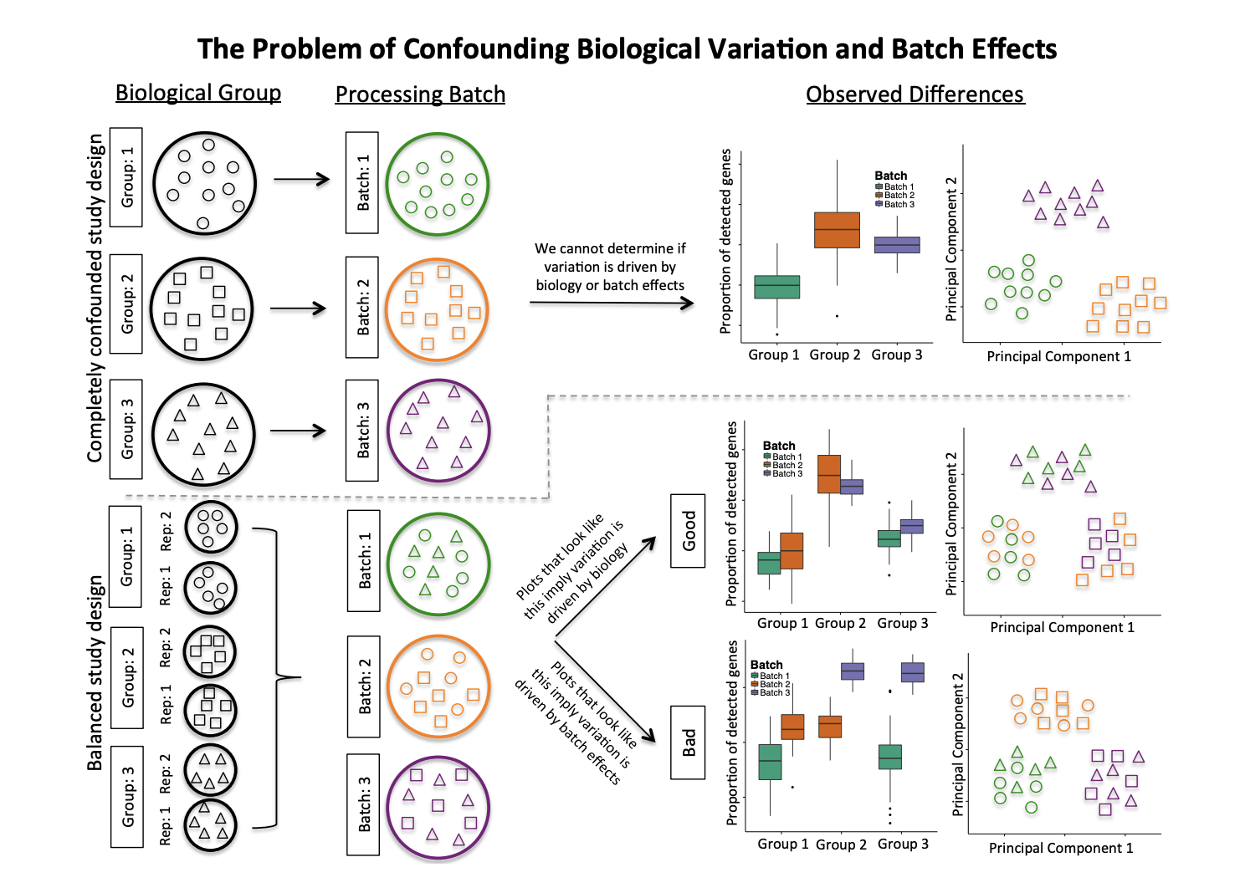
Experimental design can mitigate the need for batch correction
Hicks et al 2017

Slide 12
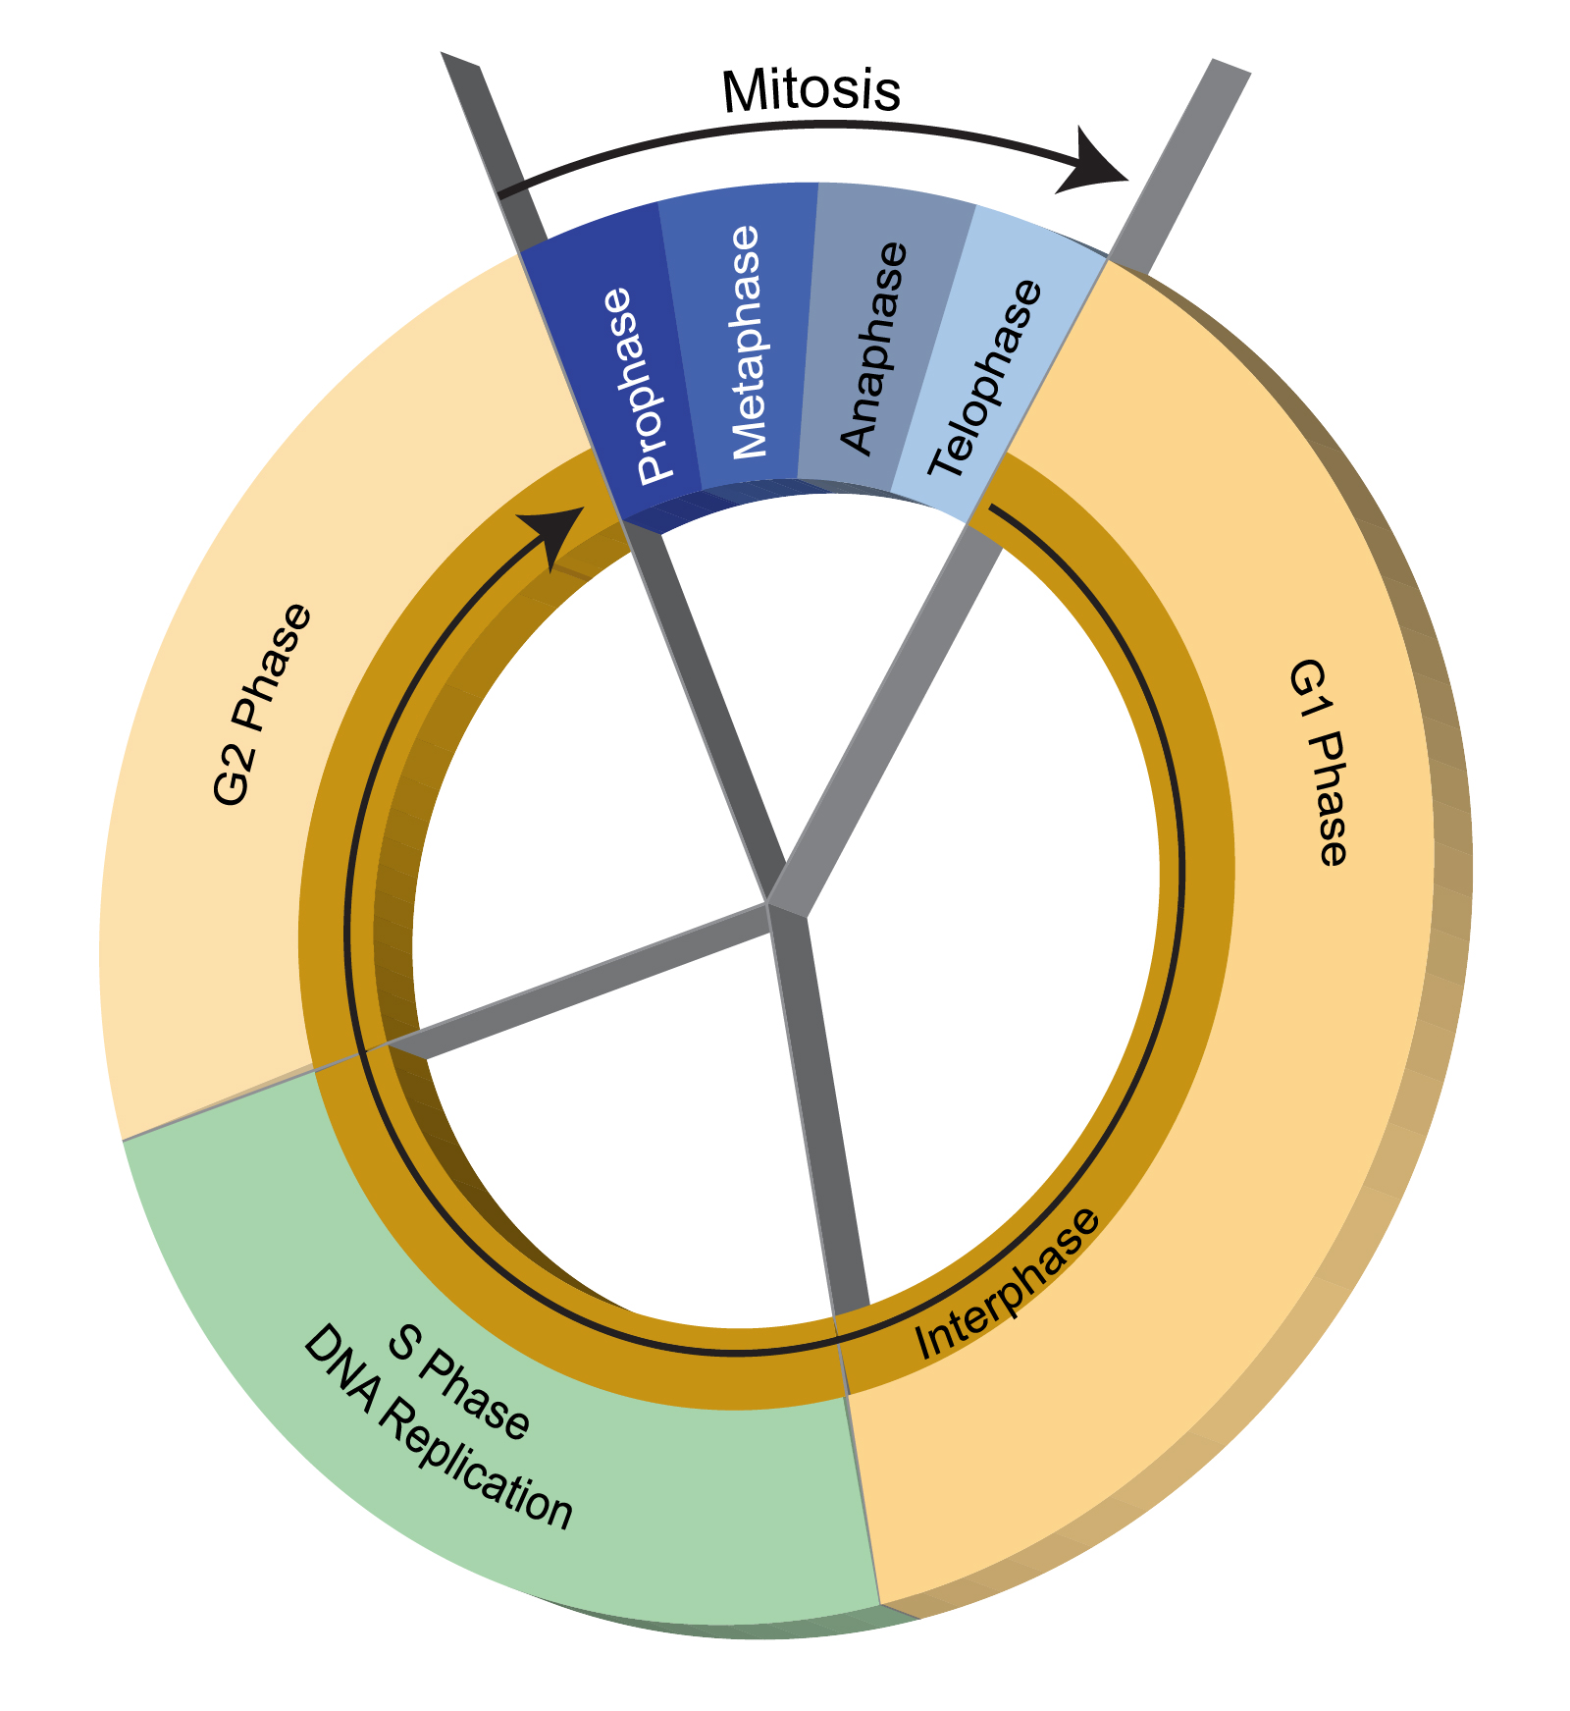
“Regressing out” effects of the cell cycle?
The cell cycle can have a strong influence over the transcriptome
The cell cycle is almost certainly not independent from the other biological processes in the cell
Be extremely wary about using linear regression methods in single cell analyses to remove “uninteresting” variation
https://www.genome.gov/genetics-glossary/Cell-Cycle

Slide 13
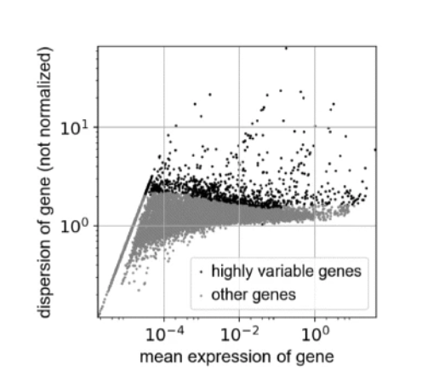
Feature Selection: Highly variable genes are used to reduce dimensionality
Even after filtering, some scRNAseq datasets may still have ~15000 genes
Keep only genes that are “informative” of the variability
Typical programs will use 1k-5k genes
Popular method bins genes by mean expression and selects the top genes with largest variance-to-mean ratio from each bin

Slide 14
Typical Analysis Paths
Dimensionality Reduction
Projection (tSNE, UMAP, etc)
Visualization
Counts matrix
Unsupervised Clustering
Differential Expression
Marker Gene Analysis
Differences in Proportion

Slide 15
Dimensionality Reduction
Counts matrix may have many dimensions
1000s of genes x 1000s of cells
Designed to capture the underlying structure of the data in fewer dimensions
May be necessary for large datasets (>1M cells) to make downstream analysis algorithms tractable
Many methods available, including:
PCA
Multidimensional Scaling (MDS)
Downsampling

Slide 16
Projection + Visualization
Goal: accurately visualize cell clusters in two dimensions
Projection: embed samples of high dimensional space into lower dimensional space, retaining structure of data
e.g. map from (1000s genes x 1000s cells) to 2 (i.e. <x,y>)
Ideally preserve both local and global structure
NB: this is challenging to do efficiently+accurately!
Available methods:
t-SNE: t-statistic Stochastic Neighbor Embedding
UMAP: Uniform Manifold Approx. and Mapping
PCA

Slide 17
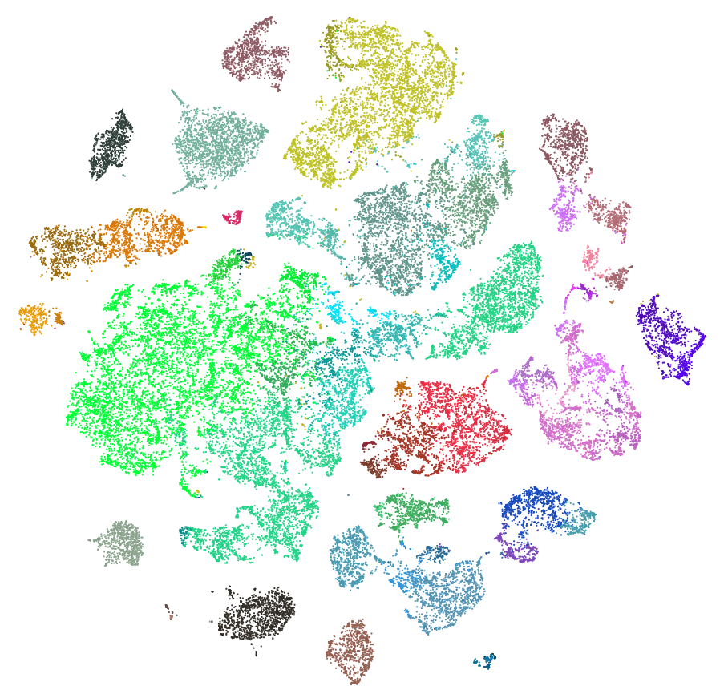
t-SNE, UMAP, et cetera
Conceptual idea:
Compute distance between all pairs of cells in high dimensional (i.e. all genes) space
Find a function that maps samples into 2D space s.t. cells that are close in original space are also close in embedded space
Can compute locally accurate mapping quickly:
Cells near each other are similar
BUT cells far away from each other are not necessarily proportionately far from each other!
Local structure is preserved, global structure is not!
t-SNE projections from human cortex single nuclear RNA-Seq https://portal.brain-map.org/atlases-and-data/rnaseq

Slide 18
Visualizing Projections
Wish to use clustering to interpret data
Projection methods produce an embedding
Strategy: map cell metadata onto embedding and visualize
Following slides:
Single nuclear RNA-Seq from human cortex
6 regions sampled
Source: Brain-Map Cell Type Database https://portal.brain-map.org/atlases-and-data/rnaseq

Slide 19
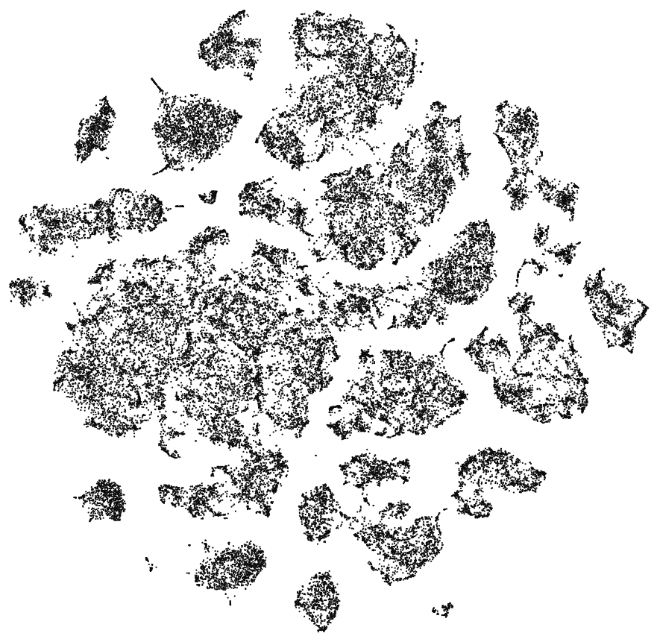
Visualizing Projections
No color
Colored by unsupervised clustering

Slide 20
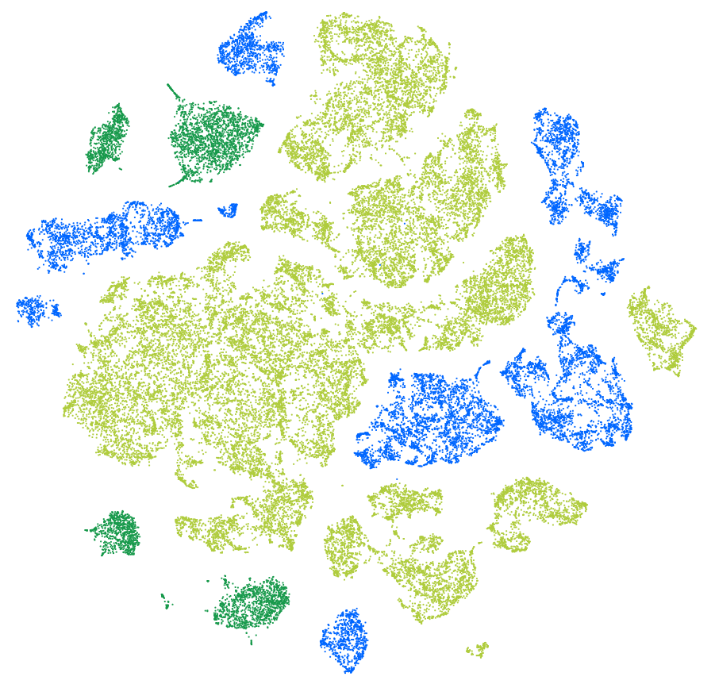
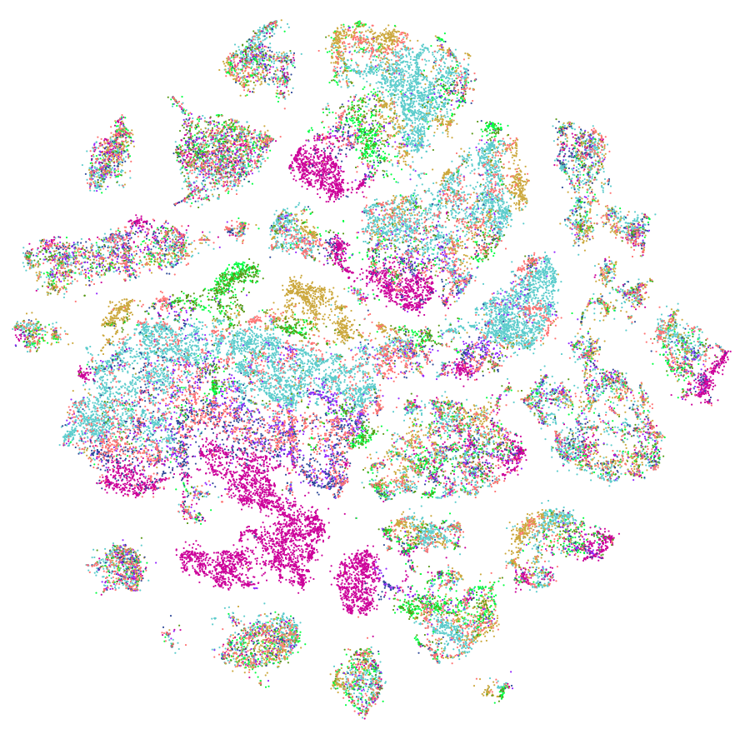
Visualizing Projections
Colored by cell class, labeled by known marker genes
Non-neuronal (glia)
Glutamatergic neurons
GABAergic neurons
Colored by brain region

Slide 21
Unsupervised Clustering
Wish to identify subpopulations of cells using similarity of transcript abundance
Clustering methods discover patterns in the data
A priori no knowledge of number of clusters
Many available methods and metrics:
PCA/Spectral analysis
Hierarchical or Ward agglomerative clustering
K-nearest neighbor clustering
Jaccard similarity
Louvain community detection
K-means
Graph based clustering
Many, many more...

Slide 22
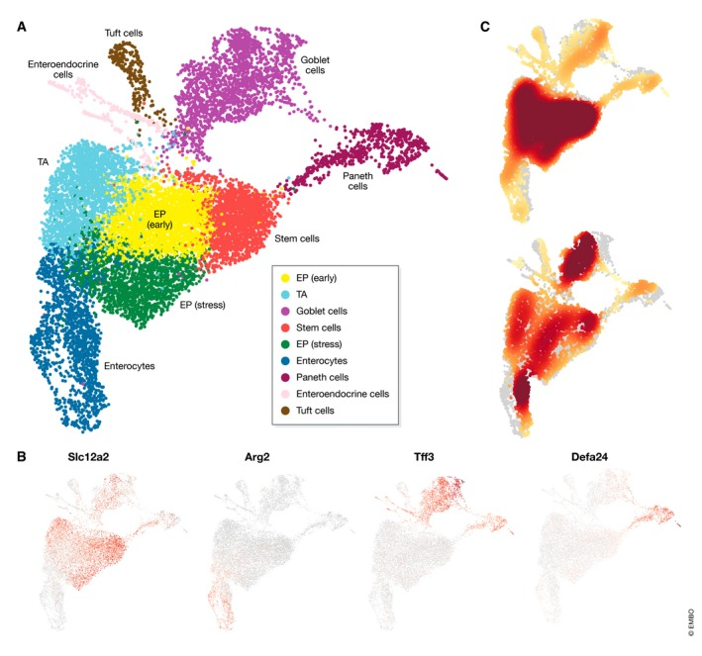
Clustering algorithms will create partitions of cells
There are many cell types that have many subpopulations and subtypes that are biologically relevant (T cells)
Various conditions or stimuli (or different responses to stimuli) could cause cells of the same type to be separated into different clusters
Need to look at the biology of the cells in the cluster to determine if clustering was successful
Luecken et al 2019

Slide 23
Marker Gene Identification
Goal: identify gene expression differences between cell types (i.e. clusters)
Simple solution: DE of each cluster vs all the others (some programs use a simple wilcoxon rank sum test or t-test)
Significant genes drove the clustering

Slide 24
Marker Gene Analysis
Goal: Label each cluster to known cell type
Biological domain experts know which genes are expressed by each cell type
Recent tools have been developed for automated cluster annotation which simultaneously annotates and assigns cells to clusters using reference databases

Slide 25
Marker Gene Analysis Considerations
Marker genes may be different from classical cell surface markers used for FACS (need to look at scRNAseq specific experiments for markers)
Typically we look only at upregulated marker genes (genes that are strongly expressed in the cluster of interest vs. the others)
Recommendation: Use both automated cluster annotation and manual curation of cluster annotations together
Automated annotation can be the first pass
Manual curation will ensure validity and help with difficult clusters

Slide 26
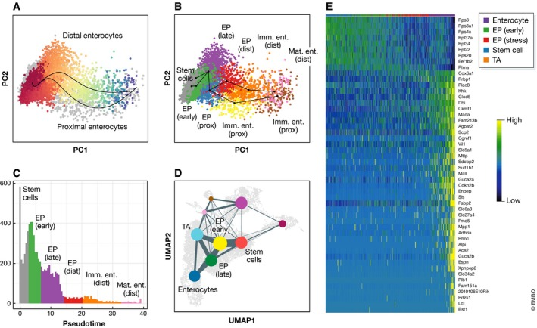
Pseudotime Analysis
Cells don’t exist in discrete states as simple as clusters
Most biological processes are continuous
Pseudotime analysis
Provides an ordering of cells according to some state
Can identify cells and their transcriptional signature at the beginning or ends of states or even in the middle
Widely used for processes with temporal dynamics (immune response, development, differentiation etc.)
Luecken et al 2019

Slide 27
Differential expression Testing
Goal: Determine genes that are changing between conditions or cells of interest
Methods from bulk RNAseq analysis
perform decently compared to single cell specific tools
MAST (single cell specific) performs very well
https://www.nature.com/articles/nmeth.4612

Slide 28
Compositional Analysis
Goal: Is the proportion of certain cell types changing across conditions or due to the experimental stimulus?
Cell identities are inherently compositional (i.e. when one cell identity changes, all others shift as well in proportion)
Common statistical methods may ignore this and lead to high rate of false positives
Newer methods borrow elements from microbiome research incorporating compositional statistics
scCODA (Buttner et al, 2021)

Slide 29
The Many Subjects We Didn’t Cover
Supervised clustering of cells by known markers/cell states (e.g. cell cycle)
Integration with scATACseq
Spatial transcriptomics
Imputation
Infer expression values for “dropout” genes
Metastable States
Many more...

Slide 30
Current Software
Bioconductor
Seurat - One of the first analysis software packages
SingleCellExperiment - official Bioconductor class
scater - Single Cell Analysis Toolkit
Single Cell Toolkit (SCTK)
scanpy - single cell analysis in python
Many others now
Millions of others soon...

