Slide 1
Problem 1 : sum
Program received N as input, Return summation value of index 1 to N
index | 1 | 2 | 3 | 4 | 5 | 6 | 7 | 8 | 9 | 10 | 11 | 12 | 13 | 14 | 15 | 16 | 17 | 18
value | 1 | 2 | 6 | 4 | 15 | 12 | 7 | 8 | 18 | 30 | 11 | 24 | 13 | 14 | 150 | 16 | 17 | 36
N = 5 , output = 1+2+6+4+15 = 28
N = 15, output = 1+2+6+4+15+12+7+8+18+30+11+24+13+14+150 = 315
Example Input | Example
5 | 28
15 | 315

Slide 2
Problem 2 : coin
Given two type of coin, which have value A bath and B bath. Determine whether the target value T can be summed by the given types of coin.
6,8,10 -> A=6, B=8, target value=10; Coins 6 and 8 cannot sum up to 10
2,3,10 -> A=2, B=3, target value=10; Coins 2 and 3 can sum up to 10
If there are many possible answers, print any of them
Example Input | Example
6, 8, 10 | IMPOSSIBLE
2, 3, 10 | na: 2, nb: 2

Slide 3
Problem 2 : coin
find such a case that T = a*na + b*nb
Propose algorithm
loop find na
if b | T - (a * na) then
nb = ( T - (a*na) )/ b

Slide 4
Problem 3: anagram
A word is an anagram of another if the second is simply a rearrangement of the first.
Example Input | Example
APPLE | ['APPEL', 'APPLE', 'PEPLA']
PIE | ['EPI', 'IPE', 'PEI', 'PIE']
noon | ['NONO’, 'NOON']

Slide 5
Problem 3: anagram
Propose algorithm
We gonna count number of alphabet as shown below, get_key(PIE) -> 0_0_0_0_1_0_0_0_1_0_0_0_0_0_0_1_0_0_0_0_0_0_0_0_0_0
0 | 0 | 0 | 0 | 1 | 0 | 0 | 0 | 1 | 0 | 0 | 0 | 0 | 0 | 0 | 1 | 0 | 0 | 0 | 0 | 0 | 0 | 0 | 0 | 0 | 0
A | B | C | D | E | F | G | H | I | J | K | L | M | N | O | P | Q | R | S | T | U | V | W | X | Y | Z
2.Then, we will store “PIE” into the dictionary, using our precompute key
dict[get_key(PIE)].append(“PIE”)
3.In the end, dictionary should contains all words with the same alphabet count
dict[get_key(PIE)] = ['EPI', 'IPE', 'PEI', 'PIE']

Slide 6
Problem 4: connected component
Visualized coloring algorithm

Slide 7
Connected Component -- Step 1
1
top
bottom
left
right
2

Slide 8
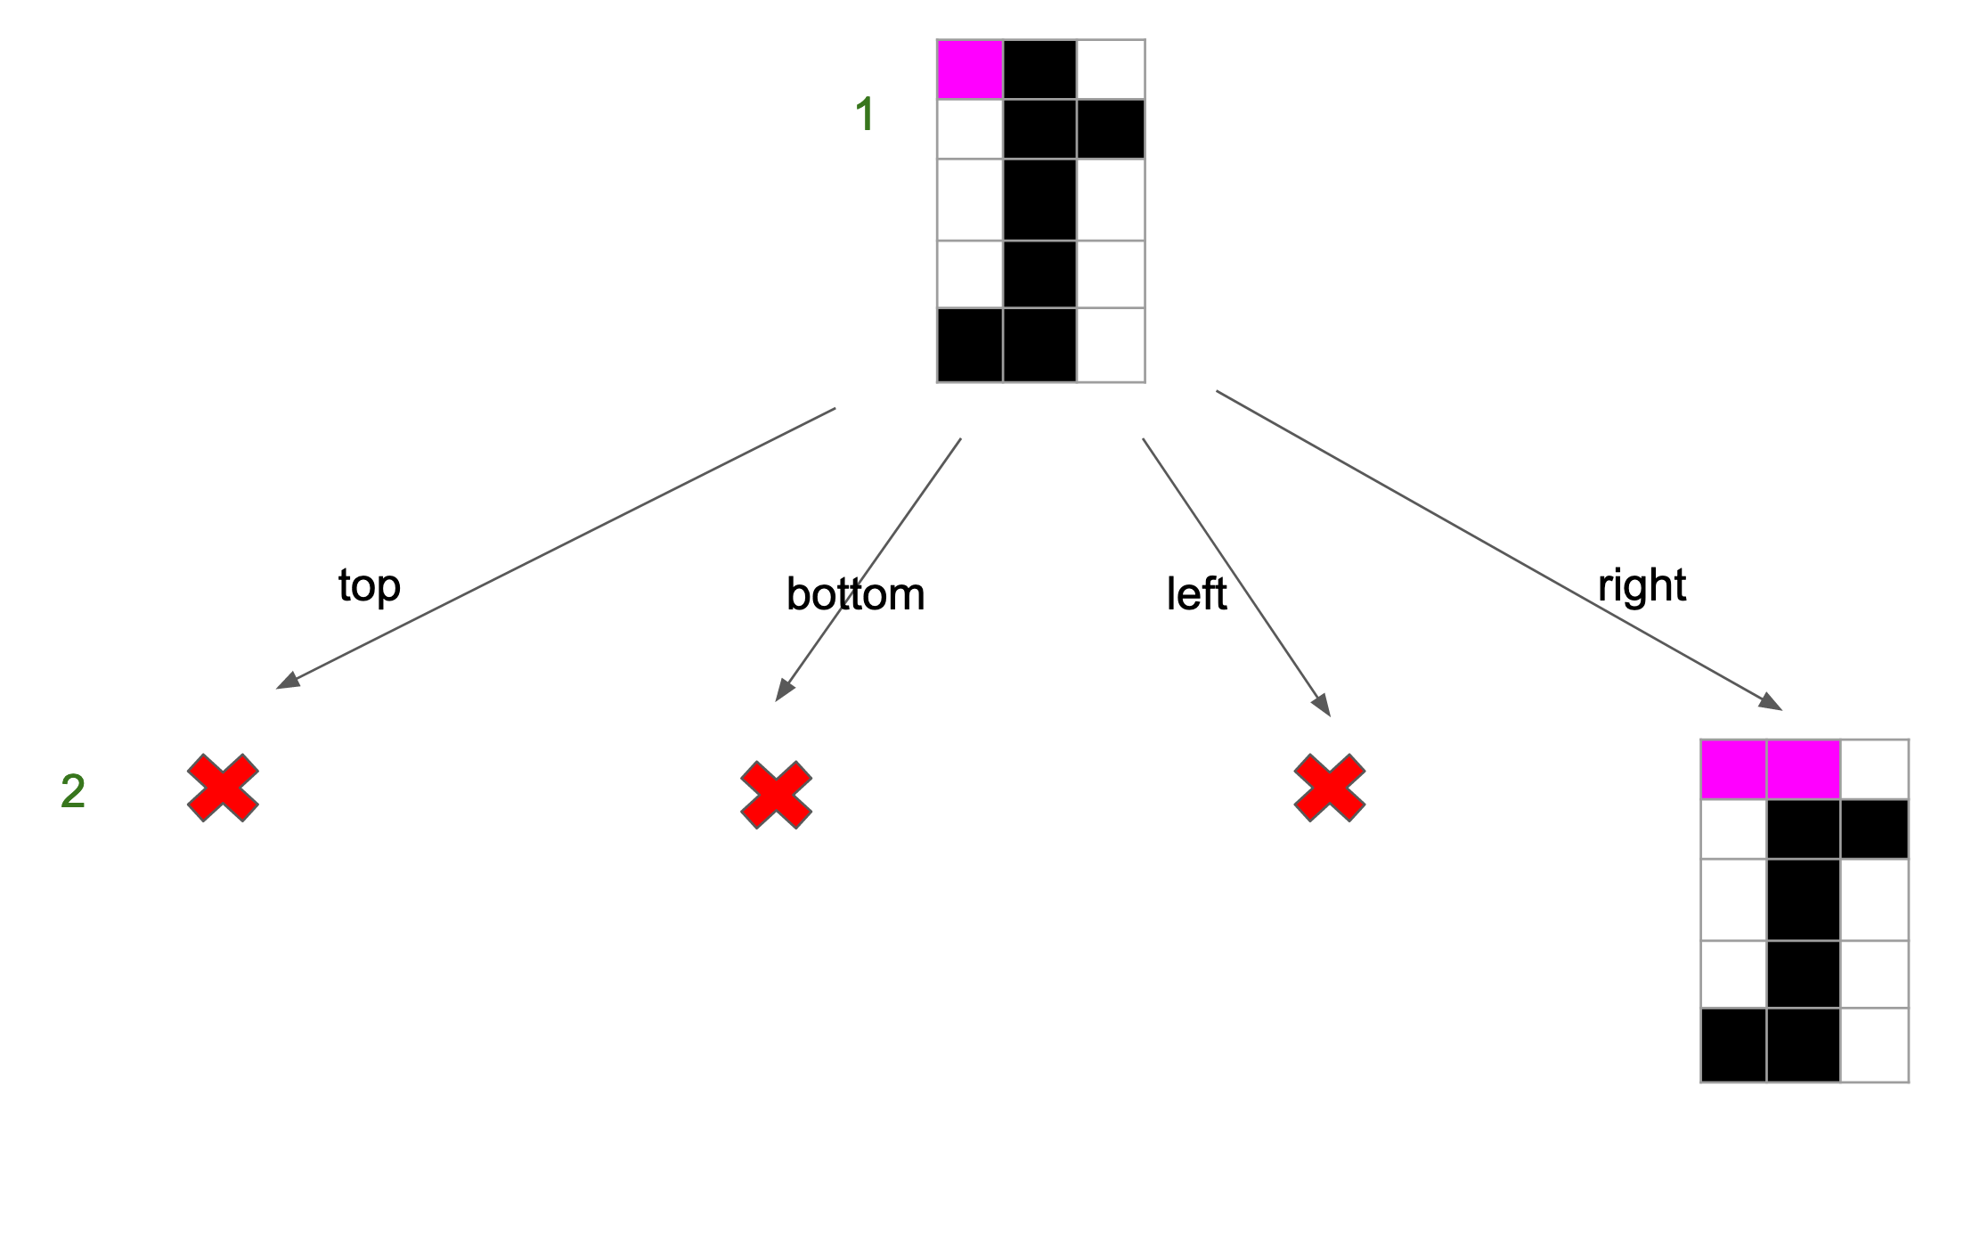
Connected Component -- Step 2
top
right
bottom
left
3
?
?

Slide 9
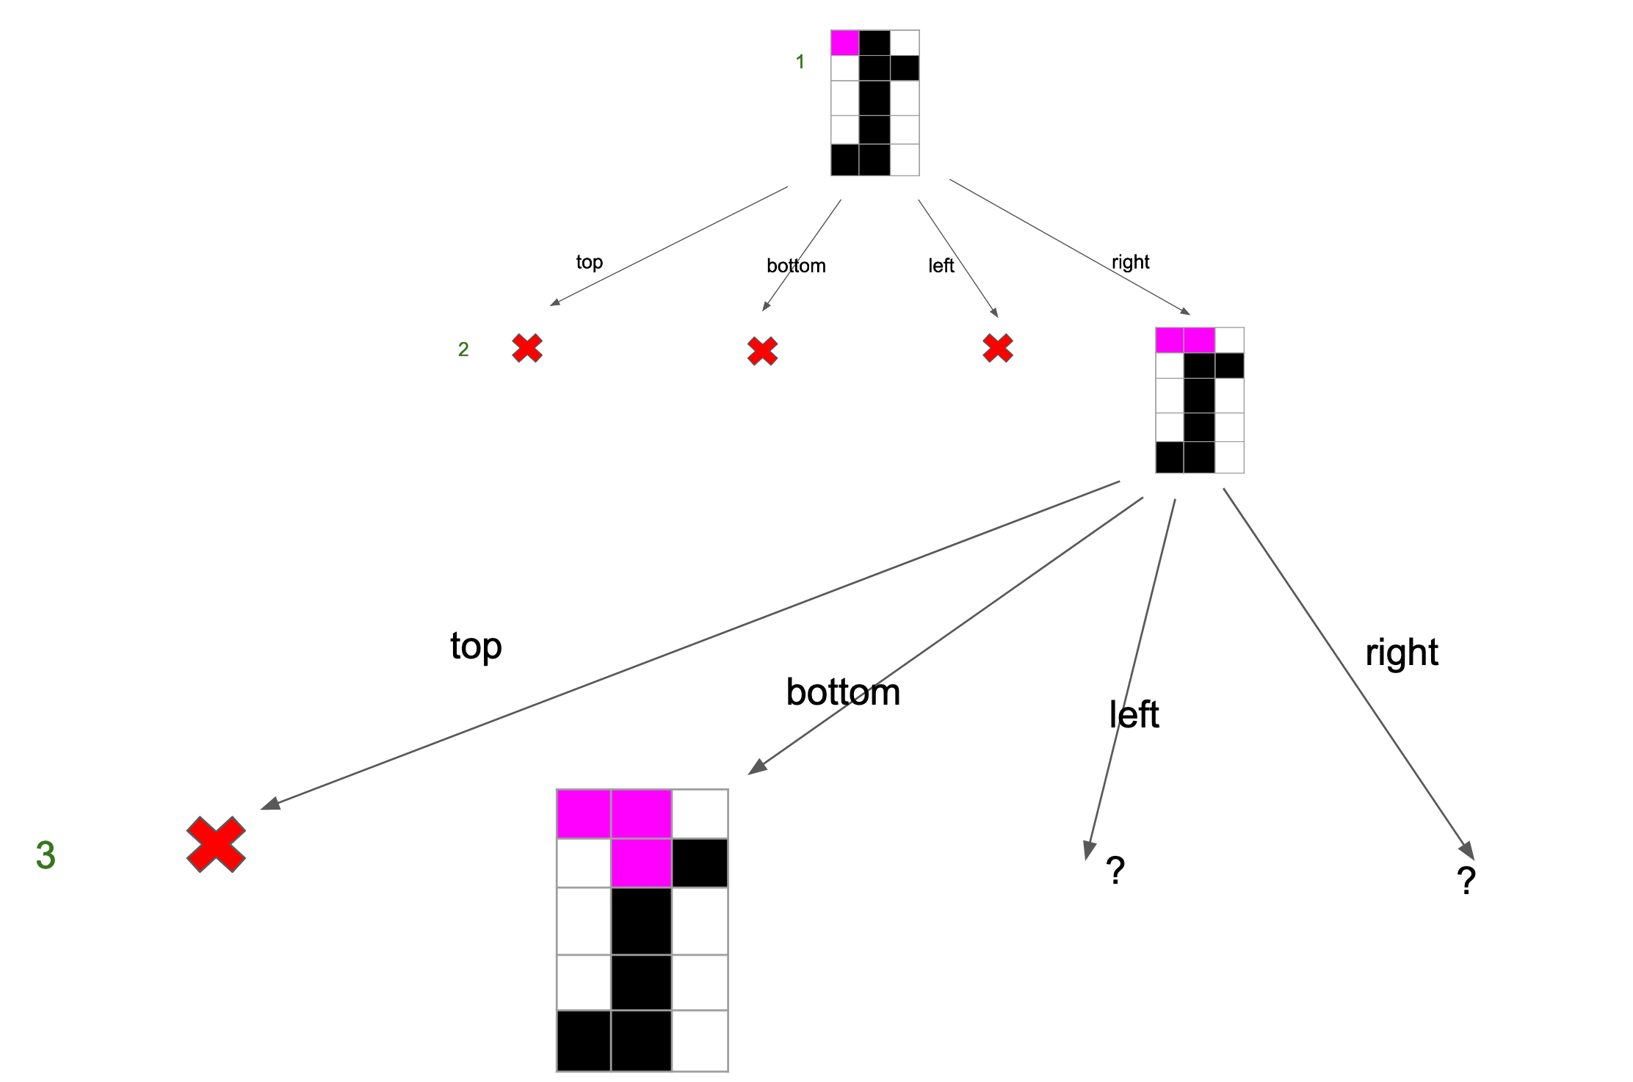
Connected Component -- Step 3
top
bottom
left
right
4
?
?

Slide 10
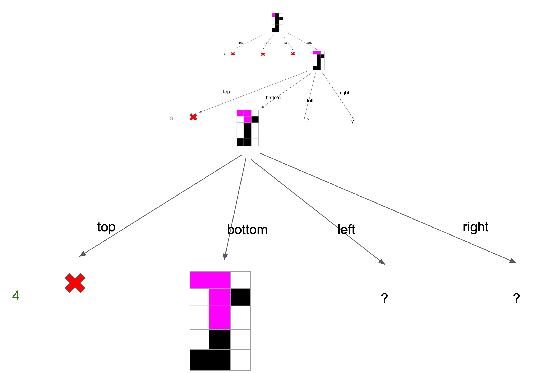
Connected Component -- Step 4
top
bottom
left
right
5
?
?

Slide 11
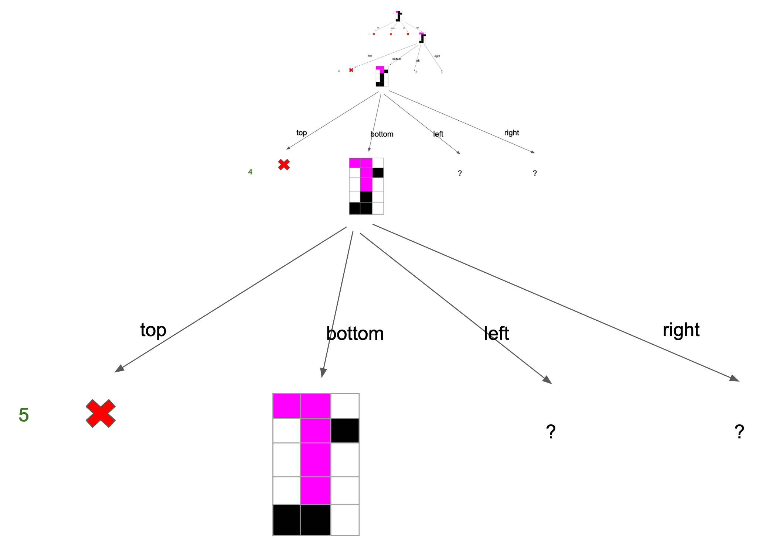
Connected Component -- Step 5
top
bottom
left
right
6
?
?

Slide 12
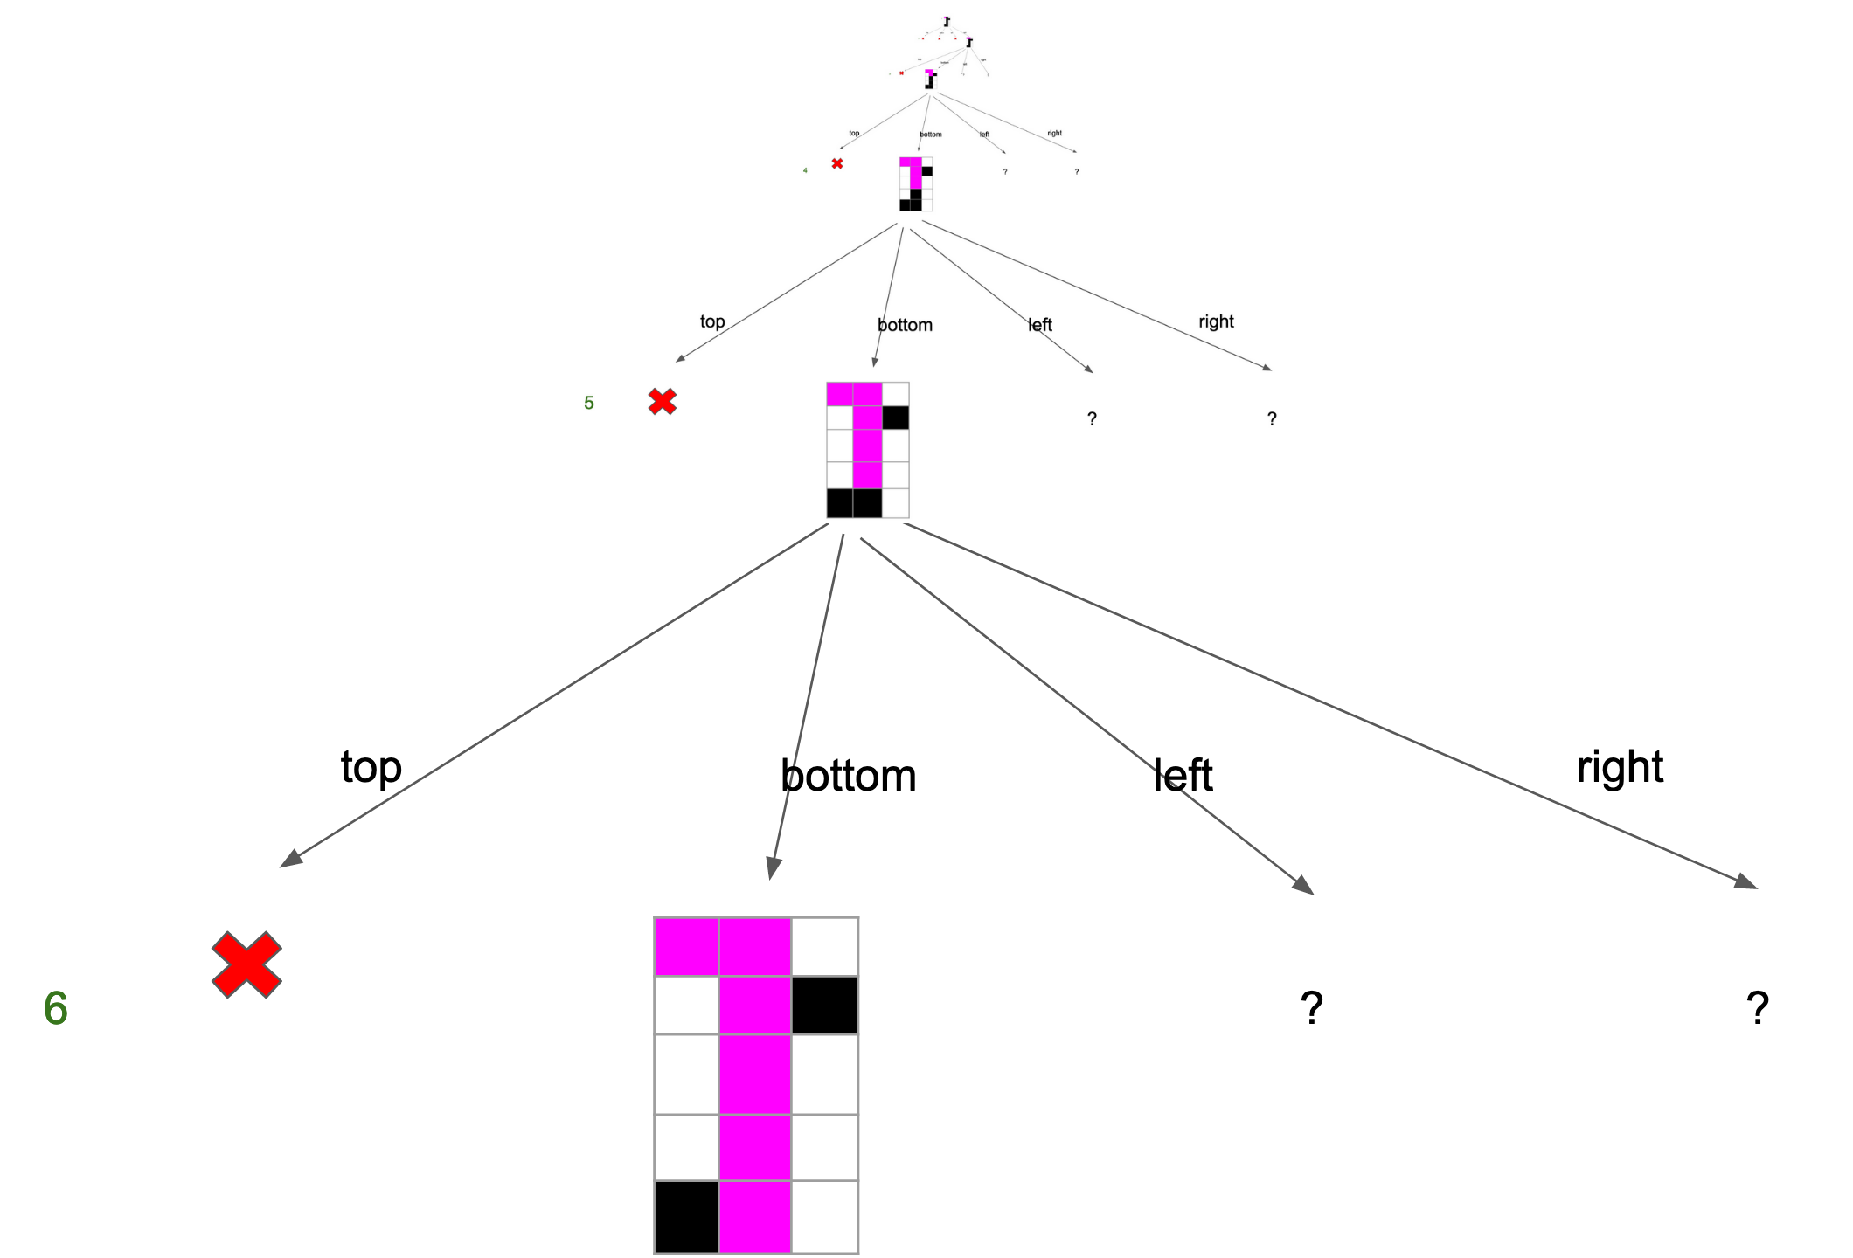
Connected Component -- Step 6
top
bottom
left
right
7
?
?

Slide 13
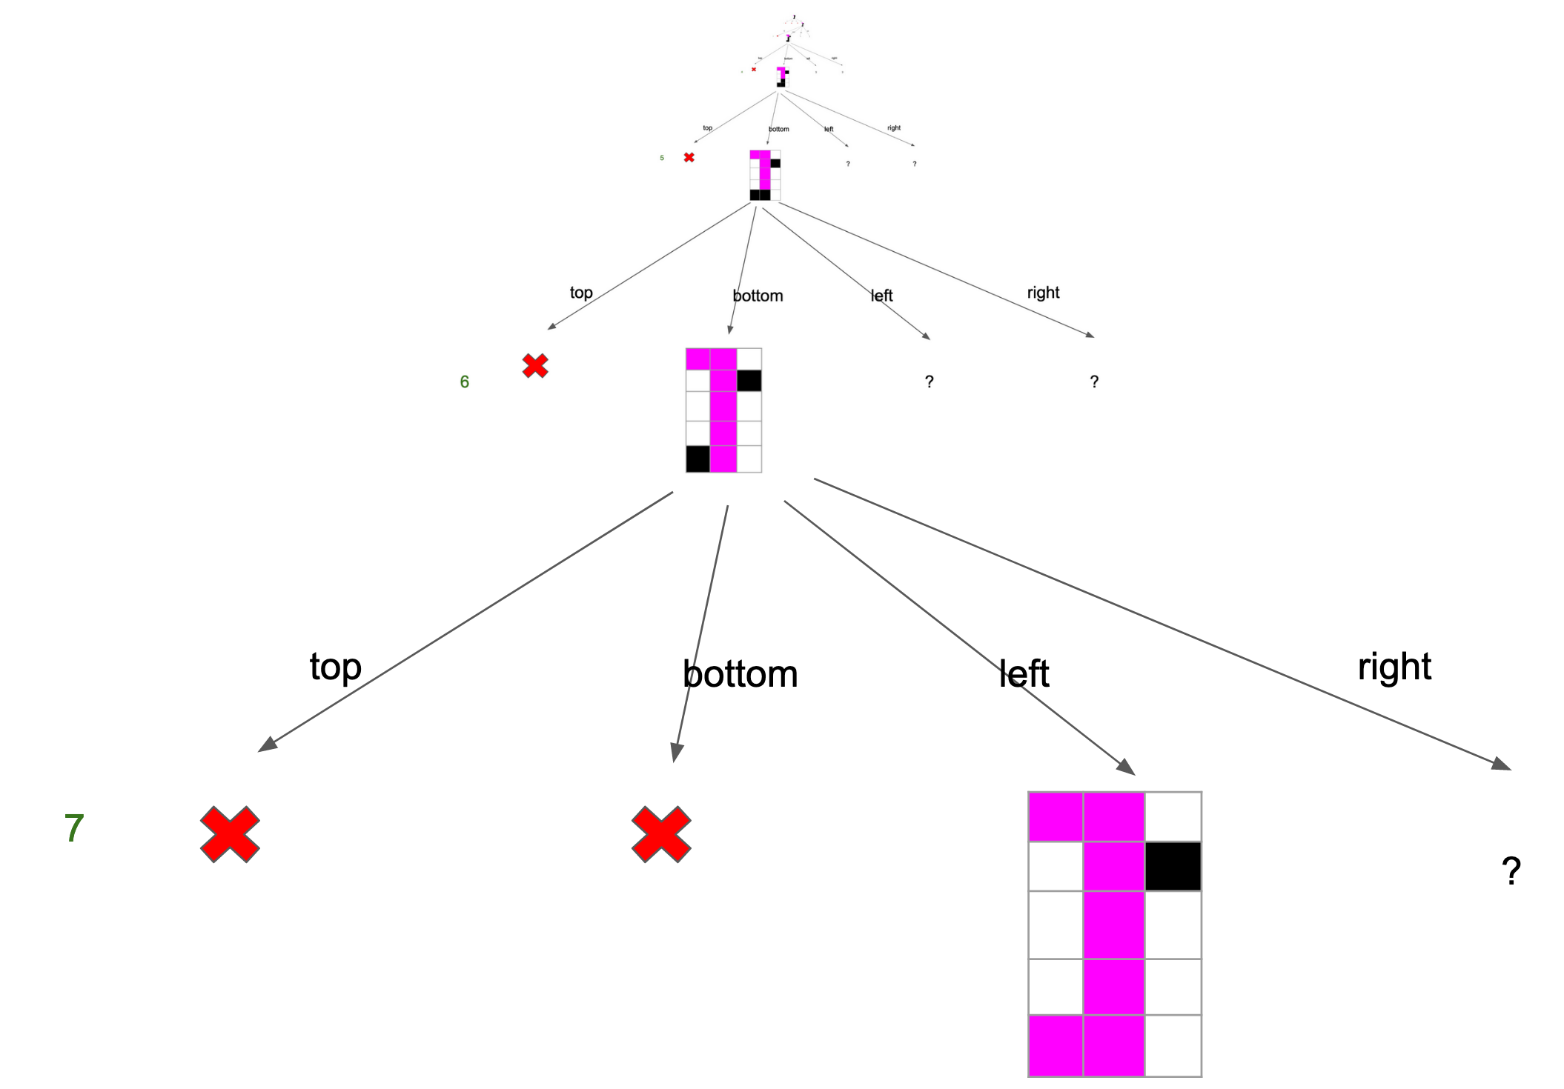
Connected Component -- Step 7
top
bottom
left
right
8

Slide 14
Connected Component -- Step 8
top
bottom
left
right
7
?

Slide 15
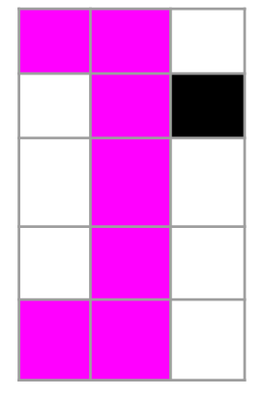
Connected Component -- Step 9
top
bottom
left
right
6
?

Slide 16
Connected Component -- Step 10
top
bottom
left
right
5
?
?

Slide 17
Connected Component -- Step 11
top
bottom
left
right
4
?
?

Slide 18
Connected Component -- Step 12
top
right
bottom
left
3
?
?

Slide 19
Connected Component -- Step 13
top
right
bottom
left
3
?

Slide 20
Connected Component -- Step 14
top
right
bottom
left
3
?

Slide 21
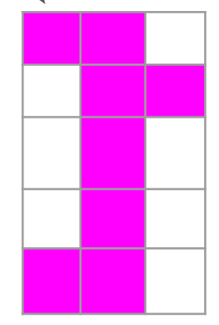
Connected Component -- Step 15
1
top
bottom
left
right
2

