Slide 1
MEDICARE FRAUD DETECTION

Slide 2
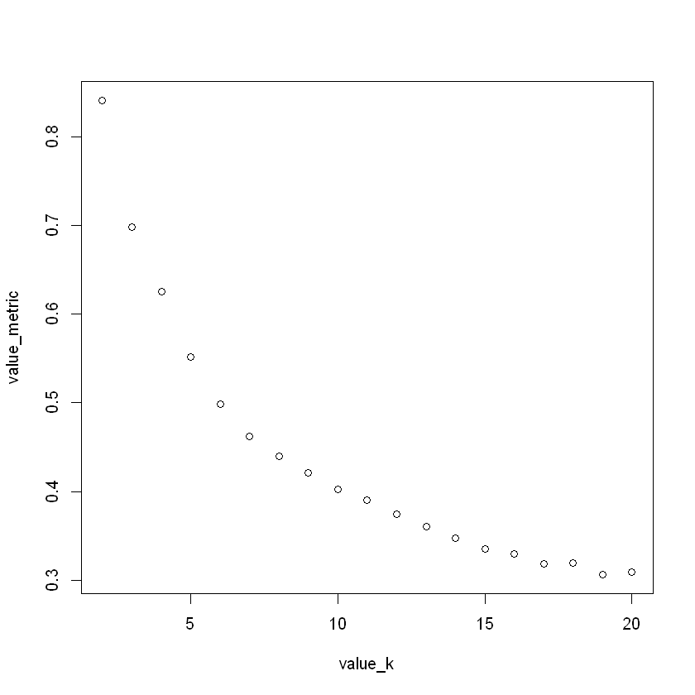
VARIABLES
I chose 6 Variables for analysis:
BY City and Provider
- Ratio total discharges - Ratio average covered charges - Ratio average total payments - Ratio average Medicare payments
- Ratio payment to Charge
- percent of DRG by Provider
SCALE VARIABLES
train <- scale(data)
OPTIMAL NUMBER OF CLUSTERS

Slide 3
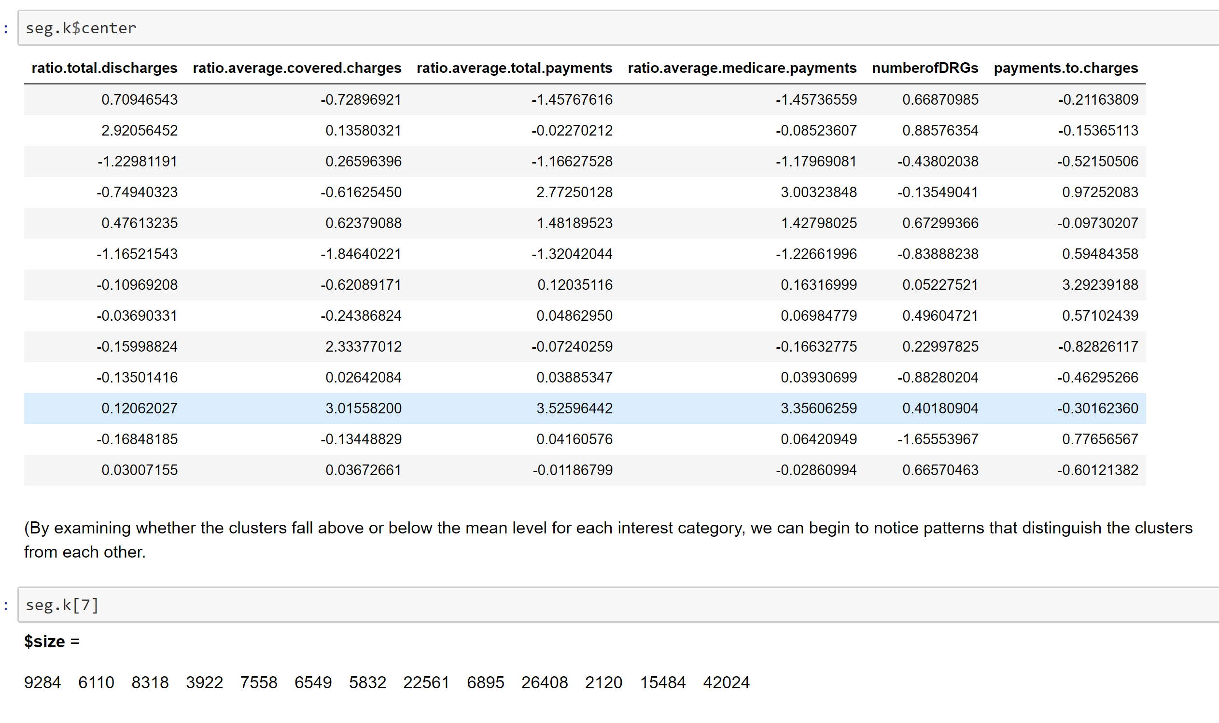
13 clusters
(between_SS / total_SS = 64.4 %)

Slide 4
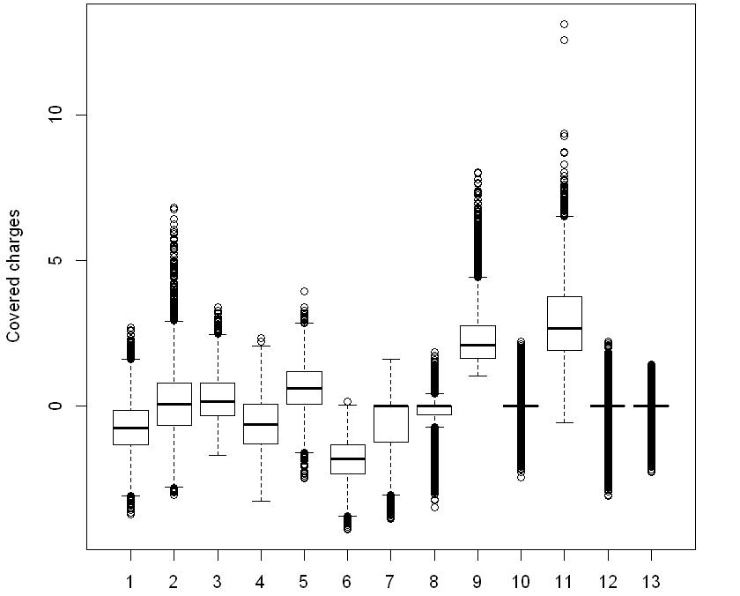
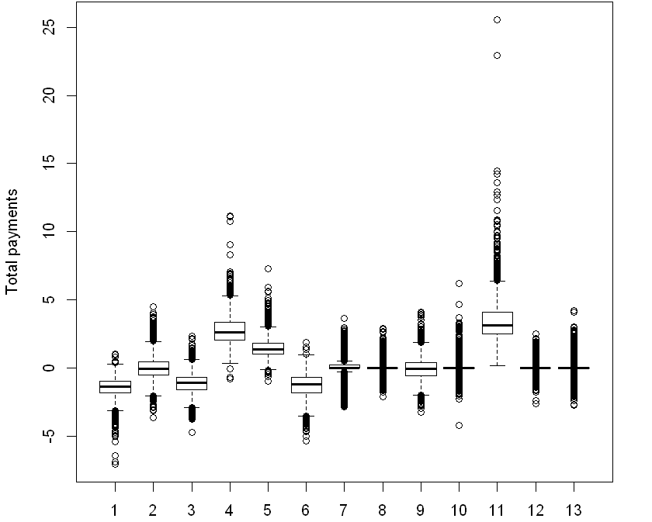
Centroids of each cluster.
Cluster 11 consists of 2120 observations, which is around 1.3% of the whole observations.
have the highest
“ratio.average.covered.charges“
"ratio.average.total.payments“
"ratio.average.medicare.payments"
THANK YOU!

