Slide 1
NATALLIA CASEY
ANALYSIS of IMDb MOVIE RATINGS

Slide 2
Introduction
Focus: The ratings of the movies; Analysis of variables potentially affecting the scores.
IMDb is a database with information about movies, video games, tv shows and other streaming content. The movie scores are given by the registered users, and the weighted mean is used to calculate the score. Certain filters are used to make sure that the score is not affected by the people who intend to change the current rating of a movie rather than give an honest opinion of it (IMDb).
Data set: 6820 observations of 15 variables. Source: https://www.kaggle.com/danielgrijalvas/movies

Slide 3
Hypotheses
There is a positive relationship between number of votes and the rating score.
There is a positive relationship between runtime and a rating score.
There is a positive relationship between budget and a rating score.
There is a positive relationship between gross and a rating score.
Horror movies are rated lower than other movies.

Slide 4

Mean
Mode
Variance
Score: IMDB User Rating
6.4 | 6.7 | 1.02
36145601 | 20000000 | 1597558792556887
46074694 | 20100000 | 4394865815411431
107.6 | 100 | 325
95702 | 5757 | 22316723421
Budget: Budget of Movie
Gross: Revenue of Movie
Runtime: Duration of Movie
Votes: Number of User Votes

Slide 5
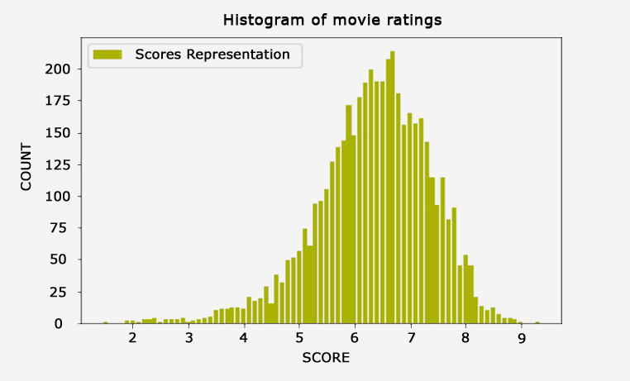
Histogram of the variable “score”
Very roughly bell-shaped distribution with the tail extending further to the left than right, which means the distribution is negatively skewed.

Slide 6
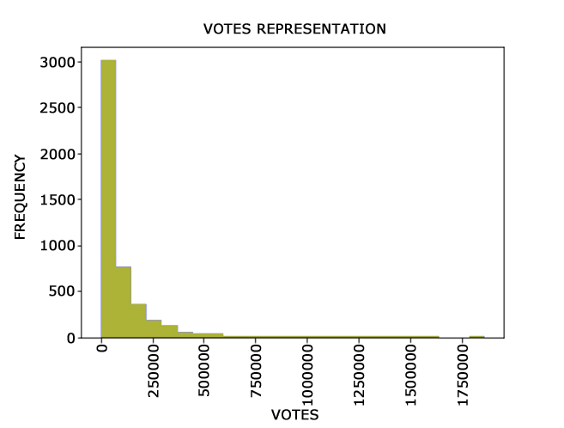
Histogram of the variable “votes”:
The right tail of the histogram is significantly longer than the left one which means the distribution is positively skewed.

Slide 7
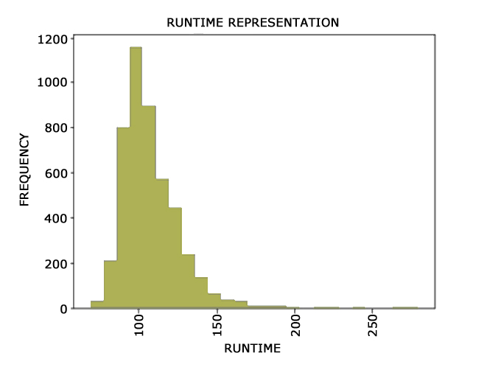
Histogram of the variable “runtime”:
The right tail of the histogram is significantly longer than the left one which means the distribution is positively skewed.

Slide 8
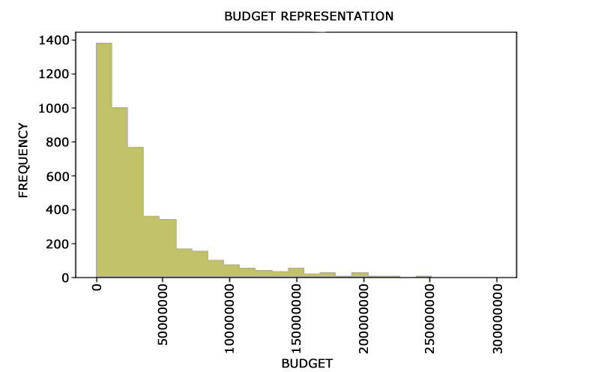
Histogram of the variable budget:
The right tail of the histogram is significantly longer than the left one which means the distribution is positively skewed.

Slide 9
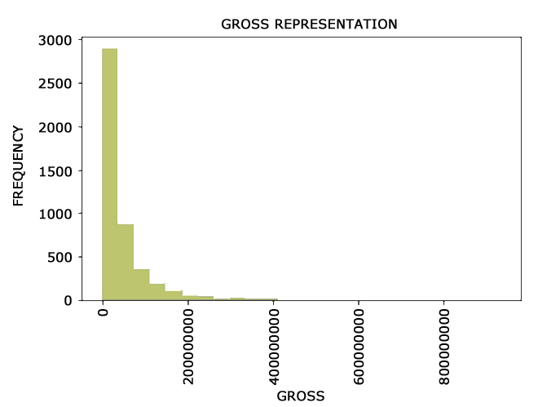
Histogram of the variable “gross”:
The right tail of the histogram is significantly longer than the left one which means the distribution is positively skewed.

Slide 10
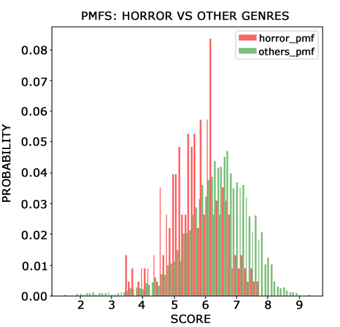
HISTOGRAM OF PMFS:
The mean for the variable score is 6.356317378180231. The mean for the ratings of horror movies is 5.719298245614037. The mean for the rating of all genres but the horror movies is 6.389251700680251. The difference in the means is 0.67 . As a fraction of the typical score, the difference represents about 10.5%. By looking at the histogram we can tell that horror movies are more likely to get lower rating scores than movies of other genres.

Slide 11
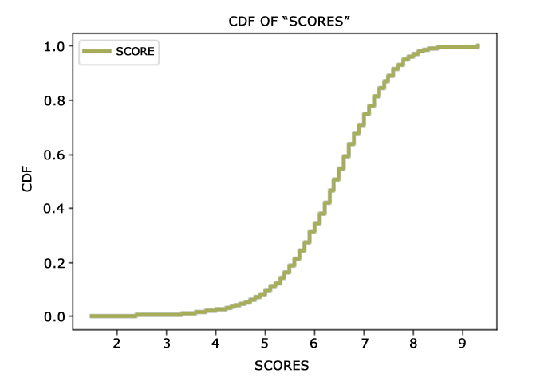
CDF:
Looking at the CDF graph I can tell that the median value for the score is around 6.3. The minimum value is around 1.4, the maximum around 9.3. Also, it looks like about 10% of the scores are below the score of 5.2 and 90% of scores are below the rating of 7.5.

Slide 12
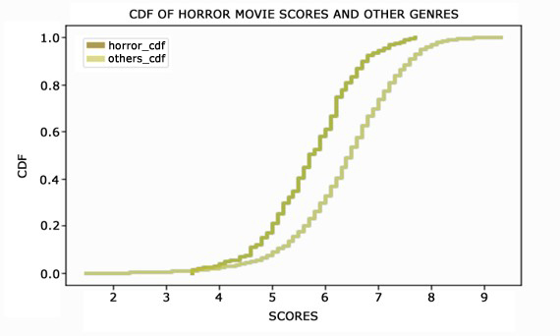
CDFs
The graph reflects that horror movies tend to be rated lower than other genres of movies. 90% of the horror movies are below the score of 6.5 and 90% of movies of other genres are below 7.5

Slide 13
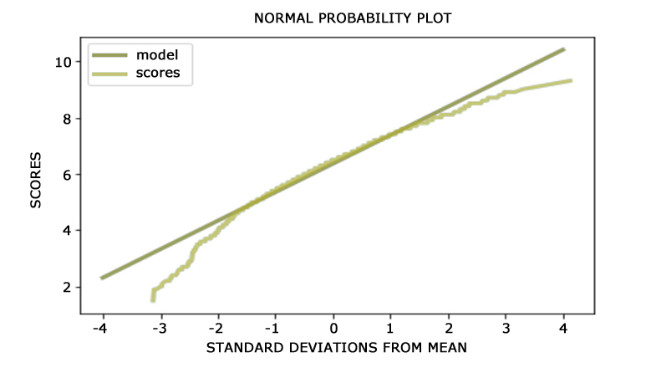
NORMAL DISTRIBUTION
We observe that there are deviations from the model in the tails. The normal distribution does not describe the distribution of the variable “score” well in the tails. Both the highest and the lowest scores are lower compared to what the normal distribution model expects them to be.

Slide 14
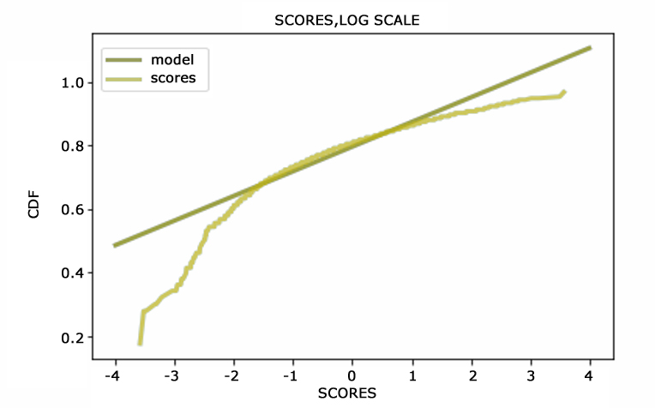
LOG NORMAL DISTRIBUTION
Lognormal distribution doesn't look like a good match for the data because of the deviations in the tails, especially in the left one.

Slide 15
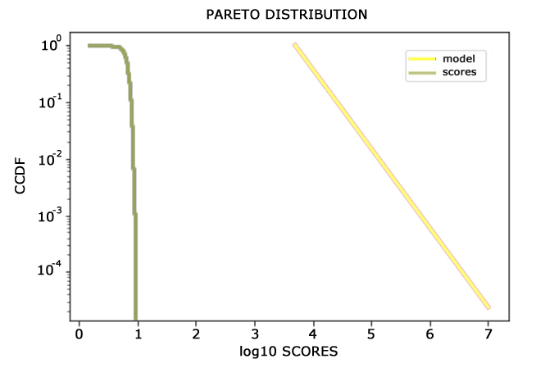
PARETO DISTRIBUTION
Pareto distribution. Tails. The model does not fit the data well in the tail.

Slide 16
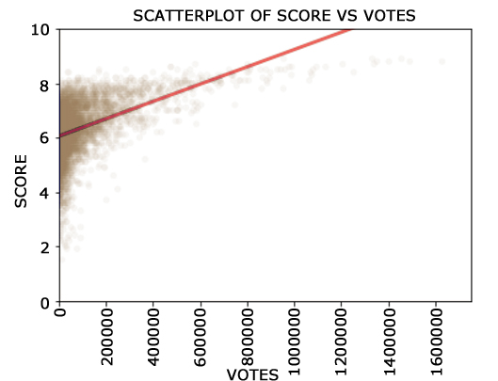
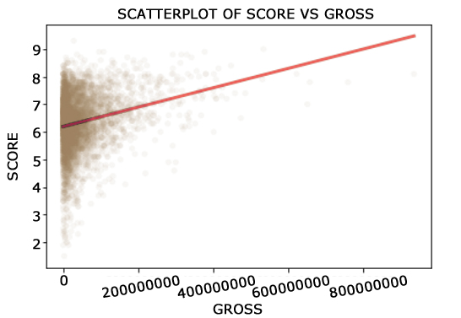
Scatterplots and Least squares fit
The shape of the relationship between score and gross, score and votes looks positive linear. Relationship of score and votes looks stronger than that of score and gross.

Slide 17
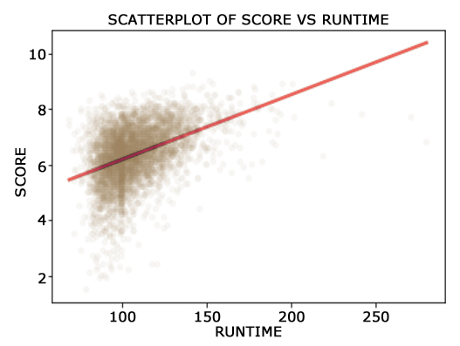
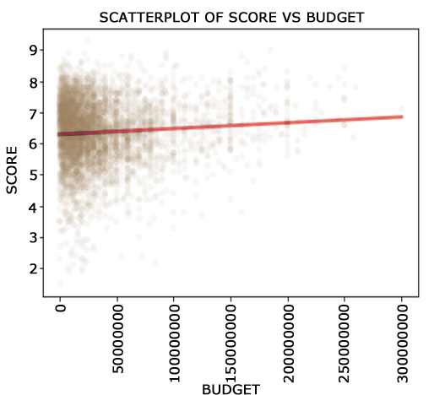
Scatterplots and Least squares fit
The shape of the relationship between score and budget, score and runtime looks positive linear. Relationship between score and runtime (scatters are closer together) looks stronger than that of score vs budget.

Slide 18
COVARIANCE, CORRELATION, HYPOTHESIS TESTING
Covariance
Pearson’s
Spearman’s
p-values for Pearson’s correlation tests
score vs gross
15382930 | 0.23 | 0.15 | 0.0
71071 | 0.47 | 0.49 | 0.0
2972822 | 0.073 | -0.13 | 0.0
7 | 0.42 | 0.42 | 0.0
score vs votes
score vs budget
score vs runtime
All of the pairs of variables have positive correlations that are significant (relying on p-values), which means that the variables change in the same direction: when one variable increases, so does the other one. The sign for Pearson’s and Spearman’s correlations is different for score vs budget. By looking at the correlation coefficients we can tell that there is possibly an extremely weak relationship. I believe there is a linear very weak positive relationship here. My explanation: covariance is positive, simple regression shows a positive relationship and the plot showed a very weak positive relationship with a fitted Least Squares line without curvature. I believe that result of a Pearson's correlation coefficient is more accurate than the Spearman’s.

Slide 19
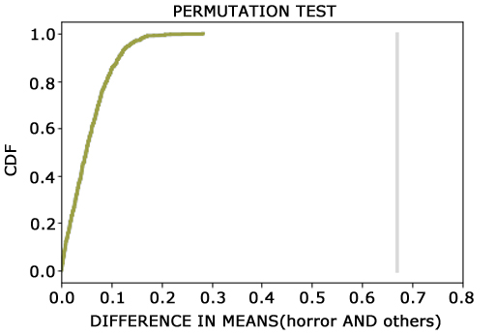
MORE TESTING
The chi-square test was used to check whether the difference between the scores of horror movies and the scores of other genres is statistically significant. With the p-value: 0.0, the result shows the difference is indeed significant.
As one can see, my simulation analysis did not yield the effect as big as the observed difference of 0.67 score points. p-value is 0.0 . The difference in scores is statistically significant.

Slide 20
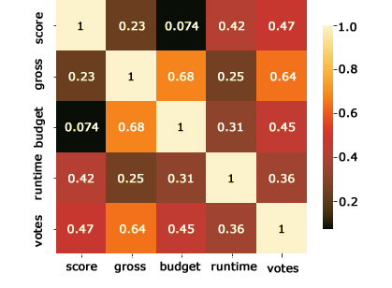
Checking Signs that Could Lead to Multicollinearity. Heatmap of coefficients and VIF.
Variable
VIF
score | 1.504287
gross | 2.548072
budget | 2.033098
runtime | 1.358285
votes | 2.136156
Correlation of gross and budget could be of concern; votes and gross could be of concern as well.
"gross", "budget", and "votes" have values of VIF above 2.
According to the article ,variables gross, budget and votes could be of concern, especially gross with the VIF greater than 2.5

Slide 21
LINEAR REGRESSION MODELS
runtime
votes
gross
budget
budget2
R²
Std(ys)-Std(res)
Warning/change of sign
MODEL 1
0.0234* | -- | -- | -- | -- | 0.1739* | 0.09 | No/No
 | 3.19e-06* |  |  |  | 0.2215* | 0.1189 | Yes/No
 |  | 3.5e-09* |  |  | 0.05269* | 0.0269 | Yes/N0
 |  |  | 1.86e-09* |  | 0.005414* | 0.003 | Yes/No
0.016* | 2.49e-06* |  |  |  | 0.292* | 0.1603 | Yes/No
0.0183* | 3.11e-06* |  | -5.97e-09* |  | 0.3349* | 0.1864 | Yes/Yes
0.0162* | 3.07e-06* | -2.06e-09* |  |  | 0.3027* | 0.1667 | Yes/Yes
0.0184* | 3.02e-06* | 4.59e-10* | -6.35e-09* |  | 0.3352* | 0.1866 | Yes/Yes
0.0592* | 1.61e-06* | 1.8e-09* | -1.01e-08* | 1.4e-17 (0.014) | -0.1223* | -0.057 | Yes/Yes
0.0215* |  | 2.02e-09* |  |  | 0.1903* | 0.1012 | Yes/No
MODEL 2
MODEL 3
MODEL 4
MODEL 5
MODEL 6
MODEL 7
MODEL 8
MODEL 9
MODEL 10

Slide 22
Analysis of the models
All of these models are statistically significant. By squaring the budget variable in model 8 , I was trying to see if the relationship between budget and score was polynomial. R-squared for the model resulted in a negative number which is a clear indicator that this model does not fit the data. My conclusion is the same: the relationship between these two variables is linear, positive and very weak.
The warning of possible multicollinearity shows for all of the models except for the simple regression model of score~runtime. Since there can’t be multicollinearity in simple regression models, the warning should be disregarded for this type of model. Variables gross and budget act unstable by changing their sign in some of the models. When the sign is changed (a dramatic change in a coefficient) the models could be affected by multicollinearity (https://blog.minitab.com/blog/understanding-statistics/handling-multicollinearity-in-regression-analysis). Multicollinearity can make interpreting results problematic. This analysis was problematic because of the changes in the sign of coefficients of the variables that have high VIF, and have correlation close to high. Decision to interpret results for the models with the variables staying stable overall was made.
By looking only at the models that do not experience any change in the sign and taking into account information about VIF and correlation coefficients, the model that has the highest R-squared and the highest difference between Std(ys) and Std(res) is the model score~runtime+votes. R-squared of 0.292 indicates that variables runtime and votes account for 29.2 percent of the variation in the scores. The difference between the standard deviation of the outcome variable "score" and the standard deviation of the residuals is 0.1603 which indicates that knowing the runtime and votes provides improved prediction since the value is greater than that of improvement from just knowing runtime, or votes, or not knowing any information about these variables at all. The parameters of the model are statistically significant.

Slide 23
Top Highly-grossing Movies
Star Wars: The Force Awakens
Avatar
Titanic
Jurassic World
The Avengers
The Dark Knight
Rogue One
Avengers: Age of Ultron
Finding Dory
Star Wars: Episode I – The Phantom Menace

Slide 24
Highest Rated Movies
Shawshank Redemption
The Dark Knight
Schindler’s List
Pulp Fiction
The Lord of the Rings: The Return of the King
Forrest Gump
Fight Club
The Lord of the Rings: The Fellowship of the Ring
Inception
Goodfellas

Slide 25
Limitations of the Analysis
The project has some limitations. Even though it provides results for effects of variables budget, gross, runtime and votes, it doesn’t explain other factors that could be influencing the outcome “scores”. Considering performing the analysis of other variables from the data set can allow for discovery of additional factors influencing the outcome variable “score”.
Missing values significantly reduced the amount of observations available thus reducing the possibility of accounting for all of the information for the variables. Looking for the sources containing the information that was missing could potentially solve this issue.
Additional analysis of all of the assumptions that multiple linear regression model should meet for valid results can be considered to double check the validity of the model and its results.
The time frame for this analysis of the movies ratings was 1986-2016. Some new information could be added to the data set to make the results more up-to-date.

Slide 26
conclusion
The analysis performed showed that there are 4 positive relationships between each of the independent variables and the outcome variable score that are statistically significant. The relationship of votes and score, runtime and score are close to moderate positive linear. The relationships of gross and score, budget and score are very weak positive linear. Additional analysis of the budget and score relationship was needed due to opposite signs in Pearson’s and Spearman’s correlations. The behavior of the variable “budget” was paid extra attention to in the models. Possible issue of multicollinearity for variables budget and gross resulted in their omission in the final model thus making runtime and votes being accountable for better prediction of scores given by the user. It is important to remember that the relationships discovered do not imply causation.
Hypothesis of scores of horror movies vs other genres of movies being rated lower was tested with the help of CDFs, PMFs, chi-square test. The difference between the scores of these two variables was concluded to be statistically significant, with PMFs and CDFs illustrating the lower scores for horror movies genres being more prevalent than those of the other genres.

