Slide 1

HEALTH OF CHILDREN
OF THE WORLD
ARE WE DOING ENOUGH?

Slide 2
AGENDA: FINDINGS , CONCERNS AND RECOMMENDATIONS ON CHILDREN’S HEALTH IMPROVEMENT PROGRESS
ACHIEVEMENTS, CONCERNS AND RECOMMENDATIONS ON
mortality situation
nutrition
infectious diseases
preventative measures

Slide 3
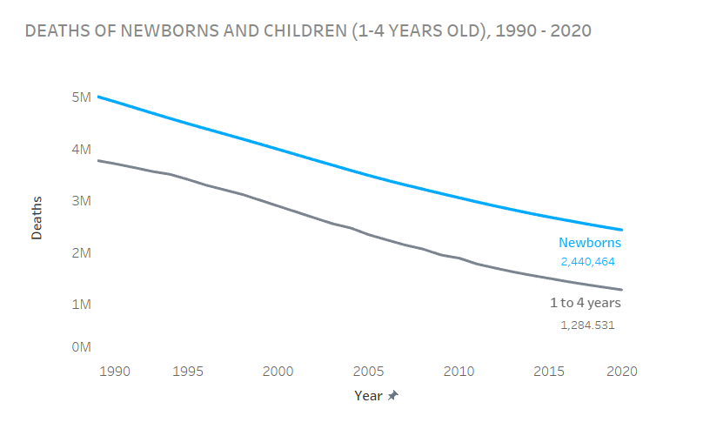
CHILDREN’S DEATH CRISIS. ARE WE DOING ENOUGH?
Even though there is a noticeable progress in mortality deaths reduction, newborns are still at a higher risk of dying.

Slide 4
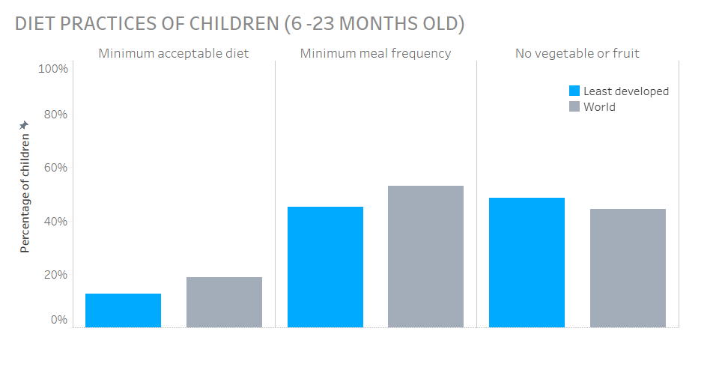
INEQUITIES IN NUTRITION
More children from least developed countries are in need of improved nutrition in the earliest years of life compared to the world.

Slide 5
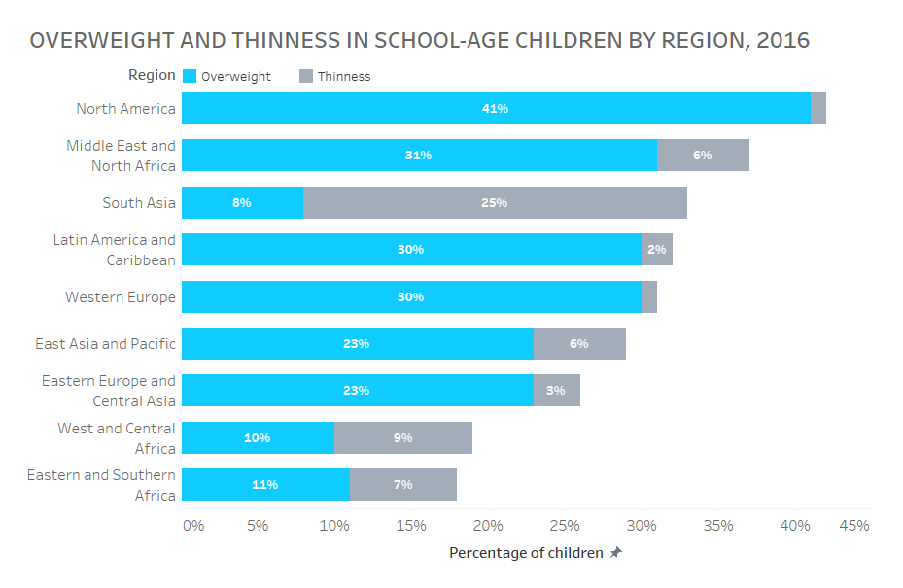
CONCERNING LEVELS OF OVERWEIGHT AND THIN CHILDREN
The number of overweight children is concerning in most of the regions. The number of thin children is especially high in South Asia.

Slide 6
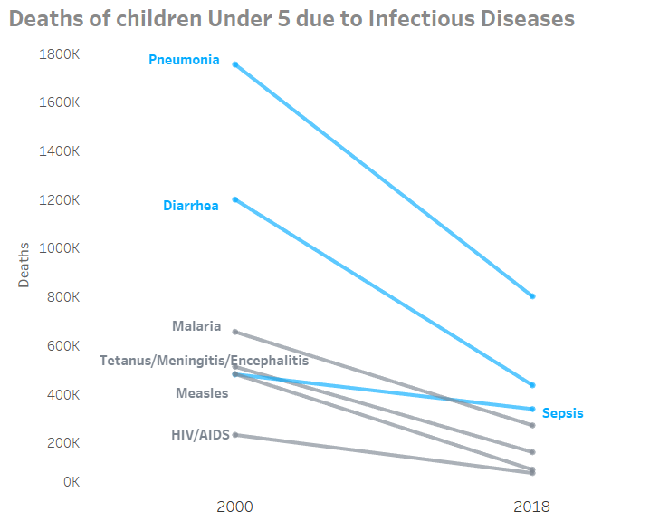
TACKLING INFECTIOUS DISEASES FOR A BETTER SURVIVAL
Despite the noticeable progress in deaths related to infectious diseases pneumonia, diarrhea and sepsis still claim lives of too many children under 5 years old. Many of these deaths are preventable.

Slide 7
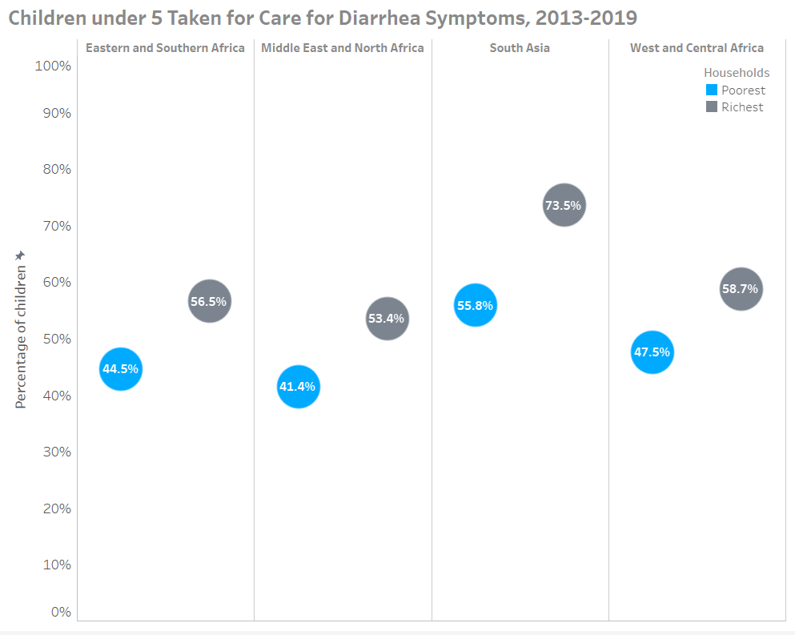
DIVIDE BETWEEN CHILDREN FROM DIFFERENT HOUSEHOLDS FOR DIARRHEA SYMPTOMS CARE.
Fewer children from poor households with diarrhea symptoms seek care from a healthcare provider than those from richer households.

Slide 8
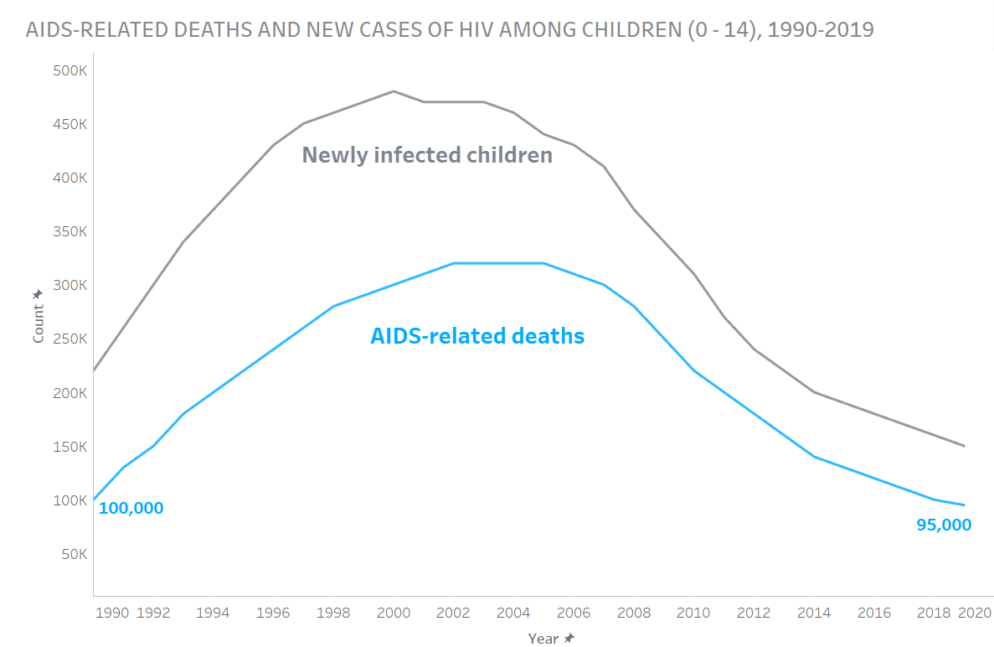
HOW CLOSE ARE WE TO ENDING THE THREAT OF HIV?
While the number of newly infected cases among children is lower than almost 3 decades ago, the recent number of AIDS-related deaths is not much different from that in 1990.

Slide 9
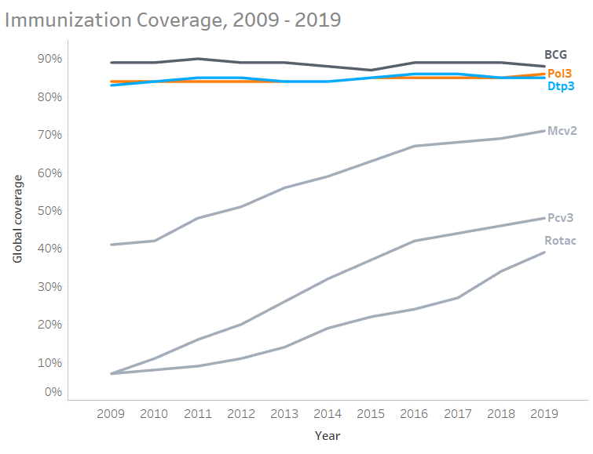
VACCINATIONS. NEED TO TIP THE SCALES.
There is a noticeable plateau in the progress of increasing pneumococcal, tuberculosis, and diphtheria, tetanus, and pertussis immunization coverage.

Slide 10
WHAT COULD WE DO TO HELP CHILDREN OF THE WORLD THRIVE?
Despite the significant process in the improvement of children’s quality of health indicators, there is a need for accelerated action to invest more effort into:
- preventing children’s deaths with the focus on newborns survival
- responding to health challenges in less developed countries and poor households
- providing healthy nutrition and creating approaches for achieving and maintaining healthy weight in children
- creating preventative approaches for fighting infectious diseases such as increase in immunization coverage and better healthcare accessibility.

