Slide 1


Midway Milestone
Natasha Goh, Ben Gregory, Michelle Huang, Cooper Reed

Slide 2
Problem
Value Proposition
Solution
Millennials and Gen Z have a desire to support socially conscious brands but have difficulty finding these brands locally.
Our smartphone app enables users to search for shops based on ethical criteria, exchange recommendations to friends, and develop relationships with local businesses.
Local Made Easy

Slide 3

Overview
Heuristic Eval Results
Design Revisions
Prototype Status
Demo
Summary

Slide 4

Heuristic Evaluation Results
Notes:
Will go over the 2 severity 4 violations
Summary of severity 3 violation trends

Slide 5
Heuristic Evaluation Overview
71
violations
Notes:
+ not going to worry about password-related issues / receipt validation / read receipts

Slide 6
Heuristic Evaluation Overview
26
45
sev 3 + 4
sev 1 + 2
Notes:
+ not going to worry about password-related issues / receipt validation / read receipts

Slide 7
Heuristic Evaluation Overview
26
45
sev 3
sev 1 + 2
2 sev 4
Notes:
+ not going to worry about password-related issues / receipt validation / read receipts

Slide 8
Heuristic Evaluation Overview
Most violated heuristics:
H7 - efficiency of use (12)
H4 - consistency (11)
H2 - match between system & world (9)
Addressing issues
Severity 4 - will address all of these
Severity 3 - will first address issues around card information, social features, filtering, and tags
Notes:
+ not going to worry about password-related issues / receipt validation / read receipts

Slide 9
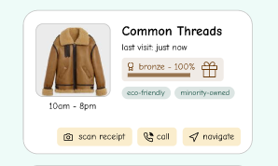
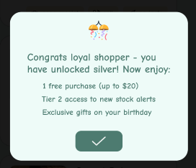
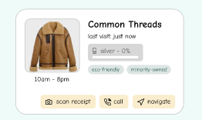
Severity 4:
Reward Retrieval
Type: H1, Visibility of System Status
Problem: When you press the “100 % Bronze” button, and your prize does appear, once you click the green check on the pop up, your reward disappears and there is nowhere to retrieve it.
Fix: Include a separate “Rewards” section, where users can see all the previous rewards they’ve earned and how to claim them.

Slide 10
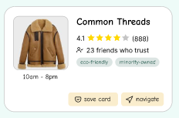
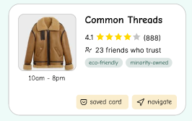
Severity 4:
Undo Card Save
Type: H3, User Control and Freedom
Problem: It doesn’t seem like there’s any easy way to undo saving a card. When you search for a store and save its card, it’s an easy button press, but the reverse action doesn’t seem available.
Fix: Make clicking “saved card” undo it being saved.

Slide 11
Severity 3 Violations Overview
Most violated heuristics were H2 (match between system and world) at 5 and H7 (efficiency of use) at 4 violations
Some trends:
Unclear or inconsistent wording
Streamlining friends, messaging, & card sharing
Streamlining the filtering system and having better organization for value tags (i.e. tags by business type)
Card variants being too similar and lacking in information + features (i.e. favoriting)
Lack of FAQ and info on what would happen if no results
Lacking receipt validation and password functionality

Slide 12

Design Revisions
Notes:
Will go over the 2 severity 4 violations
Summary of severity 3 violation trends

Slide 13
Design Revisions: Big Changes
Reward claiming + viewing accumulated rewards
Card revisions + expanding for more information
Streamlining social functionality for more clarity
More organization for value tags during filtering

Slide 14
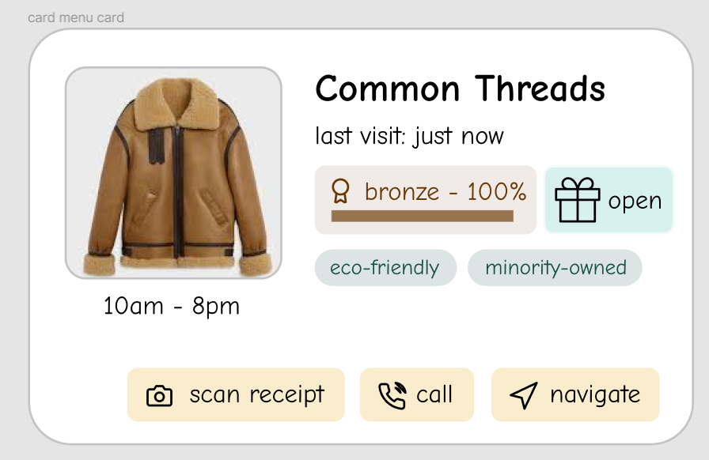
Design Revision:
Rewards
Before
Problem: Process of claiming rewards was unclear, and no way to view accumulated rewards
Fix: “open” button + “view perks” to check previous rewards
After

Slide 15
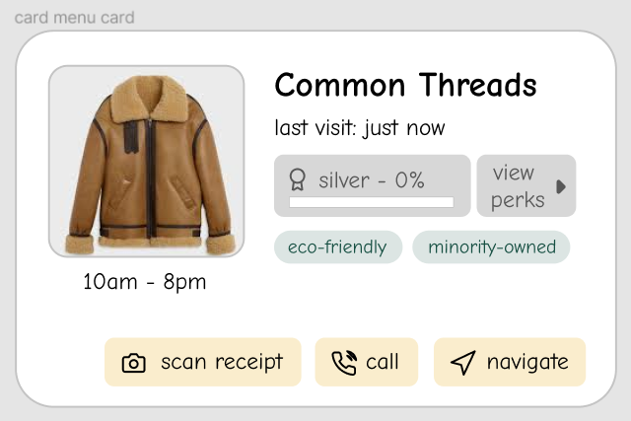
Design Revision:
Rewards
Before
Problem: Process of claiming rewards was unclear, and no way to view accumulated rewards
Fix: “open” button + “view perks” to check previous rewards
After

Slide 16
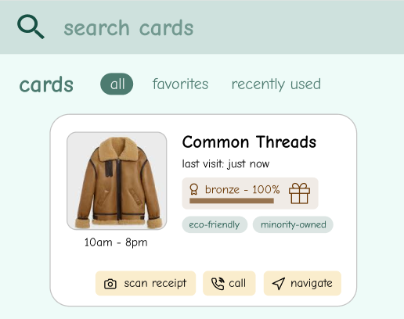
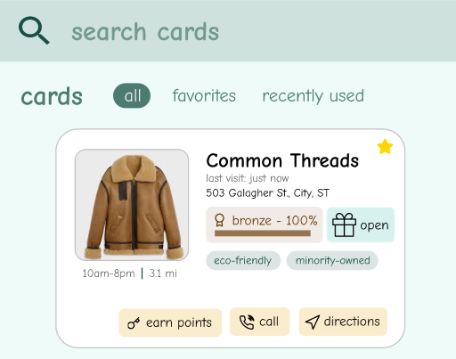
Design Revision:
Cards
Before
Problem: Business cards had unintuitive language and lacked features + information like favoriting and location
Fix: Make wording changes, add location info, and add the ability to favorite cards from “Cards” section
After
Notes:
Navigate -> directions
Scan receipt -> earn points
We also plan to add an expanded card with more information - i.e. store description, ratings, etc.

Slide 17
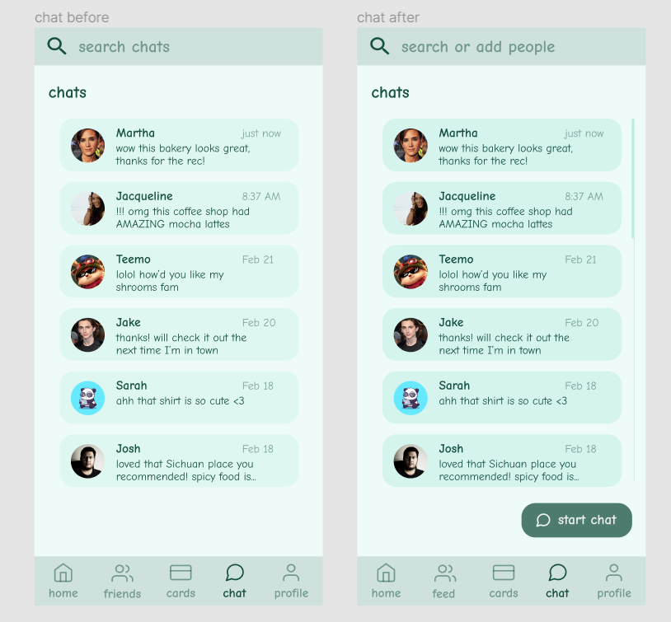
Design Revision:
Social Functionality
Before
After
Problem: Having “Friends” and “Chats” separated was unintuitive, users could not add friends in “Friends,” or start a new chat in “Chats”
Fix: Rename “Friends” section, add ability to start new chats and add friends to “Chats”

Slide 18
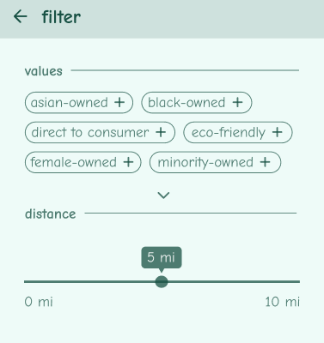
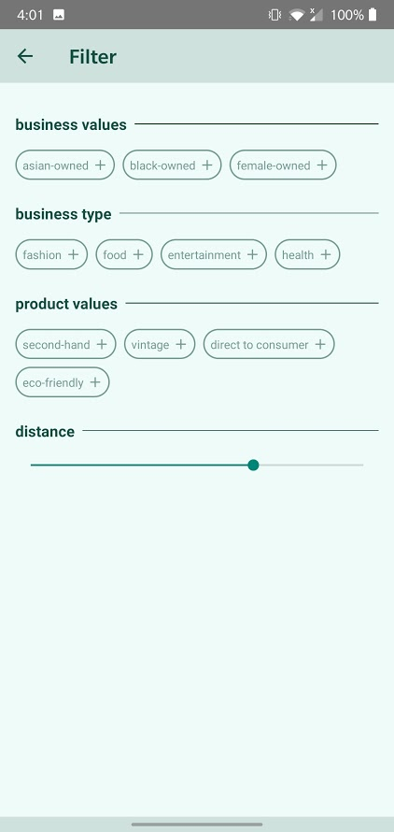
Design Revision:
Value Tag Organization
Before
Problem: Not all value tags are applicable to all types of stores, and this can create confusion when filtering
Fix: Add business type to filter, have suggested tags adjust depending on type, also have product-specific tags
After
Notes:
Example: product might be gluten free but not a business

Slide 19
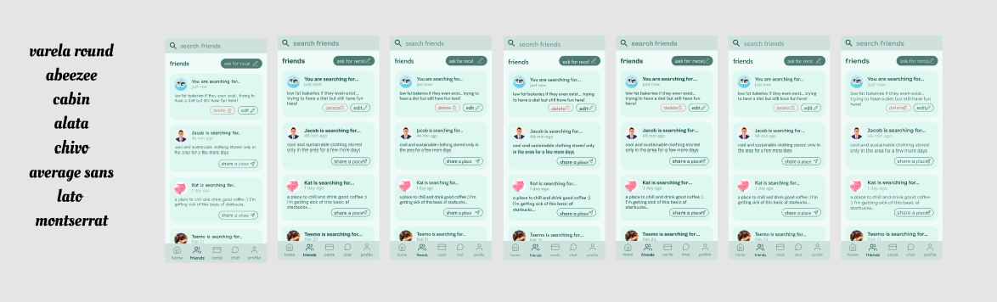
Design Revisions: Small Fixes
Font change from Comic Neue to Lato
Accessibility issues and connotations of a “Comic” font
Display message if no results are when searching/filtering
Adjusting colors for better contrast
Message timestamps
Notes:
Font change: we wanted to do this during end of med-fi process but by then was too late

Slide 20

Prototype Implementation Status
Notes:
Will go over the 2 severity 4 violations
Summary of severity 3 violation trends

Slide 21





Tools Used
React Native (application framework)
VS Code (code editor)
Android Studio Emulator (simulation)
GitHub (collaboration + version control)
Figma (design)

Slide 22
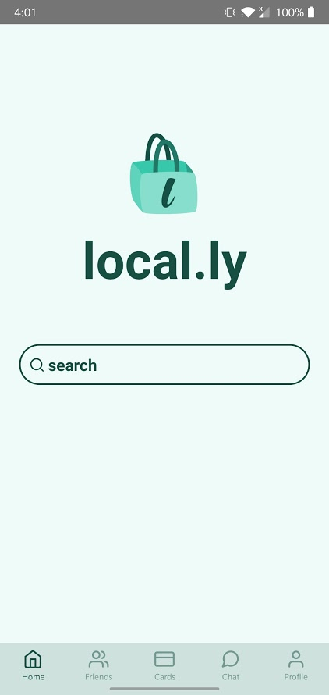
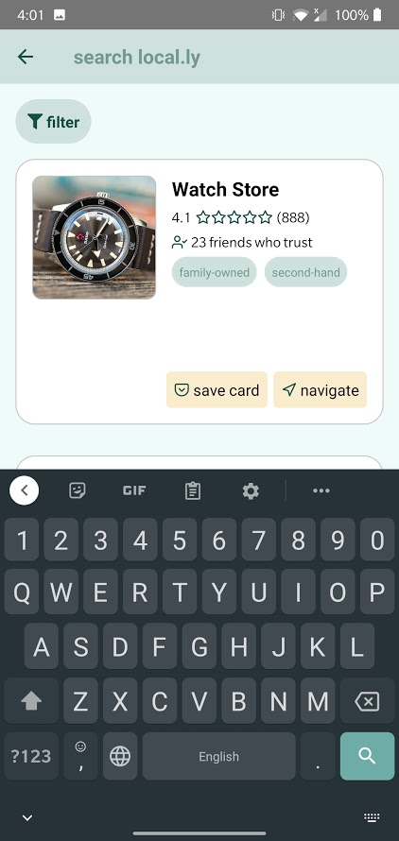
Implemented Features
Task 1 flow

Slide 23
Components
Navigation
Business card
Buttons galore

Slide 24
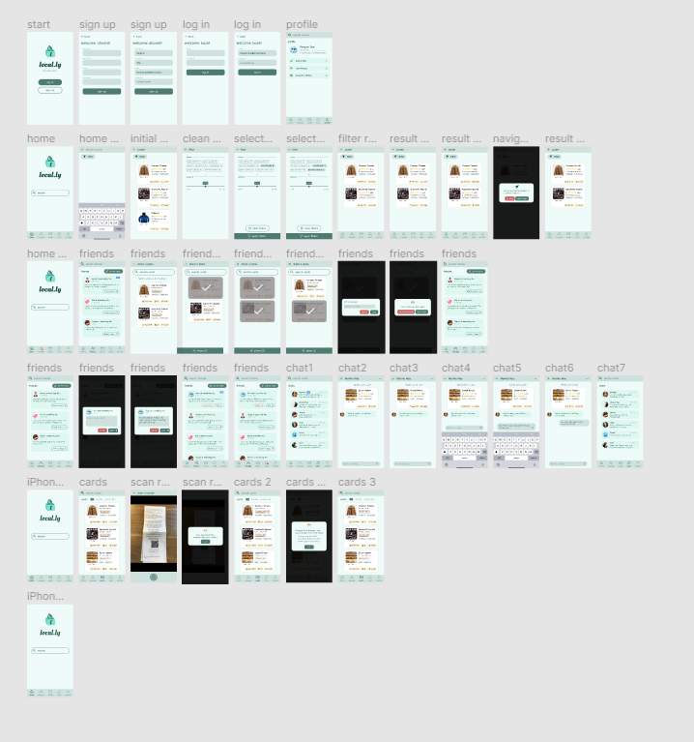
Components
Navigation
Business card
Buttons galore

Slide 25
Unimplemented Features
Log in/Sign up
Friends
Chat
Internal details
Flesh out internal app state storage
Screen connections/actions

Slide 26
Implementation Plan
Finish implementing remaining base components
Card reward/upgrade
Aesthetic changes, nice-to-haves
Friends + chat + cards screens
Looking for & sharing businesses

Slide 27
Wizard of Oz Techniques
Pre-filled chat messages to simulate time progression
Notification pop-up to signal message from friend
User will be limited in what they can search to receive results
Receipt scanning process will use a fake image
Lots of hard coded data

Slide 28
Hard-Coded Data
Login & logout
User profile data
All store-related info, including relationship progress and rewards
Receipt image
Friend list and “looking for” feed
Chat messages
Value tags used for filtering

Slide 29
Task 1 Demo!

Slide 30
Summary
20+ high severity issues
H7 - efficiency of use (12)
H4 - consistency (11)
H2 - match between system & world (9)
So far: good progress on task 1 + custom component library
To do: finish implementing base component library and continue building up functionality

Slide 31
QUESTIONS?
Notes:
What to rename friends to

