Slide 1
Exploration & Connection
(un)travel
Ben Gregory, Cooper Reed, Michelle Huang, Natasha Goh

Slide 2
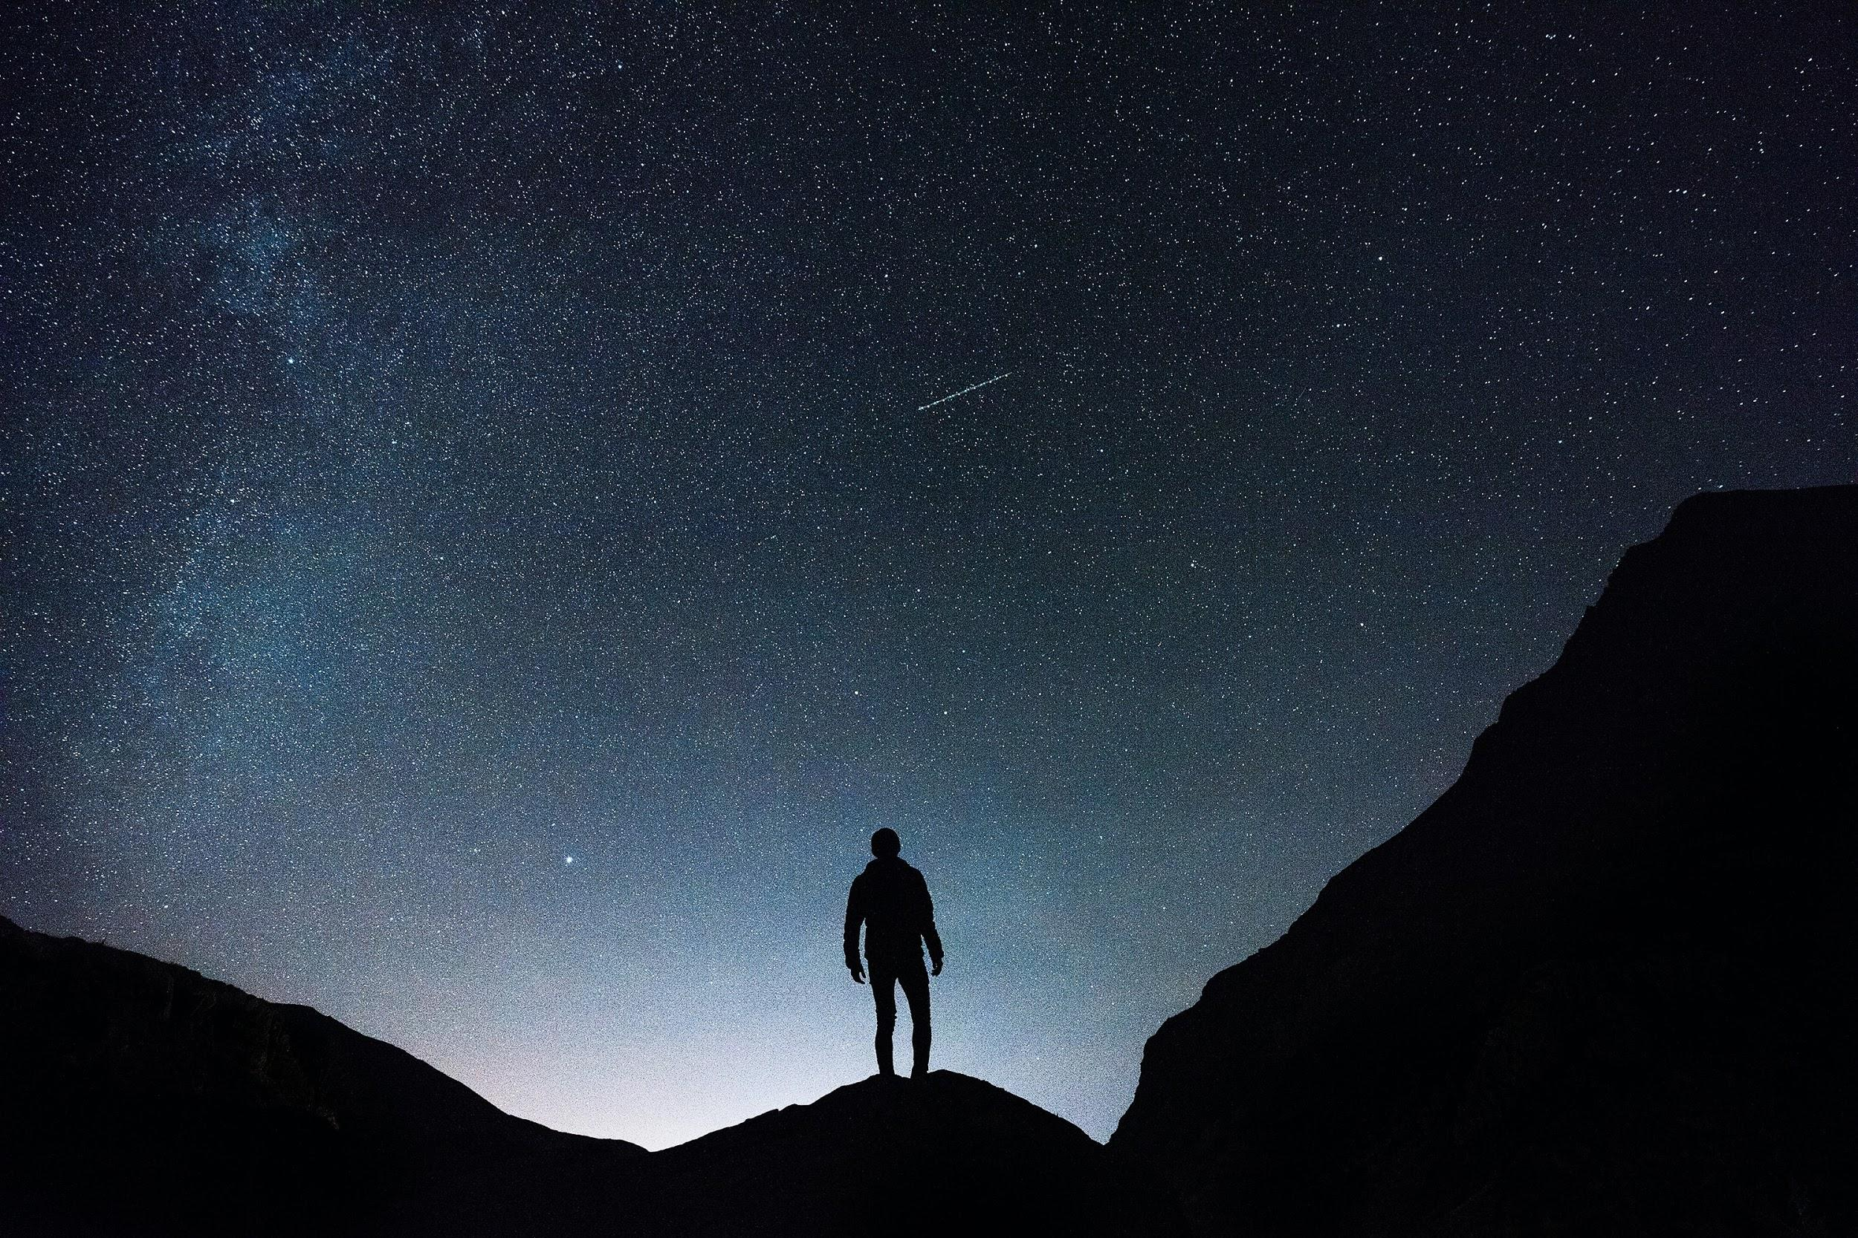
How can we use technology to promote exploration/engagement with physical places and connect people together?

Slide 3
Why?
Who?
How?
Interviews {6}
Notes:
Methodology: Found extreme users on two spectrums
Wanderlust / Exploration: Some interviewees loved to travel and explore new places while others liked to explore in moderation
Tech savviness / Gaming: Some interviewees played AR games daily while others hadn’t bought a new phone in six years.

Slide 4
Who do we want to hear from?
What do we want to hear?
Extreme Users
Low - hermits - low social media/tech
Average - social media user - access to data
High
Pokemon Go / Geocachers, listen to exploration suggestions
digital community players like discord, reddit
Exploration extreme
Adventurous & suggestible
Professionals / Experts
Google Local Guides
Business owners(?) / People who would benefit
Quarantine experience
Exploration & Engagement
Gamification, Motivation, Rewards
Community Connection & Contribution
Notes:
Tell me about your favorite game.
Walk me through the last time you connected with friends.
How do you find out about new places?
How has your quarantine experience been?
How do you respond to recommendations?
Would you consider yourself adventurous?
Why do you like to try new things?

Slide 5
Questions We Asked
Why do you like to try new things, and how?
?
Walk me through the last time you connected with friends.
Tell me about your experience with augmented reality.
Tell me about your favorite game.
Would you consider yourself adventurous?
How has your quarantine experience been? What’s missing?
What’s an urge that no existing app satisfies?
Tell me about the last time you travelled.
How do you find out about new places?
Is it important to you that something is popular? Unpopular?
How do your digital relationships compare with in-person ones?
Notes:
Tell me about your favorite game.
Walk me through the last time you connected with friends.
How do you find out about new places?
How has your quarantine experience been?
How do you respond to recommendations?
Would you consider yourself adventurous?
Why do you like to try new things?

Slide 6
Interview Results

Slide 7
“Travelling with family was stressful since we were always trying to hit all the tourist spots.”
KW
tech savvy,
Bay Area new grad

Slide 8
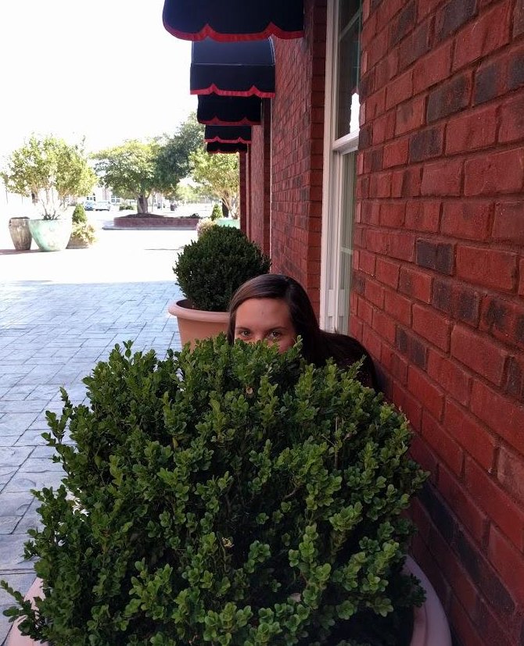
“I especially like it when...you have sort of an experience that not many people have because you went out and you were curious and explored. ”
KB
artsy gamer,
state college student

Slide 9
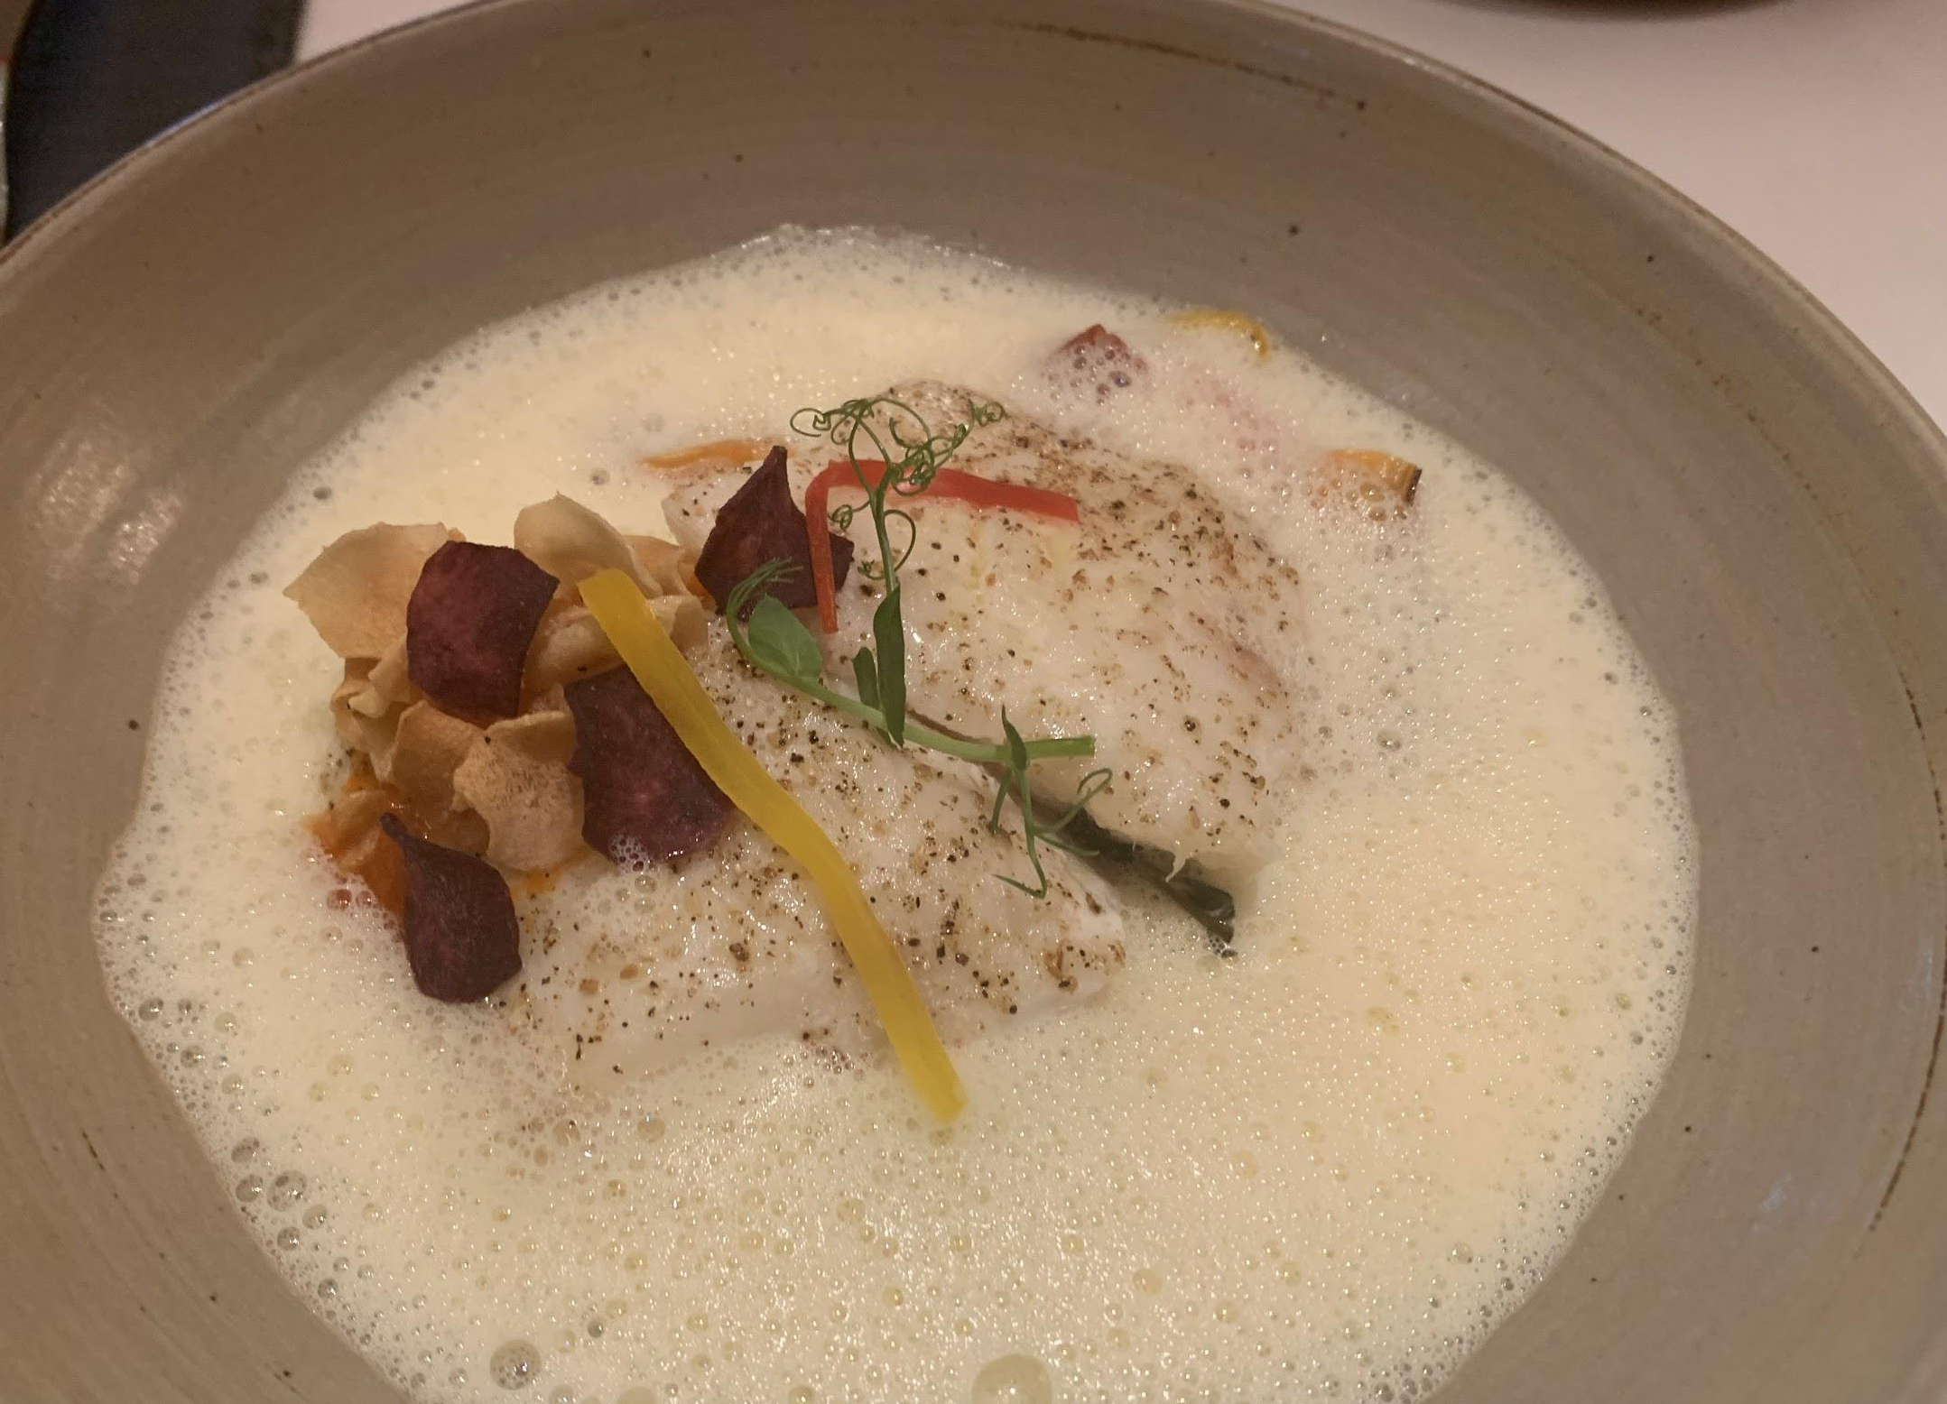
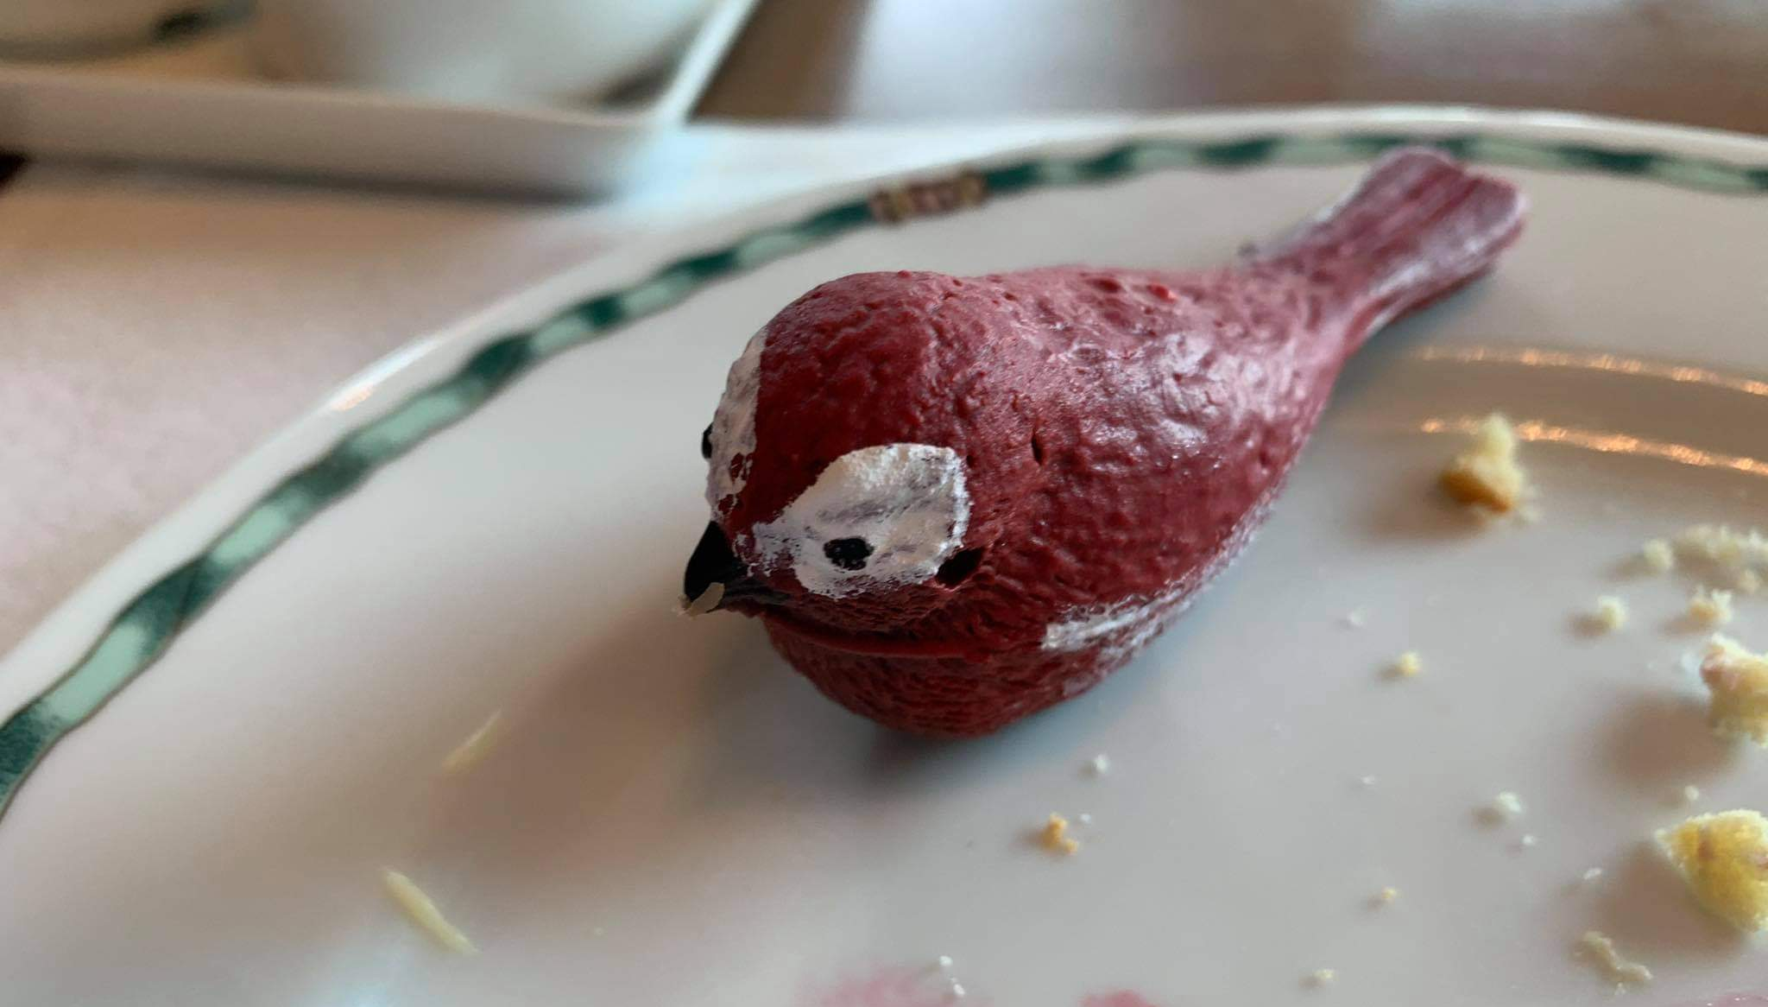
“I felt like I knew [Bangkok] well, but then, recently I found a very good [restaurant] hiding in a corner. It had been open for 10 years already, but I didn’t realize it was there.”
AN
Thailand resident,
avid foodie,
competitive gamer

Slide 10
“Do you want utility, safety, community or fun? Better get downloading, because you’ll never find those all in the same app.”
MR
Pokémon Go enthusiast,
Google local guide,
travel photographer

Slide 11

“I haven’t really tried to explore new places recently. It’s just philosophically intimidating.”
PF
non-tech savvy,
early 30s professional,
LA urban explorer

Slide 12

“I’m a completionist...Honestly, completing the rings in Apple Fitness is probably the main reason I exercise.”
EM
moderate tech user,
collector hobbyist,
Pokémon Go enthusiast

Slide 13
Empathy Maps

Slide 14
SAY
"I like to go for as many things as I can when I'm traveling"
“I have a tendency to move on from trends that have already crested.”
"Travelling with family was stressful since we were always trying to hit all the tourist spot.s"
“You should always be able to discover something new and completely different.”
“I’ll find a place I like and not want to explore as much”
“Not a Gamer” (despite playing Pokemon Go for up to an hour daily)
“I am someone who believes winning is fun and losing is not fun”
“If a place has less than 4 stars on Yelp, I won't even consider it.”
“I need not just NOT TripAdvisor, but ANTI-TripAdvisor”
"I enjoy adventure in moderation"
"Sometimes you just prefer chatting at home because you are lazy"
“Even trailblazers shouldn’t have to start with a blank slate”
Notes:
A strong desire for new experiences
Sustained effort without rewards becomes increasingly boring
Newness is risky and uncertain; a strong desire for trust and safety
Current apps have become too useful to be fun, or too fun to be useful, or too sophisticated to be welcoming, or too welcoming to get sophisticated

Slide 15
THINK
Google recs are not personal, local guides have varied taste & tastes
"Easter eggs" are rewarding, in games and in real life
Pokemon Go is gimmicky, difficult for sustained effort and ultimately unrewarding
It's important to be able to play a game competitively
Considers gamers to be someone who owns a console or “really intense” about mobile gaming
It's not safe to travel much during quarantine
Being stuck in one place for the rest of your life is terrible
A blank slate is intimidating, an entry questionnaire should establish preferences and recommend
Not sure if he will live in Bay Area forever so wants to see things while here.
There are established places to visit that are safe because he knows the precautions owners take.
Winning is fun and important, and so is improving always
Frustrated by how unconstructed most exploration apps feel
Notes:
Desire for new and better experiences // Wanderlust
Breaking the routine // spontaneity
Strong desire for better trust & transparency // new tech paranoia
Vastly different use-cases // Multi-modality // Barriers to entry

Slide 16
DO
Meeting people for 1:1 walks
Will make a note of recommendations and commit to memory (girlfriend keep pins in map)
Finds out about new places from internet "research"
Got bored of simply collecting Pokemon, ended up exploring cities instead
Works out a lot because of "completionism" with Apple Fitness Rings
Seeks out new / interesting places when she has time
Is not motivated to go out unless strictly necessary
Search for friends and items of interest near her (only so much time to explore)
Took long bike ride meandering into downtown LA; found two new taco spots
Focuses on getting from point A to B when pressed for time
Keeps an eye out when at the shopping mall for new restaurants
Has only been grocery shopping during quarantine
Notes:
Constraint: time and efficiency
A natural instinct to explore often comes into conflict with the need for a utility

Slide 17
FEEL
Didn't see himself catching up to all the other people who already played Pokemon Go
Very "check the box" kind of person with responding to challenges
Believes mental framework of the world isn’t expanding because of being in one place
Must have robust safeguards against stalking
Misses the "loose" connections of running into people
In-person interactions are more spontaneous
Needs better return on effort at all stages of involvement (more and better rewards)
Privacy concerns with snap map - ie apps constantly tracking your location in the background
Worried about risks of going to new places/being tracked - app must have robust safeguards against stalking
Did not want to explore as much during covid to avoid seeing people (and getting potentially infected)
People have adapted to covid times, (e.g. livestreamed concerts)
Shocked but also happy when came across a new hidden restaurant

Slide 18
Needs ◦ Insights ◦ Analysis

Slide 19
[Insight]
Once people get comfortable in an area, they stop exploring
“
I feel terrible that I’ve mainly been in one place for most of my life... I feel like my mental framework of the world isn’t expanding.
[Need]
A way to make exploring new areas feel comfortable

Slide 20
[Insight]
People prefer recommendations from close friends and family
“
If a place has less than 4 stars on Yelp, I won’t even consider it.
[Need]
A way to create trust networks and relationships with online reviewers
Notes:
From EM interview: will typically trust Yelp / online aggregated reviews but will preference close friends recommendation over that even if online reviews are bad.

Slide 21
[Insight]
People are concerned with their location data being collected
“
[I] deleted Snapchat after I found out they were tracking my location even when the app wasn’t open - that’s so creepy.
[Need]
Confidence that they are exploring safely and not being tracked without consent.

Slide 22
[Insight]
People vary in how they like to explore (or not.)
“
I enjoy adventure in moderation.
“
[Need]
Ability to balance efficiency vs entertainment when discovering new places.
It’s tough to choose between new and completely different or new and exactly the same.

Slide 23
[Insight]
Once a trend has been established, new users find it hard to gain a foothold among more advanced users.
“
I have a tendency to move on from trends that have already crested.
“
[Need]
Ability to jump in and out of discovering without feeling pressure to keep up with others.
Square one is terrible on any platform - on most, square 2 and 3 too.

Slide 24
[Insight]
Despite broad appeal, no two users will use this platform with the same priorities, concerns, histories, or preferences.
“
Some days I’m an explorer and an extrovert, wanting to join a movement and raise our voices together. Some days I just wanna eat, and there better not be a crowd.
[Need]
Users should be able to set strong preferences so that this tool suits their needs/use cases.

Slide 25
Summary

Slide 26
People need…
A trustworthy way to make exploring new areas feel comfortable
A personable way to create connection with online reviewers
Confidence in the safety of themselves and their data
Ability to balance efficiency vs. entertainment when discovering new places
Ability to jump in and out of discovering without feeling pressure to keep up with others
A platform with a universal language of usefulness, fun, and trust

Slide 27
Questions?

