Slide 1
local.ly
local made easy
Ben Gregory, Cooper Reed, Michelle Huang, Natasha Goh

Slide 2
Problem/Solution Overview
Problem: People who want to shop locally have a hard time finding products that align with their values at nearby stores and easily connecting with local business owners
Solution: Platform where users can search for nearby products using value-centric filters, and local businesses can authentically communicate with users and form “guilds” with other businesses based on shared values

Slide 3
Tasks
Simple: Shopper can easily find what stores carry brands/products that fit their shopping criteria (e.g. locally sourced, minority owned, sustainably made, etc).
Medium: Shopper can flag stores as trustworthy and deepen connections with business employees, helping them feel like a local even if they are not a "regular".
Complex: Shopper can discover & share trustworthy businesses that align with their values before they walk in the door.
Notes:
shoppers can flag businesses they've visited as trustworthy to make future searches go more smoothly
Shopper can discover and share other businesses that they can
automatically trust align with their values before they walk
in the door.
people with verified expertise/experience in specific areas can help others in the local community out by sharing business recs

Slide 4
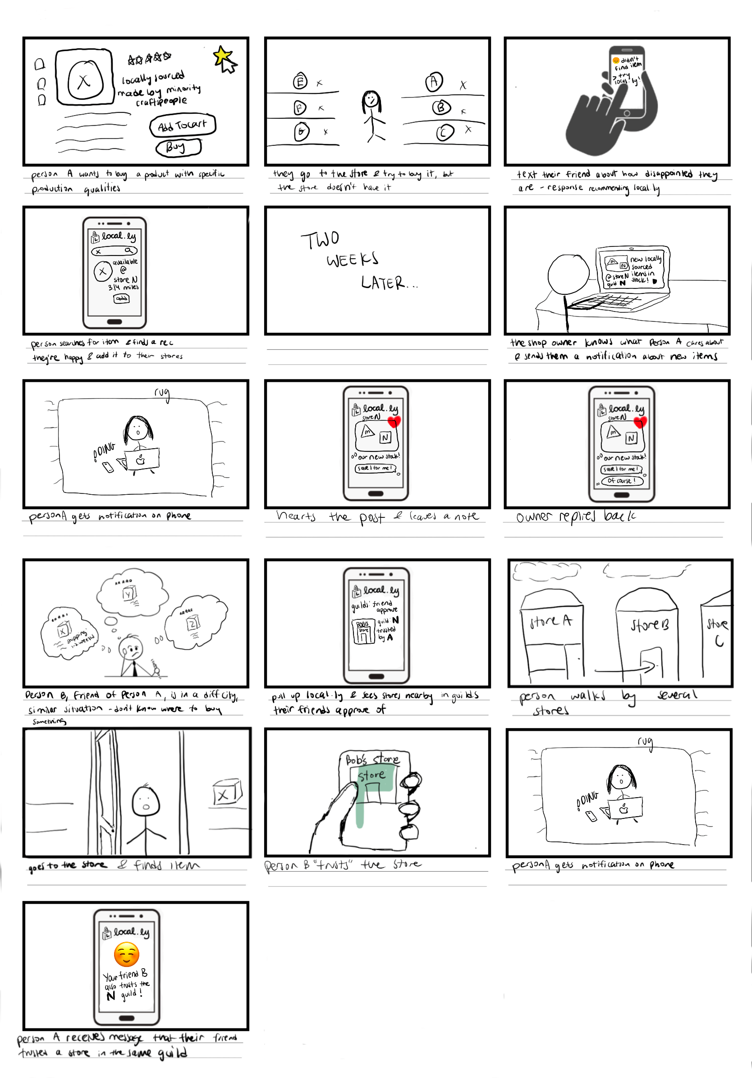
Storyboard

Slide 5
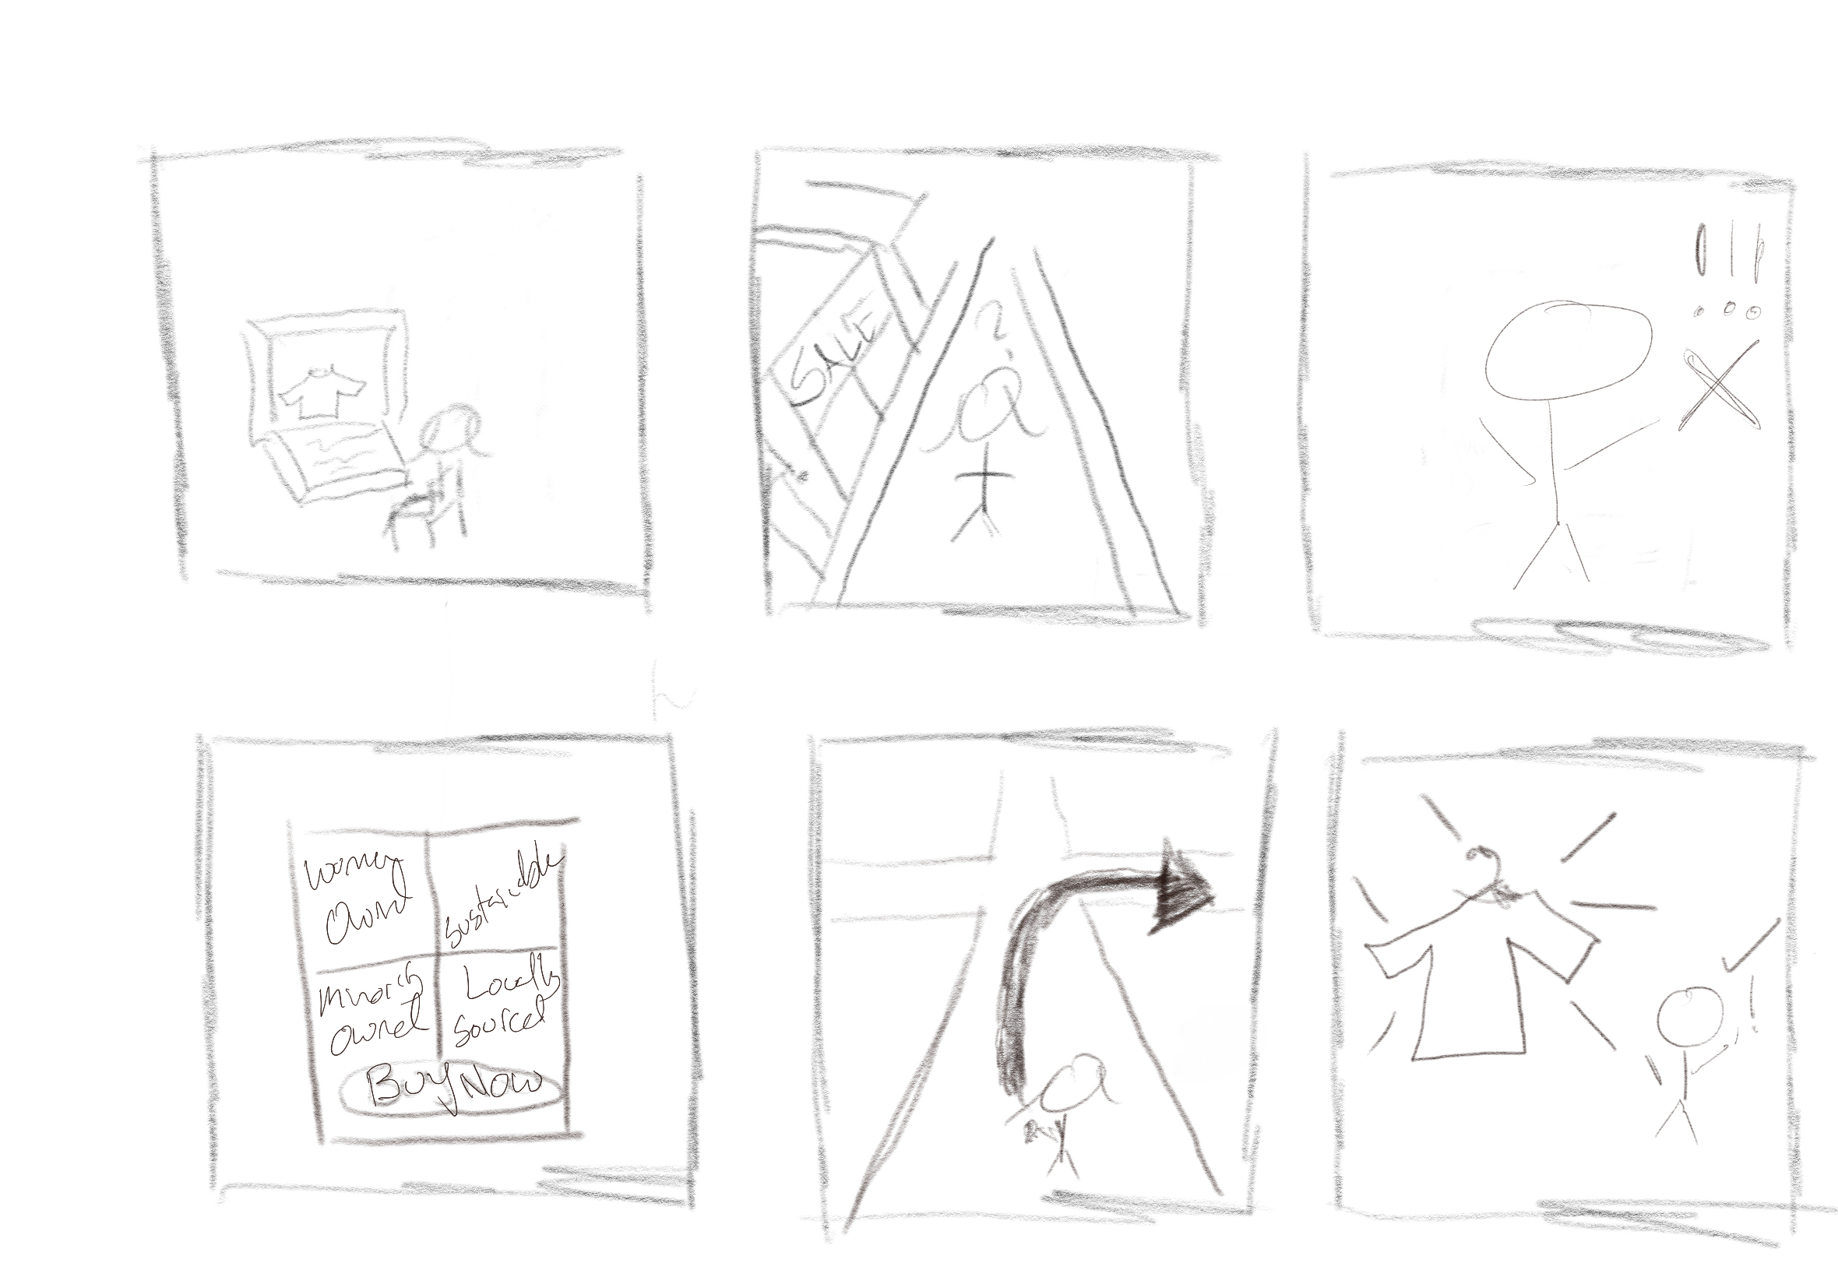
Storyboard - Task 1

Slide 6
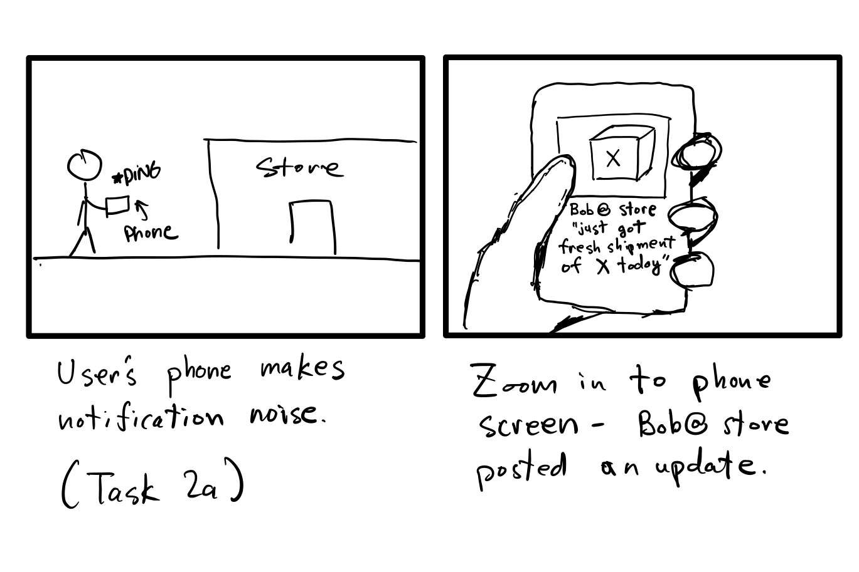
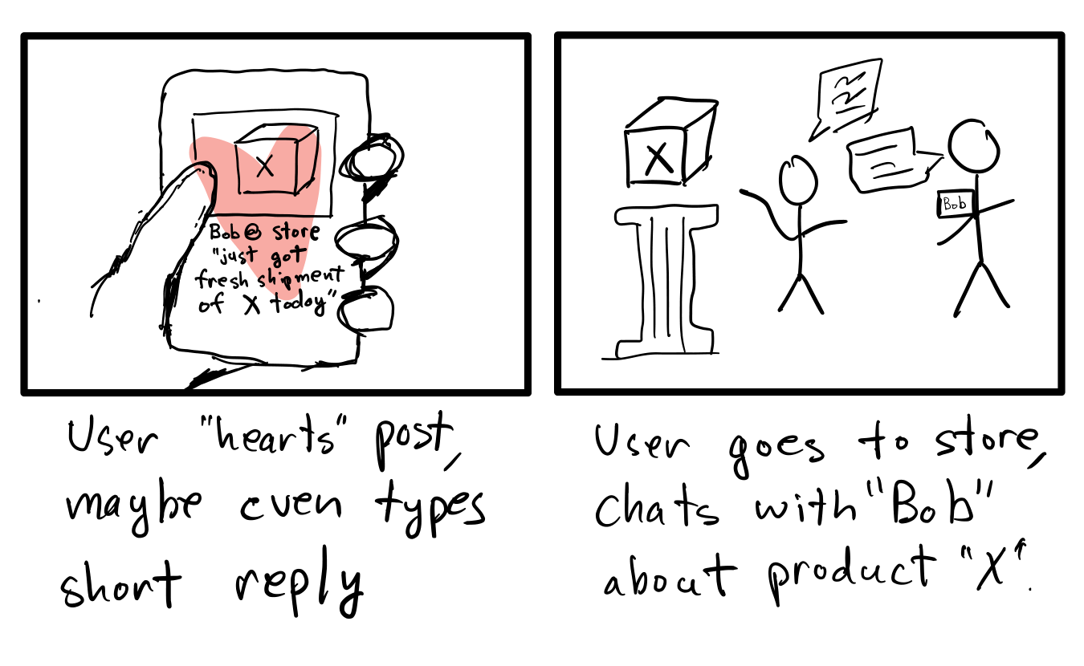
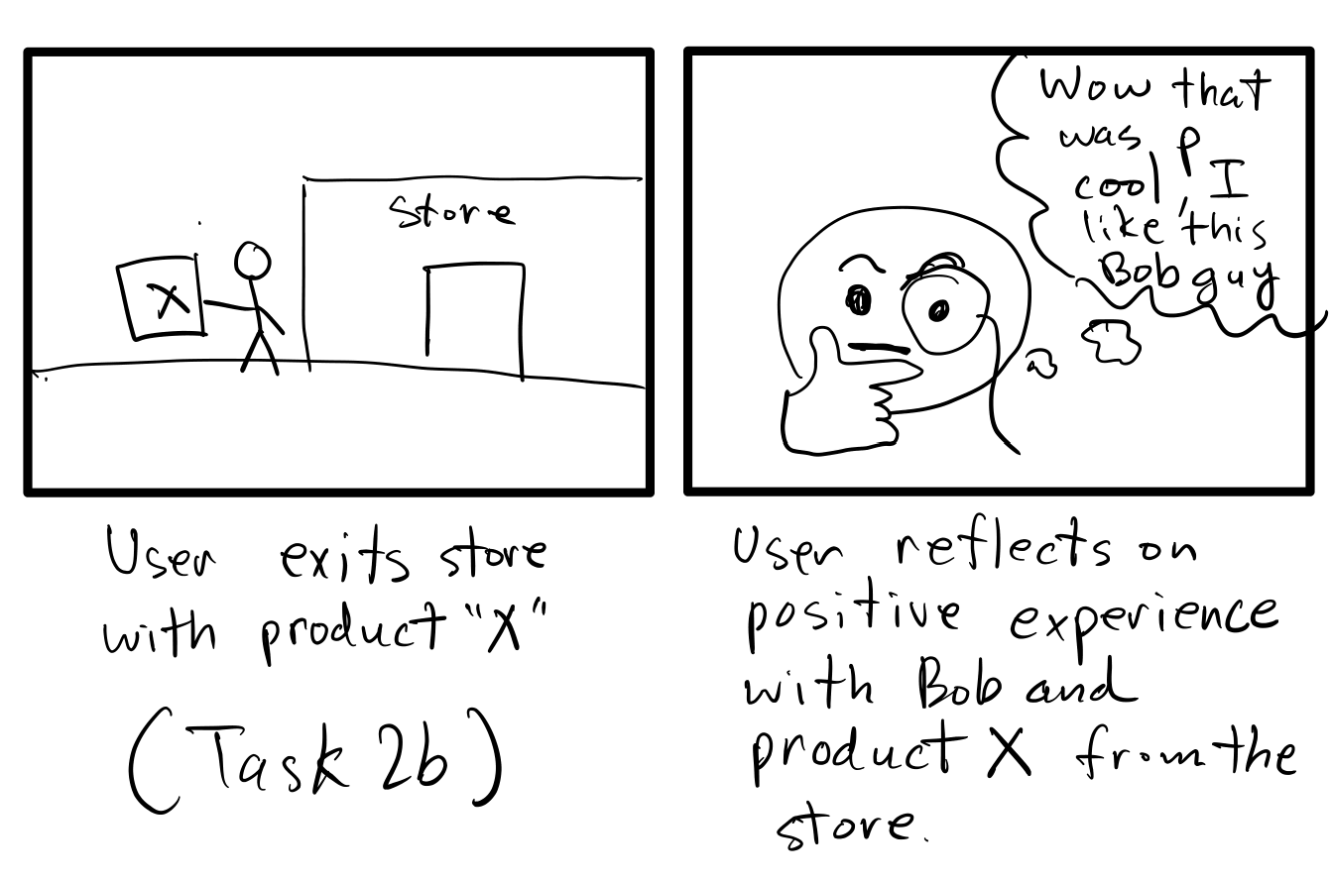
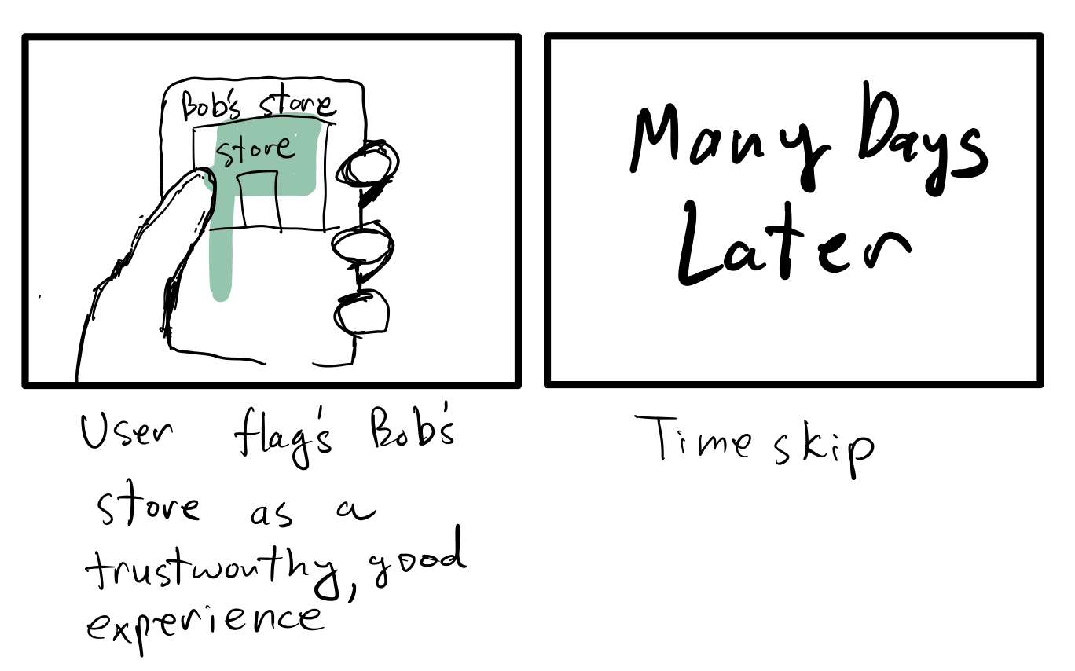
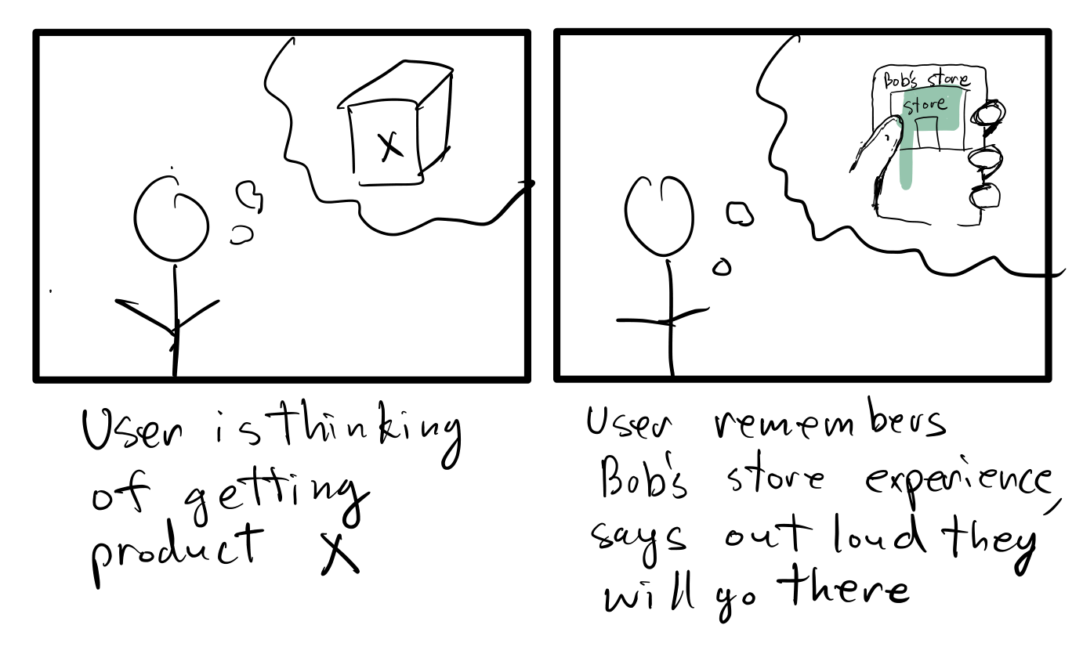
Storyboard - Task 2

Slide 7
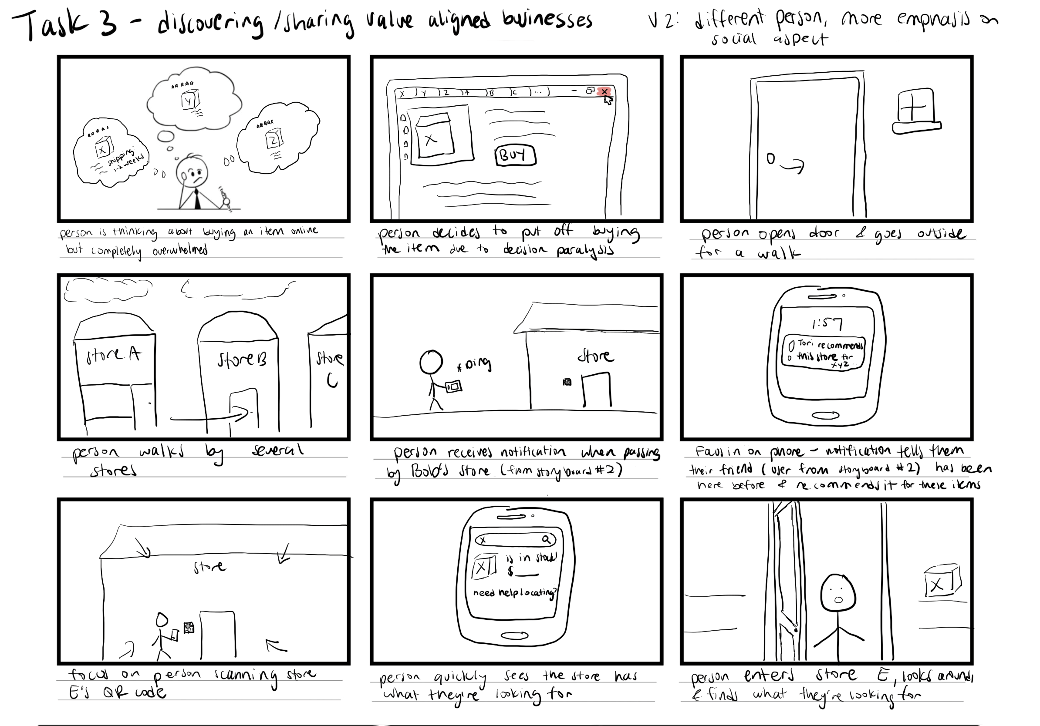
Storyboard - Task 3

