Slide 1




PSY.847 Advanced neuroimaging methods
Natalia Zaretskaya
Department of Cognitive Psychology and Neuroscience
neurovision.uni-graz.at

Slide 2
Typical structural parameters
Thickness
Gray matter density (VBM)
Volume
Surface area
Gyrification
Intracortical myelin (T1/T2)
Characteristics of white matter *fibers* (diffusion-weighted MRI)
T1w

Slide 3
Typical parameters
Structural
Functional
Thickness
Gray matter density (VBM)
Volume
Surface area
Gyrification
Intracortical myelin (T1/T2)
Characteristics of white matter *fibers* (diffusion-weighted MRI)
Task-based fMRI
Resting-state fMRI
T1w

Slide 4
Resting-state fMRI

Slide 5
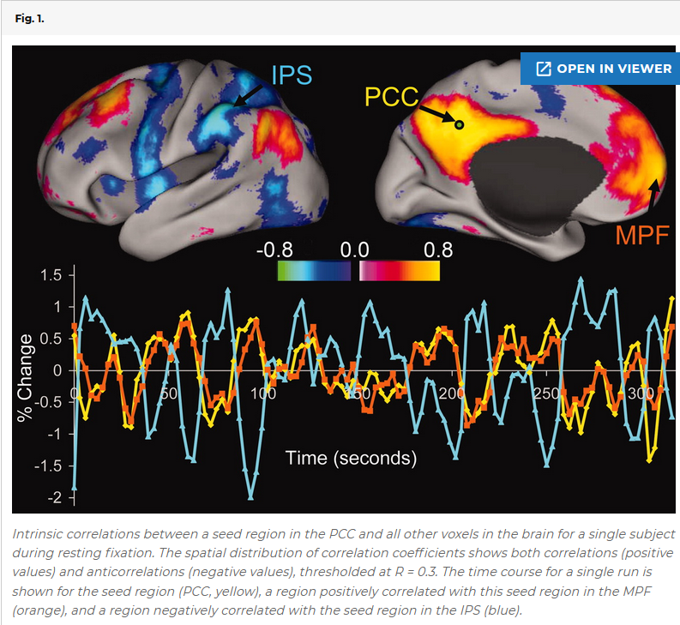
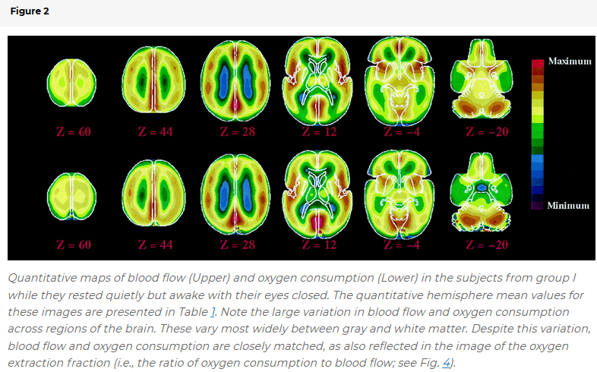
Resting-state fMRI
DMN
Functional connectivity
Raichle et al., PNAS 2001
Fox et al., PNAS 2005

Slide 6
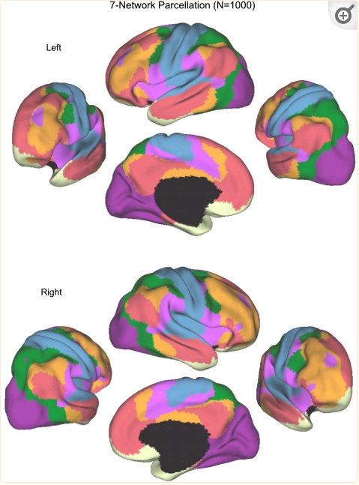
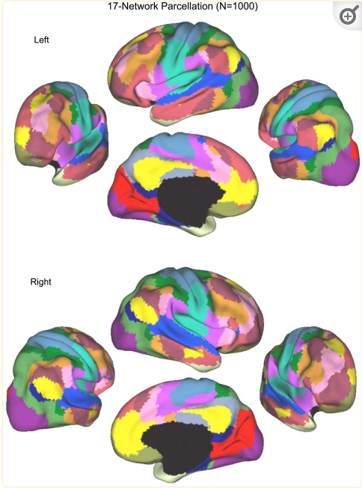
Resting-state networks
Yeo et al., 2011

Slide 7
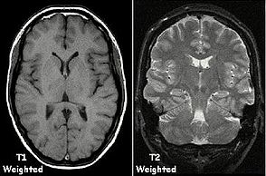
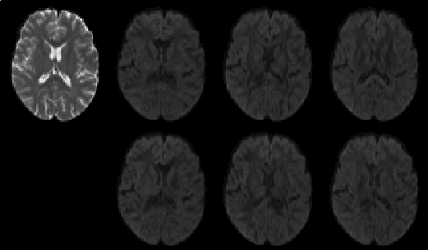
Dataset
“excite” dataset
60 healthy adult participants
Session 1: T1, T2, diffusion, task-fMRI rs-fMRI and high-res T1 scans
Session 2: vision tests, visual illusions
Diffusion weighted
https://en.wikipedia.org/wiki/Magnetic_resonance_imaging

Slide 8
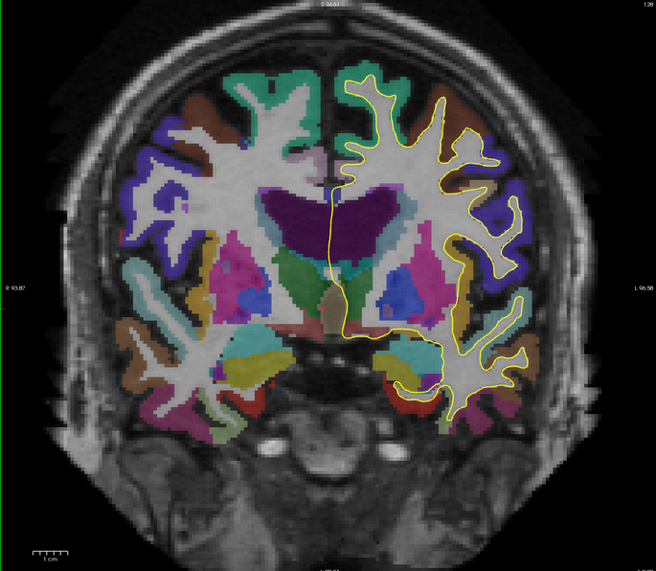
Dataset
Have
TODO
Surface-based gray-white matter segmentation and subcortical segmentation with FreeSurfer
Preprocessed of functional data
Physiology regressors
Configure your seed regions
Perform a GLM analysis with the time course of your region as a regressor; use additional nuisance physiology regressors
Perform group analysis (project 4.1 and 4.2)

Slide 9
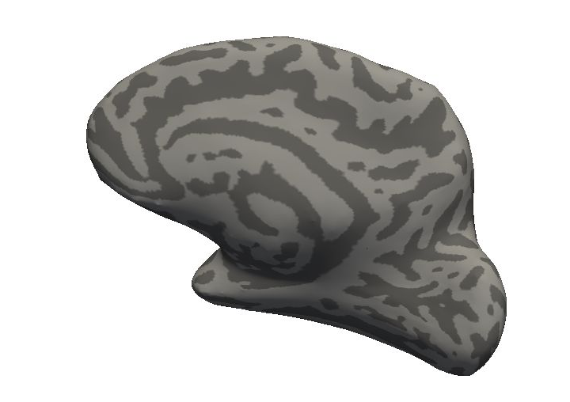
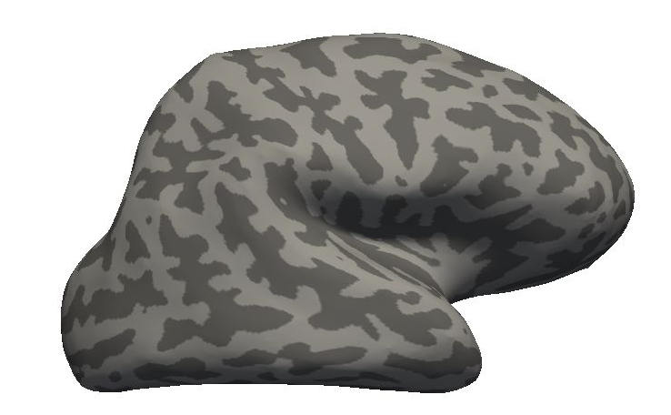
Seed regions
Primary visual cortex (V1)
Right Intraparietal sulcus (IPS)

Slide 10
Myopia
Research question 4.1: is uncorrected myopia related to differences in functional connectivity?
3 groups based on prescreening/visual acuity test
Uncorrected myopia
Corrected myopia
Emmetropia (= normal vision)
(Bach, 2021)

Slide 11
Project 4.1
Group analysis
For the presentation
Group comparison of myopia groups
See FreeSurfer tutrial for group analysis
https://surfer.nmr.mgh.harvard.edu/fswiki/FsTutorial/GroupAnalysisV6.0
Only group comparsion (no age, gender or other regressors)
Explain the background
Research question
Statistical tests, dependent and independent variables

Slide 12
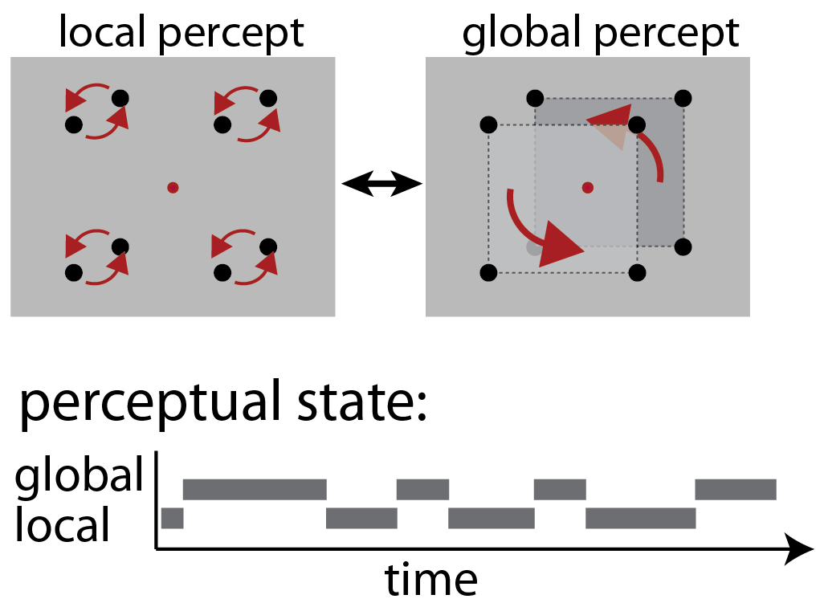
Inter-individual differences in illusion perception
Zaretskaya, Anstis and Bartels, Journal of Neuroscience 2013
After Anstis and Kim, JoV, 2010

Slide 13
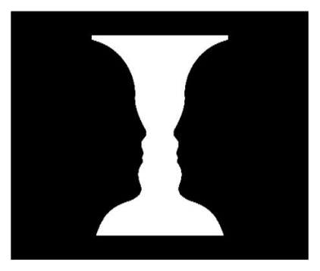
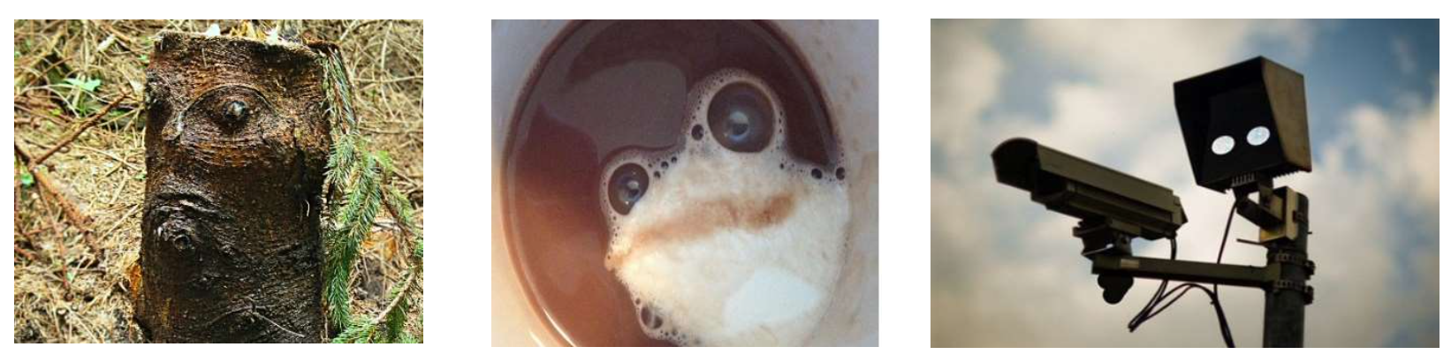
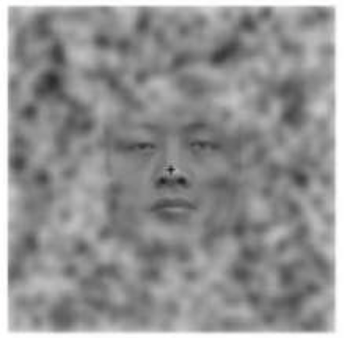
Inter-individual differences in illusion perception
Research question 4.2: Do inter-individual differences in visual illusion perception correlate with the strength of functional connectivity?
Myopia is mild, visual acuity differences can be disregarded (alternatively, you can add visual acuity as a covariate)
Focus on one visual illusion and one illusion aspect (e.g. global predominance: duration of global / duration of local)
For the list of visual Illusions and the description of the whole procedure, see the corresponding Ethics Proposal on moodle

Slide 14
Project 4.2
Dataset
For the presentation
Regression with one illusion parameter (e.g. global predominance)
Explain the background
Research question
Statistical tests, dependent and independent variables

Slide 15
Useful links
FreeSurfer functional connectivity tutorial
https://surfer.nmr.mgh.harvard.edu/fswiki/FsFastFunctionalConnectivityWalkthrough
FreeSurfer group analysis
https://surfer.nmr.mgh.harvard.edu/fswiki/FsFastTutorialV5.1/FsFastGroupLevel
FreeSurfer YouTube Channel
https://www.youtube.com/watch?v=DavxePlS94w&t=61s

