Slide 1
Student: Natalia Solorzano Perez W207818526 Course: ITAI 2377 - Data Science in Artificial Intelligence Professor: Viswanatha Rao Group ID: DS_WED_21229Spring 2025
Final Project:
Salary Prediction
using Machine Learning

Slide 2
Agenda
Dataset Overview, Preprocessing and Feature Engineering
Model Training and Evaluation
Ensemble and Best Model
Conclusion & Application
References

Slide 3

Dataset Overview, Preprocessing and Feature Engineering
Source: Kaggle – Salary VS Experience
Columns:
YearsExperience
Salary
Preprocessing:
Removed Duplicates & Outliers
Handled Skewness with Log Transform
Engineered Polynomial Features
Scaled Features with StandardScaler
Split:
Train: 70 %
Val: 15%
Test: 15%
Goal:
Determine the best model

Slide 4
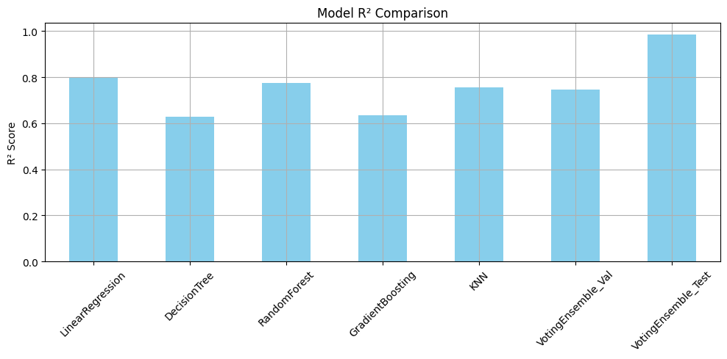
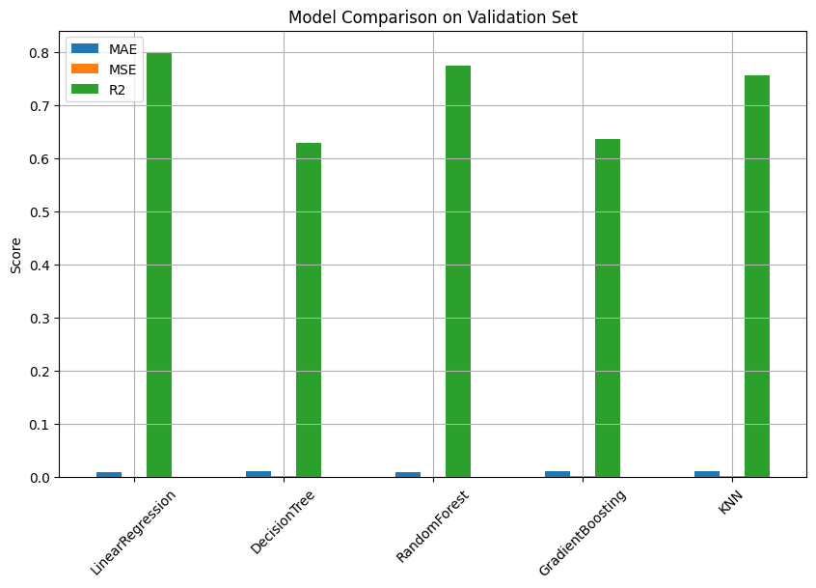
Model Evalutation & Ensemble
Models Trained:
- Linear Regression
- Decision Tree
- Random Forest
- Gradient Boosting
- KNN
Validation R² Scores:
- Linear Regression: 0.80
- Random Forest: 0.77
- KNN: 0.75
Winner
LINEAR
REGRESSION!!!

Slide 5
Conclusion
Linear Regression best fit the data
Simpler model outperformed complex ones
Clean data is key to strong performance
✔️ Salary estimators for job seekers
✔️ HR tech compensation tools
✔️ Career planning insights
Applications
Thank you! Natalia Solorzano Perez W207818526

Slide 6
References
Sharma, A. (n.d.). *Salary Dataset - Simple Linear Regression*. Kaggle. https://www.kaggle.com/datasets/abhishek14398/salary-dataset-simple-linear-regression
Pedregosa, F., Varoquaux, G., Gramfort, A., Michel, V., Thirion, B., Grisel, O., ... & Duchesnay, É. (2011). Scikit-learn: Machine learning in Python. *Journal of Machine Learning Research*, 12, 2825–2830.
McKinney, W. (2010). Data structures for statistical computing in Python. In *Proceedings of the 9th Python in Science Conference*, 51–56.
Hunter, J. D. (2007). Matplotlib: A 2D graphics environment. *Computing in Science & Engineering*, 9(3), 90–95.
Waskom, M. (2021). Seaborn: Statistical data visualization. https://seaborn.pydata.org
Chen, T., & Guestrin, C. (2016). XGBoost: A scalable tree boosting system. In *Proceedings of the 22nd ACM SIGKDD International Conference on Knowledge Discovery and Data Mining*, 785–794.Microsoft. (n.d.).
LightGBM documentation. https://lightgbm.readthedocs.io

