Slide 1
Machine-Learning Ciphertext Decryption Algorithm
Natalia Koliou

Slide 2

What is this project all about?
This project aims to build a decryption tool, that uses a multi-class support vector machine (SVM) classification model to decrypt ciphertexts, encrypted with some randomly generated mixed-ciphertext alphabet.
Plaintext Alphabet:
Ciphertext Alphabet:
a | b | c | d | e | f | g | h | i | j | k | l | m | n | o | p | q | r | s | t | u | v | w | x | y | z
d | t | j | w | k | g | r | a | h | q | b | c | m | v | z | l | f | y | o | p | s | i | n | e | u | x
e | i
i | e
if i could only wake some still bright morning and feel that life had begun again
ef e could only waki somi stell breght morneng and fiil that lefi had bigun agaen
Example:

Slide 3
What is this project all about?
This project aims to build a decryption tool, that uses a multi-class support vector machine (SVM) classification model to decrypt ciphertexts, encrypted with some randomly generated mixed-ciphertext alphabet.
Features: the way in which letters function within texts (letter-based approach)
Labels: lowercase letters of the English alphabet (a, b, c, … , z) – 26 in total
Example:
if i could only wake some still bright morning and feel that life had begun again
e: is one of the most common letters (f = 6) and can be found as a double letter within words (see: feel).
i: is the most common letter (f = 7) and the only one that forms a single-letter word (see: i).

Slide 4
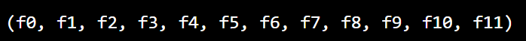
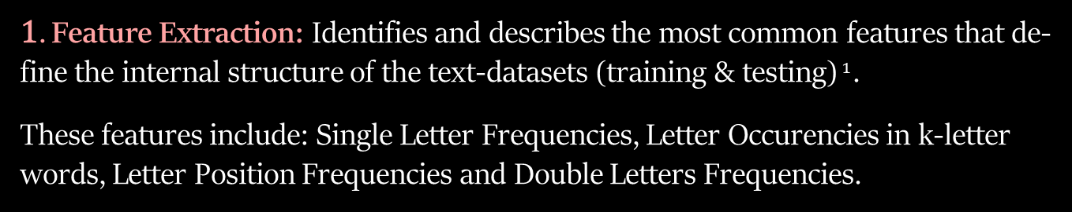
The Steps of the Classification Process
1. Feature Extraction: Identifies and describes the most common features that de-fine the internal structure of the text-datasets (training & testing)$^{1}$.
These features include: Single Letter Frequencies, Letter Occurencies in k-letter words, Letter Position Frequencies and Double Letters Frequencies.
2. Feature Selection: Creates feature-set (X) and label-set (y), by selecting the fea-tures that describe best each class.
$^{1}$ Training uses plaintext, whereas testing uses ciphertext encrypted with a randomly generated key (mixed ciphertext alphabet).

Slide 5

The Steps of the Classification Process
3. Iterative Classification: Trains an SVM classifier on the training plaintext. It then uses this classification model iteratively, to assign class-labels to the testing ciphertext (decryption alphabet prediction).
Why iterative though?
Validity and Completeness: every letter of the English alphabet should occur exactly once in the decryption alphabet – here is an example of an invalid decryption alphabet: abaeyoddtag opkuklapezjpnve.
Solution: training and testing iteratively up until the predicted decryption alphabet becomes valid and complete.

Slide 6
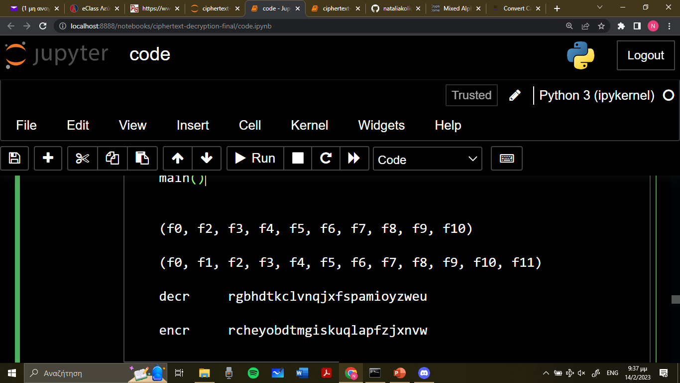
The Steps of the Classification Process
4. Ciphertext Decryption: Applies the predicted decryption alphabet to the testing ciphertext to decrypt it.
Example:
Suppose this is the predicted decryption alphabet:
i.e., cipher-letter “b” is encrypted by that letter, whose index in the English alphabet is the one that “b” has in this predicted decryption alphabet. So “b” corresponds to the encrypted letter “c”.
sv aypf tp buky sv dyraf tp puay qyrhy otke t kyjya rke kyjya suay xdyay dy tp kuf itoy tp fdy fusc fdy xuaie tp ctffyakypp rke biuus harwye tp sv quua etpfarhfye cartk sv fdayre uo fduzbdf tp aykf tk fxrtk sv aypf tp buky sv dyraf tp puay qyrhy otke t kyjya rke kyjya suay
my rest is gone my heart is sore peace find i never and never more where he is not life is the tomb the world is bitterness and gloom crazed is my poor distracted brain my thread of thought is rent in twain my rest is gone my heart is sore peace find i never and never more
→

Slide 7

Experimental Results & Observations$^{2}$
1A. Testing Ciphertext: Eugene Onegin | Alexander Pushkin
feature-tuple:
decryption key:
accuracy classification score: 1.00
→ predicted decryption key:
Encrypted Ciphertext
Decrypted Ciphertext
ftsy xrp xdyk huie pyezhftuk pfaujy fu pxrbbya rp fdy raf uo iujy yjyavxdyay fazsqyftkb tfp oyrfp kuf pyygtkb iujy czf pykpzri pxyyfp czf fdtp rszpysykf eyithrfy xrp xuafdv uo fdrf uie crcuuk uza orfdyap zpye fu eufy zquk fdy iujyirhyp ray uzf uo erfy fdyta biuav xtfd fdyta dyyip uo aye rke iukb qyazgyp drfd jrktpdye
time was when cold seduction strove to swagger as the art of love everywhere trumpeting its feats not seeking love but sensual sweets but this amusement delicate was worthy of that old baboon our fathers used to dote upon the lovelaces are out of date their glory with their heels of red and long perukes hath vanished
$^{2}$ Training text: approx. 99% of the book “Anna Karenina” by L. Tolstoy.

Slide 8
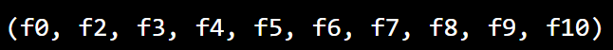

Experimental Results & Observations
1B. Testing Ciphertext: Eugene Onegin | Alexander Pushkin
feature-tuple:
decryption key:
accuracy classification score: 0.92
→ predicted decryption key:
Encrypted Ciphertext
Decrypted Ciphertext
ftsy xrp xdyk huie pyezhftuk pfaujy fu pxrbbya rp fdy raf uo iujy yjyavxdyay fazsqyftkb tfp oyrfp kuf pyygtkb iujy czf pykpzri pxyyfp czf fdtp rszpysykf eyithrfy xrp xuafdv uo fdrf uie crcuuk uza orfdyap zpye fu eufy zquk fdy iujyirhyp ray uzf uo erfy fdyta biuav xtfd fdyta dyyip uo aye rke iukb qyazgyp drfd jrktpdye
time whs waen cold seduction strove to swhgger hs tae hrt of love everywaere trumpeting its fehts not seeking love but sensuhl sweets but tais hmusement delichte whs wortay of taht old bhboon our fhtaers used to dote upon tae lovelhces hre out of dhte taeir glory wita taeir aeels of red hnd long perukes ahta vhnisaed

Slide 9
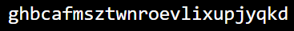
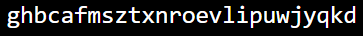
Experimental Results & Observations
2A. Testing Ciphertext: The Sorrows of Young Werther | Goethe
feature-tuple:
decryption key:
accuracy classification score: 0.88
→ predicted decryption key:
Encrypted Ciphertext
Decrypted Ciphertext
werther began to write and the words flowed from his pen as if of their own accord he told of his love for lotte and hop she was engaged to be married to albert he wrote of his pain and heartache and of the constant battle he waged against his own feelings he described the beauty of the countryside and the peace he found in nature but also his own inner turmoil and his longing for something more
xerther began to xrite and the xords floxed from his wen as if of their oxn accord he told of his love for lotte and hox she xas engaged to be married to albert he xrote of his wain and heartache and of the constant battle he xaged against his oxn feelings he described the beauty of the countryside and the weace he found in nature but also his oxn inner turmoil and his longing for something more

Slide 10
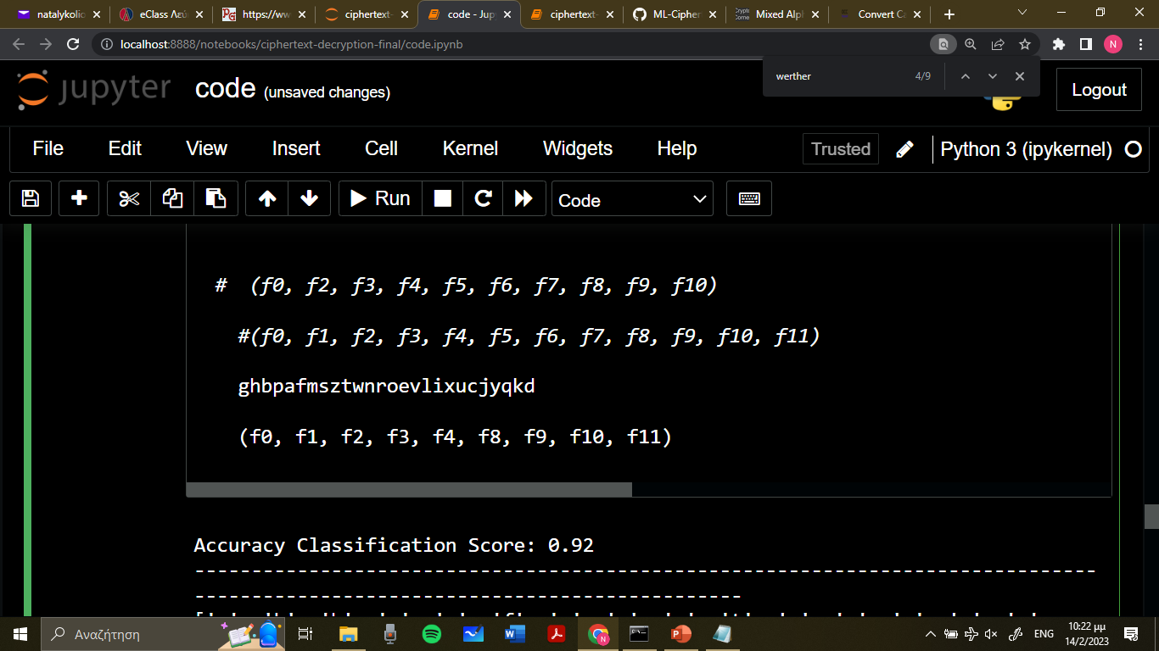
Experimental Results & Observations
2B. Testing Ciphertext: The Sorrows of Young Werther | Goethe
feature-tuple:
decryption key:
accuracy classification score: 0.92
→ predicted decryption key:
Encrypted Ciphertext
Decrypted Ciphertext
werther began to write and the words flowed from his pen as if of their own accord he told of his love for lotte and how she was engaged to be married to albert he wrote of his pain and heartache and of the constant battle he waged against his own feelings he described the beauty of the countryside and the peace he found in nature but also his own inner turmoil and his longing for something more
werther began to write and the words flowed from his cen as if of their own appord he told of his love for lotte and how she was engaged to be married to albert he wrote of his cain and heartaphe and of the ponstant battle he waged against his own feelings he despribed the beauty of the pountryside and the ceape he found in nature but also his own inner turmoil and his longing for something more

Slide 11
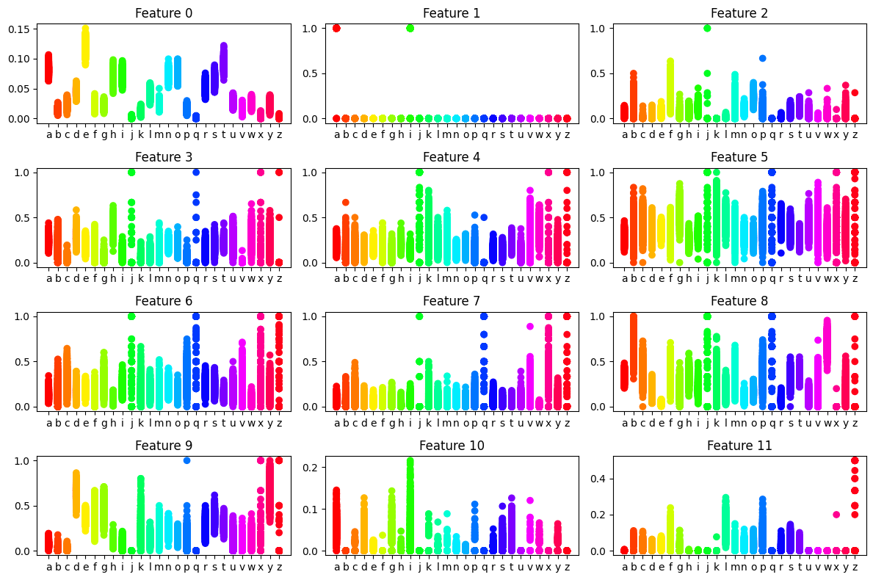
Feature Diagrams & Outputs
Training Process: a,b,c,...,z refer to the real-letters of the English alphabet.

Slide 12
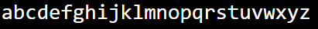
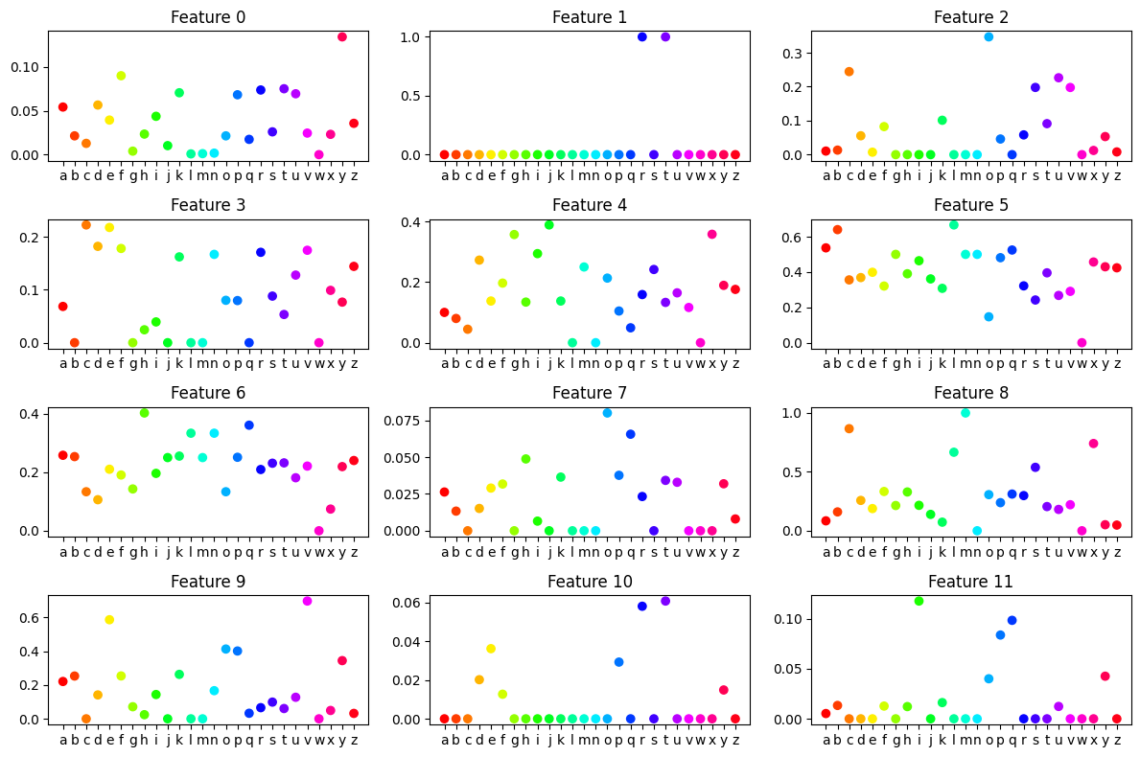
Feature Diagrams & Outputs
AB:
PDK:
Testing Process: a,b,c,...,z refer to cipher-letters!

Slide 13
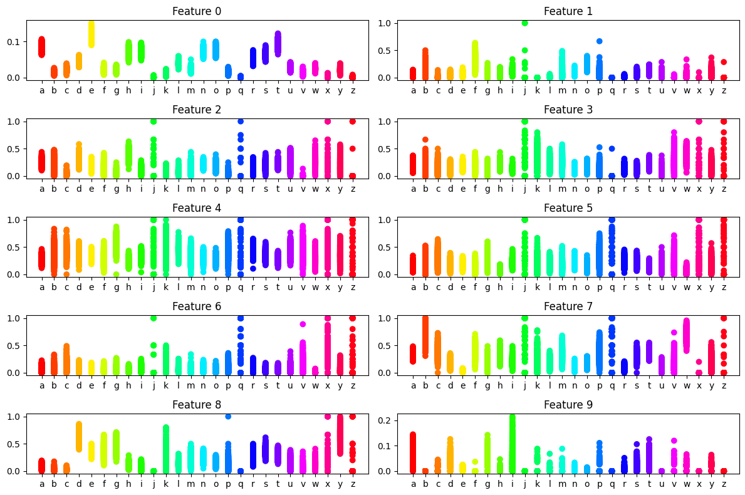
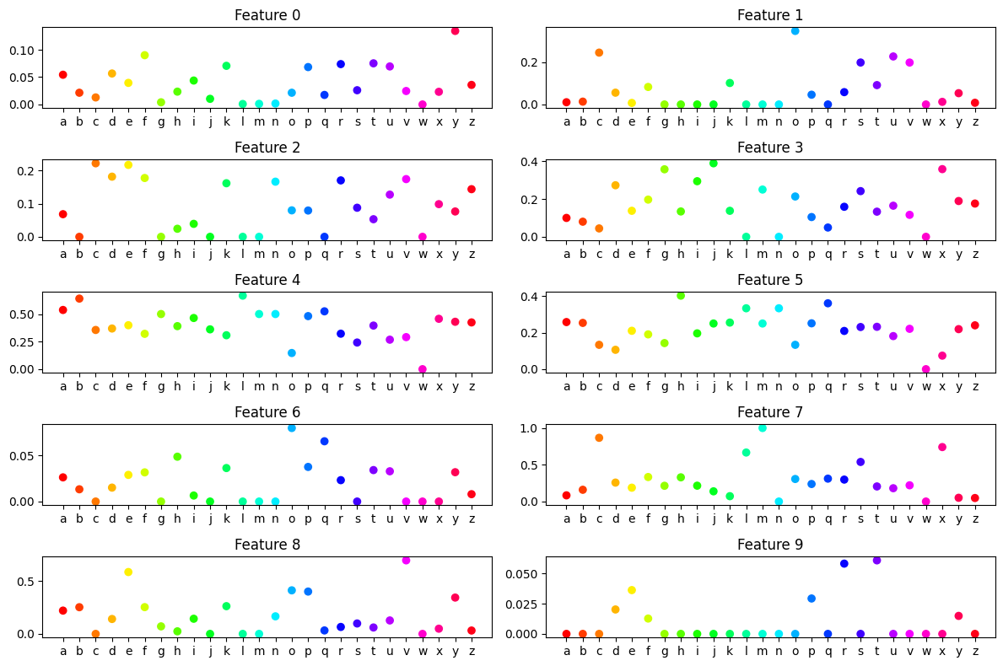
Feature Diagrams & Outputs
AB:
ADK:
PDK:
Why did we get a wrong prediction?
The algorithm thinks that real-letter “a” is encrypted as “d”! The testing-features of “d” are more similar to the training-features of “a”, rather than the ones of “h”. Is that really so?

Slide 14
Any Questions?

Slide 15
Thank you!
Natalia Koliou

