Slide 1

The role of endoplasmic reticulum stress in the immune response to cancer
Natalia Lopez-Barbosa

Slide 2





THE CHARACTERS: IMMUNE CELLS
(SOME)
IN CANCER
Dendritic cell
Neutrophil
Myeloid-derived suppressor cell
Cytotoxic T cell
Antigen presentation for T cell recognition
First responders to inflammation
Activate by antigen recognition on dendritic cells. Release of cytotoxins into antigen presenting cells
Serve as immunosuppressor cells

Slide 3

THE BIOLOGY: THE ENDOPLASMIC RETICULUM (ER)
Organelle found in eukaryotic cells
Protein synthesis and folding
Post-translation protein modifications
Disulfide bonds
N-linked glycosylation

Slide 4
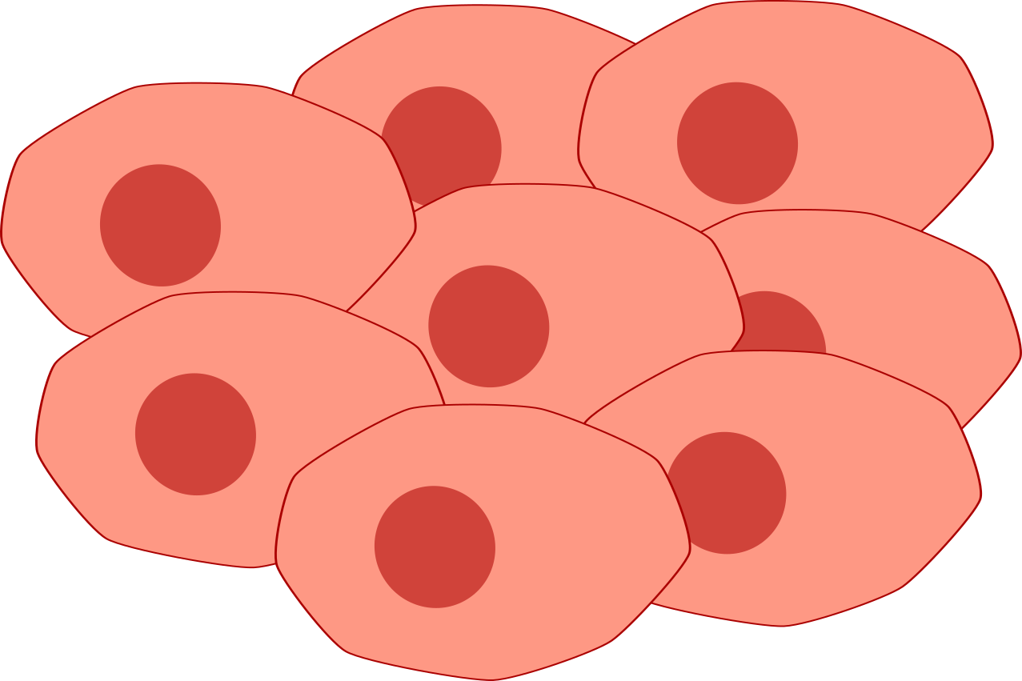
THE BIOLOGY: THE TUMOR MICROENVIRONMENT
IMMUNE CELLS IN
Neutrophil
(ROS, Arginase)
Glucose deprivation/impaired glucose uptake
Dendritic cell
ER Stress
Defective antigen presentation
Cancer cells
Cytotoxic T cell
(IL6, Arginase)
MDSC

Slide 5
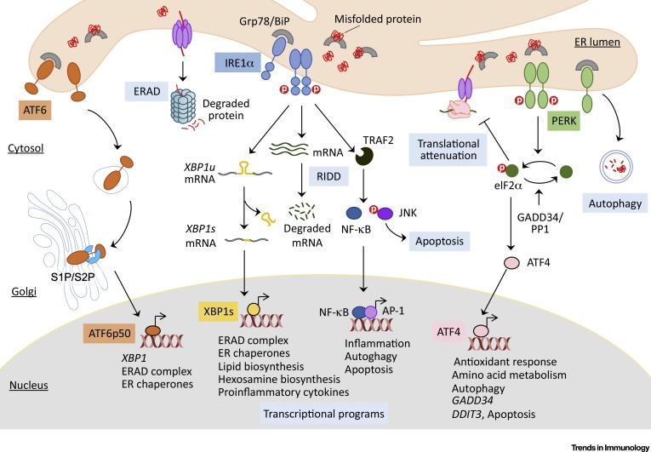
THE BIOLOGY: UNFOLDED PROTEIN RESPONSE
Song et al. (2019) Trends in Immunology

Slide 6
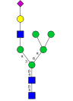
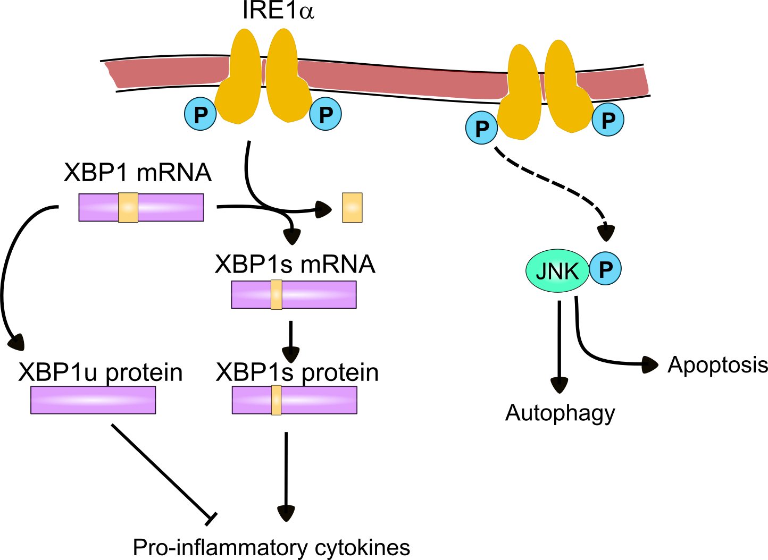
THE BIOLOGY: UNFOLDED PROTEIN RESPONSE
ER Stress
Cytotoxic T cell
Song et al. (2019) Nature

Slide 7
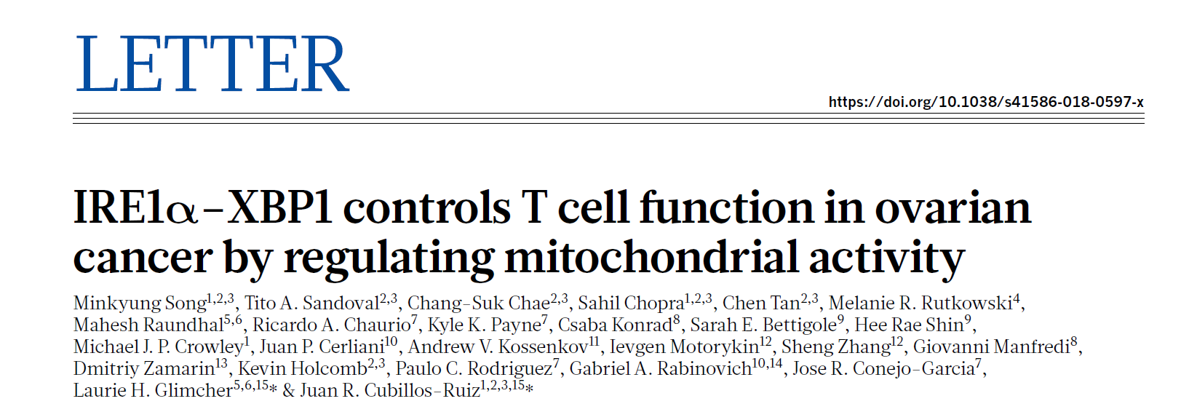
THE PAPER
PATHWAY OF INTEREST!

Slide 8
THE PAPER: CONCEPTS
ASCITES: Immunomodulatory and tumorigenic fluid that often accumulates in patients with metastatic or recurrent cancer
SPLICING: Removing a piece of mRNA
ACTB: Beta-actin protein. It is often used as a loading control in WB
IFN-γ: Interferon gamma is a cytokine that promotes antigen presentation by MHC molecules

Slide 9
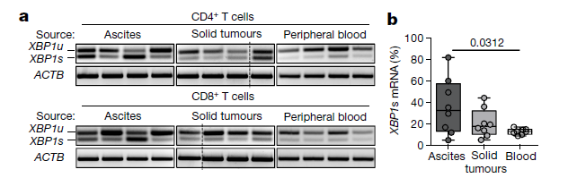
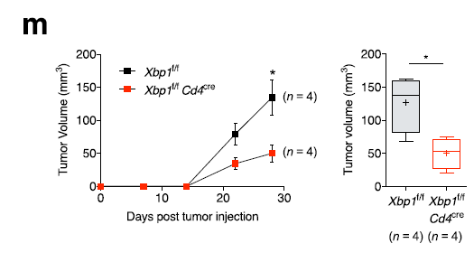
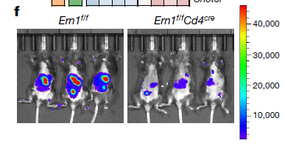
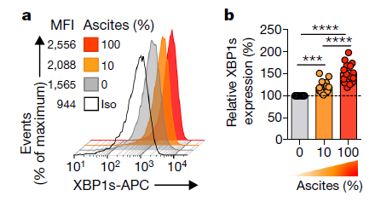
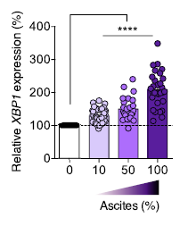
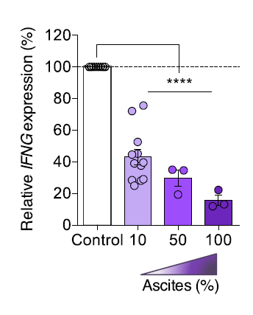
THE PAPER
Song et al. (2019) Nature

Slide 10
MODEL PARAMETERS
IRE1, IRE1α
XBP1 mRNA
XBP1s mRNA
XBP1u protein
XBP1s protein
JNK, JNKα
Pro-inflammatory cytokines
Autophagy and Apoptosis

Slide 11









MODEL EQUATIONS
$$\frac{dIRE1}{dt}=r_{p}^{−}IREα−r_{p}^{+}IRE1−d_{L}IRE1+IN_{IRE1}$$
$$\frac{dXBP1s}{dt}=r_{Ls}mXBP1s−d_{L}XBP1s$$
$$\frac{dIRE1α}{dt}=r_{p}^{+}IRE1−r_{p}^{−}IRE1α−d_{L}IRE1α$$
$$\frac{dJNK}{dt}=r_{JNK}^{−}JNKα−r_{JNK}^{+}JNK IRE1α−d_{L}JNK+IN_{JNK}$$
$$\frac{dmXBP1}{dt}=r_{x}IRE1α−d_{x}mXBP1−r_{s}mXBP1$$
$$\frac{dJNKα}{dt}=r_{JNK}^{+}JNK IRE1α−r_{JNK}^{−}JNKα−d_{L}JNKα$$
$$\frac{dmXBP1s}{dt}=r_{s}mXBP1−d_{x}mXBP1s$$
$$\frac{dCyt}{dt}=r_{c}^{+}XBP1s−r_{I}XBP1u−r_{c}^{−}Cyt$$
$$\frac{dXBP1u}{dt}=r_{Lu}mXBP1−d_{L}XBP1u$$
$$\frac{dApop}{dt}=r_{a}^{+}JNKα−r_{a}^{−}Apop$$

Slide 12
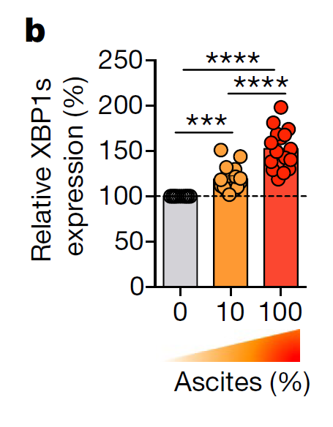
STEADY-STATE
Song et al. (2019) Nature

Slide 13



FUTURE DIRECTIONS
(NEXT WEEK)
Compare with experimental data
Tune parameters
What parameters matter?

Slide 14


QUESTIONS?

Slide 15
a
b

