Slide 1
Airbnb Occupancy Drivers in Albany, NY
What factors are associated with higher estimated occupancy?
Capstone summary presentation
Problem statement
Analyze Airbnb listings to identify which listing characteristics, host attributes, neighborhoods, and amenities are linked to stronger booking performance.
Airbnb Occupancy Capstone | 1/6

Slide 2
Workflow: from raw listings to business insights
The analysis focused on estimated occupancy because pricing and revenue data were incomplete.
1
Cleaned the data
Handled missing values, fixed data types, checked duplicates, and grouped property types and grouped amenity types by category.
2
Explored patterns
Reviewed relationships between occupancy and location, property type, superhost status and property amenities.
3
Tested key relationships
Compared superhosts vs. non-superhosts and ran a Welch’s t-test.
4
Segmented the market
Compared high- and low-occupancy neighborhoods, property types, and amenity categories.
Primary target metric: estimated occupancy in the last 365 days.
Airbnb Occupancy Capstone | 2/6

Slide 3
Key insight 1: demand is uneven, and superhosts stand out
Occupancy is concentrated among a smaller group of high-performing listings.
Superhost listings had much stronger occupancy than non-superhost listings.
113.69
49.65
96 vs 12
p < .001
average occupied days
Superhost listings
average occupied days
Non-superhost listings
median occupied days
Superhost vs non-superhost
Welch’s t-test confirmed
a significant difference
Interpretation
Superhost status is one of the clearest indicators of stronger booking performance, but it should be interpreted as association rather than causation.
Airbnb Occupancy Capstone | 3/6

Slide 4
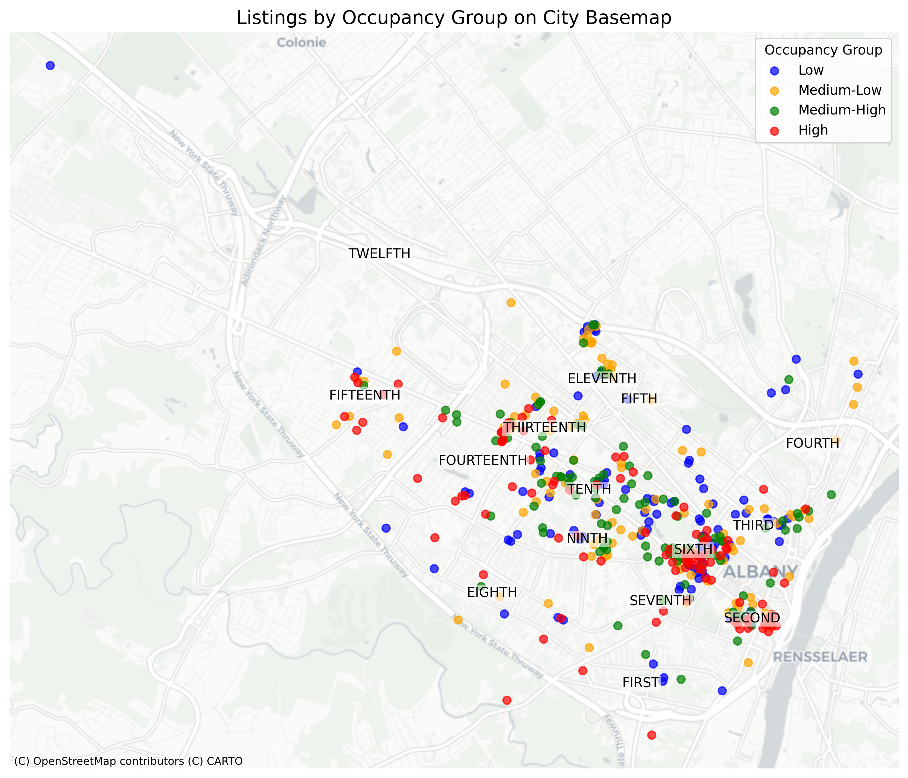
Key insight 2: location matters, but it is not the whole story
Top-performing neighborhoods showed higher median occupancy, but listing-level factors still matter.
Highest median occupancy neighborhoods
Fourteenth Ward — 126 median days
Fifteenth Ward — 108 median days
Second Ward — 108 median days
Why the Second Ward is notable
It had strong occupancy and the highest median reviews per month, despite a lower superhost rate than other top-performing wards.
This suggests location-based demand may be especially strong there.
Bottom line: neighborhood is associated with occupancy, but high and low performers can still exist within the same area.
Airbnb Occupancy Capstone | 4/6

Slide 5
Key insight 3: property type is not enough — amenities add context
Entire-place listings dominate, but occupancy differences appear tied to multiple listing-level features.
Property type finding
Amenity categories with higher median occupancy
Entire-place listings dominate the market and appear in both high- and low-performing neighborhoods. So property type alone does not explain occupancy.
View / water access: +90 days
Family-friendly: +51 days
Self check-in: +50 days
Important nuance
View or water access had the largest gap, but only 33 listings had that feature. Self check-in may be a more practical improvement because it had a stronger sample size.
Airbnb Occupancy Capstone | 5/6

Slide 6
Recommendations and limitations
The strongest recommendations focus on service quality, convenience, and careful location evaluation.
Recommended actions
Limitations to mention
• Prioritize superhost-level standards: responsiveness, accuracy, cleanliness, reliability, and guest experience.
• Add practical convenience amenities, especially self check-in; consider family-friendly features where feasible.
• Evaluate neighborhood demand carefully but avoid relying on location or property type alone.
• Results show association, not causation.
• Some groups are small, especially view / water access listings.
• Missing pricing and revenue data limited profitability analysis.
• Amenity categories were manually grouped; geography used point locations without ward boundaries.
Takeaway: higher occupancy appears to come from a combination of host quality, location demand, and practical guest-centered listing features.
Airbnb Occupancy Capstone | 6/6

