Slide 1


Shift Managment
Shalev Sharabi 31387823 Natali Dahary 205871049

Slide 2
About The Project
The project is employee shift management. Employees enter their user and password to log in.
salary
Shift Manager
person
Shift Management
user
employee
WorkingDay

Slide 3
Also...
Each employee may enter a user and password in the system.
He can fill his shifts each given month and see his monthly salary.
In addition, he can change his password in a system defined by the shift manager.
The shift manager also has access to the system by username and password.
He may add and remove employees from the system, he updates the salaries of the employees in the system.
In addition, the manager also has the option to change the password.
After each change of information, the change is made in both java program and MySQL database.

Slide 4

What is the Database for?
The database stores all the information about the users of the shift management system who are employees.
The presentation of the information is done in a more orderly and organized manner.
This is a more efficient way for employees and the shift manager to synchronize all information.

Slide 5

Who are the users of the system?
We have the employees for whom the system is actually designed so that they can submit their shifts in an orderly manner.
They can see the shifts they are filing and their personal salary.
The shift manager who manage the system can see the shifts and salaries of all the employees in the system.

Slide 6
Our entities in Database:
manager_id num_of_employees
Shift manager
User
Person
Employee Salary
working Day
Functionalities and relationships:
Inside the employee and within the shift manager there is the user object.
There is the person department where there are features that every employee needs such as: name, last name and ID. Therefore, the employee department inherits from a person.
You can search for a user in the system by ID or username.
Id firstName lastName
employee_Id serial_number role hourly_wage
serial key week regular_hours additional_hours salary
user_Id username password
Serial_num date
start_time
finish_time

Slide 7
All tables based on ERD:
Person
id | first_name | last_name
User
user_id* | username | password
Employee
employee_id* | Serial_number | role | hourly_wage
Shift Manager manager
manager_id* | numOfEmployee
Salary
salary_id* | serial_key | week | regular_hours | additional_hours | salary

Slide 8
All tables based on ERD:
Salary_Working
Person
id | first_name | last_name
P_ID | Salary_id
Salary
Salary_id | serial_key | week | regular_hours | additional_hours | salary
Working_Day
Salary_id | serial_key | week | regular_hours | additional_hours | salary

Slide 9
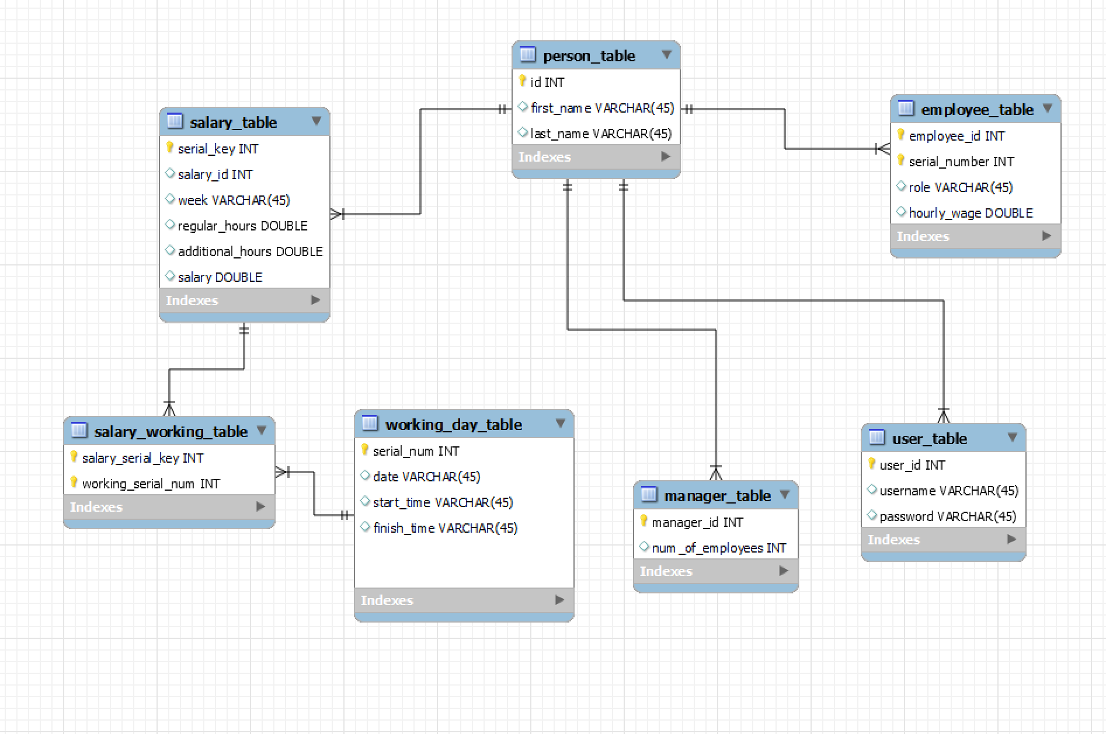
ERD

Slide 10
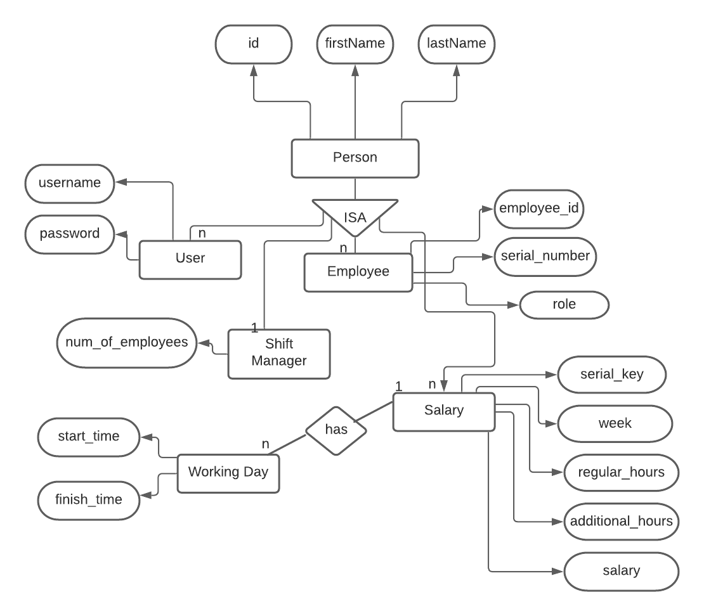
ERD – Entity Realationship Database:

