Slide 1
JUNE 2026
Service Overview & Impact Report
General Mills

Slide 2
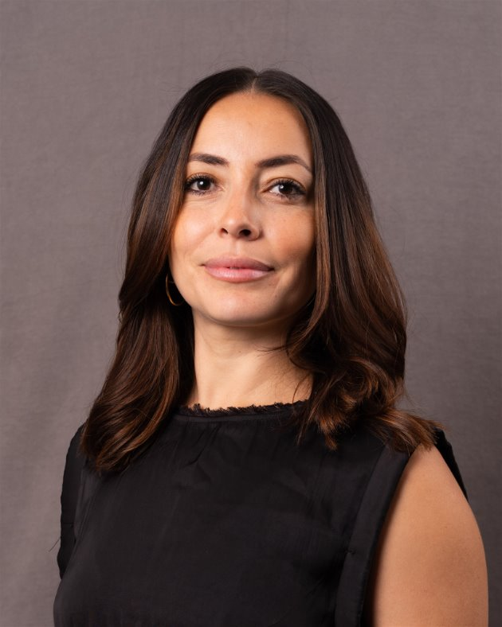
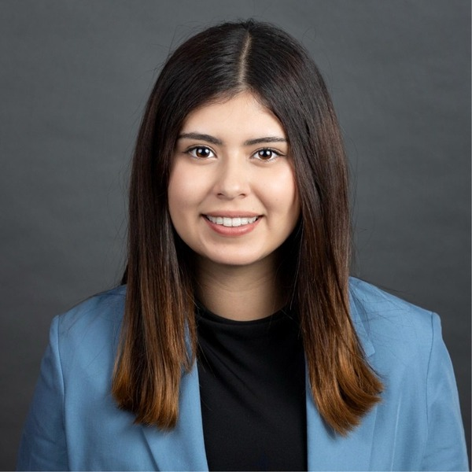
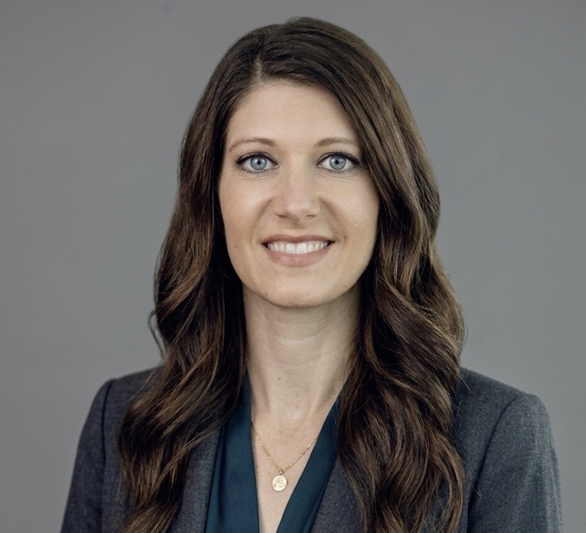
Presenters
Anglepoint Team
Lina Vergara
VP, Account Management
Natalie Castro
Intern
Ashlee Gohdes
VP, Client Success

Slide 3
AGENDA
01 | ITAM STRATEGY
02 | SERVICE OVERVIEW
03 | IMPACT HIGHLIGHTS
04 | SAP EXPANSION
05 | 90 DAYS TO SUCCESS
06 | NEXT STEPS

Slide 4
SAM Charter Statement:
CLIENT MISSION:
“Nourishing lives. Protecting every dollar.”
●●●●●
“The Software Asset Management (SAM) Service exists to govern the Software Asset Lifecycle and provide actionable asset intelligence to decision-makers in order to optimize costs, minimize risks, and maximize negotiation leverage related to material software assets¹ across General Mills.”

Slide 5
Impact Highlights
1. | IBM — $8M in audit exposure avoided | ✓
2. | Broadcom/VMware — $1.3M saved, dispute won | ✓
3. | Microsoft M365 + SQL — $600K in reclaimed licenses | ✓
4. | Oracle, Adobe, Red Hat — $1M+ in risk reduction | ✓
5. | Salesforce + Informatica — $150K reclaimed | ✓
6. | $11M total — 5x program ROI in 18 months | ✓

Slide 6
Driving to Continuous Outcomes Structure
2019 | 2020 | 2021 | 2023 | 2025
Why we were hired Anglepoint selected as partner and ITAM engagement initiated through workshop | Outcome Event Short summary of the results of the event here. | Outcome Event ServiceNow SAM Pro health checks, training, and broad publisher onboarding | Outcome Event Continued SAM Pro optimization, training, and targeted Oracle Java assessment | Outcome Event here Strategic planning engagement to define future-state SAM roadmap and priorities
2019
2026
2019 | 2020 | 2022 | 2024
Outcome Event here Established SAM foundations including policies, IBM tooling, and initial publisher compliance | Outcome Event Ongoing IBM license health checks, compliance reporting, and contract renewal support | Outcome Event Expanded ServiceNow SAM Pro health checks with increased publisher coverage | Outcome Event Audit support, ServiceNow SAM consulting, and ITAM/HAM framework alignment across publishers

Slide 7
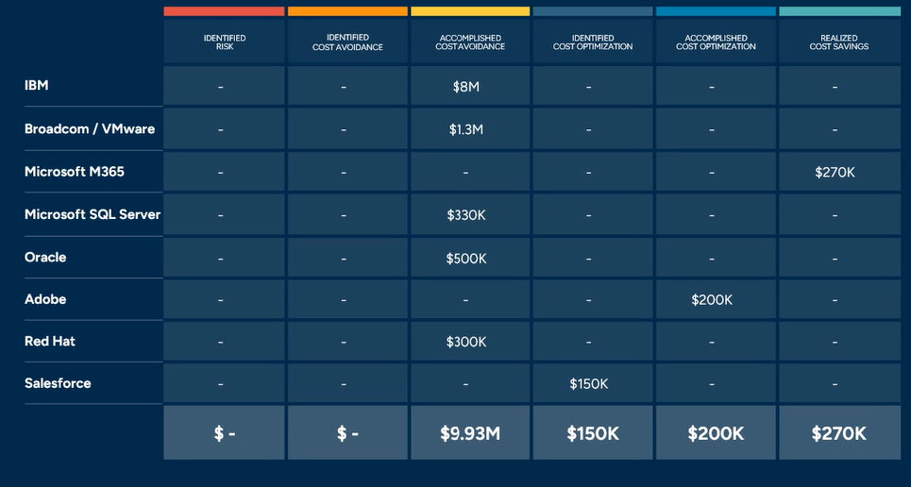
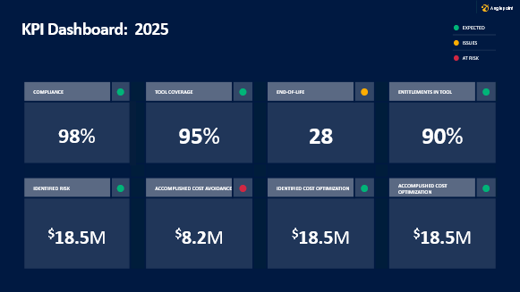
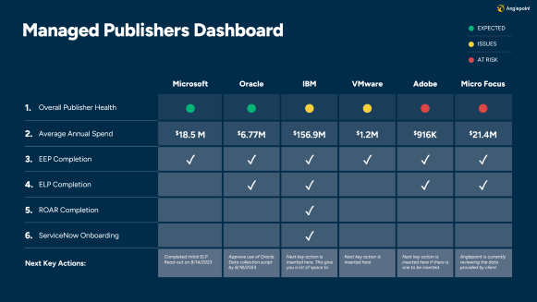
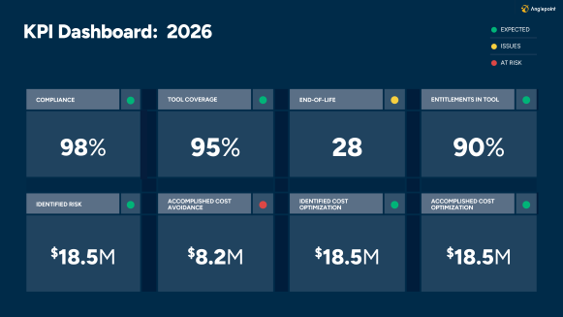
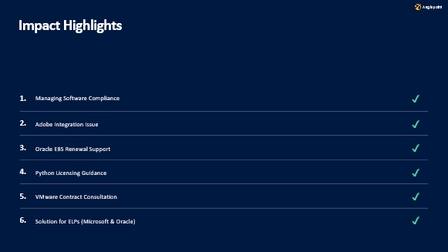
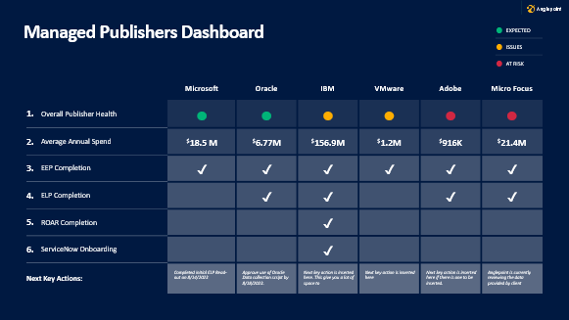
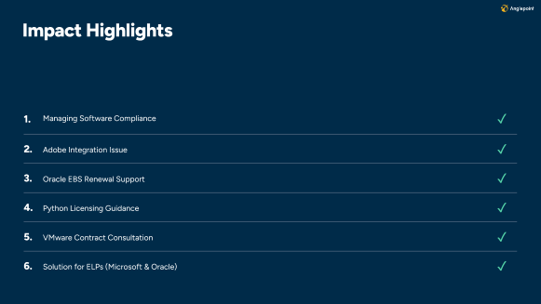
Executive Summary

Slide 8
Managed Publishers Dashboard
● | EXPECTED
● | ISSUES
● | AT RISK
 |  |  | Microsoft | Broadcom / VMware | IBM | Oracle | Adobe | Micro Focus
1. | Overall Publisher Health |  | ● | ● | ● | ● | ● | ●
2. | Average Annual Spend |  | $18.5 M | $6.77M | $156.9M | $1.2M | $916K | $21.4M
3. | EEP Completion |  | ✓ | ✓ | ✓ | ✓ | ✓ | ✓
4. | ELP Completion |  |  | ✓ | ✓ |  | ✓ | ✓
5. | ROAR Completion |  |  |  | ✓
6. | ServiceNow Onboarding |  |  |  | ✓
Next Key Actions: |  |  | Completed initial ELP Read-out on 8/14/2023 | Approve use of Oracle Data collection script by 8/18/2023. | Next key action is inserted here. This give you a lot of space to | Next key action is inserted here | Next key action is inserted here if there is one to be inserted. | Anglepoint is currently reviewing the data provided by client

Slide 9
90-Day Success Plan
 |  |  | –––– OWNER ––––
 | OBSERVATION | SOLUTION | APT | CLIENT | TARGET DATE
SAP Workstream Scoping | SAP S/4HANA has never been assessed. Indirect access and named user risk is unquantified. | Begin SAP scoping immediately upon renewal approval. Define data, scope, and timeline. | ● |  | 03/25/2026
ServiceNow SAM Pro Boundary | ServiceNow SAM Pro support has been informal. Scope must be formally defined. | Formalize SAM Pro as a managed workstream or establish a clear out-of-scope boundary in the SOW. | ● | ● | 03/25/2026
Oracle Java Assessment | Oracle changed Java licensing in 2023. General Mills exposure is unquantified. | Initial Oracle Java conversation with Marcus within 30 days to assess inclusion in next phase. |  | ● | 03/25/2026
Ongoing Publisher Governance | Nine active workstreams require continuous monitoring. No single owner for cross-publisher risk view. | Monthly publisher health review cadence with Marcus. Quarterly executive summary for Sandra and Kevin. | ● |  | 09/25/2026
Renew at Current Scope | Contract ends in 6 months. Renewal not yet formally approved. SAP expansion add-on pending Kevin sign-off. | Align on renewal SOW by Q3 2026. Include SAP as new workstream. Engage Priya early in commercial process. | ● |  | 08/25/2026
Engage Priya in SOW Process | Priya was not included in scope expansions at months 6 and 12. Relationship risk going into renewal. | CSM to schedule direct meeting with Priya before QSR. Present SAP case and SOW structure in advance. | ● | ● | 07/25/2026
 |  |  |  | ●
Notes:
Ashlee

Slide 10












2026 Audit Activity
Publishers currently auditing our clients:
Common Triggers for Audits:
Economic downturn
Length of time since the last audit
Mergers, acquisitions & divestitures
Reports of increased or decreased in profits
Increase in employee count
Publisher loss of revenue
Publisher mergers, acquisitions, equity firm takeovers & divestitures
Contract/maintenance cancellations
Reduction in or static publisher spend
Customers not following publisher strategy and adoption of hero products, including not transitioning to the cloud and subscription options
Support tickets raised for unlicensed programs
Expiration of Agreements
Failure to meet obligations (true ups, annual reporting, ILMT)
Publisher changes to licensing models
Just for fun

Slide 11
Recommended Next Steps
30
Confirm SAP expansion approval and initiate scoping. Meet with Marcus and Priya to align on SOW structure and ServiceNow SAM Pro boundary.
DAYS
60
Deliver SAP scoping output. Begin Oracle Java initial assessment conversation. Finalize renewal SOW for signature.
DAYS
SUCCESS FACTOR:
$11M delivered in 18 months. The next chapter starts with SAP — the most critical unassessed software relationship General Mills has.
90
SAP workstream live in Elevate. First SAP findings delivered to Marcus and Sandra. Renewal contract active.
DAYS

Slide 12
Thank YOu

