Slide 1
JUNE 2026
Service Overview & Impact Report
General Mills

Slide 2
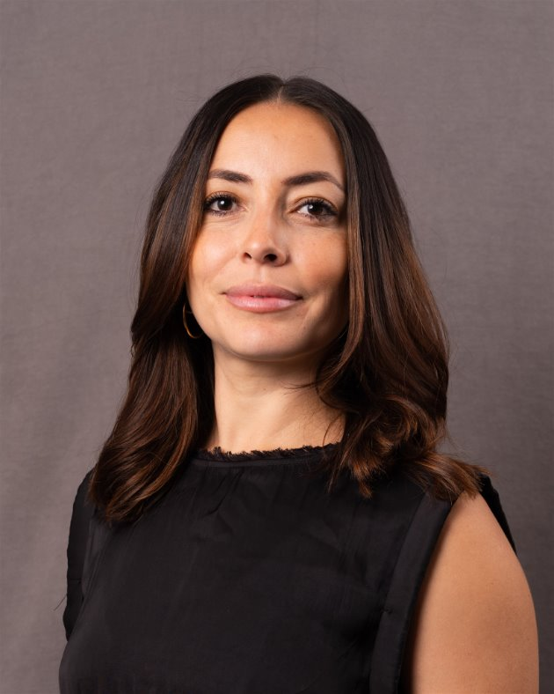
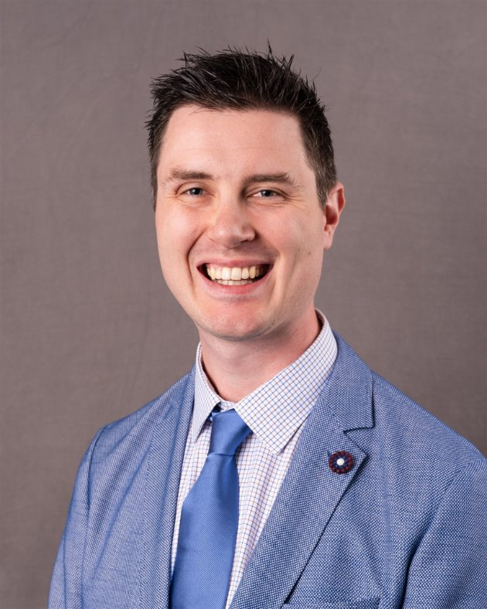
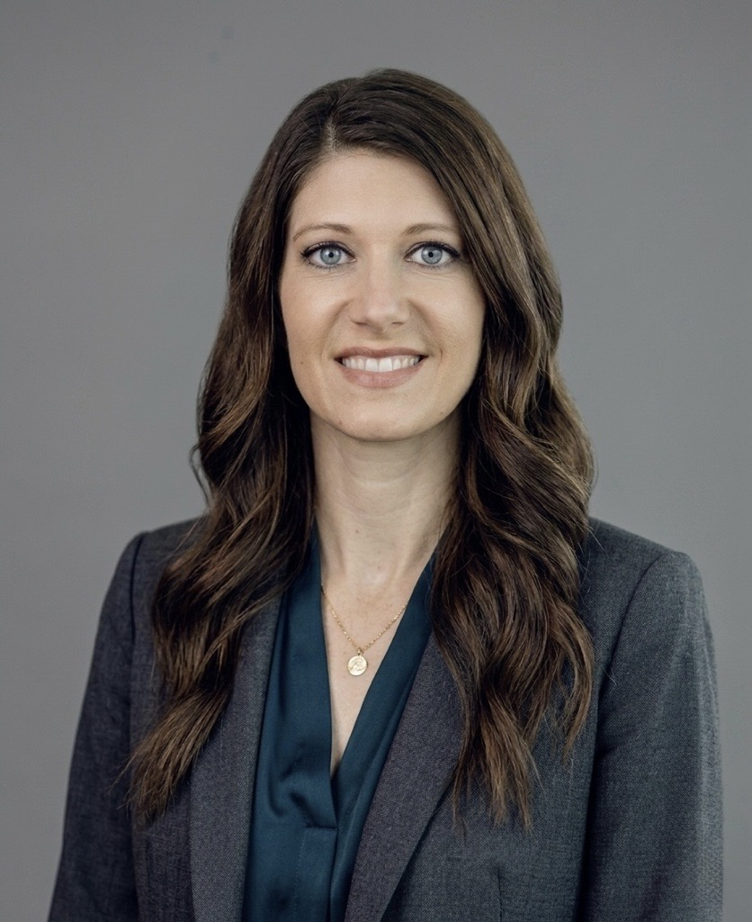
Presenters
!
Slide info: Update with correct Presenters/Anglepoint support on the call. Be sure to always introduce all member from the AP team.
Anglepoint Team
Lina Vergara
VP, Account Management
Natalie Castro
Senior Client Success Manager
Ashlee Gohdes
VP, Client Success

Slide 3
AGENDA
01 | ITAM STRATEGY
02 | SERVICE OVERVIEW
03 | IMPACT HIGHLIGHTS
04 | SAP EXPANSION
05 | 90 DAYS TO SUCCESS
06 | NEXT STEPS

Slide 4
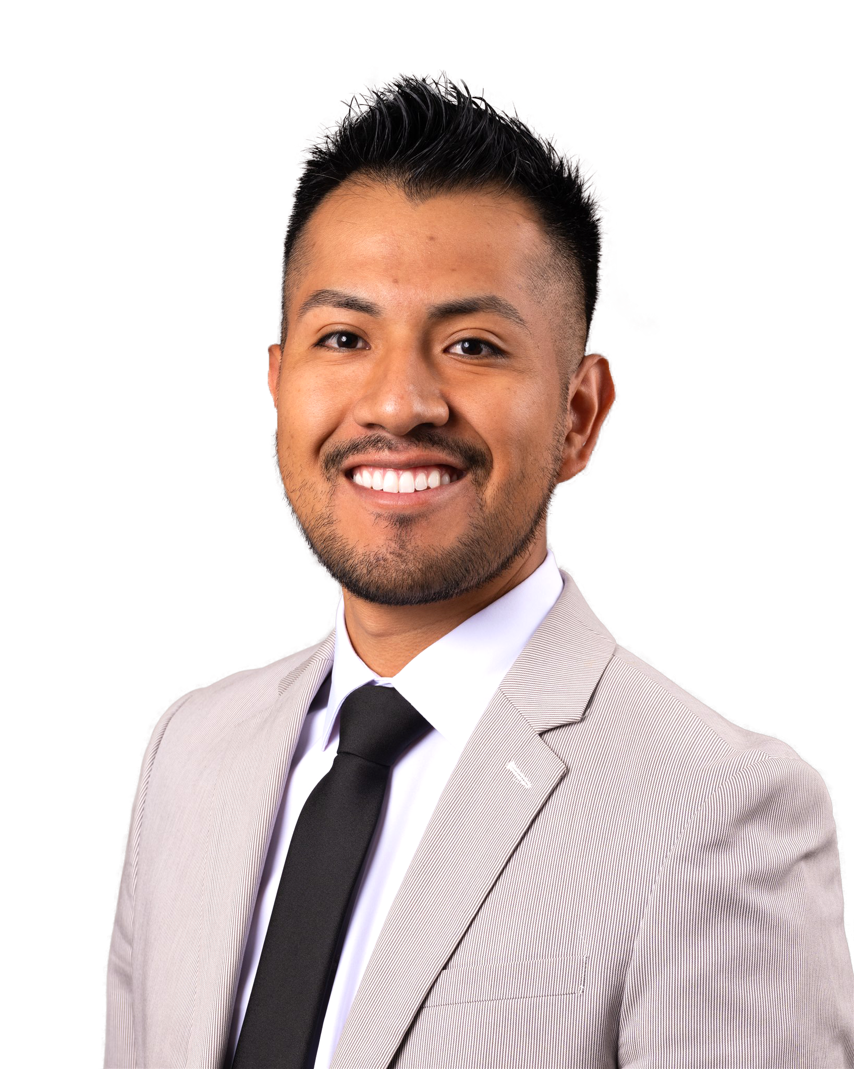
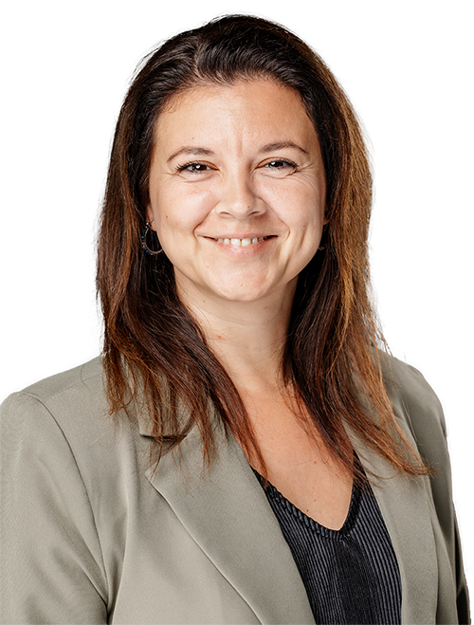
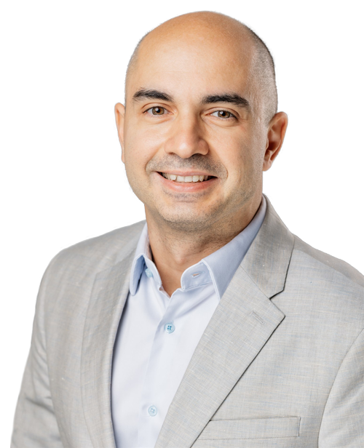
Our Culture & Values
The core of Anglepoint DNA
!
Slide info: This slide shows are culture and values at Anglepoint. Please move to the appendix if the audience is not new.
DELETE ME WHEN DONE
Prioritize
People
Value every individual, their passion & purpose
Deliver
Value
Produce a positive result in every interaction
Improve
Everything
From our teams & results, to our communities & selves
Relationships
Be a genuinely good human.
Proactively listen & communicate.
Keep commitments.
Respectfulness
Be authentic & considerate.
Champion diversity & inclusivity.
Dissolve division & bias.
Client Success
Learn what the client values.
Ease their pain.
Achieve outcomes.
Team Success
Client success = team win = individual win.
Check your ego at the door.
Cultivate excellence.
Innovation
Do it better, do it faster.
Intelligently automate & streamline.
Productively challenge the status quo.
Growth
Give & receive candid feedback.
Be vulnerable, defy groupthink.
Embrace dialectics.
HENRY JIMENEZ | Value Award: Relationships
Roxana Leonte-Andone | Value Award: team Success
Octavian Papacica | Value Award: growth
5
Notes:
Ashlee

Slide 5
SAM Charter Statement:
CLIENT MISSION:
“Nourishing lives. Protecting every dollar.”
!
●●●●●
“The Software Asset Management (SAM) Service exists to govern the Software Asset Lifecycle and provide actionable asset intelligence to decision-makers in order to optimize costs, minimize risks, and maximize negotiation leverage related to material software assets¹ across General Mills.”

Slide 6
Impact Highlights
1. | IBM — $8M in audit exposure avoided | ✓
2. | Broadcom/VMware — $1.3M saved, dispute won | ✓
3. | Microsoft M365 + SQL — $600K in reclaimed licenses | ✓
4. | Oracle, Adobe, Red Hat — $1M+ in risk reduction | ✓
5. | Salesforce + Informatica — $150K reclaimed | ✓
6. | $11M total — 5x program ROI in 18 months | ✓

Slide 7
Managed Publishers Dashboard
● | EXPECTED
● | ISSUES
● | AT RISK
 |  |  | Microsoft | Oracle | IBM | VMware | Adobe | Micro Focus
1. | Overall Publisher Health |  | ● | ● | ● | ● | ● | ●
2. | Average Annual Spend |  | $18.5 M | $6.77M | $156.9M | $1.2M | $916K | $21.4M
3. | EEP Completion |  | ✓ | ✓ | ✓ | ✓ | ✓ | ✓
4. | ELP Completion |  |  | ✓ | ✓ |  | ✓ | ✓
5. | ROAR Completion |  |  |  | ✓
6. | ServiceNow Onboarding |  |  |  | ✓
Next Key Actions: |  |  | Completed initial ELP Read-out on 8/14/2023 | Approve use of Oracle Data collection script by 8/18/2023. | Next key action is inserted here. This give you a lot of space to | Next key action is inserted here | Next key action is inserted here if there is one to be inserted. | Anglepoint is currently reviewing the data provided by client

Slide 8
90-Day TO SUCCESS
05
Strategic Roadmap for the Next 90 Days

Slide 9
90-Day Success Plan
!
Slide info: This slide is Mandatory to highlight Anglepoint’s response to feedback:
 |  |  | –––– OWNER ––––
 | OBSERVATION | SOLUTION | APT | CLIENT | TARGET DATE
SAP Workstream Scoping | SAP S/4HANA has never been assessed. Indirect access and named user risk is unquantified. | Begin SAP scoping immediately upon renewal approval. Define data, scope, and timeline. | ● |  | 03/25/2026
ServiceNow SAM Pro Boundary | ServiceNow SAM Pro support has been informal. Scope must be formally defined. | Formalize SAM Pro as a managed workstream or establish a clear out-of-scope boundary in the SOW. | ● | ● | 03/25/2026
Oracle Java Assessment | Oracle changed Java licensing in 2023. General Mills exposure is unquantified. | Initial Oracle Java conversation with Marcus within 30 days to assess inclusion in next phase. |  | ● | 03/25/2026
Ongoing Publisher Governance | Short summary of the observation | Short summary of the solution | ● |  | 03/25/2026
Renew at Current Scope | Short summary of the observation | Short summary of the solution | ● |  | 03/25/2026
Engage Priya in SOW Process | Short summary of the observation | Short summary of the solution | ● | ● | 03/25/2026
Observation | Short summary of the observation | Short summary of the solution |  | ● | 03/25/2026
Notes:
Ashlee

Slide 10

Recommended Next Steps
30
Confirm SAP expansion approval and initiate scoping. Meet with Marcus and Priya to align on SOW structure and ServiceNow SAM Pro boundary.
DAYS
60
Deliver SAP scoping output. Begin Oracle Java initial assessment conversation. Finalize renewal SOW for signature.
DAYS
SUCCESS FACTOR:
$11M delivered in 18 months. The next chapter starts with SAP — the most critical unassessed software relationship General Mills has.
90
SAP workstream live in Elevate. First SAP findings delivered to Marcus and Sandra. Renewal contract active.
DAYS

Slide 11
Thank YOu

