Slide 1
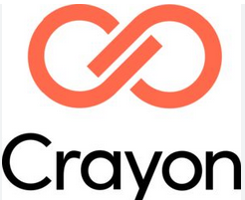

IBM Risk & Opportunity Assessment Report (ROAR)
2026
OneMain

Slide 2


PRESENTERS
ANGLEPOINT
Priyanka Desai
Senior Consultant, IBM & Red Hat
Malia Wallace
Consultant, IBM & Red Hat

Slide 3
AGENDA
01 | ENGAGEMENT OVERVIEW
02 | EXECUTIVE SUMMARY
03 | RECOMMENDATIONS
04 | QUESTIONS & ANSWERS
05 | NEXT STEPS
06 | APPENDIX

Slide 4
Engagement overview
01

Slide 5
Engagement Objectives
ENGAGEMENT OVERVIEW
ENGAGEMENT OBJECTIVES:
● | ILMT configuration, agent health check, upgrades and recommendation reports
● | Quarterly Entitlement Review, Product bundling of IBM Distributed products
● | Quarterly sub-capacity and annual baseline IBM IASP ELP report
● | Annual Risk & Opportunity Assessment Report (ROAR) for all IBM products
● | Remote Licensing Support

Slide 6
Engagement Scope
ENGAGEMENT OVERVIEW
SCOPE:
Up to 1 ILMT Instance
Up to 38 IBM Distributed products
Up to 1900 servers running on IBM products
OUT OF SCOPE:
Mainframe
Red Hat and HCL Products
Deploying agents to any machine
Participation in legal proceedings

Slide 7
Process Overview
Engagement overview
PROCESS:
STEPS:
Contract Discovery
● | Gather and review all contract documents necessary to establish complete and accurate license entitlement and usage rights
● | All in-scope software deployments are discovered and mapped to device/users
● | Product-level entitlement quantities are established using contract documentation
● | Product-level consumption quantities are established based on discovery data
● | The entitlement position is compared against the consumption position, validated, presented and finalized
● | High-level findings from the ELP are presented in the ROAR, including quantified cost savings and avoidance recommendations
1
2
Deployment Discovery
3
Effective Entitlement Position
4
Consumption Position
5
Effective License Position (ELP)
6
Risk & Opportunity Assessment Report (ROAR)

Slide 8
Executive Summary
02

Slide 9
Executive Summary
DEFINITIONS:
Identified Risk: Quantified financial exposure to OneMain due to non-compliance with software licensing or contractual terms. Calculated based on available data, this risk underscores the urgency for corrective action.
Identified Cost Avoidance: Potential unbudgeted costs to OneMain that can be prevented through proactive compliance and financial controls. These savings may not appear in financial statements but are measurable in avoided liabilities.
Accomplished Cost Avoidance: The quantified result of actions taken to prevent unbudgeted costs, ensuring compliance and financial control. While not directly reflected in financial statements, these actions reduce or remove future financial exposure.
Identified Cost Optimization: Opportunities to reduce software, hardware, or cloud expenses through license optimization, contract negotiations, or strategic adjustments.
Accomplished Cost Optimization: Verified cost reductions achieved through software, hardware, or cloud optimization. These optimizations may involve renegotiations, contract adjustments, or technology shifts.
Realized Cost Savings : Direct financial savings reflected in budgets or financial statements due to negotiated reductions or decreased expenses.
Total optimization: Anglepoint identified potential cost avoidance and savings totaling $330K over a 1-year period.
$330K
Notes:
Realized Cost Savings refers to hard dollar savings

Slide 10

Identified Cost Optimization
EXECUTIVE SUMMARY
REALIZED COST SAVINGS:
PRODUCTS |  | DATE ACCOMPLISHED/ TARGET DATE² | UTILIZATION % | COST SAVINGS¹
IDENTIFIED COST OPTIMIZATION: | Current Year Details [2021]
● | IBM Rational Application Developer for WebSphere Software | 2026-08-31 | 24% | $33K
● | IBM InfoSphere DataStage and QualityStage Designer | 2026-08-31 | 66% | $2.5K
● | IBM Rational Developer for i RPG & COBOL Tools | 2026-08-31 | 30% | $45.7K
● | IBM Sterling Connect: Direct Standard Edition | 2026-08-31 | 80% | $1.3K
● | IBM InfoSphere Information Server Enterprise Edition | 2026-08-31 | 99% | $9.7K
● | IBM InfoSphere Information Server Enterprise Edition for Non-Production Environments | 2026-08-31 | 78% | $73.2K
● | IBM InfoSphere Optim Management Test Data Enterprise Edition | 2026-08-31 | 20% | $114K
● | IBM Cloud Pak for Integration | 2026-08-31 | 98% | $7.4K
● | IBM WebSphere Hybrid Edition | 2026-08-31 | 82% | $43.4K
● | IBM Vault Self-Managed Non-Production | 2026-08-31 | 75%
● | IBM Vault Self-Managed Single Data Center Client | 2026-08-31 | 97%
 |  |  |  | $330.4K
Note : Pricing for potential cost savings have been considered based on Last Transaction Pricing.
Anglepoint identified cost optimization totaling $330K over a 1-year period.
IDENTIFIED COST OPTIMIZATION:
$330K

Slide 11
recommendations
03

Slide 12
Actionable Cost Savings Recommendations
RECOMMENDATIONS
Product-specific tactical actions to achieve strategic program outcomes
OBSERVATIONS & RECOMMENDATIONS:
OBSERVATION | RECOMMENDATION | IDENTIFIED COST SAVINGS | OWNER | PRIORITY | DATE ACCOMPLISHED/ TARGET DATE
Unused Subscription & Support licenses | Reduce S&S during next renewal | $330K | OneMain | Medium | August 31, 2026 (Renewal Date)

Slide 13
Questions & Answers
04

Slide 14
Next steps
05

Slide 15
Recommended Next Steps
Q2 ELP
Business Needs
Maintenance Renewal
JUNE 2026
NEXT STEPS:
Continue to track and report deployment quantities using ILMT
MAY 2026
NEXT STEPS:
Discuss with internal team future business needs within the environment
AUGUST 2026
NEXT STEPS:
Optimize Subscription & Support (S&S) quantities as part of the renewal

Slide 16
How are we doing?
Scan the QR code or click the link below to take a 3-minute survey to share feedback on your experience.
Start Survey

Slide 17
Appendix
06

Slide 18
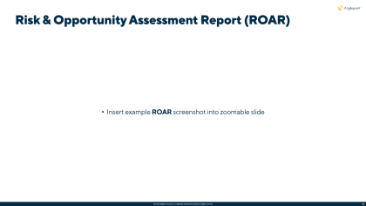
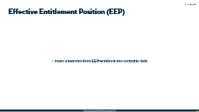
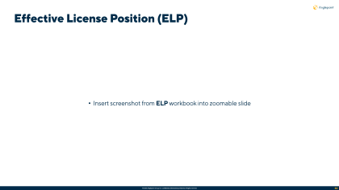
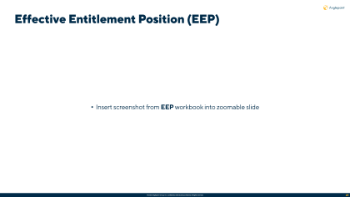
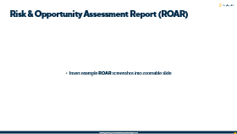
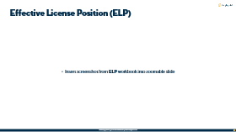
Definitions: EEP, ELP and ROAR
KEY DELIVERABLES
Effective Entitlement Position:
Effective License Position:
Risk & Opportunity Assessment Report:
An accurate and up-to-date understanding of an organization's software license entitlements and their corresponding usage rights. A comprehensive record of the licenses owned, the terms and conditions associated with each license, and the rights granted to the organization for deploying and using the software.
A review and comparison of an organization’s software entitlements against the corresponding consumption, taking into account an organization’s software contracts and associated documentation. The ELP indicates a current compliance position at a particular point in time.
Gleans findings from the ELP to outline license compliance risks & areas of opportunities for optimization to reduce license consumption and gain better value from software contracts through improved license deployment and allocation.

Slide 19
Definitions: Risk, Cost Avoidance, & Cost Savings
appendix
Risk: | Cost Avoidance: | Cost Savings:
Identified financial impact to OneMain as a result of under or incorrectly licensed IBM software, based on the data shared with Anglepoint by OneMain to date. Highlights necessity of immediate actions/additional spend liability. Remaining risk refers to all cost(s) that cannot be avoided. | Any action that avoids having to incur (non-budgeted) costs in the future. Cost Avoidance measures are never reflected in the financial statements or next year’s budget. They will only be reflected in situations where the proposed action is not implemented, resulting in a cost increase. | Any action that results in a tangible financial benefit that lowers current spending, investment or debt levels. Cost savings measures are reflected in the financial statements and next year’s budget.

Slide 20
Notable Contract Events

Slide 21
Notable Contract Terms

Slide 22
IBM Managed Service Process Overview
Planning & Prep
Review & validate known scoping details Review & validate known assumptions, dependencies and/or constraints Identify relevant OneMain stakeholders, business application and/or product owners responsible for providing access and/or data Review and agree upon project risk matrix and communication plan
Data Collection
Configure & set up Elevate® access to relevant OneMain stakeholders Gather Product-level entitlement quantities and usage rights using all available proof-of-purchase and contract documentation Gather Product-level consumption quantities from discovery data Gather Product-level roadmap details (demand planning/forecasted usage - Grow, Shrink, Maintain)
Data Analysis
Normalize & consolidate all collected data Create & review Effective Entitlement Position (EEP) OneMain review, validation & sign-off of EEP Apply license consumption rules to validated entitlement Create & review Effective License Position (ELP) OneMain review, validation & sign-off of ELP
Recommendations
Application of future demand & forecasting plans Summarized findings from the ELP presented in the Risk & Opportunity Assessment Report (ROAR), including quantified cost savings and avoidance recommendations, as well as expert best practice guidance on ITAM Asset & License Management OneMain acceptance of ROAR deliverable
Optimization
Register, categorize, prioritize, and track risk remediation & opportunity realization in Elevate® with actionable intelligence Answer questions and enable stakeholders to understand options and take action Report realized cost savings & avoidance in Quarterly Service Review (QSR)
We Are Here

Slide 23
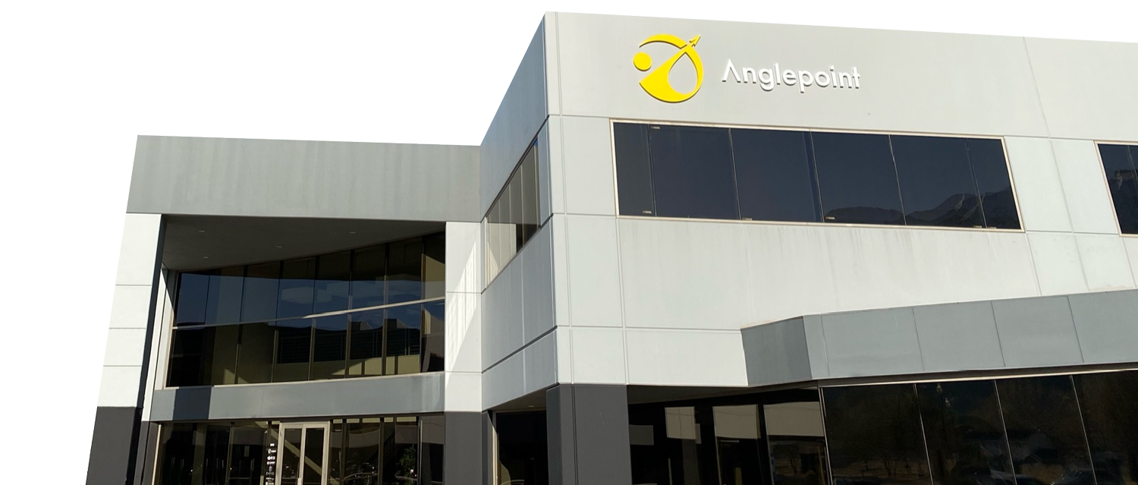
Anglepoint is the leading provider of ITAM & cloud managed services to the Forbes Global 2000.
Our Services eliminate cloud, software, & IT waste with actionable insights that drive agile forecasting within the world’s largest & most complex hybrid IT environments.
We Deliver comprehensive managed services to assess, design, transform, & operate world-class programs that follow the industry standard, ISO 19770-1.

Slide 24
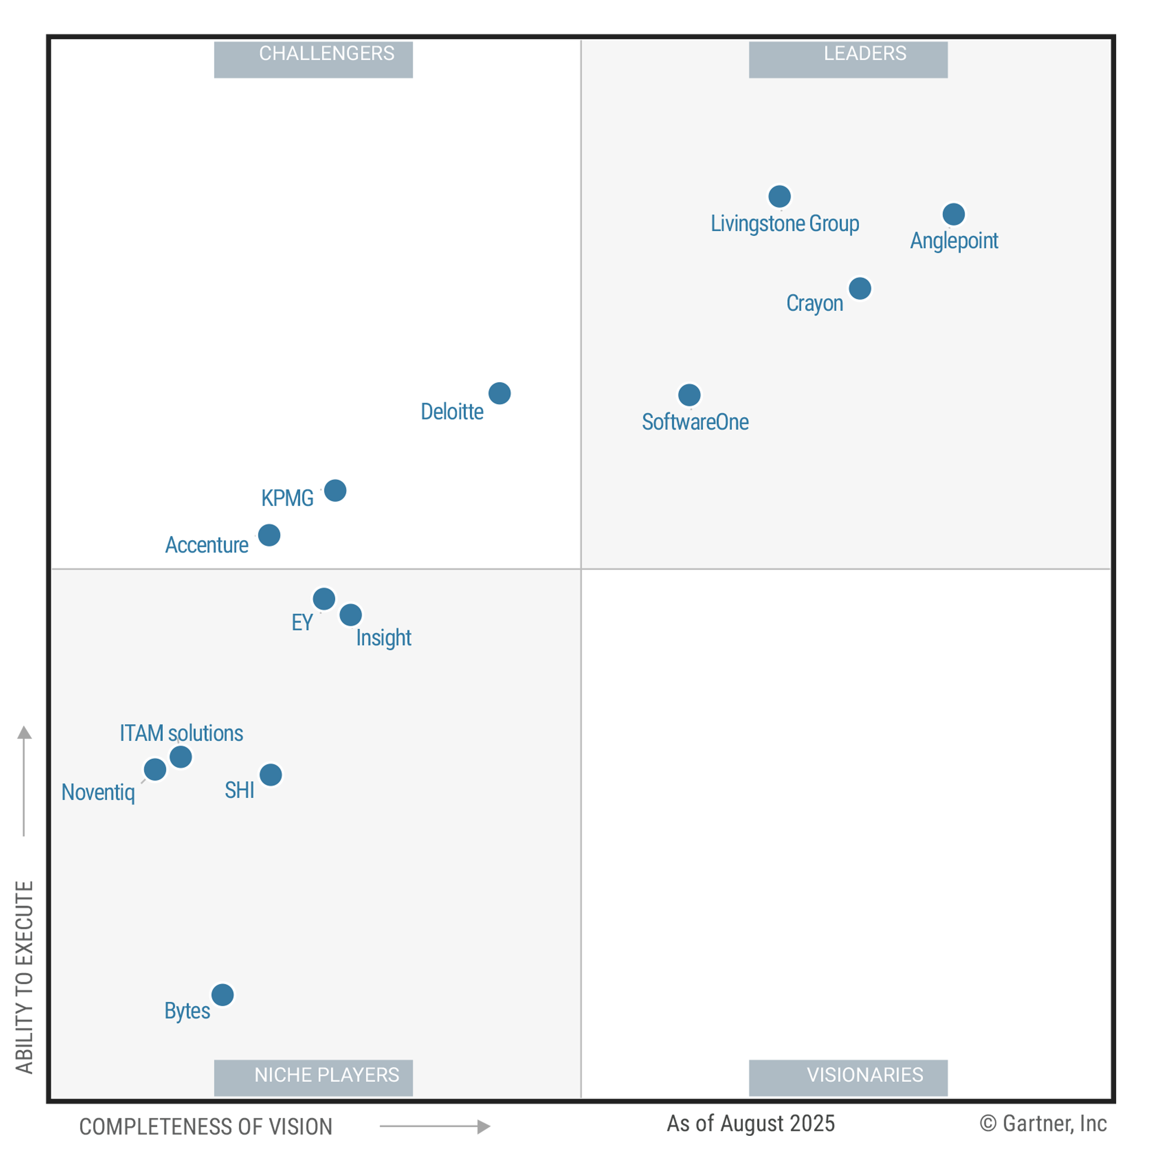
2025
Recognized Global Leader in SAM Managed Services
For 6 years Gartner® has named Anglepoint a Leader in SAM Managed Services, reflecting our clients’ success and trust.
These graphics were published by Gartner®, Inc. as part of a larger research document and should be evaluated in the context of the entire document. The Gartner® document is available upon request from Anglepoint. Gartner® Peer Insights reviews constitute the subjective opinions of individual end users based on their own experiences and do not represent the views of Gartner or its affiliates.
As of April 2024
As of April 2024
© Gartner, Inc

Slide 25
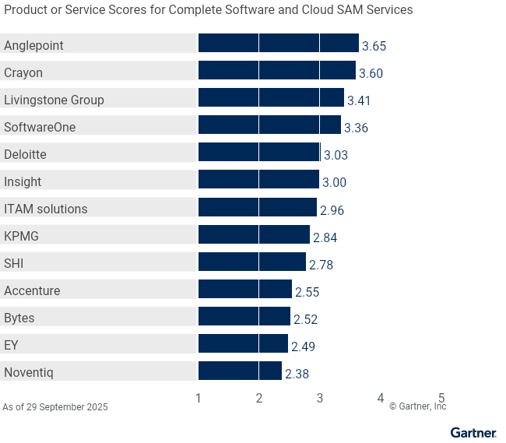



Recognized for Consistent Leadership
RANKED
IN EVERY USE CASE
For six consecutive years, Anglepoint has ranked first in all three use cases among 13 profiled providers in Gartner’s Critical Capabilities for SAM Managed Services report.
#1
1
2
3
Gartner, Critical Capabilities for Software Asset Management Managed Services, Rob Schafer, Yolanda Harris, Jaswant Kalay, Charity Hooper, 6 October 2026, G00824336. This graphic was published by Gartner, Inc. as part of a larger research document and should be evaluated in the context of the entire document. The Gartner document is available upon request from Anglepoint at www.anglepoint.com/cc. Gartner does not endorse any vendor, product or service depicted in its research publications and does not advise technology users to select only those vendors with the highest ratings or other designation. Gartner research publications consist of the opinions of Gartner’s research organization and should not be construed as statements of fact. Gartner disclaims all warranties, expressed or implied, with respect to this research, including any warranties of merchantability or fitness for a particular purpose. GARTNER and Critical Capabilities are registered trademark and service mark of Gartner, Inc. and/or its affiliates in the U.S. and internationally and is used herein with permission. All rights reserved.

Slide 26
Product/Service Rating on Critical Capabilities
X
Highest Ratings
▼ CAPABILITIES |  | Accenture | Anglepoint | Bytes | Crayon | Deloitte | EY | Insight | ITAM Solutions | KPMG | Livingstone Group | Noventiq | SHI | SoftwareOne
 | Process and Transformation | 3.0 | 4.0 | 2.7 | 3.5 | 3.2 | 2.6 | 2.8 | 3.3 | 2.9 | 3.2 | 2.4 | 2.5 | 3.7
 | Trustworthy Data | 2.4 | 3.7 | 2.9 | 3.6 | 3.0 | 2.6 | 2.7 | 3.0 | 3.2 | 3.4 | 2.5 | 2.6 | 3.3
 | Entitlement and Use Rights | 1.9 | 3.6 | 2.8 | 3.8 | 3.0 | 2.7 | 2.8 | 3.0 | 3.2 | 3.4 | 2.5 | 2.7 | 3.3
 | FinOps | 3.2 | 3.9 | 2.4 | 3.8 | 2.9 | 2.6 | 3.0 | 2.3 | 2.8 | 3.5 | 2.3 | 2.6 | 3.2
 | SaaS and Cloud License Management | 2.2 | 3.6 | 2.0 | 3.2 | 2.9 | 2.4 | 3.1 | 3.0 | 3.0 | 3.1 | 2.7 | 3.0 | 3.4
 | Governance and Optimization | 2.4 | 3.6 | 2.5 | 3.5 | 3.3 | 2.5 | 3.2 | 2.9 | 2.8 | 3.8 | 2.2 | 2.6 | 3.4
 | Life Cycle Management | 2.5 | 3.7 | 2.4 | 3.6 | 3.0 | 2.7 | 3.1 | 2.6 | 3.0 | 3.7 | 2.4 | 2.7 | 3.6
 | Continuous Delivery Platform | 2.1 | 3.7 | 2.3 | 3.7 | 2.7 | 1.9 | 2.5 | 2.7 | 3.0 | 3.4 | 2.3 | 3.4 | 3.5
 | Value Realization | 2.8 | 3.6 | 2.6 | 3.6 | 3.1 | 2.5 | 3.5 | 3.4 | 2.4 | 3.2 | 2.4 | 2.9 | 3.3
 | Environmental Sustainability | 3.0 | 2.7 | 2.1 | 3.6 | 3.1 | 2.2 | 2.6 | 2.7 | 2.3 | 3.6 | 2.0 | 2.7 | 2.5
1
2
3
4
5
6
7
8
9
10

Slide 27
Service Practice Areas
What We Do
Intentionally organized for wholistic, modular managed services
Managed Services
modular services components from all other practice areas governance administration remediation management license management license service desk cracked key management program transformation tooling run & maintain cloud consumption metering
License Management
Effective License Position (ELP) Risk & Opportunity Assessment Report (ROAR) audit support cracked key analysis negotiation support renewals management agreement consolidation & terms development post-merger contract novation
Cloud FinOps
multi-platform assessment (Azure, AWS, GCP) cloud rightsizing pricing optimization resource consumption monitoring & reporting cloud resource tagging audit FinOps governance workshop
ITAM Tooling
requirements assessment technical capabilities verification selection & RFP support implementation & integration configuration & publisher onboarding health check & remediation run & maintain
IT Security
ISO 27001 certification readiness cybersecurity assessment & remediation multi-cloud security assessment & remediation privacy & security compliance assessment (SOX, PCI, FISMA, HIPPA, FFIEC)
Program Transformation
strategy development workshop (charter, RACI, prioritization, data quality, POAP) process design & implementation workflow automation policy, control, & KPI development maturity assessment & 19770-1 certification readiness
Anglepoint Academy
authorized training for IAITAM certifications SAM 101 & 102 publisher-specific licensing training Anglepoint audit response framework understanding licensing terms tool admin training
Notes:
We’ve organized our service practice areas to be components of a managed service so they can easily be brought in to provide the right combination to meet a particular client’s needs.
So it’s not just about software licensing and the program development aspects, but its also tooling selection, implementation, & run & maintain services.
We also have a FinOps practice to help our clients rightsize their cloud footprint, optimize their spend with cloud service providers, & implement cloud management best practices.
It’s also helping build those bridges with the security organization providing specific security services in tandem with the SAM services.
And we also provide specialized training through the Anglepoint Academy to help our clients extend their own education and certifications to become more capable practitioners.

Slide 28


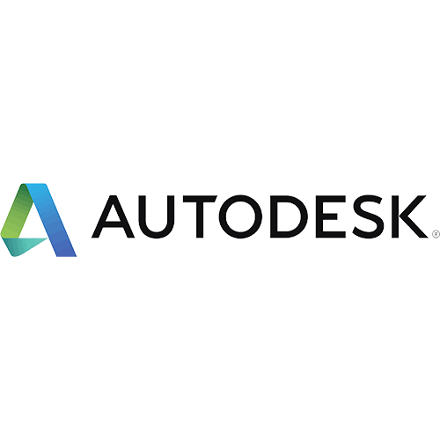




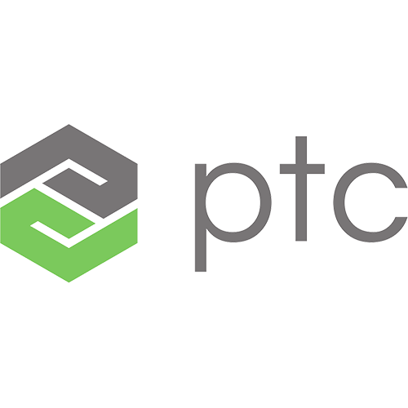

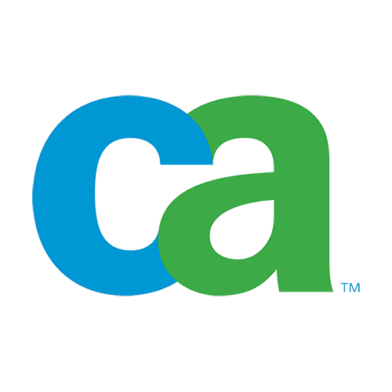








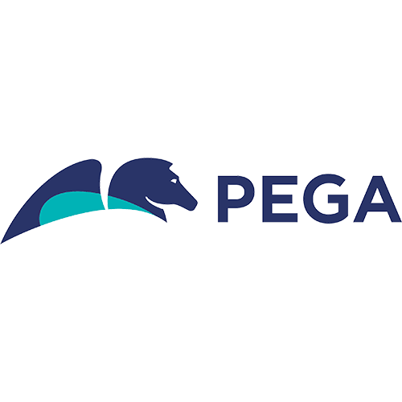

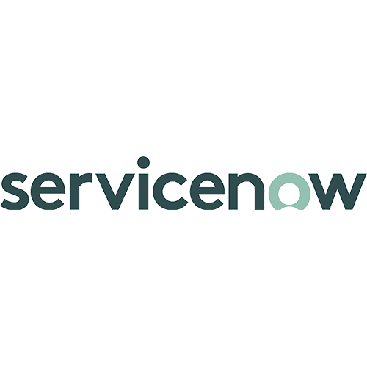

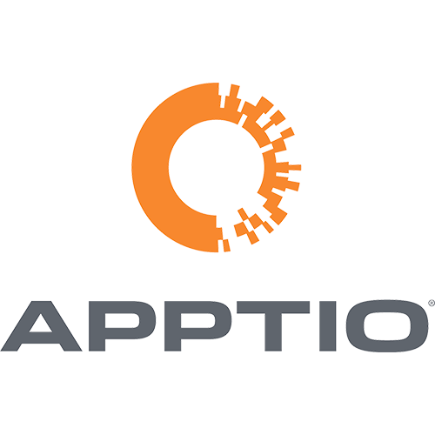


JAN
FEB
MAR
APR
Are you Renewal Ready?
MAY
JUN
JUL
AUG
We can help you to prepare for your next renewal. Anglepoint covers 500+ software publishers & have what we consider industry-leading expertise in 100+.
SEP
OCT
NOV
DEC

Slide 29
Effective Entitlement Position (EEP)
Insert screenshot from EEP workbook into zoomable slide

Slide 30
Effective License Position (ELP)
Insert screenshot from ELP workbook into zoomable slide

Slide 31
Risk & Opportunity Assessment Report (ROAR)
Insert example ROAR screenshot into zoomable slide

Slide 32
Cost Avoidance Recommendations
From Potential Recommendations to Realized Cost Avoidance
OBSERVATIONS & RECOMMENDATIONS:
OBSERVATION | RECOMMENDATION | QUANTIFIED COST AVOIDANCE | OWNER | LATEST UPDATE | TARGET DATE FOR RESOLUTION
Non-EBA installations Local installations identified outside the EBA which is non-compliant | Educate users on Autodesk EBA rules Migrate licenses from local unsupported versions to the EBA Global Pool | $89K | Leo Frias, SAM Manager | Confirmed with Business Units to accept risk and not migrate. | Closed
Unsupported Software Unsupported AutoCAD 2015 & AutoCAD Electrical 2017 in use by 50 users | Understand the use case for generic users Educate users on security risks and risks of non-compliance Upgrade users where possible Consider negotiating EOL software into next EBA | $262K | Leo Frias, SAM Manager Piotr Ciaston, Vendor Manager | 5 users have upgraded. In contact with 20 users who confirmed use case for old versions is required. Autodesk confirmed older versions will be included in next EBA as part of Piotr’s negotiation. | April 4, 2026 (EBA Renewal)
Generic Users Generic Usage has been identified by Autodesk in the ‘License Red Flags’. Autodesk has agreed with Piotr that Generic Usage is permitted relating to VDI usage, however, in most other cases is not allowed. | Identify users and understand the use case for generic users Educate users on Autodesk licensing rules Remove generic accounts and ensure each user accesses Autodesk software for one account | $554K | Leo Frias, SAM Manager | 2 generic users unknown. 1 generic account removed with correct user accounts 1 account cannot be adjusted. Piotr to negotiate potential pre-set token consumption rate for generic users in next EBA. | April 4, 2026 (EBA Renewal)

Slide 33
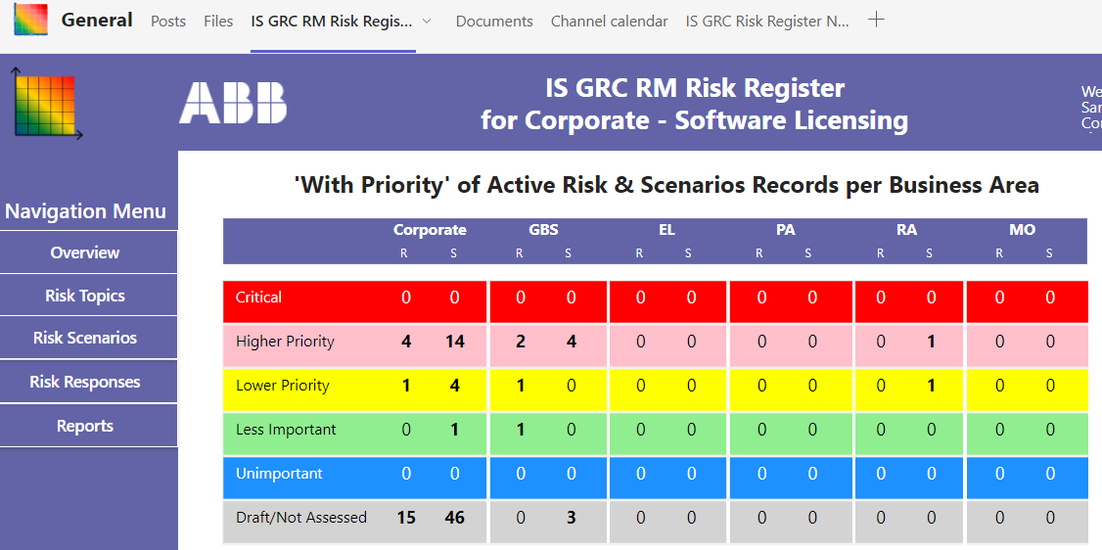
Recommendations Registered
Out Clients take our recommendations seriously and actually do something about it
Notes:
All ROAR recommendations are registered in Client’s internal GRC tool
Risk categorised by Risk value and urgency in line with Client’s Corporate Framework
Distributed risk across the Business Units and assigned to individual stakeholders
C-Suite & Steering Committee have visibility into GRC and set Program priorities based on risk matrix. Business Units are held Accountable to remove risks within 90 days per the SAM Procedure Governance Framework.
Business stakeholders to understand options to mitigate risk or pursue optimization, and then decide the business strategy or choose to accept the risk. If risk is accepted, provisions are made within their P&L
Distributed, emergent, empirical, continuous, calculated risk

Slide 34
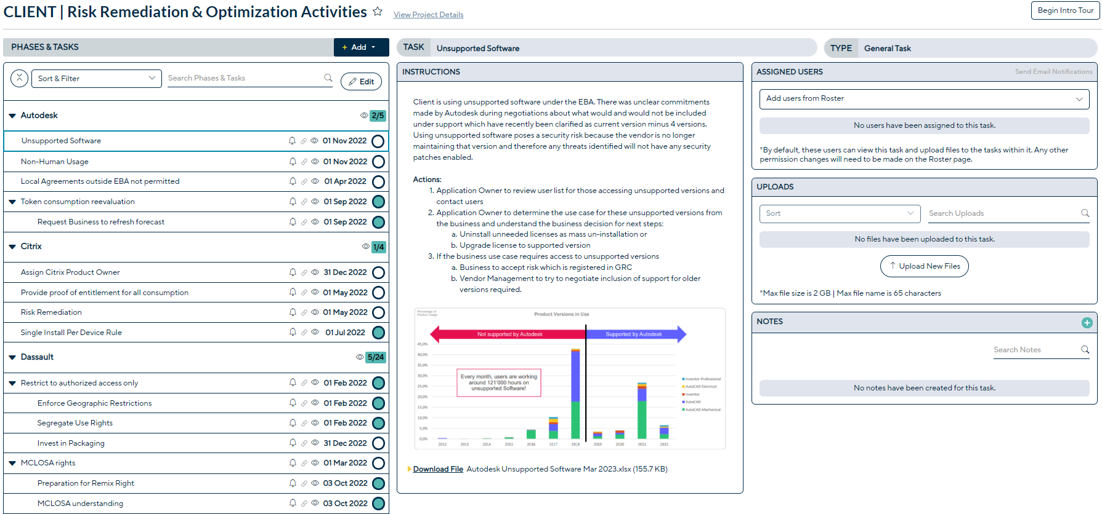
Managed Remediation Activities
Relentless pursuit to convert potential opportunities to realized avoidance & savings

Slide 35
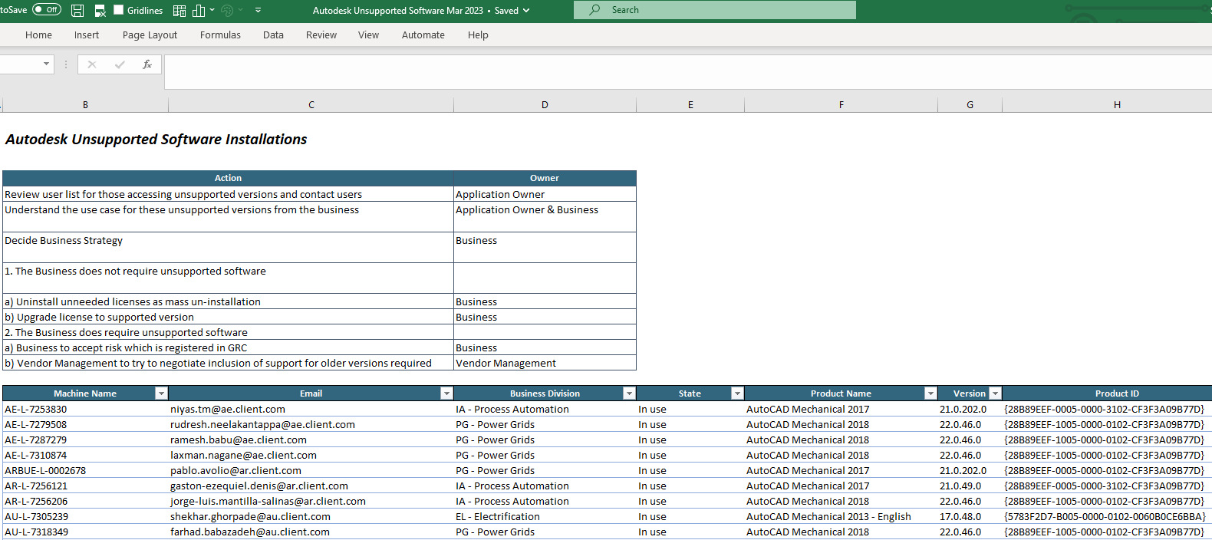
Actionable Intelligence Provided
Everything needed to know how to remove the risk in one place

Slide 36
Executive Summary
IDENTIFIED RISK & COST AVOIDANCE:
PRODUCTS |  | REMEDIATION ACTION | IDENTIFIED RISK | POTENTIAL COST AVOIDANCE | REMAINING RISK
● | On-premise local installations outside the EBA in use, but are not permitted | Transition all users to the Global EBA and remove all traces of local installation. | $89K¹ | $89K | $-
● | Unsupported AutoCAD 2015 & AutoCAD Electrical 2017 in use | Upgrade unsupported versions or negotiate inclusion with support into EBA. | $262K | $262K | $-K
● | Non-human usage of multiple products identified in breach of user-based license metric use-rights | Remove generic accounts and ensure each user accesses Autodesk software for one account | $554K | $- | $554K
 |  |  | $905K | $351K | $554K
IDENTIFIED RISK:
$905K
POTENTIAL COST AVOIDANCE:
$351K
REMAINING RISK: $554K
POTENTIAL COST SAVINGS: $1.1M
POTENTIAL COST SAVINGS:
PRODUCTS |  | COST SAVINGS ACTION | TIMELINE | POTENTIAL COST SAVINGS
● | Duplicate maintenance payment between local agreement and Global contract | Cease maintenance on local agreement and transition to global pool | Feb 2022² | $126K
● | Under-utilized consumption of pre-paid tokens | Negotiate decreased value of EBA | Nov 2022³ | $1M
 |  |  |  | $1.1M
Notes: ¹ The value of EBA token for local installation licenses has been used to calculate risk identified. ² Cost Savings can be realized at the expiry date of the local agreement. 3 Cost Savings opportunities can be realized in line with future forecasted business growth at the EBA renewal in November 2022. |  |  | NOTE: Identified shortages in these areas represent a cost savings of $55k over a 3-year period.

