Slide 1

IBM Risk & Opportunity Assessment Report (ROAR)
JANUARY 2026
Encova Insurance
+

Slide 2



MEET THE TEAM
ANGLEPOINT
Cliff Jespersen
Milan Subotic
Julie Parent
Manager, IBM License Management
Analyst, IBM License Management
Client Success Specialist

Slide 3
AGENDA
01 | ENGAGEMENT OVERVIEW
02 | EXECUTIVE SUMMARY
03 | RECOMMENDATIONS
04 | QUESTIONS & ANSWERS
05 | NEXT STEPS
06 | APPENDIX

Slide 4
Engagement overview
01

Slide 5
Engagement Objectives
ENGAGEMENT OVERVIEW
ENGAGEMENT OBJECTIVES:
● | The Anglepoint team will work with Encova to develop a project plan and schedule to address Encova’s IBM CVA goals and objectives in scope of this SOW
● | Establish an Effective Entitlement Position (EEP)
● | Establish an Effective License Position (ELP)
● | Identify risk and opportunities found and optimize the license position
● | Perform quarterly ILMT health checks and tool recommendations

Slide 6
Engagement Scope
ENGAGEMENT OVERVIEW
SCOPE:
9 distributed IBM products
262 servers and 50 containers running IBM software
1 ILMT instance

Slide 7
Process Overview
Engagement overview
PROCESS:
STEPS:
Contract Discovery
● | Gather and review all contract documents necessary to establish complete and accurate license entitlement and usage rights
● | All in-scope software deployments are discovered and mapped to device/users
● | Product-level entitlement quantities are established using contract documentation
● | Product-level consumption quantities are established based on discovery data
● | The entitlement position is compared against the consumption position, validated, presented and finalized
● | High-level findings from the ELP are presented in the ROAR, including quantified cost savings and avoidance recommendations
1
2
Deployment Discovery
3
Effective Entitlement Position
4
Consumption Position
5
Effective License Position (ELP)
6
Risk & Opportunity Assessment Report (ROAR)

Slide 8
Executive Summary
02

Slide 9



IBM Managed Service Snapshot
Service overview
TOOLING UPDATE
COMPLIANCE SUMMARY
44 IBM Devices in ILMT | v9.2.40 ILMT Version
Identified Risk and Accomplished Cost Avoidance
Identified Risk | Accomplished Cost Avoidance | Remaining Risk
$221.6K | $221.6K | $0
OS Breakdown
Cost Savings
Identified Cost Optimization | Accomplished Cost Optimization | Potential Cost Savings
$507K | $282K | $225K
QUARTER IN REVIEW
■ In Flight Activities / Next Steps
Quarterly Service Review – 1/26/26
Bi-weekly ILMT classifications
ILMT Upgrade
■ Key Issues Raised
None
■ Recent Accomplishments
Q4 2025 Baseline CVA ELP Submission – 12/29/25
Q4 2025 EEP Deliverable – 11/3/25

Slide 10

Identified Risk & Cost Avoidance
EXECUTIVE SUMMARY
IDENTIFIED RISK & COST AVOIDANCE:
PRODUCTS |  | IDENTIFIED RISK¹ | COST AVOIDANCE¹ |  | REMAINING RISK ¹
 |  |  | IDENTIFIED | ACCOMPLISHED
CURRENT YEAR DETAILS 2025 | Current Year Details [2021]
● | IBM Websphere Application Server Network Deployment | $222K | $222K | $222K | $0K
 |  | $222K | $222K | $222K | $0K
Notes: ¹Using IBM List Pricing
Anglepoint identified a total risk of $222K and a cost avoidance of $222K in the baseline analysis.
The Accomplished cost avoidance is also $222K over same period
IDENTIFIED RISK:
$222K
IDENTIFIED AVOIDANCE:
$222K
REMAINING RISK: $0K

Slide 11
Executive Summary
DEFINITIONS:
Identified Risk: Quantified financial exposure to Encova due to non-compliance with software licensing or contractual terms. Calculated based on available data, this risk underscores the urgency for corrective action.
Identified Cost Avoidance: Potential unbudgeted costs to Encova that can be prevented through proactive compliance and financial controls. These savings may not appear in financial statements but are measurable in avoided liabilities.
Accomplished Cost Avoidance: The quantified result of actions taken to prevent unbudgeted costs, ensuring compliance and financial control. While not directly reflected in financial statements, these actions reduce or remove future financial exposure.
Identified Cost Optimization: Opportunities to reduce software, hardware, or cloud expenses through license optimization, contract negotiations, or strategic adjustments.
Accomplished Cost Optimization: Verified cost reductions achieved through software, hardware, or cloud optimization. These optimizations may involve renegotiations, contract adjustments, or technology shifts.
Realized Cost Savings : Direct financial savings reflected in budgets or financial statements due to negotiated reductions or decreased expenses.
Total optimization: Anglepoint identified potential cost avoidance and savings totaling $507K over a 1-year period.
^{$507K}
Notes:
Realized Cost Savings refers to hard dollar savings

Slide 12
Identified Cost Optimization
EXECUTIVE SUMMARY
PRODUCTS |  | DATE ACCOMPLISHED/ TARGET DATE² | COST SAVINGS¹
IDENTIFIED COST OPTIMIZATION: | Current Year Details [2021]
● | IBM DataCap (Cloud Pak for Business Automation) | 2025-12-17 | $282K
● | 4 Products with Potential S&S Reduction | 2026-01-31 | $225K
 |  |  | $507K
ACCOMPLISHED COST OPTIMIZATION: Notes: ¹ Based on IBM List Price for DataCap & achieved by excluding non-Rulerunner servers; Based on Encova discounted pricing for 4 products with potential S&S reduction ² As of 12/17/25 baseline ELP
Anglepoint identified cost optimization totaling $507K over a 1-year period.
IDENTIFIED COST OPTIMIZATION:
$507K
ACCOMPLISHED COST OPTIMIZATION:
$282K
● | IBM DataCap (Cloud Pak for Business Automation) | 2025-12-17 | $282K

Slide 13
Executive Summary
EXECUTIVE SUMMARY
IDENTIFIED RISK & COST AVOIDANCE:
PRODUCTS |  | IDENTIFIED RISK | COST AVOIDANCE |  | REMAINING RISK
 |  |  | IDENTIFIED | ACCOMPLISHED
● | IBM Websphere Application Server Network Deployment | $222K | $222K | $222K | $0K
 |  | $222K | $222K | $222K | $0K
IDENTIFIED RISK:
$222K
IDENTIFIED COST AVOIDANCE:
$222K
ACCOMPLISHED COST AVOIDANCE:
$222K
REMAINING RISK: $0K
ACCOMPLISHED COST OPTIMIZATION: $282K
ACCOMPLISHED COST OPTIMIZATION:
PRODUCTS |  | DISCOUNT % | DATE ACCOMPLISHED/ TARGET DATE | ACCOMPLISHED COST OPTIMIZATION
● | IBM DataCap (Cloud Pak for Business Automation) | 0% | 2025-12-17 | $282K
 |  |  |  | $282K
 |  |  | NOTE: Identified shortages in these areas represent a cost savings of $55k over a 3-year period.

Slide 14
recommendations
03

Slide 15
Actionable Cost Savings Recommendations
RECOMMENDATIONS
Product-specific tactical actions to achieve strategic program outcomes
OBSERVATIONS & RECOMMENDATIONS:
OBSERVATION | RECOMMENDATION | IDENTIFIED COST SAVINGS | OWNER | PRIORITY | DATE ACCOMPLISHED/ TARGET DATE
Potential S&S reduction opportunities | Evaluate current and future state needs to determine reduction quantities | $225K | Ajay Kumar / Steve Weiland | Medium | January 31, 2026 (Renewal Date)

Slide 16
Questions & Answers
04

Slide 17
Next steps
05

Slide 18
Recap of High-Level Next Steps
1
Execute Annual S&S Renewal
Renew subscription & support considering potential reduction opportunities
2
Continue IBM CVA Services
Continue managing IBM software licenses through the CVA program
SUCCESS FACTOR:
Overall key success factor or reminder goes here. Overall key success factor or reminder goes here.
3
Expand Publisher Scope
Expand publisher scope to include Oracle, Microsoft, VMware, etc.

Slide 19
Recommended Next Steps
Annual S&S Renewal
Quarterly CVA Submission
SOW Renewal
JANUARY 31
NEXT STEPS:
Execute annual S&S renewal with focus on potential reduction quantities
MARCH 31
NEXT STEPS:
Deliver quarterly sub-capacity product CVA report
AUGUST 31
NEXT STEPS:
Renew IBM CVA managed services

Slide 20

How are we doing?
Scan the QR code or click the link below to take a 3-minute survey to share feedback on your experience.
Start Survey

Slide 21
Appendix
06

Slide 22
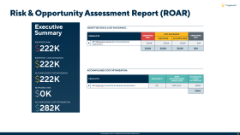
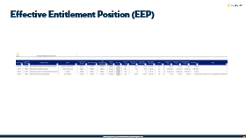
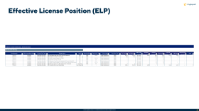
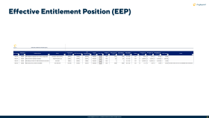
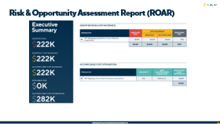
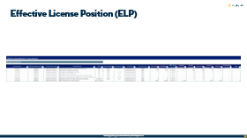
Definitions: EEP, ELP and ROAR
KEY DELIVERABLES
Effective Entitlement Position:
Effective License Position:
Risk & Opportunity Assessment Report:
An accurate and up-to-date understanding of an organization's software license entitlements and their corresponding usage rights. A comprehensive record of the licenses owned, the terms and conditions associated with each license, and the rights granted to the organization for deploying and using the software.
A review and comparison of an organization’s software entitlements against the corresponding consumption, taking into account an organization’s software contracts and associated documentation. The ELP indicates a current compliance position at a particular point in time.
Gleans findings from the ELP to outline license compliance risks & areas of opportunities for optimization to reduce license consumption and gain better value from software contracts through improved license deployment and allocation.

Slide 23
Definitions: Risk, Cost Avoidance, & Cost Savings
appendix
Risk: | Cost Avoidance: | Cost Savings:
Identified financial impact to Encova as a result of under or incorrectly licensed IBM software, based on the data shared with Anglepoint by Encova to date. Highlights necessity of immediate actions/additional spend liability. Remaining risk refers to all cost(s) that cannot be avoided. | Any action that avoids having to incur (non-budgeted) costs in the future. Cost Avoidance measures are never reflected in the financial statements or next year’s budget. They will only be reflected in situations where the proposed action is not implemented, resulting in a cost increase. | Any action that results in a tangible financial benefit that lowers current spending, investment or debt levels. Cost savings measures are reflected in the financial statements and next year’s budget.

Slide 24
Notable Contract Events

Slide 25
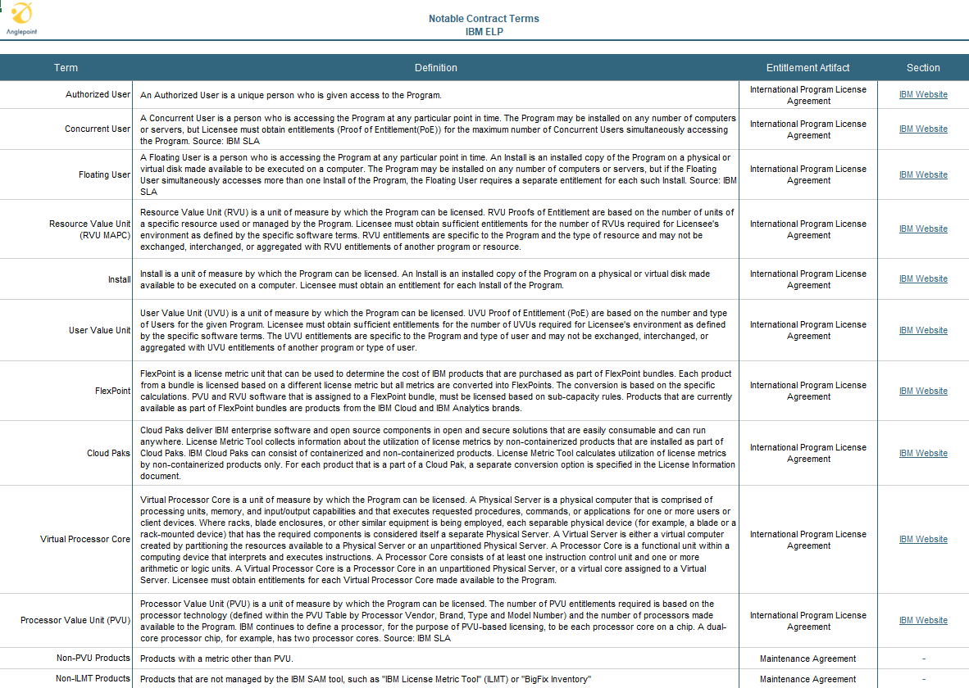
Notable Contract Terms

Slide 26
IBM Managed Service Process Overview
Planning & Prep
Review & validate known scoping details Review & validate known assumptions, dependencies and/or constraints Identify relevant Encova stakeholders, business application and/or product owners responsible for providing access and/or data Review and agree upon project risk matrix and communication plan
Data Collection
Configure & set up Elevate® access to relevant Encova stakeholders Gather Product-level entitlement quantities and usage rights using all available proof-of-purchase and contract documentation Gather Product-level consumption quantities from discovery data Gather Product-level roadmap details (demand planning/forecasted usage - Grow, Shrink, Maintain)
Data Analysis
Normalize & consolidate all collected data Create & review Effective Entitlement Position (EEP) Encova review, validation & sign-off of EEP Apply license consumption rules to validated entitlement Create & review Effective License Position (ELP) Encova review, validation & sign-off of ELP
Recommendations
Application of future demand & forecasting plans Summarized findings from the ELP presented in the Risk & Opportunity Assessment Report (ROAR), including quantified cost savings and avoidance recommendations, as well as expert best practice guidance on ITAM Asset & License Management Encova acceptance of ROAR deliverable
Optimization
Register, categorize, prioritize, and track risk remediation & opportunity realization in Elevate® with actionable intelligence Answer questions and enable stakeholders to understand options and take action Report realized cost savings & avoidance in Quarterly Service Review (QSR)
We Are Here

Slide 27
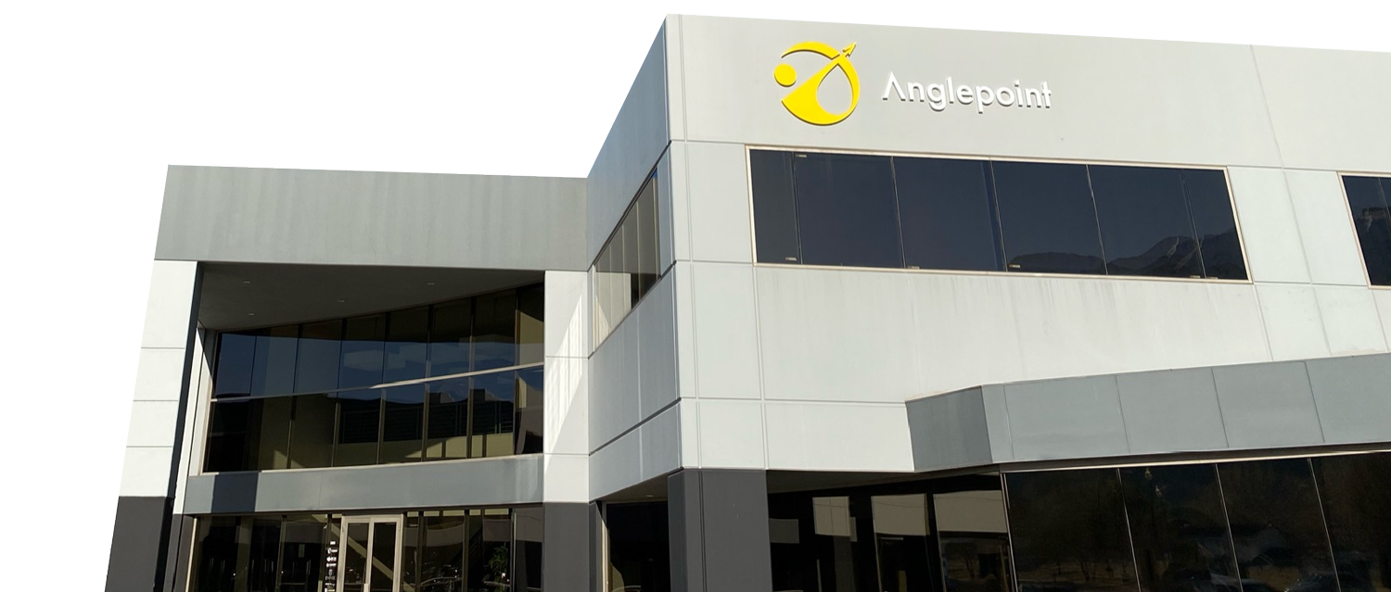
Anglepoint is the leading provider of ITAM & cloud managed services to the Forbes Global 2000.
Our Services eliminate cloud, software, & IT waste with actionable insights that drive agile forecasting within the world’s largest & most complex hybrid IT environments.
We Deliver comprehensive managed services to assess, design, transform, & operate world-class programs that follow the industry standard, ISO 19770-1.

Slide 28
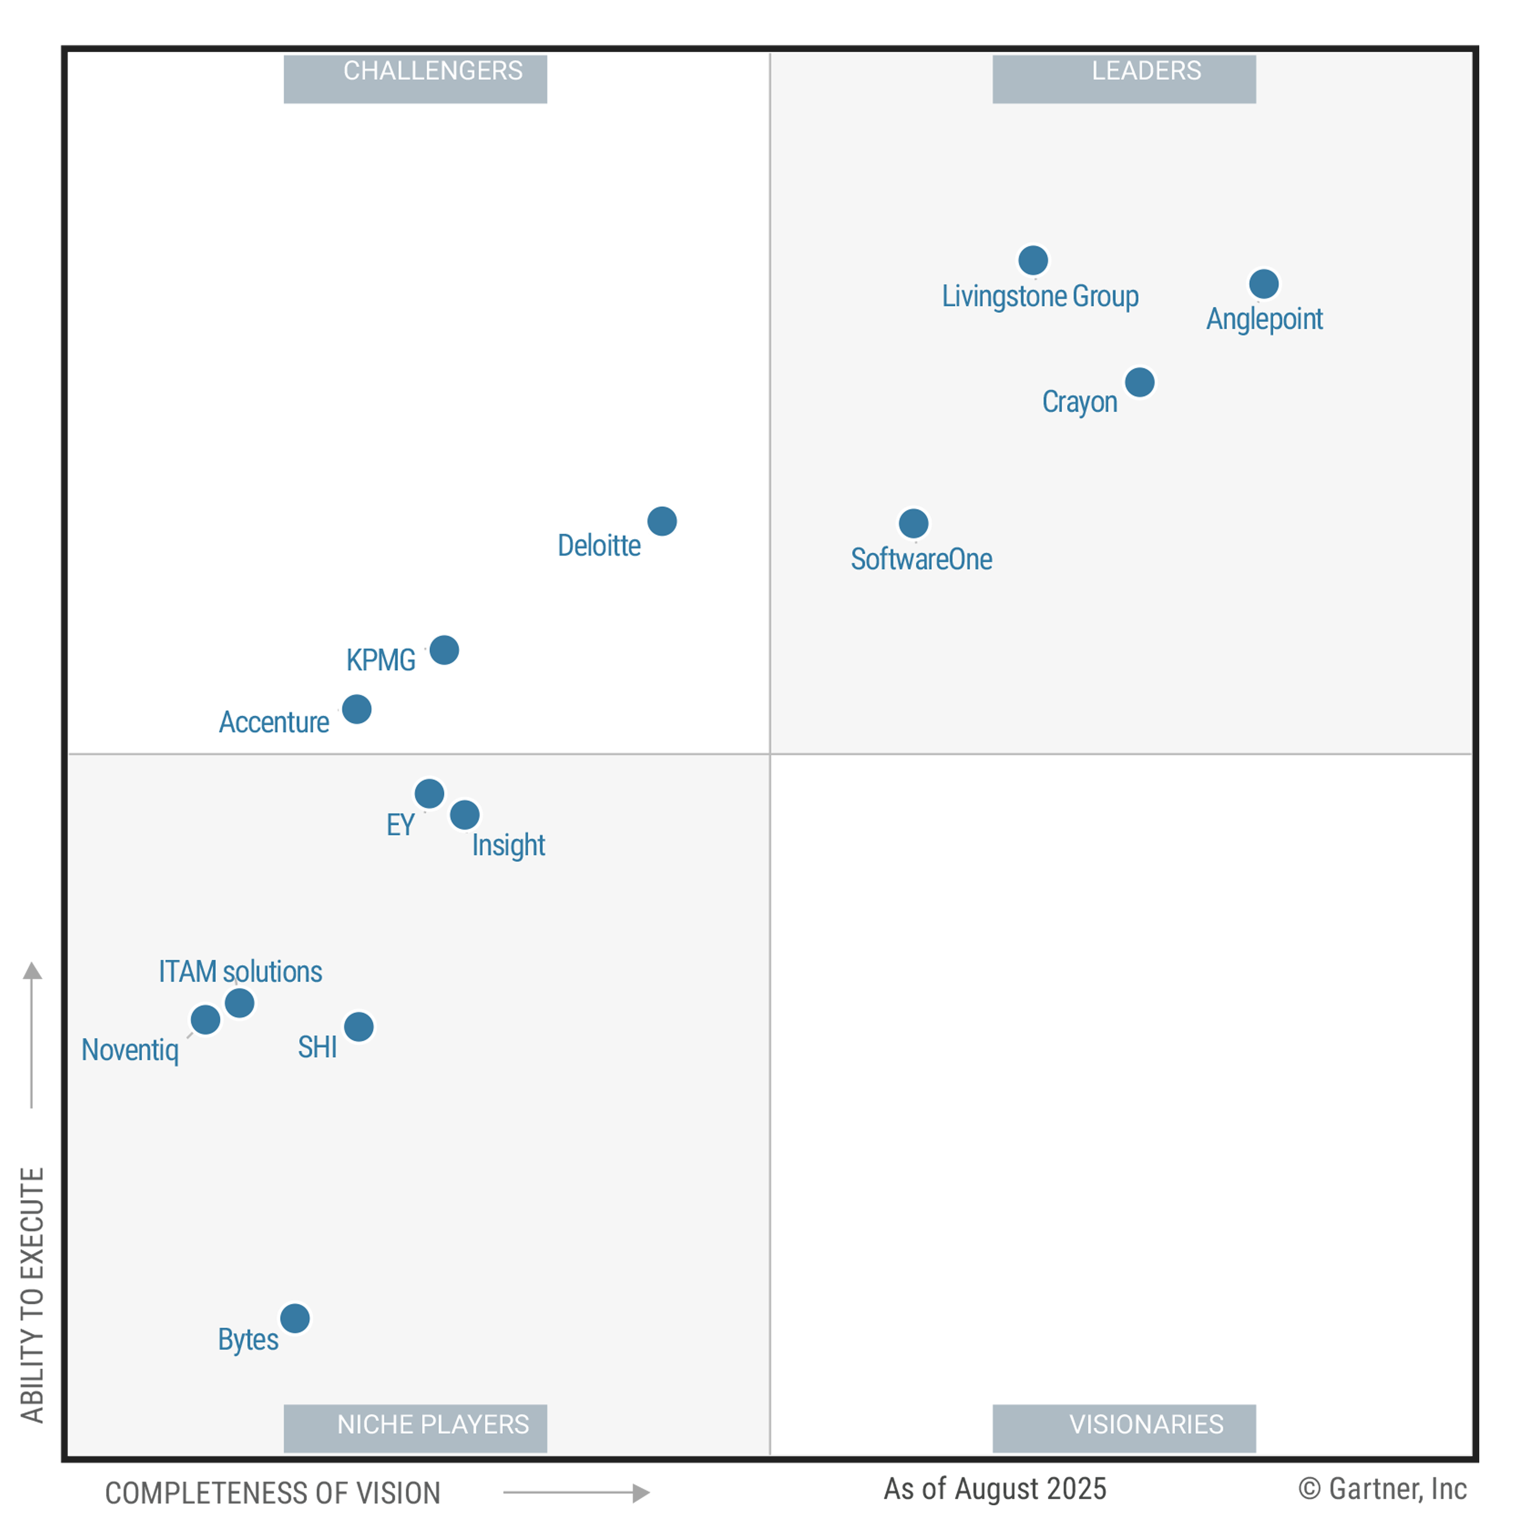
2025
Recognized Global Leader in SAM Managed Services
For 6 years Gartner® has named Anglepoint a Leader in SAM Managed Services, reflecting our clients’ success and trust.
These graphics were published by Gartner®, Inc. as part of a larger research document and should be evaluated in the context of the entire document. The Gartner® document is available upon request from Anglepoint. Gartner® Peer Insights reviews constitute the subjective opinions of individual end users based on their own experiences and do not represent the views of Gartner or its affiliates.
As of April 2024
As of April 2024
© Gartner, Inc

Slide 29
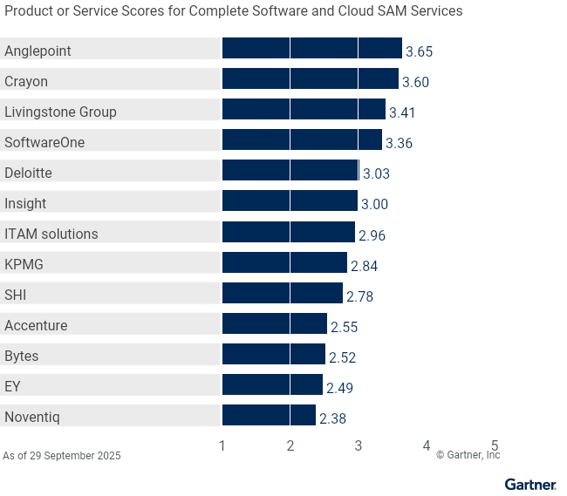



Recognized for Consistent Leadership
RANKED
IN EVERY USE CASE
For six consecutive years, Anglepoint has ranked first in all three use cases among 13 profiled providers in Gartner’s Critical Capabilities for SAM Managed Services report.
#1
1
2
3
Gartner, Critical Capabilities for Software Asset Management Managed Services, Rob Schafer, Yolanda Harris, Jaswant Kalay, Charity Hooper, 6 October 2025, G00824336. This graphic was published by Gartner, Inc. as part of a larger research document and should be evaluated in the context of the entire document. The Gartner document is available upon request from Anglepoint at www.anglepoint.com/cc. Gartner does not endorse any vendor, product or service depicted in its research publications and does not advise technology users to select only those vendors with the highest ratings or other designation. Gartner research publications consist of the opinions of Gartner’s research organization and should not be construed as statements of fact. Gartner disclaims all warranties, expressed or implied, with respect to this research, including any warranties of merchantability or fitness for a particular purpose. GARTNER and Critical Capabilities are registered trademark and service mark of Gartner, Inc. and/or its affiliates in the U.S. and internationally and is used herein with permission. All rights reserved.

Slide 30
Product/Service Rating on Critical Capabilities
X
Highest Ratings
▼ CAPABILITIES |  | Accenture | Anglepoint | Bytes | Crayon | Deloitte | EY | Insight | ITAM Solutions | KPMG | Livingstone Group | Noventiq | SHI | SoftwareOne
 | Process and Transformation | 3.0 | 4.0 | 2.7 | 3.5 | 3.2 | 2.6 | 2.8 | 3.3 | 2.9 | 3.2 | 2.4 | 2.5 | 3.7
 | Trustworthy Data | 2.4 | 3.7 | 2.9 | 3.6 | 3.0 | 2.6 | 2.7 | 3.0 | 3.2 | 3.4 | 2.5 | 2.6 | 3.3
 | Entitlement and Use Rights | 1.9 | 3.6 | 2.8 | 3.8 | 3.0 | 2.7 | 2.8 | 3.0 | 3.2 | 3.4 | 2.5 | 2.7 | 3.3
 | FinOps | 3.2 | 3.9 | 2.4 | 3.8 | 2.9 | 2.6 | 3.0 | 2.3 | 2.8 | 3.5 | 2.3 | 2.6 | 3.2
 | SaaS and Cloud License Management | 2.2 | 3.6 | 2.0 | 3.2 | 2.9 | 2.4 | 3.1 | 3.0 | 3.0 | 3.1 | 2.7 | 3.0 | 3.4
 | Governance and Optimization | 2.4 | 3.6 | 2.5 | 3.5 | 3.3 | 2.5 | 3.2 | 2.9 | 2.8 | 3.8 | 2.2 | 2.6 | 3.4
 | Life Cycle Management | 2.5 | 3.7 | 2.4 | 3.6 | 3.0 | 2.7 | 3.1 | 2.6 | 3.0 | 3.7 | 2.4 | 2.7 | 3.6
 | Continuous Delivery Platform | 2.1 | 3.7 | 2.3 | 3.7 | 2.7 | 1.9 | 2.5 | 2.7 | 3.0 | 3.4 | 2.3 | 3.4 | 3.5
 | Value Realization | 2.8 | 3.6 | 2.6 | 3.6 | 3.1 | 2.5 | 3.5 | 3.4 | 2.4 | 3.2 | 2.4 | 2.9 | 3.3
 | Environmental Sustainability | 3.0 | 2.7 | 2.1 | 3.6 | 3.1 | 2.2 | 2.6 | 2.7 | 2.3 | 3.6 | 2.0 | 2.7 | 2.5
1
2
3
4
5
6
7
8
9
10

Slide 31
Service Practice Areas
What We Do
Intentionally organized for wholistic, modular managed services
Managed Services
modular services components from all other practice areas governance administration remediation management license management license service desk cracked key management program transformation tooling run & maintain cloud consumption metering
License Management
Effective License Position (ELP) Risk & Opportunity Assessment Report (ROAR) audit support cracked key analysis negotiation support renewals management agreement consolidation & terms development post-merger contract novation
Cloud FinOps
multi-platform assessment (Azure, AWS, GCP) cloud rightsizing pricing optimization resource consumption monitoring & reporting cloud resource tagging audit FinOps governance workshop
ITAM Tooling
requirements assessment technical capabilities verification selection & RFP support implementation & integration configuration & publisher onboarding health check & remediation run & maintain
IT Security
ISO 27001 certification readiness cybersecurity assessment & remediation multi-cloud security assessment & remediation privacy & security compliance assessment (SOX, PCI, FISMA, HIPPA, FFIEC)
Program Transformation
strategy development workshop (charter, RACI, prioritization, data quality, POAP) process design & implementation workflow automation policy, control, & KPI development maturity assessment & 19770-1 certification readiness
Anglepoint Academy
authorized training for IAITAM certifications SAM 101 & 102 publisher-specific licensing training Anglepoint audit response framework understanding licensing terms tool admin training
Notes:
We’ve organized our service practice areas to be components of a managed service so they can easily be brought in to provide the right combination to meet a particular client’s needs.
So it’s not just about software licensing and the program development aspects, but its also tooling selection, implementation, & run & maintain services.
We also have a FinOps practice to help our clients rightsize their cloud footprint, optimize their spend with cloud service providers, & implement cloud management best practices.
It’s also helping build those bridges with the security organization providing specific security services in tandem with the SAM services.
And we also provide specialized training through the Anglepoint Academy to help our clients extend their own education and certifications to become more capable practitioners.

Slide 32


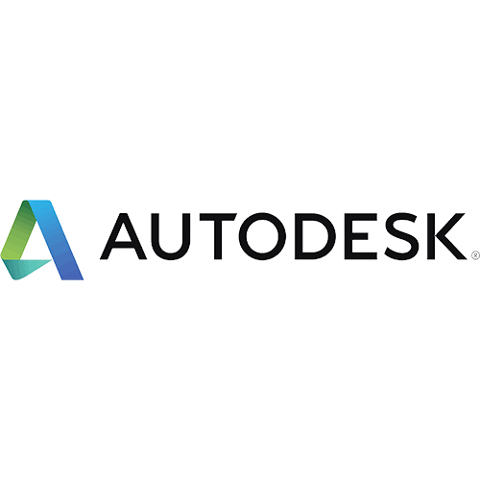















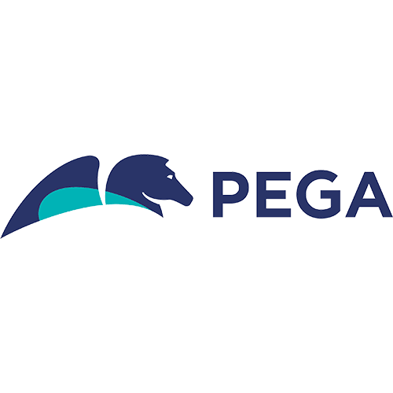

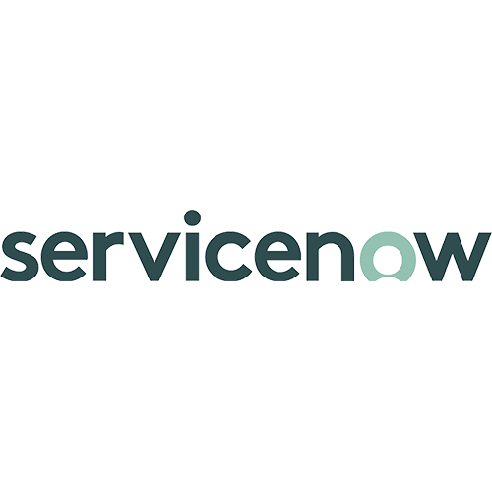




JAN
FEB
MAR
APR
Are you Renewal Ready?
MAY
JUN
JUL
AUG
We can help you to prepare for your next renewal. Anglepoint covers 500+ software publishers & have what we consider industry-leading expertise in 100+.
SEP
OCT
NOV
DEC

Slide 33
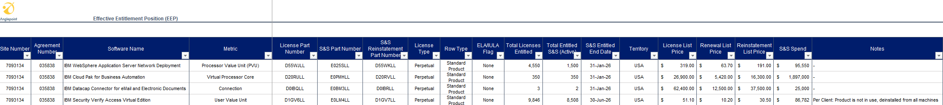
Effective Entitlement Position (EEP)

Slide 34
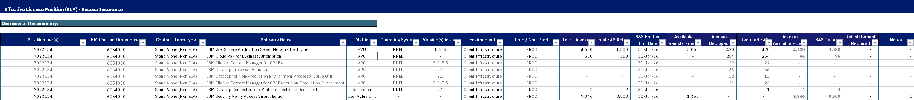
Effective License Position (ELP)

Slide 35
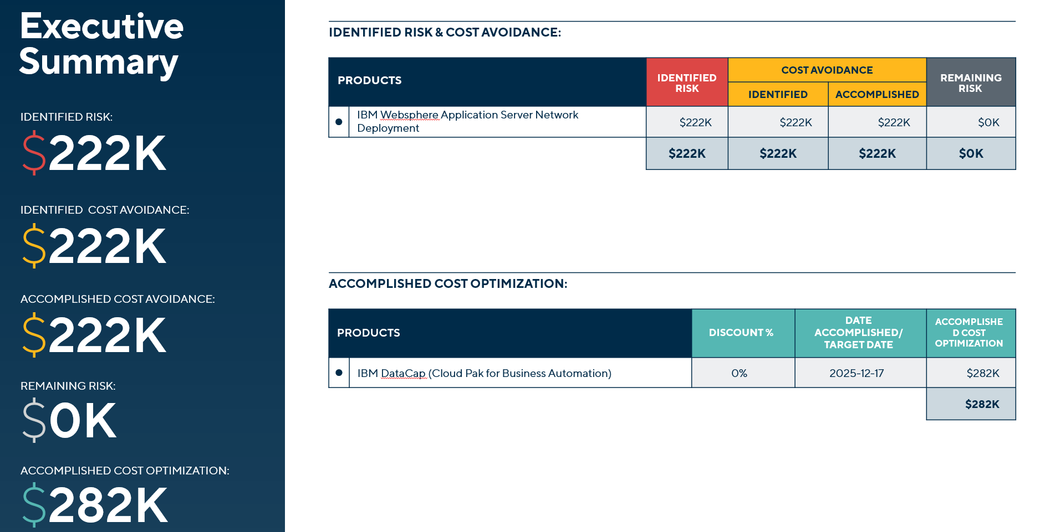
Risk & Opportunity Assessment Report (ROAR)

Slide 36

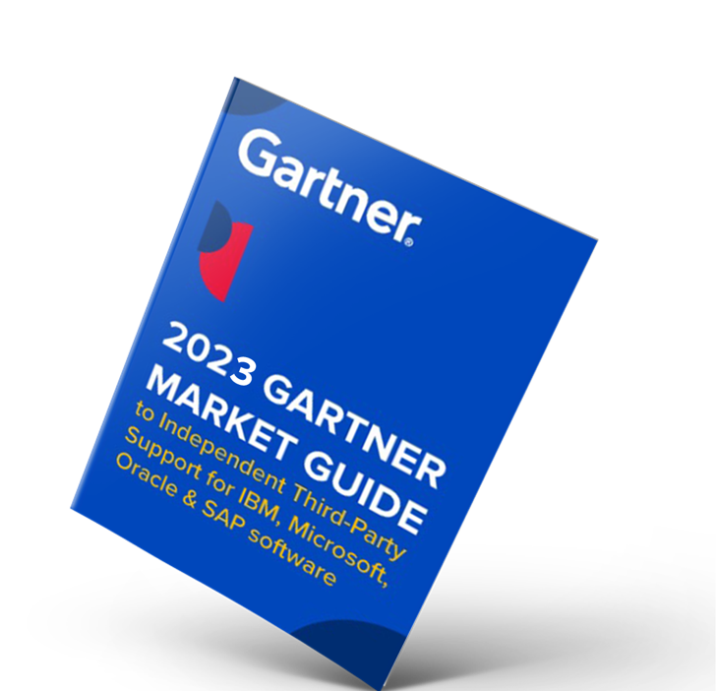
Origina at a Glance
Extensive pool of Global Independent Experts (GIEs)
Recommended TPSS provider
IBM + HCL + VMware
Products supported
Gartner
Recommended TPSS provider
$1bn+
Savings, risk & cost avoidance
Fortune 500/Global 1000
Customers
GARTNER’S TOP RECOMMENDATION for Independent “third-party” support for 5 years
2019, 2020, 2021, 2022 & 2023
Ireland INC US 250
Investing in our US footprint

