Slide 1
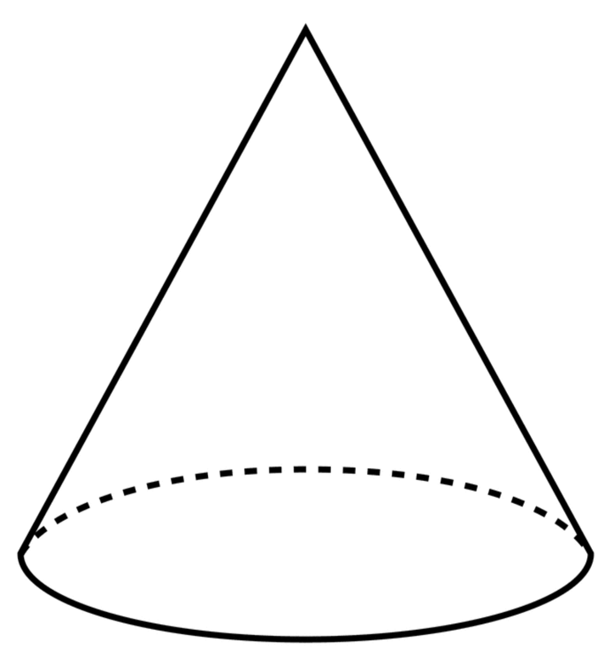
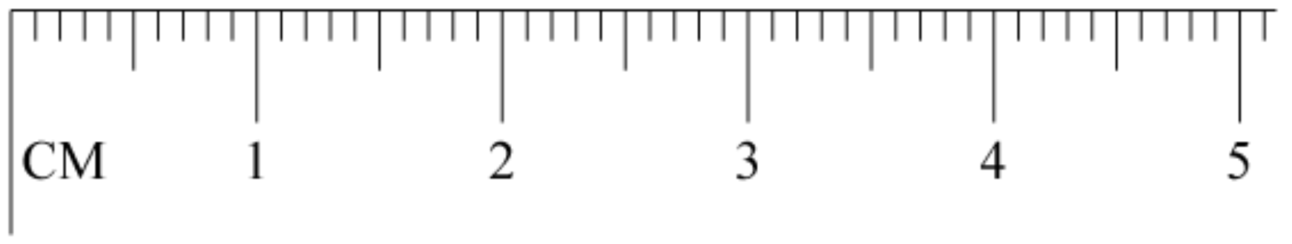
*larger than default error since it can be difficult to project the top point over to the ruler

