Slide 1
Each card below contains a letter-number pair.
Rule: Any vowel card will also have an even number.
How many “?”s must be revealed to verify this rule?
A
D
?
?
E
?
4
?
8
3
?
5

Slide 2
Each card below contains an age-beverage pair.
Rule: Only ages >= 21 can drink alcohol.
How many “?”s must be revealed to verify this rule?
11
19
?
?
31
?
?
?
Lemonade
Wine
Whiskey
Soda

Slide 3
* Thinking abstractly and recognizing similarities between different problems can make difficult questions easier – this is an essential part of physics!
* Be careful about jumping to conclusions. The rule vowel→even does not imply consonant→odd.

Slide 4
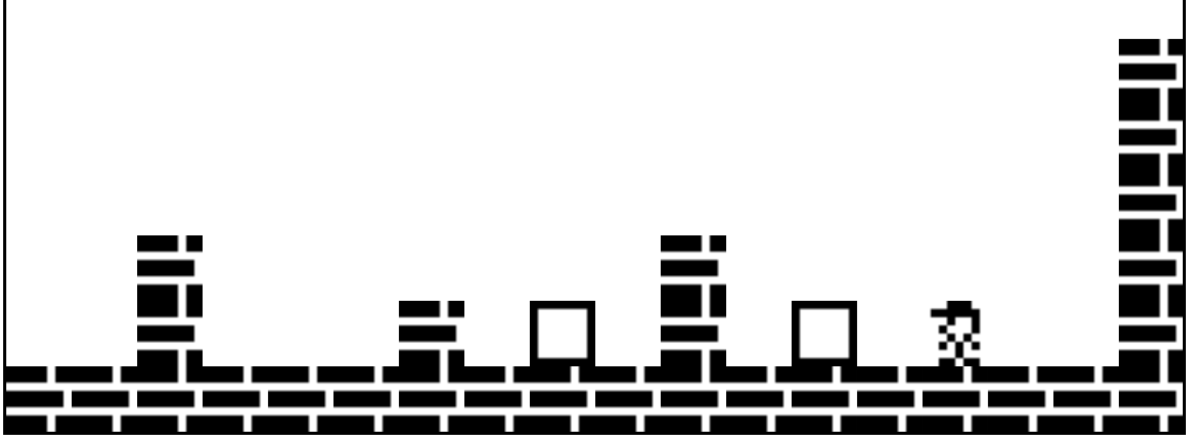
Blockdude
http://azich.org/blockdude/
In-class (solo) activity: complete levels 1-3
Similarities to physics:
* Learning the rules of the universe requires experimentation and observation (and sometimes luck)
* Incomplete knowledge of the rules can prevent success
* Merely knowing the rules usually isn’t sufficient for solving a problem – critical thinking and problem solving skills are also necessary
* Solving a difficult problem may require starting from scratch multiple times
* Planning ahead can make you life much easier

Slide 5
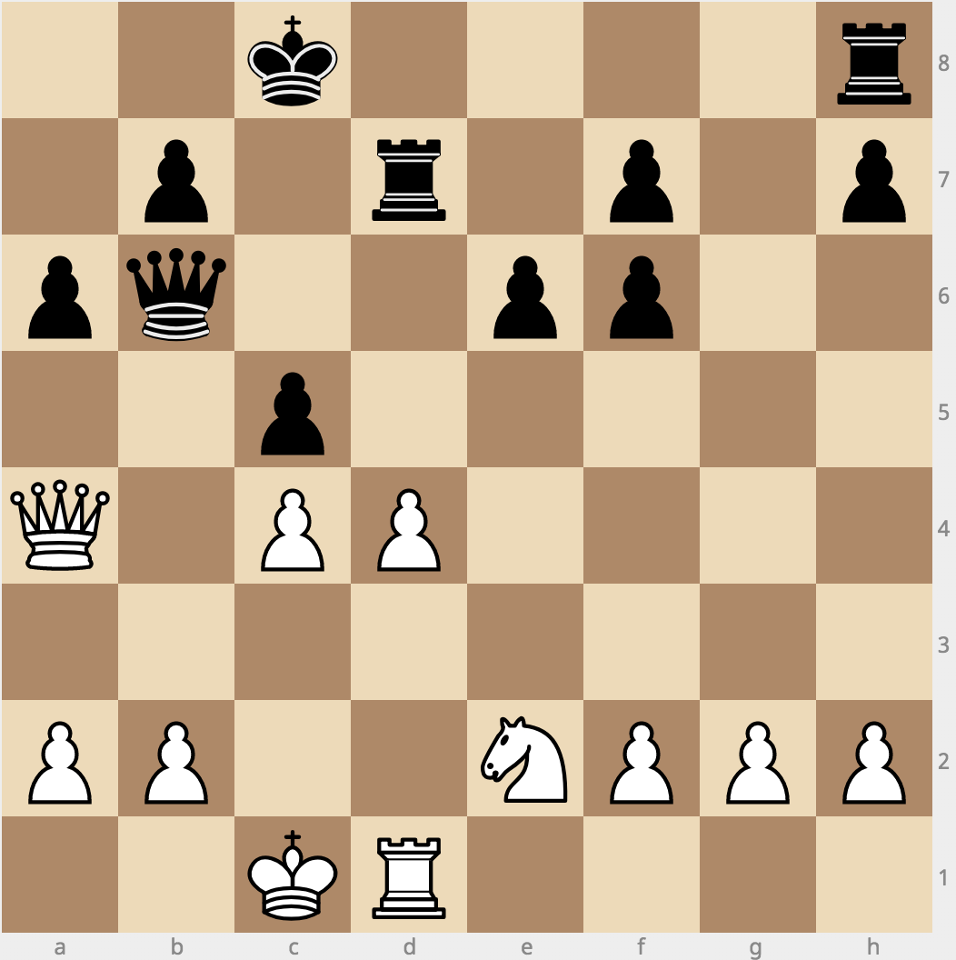
In-class (group) activity:
White to move.
Find the best move.
(2k4r/1p1r1p1p/pq2pp2/2p5/Q1PP4/8/PP2NPPP/2KR4 w KQkq -)
Similarities to physics:
* Learning the rules of the universe requires experimentation and observation (and sometimes luck)
* Incomplete knowledge of the rules can prevent success
* Merely knowing the rules usually isn’t sufficient for solving a problem – critical thinking and problem solving skills are also necessary
* Solving a difficult problem may require starting from scratch multiple times
* Planning ahead can make you life much easier

