Slide 1

Iterations, conditional statements, & functions
Lise Montefiore and Natalie Nelson, PhD

Slide 2
Part I: Conditional statements
Sometimes, you prepare code that only needs to be run under certain conditions. When this happens, you can use conditional statements that dictate whether code runs or not. The following statements can be used in R: if, if else, else if.

Slide 3
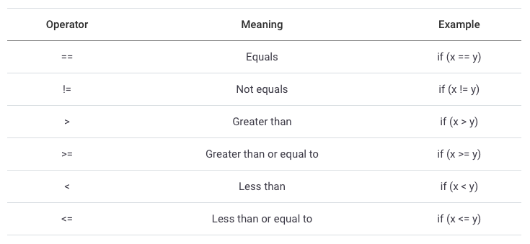
Commonly-used operators in conditional statements
Notes:
NN: Slide needs a source for the table screenshot. Note that the students already know these, but I think it’s a nice reminder to include here.

Slide 4
The “if” statement
if statements test a condition:
If TRUE, a given set of instructions (= code) is run
Syntax: if (condition) { Instructions }
Start
if block
Yes
Condition true?
No
Execute code in if block
Execute code outside if block
Adapted from material prepared by Dr. Ashley Beck

Slide 5
The “if else” statement
if else statements test a condition:
If a condition is TRUE, a certain task is carried out
If a condition is FALSE, a different task is carried out
Syntax: if (condition) { Instructions 1 } else { Instructions 2 }
Start
if-else block
Yes
Condition true?
No
Execute code in if block
Execute code in else block
Execute code outside if else block
Adapted from material prepared by Dr. Ashley Beck

Slide 6
The “if / else if / else…” statement
Start
if-else if-else statements test multiple conditions
Syntax: if (condition 1) { Instructions 1 } else if (condition 2) { Instructions 2 } else if (condition 3) { Instructions 3 } else { Instructions 4 }
if block
Yes
Condition true?
No
Execute code in if block
else if block
Yes
Condition true?
No
Execute code in else if block
else if block
Yes
Condition true?
No
Execute code in else if block
Execute code in else block
Execute code outside if else if else block
Adapted from material prepared by Dr. Ashley Beck

Slide 7
Example of if statement
a <- 15
b <- 3
if (a > b){
print( “a is greater than b”)
}
[1] “a is greater than b”

Slide 8
Example of else statement
a <- 3
b <- 15
if (a > b) {
print(“a is greater than b”)
} else {
print(“b is greater than a”)
}
[1] “b is greater than a”
You can also write:
if (a > b) print(“a is greater than b”) else print(“b is greater than a”)
[1] “b is greater than a”
a

Slide 9
Example of else if statement
a <- 25
b <- 25
if (a > b) {
print(“a is greater than b”)
} else if (b > a) {
print(“b is greater than a”)
} else {
print(“a is equal to b”)
}
[1] “a is equal to b”

Slide 10
Similar to if_else()
Note that if, else, and elseif statements are used with code blocks in cases where you want to run multiple lines of code depending on whether the conditional statement is TRUE or FALSE
If you are just interested in running a simple calculation with conditional statements, if_else() are easier to work with.
data %>%
mutate(new_column = if_else(conditional statement,
output_if_TRUE,
output_if_FALSE)
new_object <- if_else(my_date > ymd(20170707), 1, 0)
Notes:
The students already know this function, but they use if_else()

Slide 11
Part II: Loops

Slide 12
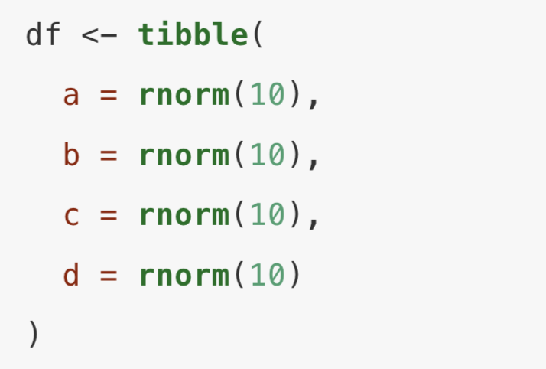
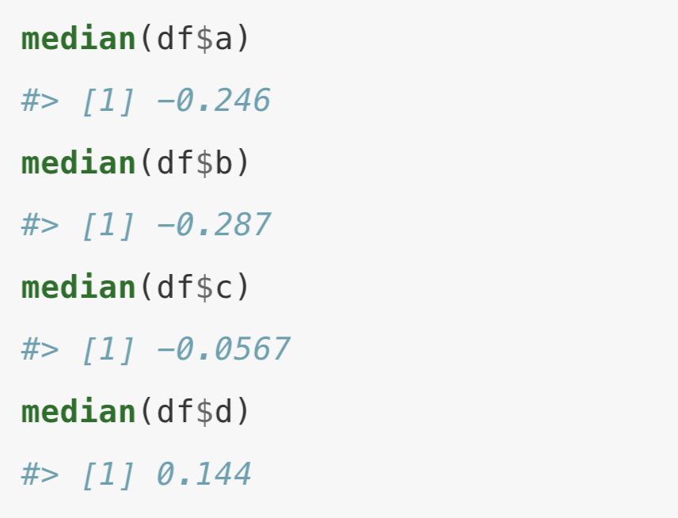
Say you have a tibble, df:
And you want to calculate the median of each column:
Is there a way to do this without copying and pasting the line of code?
Gromelund and Wickham, R for Data Science: Chapter 21 – Iteration

Slide 13
Say you have a tibble, df:
And you want to calculate the median of each column:
Yes! With a loop:
medians <- rep(NA, 4) for (i in 1:length(medians)) { medians[i] <- median(df[,i]) }
Gromelund and Wickham, R for Data Science: Chapter 21 – Iteration

Slide 14
Loops
A loop is a coding structure for repetition of a task(s)
Loops iteratively apply a group of instructions to data
Loops automate code
Loops can be included in user-defined functions
Different types of loops in R: for and while
We will focus on for
Adapted from material prepared by Dr. Ashley Beck

Slide 15
The “for” loop
for loops iteratively apply a group of instructions a specified number of times
for loops consist of three elements:
Output
Sequence
Body (= code)
Syntax:
out <- rep(NA, 5) for (i in 1:length(out)) { out[i] <- 2 ^ i }
→ 1. Initialize output vector: create an empty vector
→ 2. Specify the sequence of your loop iterations
→ 3. Apply the body of your loop: run code to produce output
Gromelund and Wickham, R for Data Science: Chapter 21 – Iteration

Slide 16
The “for” loop
Start
i = 1
Execute code in body; update out[1]
for i in 1:5
i = 2
Execute code in body; update out[2]
out <- rep(NA, 5) for (i in 1:length(out)) { out[i] <- 2 ^ i }
i = 3
Execute code in body; update out[3]
for block
i = 4
Execute code in body; update out[4]
i = 5
Execute code in body; update out[5]
End

Slide 17
The “for” loop
Start
Prior to running loop: create empty vector to populate with for loop
for i in 1:5
i = 1
Execute code in body; update out[1]
out <- rep(NA, 5)
print(out)
NA, NA, NA, NA, NA
for (i in 1:length(out)) { out[1] <- 2 ^ 1
print(out)
2, NA, NA, NA, NA
}
for block
End

Slide 18
The “for” loop
Start
Prior to running loop: create empty vector to populate with for loop
for i in 1:5
i = 2
Execute code in body; update out[2]
out <- rep(NA, 5)
print(out)
NA, NA, NA, NA, NA
for (i in 1:length(out)) { out[2] <- 2 ^ 2
print(out)
2, 4, NA, NA, NA
}
for block
End

Slide 19
The “for” loop
Start
…i =3, i = 4…
Prior to running loop: create empty vector to populate with for loop
for i in 1:5
i = 5
Execute code in body; update out[5]
out <- rep(NA, 5)
print(out)
NA, NA, NA, NA, NA
for (i in 1:length(out)) { out[5] <- 2 ^ 5
print(out)
2, 4, 8, 16, 32
}
for block
Output now contains values from formula 2 ^ i
print(out)
2, 4, 8, 16, 32
End

Slide 20
Sequence vector
The sequence vector can include any set of numbers you’d like
Since the sequence vector is used as an index, the values must be positive and greater than 0
ind <- seq(from = 5, to = 20, by = 5)
print(ind)
5, 10, 15, 20
for (i in ind) {
...
}
→ Loop will run over:
i =5
i = 10
i = 15
i = 20

Slide 21
Loops can be nested
You can have for loops within for loops (= “nested” loops). Useful for working with data frames.
for (i in 1:10) {
for (j in 1:5) {
out[i, j] <- ...
}
}

Slide 22
When should you use a for loop?
When mutate() or group_by()/summarize() won’t do the trick
Always opt for using mutate() or summarize() instead of a loop, when possible
Remember the if_else() function, which is often easier to use than if else statements
Usually, for loops are used to apply complicated workflows that require multiple functions or to perform repetitive tasks (e.g. create multiple plots)

Slide 23
Say you have a tibble, df:
And you want to calculate the median of each column:
Yes! With a loop:
medians <- rep(NA, 4) for (i in 1:length(medians)) { medians[i] <- median(df[,i]) }
Gromelund and Wickham, R for Data Science: Chapter 21 – Iteration

Slide 24
Part III: Functions
Set of statements organized together to perform a specific task.
Functions can be used repeatedly in a program.
R provides many built-in functions and allows programmers to define their own functions. We refer to these as “user-defined” functions.

Slide 25

Function syntax
(1) Function name:
The name you want the function to be called – you pick!
(2) Arguments:
Values to be passed to the function as arguments
name <- function (args) {
return(value)
}
(3) Function body:
Here, you can write the code you want to run every time your function is called
statement
statement
…
statement
(4) Return value (optional):
Ends the function and returns output
You can call the function with this line of code: name(args)
Notes:
NN: I don’t think return is optional?

Slide 26
Function arguments
(1) Function name
(2) Arguments:
separate arguments with commas
> calc <- function (x, y, z) {
x + y * z
}
(3) Function body:
Call your function
> calc(1, 3, 5)
[1] 16

Slide 27
Function argument names
(1) Function name
(2) Arguments:
separate arguments with commas
> calc <- function (x, y, z) {
x + y * z
}
(3) Function body:
Call your function
> calc(1, 3, 5)
[1] 16
> calc(z=5, x=1, y=3)
[1] 16
If you pass arguments with a name, those arguments can be arranged in any order.

Slide 28
Return multiple values
(1) Function name
(2) Arguments:
separate arguments with commas
> calc2 <- function (a, b) {
add<- a +b
mult <- a*b
return(c(addition=add, multiplication=mult))
}
(3) Function body
> calc2 (2,3)
addition
multiplication
5
6
Results can be saved in a vector or a list.
Notes:
NN: Note that the students have been briefly introduced to lists, but haven’t worked with them yet. So they aren’t very familiar with lists.

