Slide 1

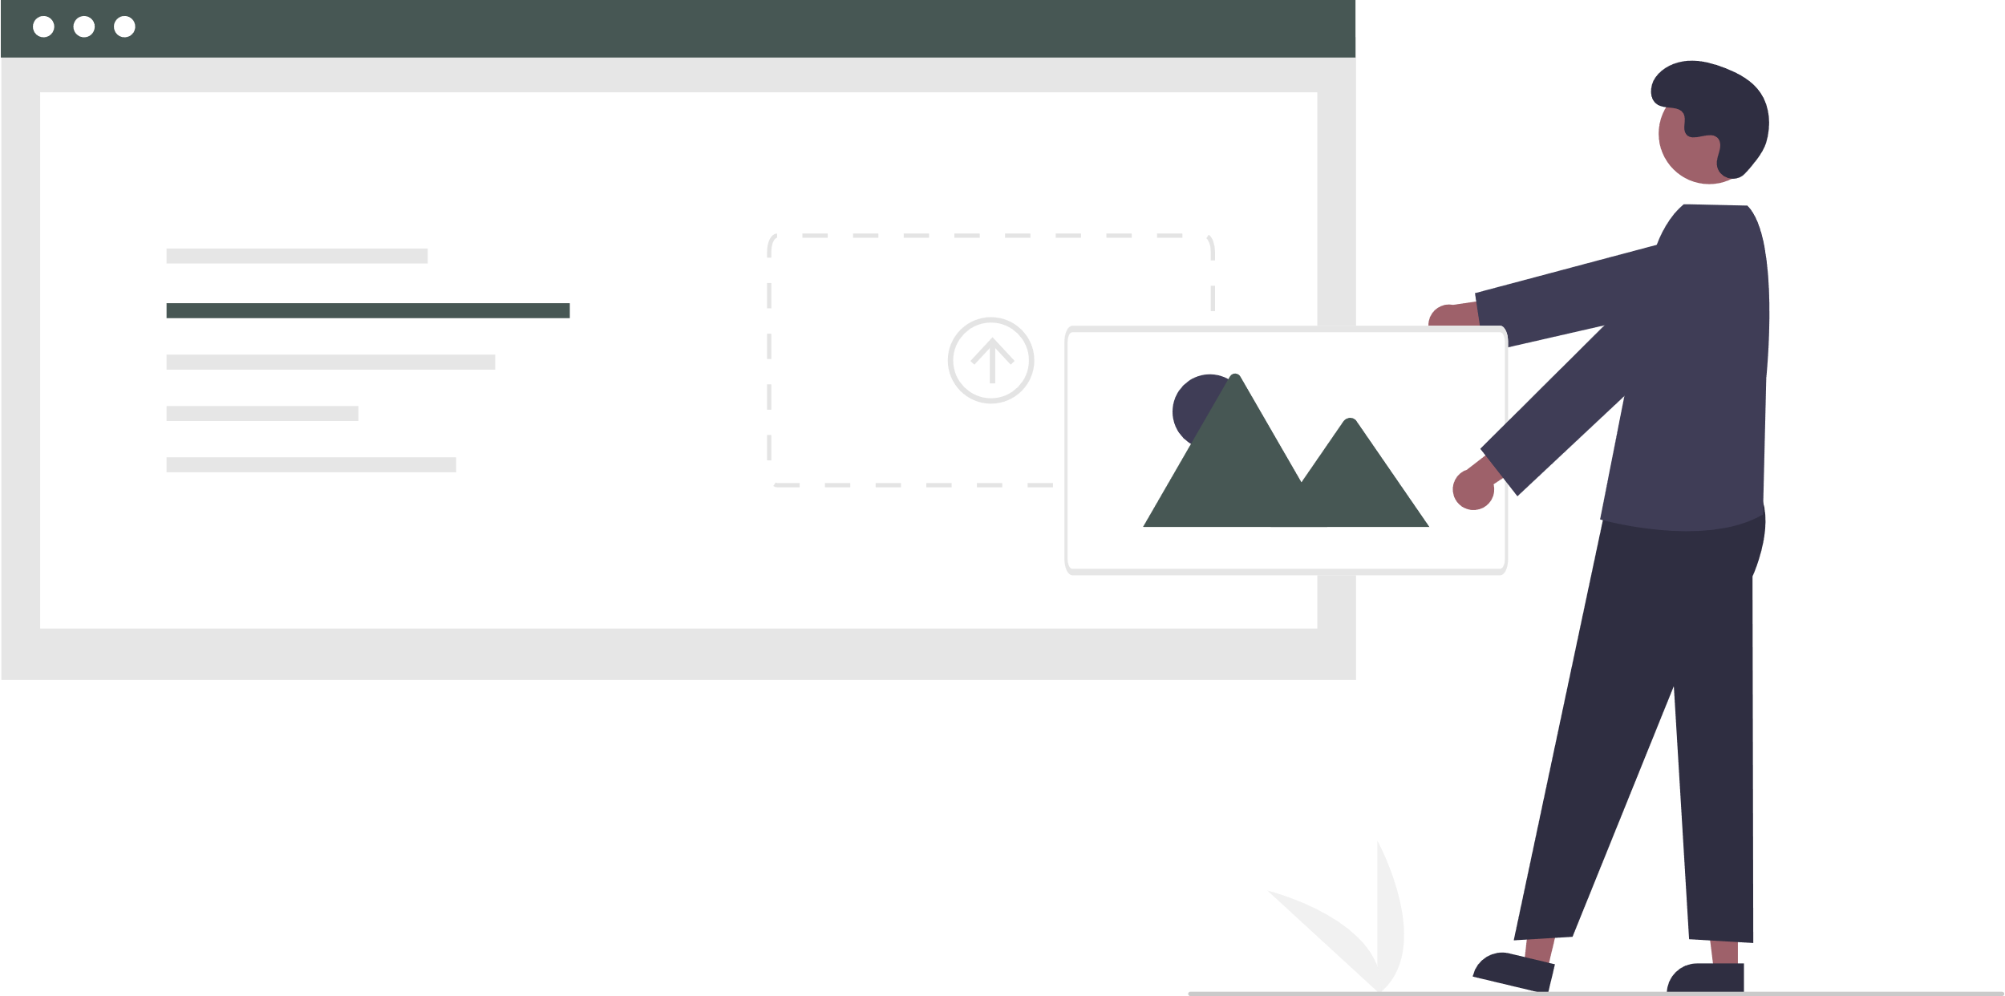
By Team 4

Slide 2
Team Introduction
Matt Bolles - Team Lead
Adam Belaid - Backend Lead
Jo Ey Chong - Frontend Lead
Raza Ali - Github Master
Natalie Christie - Scrum Master
Eric Chie - Backend

Slide 3


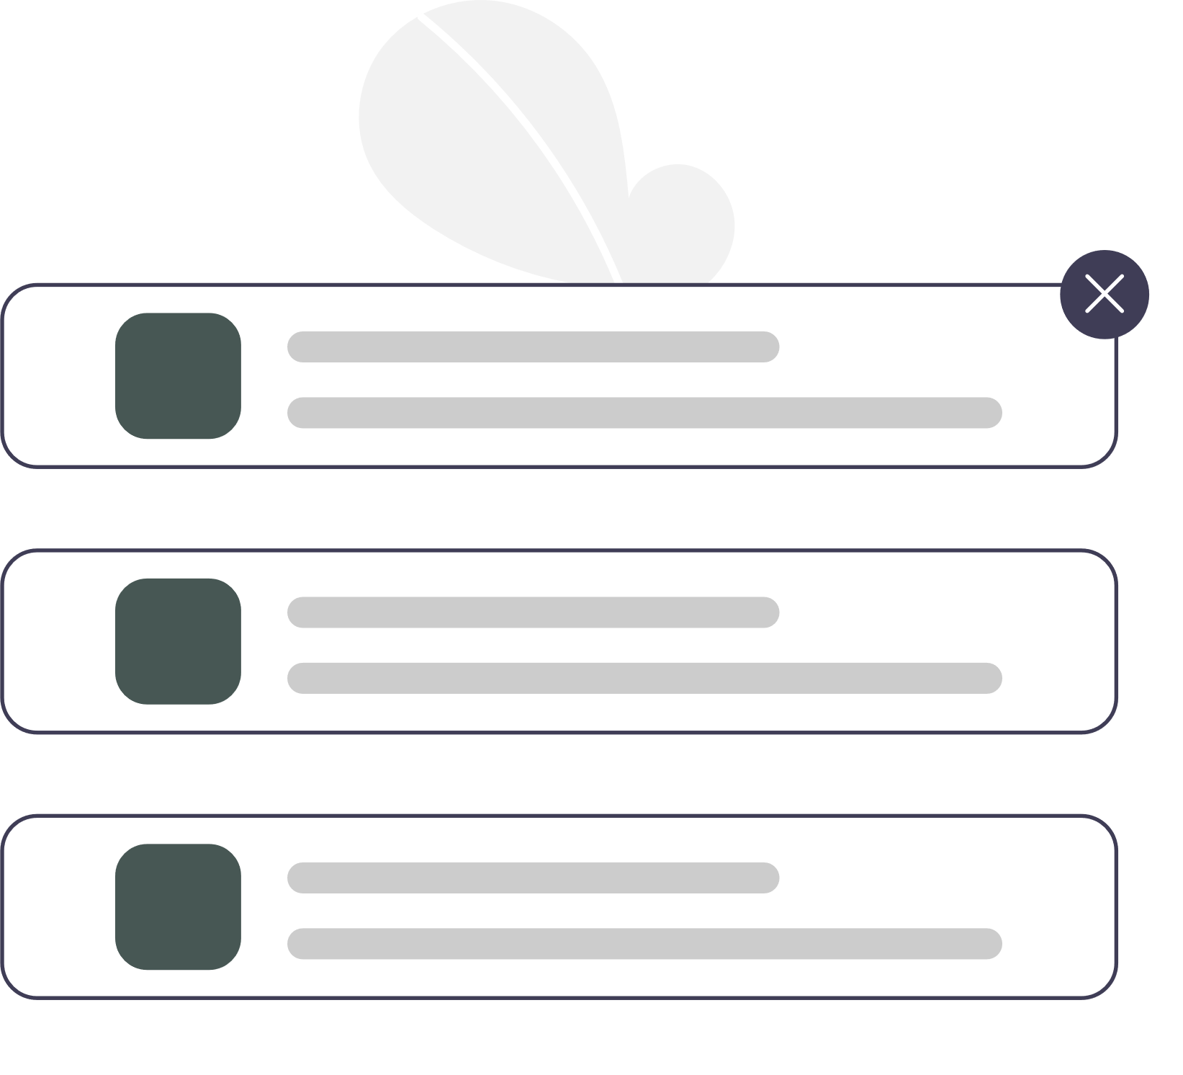
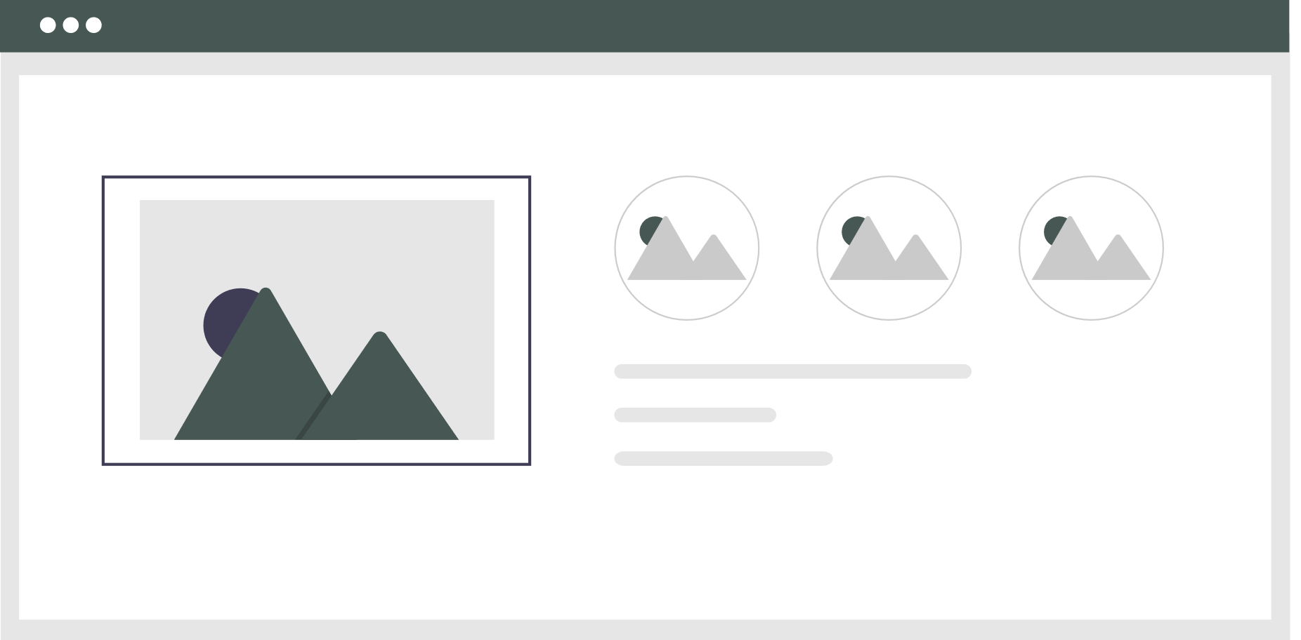
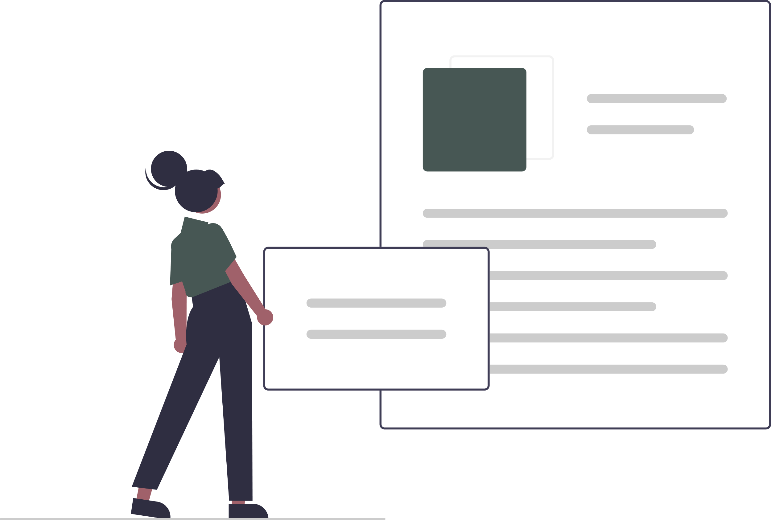

What’s Momentus?
Social platform for creators
Browse
Organize
Share
Opinions
Notes:
It’s a social media platform specialized for creators, allowing them to browse for inspirations, share their work of art, give and receives opinions, and most importantly, to help these creators organize their published work on the platform (what for)
Mention the main customers of our platform (Content creators, artistic types)

Slide 4
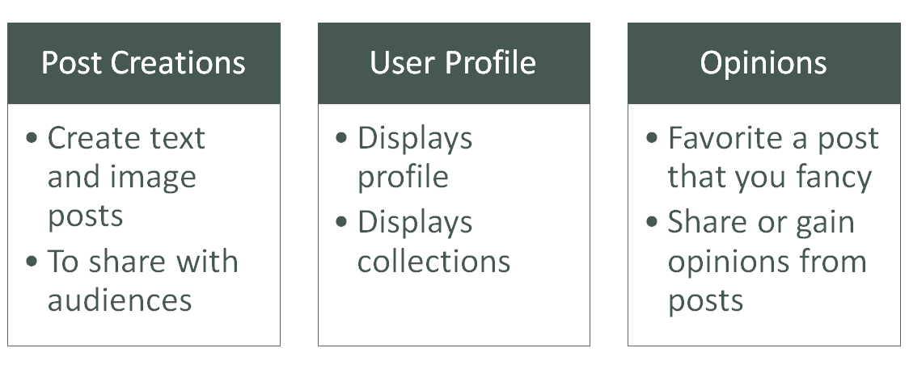
Features
Notes:
Elaborate on our different features a little bit
who is customer? features to satisfy customer?

Slide 5
Processes
Momentus
Frontend
Backend
UX Design
API Connections
Database Queries
API Endpoints
Notes:
The developments of Momentus are broken down into two parts, frontend and backend.
The frontend handles anything the users can interact and is also responsible to make sure that when user interacts something, the backend can receive and process a response back to the user.
The backend handles the database, which includes information and data of all the registered users of Momentus, they are also responsible of creating the server that process the data mentioned.

Slide 6
Technologies
Frontend
Backend
React
Express
Axios
SQL
Redux
CORS and Multer
Bootstrap
Express Sessions
Notes:
Here are the major frameworks or libraries that we used to help us build Momentus.
Frontend:
To build the user interface, React alongside Bootstrap is used to create layouts and components. React has a modular architecture, allowing us to create components that need to be put on the page repeatedly. This means that we can write a component can call it multiple times to the page instead of writing the same code each time we need them. This allows us to keep the files shorter and let us easily maintain them.
Axios is an AJAX library that allows us to make request from the frontend to the back.
Redux is a global state management for React, this allows us to store global variables that can be accessed when we call it anywhere in the app.
Backend:
We used express to handle requests and response and SQL as database
The platform also has sessions handling, so if a user logged in before, the server knows from the cookies and will direct users to logged in page. Similar to facebook and twitter.
CORS and multer helps us with uploading images.

Slide 7
Development Organization
Communications
Discord
Meetings
Code Conventions
Styles
Prettier
Organization
Git Branches
Each ongoing features with branches
Code reviews
Collaborations
Strategies
Priorities
Notes:
For our team we needed a properly organized plan for how we intended to develop our platform. To start off communication is very important, we made sure to have that line of communication via discord and setting team meeting times that worked for all of us that will be discussed later.
For our coding conventions we made sure to make use of the appropriate coding styles that were talked about in class, the coding convention that we deployed was prettier which was super simple and easy to use.
Regarding our git branches we made sure to make use of the exact styling that was discussed in the lectures. Each team member would make sure to work on a feature branch that would then be pushed to the respective development branch based on each milestone we were working on. We really hammered home the point of making sure we had tons of code reviews and made sure to try to limit the merge conflicts we had.
Also In our development process we also made sure to come to an agreement with the rest of the team regarding any ideas and suggestions. This was usually done by either frontend or backend team individually depending on the functional aspect it is we were focusing on
With a team of 6 members, we sure do need a solid organization plan for the development of the platform.
Communications are very important; it’s also how we produced these different organizations plans. We mainly use Discord to communicate with each another, and meetings are set up time to time to discuss plans, ongoing situations, and also difficulties that need to be addressed, which a couple of them you will see here.
To ensure organization in codes, we used Prettier and have everyone set on default settings, so we are on the same page, this is crucial step as we found out that with the wrong stylings between members, Git sometimes take this as a change. Incidents such as deletion and addition of the same piece of code can be triggered by different indentation spaces.
We made branches for each of the Milestones, and later on we stepped up a little and branched out according to different features that needs to be worked on, and when it’s usable, we initialize a pull request and have anyone from the team review the code before approving the pull.
As mentioned awhile ago, we set up meetings for discussion, we have to come to agreement with the rest of the team for any ideas and suggestions. This is usually done by either frontend or backend team individually, if frontend has suggestion that can improve frontend works, the backend team do not need to participate unless it’s a major change. They are also kept up-to-date with changes.

Slide 8
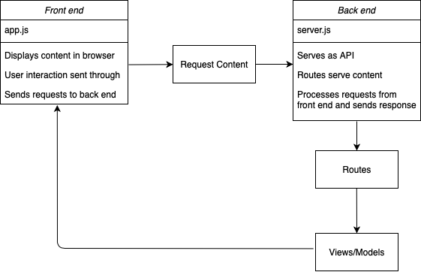
Back End
sent through axios
Notes:
Old UML diagram
call in adam

Slide 9
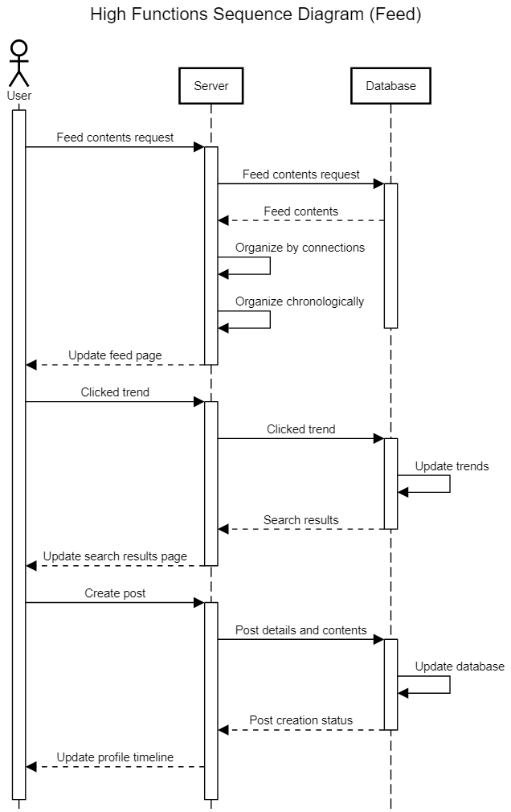
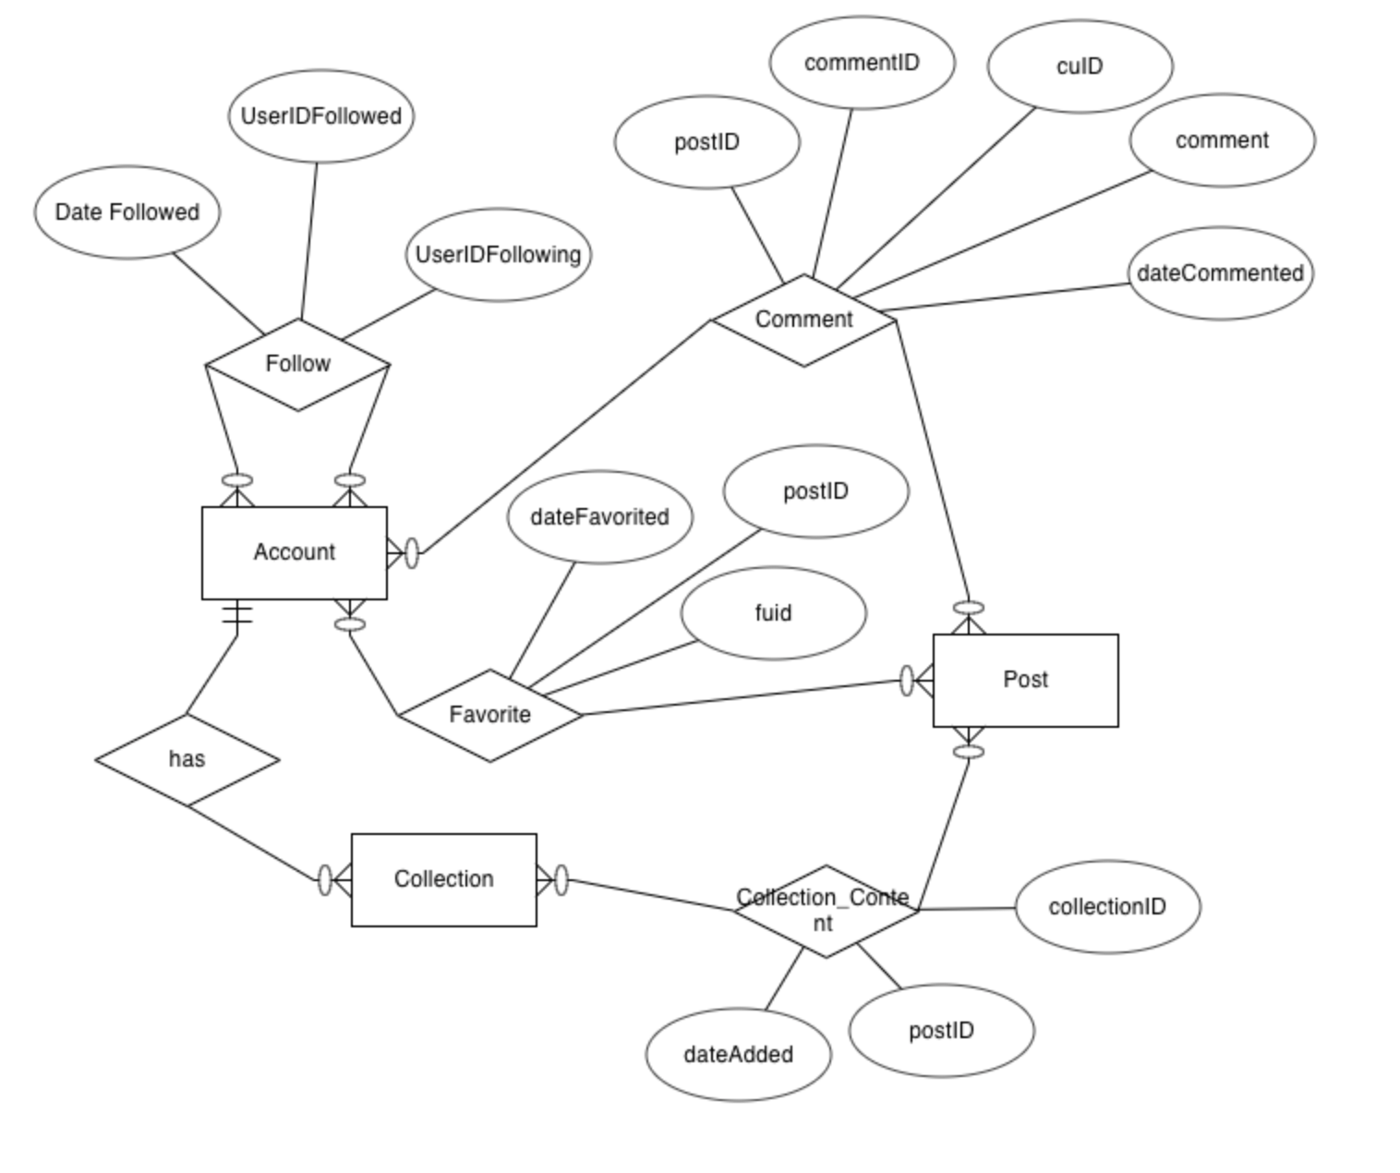
Back End
Notes:
Old UML diagram
call in adam

Slide 10
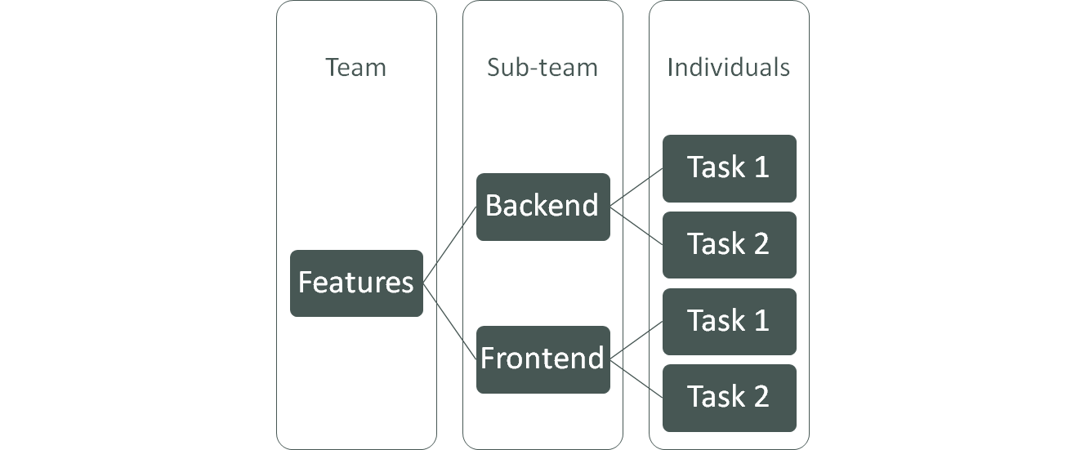


Sprints
Notes:
There are series of features that we came agree on during earlier Milestones. After meetings, we would come to agreements on feature priorities to decide which features we would want to implement first, and proceed with sprints.
For each features, they are separated into backend and frontend work. Within the sub-teams, there also needs to have an agreements so that we don’t overwrite or waste time on works that sub-teammates might have been doing. (Sprint backlogs are tasks)
The diagram goes both ways, individuals complete their tasks, gets combined, which would be work created by sub-team. These sub-teams would need to later work together to connect each other works. This makes a working feature and can be considered done.
Our definition of ‘done’ is a feature that is working, with acceptable amount of glitches or bugs that don’t post much of an issue yet.

Slide 11
UX Design Process
Wireframing
Re-evaluate
Implementation
User interface layout
Colorless
Functional
Easy access
Obvious and findable
Accessible
Useful
Gather opinions, suggestions, criticism
Improvement
Choosing frameworks
Implementing design, referencing UI wireframe
Attention to minor details that may not seem important
Notes:
Wireframe:
Gather information and resources for planning
repeating process due to new ideas, constraints and constant improvement

Slide 12
Demo

Slide 13
Team Spirit
Talked about food, interests, and what’s going on in our lives before starting meeting
Tried to keep meetings short and to the point so everyone knows what they are doing/need to do
Allowed open communication, let conversation flow where it naturally does, even if we get off topic sometimes
Encourage each other, keep a positive attitude

Slide 14
Difficulties and Challenges
Big application
Learning curve regarding technologies
Lack of in-person contact/time-zone issues
Overcommitment of functional features
Difficulties in deploying app to web
Asynchronous nature of React
Notes:
Include big database, files and folder structures

Slide 15
Lessons Learned
Don’t be overambitious in what we can accomplish
Spend extra time understanding frameworks being deployed
Improve pacing and organization from week-to-week tasks
Leave extra time to deal with merge conflicts and Github related errors

Slide 16


Thank you

