Slide 1
DISPOSITIVOS (REFERENCIAS Y PRECIOS)

Slide 2
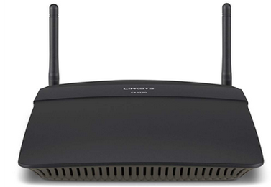
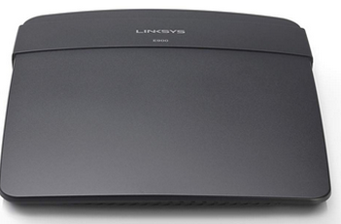
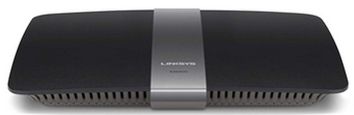
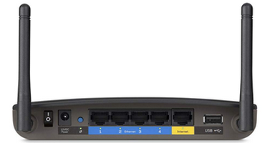


ROUTERS - LINKSYS
LINKSYS EA6500 AC1750 DUAL-BAND SMART WI-FI WIRELESS ROUTER ($240.000)
N300-E900 ($70.000) N600 DUAL-BAND
SMART WI-FI EA2750 ($260.000)

Slide 3
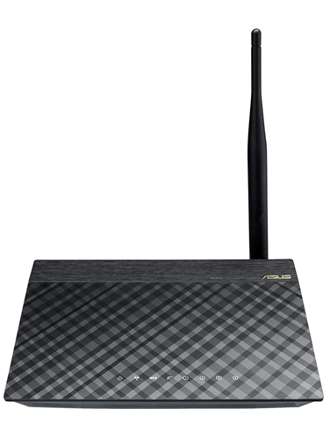
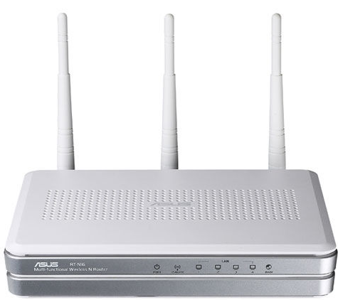
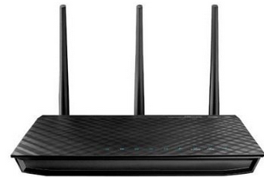
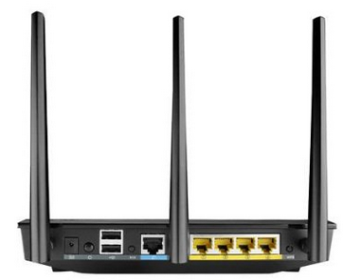
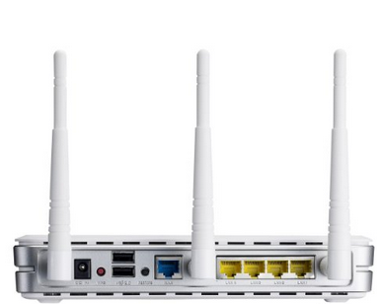
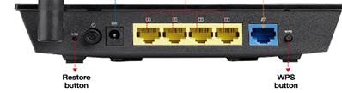
ROUTERS - ASUS
RT-N10 P ($ 95.000) N300 RT-N16 ($215.000) N900 RT-N66U ($330.000)

Slide 4
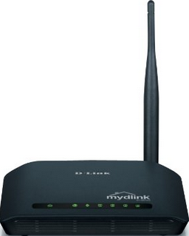
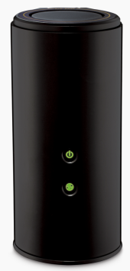
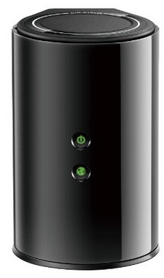
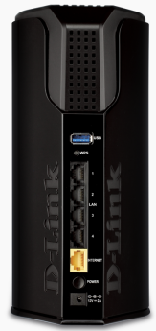
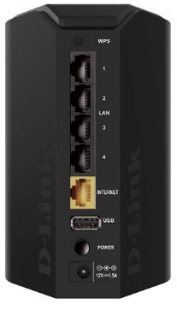

ROUTERS - D-LINK
N150 ($50.000) AC1750 DUAL BAND
GIGABIT-CLOUD ($485.000)
AC750 Dual Band Gigabit Cloud ($155.000)

Slide 5
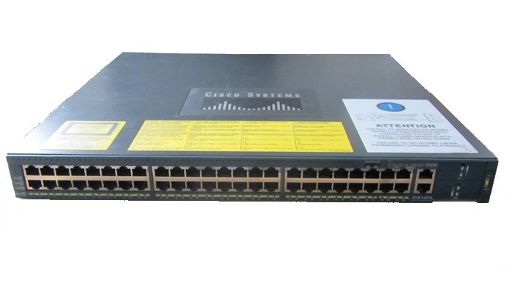
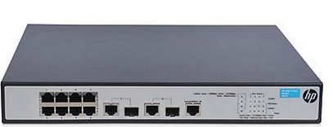
SWITCHES – CAPA 3
HP JG537A 8 PORTS ($785.000)
CISCO CATALYST 48-PORT ($925.000)

