Slide 1
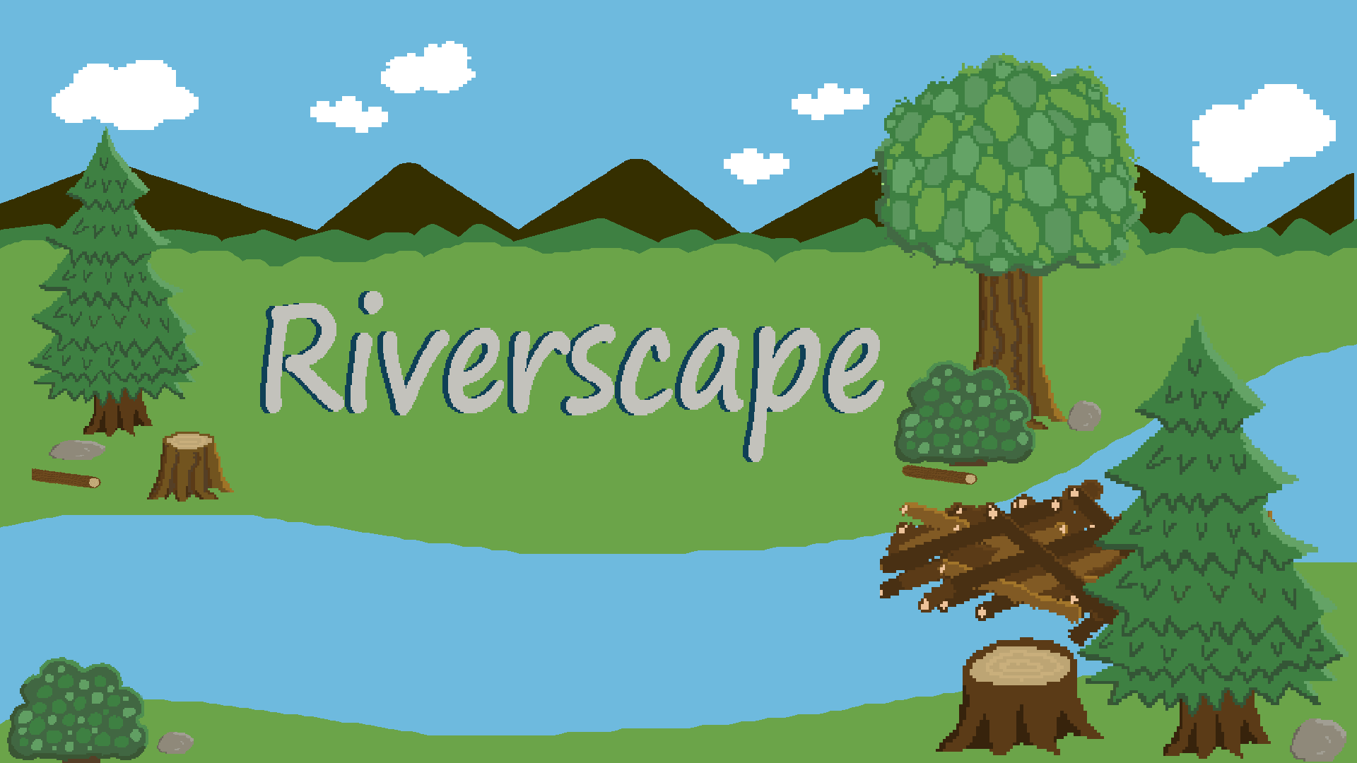
Source Code: https://github.com/natalieswork/Riverscape
Midterm Documents: https://github.com/natalieswork/SeniorProjectDocuments
Notes:
8-minute presentation and a 4-min project demo

Slide 2
Riverscape:
Midterm Project Report
March 28th, 2024
CAN Game Studio
Carrie Wasieloski cgw2@hood.edu
Austin Counterman
ac31@hood.edu
Natalie Lee
nml3@hood.edu
Notes:
We at Can game studios are proud to present the midterm report and what we've done so far in this project. If you have any questions please raise your hand or you can save them for the end of the presentation.

Slide 3
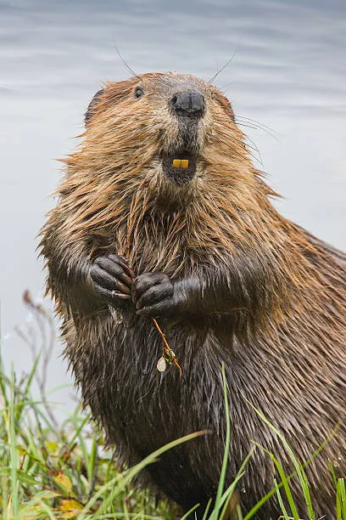
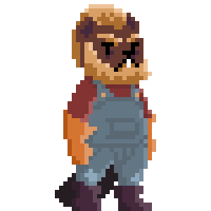
The Project
Riverscape Game
Objectives
Pleasing Design
Gameplay
Intuitive Mechanics
Combat System
The Problem
Fun Game
Cool Species
Beaver (genus Castor)
Image Source: https://www.gettyimages.com/photos/north-american-beaver
Notes:
Riverscape is a videogame that will address the importance of the North American beaver by demonstrating their expansive role in an ecosystem. Playing as a beaver, the user will harvest logs, and bring them to a dam location to build up the dam. They also will face predators and story elements along the way. This process will improve the health of the game environment. Users will see the forest come to life as the game progresses.
The chosen art style is pixel art. An example of this is Castor who is pictured on right.
This game follows a continuous gameplay loop, instead of a level based game. This is concluded when the beaver structures have been upgraded completely.
Aesthetically and audibly pleasing game design
interesting and fluid gameplay.
Intuitive mechanics of game assets including a main playable character, friendly and adversarial NPCs, and UI elements.
A dynamic world map that reflects environmental health.
Implementation of a combat system.
The main problem that we wanted to solve is that we wanted to make a fun game that
Would show off an unterapricated really cool species. The beaver.

Slide 4
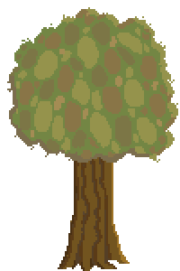
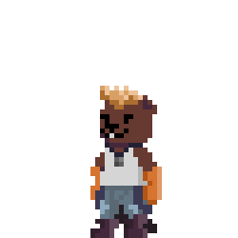

Background & Project Plan
Why?
Prior Examples:
Timberborn: City planner and micromanaging
Bingo Beaver: Bingo game
Beaver Clicker: Auto clicker game
Our Plan
Notes:
Why create the game?
Beavers are facing a serious problem that needs to be known.
Have any games attempted to tackle this topic?
Yes, but they have their issues
Examples:
Timberborn: City planner and micromanaging
Bingo Beaver: Bingo game
Beaver Clicker: Auto clicker game
Our plan:
Create a fun relaxed experience while also teaching about the importance of beavers.

Slide 5
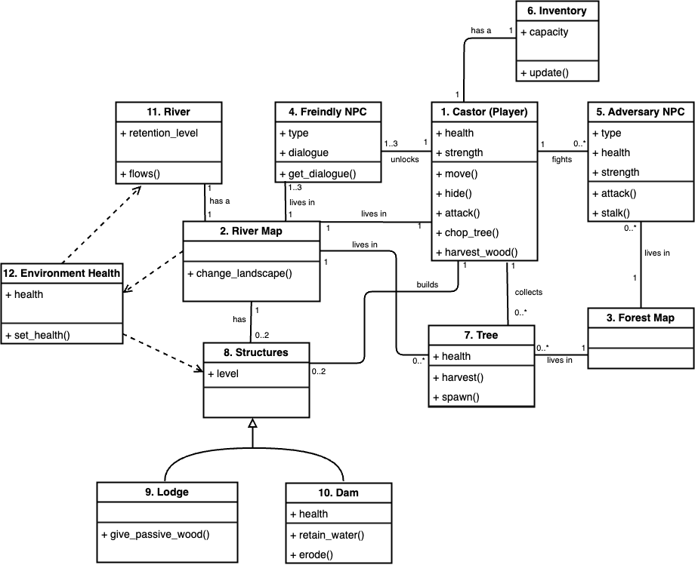
Technical Description

Slide 6
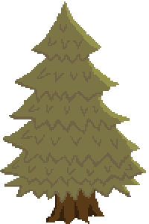
Accomplished Work
Features
Size:
5 Classes (300 Lines of Code)
62 Art Files
8 Audio Files

Slide 7

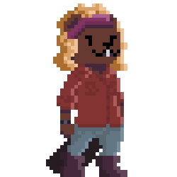
Status - Characters

Slide 8


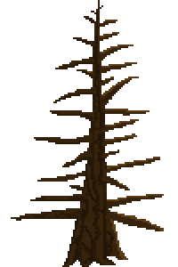
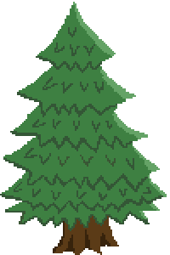
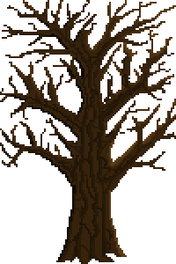
Status - Landscape
Notes:
The landscape is virtually finished just need to do tweaks. Music is finished and just needs implementation

Slide 9
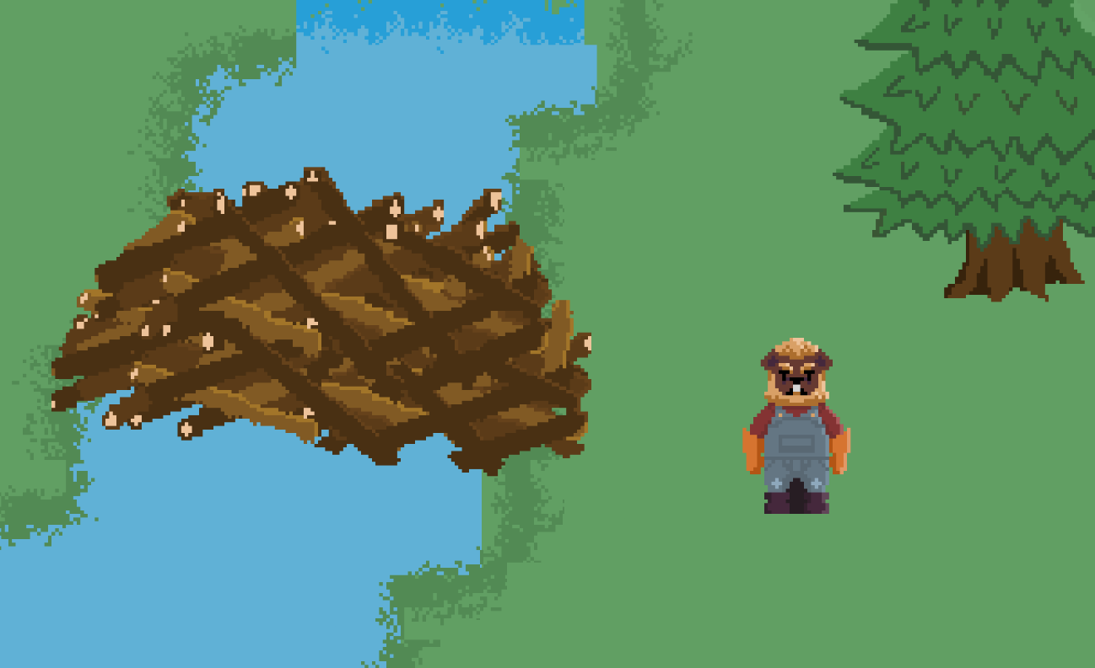
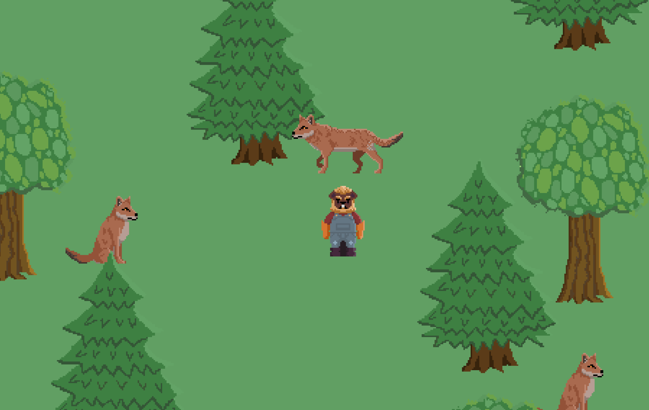
Status - Game Screenshots

Slide 10
Effort
 | Austin | Carrie | Natalie
Roles | Sprite and Animation Lead | Sound & Environmental Expert | Lead Developer
Development | 57 | 45 | 20
Reports/ Documentation | 20 | 25 | 42
Research/ Planning | 5 | 5 | 10
Total Hours: | 82 | 75 | 72
Group hours | 15
Notes:
We chose an Agile SCRUM based software development methodology. Where our team had weekly sprints up to this point where we answered to our SCRUM master. In these meetings we had every friday we discussed the prior objectives for each person and assigned new objectives for the upcoming week. In this process we had really strong communication and were really up to date with each other.

Slide 11
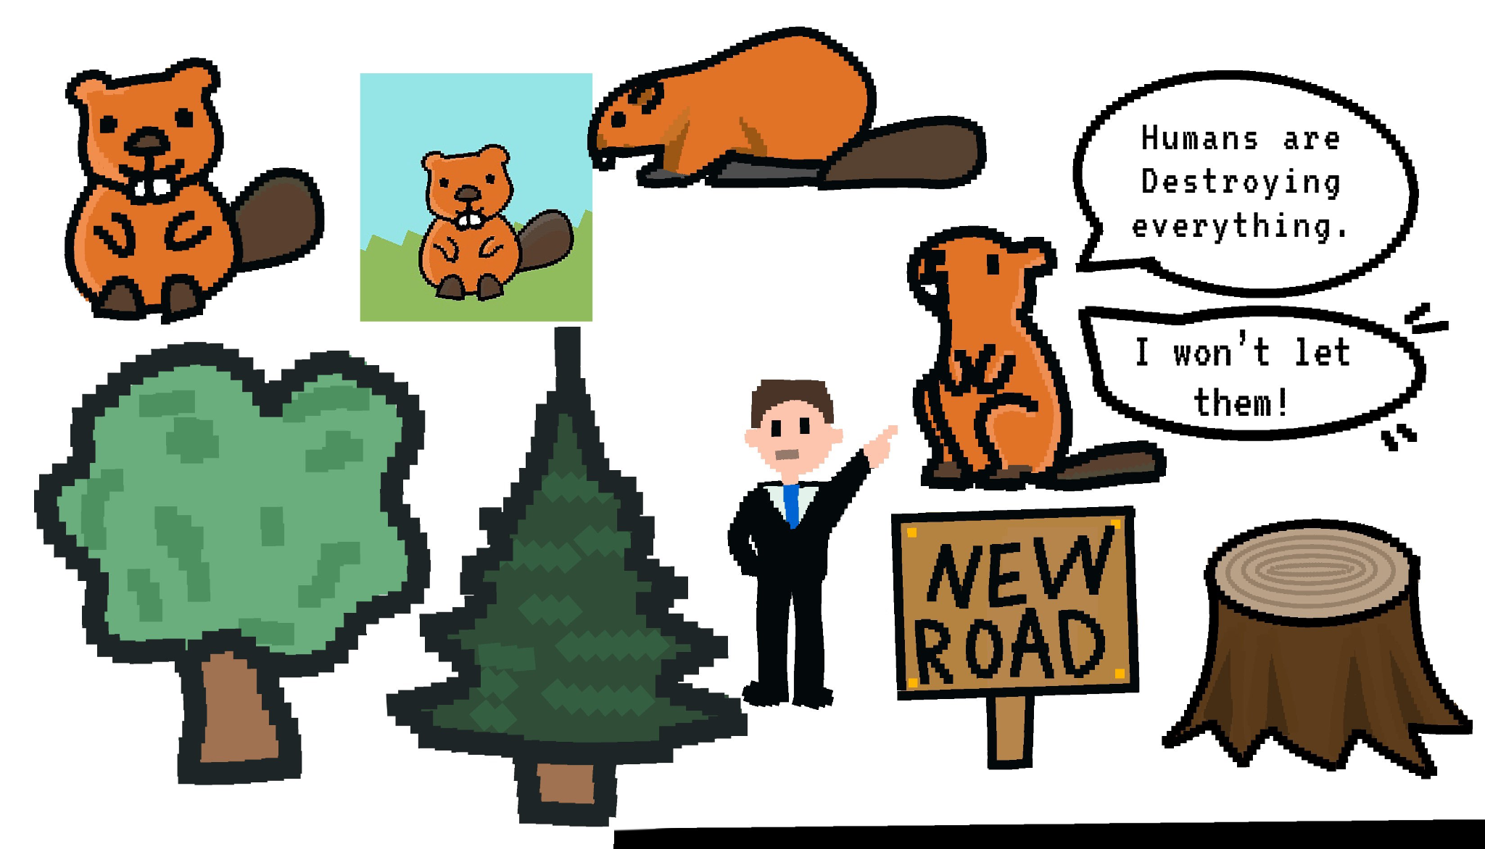
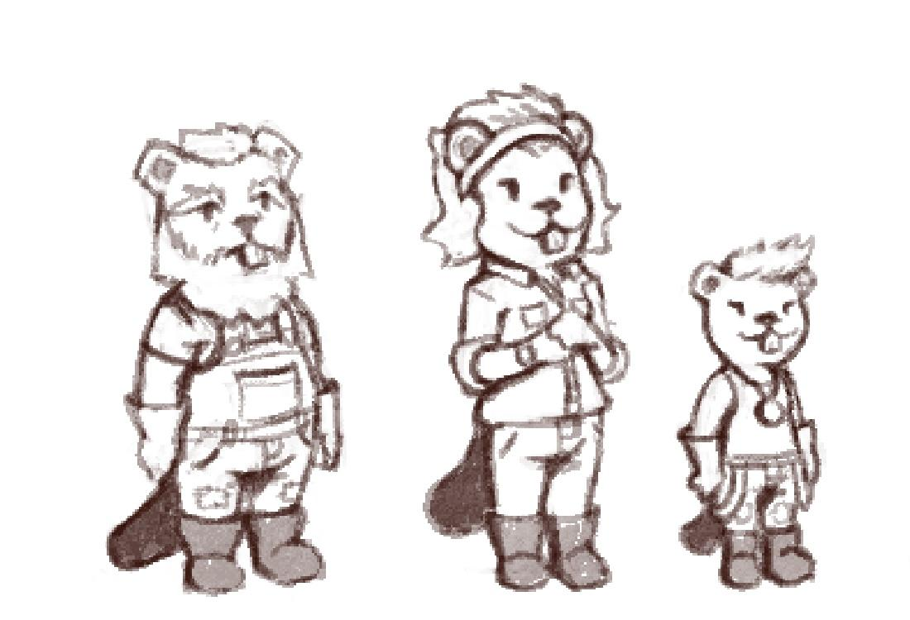
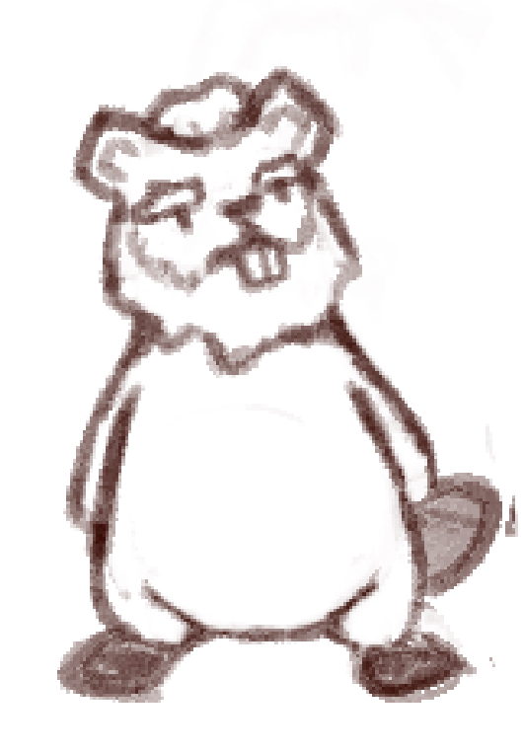
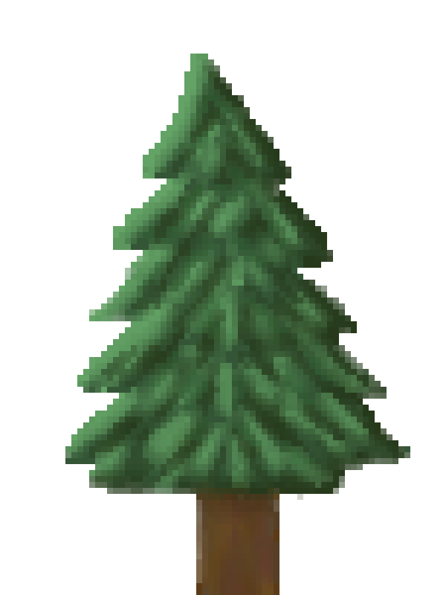
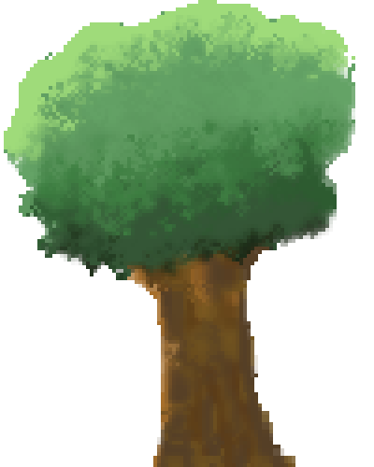
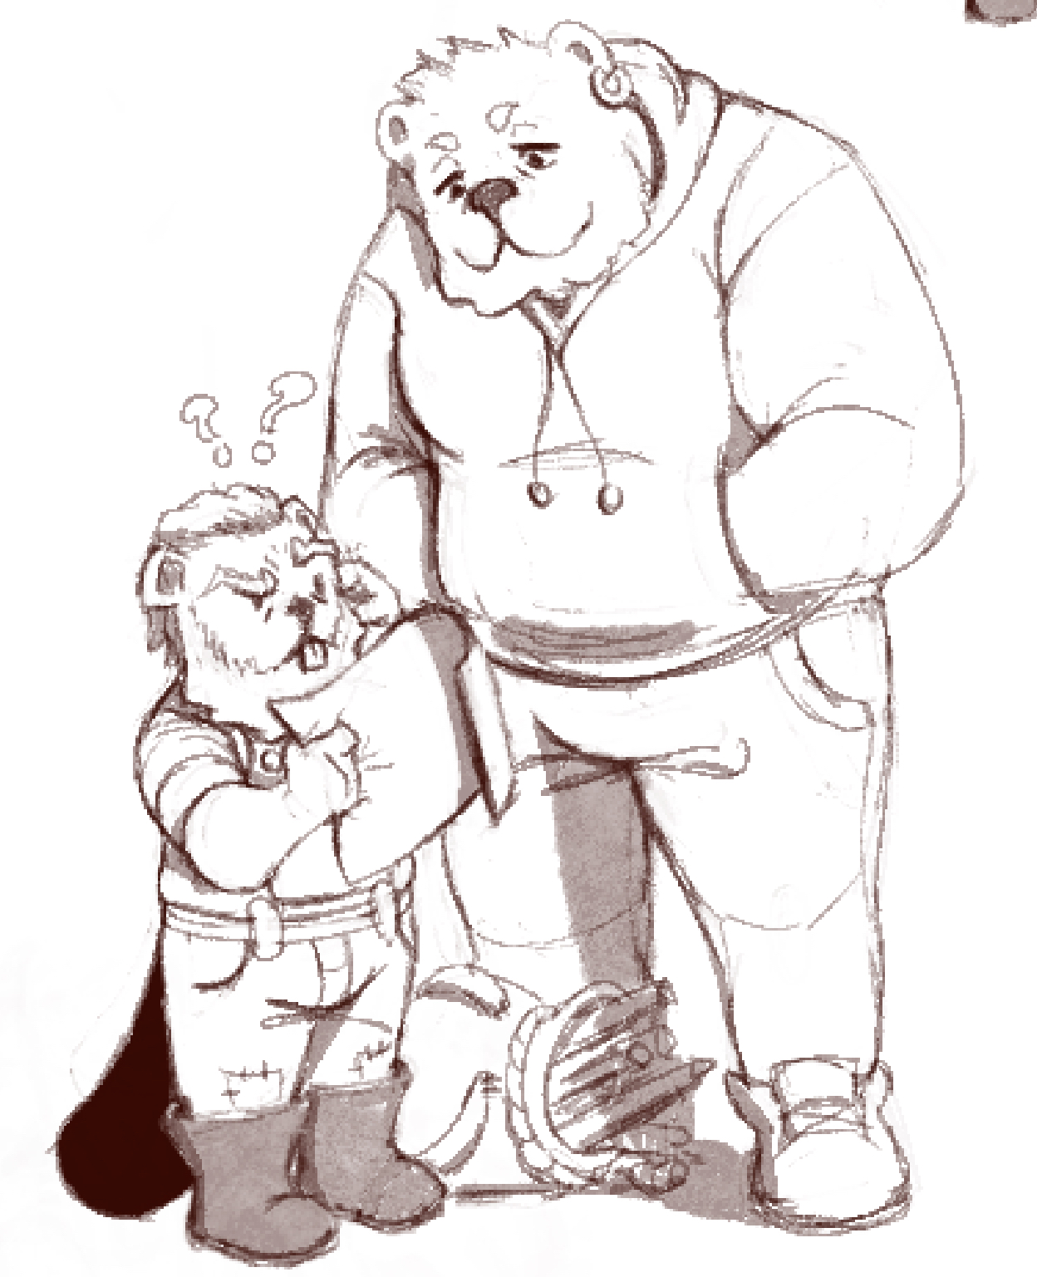
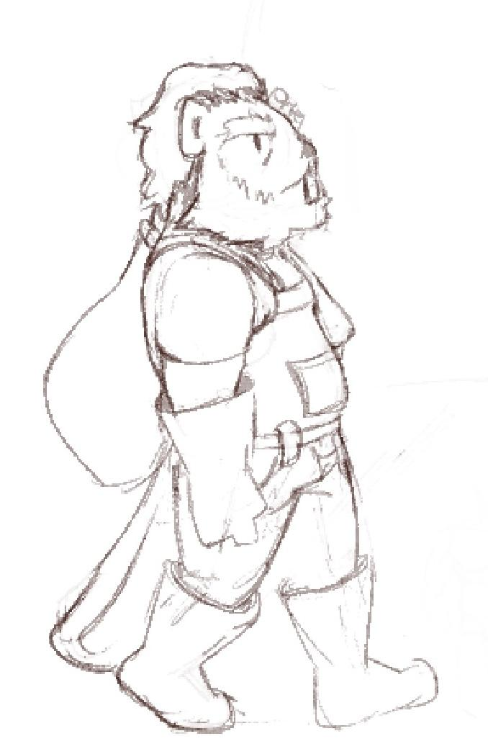
Lessons Learned
Notes:
Overall we have learned a lot of lessons
Especially about
Animation & Pixel art: how a single pixel can change the whole feel of the character, Also how pixelart as well as animation is a lot different then other art.
Game engine: how to use them and create games on them.
Game development as a whole, and how games are very much a iterative process,
This process has been super iterative, what we started with is not how it ended up as seen in the preliminary art above. This game has evolved a lot. our the vision has been refined over the course of the last few months.

Slide 12
Future Work
Future Work | Process to Accomplish | Finish Date
Dam/Lodge Upgrades | Wood allocation system | 4/5/24
Dynamic Landscape | Change map based on stats | 4/12/24
GUI Aides | Make title screen, in-game menu | 4/19/24
Multiple Saves | Implement data structure to hold game state information | 4/19/24
In Game Clock | Time system using Godot Timer | 4/26/24
Tutorial Aides | Static images, NPC advice dialogue | 4/19/24
Visual Polishing | Map and animation reworks | 4/26/24
Music/Sound Effects | Godot Audio Streams | 4/30/24

Slide 13
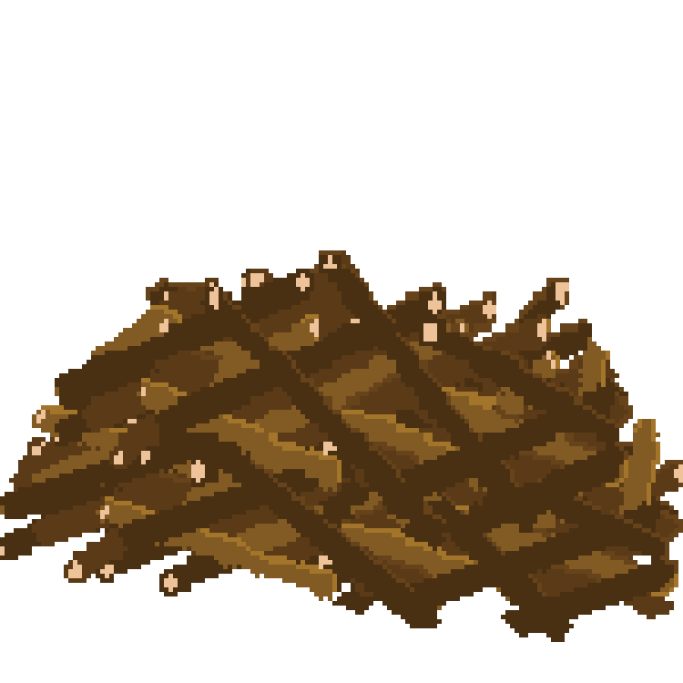
Demo
Source Code: https://github.com/natalieswork/Riverscape
Documents: https://github.com/natalieswork/SeniorProjectDocuments
Emergency Video: https://youtu.be/qOb5_b7INCQ

