Slide 1
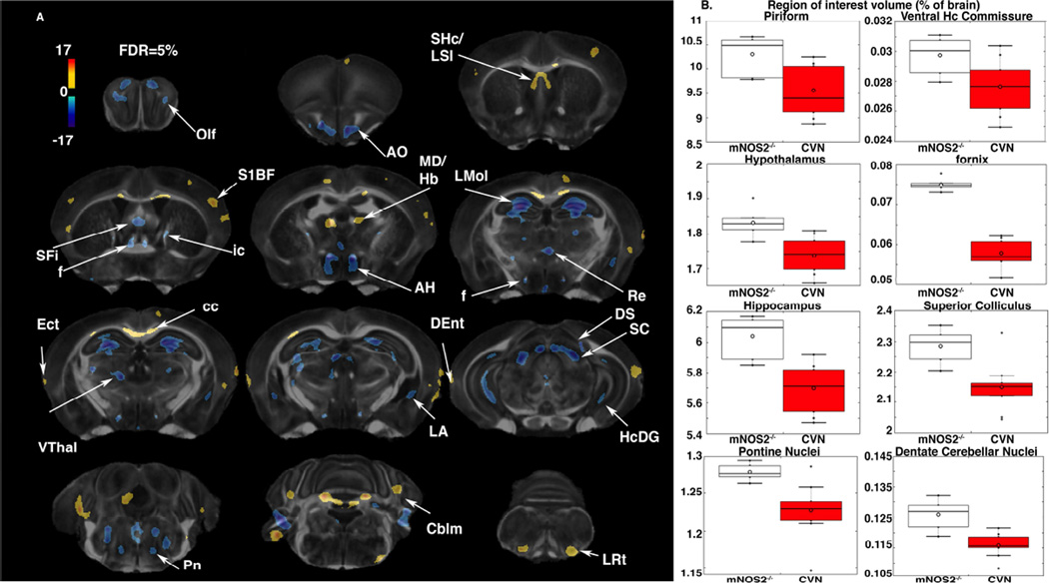
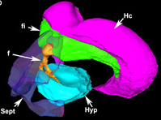
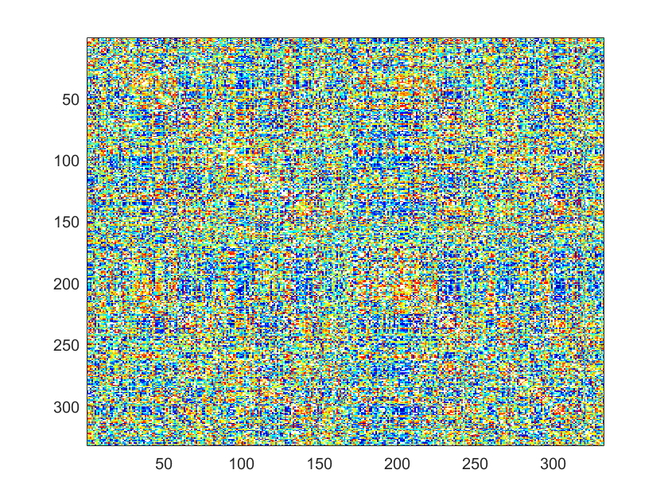
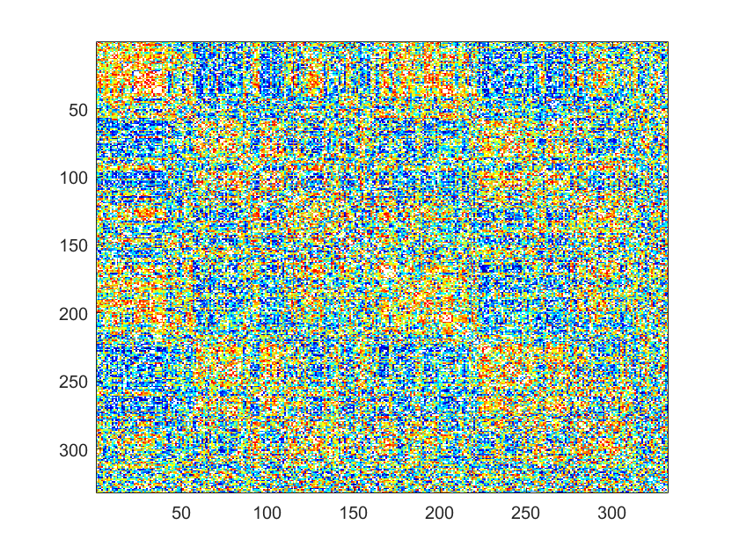
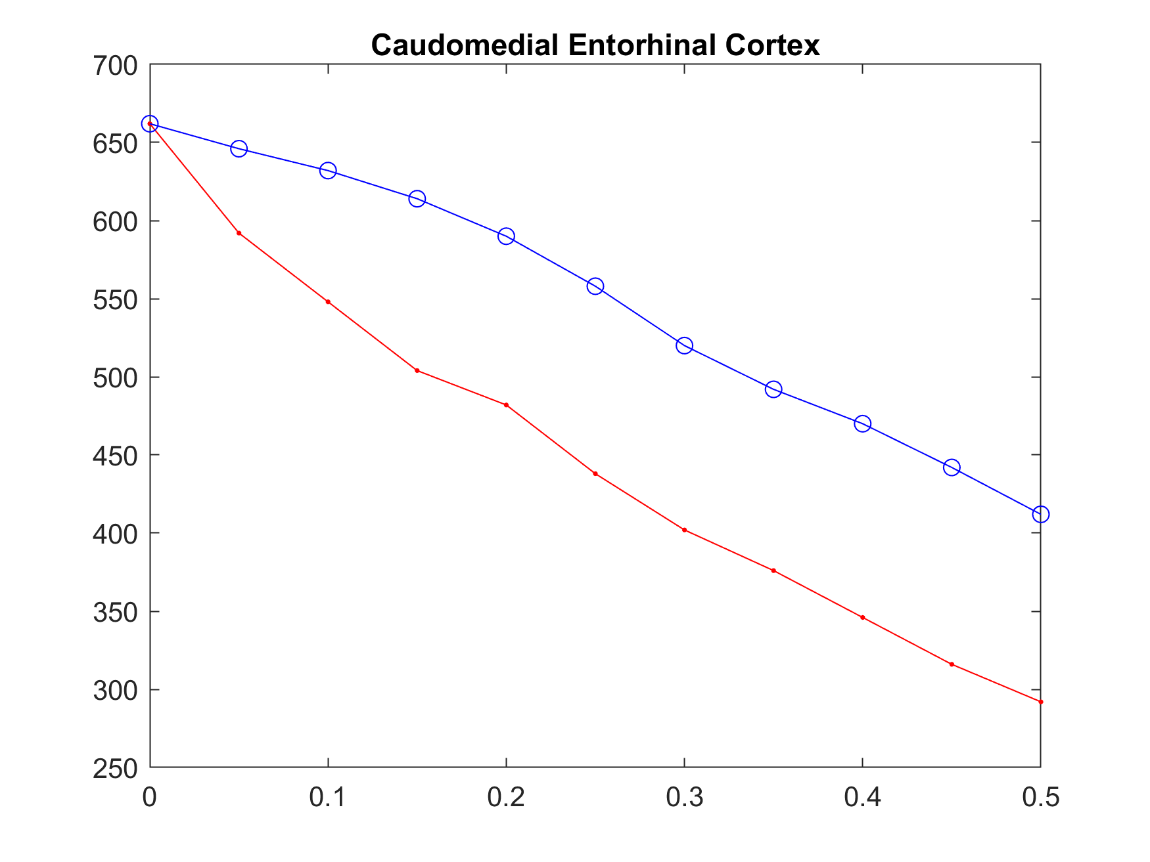
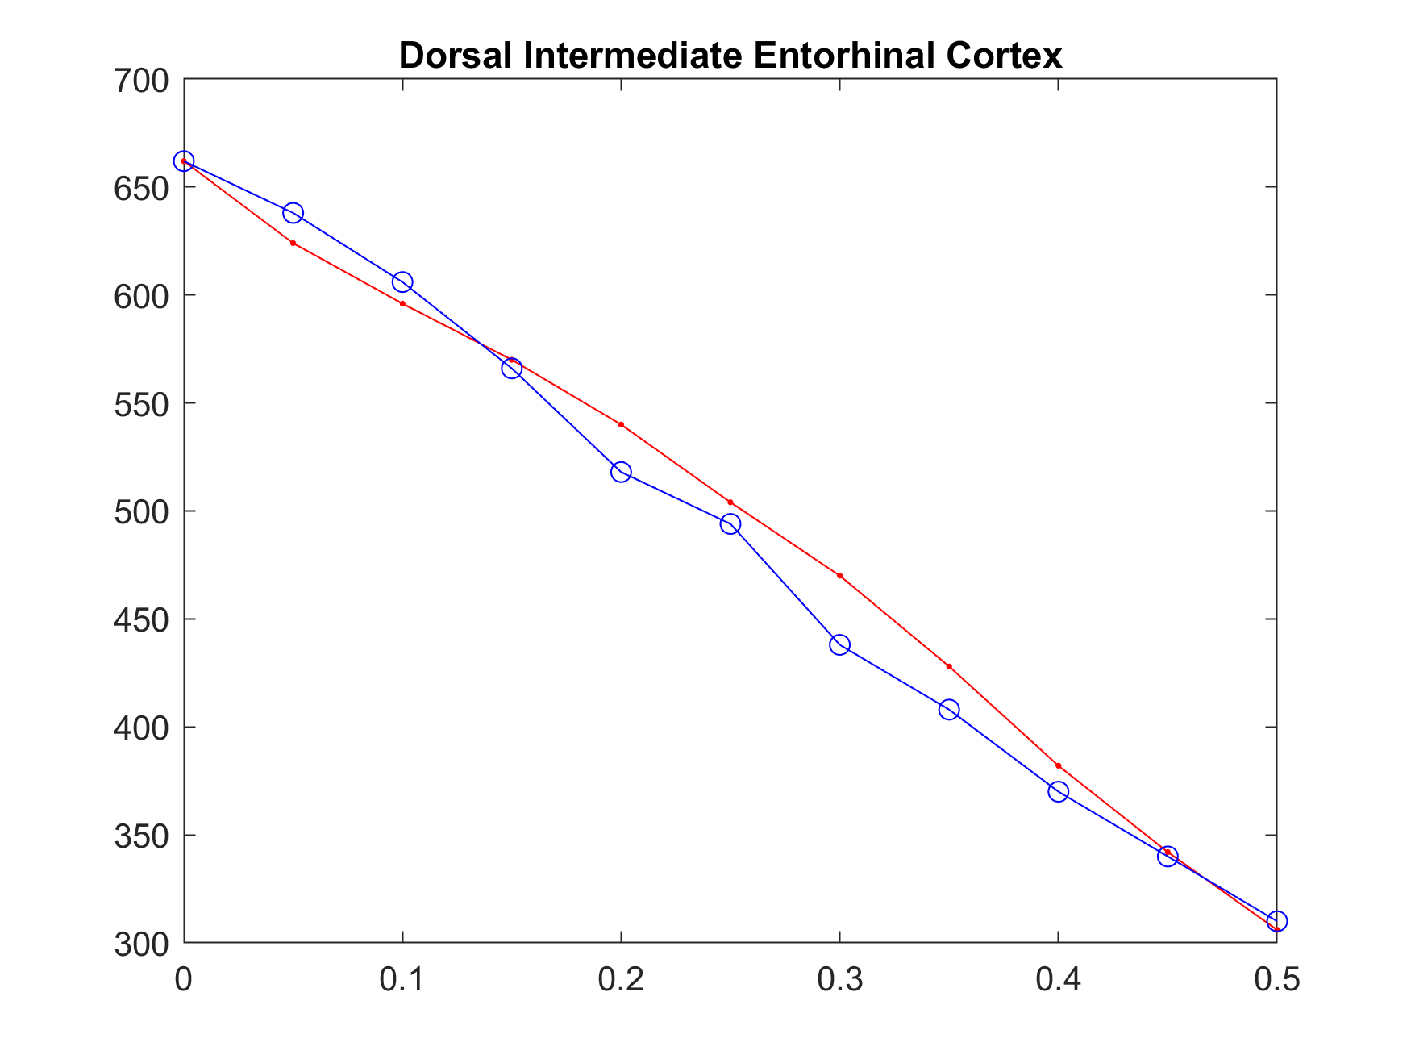
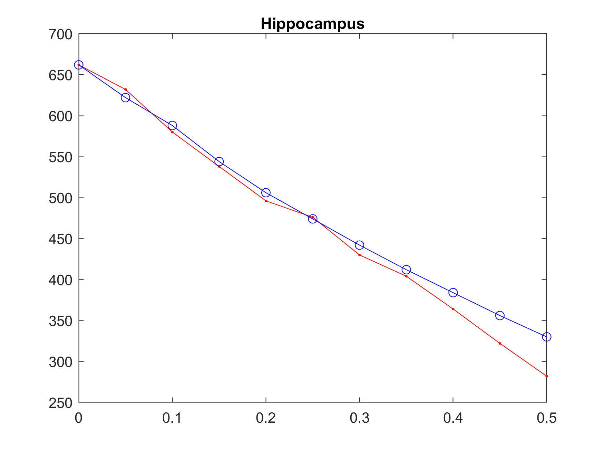
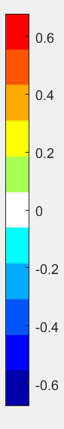
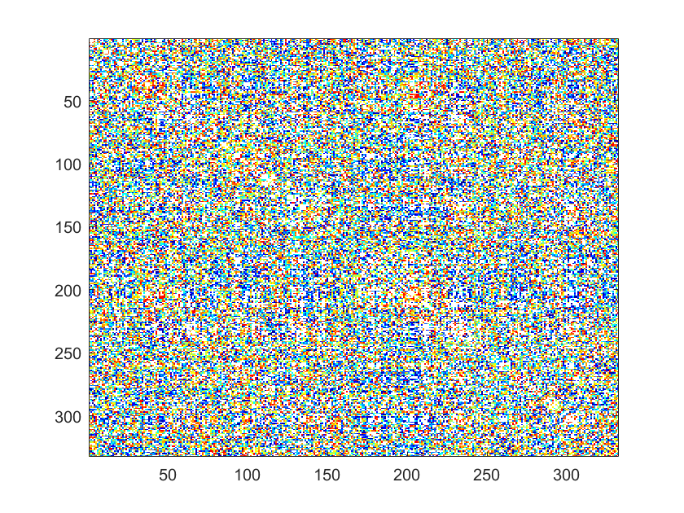
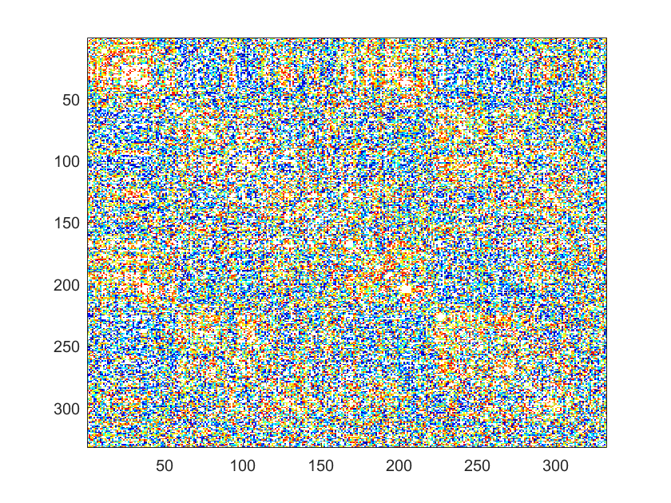
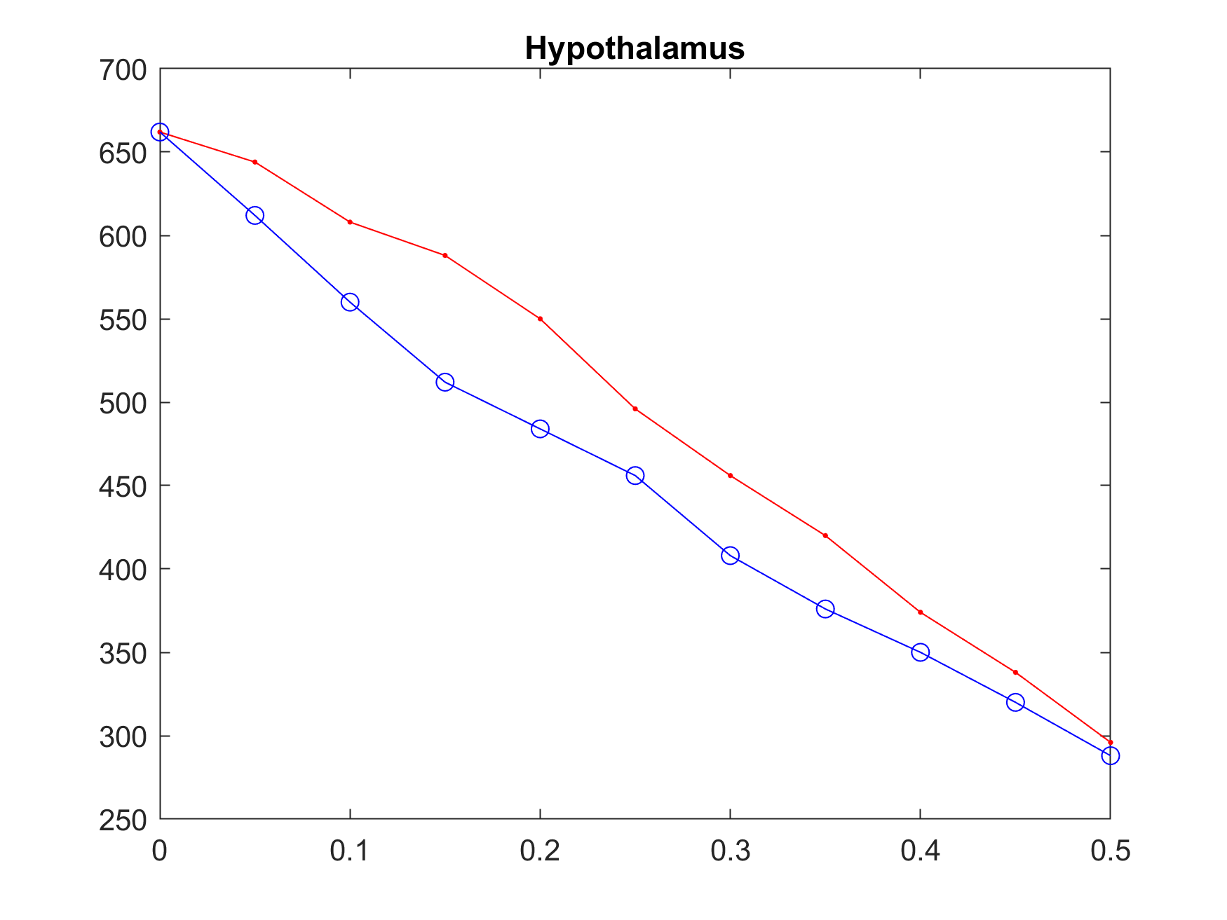
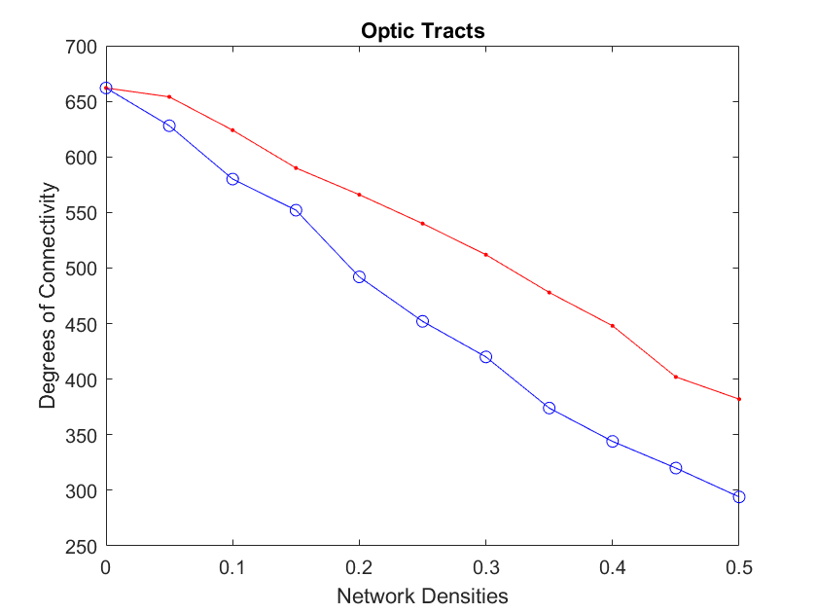
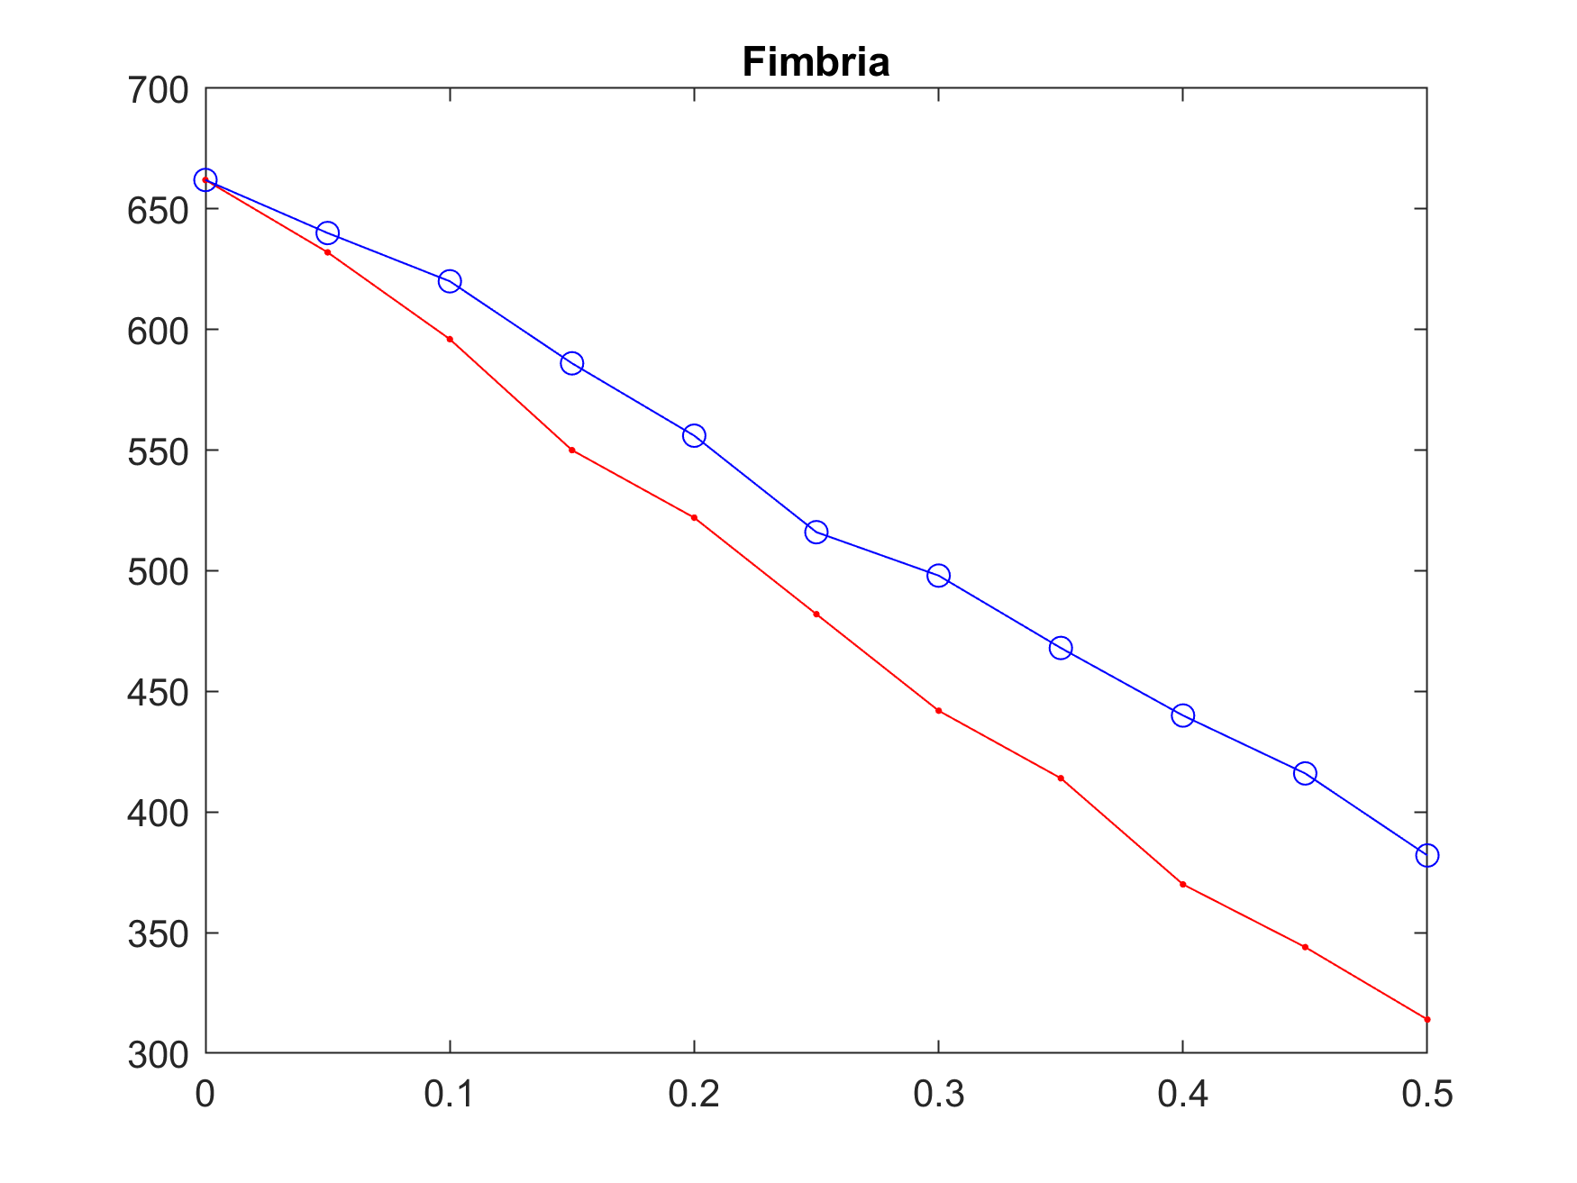
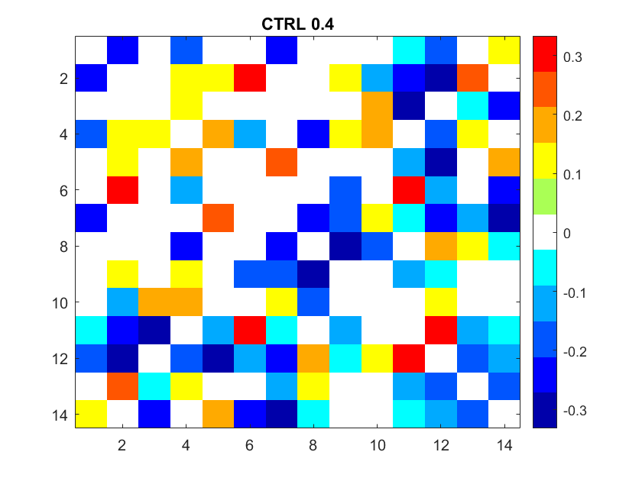
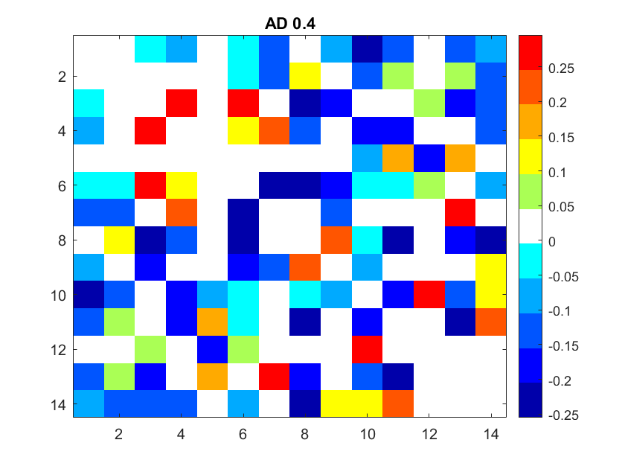
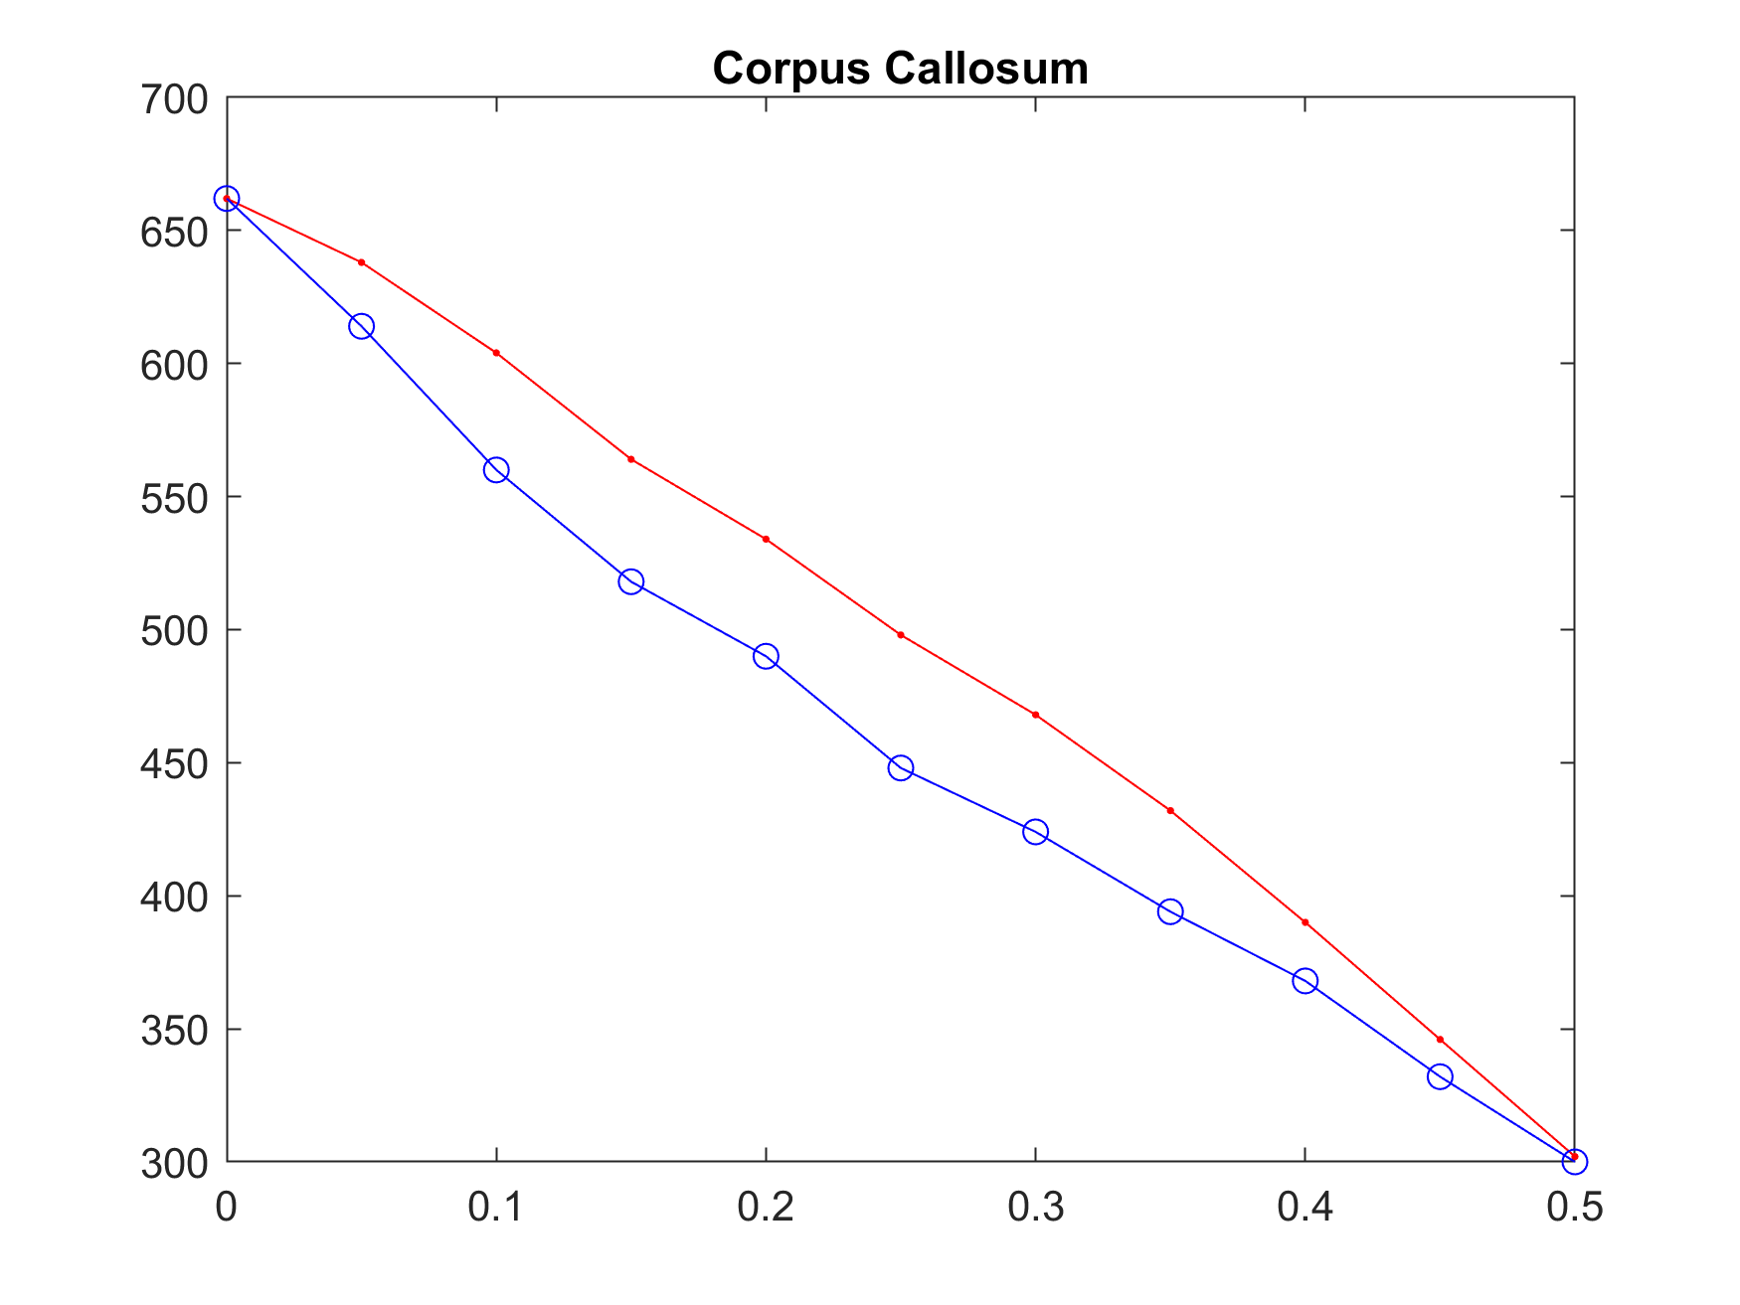
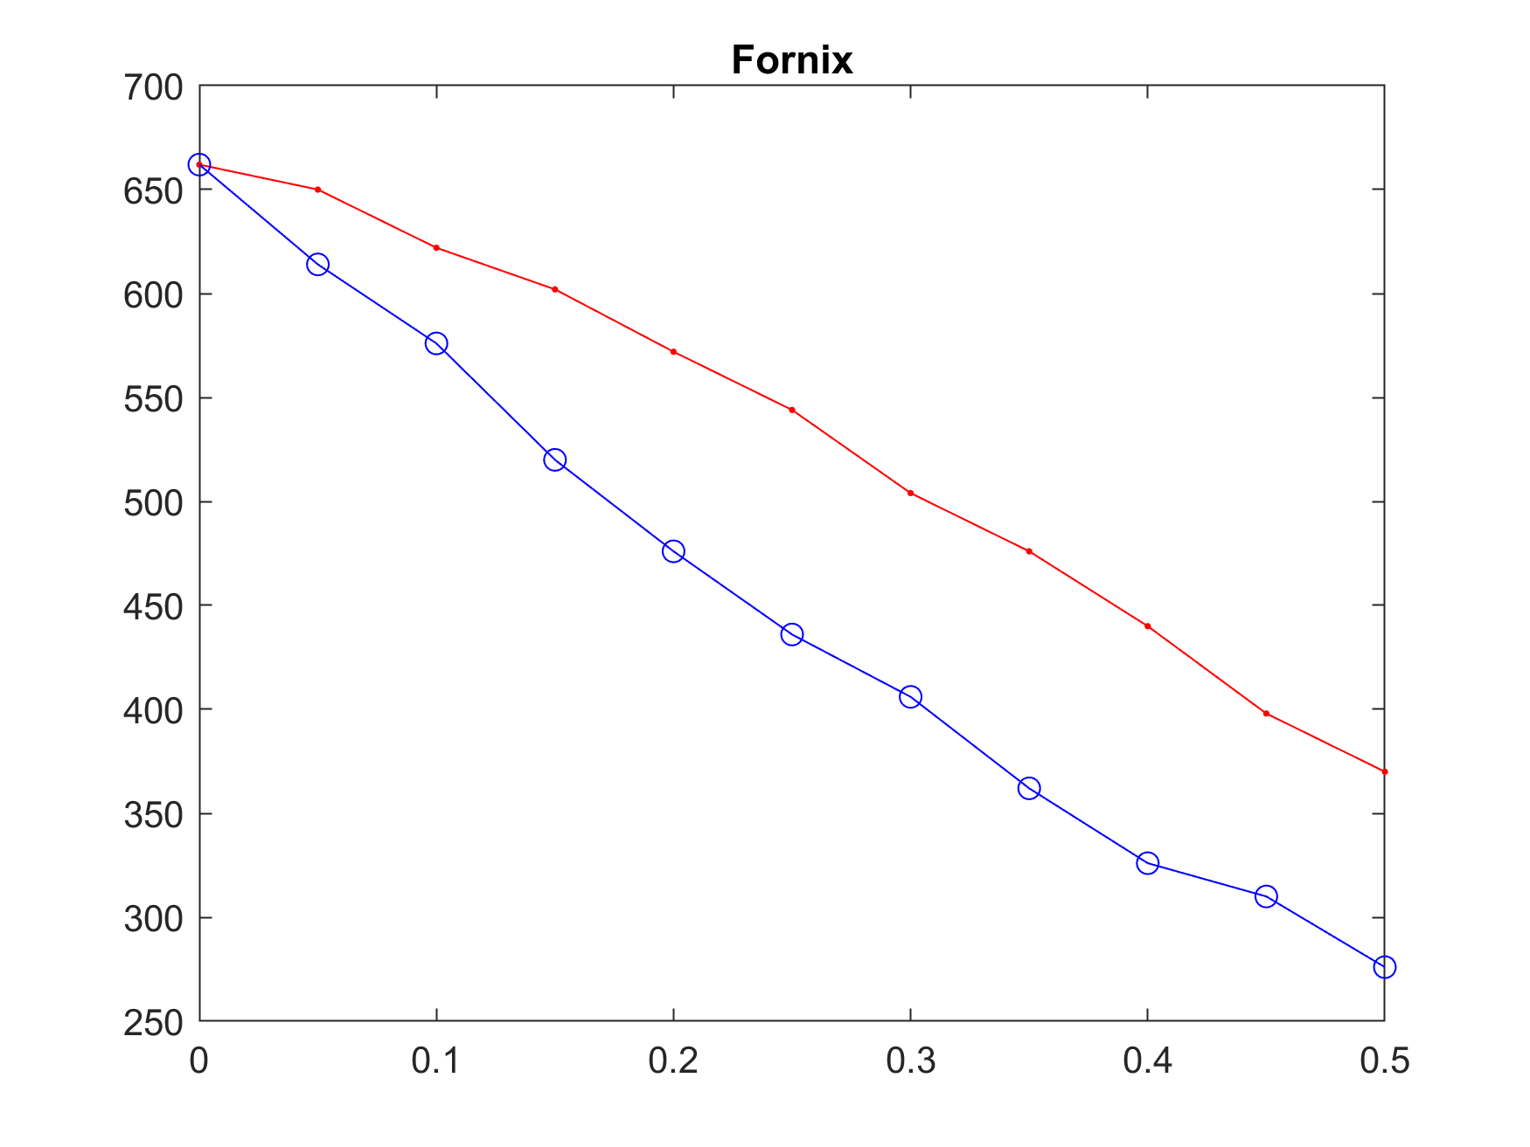
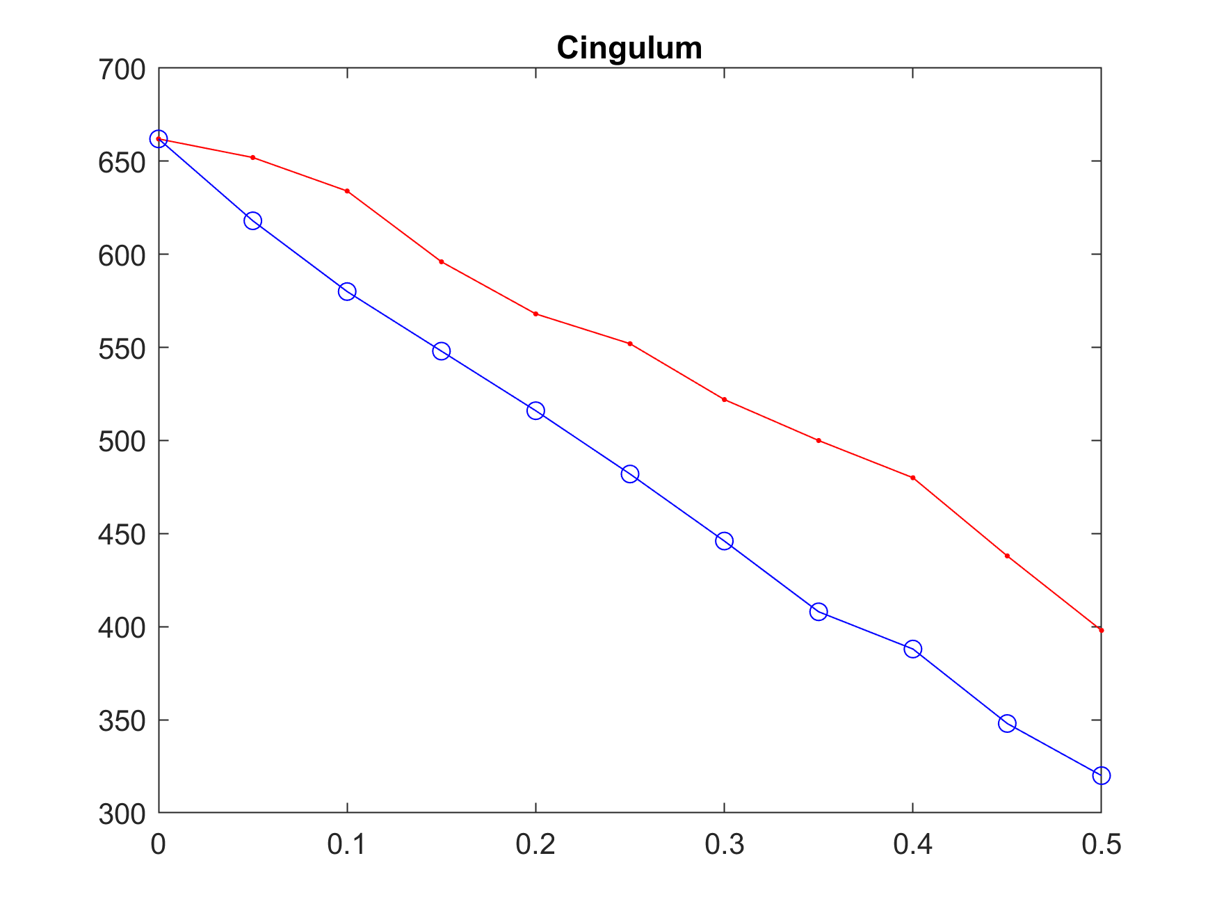
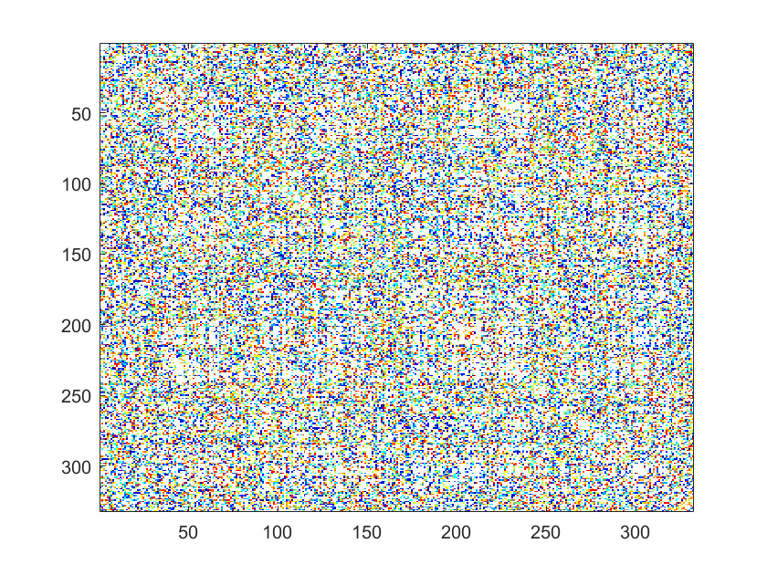
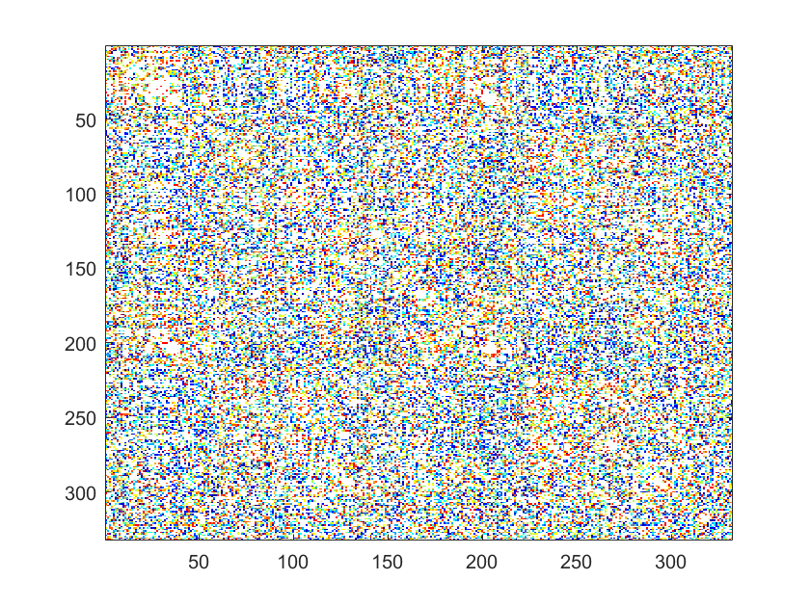

Structural Connectomes as Biomarkers for Alzheimer’s Disease
INTRODUCTION
Wilkinson Natalie, Badea Alexandra
It has been proposed that AD can be viewed from the perspective of a connectopathy. Here we examine if such an effect would translate in alterations of the structural volume covariance amongst brain regions using a mouse model of familial AD.
RESULTS
A quantitative analysis at the global level found no significant difference between the whole set of regions using structural covariance analysis with a resultant p-value of 0.2756.
A quantitative analysis at the regional level found that amongst our 19 regions of interest the fimbria showed the larges difference, while the hippocampus difference was in a quantitatively lower range.
METHODS
Fixed brain specimens were scanned on a 9.4 T, 8.9 cm vertical bore Oxford magnet with shielded coil.
We segmented the brains using an automated pipeline (2) to provide 332 regional volumes, and we selected 14 regions of interest in Alzheimer’s disease.
Among these 14 regions of interest are: Caudomedial Entorhinal Cortex, Dorsal Intermediate Entorhinal Cortex, Hippocampus, Hypothalamus, Septum, Amygdala, Superior Colliculus, Cerebellum, Dentate Nucleus of the Cerebellum, Optic Tracts, Fimbria, Corpus Callosum, Fornix, and Cingulum.
We computed Pearson correlations among each pair of regions, to construct structural covariance connectomes. We compared structural covariance connectomes after binarizing those at a range of networks densities between 5-50% of connections, using 1000 permutations.
Figure 2. The regions we selected are related to a circuit connecting the hippocampus, septum, hypothalamus.
Figure 1. We were guided by previous studies in determinations of the specific regions to analyze for connectivity/structural covariance.
DISCUSSION
These results implicate multiple regions (Caudomedial Entorhinal Cortex, Fimbria, Fornix, Cingulum, etc.) as critical regions to analyze connectivity and structural covariance.
It was determined that analysis of the implicated regions yielded the most significant results at a network density of 0.4.
Figure 3 shows a tighter covariance in the CVN-AD mice relative to control mice
Figure 4 shows the most significant differences at 40% network density
Figure 5 shows a tighter correlation between the hippocampus and entorhinal cortex in CVN-AD relative to controls but loss of covariance between white matter tracts.
mNos2 ^{-/-} controls
CVN-AD:
Chosen k=0.40
0.05
P=0.0129
P=0.000021192
P=0.0530
0.25
P=0.0467
P=0.00015272
P=0.000012919
0.50
CONCLUSION
Caudomedial Entorhinal Cortex
Dorsal Intermediate Entorhinal Cortex
Hippocampus
Hypothalamus
Septum
Amygdala
Superior Colliculus
8. Cerebellum
9. Dentate Cerebellum
10. Optic Tracts
11. Fimbria
12. Corpus Callosum
13. Fornix
14. Cingulum
P=0.00080548
P=0.0110
P=0.0615
We showed alterations of the structural covariance in mouse models of Alzheimer’s disease, and the effect of thresholding the networks at different densities.
Future studies will incorporate more network properties, such as the clustering coefficient, and network efficiency, and more animals.
Figure 3. Qualitatively CVN-AD mice indicate structural covariance differences relative to age matched mNos2-/- controls, but differences were not significant for the full network.
Figure 4. Regions involved in AD show different connectivity as derived from structural covariance, and differences were larges at 40% of the network density.
Figure 5. Subgraph for the fourteen regions of interest.
REFERENCES
1. Badea A, Kane L, Anderson RJ, Qi Y, Foster M, Cofer GP, et al. The fornix provides multiple biomarkers to characterize circuit disruption in a mouse model of Alzheimer's disease. Neuroimage. 2016;142:498-511.
2. Anderson RJ, Cook JJ, Delpratt NA, Nouls JC, Gu B, McNamara JO, et al. Small Animal Multivariate Brain Analysis (SAMBA): A High Throughput Pipeline with a Validation Framework. eprint arXiv:170910483. 2017:arXiv:1709.10483.

