Slide 1
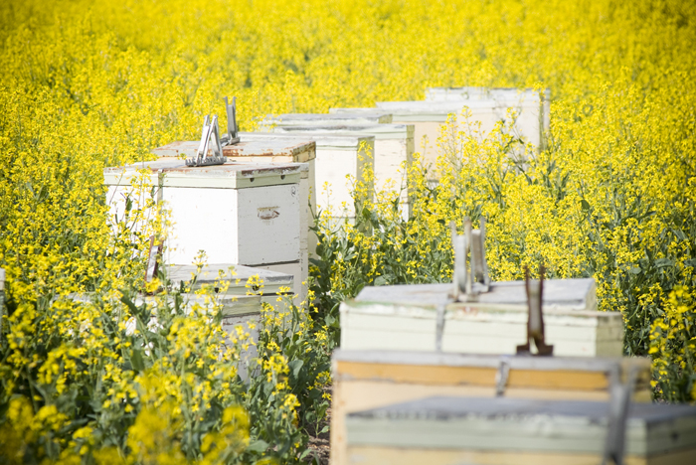
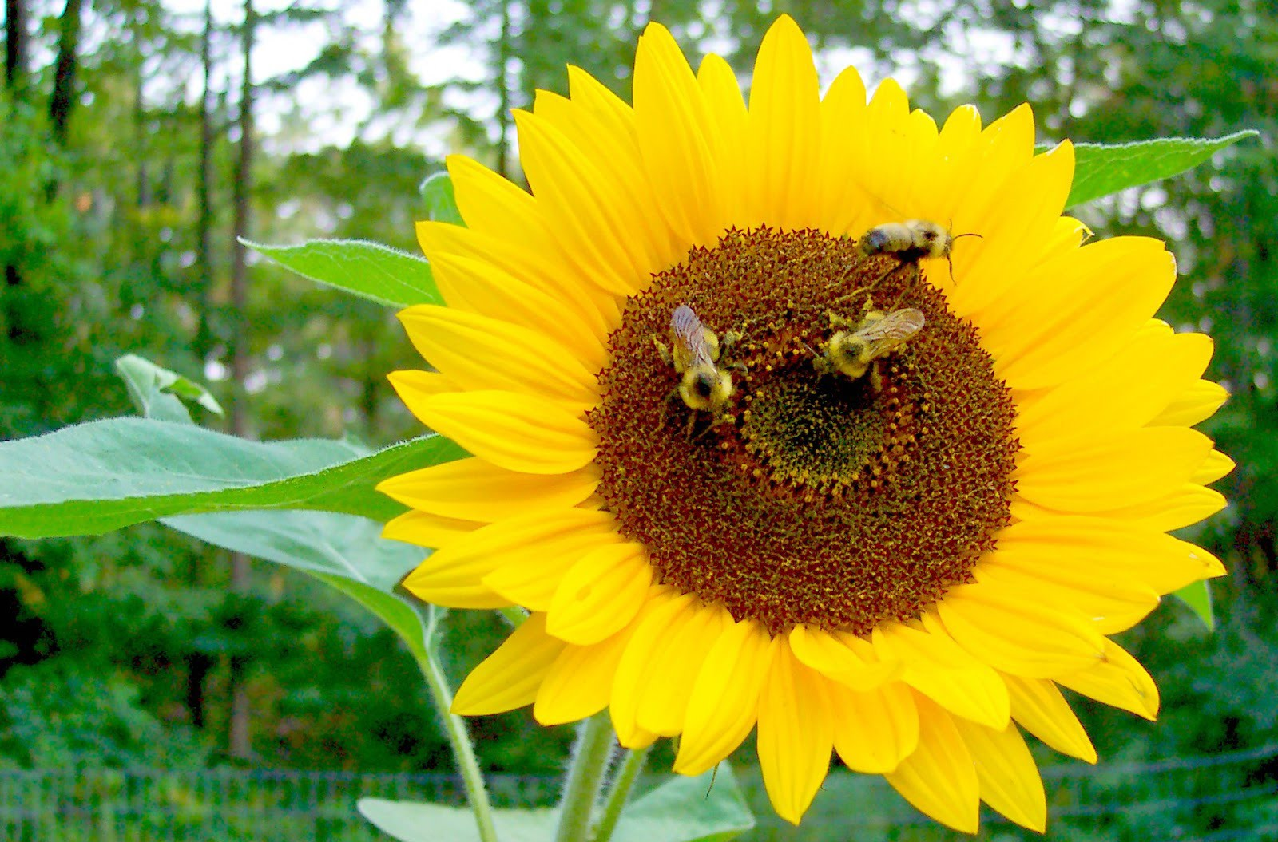
Pollination in agricultural systems
Guess lecturer: Natalie Kerr (Tufts, Phd Student)

