Slide 1
Apache OpenWhisk

Slide 2
An open source project driven by IBM and Adobe, Apache OpenWhisk is a robust Functions-as-a-Service (FaaS) platform that can be deployed in the cloud or within the data center. When compared to other serverless projects, OpenWhisk is a robust, scalable platform designed to support thousands of concurrent triggers and invocations.
What is OpenWhisk?
Available as open source via Apache openwhisk.org
Available as managed service on IBM Bluemix bluemix.net/openwhisk
Apache OpenWhisk is a serverless, open source cloud platform that executes functions in response to events at any scale
Apache OpenWhisk is a serverless platform ideally suited to a wide range of scenarios including cognitive, data, IoT, microservices, and mobile workloads.
Apache OpenWhisk is an open source, distributed Serverless platform that executes functions f(x) in response to events at any scale.

Slide 3
Evolution of serverless
PaaS Platform as a service
Serverless
Cloud & Virtualization
Timeline
IaaS Infrastructure as a service
Caas
Container as a service
Serverless != No Servers
“serverless” does not mean “without a server”—it means “without managing the server"
Instead of spending valuable time on designing and maintaining multi-servers scalable architecture OpenWhisk will handle it all for them. So, programmer only care about functions.

Slide 4
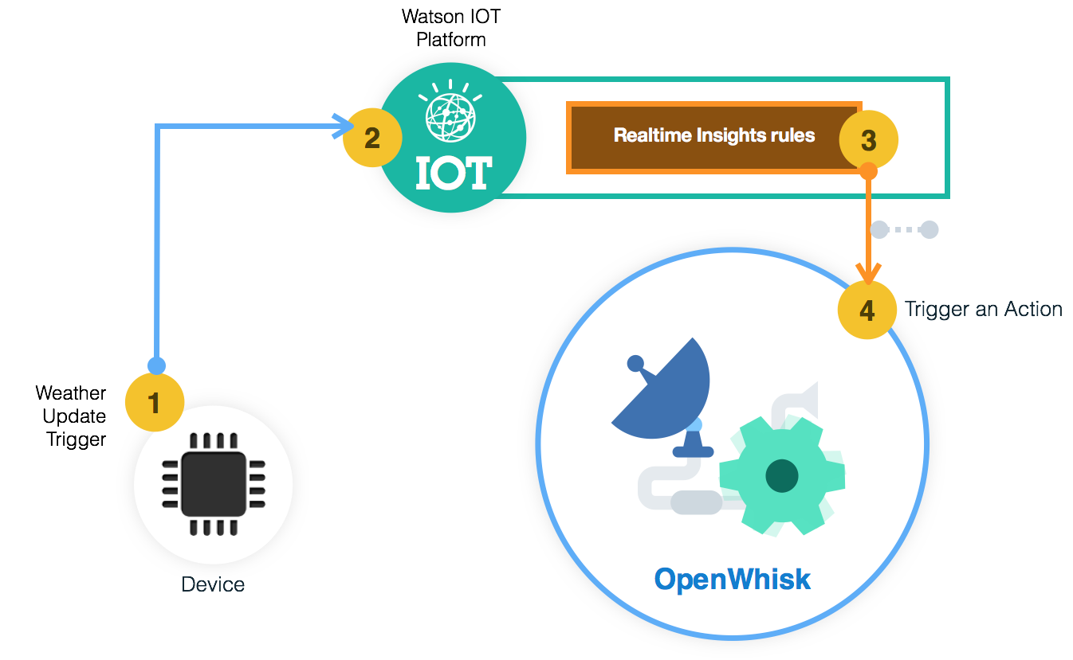
Concepts
Rules create a loosely coupled association between Triggers and Actions. This design pattern enables the same Action to get invoked by different Triggers.
Triggers, are endpoints that are explicitly called by event sources such as databases, stream processing engines, file systems, and line-of-business applications.
The backend functions which hold the business logic are called Actions. They are completely autonomous and independent of the event sources. They can be invoked as long as an event source passes the right set of parameters that are essential for the invocation.
An external event can be anything ranging from an HTTP request to a data feed such as audio, video, text etc.
Actions, Rules, and Triggers can be created and managed through REST endpoints. All that the event source needs to do to invoke an Action is to call the Trigger REST API.

Slide 5
Java,
NodeJS,
Python,
PHP,
Ruby,
Go,
Scala,
Swift,
Haskell and Docker
Supported languages
Multi-language Support
..and anything that runs on a Docker Container

Slide 6
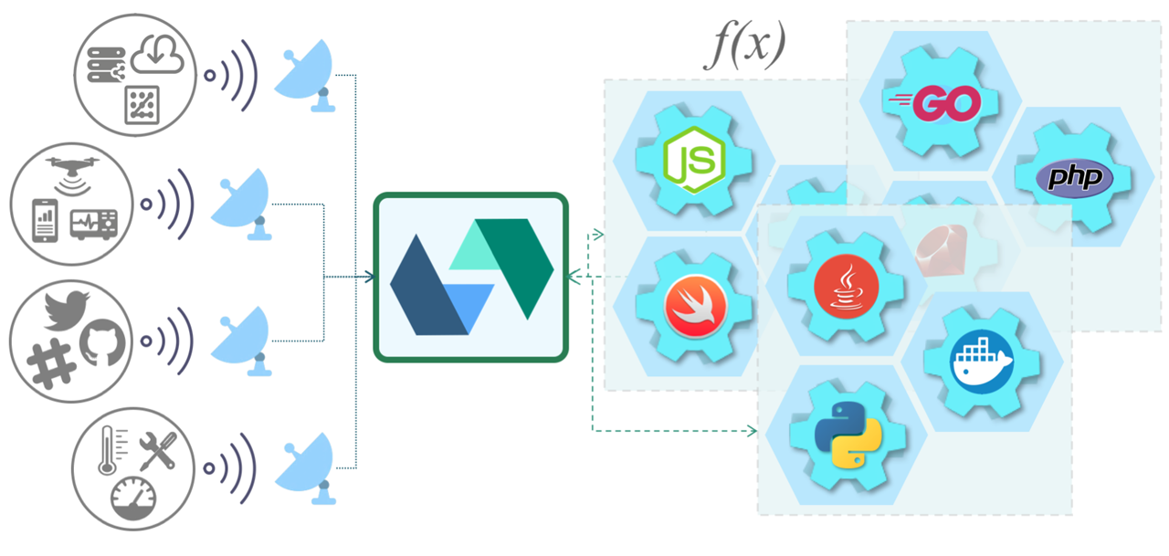
Event Provider
Developers can easily integrate their apps with other third-party services and frameworks that represent event providers (services that generate and provide events). OpenWhisk facilitates the integration of functions with Kafka queues, APIs like IBM Watson, backend schedulers, services such as push notifications for mobile, workplace messaging like Slack, code management services like Git.

Slide 7
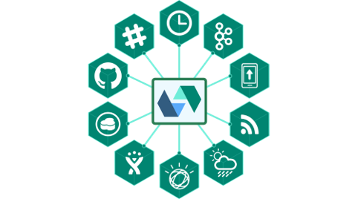
Some Event Provider Examples
Slack – messages and meeting schedules as events
Kafka – using topics and publish for creating events
GitHub – web hook (user defined HTTP callback, for example when pushing code to repo)
Push notifications on mobile systems as events

Slide 8
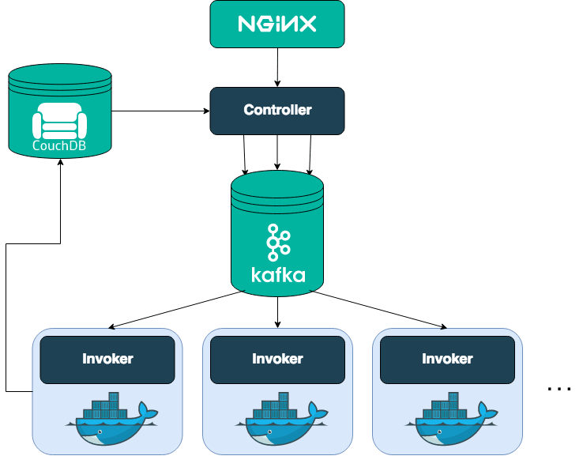
The Building Blocks of OpenWhisk
Nginx - this open source web server exposes the public-facing HTTP(S) endpoint to the clients. It is primarily used as a reverse proxy for API and also for terminating SSL.
CouchDB - The state of the system is maintained and managed in CouchDB, an open source JSON data store.
Controler - After a request passes through the reverse proxy, it hits the Controller, which acts as the gatekeeper of the system. Written in Scala, this component is responsible for the actual implementation of the OpenWhisk API.
Kafka - Apache Kafka is typically used for building real-time data pipelines and streaming applications. OpenWhisk takes advantage of Kafka to connect Controller with Invokers.

Slide 9
The Building Blocks of OpenWhisk
Invoker - Written in Scala. It spins up a new Docker container that acts as the unit of execution for the chosen Action. The Invoker copies the source code from CouchDB and injects that into the Docker container.
OpenWhisk uses Consul as the single source of truth accessible by every component of the system. It also provides service discovery capabilities making it easy for the Controller to discover the entities that will invoke an Action.
Docker
Apache OpenWhisk is built on top of proven open source technologies including Docker, which plays a very important role. Almost all the components of OpenWhisk are packaged and deployed as containers. From Nginx to Kafka to Consul, everything in the platform runs as a container.
Refer to the available images on Docker Hub for a list of OpenWhisk container images.

Slide 10
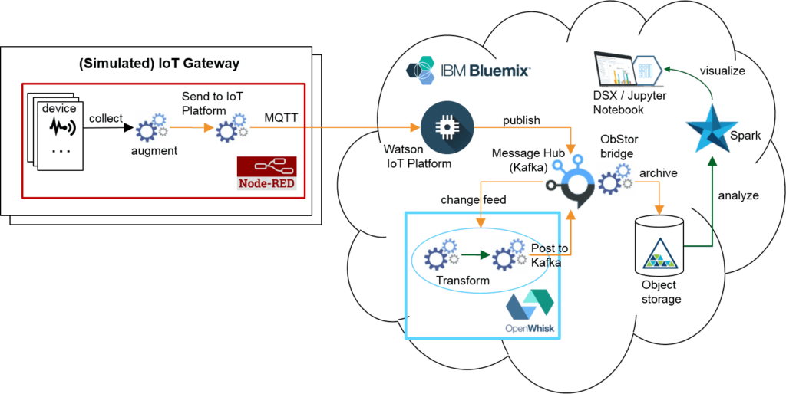
What is IBM Bluemix OpenWhisk?
IBM BlueMix OpenWhisk is the FaaS Functions as a Service programming platform of IBM based on the open source serverless project OpenWhisk.

Slide 11
Sources:
https://medium.com/openwhisk/openwhisk-for-a-smart-city-data-application-dccd7894e0e1
https://www.8bitmen.com/what-is-apache-openwhisk-why-use-it-everything-you-should-know-about-it/
https://thenewstack.io/behind-scenes-apache-openwhisk-serverless-platform/
https://www.oreilly.com/library/view/learning-apache-openwhisk/9781492046158/ch01.html
https://openwhisk.apache.org/
https://www.youtube.com/watch?v=5bOnGxgda1I

