Slide 1


Movie Metadata Analysis
By Nataliya Pivnitskaya
pivnitskaya.natali@gmail.com

Slide 2
1.
What are your observations based on exploration of this data?

Slide 3
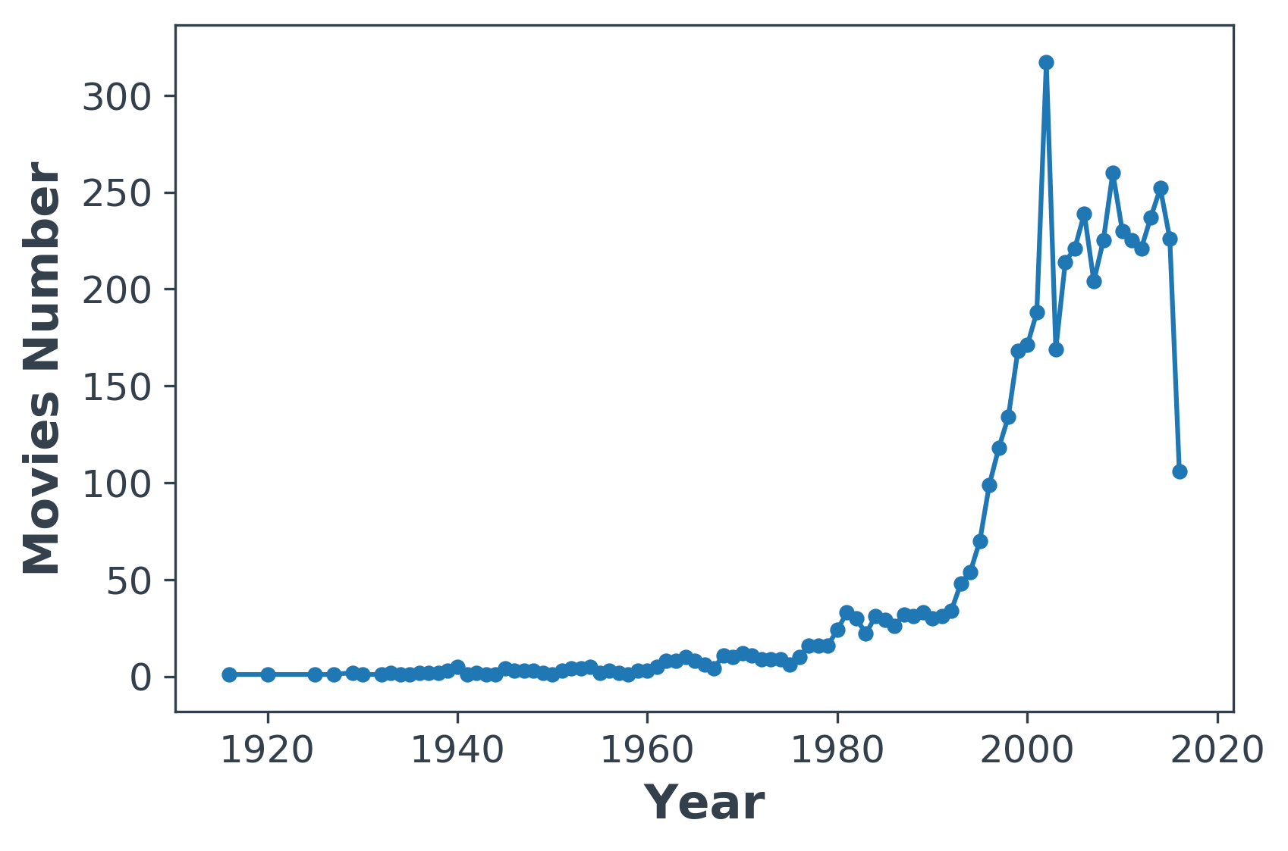
Number of Movies Over Time
Note 1. Before 1995 the number of produced movies remain very low, at the beginning of 2000 we can observe a sharp increase in produced movies number.
Note 2. The latest point significant drop most likely correspond to the lack of observations for the last year in data set so we don’t need to take it seriously as drop due movie domain overall.
Note 3. It might be difficult to features connected with ‘likes’, for example, ‘number of facebook likes’ since people start to use Facebook not so long time ago.
Note 4. We can reasonably delete very old movies without any loss since they don’t provide much information for the future implementation (due to low number and protentional old style)

Slide 4
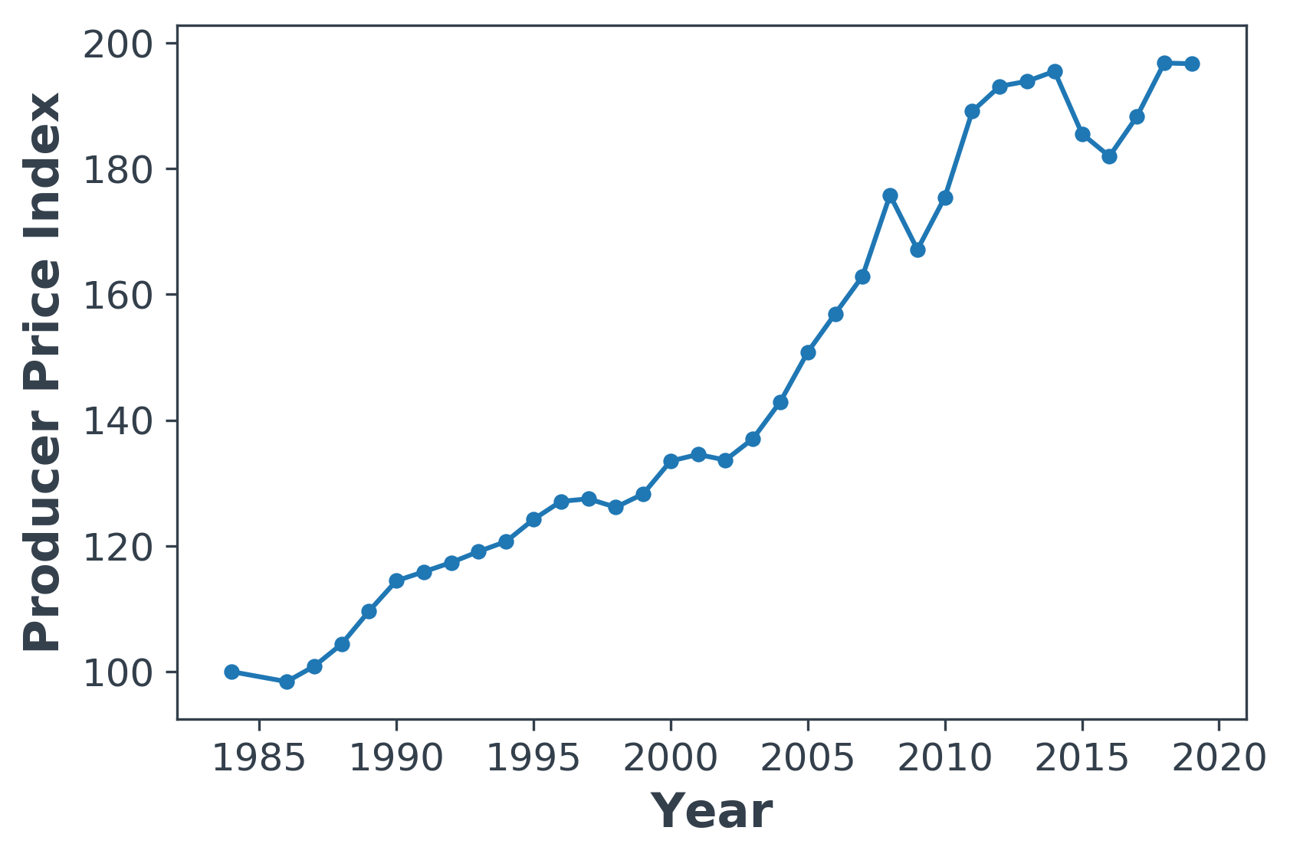
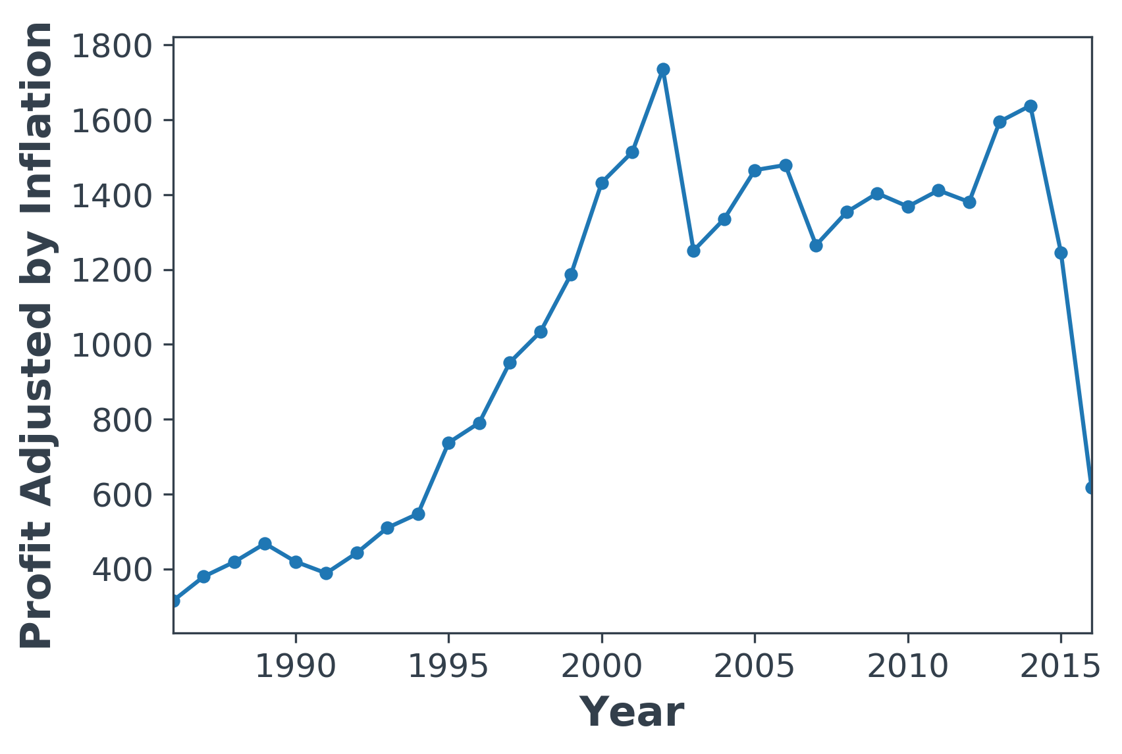
Let’s take inflation into consideration
To make analysis more fair I would like to adjust quantitative variables connected with the level of price (budget, gross, profit*) by inflation impact **
* Profit = Gross - Budget. I also analyzed relative measure (Gross – Budget)/ Budget, but results on this presentation are given in absolute profit value
** Producer Price Index was taken from https://inflation

Slide 5
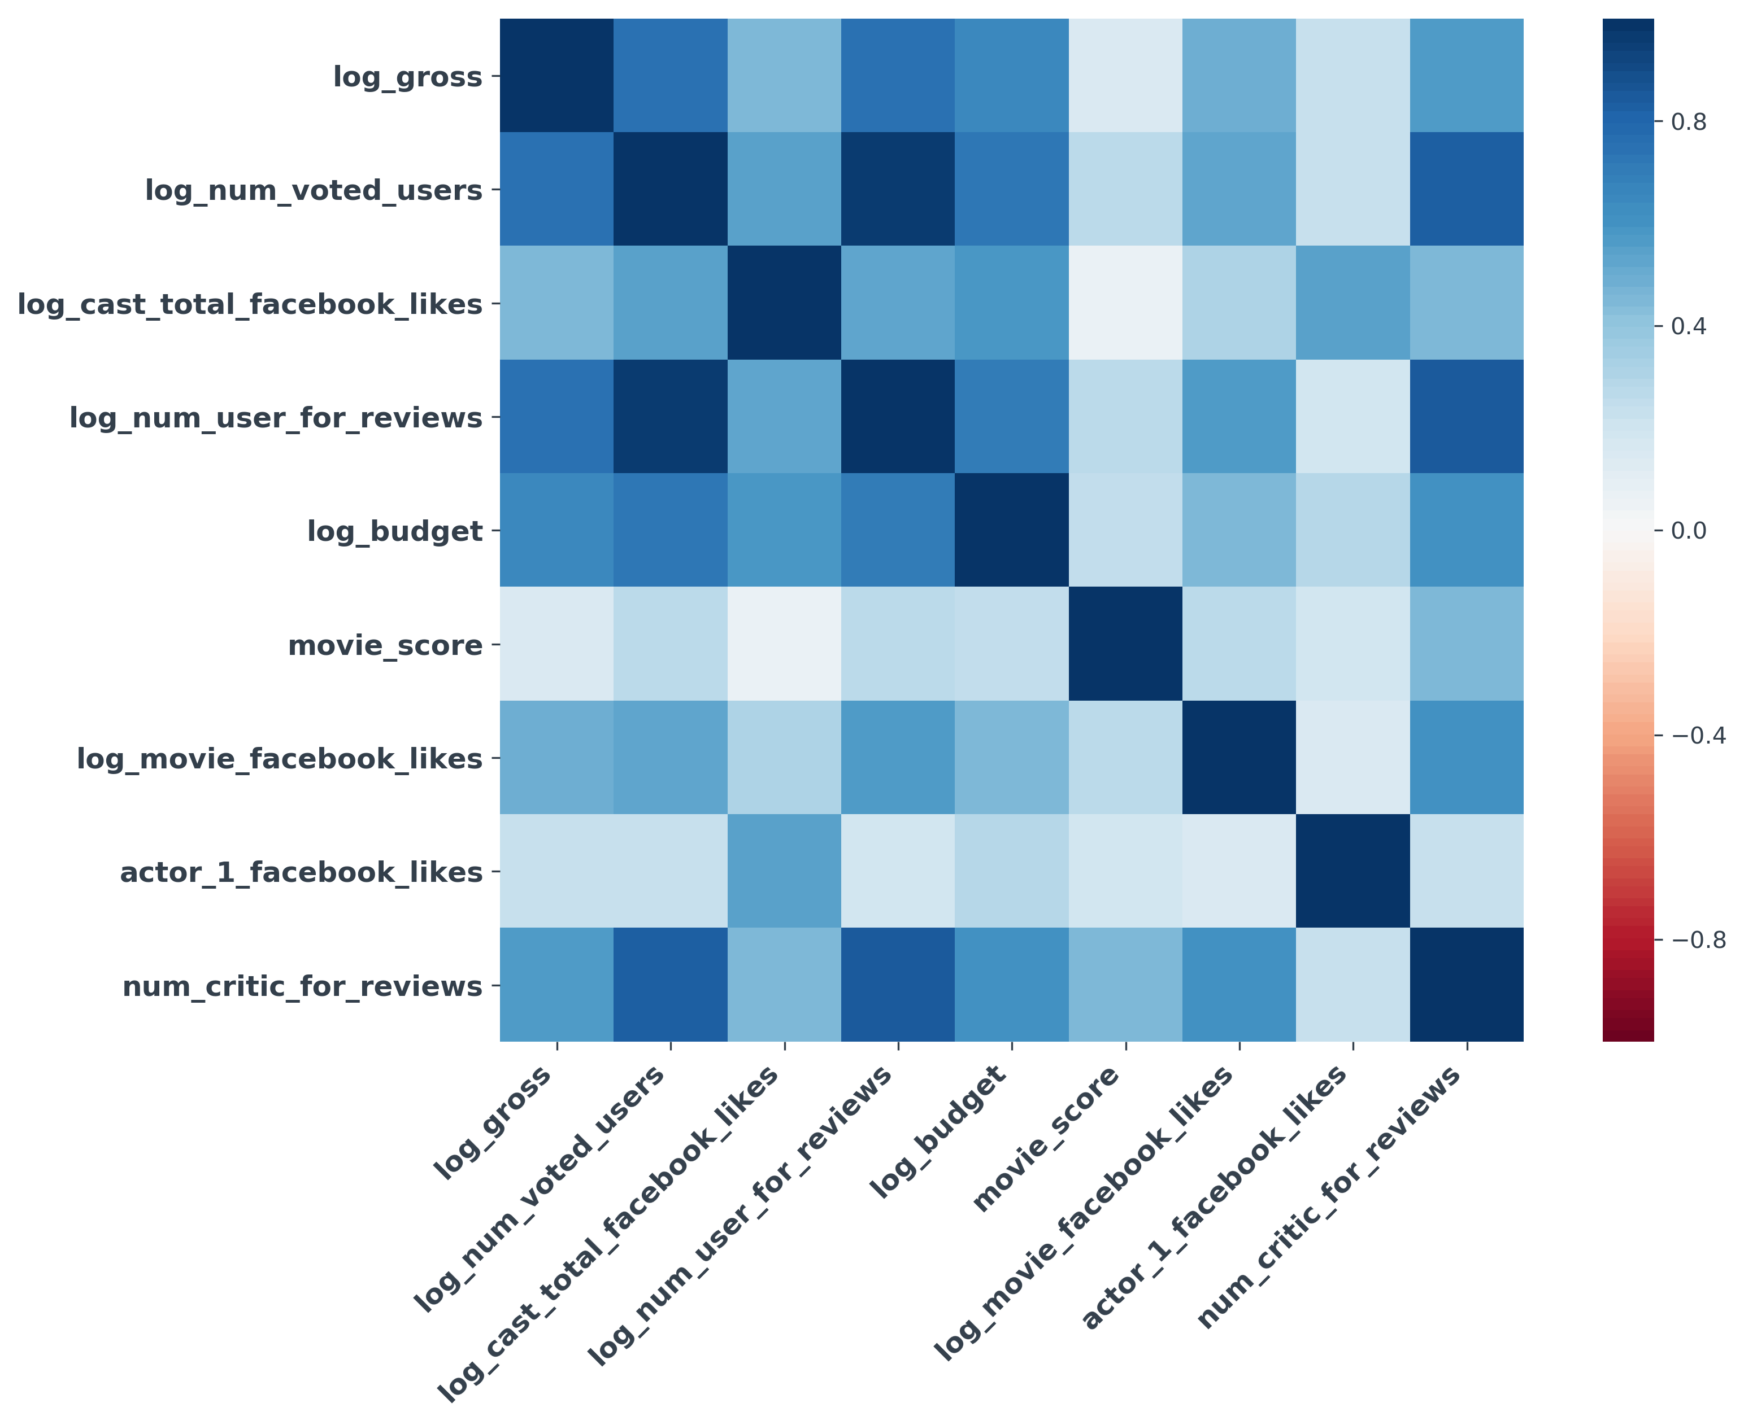
How quantitative features are correlated?
Take-aways:
Log_gross correlated with Log number of votes, Log Number of users who gave a review and Budget
‘log_num_votes_users’, ‘log_num_users_for_reviews’, ‘log_num_critic_for_reviews’ are highly correlated – no need to analyze all of them
No high correlation between gross and any sort of likes (cast and movie)
*Here and later were used only movies that were produced after 2012, because before 2012 Facebook wasn’t so popular: https://www.statista.com/)

Slide 6
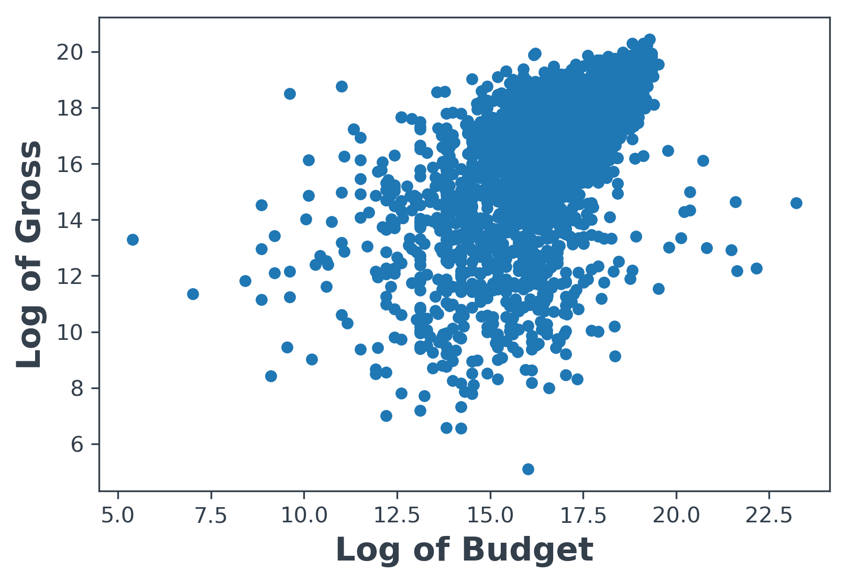
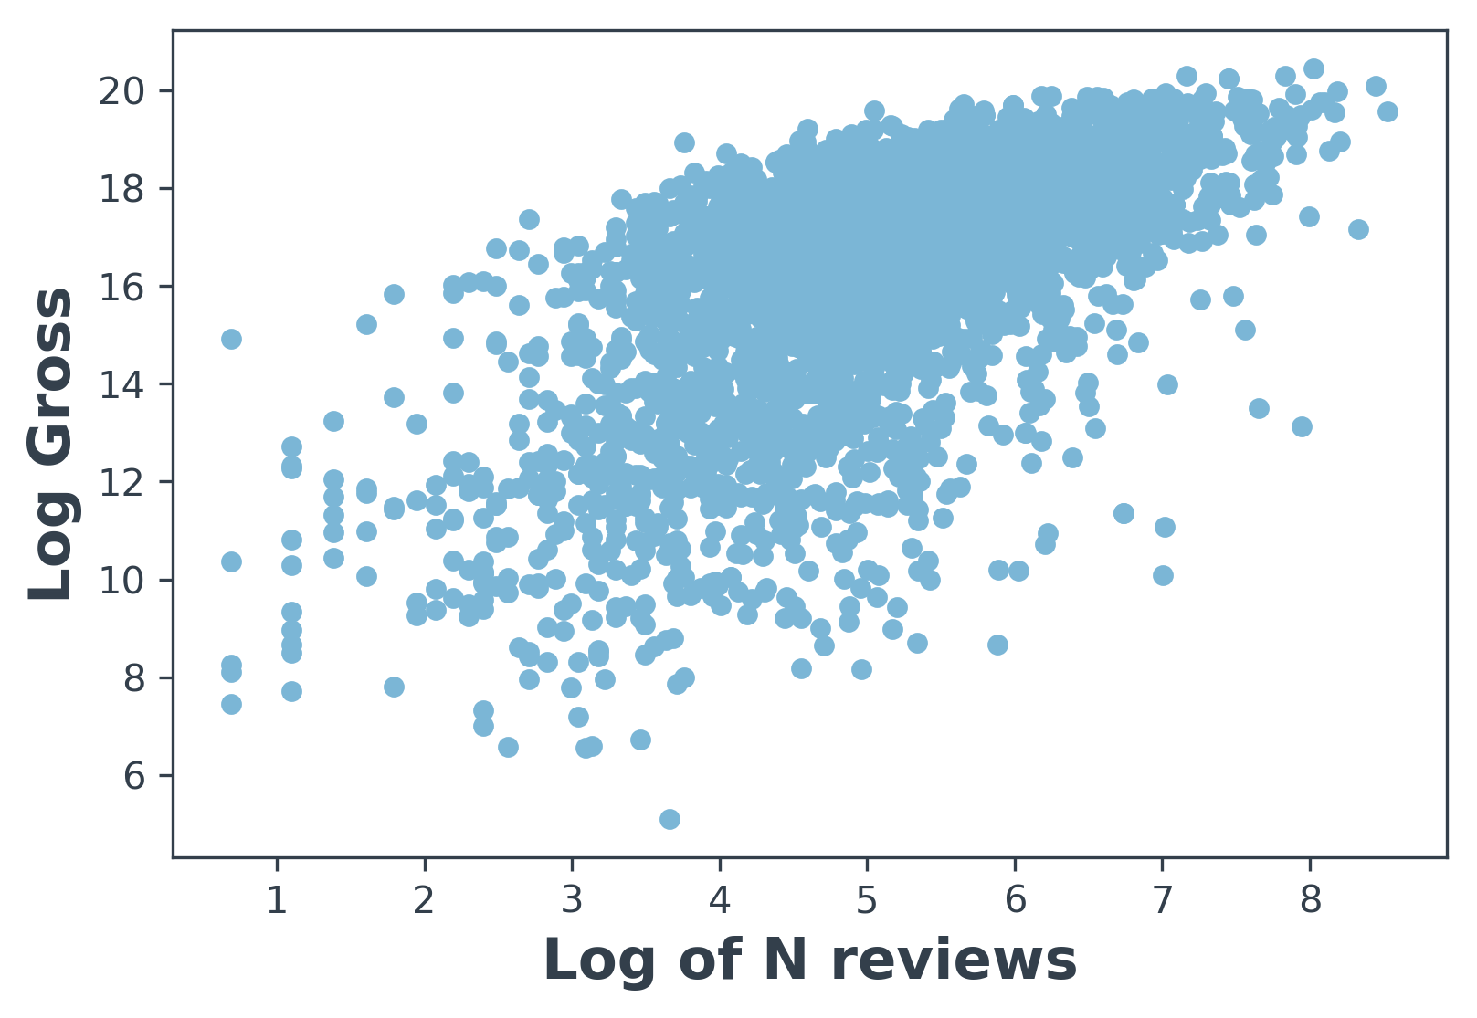
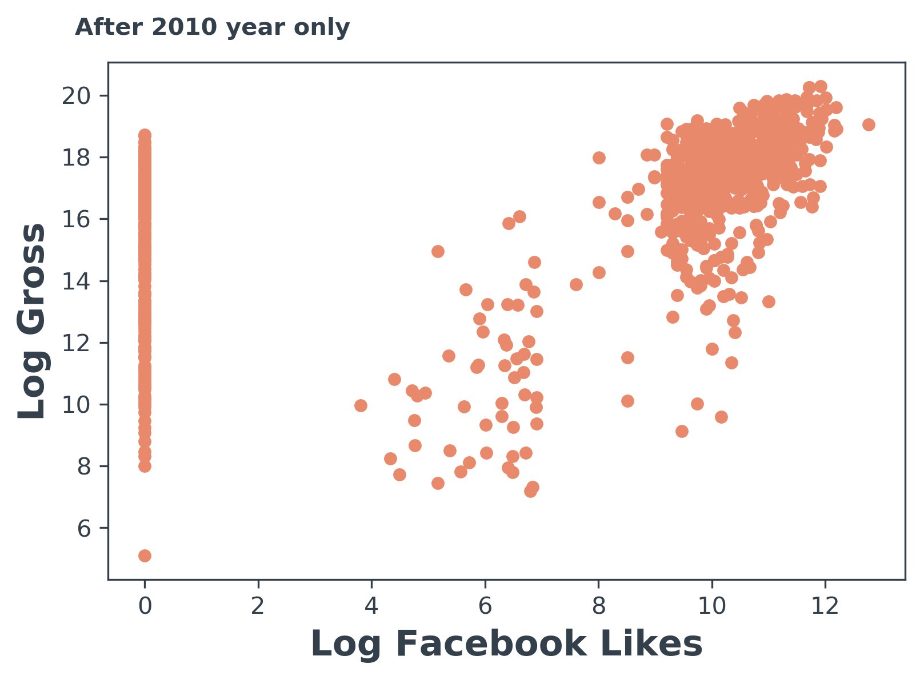
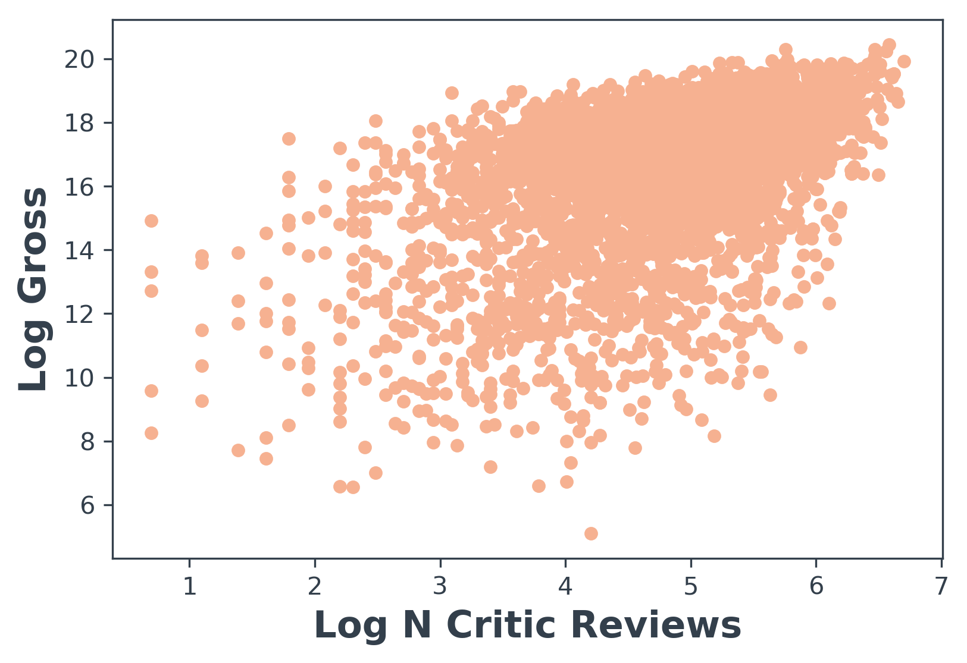
Scatter Plots
Take-away:
We haven’t found the correlation between ‘Gross’ and ‘Number of Likes’ on the previous slide (heatmap), but based on the scatterplot they actually have some sort of dependency. But still for most of the movies people don’t react on the Facebook with likes.

Slide 7
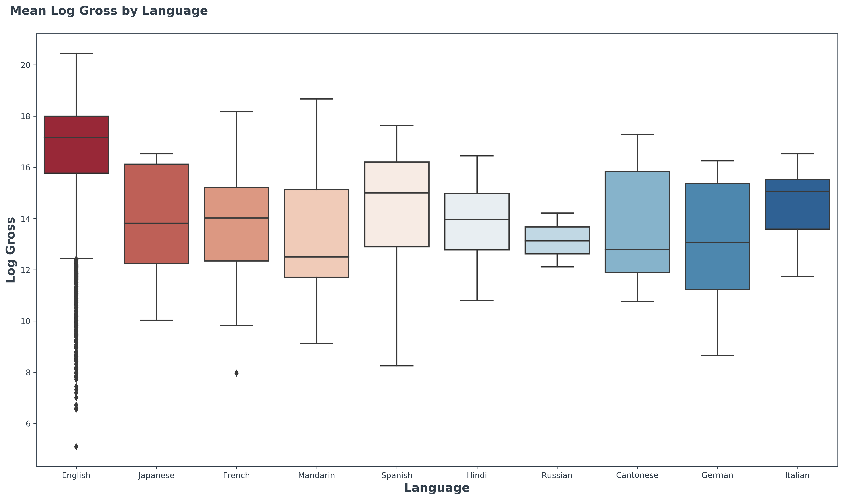
Exploring Gross by Language
Take-aways:
English movies have the highest mean of ‘Log Gross’
A lot of outliers below the 3q+1.5IQ in ‘Log Gross’ of English movies
Most of the movies in the data set are in English (93%). So this feature is no so important.

Slide 8
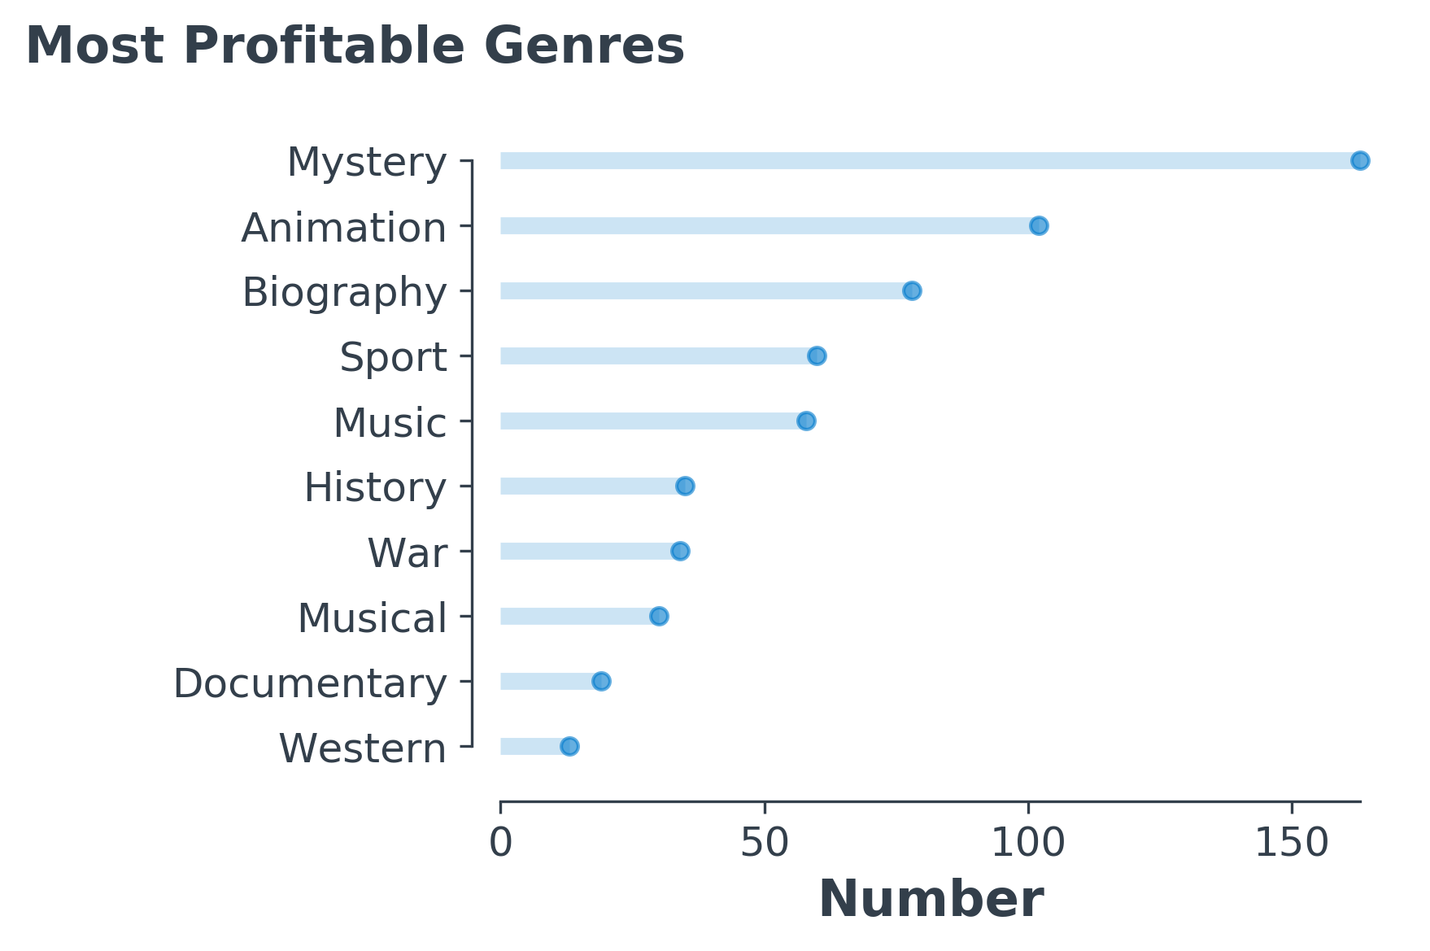
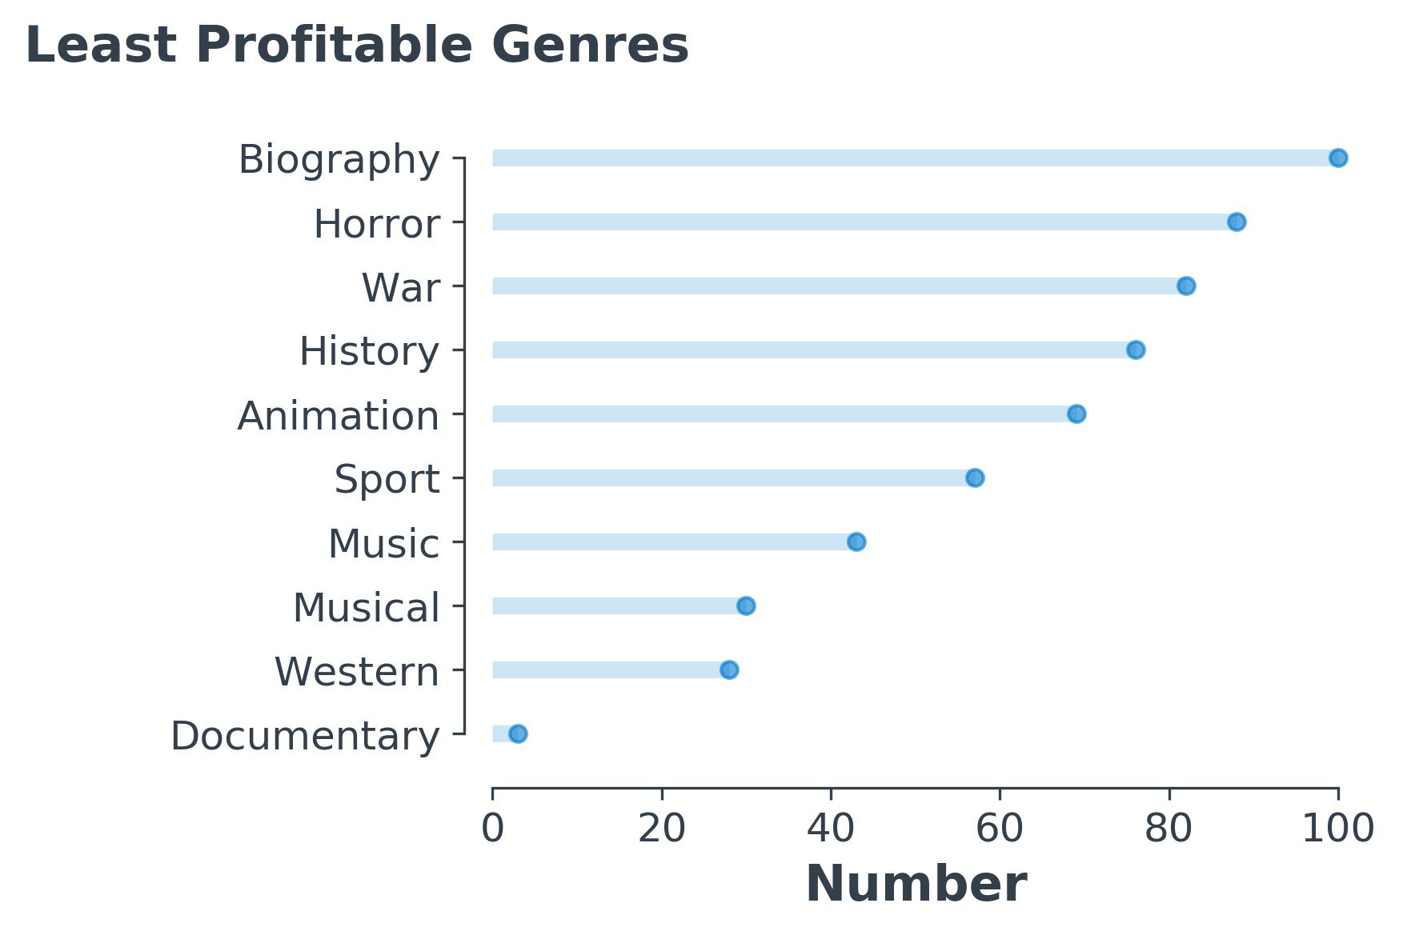
Exploring Genres
Biography, Horror, War Genres specialize on specific auditory, whereas Mystery has very wide auditory – being loved by kinds and adults

Slide 9
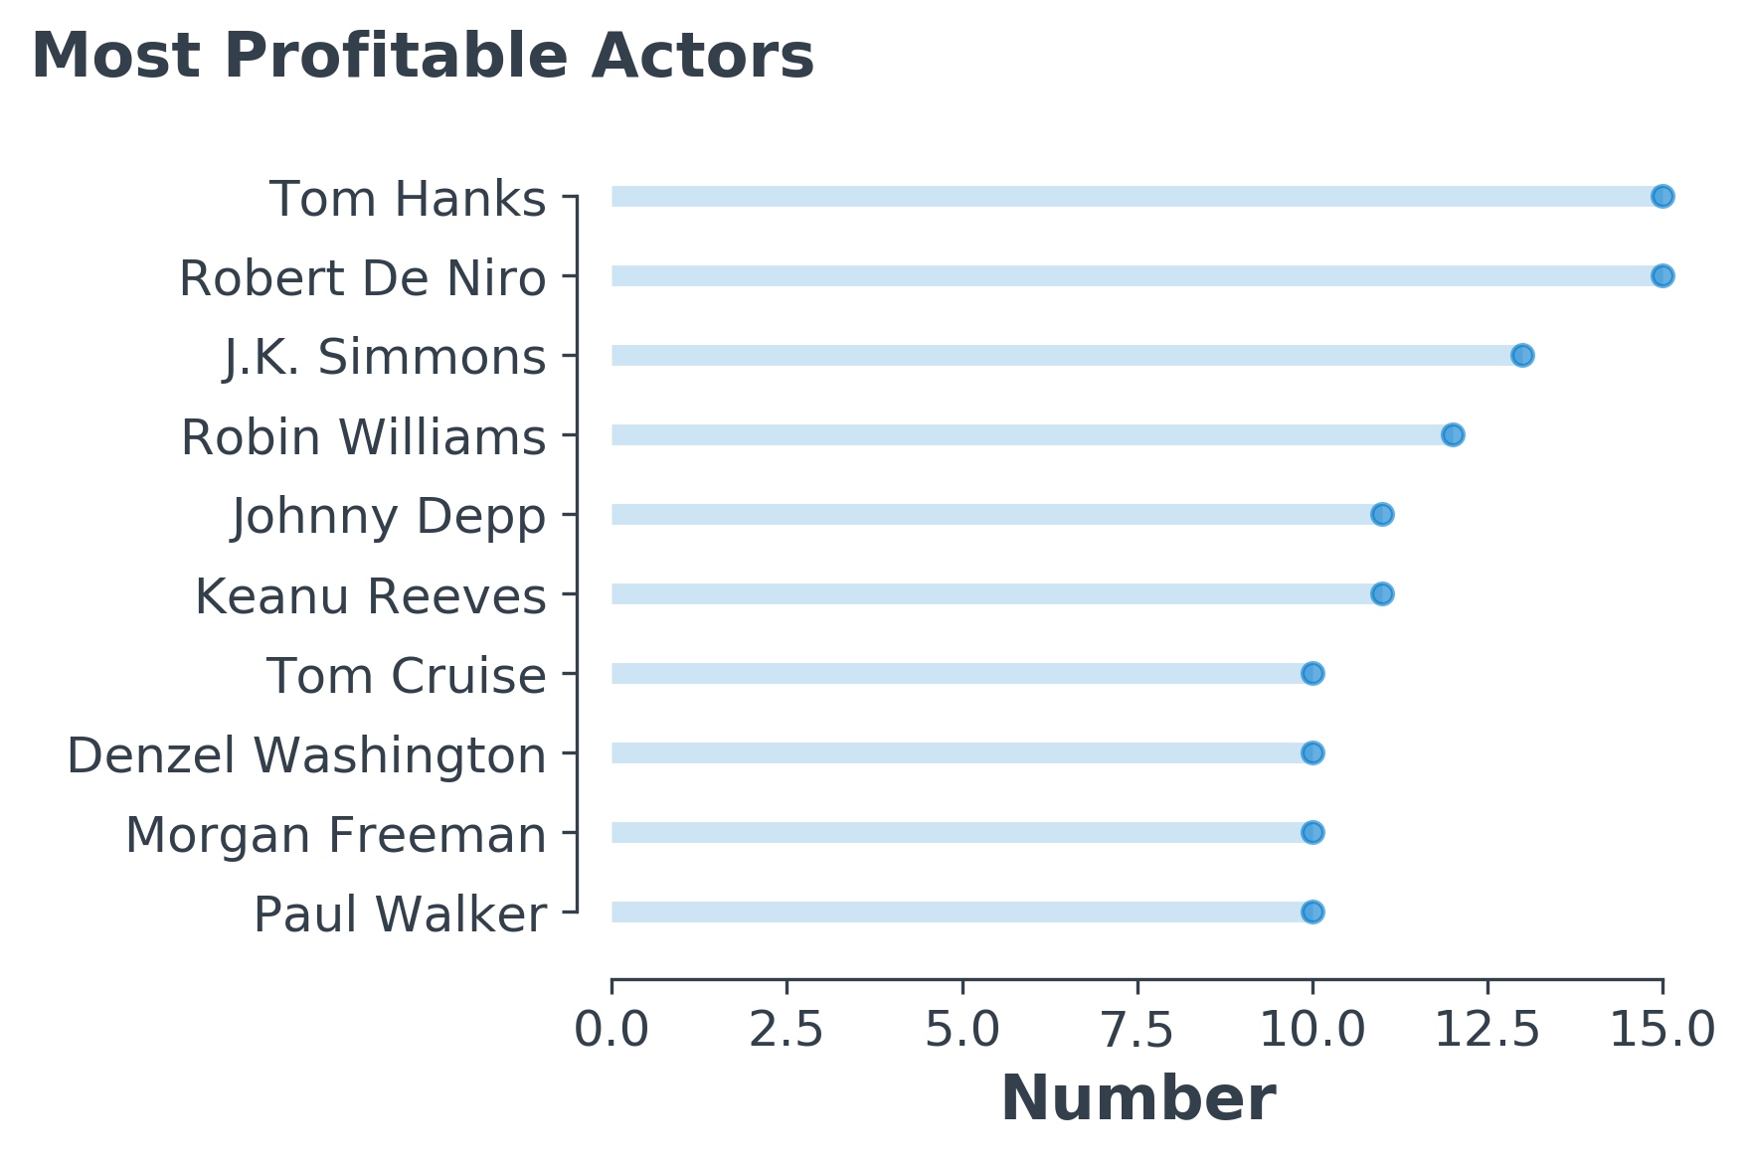
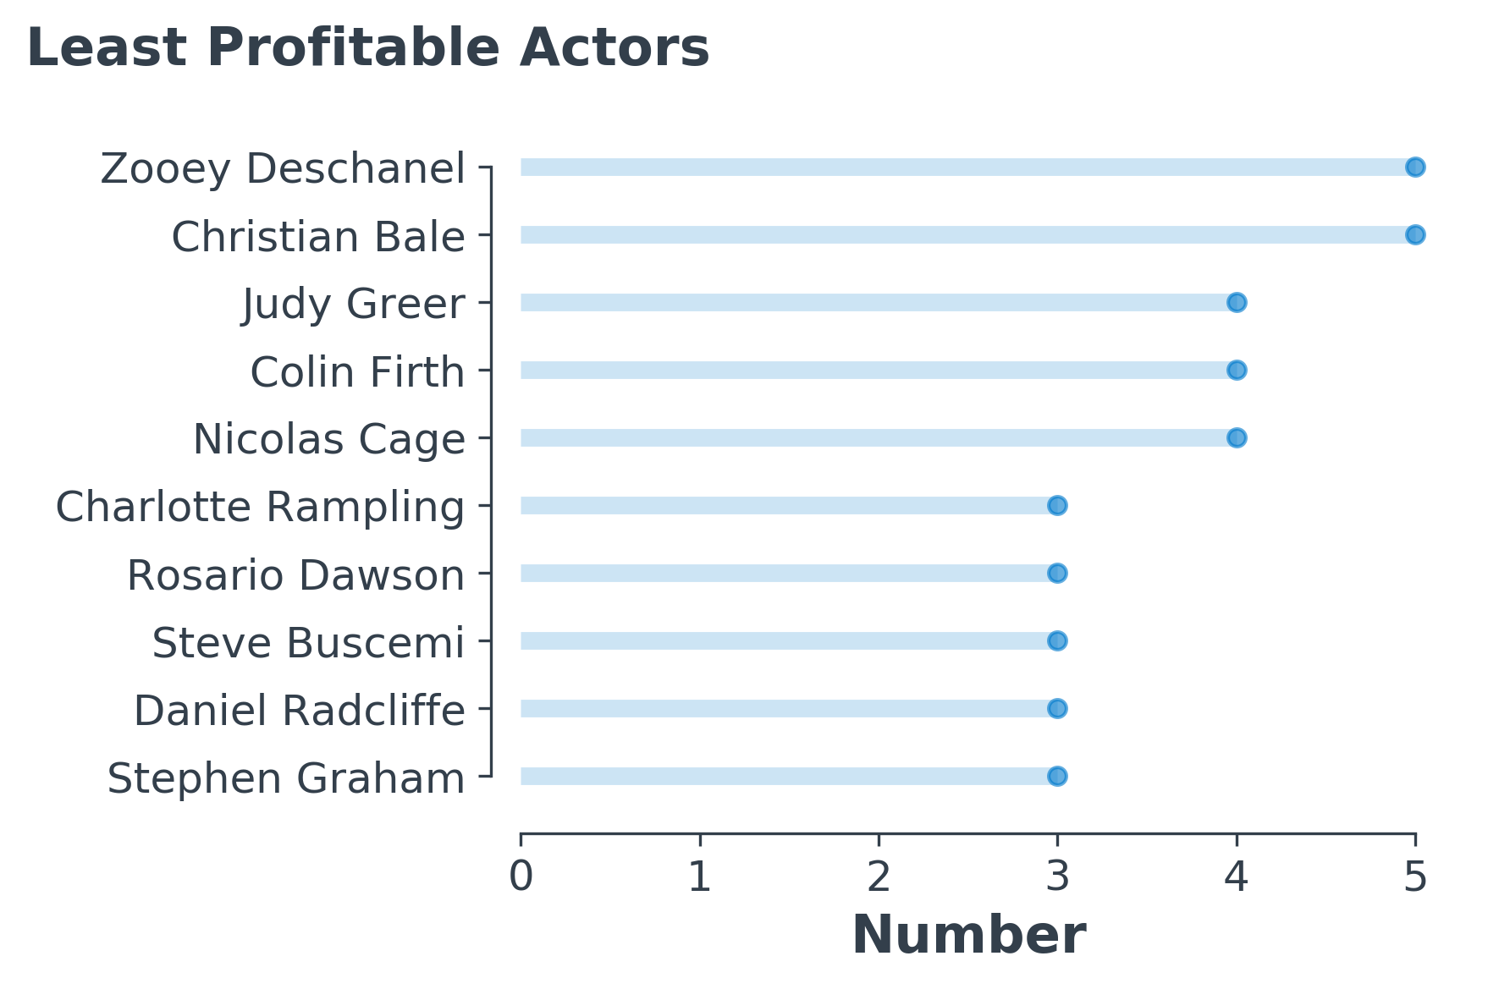
Exploring Actors
As expected we can often see most popular actors in the list of most profitable movies.

Slide 10

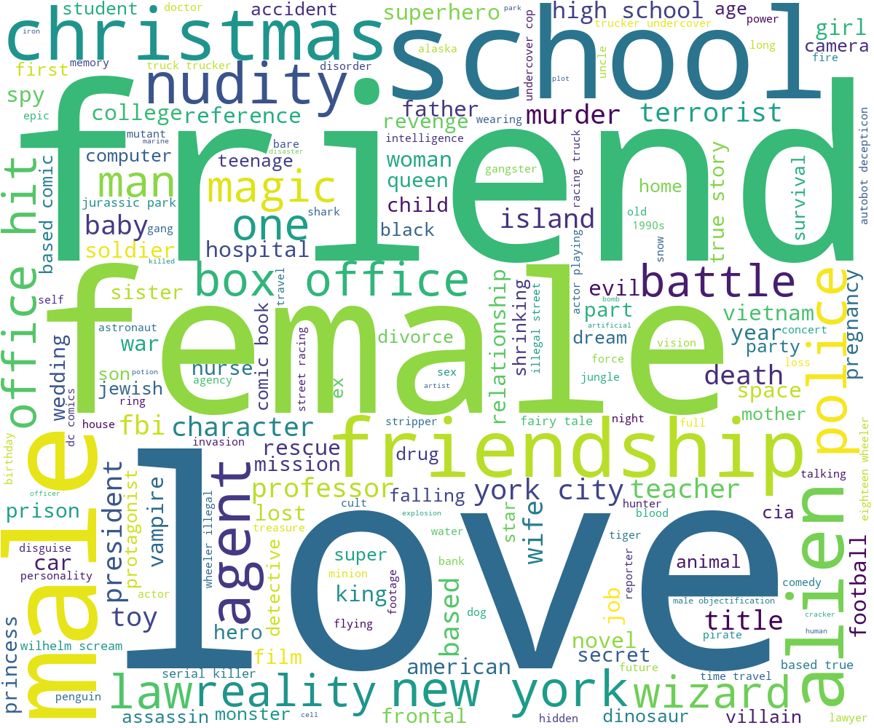
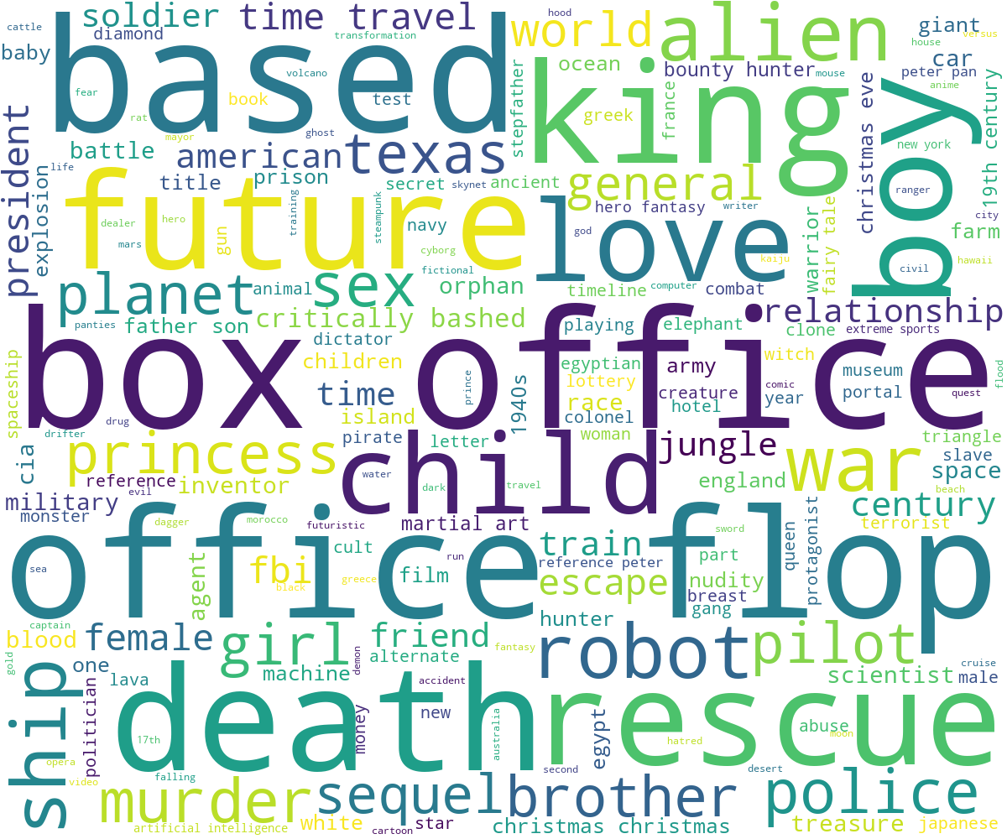
Exploring Key Words
Most Profitable Movies
Least Profitable Movies
Note. Words Cloud helps to get some understanding on what key words present in profitable and not profitable movies. Looks like most profitable more centered around the idea of friendship, love and other positive aspects of live (again this topic captures wider auditory). Whereas on the least profitable movies side we can see some more specific words, for example, ‘king’ might be connected with the historical movie, some other examples: office, war, future, etc.

Slide 11

Exploring Other Features
After some analysis some features turned out not to have any impact on profitability of movies much, for example:
Duration
Color
Face number at Poster
Movie link

Slide 12
2.
What is the recipe to make a blockbuster, profitable movie?
Share your hypothesis and insights based on the data.

Slide 13



Recipe to make a blockbuster: hypothesis
But you should keep in mind that blockbusters often combine the myth form with at least one other major genre. The other genres help to modernize the myth form, and also overcome many of the weaknesses inherent to this tricky genre. The trick is to find the one or two best forms that will bring out the 'gold' in your idea.
Hollywood is also said to be incapable of making an
inexpensive film. These
films have massive budgets,
so they are expected to make
huge revenues, as we also
observed in analysis. They go through the trouble to cast
big-name actors in their films.
A surprisingly large number of hit films are based on the myth genre. Why? Because myth beats cultural age and national boundaries. This is why ‘'Batman’ is as popular globally as it is in the U.S.

Slide 14

The typical hit film makes more money from foreign revenue than it does from the U.S. So in blockbuster recipe investigation we might want to look at some additional data.
The
Closing Remarks

Slide 15
Thank you for your attention
GitHub code can be found here

Slide 16
Appendix

Slide 17

Features Transformation
Note:
In current analysis log transformed features often used since log transformation help to make feature more normally distributed

