Slide 1


Heart Disease Analysis
Applied Data Science with Python
Codecademy Bootcamp
Python ◦ Panda ◦ NumPy ◦ SciPy ◦ Matplotlib ◦ Seaborn

Slide 2


Project Objective
Identify factors associated with heart disease
Using statistical hypothesis testing and visualization

Slide 3
Dataset Overview
303 patients records from the Cleveland Clinic Foundation
Clinical, demographic, and exercise-related variables

Slide 4
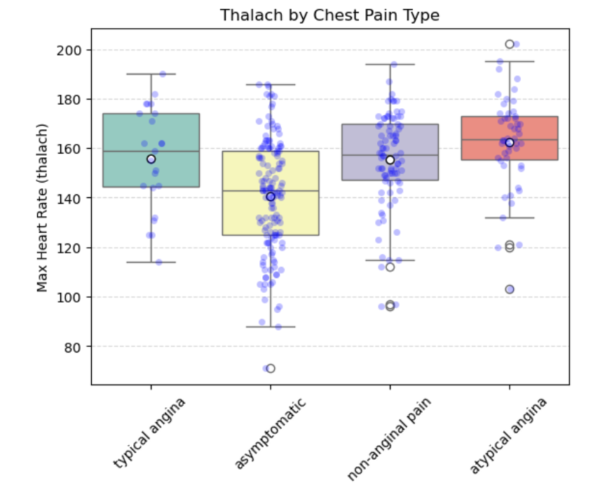
Key Findings - Symptoms
Chest pain type is a major diagnostic indicator
Exercise-induced angina signals higher risk

Slide 5
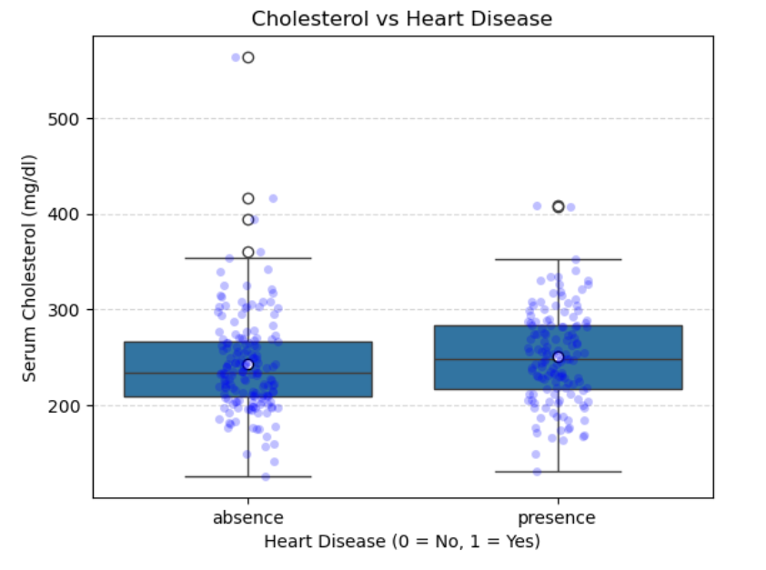
Key Findings - Metabolic
Elevated cholesterol and fasting blood sugar are more common in heart disease patients

Slide 6
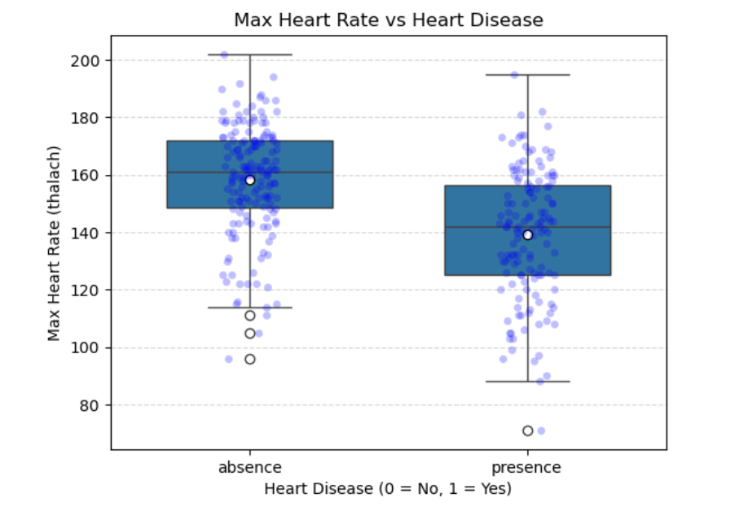
Exercise performance & heart disease
Patients with heart disease have significantly lower max heart rates than those without heart disease
Indicates a strong association between heart disease and exercise-related heart response.

Slide 7

Methods Used
Tests:
- t-tests, Binomial test
- Chi-square tests, one-way ANOVA
- Tukey’s HSD post-hoc test
Data visualization Methods:
- Box plots (Seaborn)
- Stacked bar charts (Matplotlib / Pandas)
- Side-by-side categorical plots

Slide 8
Conclusion
Combining clinical symptoms, exercise data, and metabolic indicators improves heart disease risk assessment

Slide 9
Thank You !!!

