Slide 1
Foot Sole Pressure Sensor - Wireless Plantar-pressure Sensing and Frame-synchronized Analysis for Footwear Design.
G2: Ahmed Hakim, Hamda Zarrouk, Haosong Li,
Natali Tckvitishvili, Nicholas Koch, Tianle Sun, Yi Yue

Slide 2
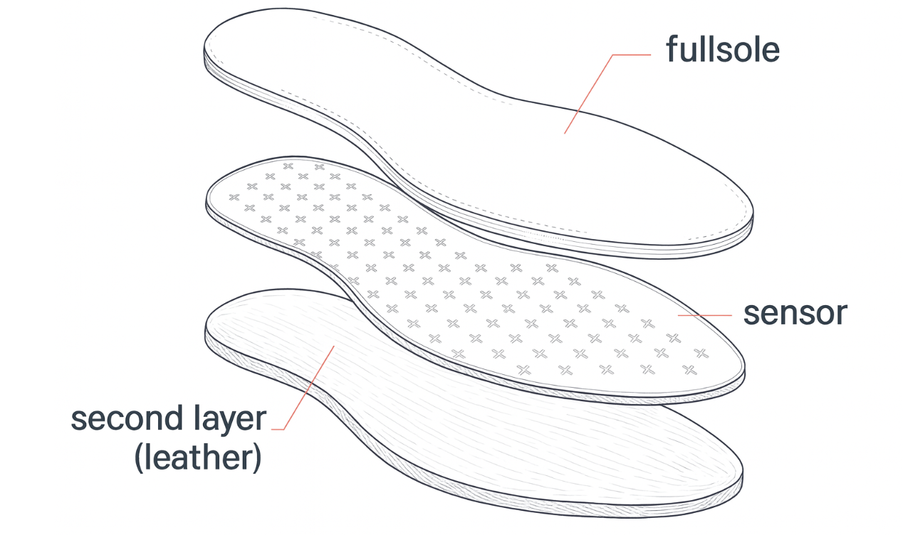
Fullsoul Runningpad - From [Burian et al., 2024]
Generated with Assistance by ChatGPT (OpenAI, 2025）

Slide 4
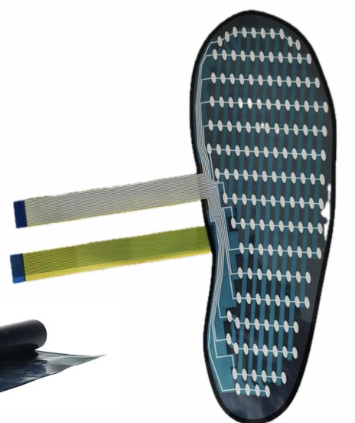
Small-form Factor ESP32 and Battery Added
Image of the original protocol
From [Burian et al., 2024], with permission.

Slide 5
Small-form Factor ESP32 and Battery Added

Slide 6
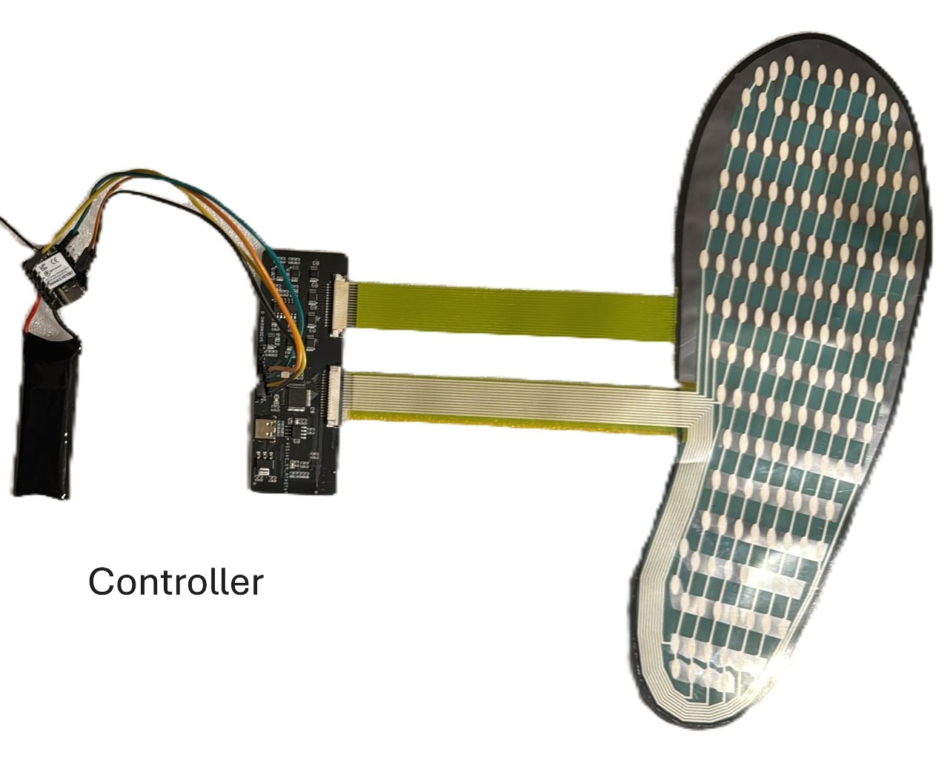
Small-form Factor ESP32 and Battery Added

Slide 7
Small-form Factor ESP32 and Battery Added

Slide 8
Small-form Factor ESP32 and Battery Added

Slide 9
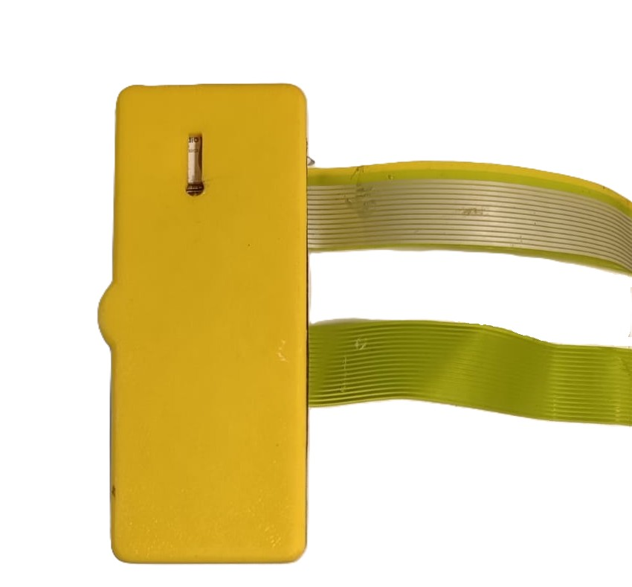
Controller Housing (3D-Printed)

Slide 10

Controller with Bluetooth Low Energie

Slide 11

Controller with Bluetooth Low Energie

Slide 12

Controller with Bluetooth Low Energie

Slide 13

Controller with Bluetooth Low Energie

Slide 14

Controller with Bluetooth Low Energie

Slide 15

Better Data Management
Source： https://www.sqlite.org/

Slide 16
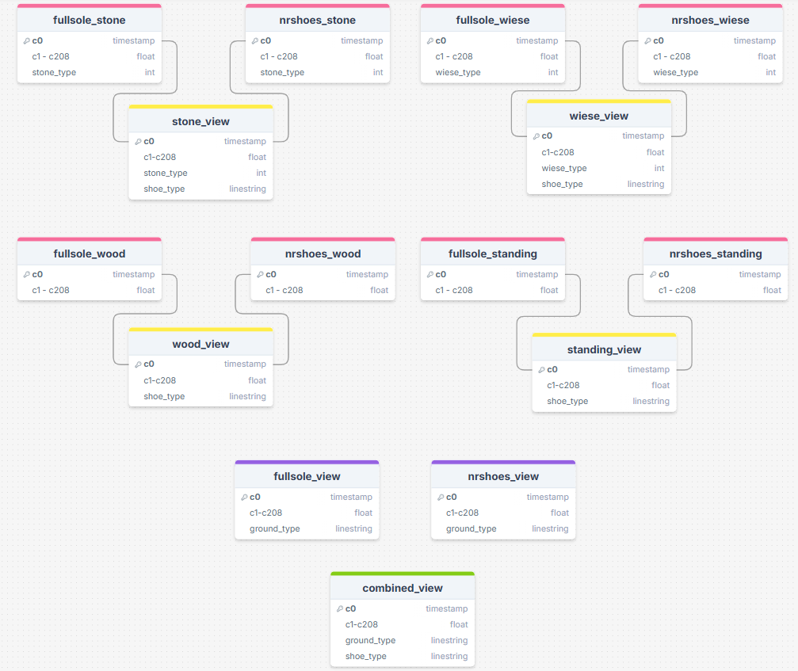
Better Data Management

Slide 17
Better Data Management

Slide 18
Experiment
Back to the Question
Does a thin leather sole affect the foot’s ability to feel?

Slide 19
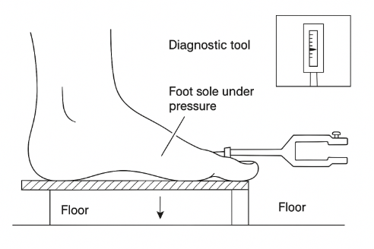
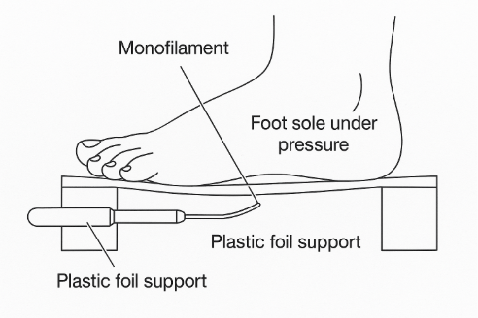
Experiment
Specialized Instruments for Mechanoreception or Tactile Sensitivity
Both generated with Assistance by ChatGPT (OpenAI, 2025）

Slide 20
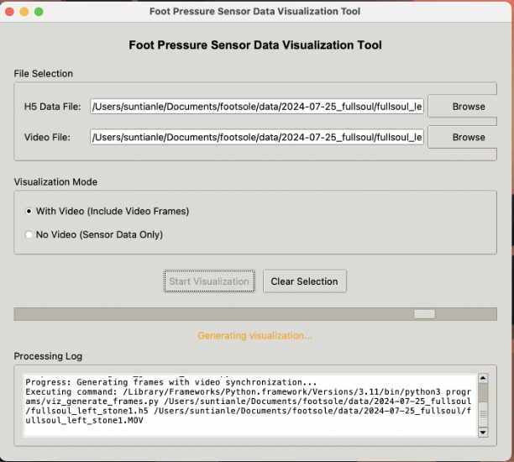
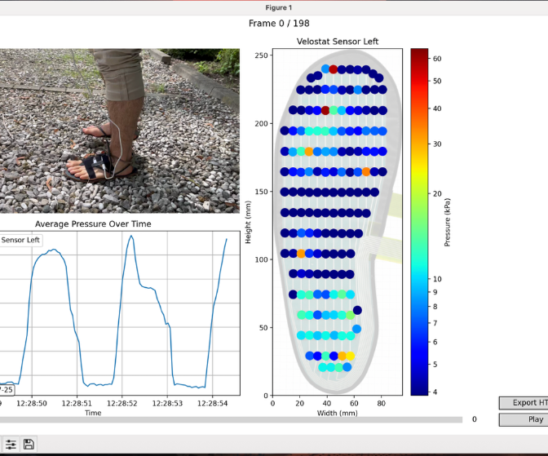
Experiment
convenient Synchronization of the Data with Video
Reproduced from [Burian et al., 2024], with permission.

Slide 21

Project Acknowledgment
With permission from the original project Fullsoul Runningpad [Burian et al., 2024], we have continued the work and introduced further optimizations and extensions.
Our code is available at https://github.com/natalyss16/footsole.git.
Work based on the Fullsole Project https://github.com/weichkai/footPressureSensor/tree/main
[Burian et al., 2024] K. Burian, C. Ren, and A. Strauch, “Foot Sole Pressure Sensing Device and Its Usage in Barefoot Shoes: Fullsoul Runningpad,” Clinical Applications of Computational Medicine (CACOM), Technical University of Munich, Jul. 30, 2024.

Slide 22
Project Acknowledgment
With permission from the original project Fullsoul Runningpad [Burian et al., 2024], we have continued the work and introduced further optimizations and extensions.
Our code is available at https://github.com/natalyss16/footsole.git.
Work based on the Fullsole Project https://github.com/weichkai/footPressureSensor/tree/main
[Burian et al., 2024] K. Burian, C. Ren, and A. Strauch, “Foot Sole Pressure Sensing Device and Its Usage in Barefoot Shoes: Fullsoul Runningpad,” Clinical Applications of Computational Medicine (CACOM), Technical University of Munich, Jul. 30, 2024.
https://github.com/natalyss16/footsole.git
https://github.com/weichkai/footPressureSensor/tree/main

