Slide 1
Projet Deep Reinforcement Learning
BENDAVID Natane
TARDY Louis
WADE Cheikh Abdourahmane

Slide 2
Sommaire
Présentation des algos :
Dynamic Programming
Monte carlo methods
Temporal difference learning
Deep reinforcement learning
Score obtenus pour chaque environnement

Slide 3
Dynamic Programming
Algo :
Policy evaluation
Policy iteration
Value iteration
Env :
Line word
Grid word
Secret env 1

Slide 4
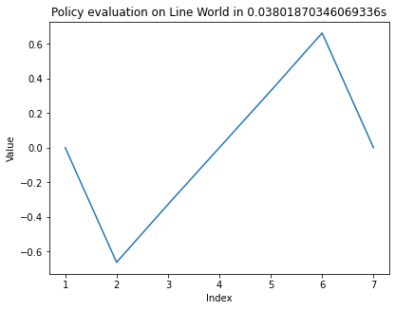
Dynamic Programming
Policy evaluation & policy iteration
Line word
Gamma 0,99
Theta 0,00001

Slide 5
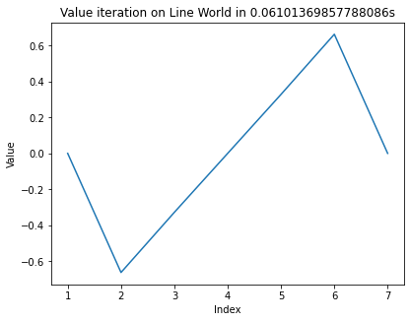
Dynamic Programming
Value iteration
Line word
Gamma 0,99
Theta 0,00001

Slide 6
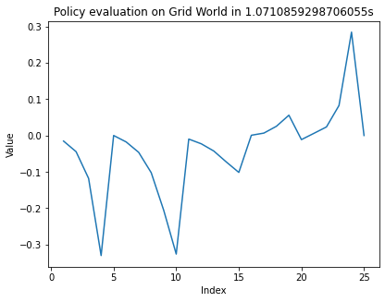
Dynamic Programming
Policy evaluation & policy iteration
Grid word
Gamma 0,99
Theta 0,00001

Slide 7
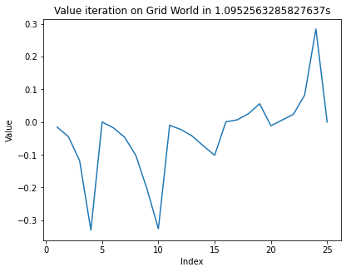
Dynamic Programming
Value iteration
Grid word
Gamma 0,99
Theta 0,00001

Slide 8
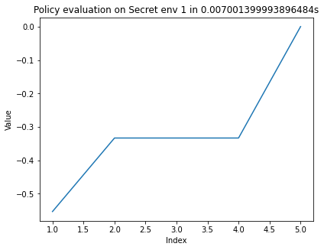
Dynamic Programming
Policy evaluation & policy iteration
Secret env 1
Gamma 0,99
Theta 0,00001

Slide 9
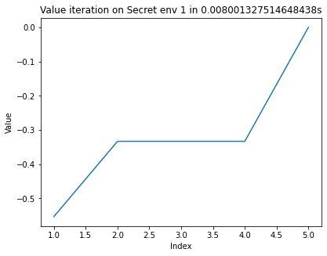
Dynamic Programming
Value iteration
Secret env 1
Gamma 0,99
Theta 0,00001

Slide 10
Monte carlo methods
Algo :
MONTE CARLO ES
On policy first Visit Monte carlo
Off policy Monte carlo Control
Env :
Tic Tac Toe
Secret env 2

Slide 11
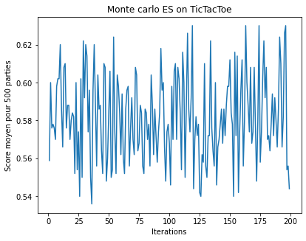
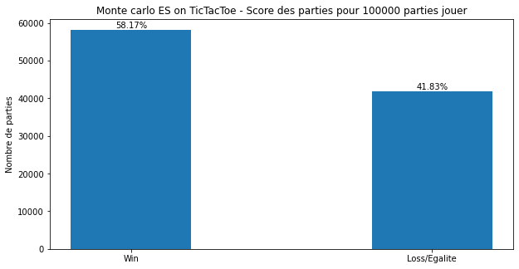
Monte carlo methods
MONTE CARLO ES
TIC TAC TOE
Gamma 0,99
58,17 % de win

Slide 12
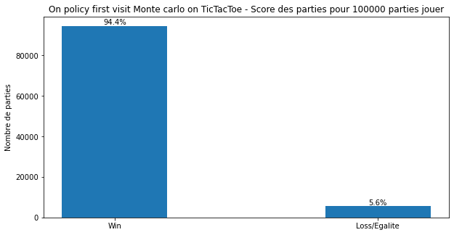
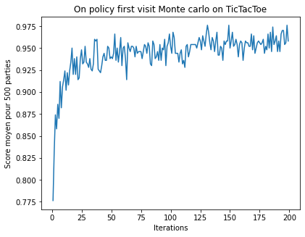
Monte carlo methods
On policy first visit Monte carlo
TIC TAC TOE
Gamma 0,99
Epsilon 0,1
94,4 % de win

Slide 13
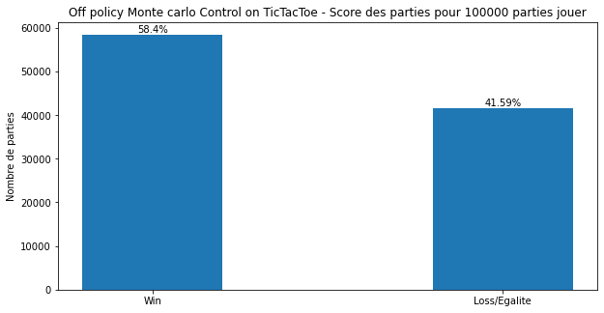
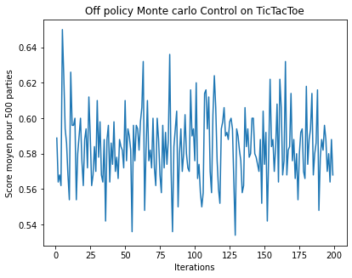
Monte carlo methods
Off policy monte carlo control
TIC TAC TOE
Gamma 0,99
58,4 % de win

Slide 14
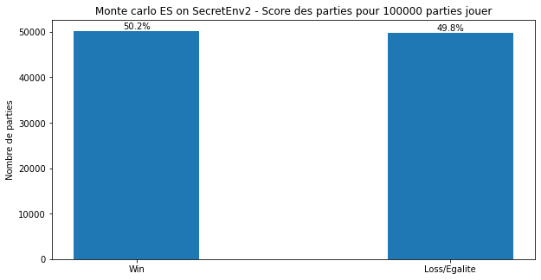
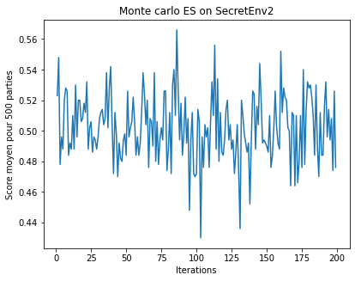
Monte carlo methods
MONTE CARLO ES
Secret env 2
Gamma 0,99
50,2 % de win

Slide 15
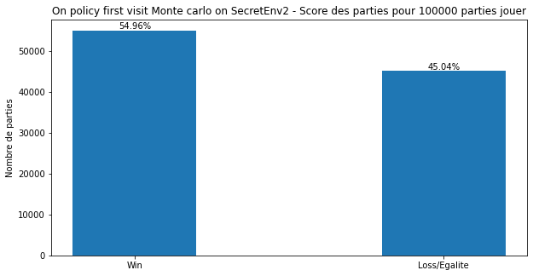
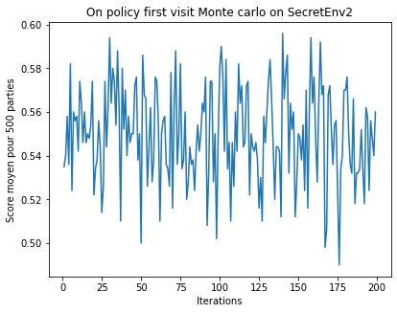
Monte carlo methods
On policy first visit Monte carlo
Secret env 2
Gamma 0,99
Epsilon 0,1
54,96 % de win

Slide 16
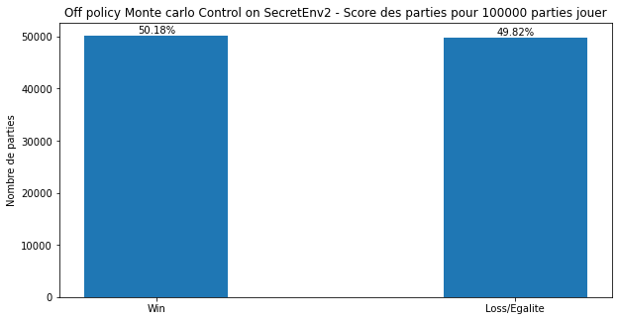
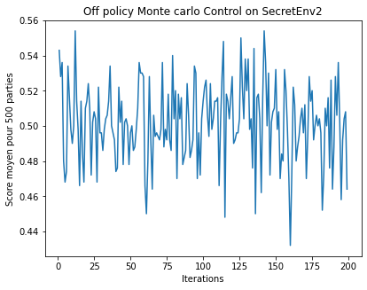
Monte carlo methods
Off policy monte carlo control
Secret env 2
Gamma 0,99
50,18 % de win

Slide 17
Temporal difference learning
Algo :
Q learning
Expected sarsa
Env :
Tic Tac Toe
Secret env 3

Slide 18
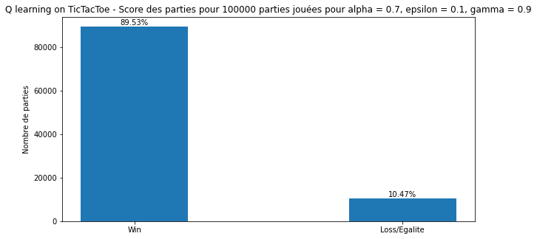
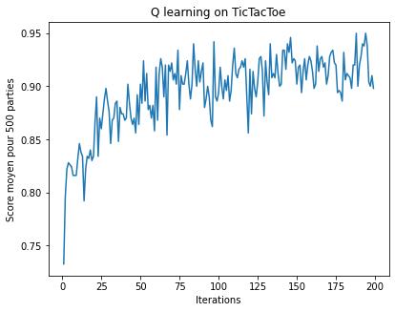
Temporal difference learning
Q learning
TIC TAC TOE
Alpha 0,7
Gamma 0,9
Epsilon 0,1
89% de win

Slide 19
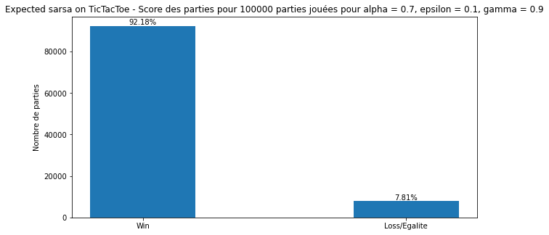
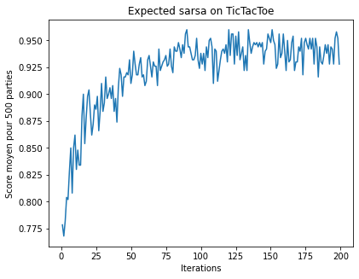
Temporal difference learning
Expected Sarsa
TIC TAC TOE
Alpha 0,7
Gamma 0,9
Epsilon 0,1
92% de win

Slide 20
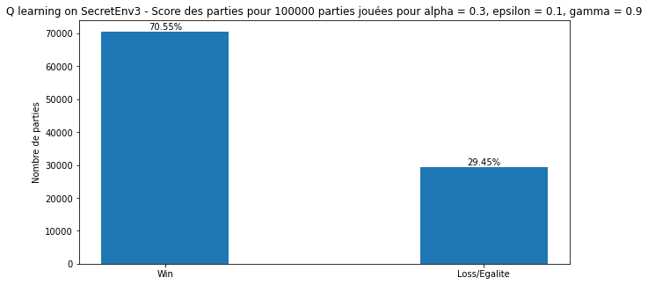
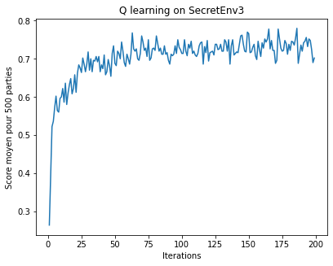
Temporal difference learning
Q learning
Secret env 3
Alpha 0,3
Gamma 0,9
Epsilon 0,1
70% de win

Slide 21
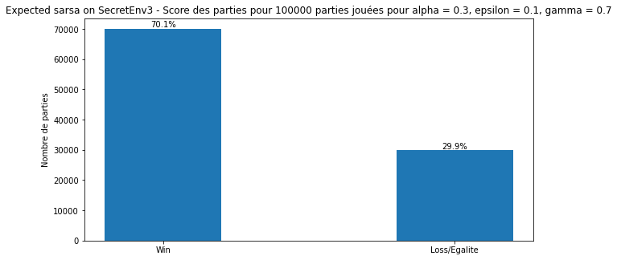
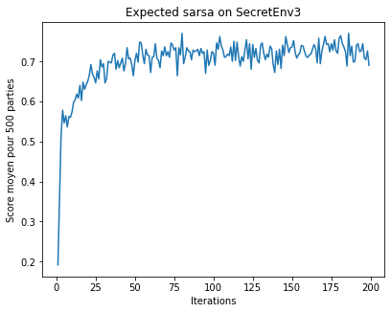
Temporal difference learning
Expected Sarsa
Secret env 3
Alpha 0,3
Gamma 0,7
Epsilon 0,1
70 % de win

Slide 22
Deep reinforcement learning
Algo :
Episodic semi gradient sarsa
Env :
Tic Tac Toe
Secret env 5

Slide 23
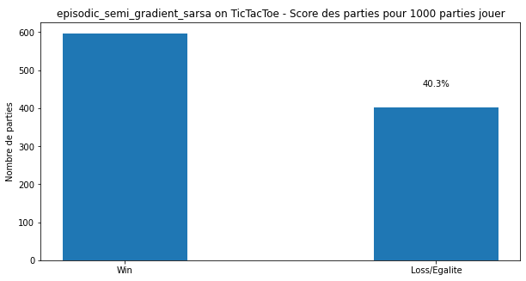
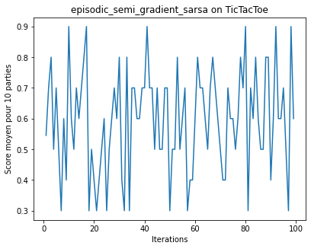
Deep reinforcement learning
Episodic semi gradient sarsa
TIC TAC TOE
Gamma 0,9
Epsilon 0,1
59 % de win
Couche dense
16
64
128
256
128
1
Optimizer
Adam

Slide 24
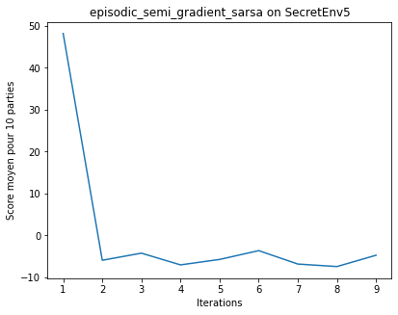
Deep reinforcement learning
Episodic semi gradient sarsa
Secret env 5
Gamma 0,9
Epsilon 0,1
Couche dense
16
64
128
256
128
1
Optimizer
Adam

Slide 25
Conclusion
Line word
Grid word
TIC TAC TOE
On policy first visit Monte carlo avec 94 % de win pour 100 000 parties
SECRET ENV 1
avec % de win pour 100 000 parties
SECRET ENV 2
On policy first visit Monte carlo avec 55 % de win pour 100 000 parties
SECRET ENV 3
Q learning avec 70 % de win pour 100 000 parties

