Slide 1
Evaluate Logical Expressions
with Conditions
Organised & Supported by RuggedBOARD

Slide 2
Agenda
If , if..else.,
Nested if..else
Ternary Operator:
switch

Slide 3
Control Statements
Def: To control the flow of sequence of execution of a program using
certain statements are called "Control Statements".
A block of code will be executed based on given criteria (condition).
Ex:
1.Ternary operator statement (conditional Operator Statement)
2.if statements
3.switch statement (multiple block statement)

Slide 4
Conditional operator statement
The statement formed with conditional operators (ternary operators)
is called "conditional operator statement".
syn: expr1 ? expr2 : expr3 ;
Here, expre1 is a condition, expr2 is a true statement and expr3 is a
false statement.
Example:
(age >= 18) ? printf("Can Vote") : printf("Cannot Vote");
#include <stdio.h>
int main()
{
int age;
// take input from users
printf("Enter your age: ");
scanf("%d", &age);
// ternary operator to find if a person can vote or not
(age >= 18) ? printf("You can vote") : printf("You cannot vote");
return 0;
}
Enter your age: 12
You cannot vote

Slide 5
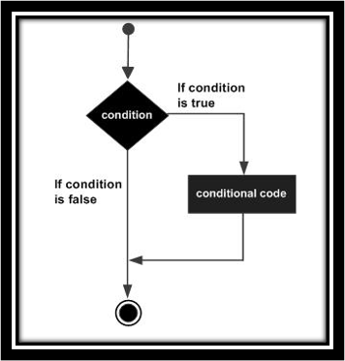
if statement
Simple if:
if (cond.)​​
{​​
//true statements​​
}
#include <stdio.h>
int main ()
{
/* local variable definition */
int a = 10;
/* check the boolean condition using if statement */
if( a < 20 )
{
/* if condition is true then print the following */
printf("a is less than 20\n" );
}
printf("value of a is : %d\n", a);
return 0;
}

Slide 6
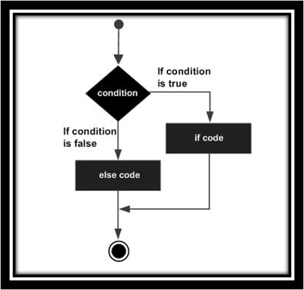
if else statement
if- else statement:​
if (cond.)​
{​
// true statements​
}​
else​
{​
//false statements
}​
#include <stdio.h>
int main ()
{
/* local variable definition */
int a = 100;
/* check the boolean condition */
if( a < 20 )
{
/* if condition is true then print the following */
printf("a is less than 20\n" );
}
else
{
/* if condition is false then print the following */
printf("a is not less than 20\n" );
}
printf("value of a is : %d\n", a);
return 0;
}

Slide 7
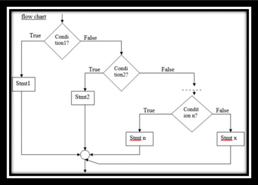
else if ladder statement
Ladder if:
if (cond1)​
{​
// 1 true statements​
}​
else if (cond2)​
{​
// 2 true statements​
}else if (cond3)​
{​
// 3 true statements​
}else​
{​
// false statements​
}

Slide 8
else if ladder statement
#include<stdio.h>
Int main ()
{
int a,b,c,d;
printf("Enter the values of a,b,c,d: ");
scanf("%d%d%d%d",&a,&b,&c,&d);
if(a>b && a>c && a>d)
{
printf("%d is the largest",a);
}else if(b>c && b>a && b>d)
{
printf("%d is the largest",b);
}else if(c>d && c>a && c>b)
{
printf("%d is the largest",c);
}else
{
printf("%d is the largest",d);
}
}

Slide 9
Nested if statement
#include <stdio.h>
int main ()
{
/* local variable definition */
int a = 100;
int b = 200;
/* check the boolean condition */
if( a == 100 )
{
/* if condition is true then check the following */
if( b == 200 )
{
/* if condition is true then print the following */
printf("Value of a is 100 and b is 200\n" );
}
}
printf("Exact value of a is : %d\n", a );
printf("Exact value of b is : %d\n", b );
return 0;
}
Nested if:
if (cond1)​
{​
// outer true statements​
if (cond2)​
{​
//inner true statements​
}​
else
{​
// inner flase statements​
}
}
else​
{​
//outer false statements ​
}

Slide 10
Switch statement
-It is similar to if - statement.​
-This is multiple blocks of statement.​
-It is also a selection statement.​
-Generally, it can used for Menu driven programs only.​
Syn :
switch( var )​
{ /*beginning of the switch */​
case const1 : ​
------------;​
------------;​
break;​
case const2 :​
------------;​
------------;​
break;​
default :​
--------------;​
break;
} /* end of switch*/
-It is an un-conditional control statement.​
-It can be used as the last statement in every case in switch​
statement. ​
-But, in default case need not necessary.​
-Because,default case is the last case in switch statement. ​
-So, control will be comes out from the switch automatically.​
-Generally, it can be used in looping statements also.​
​
Syn: break ;

Slide 11
Switch statement
#include <stdio.h>
int main()
{
int x = 2;
switch (x)
{
case 1:
printf("Choice is 1");
break;
case 2:
printf("Choice is 2");
break;
case 3:
printf("Choice is 3");
break;
default:
printf("Choice other than 1, 2 and 3");
break;
}
return 0;
}
#include <stdio.h>
int main()
{
char x = 'A';
switch (x)
{
case 'A':
printf("Choice is A");
break;
case 'B':
printf("Choice is B");
break;
case 'C':
printf("Choice is C");
break;
default:
printf("Choice other than A, B and C");
break;
}
return 0;
}

Slide 12
Questions ?

