Slide 1
Keep track of a condition true
Organised & Supported by RuggedBOARD

Slide 2
Agenda
Unconditional and Looping Statements
Looping (Iterative)Statements
While
do-while
for
goto
continue
break
Infinite loop

Slide 3
Looping and Un-conditional statements
These can be used for repeating a block of code in specified no. of times or untill the condition returns false.​
​
Ex : 1. while loop ​
2. do-while loop ​
3. for loop.​
​
Advantages :​
- To avoid the re-writing of the same code​
- To reduce the length of a program​
- Executing time is low​
- Save memory space​
- Debugging is easy.
The control will moves from one location to another location without checking any condition in a program.​
​
Ex: 1. goto statement​
2.break statement​
3.continue statement​
4.return statemen

Slide 4
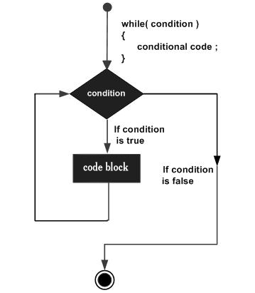
while
While:
It is a pre-checking looping statement, checks the given condition. If it returns TRUE then the block of code is executed.
That the block of code is executed until condition returns FALSE .
If it returns FALSE then exit from the loop.
These can be used for repeating a block of code in specified number of times or untill the condition returns false.
Syn : ​
​
initialization ;​
while (cond)​
{​
-----------------------;​
-----------------------;​
updatable statements;​
}​

Slide 5
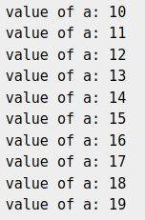
while
#include <stdio.h>
int main ()
{
/* local variable definition */
int a = 10;
/* while loop execution */
while( a < 20 )
{
printf("value of a: %d\n", a);
a++;
}
return 0;
}

Slide 6
do-while
-It is post-checking looping statement.
-after executing the block of code then the condition will be checked.
If it returns TRUE then only -repeat the code otherwise control transfers to the next statement of that loop.
Syn:
Initialization;
do
{
--------------------;
--------------------;
updatable statement;
}
while(cond) ;
Note: It can execute the block of code at least once. This is the main difference between do-while and while looping statements.

Slide 7
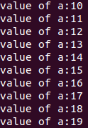
do-while
#include <stdio.h>
int main ()
{
/* local variabledefinition */
int a = 10; /* do loop execution */
do
{
printf("value of a:%d\n", a); a++;
} while( a < 20 );
return 0;
}

Slide 8
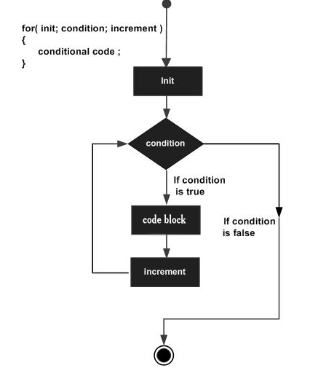
for
-It is also a pre-checking looping statement like while statement.
That means, initially checks the given condition.
-If it returns TRUE then the block of code is executed until condition returns FALSE .
-If it returns FALSE then exit from the loop.
Syn:
for ( initialization ; condition ; updatable statement )
{
// body of loop
}
Note:The main difference is the statements
(Initialization, condition and updatable) are in the same line in for loop

Slide 9
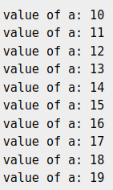
for
#include <stdio.h>
int main ()
{
int a;
/* for loop execution */
for( a = 10; a < 20; a = a + 1 )
{
printf("value of a: %d\n", a);
}
return 0;
}

Slide 10
goto
It is the un-conditional control statement.​
It can transfer the control from one location to another location​
in the same program without checking any condition.
​
The word goto is the one of the key word.
​
goto label ; // declaration or/and calling a label​
label :​
executable statements ;​
--------------------------------​
--------------------------------​
When the goto statement is executed, control transfers to the definition of the label.​
Any no. of gotos can be used in a program.​
But, each label must be defined uniquely.

Slide 11
goto
#include <stdio.h>​
​
int main() ​
{​
int num = 26;​
if (num % 2 == 0)​
// jump to even​
goto even; ​
else​
// jump to odd​
goto odd; ​
​
even:​
printf("%d is even\n", num);​
return 0; ​
odd:​
printf("%d is odd\n", num);​
return 0;​
}
26 is even

Slide 12
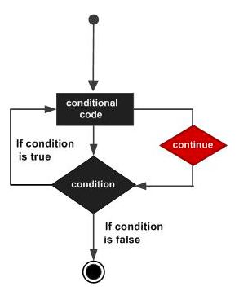
continue
Continue forces the next iteration of the loop to take place, skipping any code in between.
#include <stdio.h>
int main ()
{
/* local variable definition */
int a = 10;
/* do loop execution */
do
{
if( a == 15)
{
/* skip the iteration */
a = a + 1; continue;
}
printf("value of a: %d\n", a);
a++;
} while( a < 20 );
return 0;
}

Slide 13
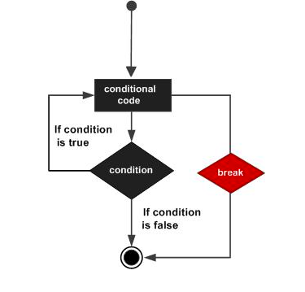
break
The break statement in C programming has the following two usages −
When a break statement is encountered inside a loop, the loop is immediately terminated and the program control resumes at the next statement following the loop.
It can be used to terminate a case in the switch statement .
[If you are using nested loops, the break statement will stop the execution of the innermost loop and start executing the next line of code after the block.]
#include <stdio.h>
int main ()
{
/* local variable definition */
int a = 10;
/* while loop execution */
while( a < 20 )
{
printf("value of a: %d\n", a);
a++;
if( a > 15)
{
/* terminate the loop
using break statement */
break;
}
}
return 0;
}

Slide 14
Thank YOU

