Slide 1
Working with fixed memory locations
Organised & Supported by RuggedBOARD

Slide 2
Agenda
Arrays
Array Declaration & Initialisation
Printing Array Elements
Array Length
2D- Arrays
2D-Array Declaration & Accessing Elements

Slide 3
Arrays
Def : Set of similar data elements has shared a common name called an Array.​
Syn: varname [ size ]​
Here, size must be a +ve integer only. ​
size represent maximum size of an Array.​
Types of Arrays:​
There are two types of arrays. ​
Those are,​
i.Single Dimensional Array [1 - D array]​
ii.Multi Dimensional Array [n - D array]
Multi dimensional array:​
A variable name followed by more than one pair of square brackets ([ ]) called 'Multi dimensional array'.​
​
Syn: Datatype varname [size1] [size2] [size3] ...[size n];​
​
2 - D Array :A variable name followed by two pair of square brackets ([ ]) called '2 - D array'.​
​
Syn: Datatype varname[size1][size2];​
​
Int a[3][2];​
Here, 3 --> rows and 2 --> columns.
Single dimensional array :​
A variable name followed by a single pair of square brackets called​
'Single dimensional array'.​
​Syn: Datatype varname [size];​
Ex: int a[5];​
​
Here, 'a' is a variable name and 5 is the maximum size of that array.​
That means 'a' can holds 5 integer values.​
​If a variable is declared as int data type that array is called 'integer array'. ​
Similarly, 'float array'. ​
But character array is called a 'string'

Slide 4
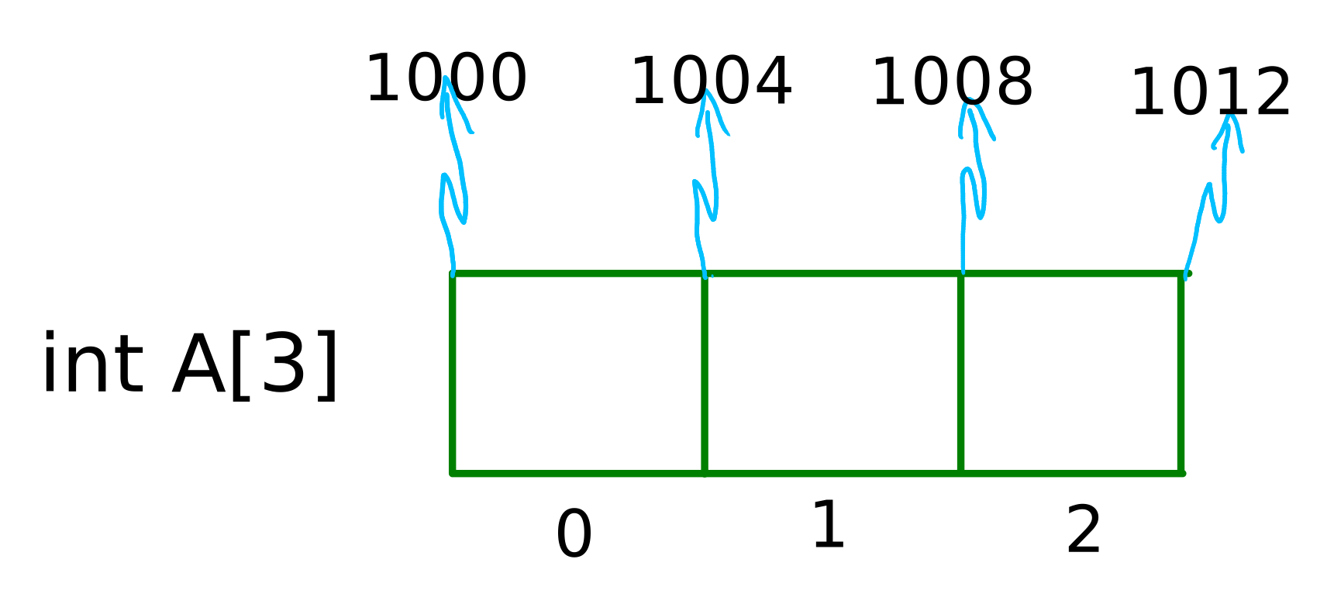
Arrays
Arrays are structures that hold multiple variables of the same data type.
An array from integer type holds integer values.​
​
int scores[10];​
​
The array "scores" contains an array of 10 integer values.​
We can use each member of array by specifying its index value.​
Members of above array are scores[0],...,scores[9] and we can work with these variables like other variables

Slide 5
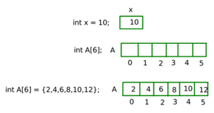
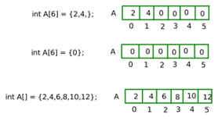
Array Declaration & Initialisation

Slide 6

Printing Array Elements
#include <stdio.h>
#include <stdlib.h>
int main()
{
int A[6]={2,4,6,8,10,12};
int *p;
int i;
for(i=0;i<6;i++)
{
printf("%d ",A[i]);
}
printf("\n");
return 0;
}
Character strings are arrays of characters.​
Each member of array contains one of characters in the string.​
#include<stdio.h>​
Int main()​
{​
char name[20];​
printf("Enter your name : ");​
scanf("%s",name);​
printf("Hello, %s , how are you ?\n",name);​
return 0;
}​
Enter your name : Brian​
If user enters "Brian" then the first member of array will contain 'B' , second cell will contain 'r' and so on.
Note: type name by leaving space and check.
Accessing Array element :
printf("%d ",A[i]);
printf("%d",i[A]);
printf("%d",*(A+i);

Slide 7
Printing Array Elements
#include<stdio.h>
int main()
{
char name[20];
printf("Enter your name : ");
scanf("%[^\n]s",name);
printf("Hello, %s , how are you ?\n",name);
return 0;
}
#include<stdio.h>
int main()
{
char arr[4] = {'a','b','c','\0'};//if no '\0' need to use loop to print
printf("arr[] is %s\n",arr);
return 0;
}

Slide 8
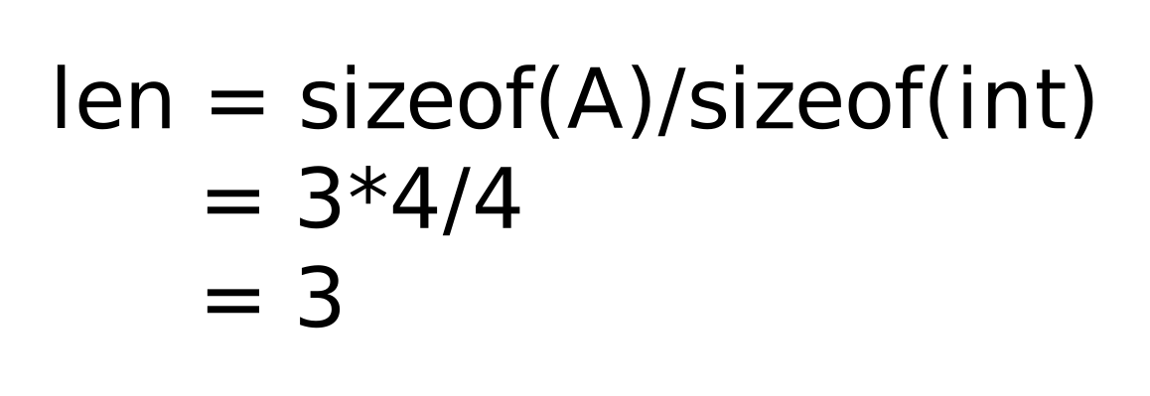
Array Length
#include<stdio.h>
int main()
{
int arr[10];
int len = sizeof(arr)/sizeof(int);
for(int i =0;i<len;i++)
arr[i] = i*2;
for(int i = 0;i<len;i++)
printf("arr[%d] is %d \n",i,arr[i]);
return 0;
}

Slide 9
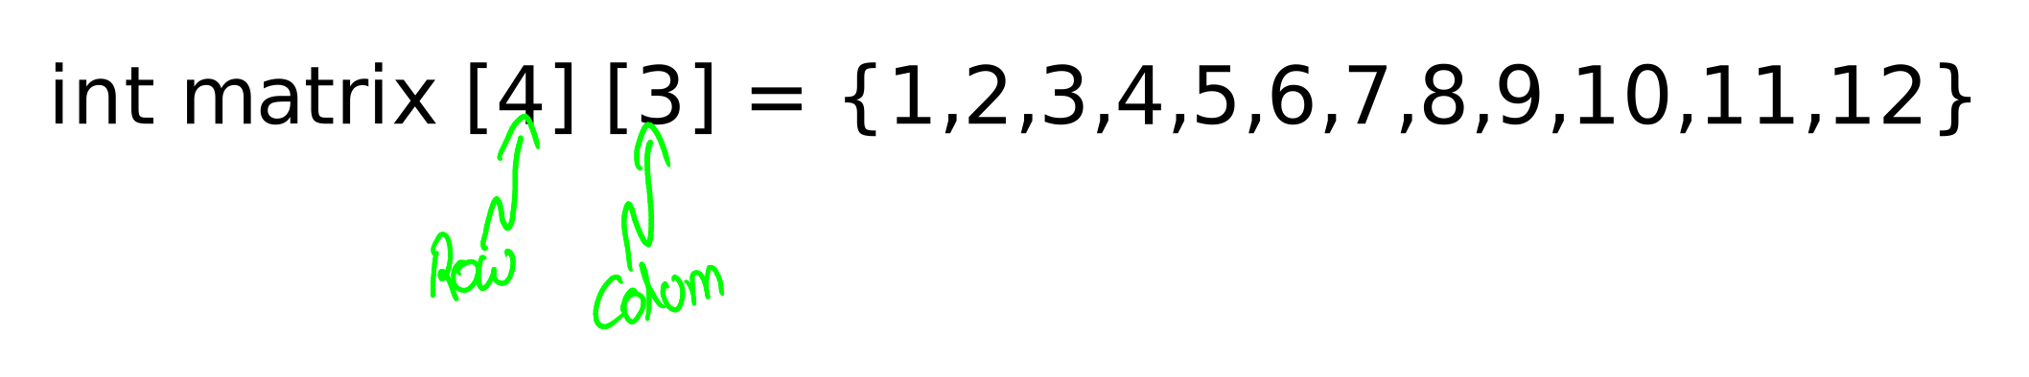
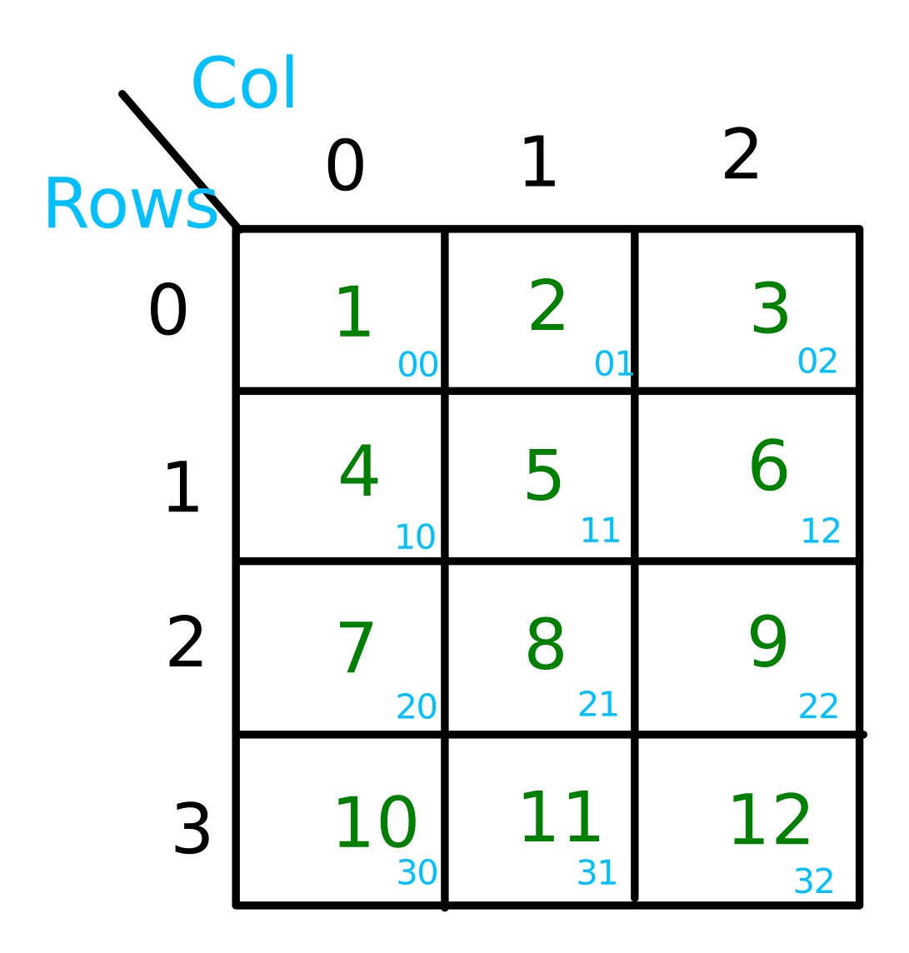
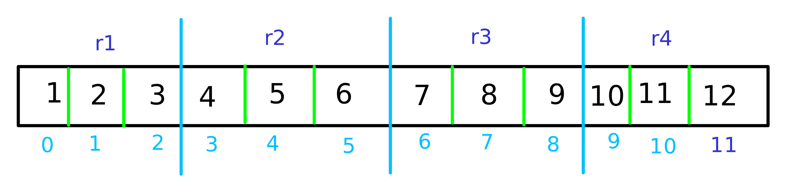
2D-Arrays
Compiler stores data in below form for 2D array

Slide 10
2D-Array Declaration & Accessing Elements
#include <stdio.h>
#include <stdlib.h>
int main()
{
int A[4][3]={1,2,3,4,5,6,7,8,9,10,11,12};
for(int i=0;i<4;i++)
{
for(int j=0;j<3;j++)
{
printf("%d ",A[i][j]);
}
printf("\n");
}
return 0;
}
#include <stdio.h>
#include <stdlib.h>
int main()
{
int A[3][4]={{1,2,3,4},{2,4,6,8},{1,3,5,7}};
for(int i=0;i<3;i++)
{
for(int j=0;j<4;j++)
{
printf("%d ",A[i][j]);
}
printf("\n");
}
return 0;
}

Slide 11
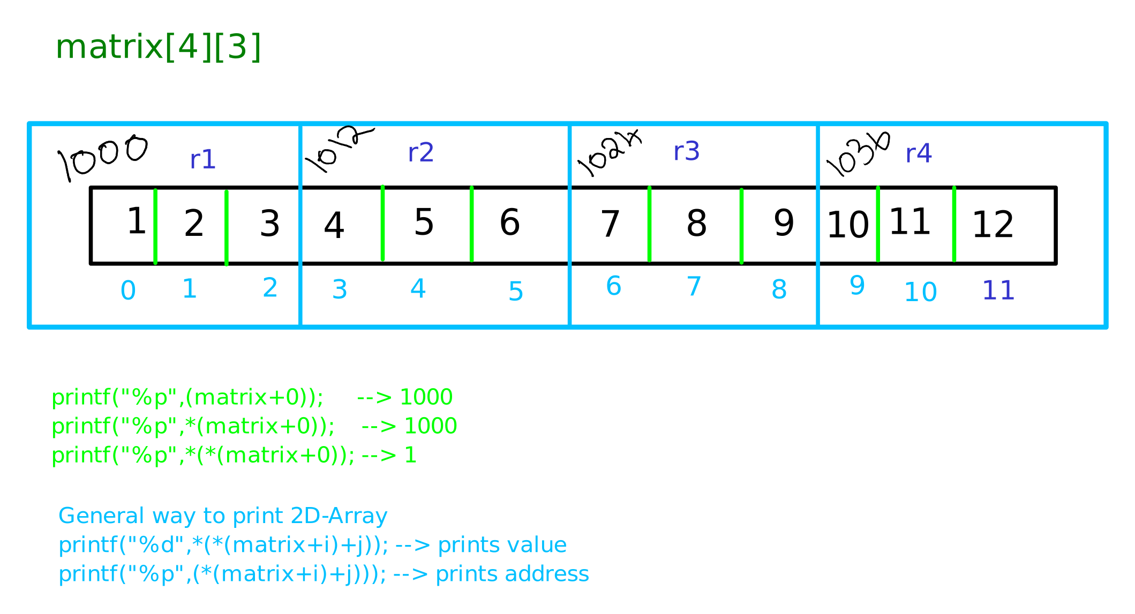
2D-Array Declaration & Accessing Elements

Slide 12
2D-Array Declaration & Accessing Elements
#include <stdio.h>
#include <stdlib.h>
int main()
{
int A[4][3]={1,2,3,4,5,6,7,8,9,10,11,12};
for(int i=0;i<4;i++)
{
for(int j=0;j<3;j++)
{
printf("%d ",A[i][j]);
printf("%p ",(*(A+i)+j));
}
printf("\n");
}
return 0;
}

Slide 13
Thank YOU

