Slide 1
Introduction to group of words and filter on condition basis
Organised & Supported by RuggedBOARD

Slide 2
Agenda
Defining a String
Printing String
ASCII Code
Length of a String
Changing case UtoL of a String
Reverse a String
String lib Functions
Typedef
Typedef Vs #define
Enumeration

Slide 3
Defining a String
A string is a sequence of text characters that can become a value for a string variable.​
Array of characters which is terminated by a null character '\0'.​
How to initialize strings?​
char c[] = "abcd";​
​
char c[50] = "abcd";​
​
char c[] = {'a', 'b', 'c', 'd', '\0'};​
​
char c[5] = {'a', 'b', 'c', 'd', '\0'};
include<stdio.h>
int main()
{
//const char name[10]="phytec";
//char name[10]="phytec";
char name[10];
name = "phytec";
name[2] = 'z';
printf("%s\n",name);
return 0;
}
Assigning Values to Strings :​
1.char c[] = "abcd";
2.char c[100];​
c = "C programming"; // Error! array type is not assignable.

Slide 4
Printing String
Reading strings: %s format
%s reads a string into a character array​ given the array name or start address. ​
It ends the string with ‘\0’
#include<stdio.h>
Int main()
{
char name[25];
scanf("%s", name);
printf("Name = %s \n", name);
return 0;
}
A string constant is treated as a pointer ​
Its value is the base address of the string​
char *p = “abc”;​
​
​
​
printf (“%s %s\n”,p,p+1); /* abc bc is printed */
p
a
b
c
\0

Slide 5
Printing String
#include<stdio.h>
int main()
{
char name[20] = "Phytec Embedded";
for(int i=0;name[i] != '\0';i++)
{
printf("%c",name[i]);
}
printf("\n");
printf("%s\n",name);
return 0;
}
#include<stdio.h>
int main()
{
char a;
while((a= getchar() != 10))
printf("%c",a);
return 0;
}

Slide 6
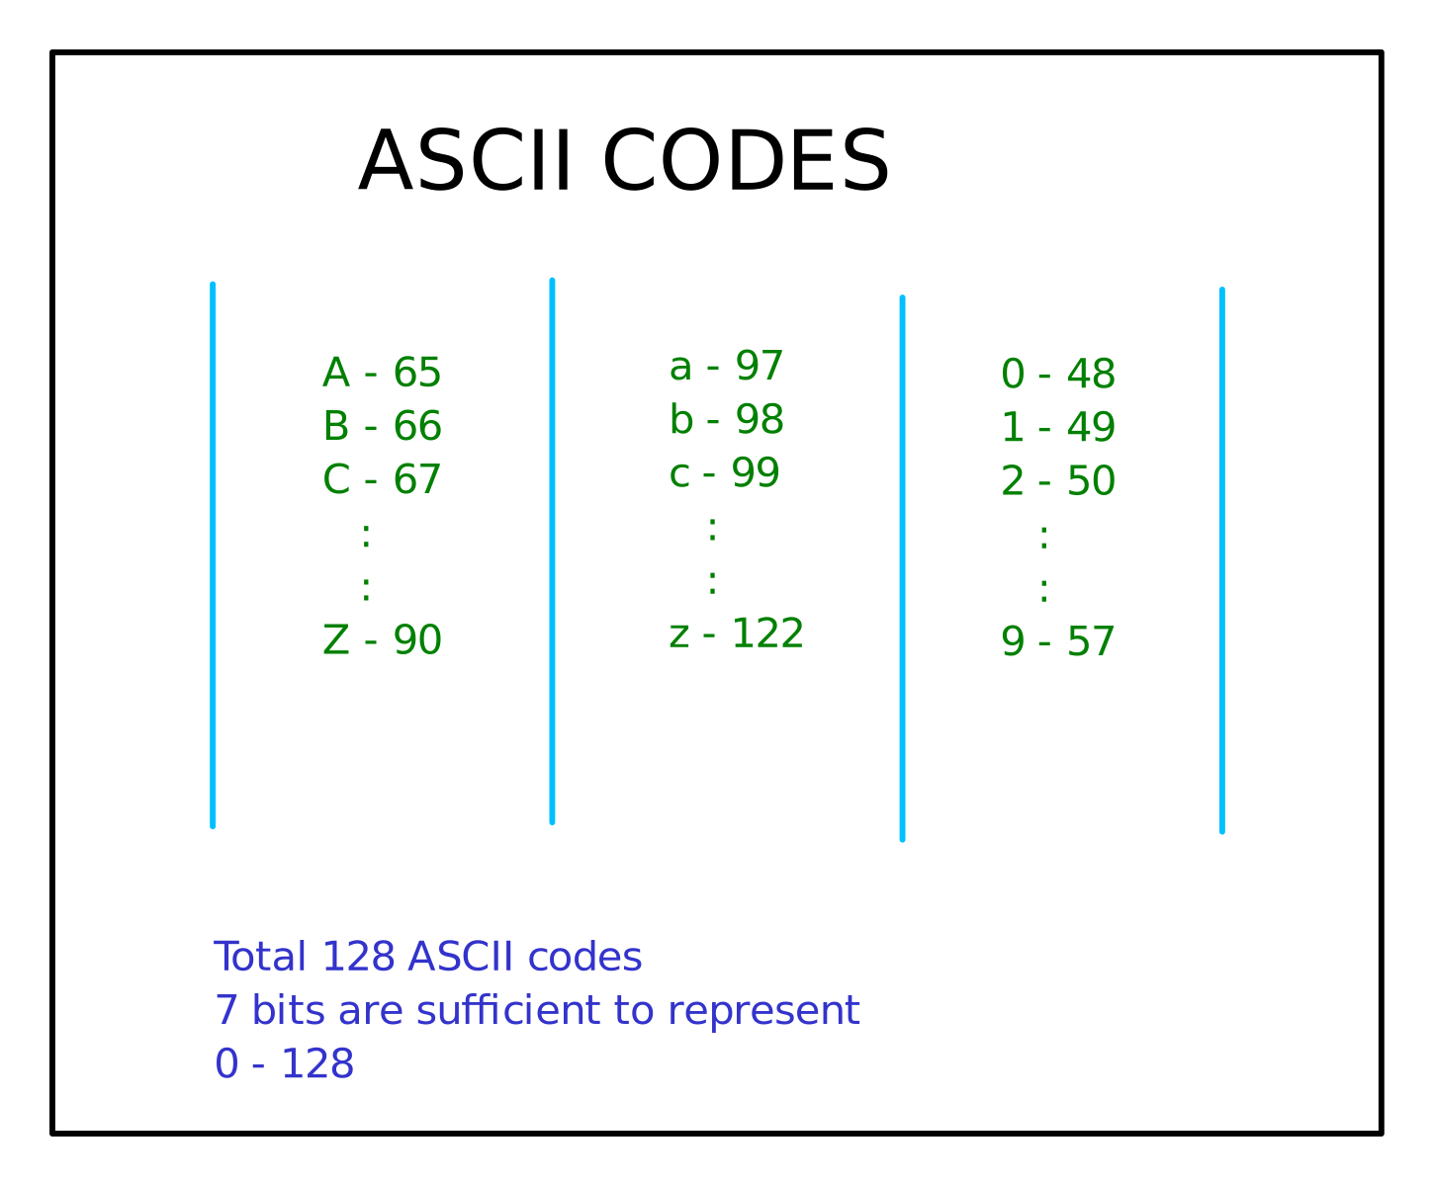
ASCII Codes

Slide 7
Length of a string
#include<stdio.h>
int string_len(char *);
int main()
{
int len;
len = string_len("Welcome");
printf("The length of the string is : %d\n",len);
return 0;
}
int string_len(char string[])
{
int len;
for(len=0 ; string[len] != '\0';len++)
{}
return len;
}

Slide 8
Changing case UtoL of a string
#include<stdio.h>
void string_case_ul(char *);
int main()
{
string_case_ul("WELCOME");
return 0;
}
void string_case_ul(char* str)
{
int i;
char a[10];
for(i=0 ; *str != '\0';str++,i++)
{
a[i] = *str + 32;
}
printf("The case changed string is '%s'\n",a);
}

Slide 9
Reverse a string
#include <stdio.h>
#include <string.h>
void reverseString(char *);
int main()
{
char str[512];
scanf("%s", str);
reverseString(str);
printf("\nString After Reverse: %s\n", str);
return 0;
}
void reverseString(char str[])
{
int n = strlen(str);
for (int i = 0; i < n / 2; i++)
{
char ch = str[i];
str[i] = str[n - i - 1];
str[n - i - 1] = ch;
}
}

Slide 10
String lib functions
String functions defined in the header file “string.h”
strcpy()
copies a string to another string
Strlen()
calculates length of a string
strcat()
concatenates two strings
strrev()
reversed strings of a string
strcmp()
compare two strings
strlwr()
converts into lower case
strupr()
converts into upper case
strstr()
substring of the given string

Slide 11
String lib functions
#include<stdio.h>
#include<string.h>
int main()
{
char name[30] = "Phytec Embedded";
char name1[30];
char * ptr;
ptr = strcpy(name1,name);
printf("name is %s\n",name);
printf("name1 is %s\n",name1);
return 0;
}
#include <stdio.h>
#include <string.h>
int main()
{
char destination[] = "Hello ";
char source[] = "World!";
strcat(destination,source);
printf("Concatenated String: %s\n", destination);
return 0;
}

Slide 12
Typedef
#include <stdio.h>
#include <string.h>
typedef struct Books
{
char title[50];
char author[50];
char subject[100];
int book_id;
} Book;
int main( )
{
Book book;
strcpy( book.title, "C Programming");
strcpy( book.author, "Nuha Ali");
strcpy( book.subject, "C Programming Tutorial");
book.book_id = 6495407;
printf( "Book title : %s\n", book.title);
printf( "Book author : %s\n", book.author);
printf( "Book subject : %s\n", book.subject);
printf( "Book book_id : %d\n", book.book_id);
return 0;
}
The C programming language provides a keyword called typedef, which you can use to give a type a new name.
typedef unsigned char BYTE;
After this type definition, the identifier BYTE can be used as an abbreviation for the type unsigned char, for example..
BYTE b1, b2;

Slide 13
Typedef vs #define
#define is a C-directive which is also used to define the aliases for various data types similar to typedef but with the following differences −
typedef is limited to giving symbolic names to types only
where as #define can be used to define alias for values as well.
you can define 1 as ONE etc.
typedef interpretation is performed by the compiler
whereas #define statements are processed by the pre-processor.
#include <stdio.h>
#define TRUE 1
#define FALSE 0
int main( )
{
printf( "Value of TRUE : %d\n", TRUE);
printf( "Value of FALSE : %d\n", FALSE);
return 0;
}

Slide 14
Enumeration
Enumeration (or enum) is a user defined data type in C. It is mainly used to assign names to integral constants, the names make a program easy to read and maintain.
#include<stdio.h>
enum week{Mon, Tue, Wed, Thur, Fri, Sat, Sun};
int main()
{
enum week day;
day = Wed;
printf("%d\n",day);
return 0;
}

Slide 15
Thank You

