Slide 1
VoiceOps Bridge(Incident Commander)
Voice-first incident triage copilot (Vocal Bridge + LiveKit)
Real-time voice
UI actions
Guardrails
Demo in ~60 seconds:
1) Start Voice Chat → speak incident context
2) Agent opens runbook + checklist (or reads aloud in voice-only) (or reads aloud in voice-only) + drafts update
3) Confirm before any write/notify action
4) End call → post-processing summary
Nataraj Sundar
Notes:
[Sources]
- Vocal Bridge Developer Guide (token generation + LiveKit connect + client actions): https://vocalbridgeai.com (Developer Guide PDF)
[/Sources]

Slide 2
Problem → Goals
On-call incidents are chaotic.
VoiceOps Bridge turns a noisy incident bridge into structured, actionable work, safely.
Pain points
Goals
• Context scattered across chat, dashboards, runbooks
• Status updates steal time from debugging
• High risk of “wrong action” under pressure
• Post-incident writeups are slow and incomplete
• Speak the incident; agent structures the triage
• Agent drives UI via client actions (runbook/checklist)
• Draft stakeholder update in real time
• Guardrails + observability baked in
Notes:
[Sources]
- Vocal Bridge Developer Guide (real-time voice via WebRTC/LiveKit; client actions via data channel): https://vocalbridgeai.com
[/Sources]

Slide 3
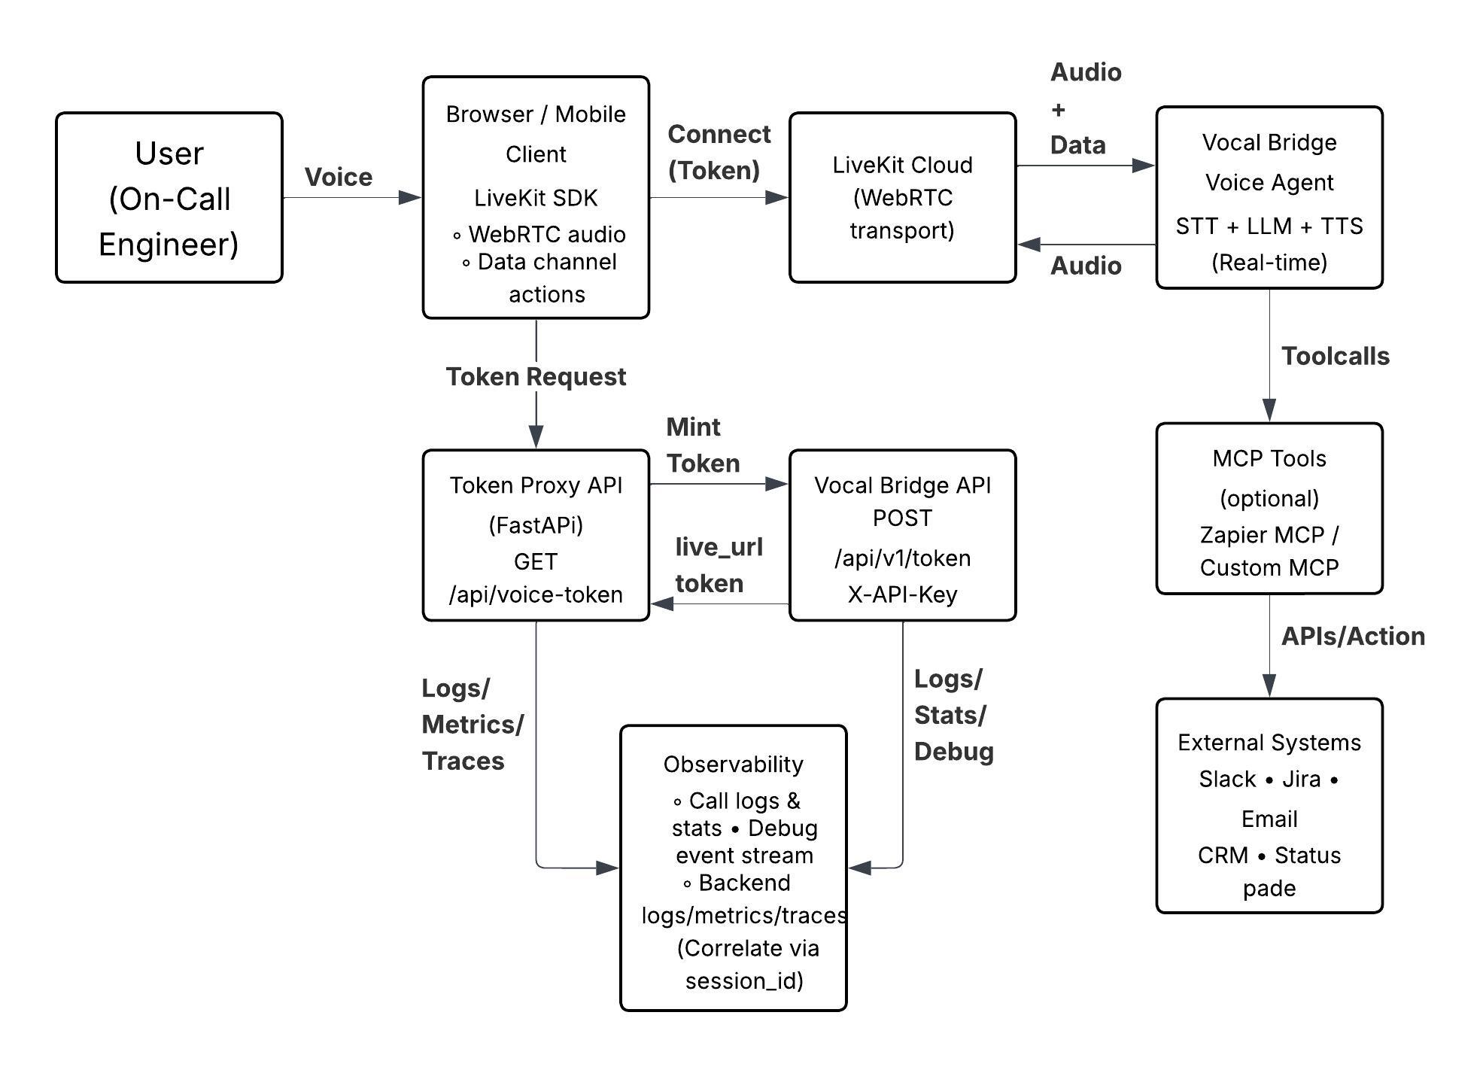
Architecture (high level)
Secure token minting + real-time voice + UI actions
Backend holds the API key and mints short-lived LiveKit tokens; the browser connects and exchanges audio + client actions.
(Phone calls skip the browser token proxy; the same agent runs via the provisioned phone number.)
Notes:
[Sources]
- Vocal Bridge Developer Guide (server-side token generation; LiveKit connect; tokens expire; client actions topic): https://vocalbridgeai.com
[/Sources]

Slide 4
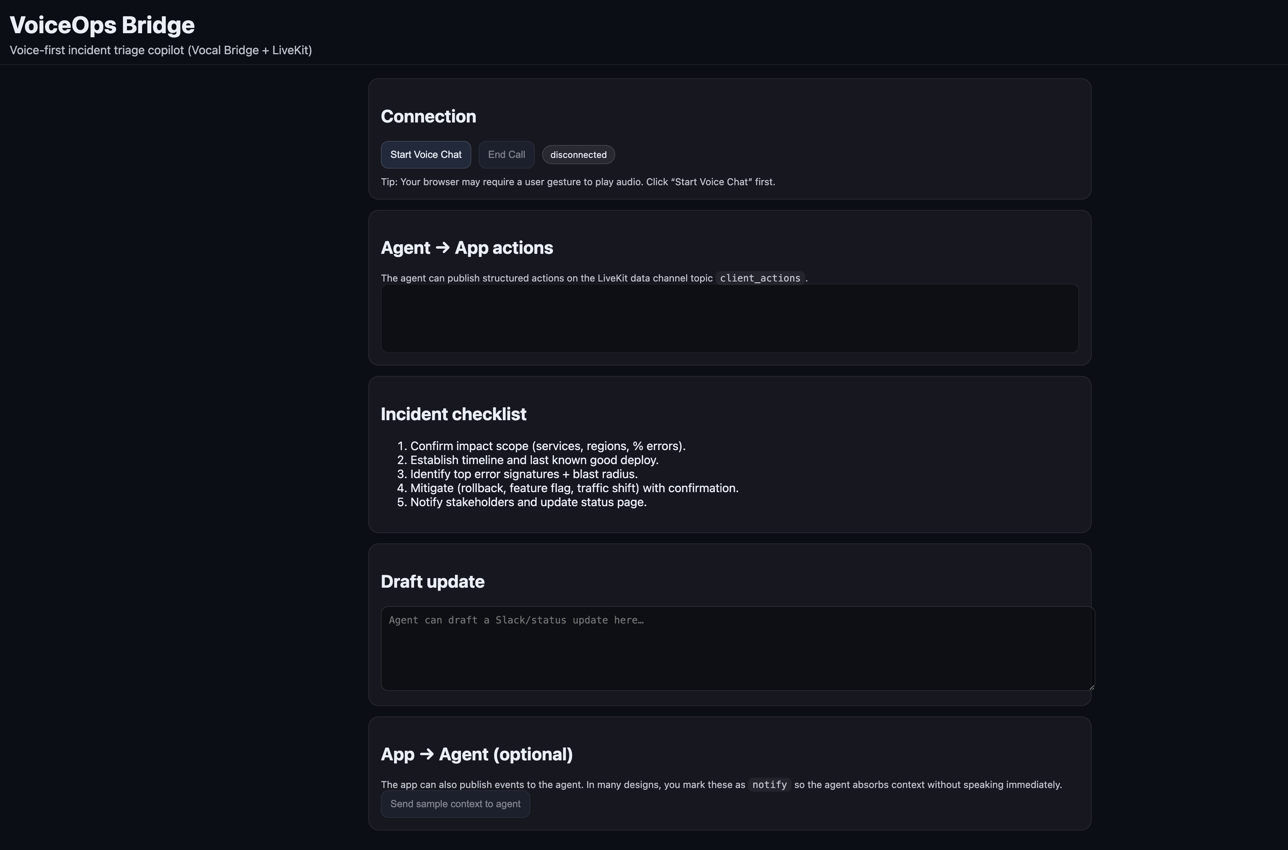
Architecture (high level)
Secure token minting + real-time voice + UI actions
Backend holds the API key and mints short-lived LiveKit tokens; the browser connects and exchanges audio + client actions.
(Phone calls skip the browser token proxy; the same agent runs via the provisioned phone number.)
Notes:
[Sources]
- Vocal Bridge Developer Guide (server-side token generation; LiveKit connect; tokens expire; client actions topic): https://vocalbridgeai.com
[/Sources]

Slide 5
Decision boundaries (guardrails)
Agentic UI control — without dangerous surprises
Boundary rules
Prevent feedback loops
Allowlist of agent→app actions (navigate, open_runbook, show_checklist, draft_update)
Two-step confirmation for any “write” (notify stakeholders, create ticket)
Payload validation: size limits, URL allowlist, schema checks
Rate-limit actions to prevent UI spam
App → Agent events are tagged with behavior:
• respond: agent replies immediately
• notify: silent context only (no immediate reply)
Use notify for UI telemetry (button_clicked, data_loaded)
Use respond only when you want the agent to speak
Stops “agent action → client event → agent reply → …” loops
Notes:
[Sources]
- Vocal Bridge Developer Guide (Client Actions + respond vs notify behavior to prevent feedback loops): https://vocalbridgeai.com
[/Sources]

Slide 6
Observability + failure handling
Ship it like production: debug, measure, recover
Observability
Failure handling
• Correlate everything with session_id
• vb logs: transcripts + recordings
• vb stats: aggregate success/failure
• vb debug: live stream (transcripts, tool calls, errors)
• Key metrics: token mint errors, reconnect rate, action reject rate
• Token failure/expiry → re-mint + reconnect
• WebRTC drop → exponential backoff + resume
• Mic permission denied → clear UX + retry
• Tool/MCP failure → safe fallback, never block call
• “Degraded mode” banner (voice-only if UI actions fail)
PII Obfuscation
Content Moderation
Permissions and Privacy
Decision Boundaries
Notes:
[Sources]
- Vocal Bridge CLI (vb logs / vb stats / vb debug): https://pypi.org/project/vocal-bridge/
- Vocal Bridge Developer Guide (token expiry; reconnect by requesting new token): https://vocalbridgeai.com
[/Sources]

Slide 7
Live demo
What I will demo
90-second flow
Repo + docs
Click “Start Voice Chat” (browser connects via LiveKit token minted by backend)
Say: “Elevated 5xx on checkout — start triage.”
Agent triggers UI: opens runbook + checklist (or reads aloud in voice-only) (or reads aloud in voice-only); begins a timeline
Ask: “Give me a Slack-ready update.” → it drafts and reads it aloud
Ask: “Notify stakeholders.” → confirmation gate triggers (requires explicit 'confirm') (requires explicit 'confirm')
End call → optional post-processing summary
Includes:
• System design
• Decision boundaries
• Observability
• Failure handling
• Presentation
github.com/natsundar/voiceops-bridge
One-line pitch:
“Voice agent that runs the incident bridge, not just listens.”
Notes:
[Sources]
- Vocal Bridge Developer Guide (backend token minting; LiveKit client connect; client actions): https://vocalbridgeai.com
[/Sources]

