Slide 1

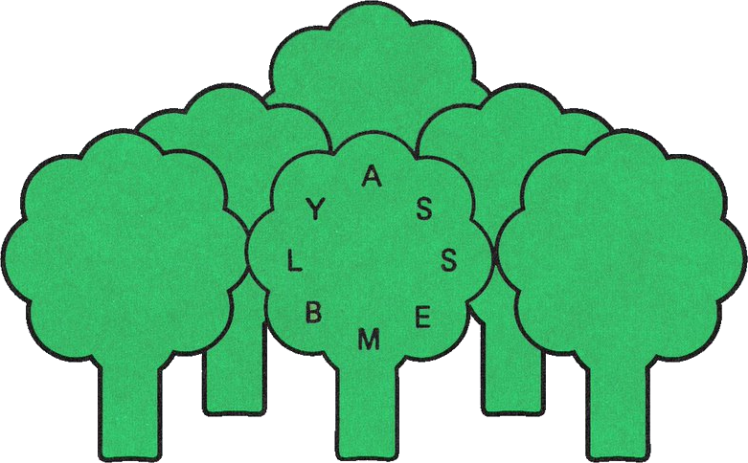
Urbit for Developers
Assembly 2021
~lagrev-nocfep · @sigilante · Neal Davis

Slide 2
“If you find your life tangled up with somebody else’s life
for no very logical reasons,” writes Bokonon,
“that person may be
a member of your karass.”
—Kurt Vonnegut, Cat’s Cradle

Slide 3
OKAY!
NOPE!
✓
✘
you are:
- done
- ready to move on
- bored
you are:
- stuck
- in need of help
- lost

Slide 4
PollEv.com/nealdavis717

Slide 5
# Python
def fibonacci(n):
i = 0
p = 0
q = 1
r = []
while (i < n):
i = i + 1
po = p
p = q
q = po + q
r.append(q)
r.reverse()
return r

Slide 6
# Python
def fibonacci(n):
i = 0
p = 0
q = 1
r = []
while (i < n):
i = i + 1
po = p
p = q
q = po + q
r.append(q)
r.reverse()
return r
:: “Aural” Hoon Pseudocode
gate n=uint {
let [i=0 p=0 q=1 \
r=(list uint)]
do {
if (i == n) return r
} loop {
i ← i+1
p ← q q ← (p + q)
r ← [q] + r
}
match-type r
apply flop
}

Slide 7
# Actual Hoon
|= n=@ud
%- flop
=+ [i=0 p=0 q=1 \
r=*(list @ud)]
|- ^+ r
?: =(i n) r
%= $
i +(i)
p q
q (add p q)
r [q r]
==
:: “Aural” Hoon Pseudocode
gate n=uint {
let [i=0 p=0 q=1 \
r=(list uint)]
do {
if (i == n) return r
} loop {
i ← i+1
p ← q q ← (p + q)
r ← [q] + r
}
match-type r
apply flop
}

Slide 8
Fakezod Setup
Navigate to a new directory /home/username/urbit
Download the pill, or pre-packaged Urbit OS configuration:
wget https://bootstrap.urbit.org/urbit-v1.6.pill
Start a new fakezod in this directory with
urbit -F zod -B urbit-v1.6.pill
Mount the filesystem: |mount %home
Press Ctrl+D to exit the Urbit session.
Copy the fakezod to a local backup: cp -r zod zod-ist-tot

Slide 9
Fakezod Development
Save the file as urbit/gen/fib.hoon
Tell the fakezod to update from Unix:
|commit %home
Run the generator in the Dojo:
+fib 15

Slide 10
|=
n=@ud
%-
flop
=+
[i=0 p=0 q=1 r=*(list @ud)]
|-
^+
r
?:
=(i n)
r
%=
$
i
+(i)
p
q
q
(add p q)
r
[q r]
==
:: Original
|= n=@ud
%- flop
=+ [i=0 p=0 q=1 r=*(list @ud)]
|- ^+ r
?: =(i n) r
%= $
i +(i)
p q
q (add p q)
r [q r]
==
:: Expanded runes & children →

Slide 11
Exercise
If we list all the natural numbers below 10 that are multiples of 3 or 5, we get 3, 5, 6 and 9. The sum of these multiples is 23.
Find the sum of all the multiples of 3 or 5 below 1000.

Slide 12
Exercise
Try the following auras:
`@ud`0x1001.1111
`@ub`0x1001.1111
`@ux`0x1001.1111
`@p`0x1001.1111
`@ud`.1
`@ux`.1
`@ub`.1
`@sb`.1
`@p`0b1111.0000.1111.0000
`@ta`'hello'
`@ud`'hello'
`@ux`'hello'
`@uc`'hello'
`@sb`'hello'
`@rs`'hello'

Slide 13
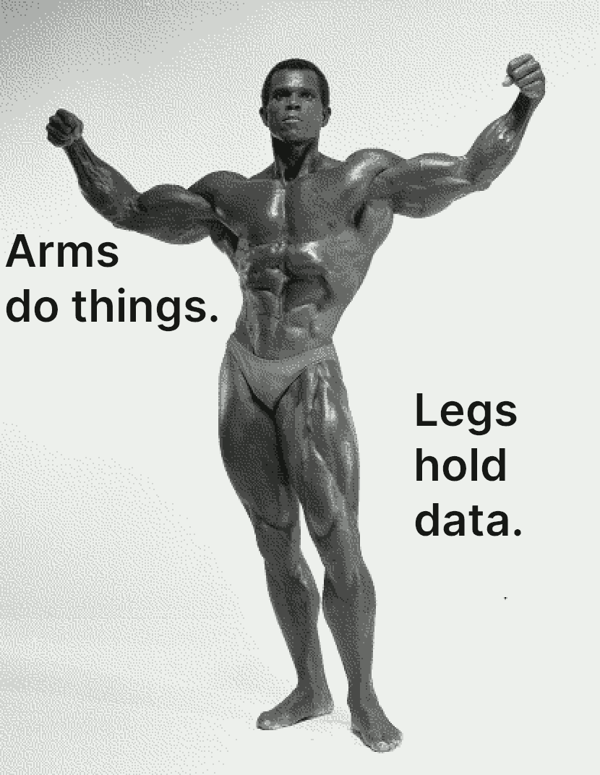

Slide 14
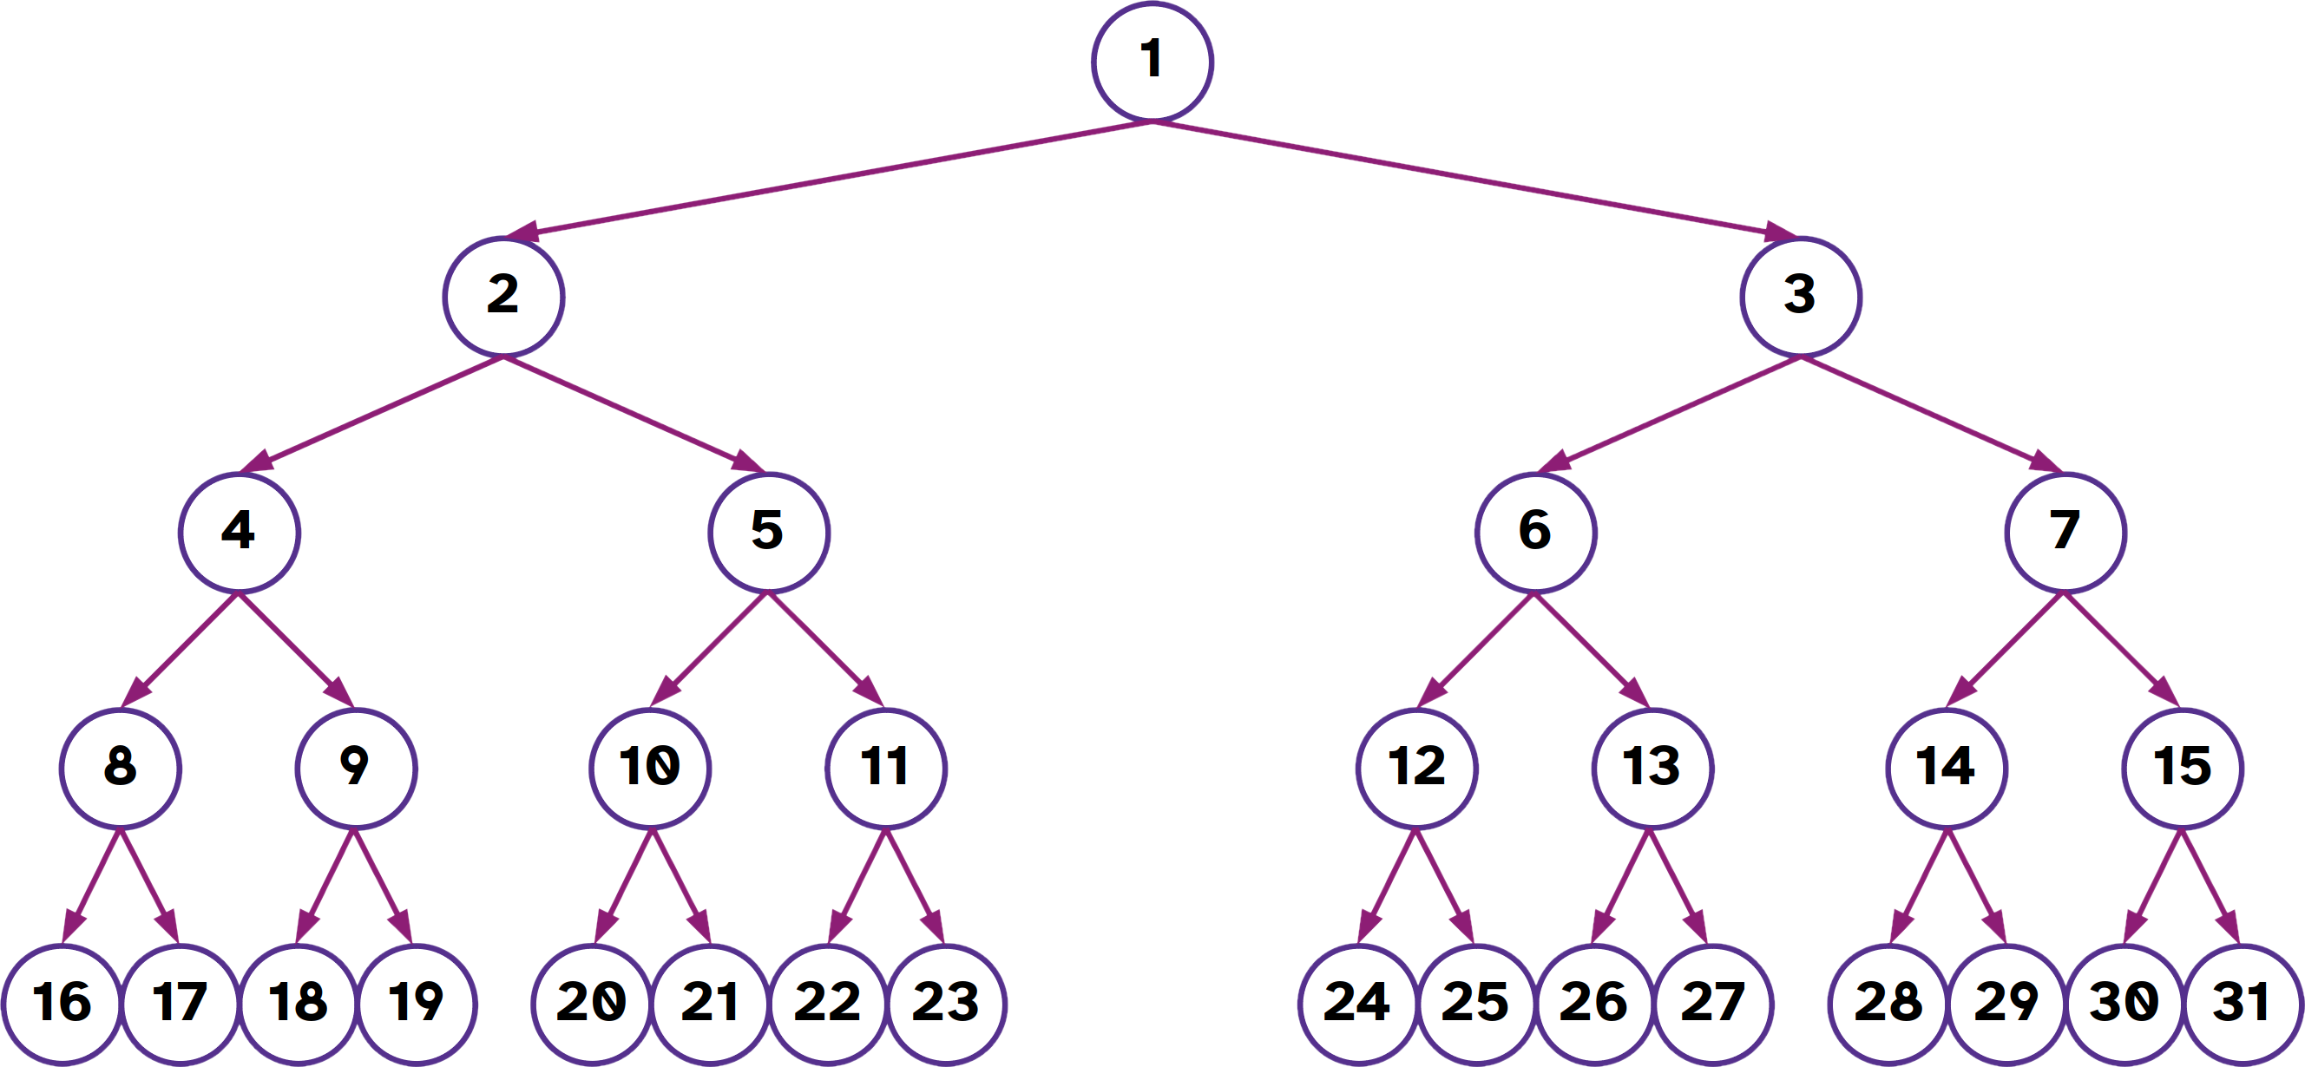

Slide 15
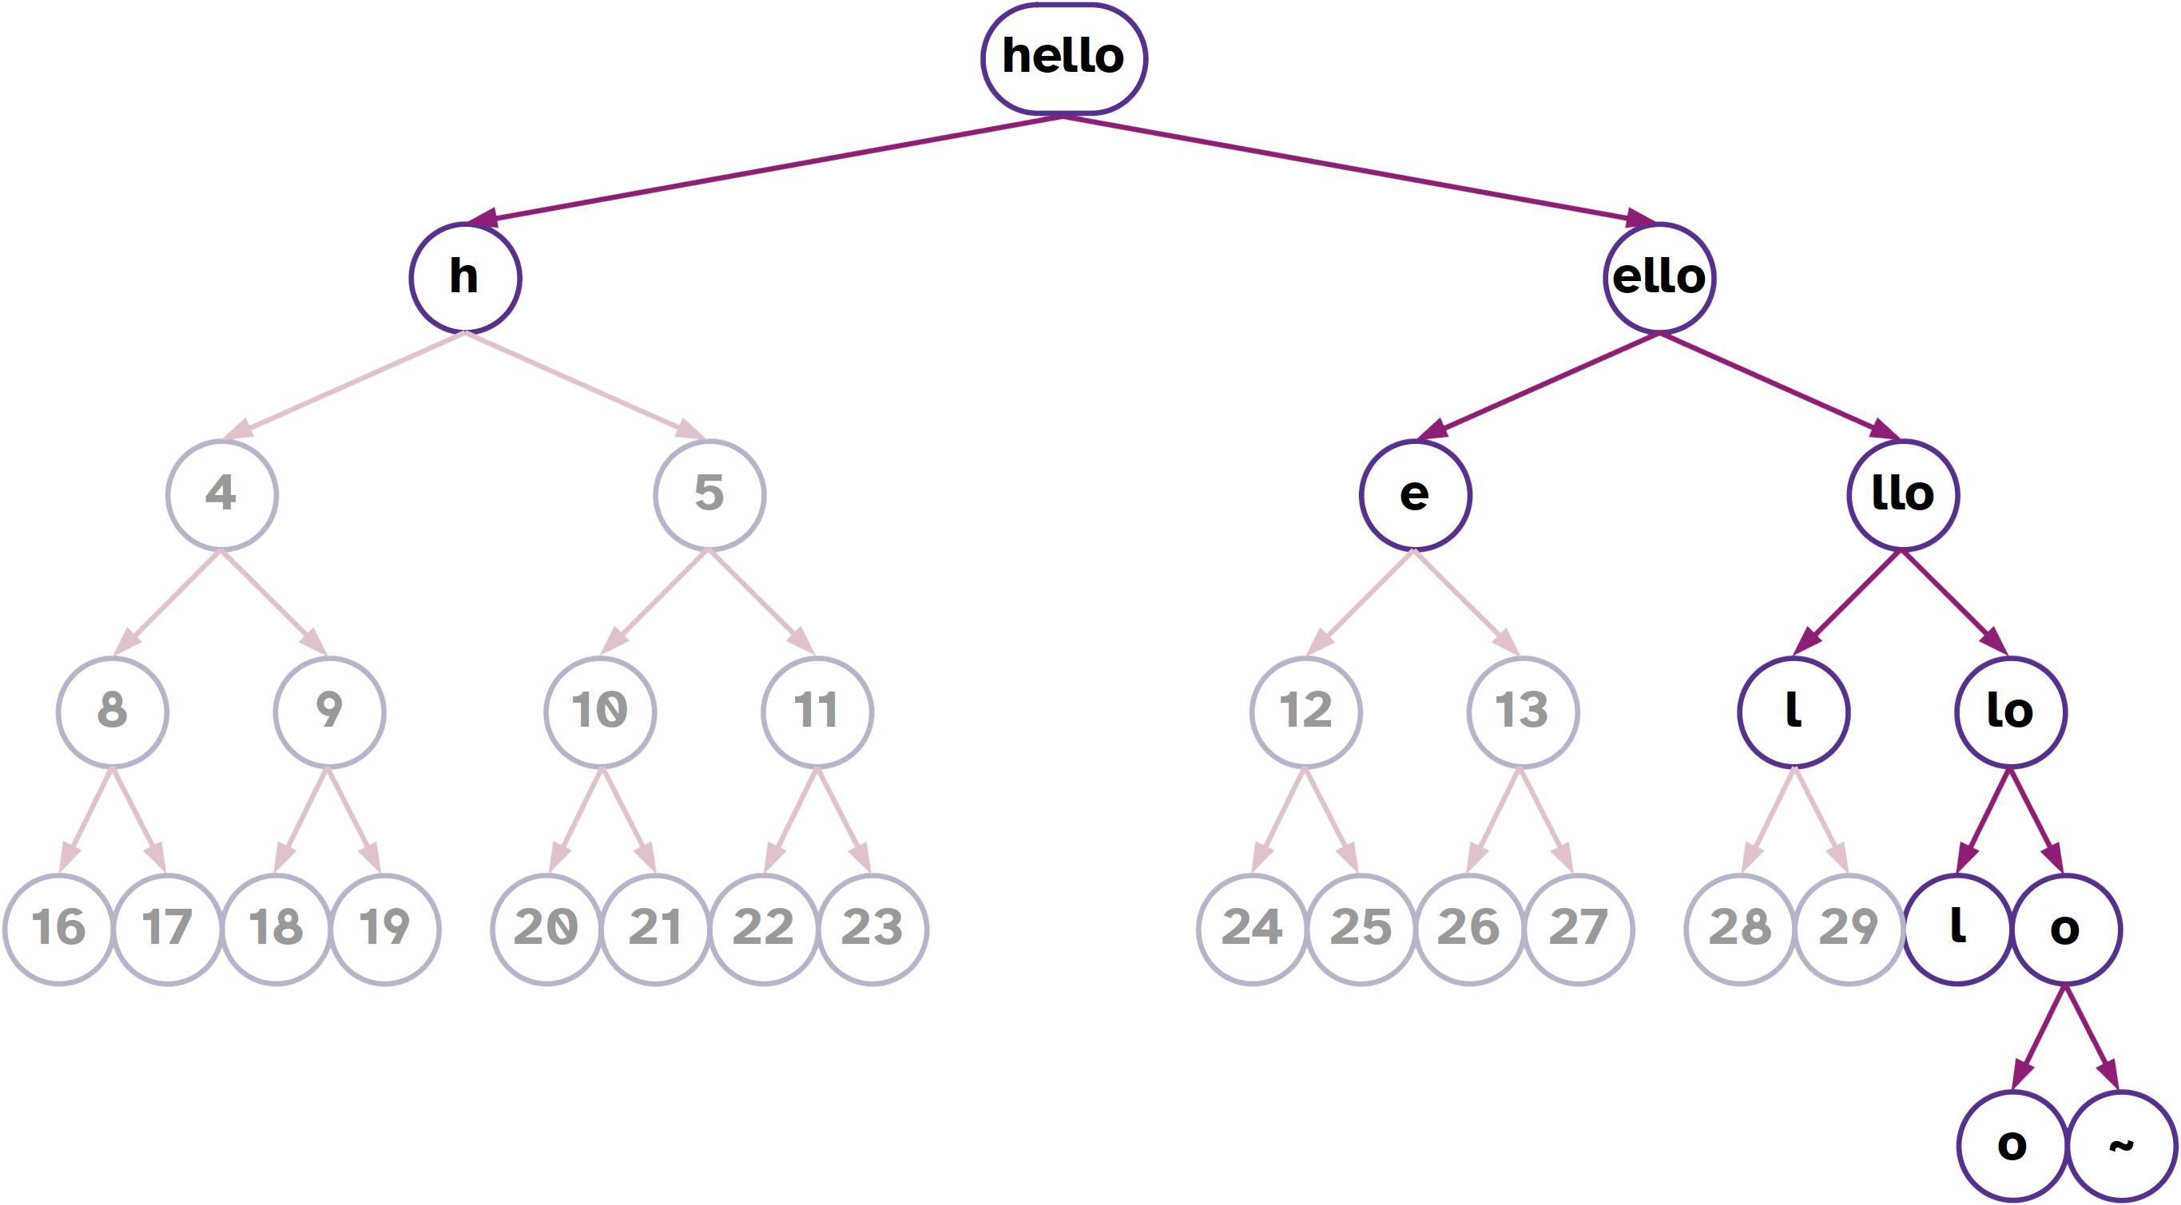

Slide 16
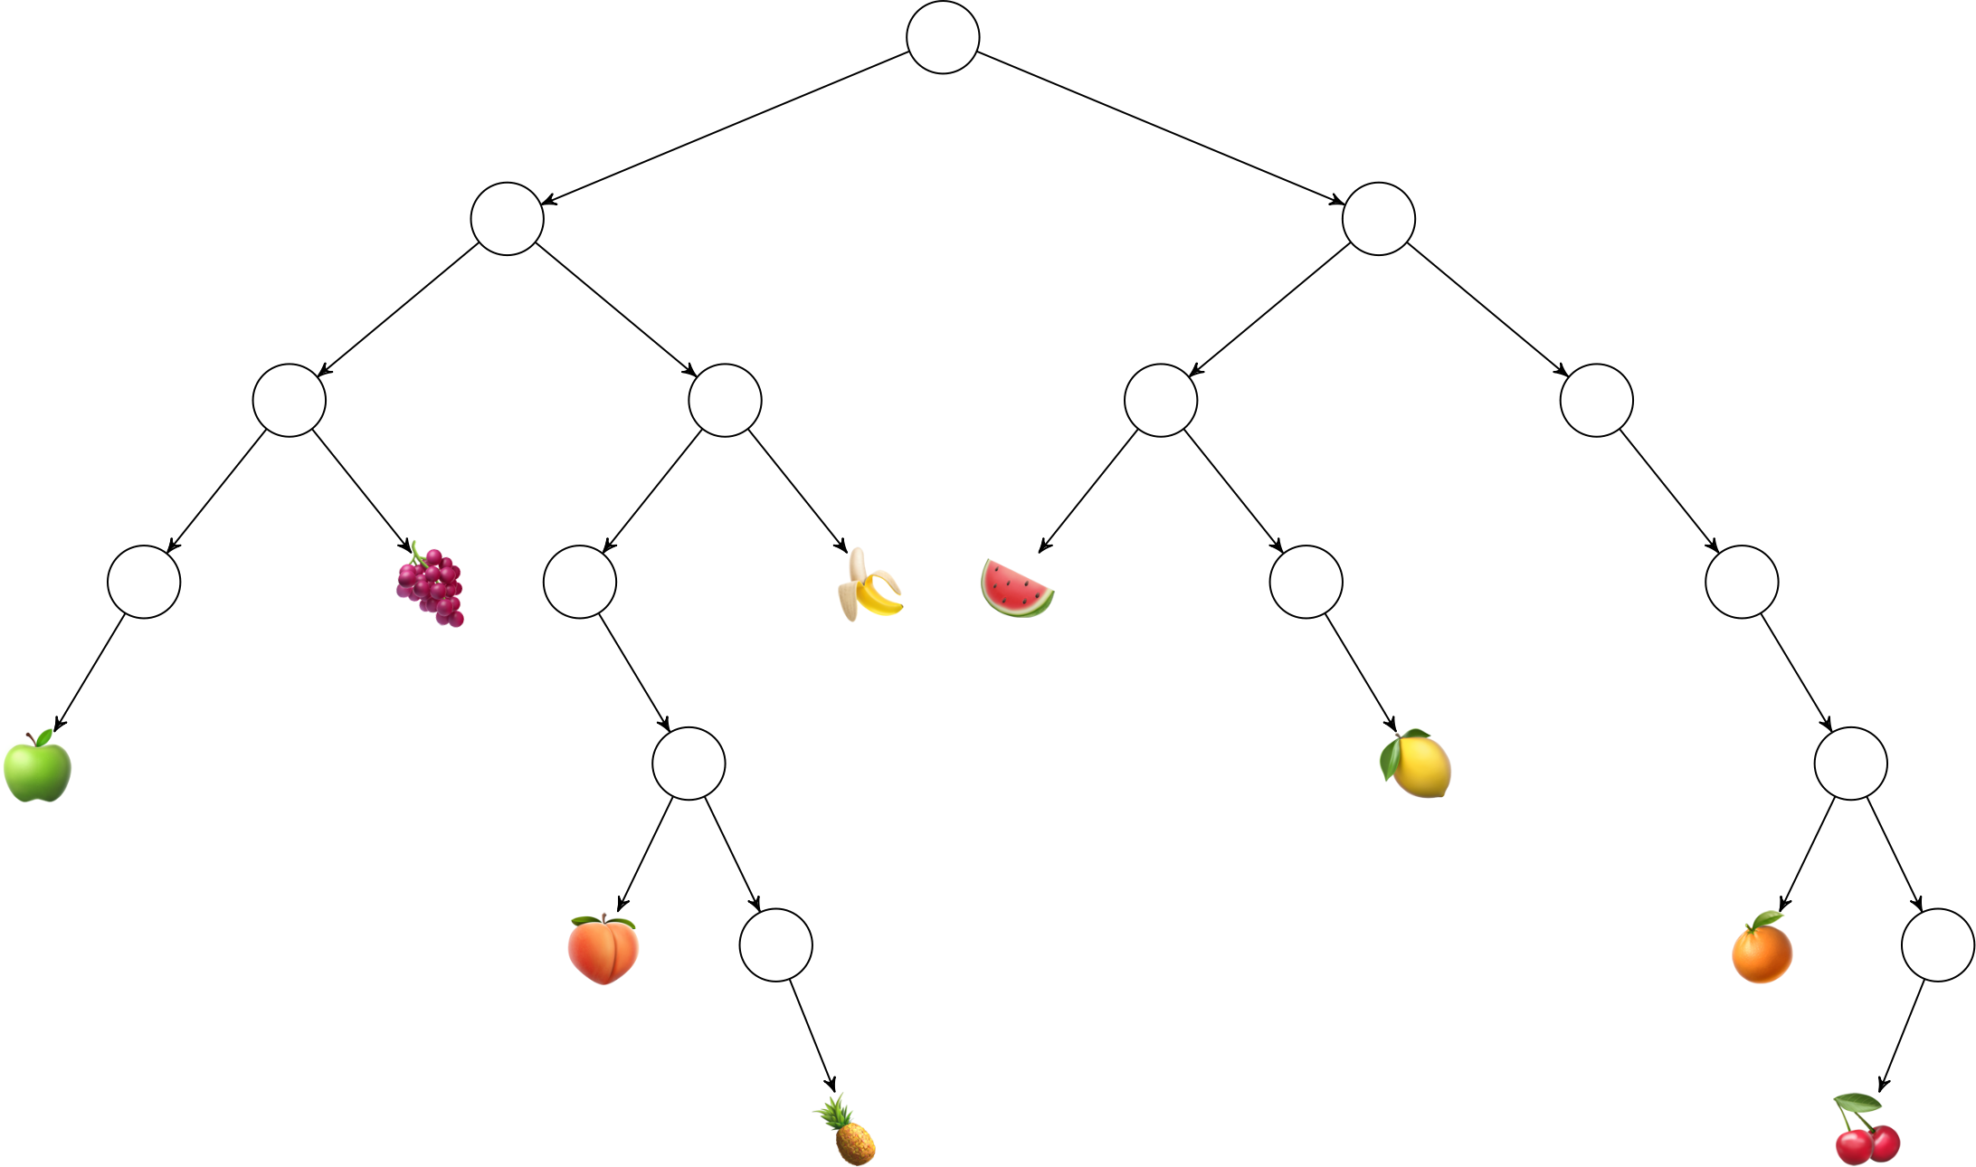
Exercise
Produce a cell representation of the fruit tree. Use `~` as a placeholder for an empty node.

Slide 17
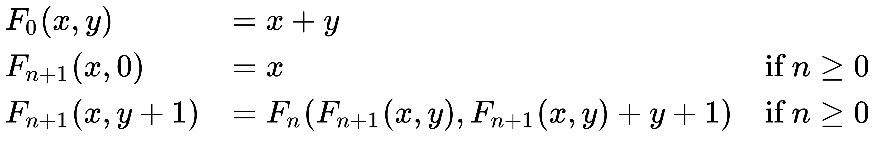
Exercise
Implement the Sudan function in Hoon.
(Check Wikipedia “Sudan Function” for trial cases.)

Slide 18
Exercise
Produce the numeric and lark-notated equivalent addresses for each of the fruit nodes in the binary fruit tree.

Slide 19
Solution
Produce the numeric and lark-notated equivalent addresses for each of the fruit nodes in the binary fruit tree.
- 9 or -<+
- 11 or ->+
- 12 or +<-
- 16 or -<-<
- 27 or +<+>
- 42 or ->->-
- 62 or +>+>-
- 87 or ->->+>
- 126 or +>+>+<

Slide 20
Exercise
Write a %say generator which simulates scoring a simple dice throw of n six-sided dice. That is, it should return the sum of n dice. If no number is specified, then only one die roll should be returned.

Slide 21
Exercise
Here is a %say generator that returns a list of n probabilities between 0–100%.
:- %say
|= [[* eny=@uv *] [n=@ud ~] ~]
:- %noun
=/ values `(list @ud)`~
=/ count 0
=/ rng ~(. og eny)
|- ^- (list @ud)
?: =(count n) values
=^ r rng (rads:rng 100) :: preserve state change
$(count +(count), values (weld values ~[(add r 1)]))

Slide 22
Exercise
The Sieve of Eratosthenes is a classic (if relatively inefficient) way to produce a list of prime numbers. Save this as a file /gen/primes.hoon, sync it, and run it as
+primes 100
(Be careful not to use too large a number—use Ctrl+C to interrupt evaluation!)

Slide 23
Exercise
Scan through the generators in /gen and see which libraries are used and how they are imported.

Slide 24
Exercise
Examine several source code files. Enumerate some principles of good Hoon style that you infer from these.

Slide 25
[~
[%o p={
[p='car'
q=~
]
[p='name'
q=[%s p='John']
]
[p='age'
q=[%n p=~.30]
]
}
]
]
{
"name": "John",
"age": 30,
"car": null
}

Slide 26


Slide 27
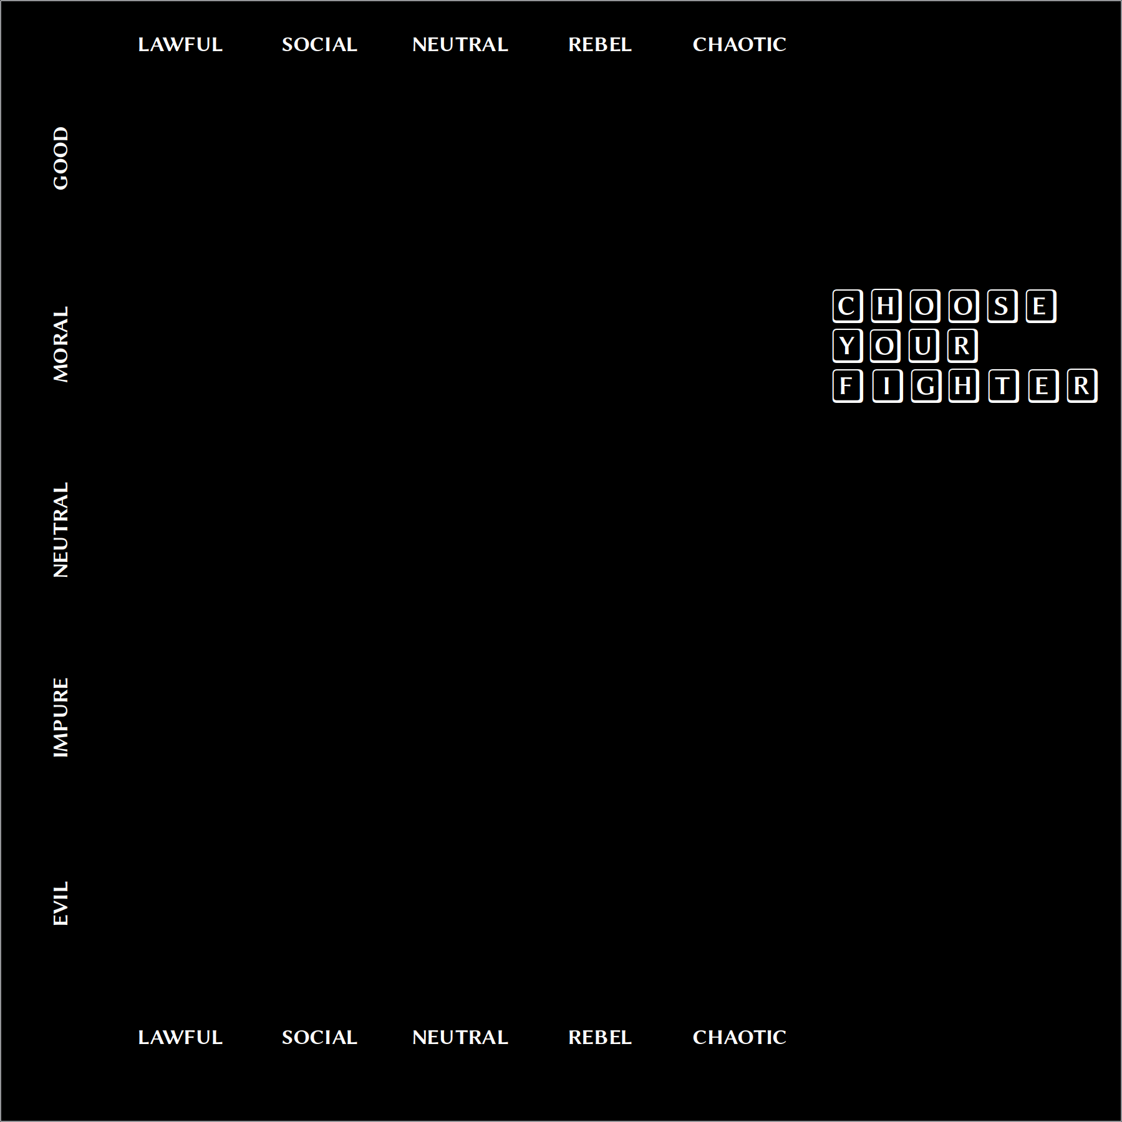

Slide 28
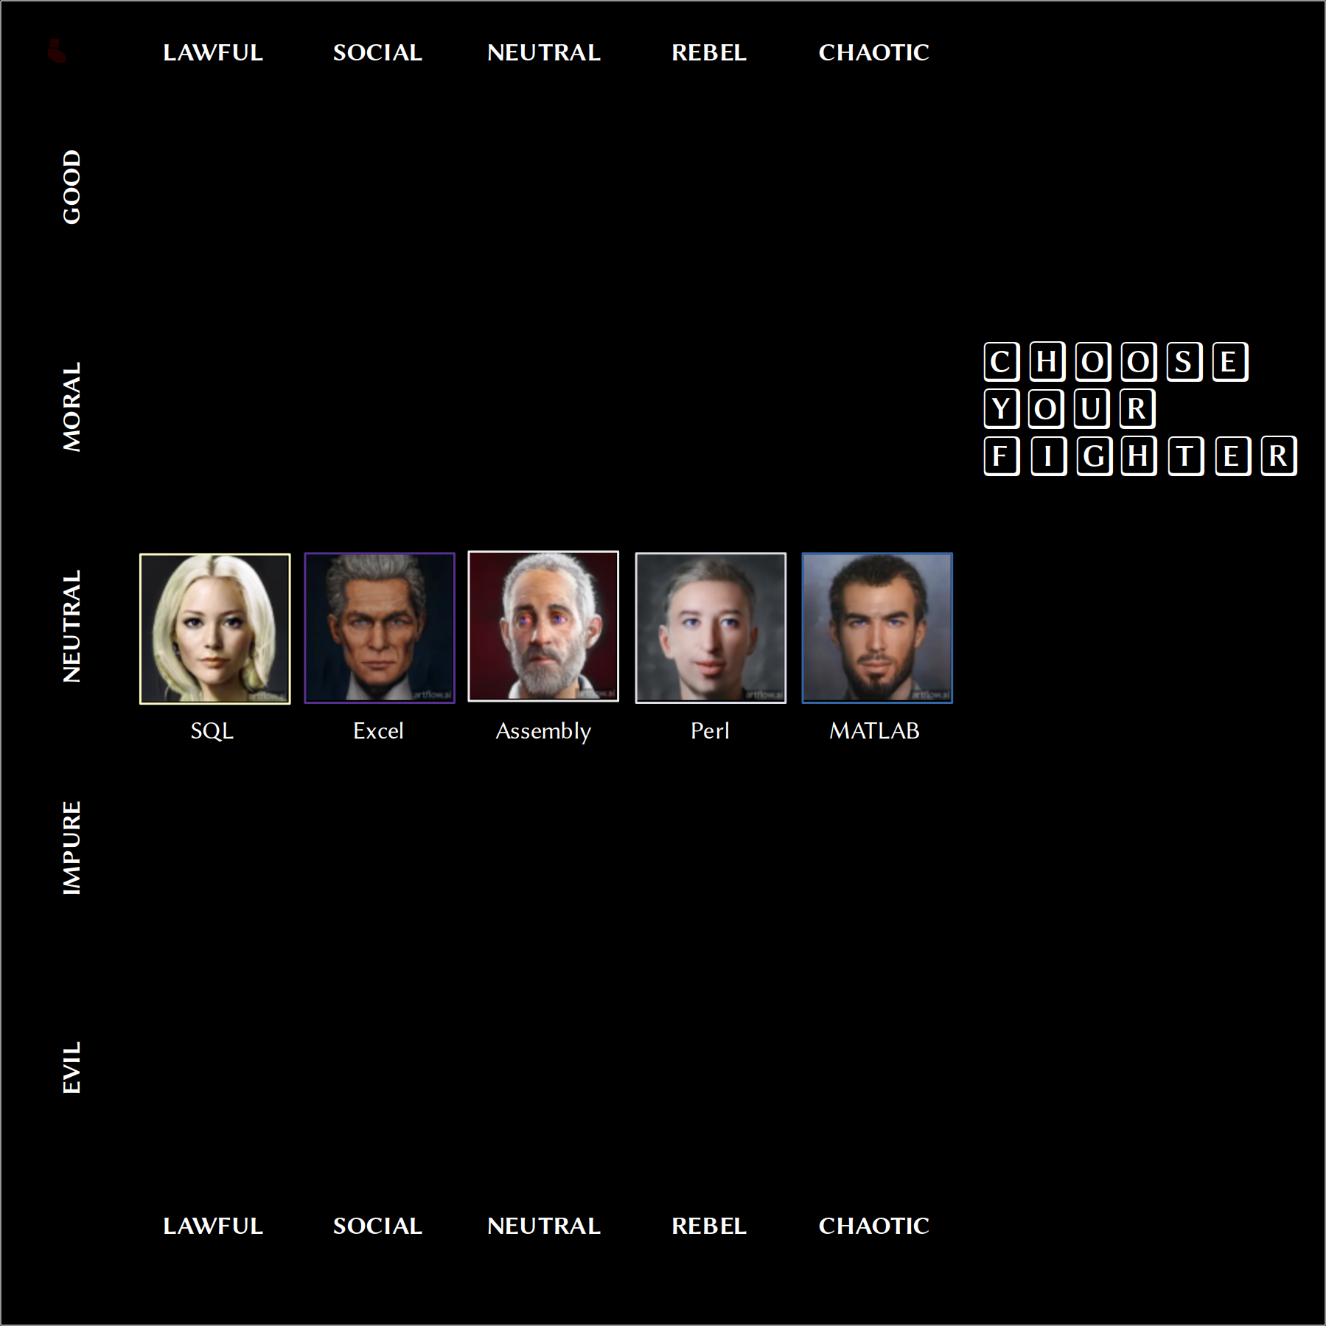

Slide 29
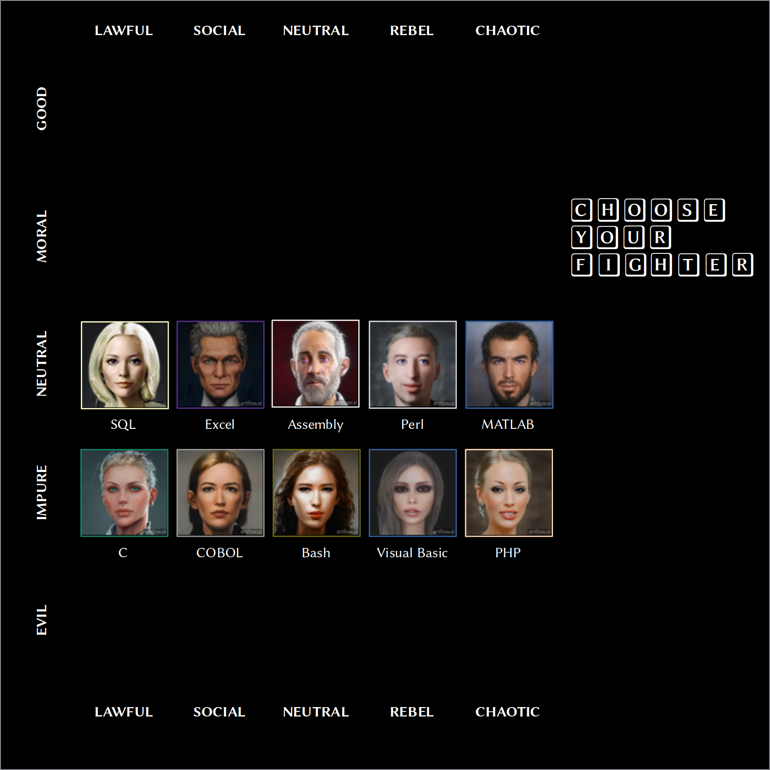

Slide 30
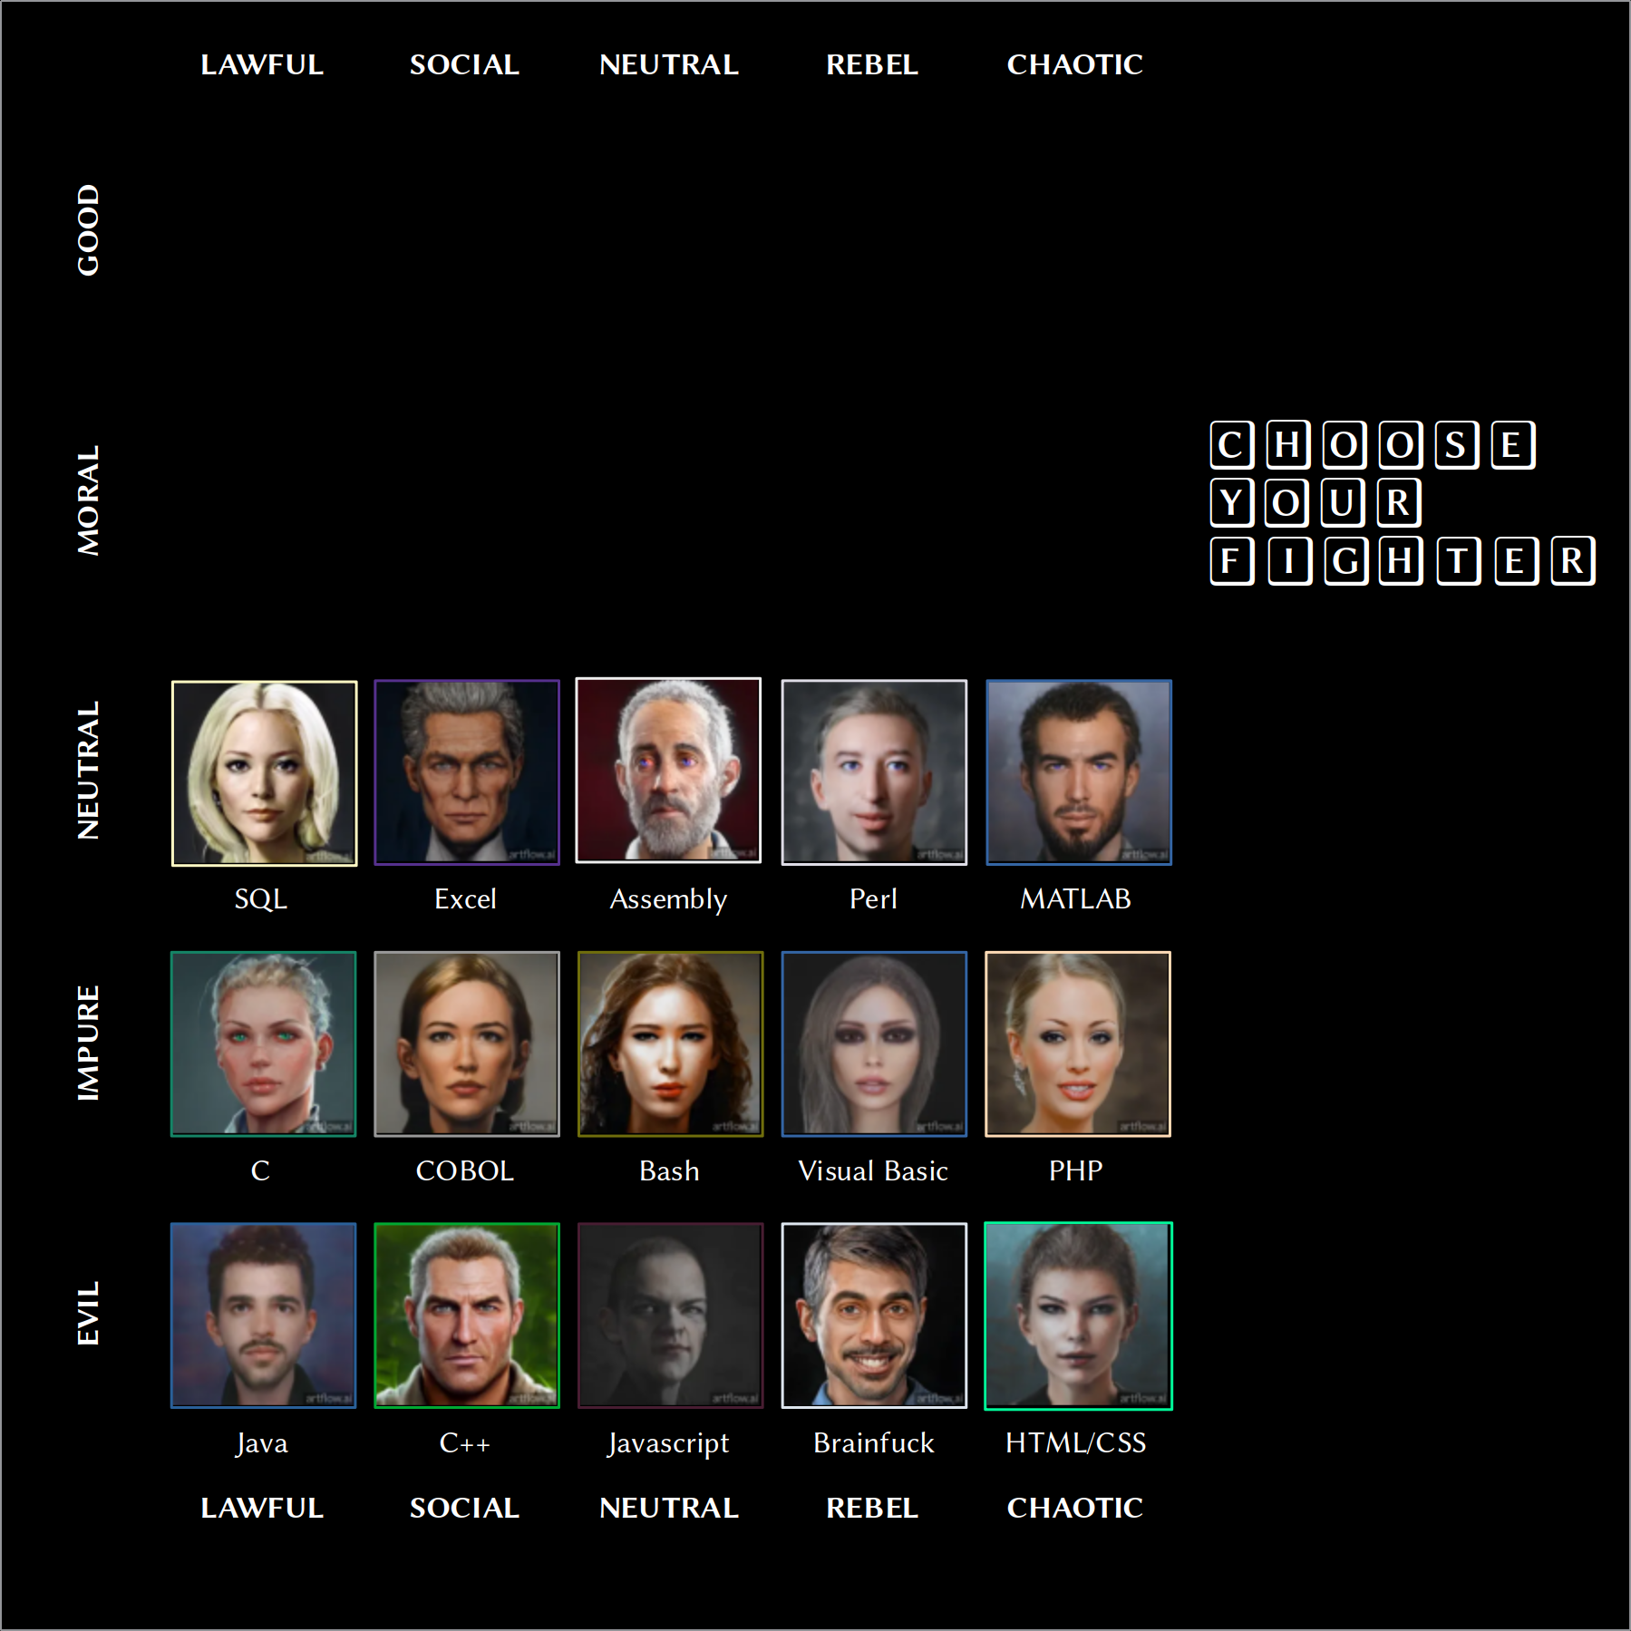

Slide 31
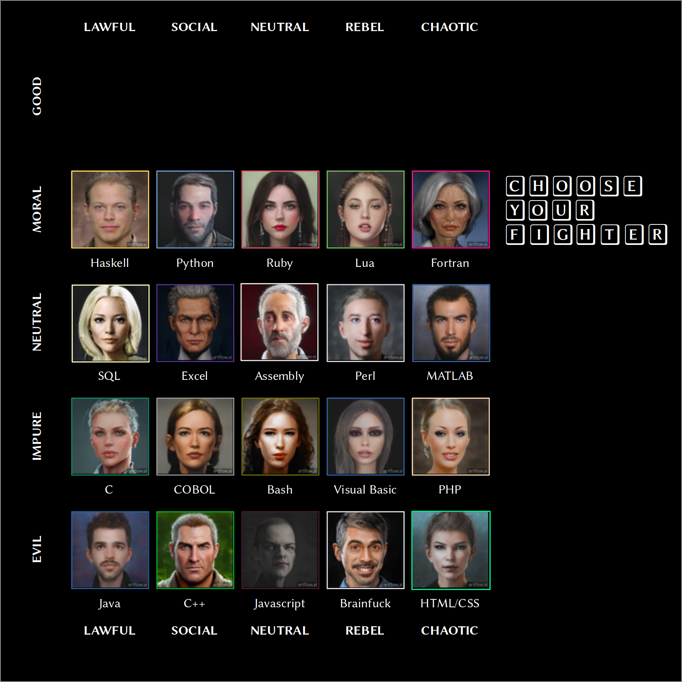

Slide 32
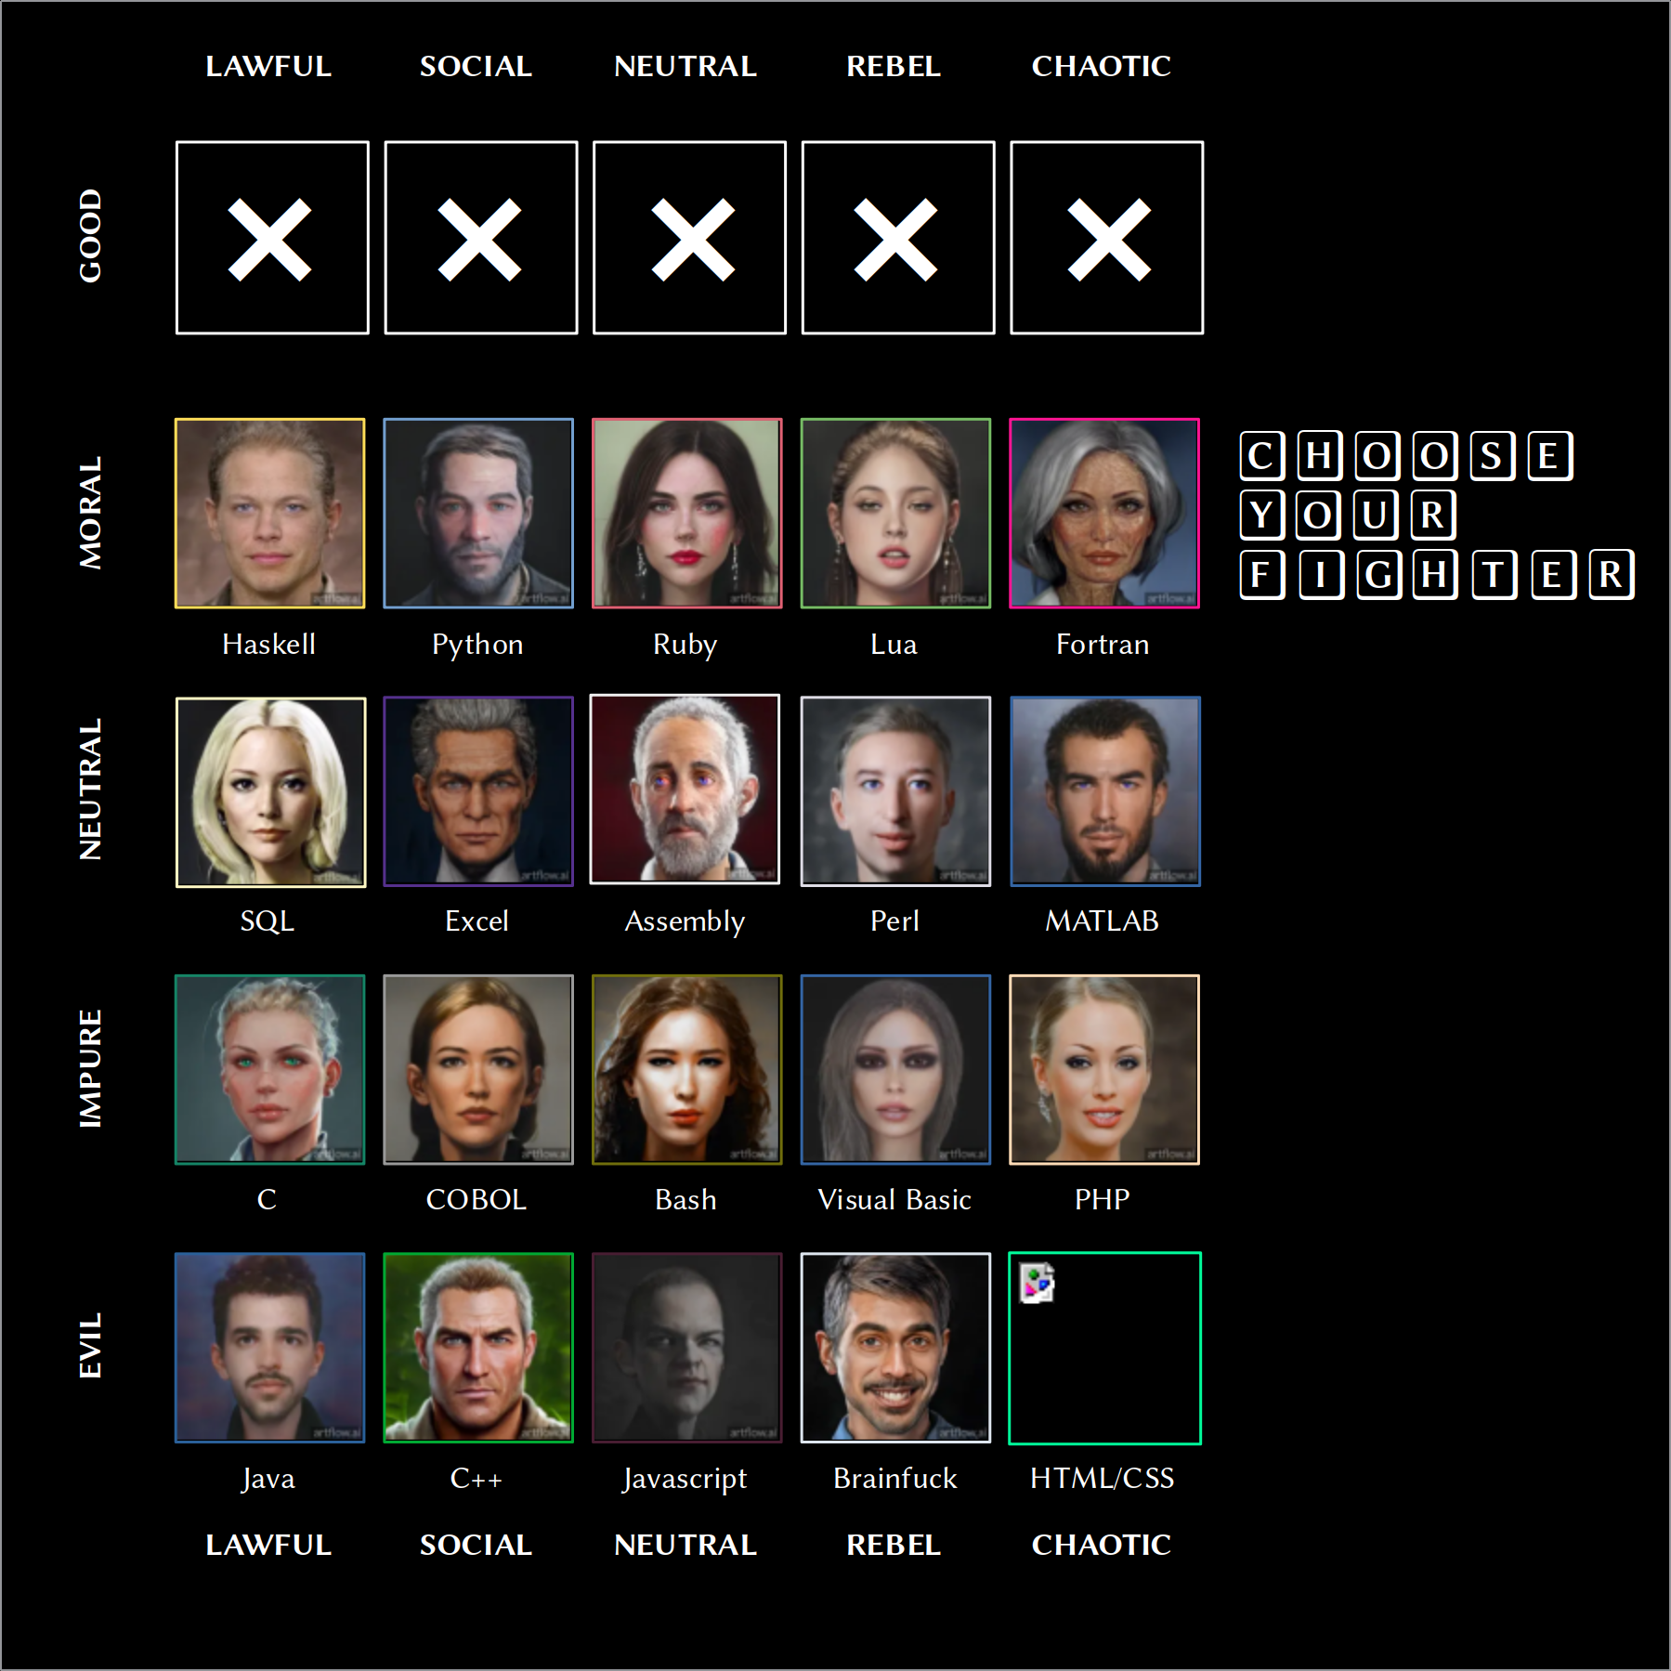

Slide 33
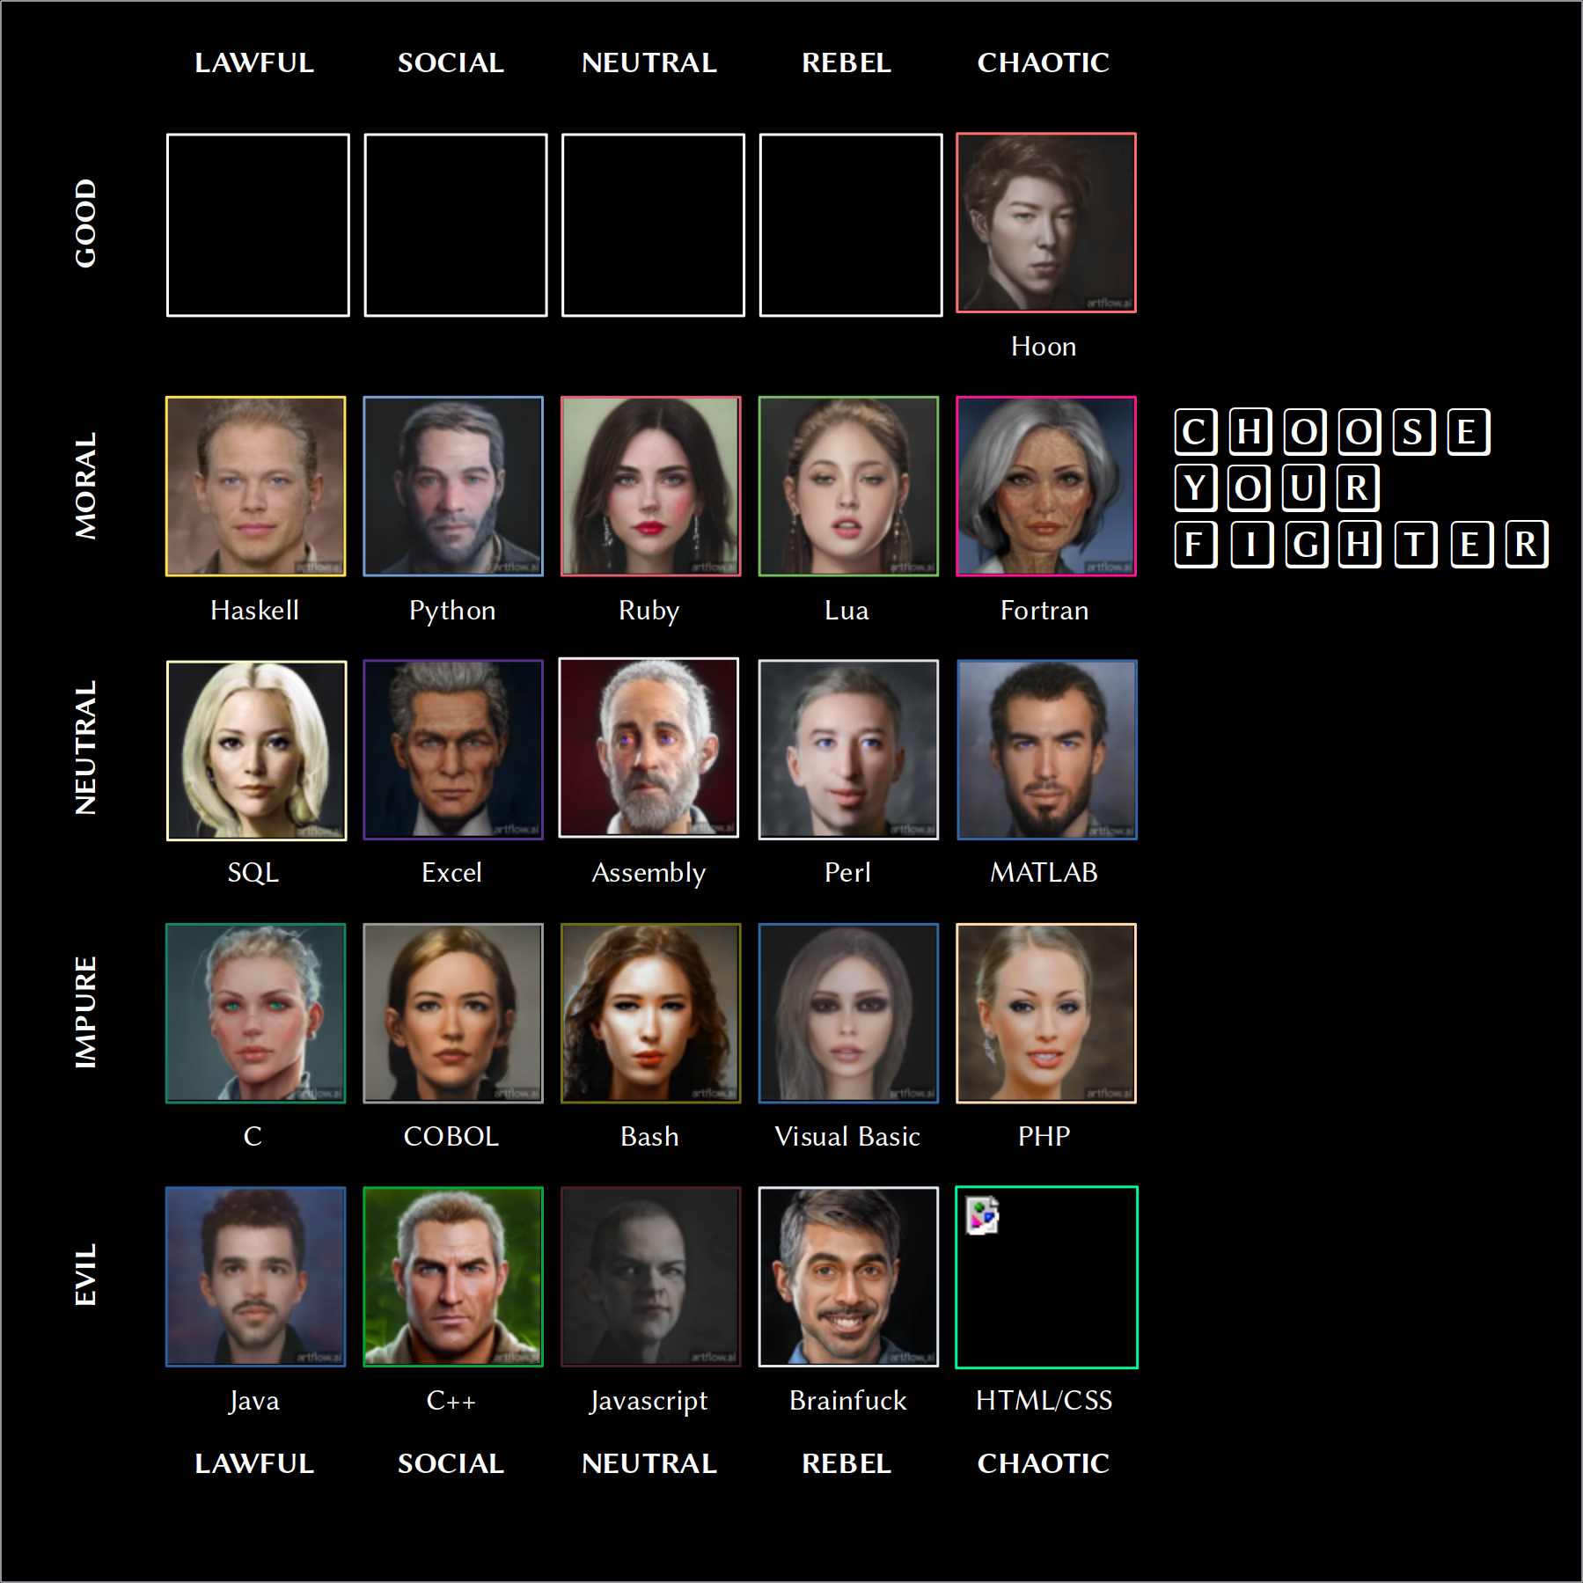

Slide 34
PollEv.com/nealdavis717

Slide 35


Slide 36
%j
%a
%i
arvo
zuse
%g
%b
lull
hoon
%e
%c
%d

Slide 37
+$ href :: where a tile links
$% [%glob base=term =glob-location] :: location of client-side data
[%site =path] :: location of server-rendered frontend
== ::
:: ::
+$ url cord :: URL type
:: ::
+$ glob-location :: how to retrieve glob (client-side)
$% [%http =url] :: HTTP source, if applicable
[%ames =ship] :: %ames source, if applicable
== ::
:: ::
+$ version :: version of app (not Kelvin version)
[major=@ud minor=@ud patch=@ud] ::
:: ::
+$ docket ::
$: %1 :: Docket protocol tag
title=@t :: text on home screen
info=@t :: long-form description
color=@ux :: app tile color
=href :: link to client bundle
image=(unit url) :: app tile background
=version :: version of app (not Kelvin version)
website=url :: URL to open on click
license=cord :: software release license
== ::

Slide 38
%alfa basic demo of Gall as MWE
%bravo add local operations
%charlie add peer-to-peer operations
%delta write complete basic app

Slide 39
Exercise
Examine /sur/dns.hoon (basic) or /sur/bitcoin.hoon (advanced).
Examine /mar/json.hoon
(and discuss with your karass)

Slide 40
|_ =bowl:gall
++ on-init
++ on-save
++ on-load
++ on-arvo
++ on-peek
++ on-poke
++ on-watch
++ on-leave
++ on-agent
++ on-fail
--

Slide 41
|_ =bowl:gall
++ on-init
++ on-save
++ on-load
++ on-arvo
++ on-peek
++ on-poke
++ on-watch
++ on-leave
++ on-agent
++ on-fail
--

Slide 42
|_ =bowl:gall
++ on-init
++ on-save
++ on-load
++ on-arvo
++ on-peek
++ on-poke
++ on-watch
++ on-leave
++ on-agent
++ on-fail
--

Slide 43
|_ =bowl:gall
++ on-init
++ on-save
++ on-load
++ on-arvo
++ on-peek
++ on-poke
++ on-watch
++ on-leave
++ on-agent
++ on-fail
--

Slide 44
Permissions Model
A store is a local database.
A hook is a permissions broker for the database.
A view is a data aggregator which parses objects for external clients such as Landscape.

Slide 45
Code courageously.
If you avoid changing a section of code for fear of awakening the demons therein, you are living in fear. If you stay in the comfortable confines of the small section of the code you wrote or know well, you will never write legendary code. All code was written by humans and can be mastered by humans.
It's natural to feel fear of code; however, you must act as though you are able to master and change any part of it. To code courageously is to walk into any abyss, bring light, and make it right.
(Philip Monk, “Urbit Precepts”)

Slide 46


Slide 47


