Slide 1
A travel advisor
Coursera Capstone Project
Natasa Plulikova

Slide 2
Business Problem
Choice of travel destinations is based on recommendations, individual preferences and requires a search of places
A travel advisor can help find the most suitable neighborhood based on user’s preferences stated in query
Proof of concept was developed for Toronto, Canada neighborhood data
Smart search can be integrated within online application to save time

Slide 3
Data definition
Neighborhoods by Postal Codes available on Wikipedia
Location data retrieved from csv provided in week 3 assignment (part of project repository)
The methodology can be repeated on any location data
Foursquare API to retrieve venues per each neighborhood
Tf-idf coding to obtain a measure that
Does not over-represent frequent categories
Give more weight to rare categories

Slide 4
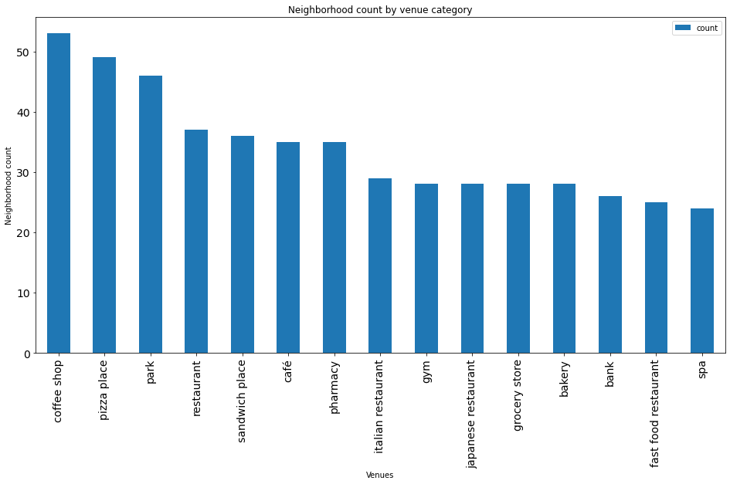
Most frequent categories

Slide 5
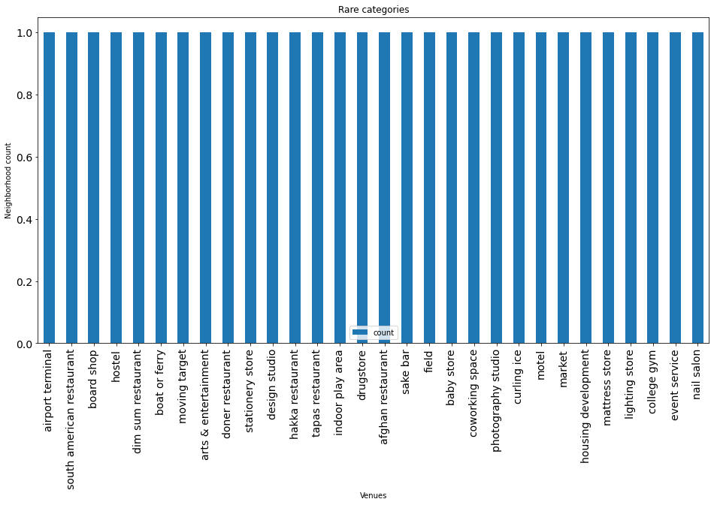
Rare categories

Slide 6
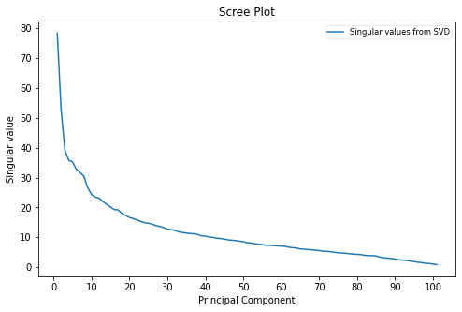
Latent Semantic Analysis
Dimensionality reduction method
50 latent features hold 94.6% data information (based on scree plot)
Creates efficient matrix of similarities

Slide 7
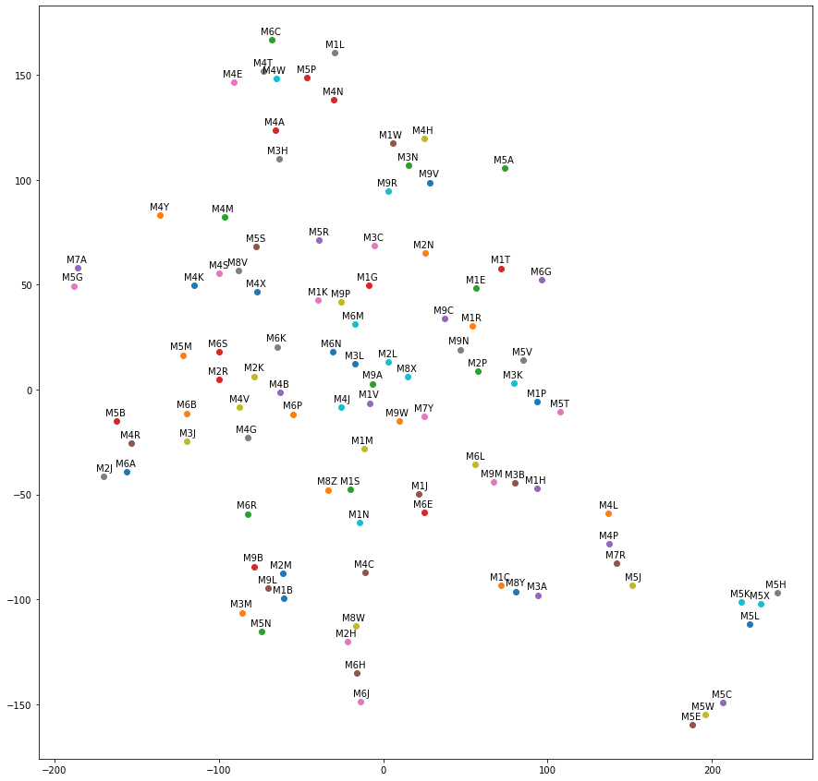
Neighborhood map based on LSI similarities

Slide 8
Examining user queries - findings
LSI search
Retrieves ranked order based on cosine similarity measure
Favors neighborhoods with more frequent occurrence of rare categories
Always retrieves results
Favors neighborhoods with similar venues even if not specified in user query
Simple keyword search
Can only match keywords
Can retrieve 0 results
Does not support ranking, always retrieves based on the order of the data

Slide 9
Potential improvements
Expand the model with user reviews and comments about the venue
Integrate the model within online application to serve major population

