Slide 1
Image Captioning
Natasa Brisudova

Slide 2
Assignment
The goal is to train an image captioning model on the Flickr Image Dataset using pretrained Resnet50 to encode the image and to learn the language generator LSTM

Slide 3
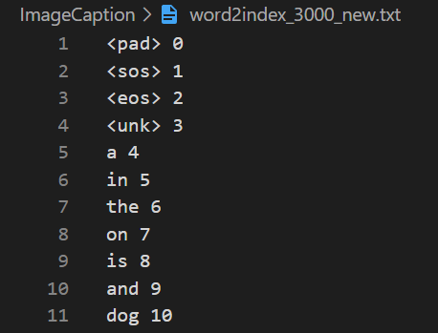
Vocabulary
class Vocab( ):
build_vocab(vocab_size, file_name):
holding dictionaries word2index and index2word
holding a counter for counting word occurences
predefined 4 tokens: <pad>, <sos>, <eos> and <unk>
file_name is a text file from which the vocabulary will be built, in format: ‘img_name, caption’
to build the vocabulary split each line of text file into img_name and caption by the first comma separator and we change it to lowercase
once we obtain the sentence, it is passed to method add_sentence
most common words from the counter are used to build the dictionaries word2index and index2word starting from index 5 (as first 4 indices are reserved for the predefined tokens)
add_sentence(sentence):
tokenize the sentence into words using regexptokenizer
update the counter with all the words from the sentence

Slide 4
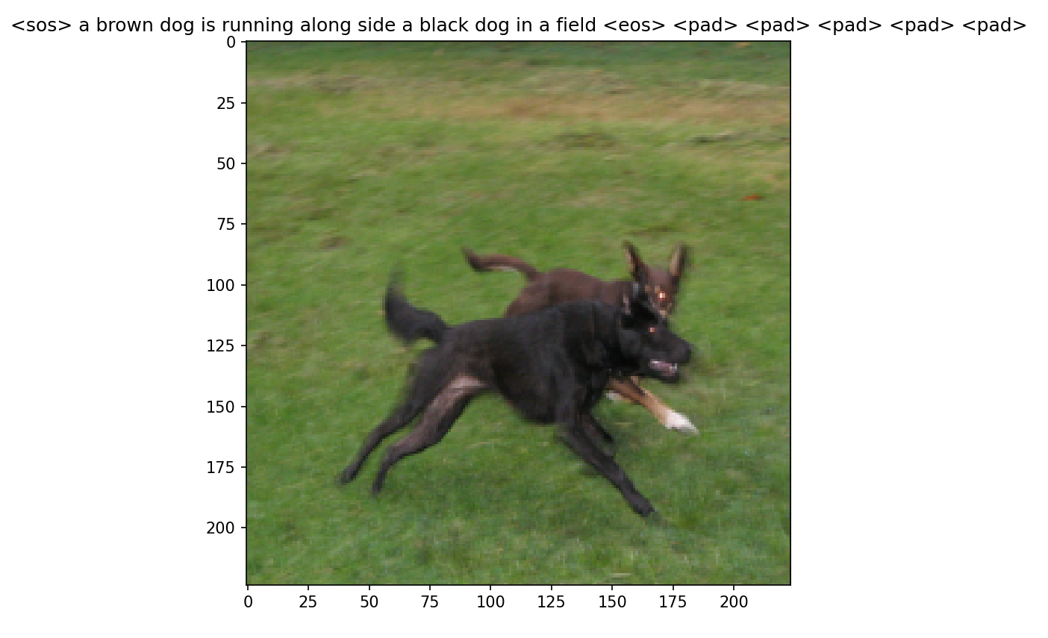
Dataset
class ImageCaptionDataset( ):
Get_data_loader( ):
holds a list of samples where each sample is a dictionary containing the image file id and caption of that image as a list of word indices (using the saved vocabulary)
caption is enriched by <sos> and <eos> token at the beginning and end of the caption respectively
returns DataLoader
performs padding on each caption in a batch according to the longest caption in batch where it belongs
shuffle = true
__getitem__( ):
To think about…
using the image id a corresponding picture is loaded for the sample
image is further preprocessed – reshaped, cropped and transformed into a tensor
the image and its caption as list of word indices is returned
it happens that some of the short sentences in the batch have too many padded elements
another approach was to sort the captions before the dataloader (with shuffle = false) - however, the model did not perform well as it in the end it either generated too short or too long captions
solution could be to shuffle already batched samples

Slide 5
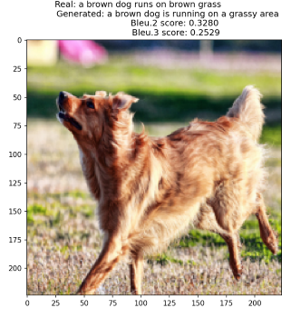
Model
Output
Image
Resnet50 encoder
features
DataLoader
Decoder
input
LSTM
decoder
Embedding
layer
Captions
as indices
embedded
captions
hidden_0
cell_0

Slide 6
Model
1. Encoder
2. Embedding layer
Image encoder to obtain features from images
Contains pretrained Resnet50 with last layer removed and a linear layer as final classifier
Final output dimension of features is (IMAGE_EMB_DIM)
Used to obtain embedded representation (as a dense vector) of captions of dimension (WORD_EMB_DIM)
When training the model, the embedding layer is updated to learn better word representation through the optimization process

Slide 7
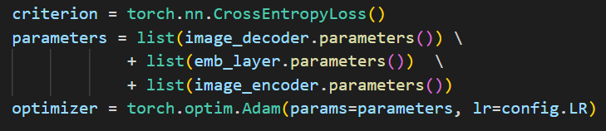
Model
3. Decoder
Other parameters for training the model
Contains LSTM layer and a linear layer as final classifier whose output is of dimension (VOCAB_SIZE)
The input for the LSTM layer is the concatenation of features from the encoder and the embedded captions from the embedding layer
Hidden and cell states are zero initialized

Slide 8
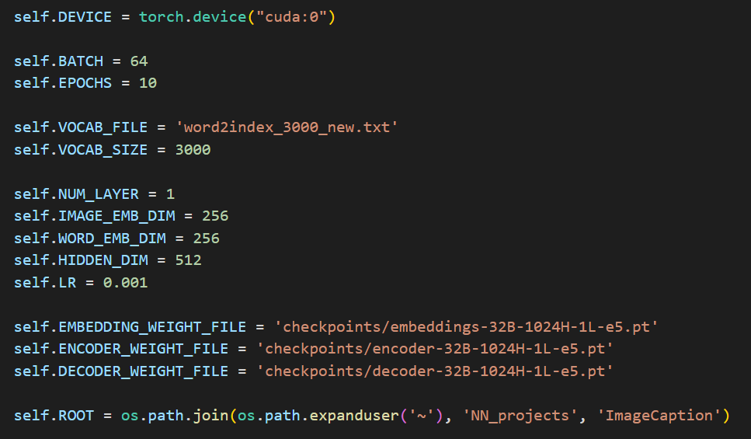
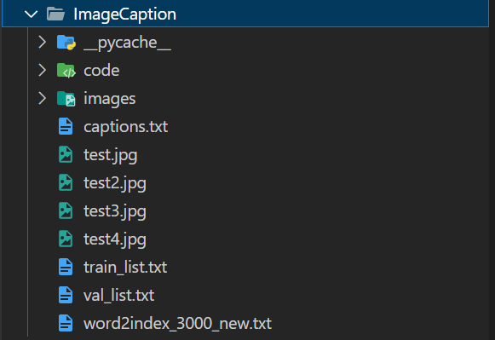
Configurations
B = batch number
H = hidden layer dimension
L = number of layers
e = epoch

Slide 9
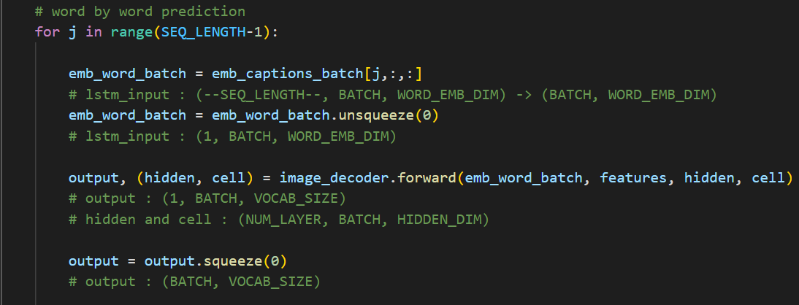
Word generation (LSTM output)
Word-by-word generation
More traditional and commonly used
LSTM generates each word of the caption on at a time, based on the previous word (index), image features and hidden and cell states
it can potentially result in more diverse and interesting captions
However, this approach can be slower and more computationally expensive, especially if the length of the captions is long

Slide 10
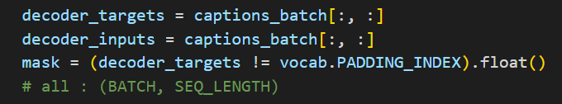
Loss computation
To think about…
Solution
All the captions are padded
We want to compute the loss over all non-padded tokens in the batch
This is necessary because the pad tokens do not contribute to the model's performance, and including them in the loss calculation would lead to inaccurate gradients and slower training
Creating a binary mask over all captions in a batch, where 1 is for all non-pad tokens
Sequence loop: loss is summed up for each non-pad token in the captions by multiplying the criterion function by the mask → loss dimension: (BATCH)
loss += criterion(output, decoder_targets[:, j+1]) * mask[:, j+1]
Training epoch loop: loss is summed up over the batch and then divided by the number of all non-pad tokens in the entire batch
loss = loss.sum()/mask.sum().item()

Slide 11
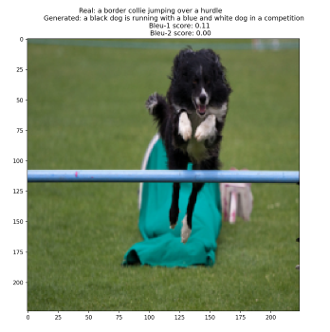
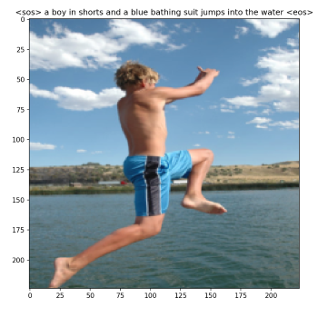
Results
From validation set
Random sample

Slide 12
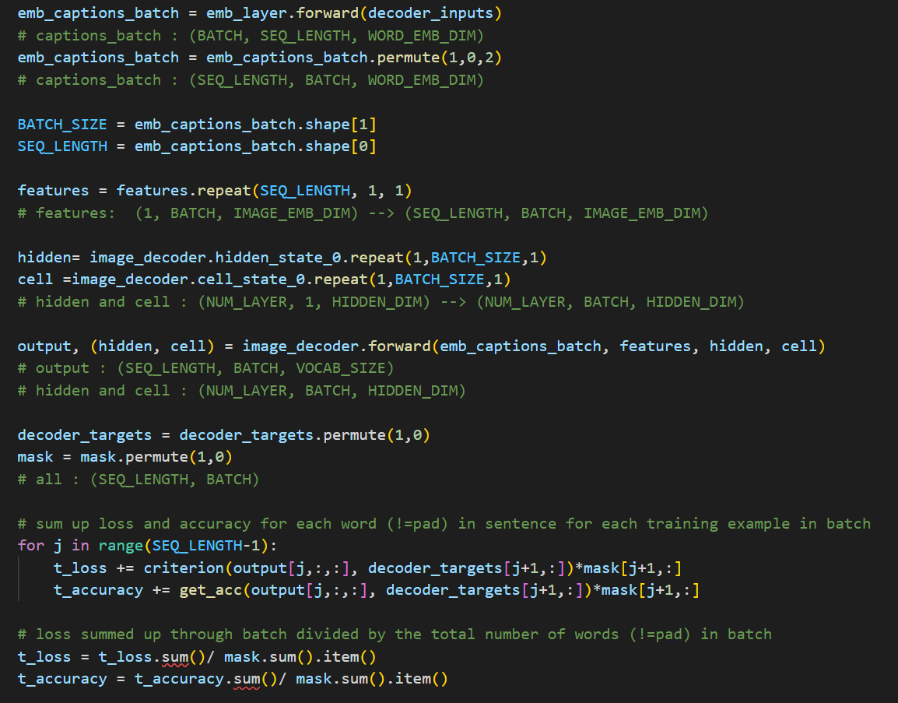
note: Update - LSTM
LSTM output
LSTM takes as input whole sequence
changes only in main_updated.py
CHANGES:
1. features: (1, B, IMAGE_EMB_DIM) → (SEQ_L, B, IMAGE_EMDB_DIM)
2. emb_captions batch[j, :, :] → as whole
3. output: (1,B,VOCAB_SIZE) → (SEQ_L, B, VOCAB_SIZE)
loss computation remains same
generation of captions and rest of code remains same as well

