Slide 1
Data Science Test
Natasa Sarafijanovic-Djukic

Slide 2
Citibikes and Taxis in NYC
Question:
Which is faster: citibikes or taxis?
Data:
Citibike: http://www.citibikenyc.com/system-data
(July 2013 – June 2015)
Taxi: http://www.andresmh.com/nyctaxitrips
(Januar 2013 – December 2013)

Slide 3
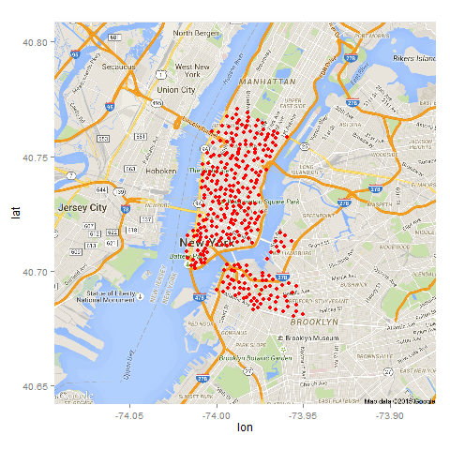
Citibike Data
Variables:
trip duration
start time, stop time
start station lat/long,
end station lat/long
station name, station id, bike ID, user type, gender, year of birth
October 2013
1 037 712 observations
330 stations

Slide 4
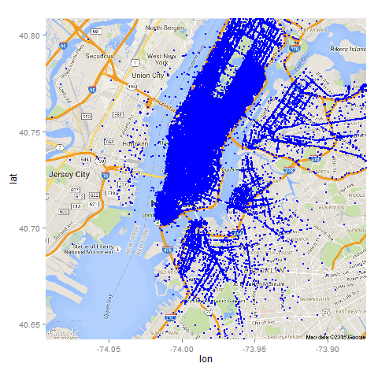
Taxi Data
Variables:
trip duration
pick-up time, drop-off time
pick-up lat/long,
drop-off lat/long
trip distance
medallion, hack license, vendor id, rate code, store and forwardd flag, passenger count
October 2013
15 004 556 observations
October 1, 2013 (Tue)
452 769

Slide 5
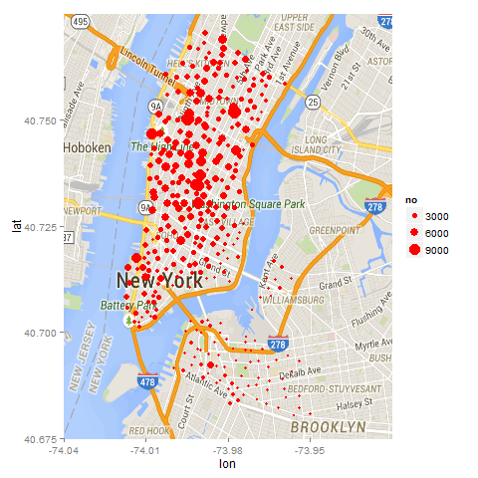
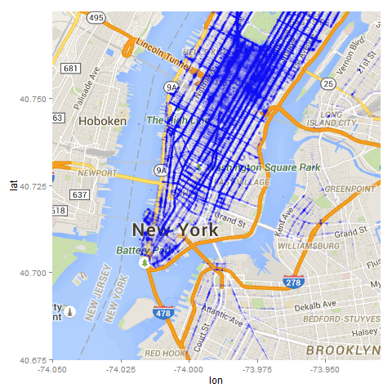
Popularity of Start Stations and Pick-up Locations

Slide 6
Method: Step 1
PREPROCESSING
MODELLING
TRIP DURATION
citibike
data
CITIBIKE
MODEL
start time (hour+min/60)
start station lat/lon
end station lat/lon
trip duration

Slide 7
Method: Step 2
PREPROCESSING
MODELLING
TRIP DURATION
taxi
data
TAXI
MODEL
pick-up time (hour+min/60)
pick-up lat/lon
drop-off lat/lon
trip duration

Slide 8
Method: Step 3
CITIBIKE MODEL
citibike
trip duration
citibike data:
start time = pick-up time
start lat/lon = pick-up lat/lon
end lat/lon = drop-off lat/lon
COMPARISON
WhichIsFaster
citibike
taxi
TAXI MODEL
taxi
trip duration

Slide 9
Method: Step 4
MODELLING
WhichIsFaster
citibike data:
start time (hour+min/60)
straight-line distance
WhichIsFaster
ANSWER:
start time and distance
at which
taxi faster than citibike

Slide 10
Data Preprocessing
PREPROCESSING
MODELLING
OF
TRIP DURATION
citibike
data
CITIBIKE
MODEL
PREPROCESSING
MODELLING
OF
TRIP DURATION
taxi
data
TAXI
MODEL

Slide 11
Data Preprocessing
Outliers for trip duration:
errors
roaming around, making a pause
end
start
start
shopping
pause
end
restaurant

Slide 12
Citibike Data Preprocessing
keep if speed between 10 and 95 percentile
all days - speed [km/h] percentile
0% | 5% | 10% | 25% | 50% | 75% | 90% | 95% | 100%
0 | 2.44 | 4.38 | 6.65 | 8.62 | 10.66 | 13.14 | 16.84 | 427.2
business days
0% | 5% | 10% | 25% | 50% | 75% | 90% | 95% | 100%
0 | 2.94 | 4.79 | 6.9 | 8.8 | 10.8 | 13.3 | 17.22 | 427.2
speed = straight line distance / trip duration

Slide 13
Taxi Data Preprocessing
keep if speed within 95 percentiles
keep if trip distance/straight line distance between 10 and 95 percentiles
keep if trip duration and trip distance not equal to 0
business day – speed [km/h] percentiles
0% | 5% | 10% | 25% | 50% | 75% | 90% | 95% | 100%
0 | 6.86 | 8.46 | 11.47 | 15.75 | 21.24 | 27.52 | 32.3 | 68365
business day – trip distance /straight line distance
0% | 5% | 10% | 25% | 50% | 75% | 90% | 95% | 100%
0 | 0.98 | 1.03 | 1.14 | 1.29 | 1.44 | 1.66 | 1.91 | 20060
speed = trip distance / trip duration

Slide 14
Modelling Trip Duration
PREPROCESSING
MODELLING
TRIP DURATION
citibike
data
CITIBIKE
MODEL
PREPROCESSING
MODELLING
TRIP DURATION
taxi
data
TAXI
MODEL

Slide 15
Citibike Model
SUPPORT VECTOR REGRESSION
SVR 5
citibike preprocessed data:
start time (hour+min/60)
start station lat/lon
end station lat/lon
trip duration
median
SVR 4
MODEL
SVR 3
687 080
SVR 2
SVR 1
60 000
random sampling
10%
TESTING

Slide 16
Taxi Model
SUPPORT VECTOR REGRESSION
taxi preprocessed data:
start time (hour+min/60)
pick-up lat/lon
drop-off lat/lon
trip duration
SVR 4
SVR 3
median
MODEL
235 266
SVR 2
SVR 1
50 000
random sampling
10%
TESTING

Slide 17
Which is faster: Citibikes or Taxis?
CITIBIKE MODEL
citibike
trip duration
test citibike data (10% ):
start time (hour+min/60)
start lat/lon
end lat/lon
COMPARISON
WhichIsFaster
citibike
taxi
TAXI MODEL
taxi
trip duration

Slide 18
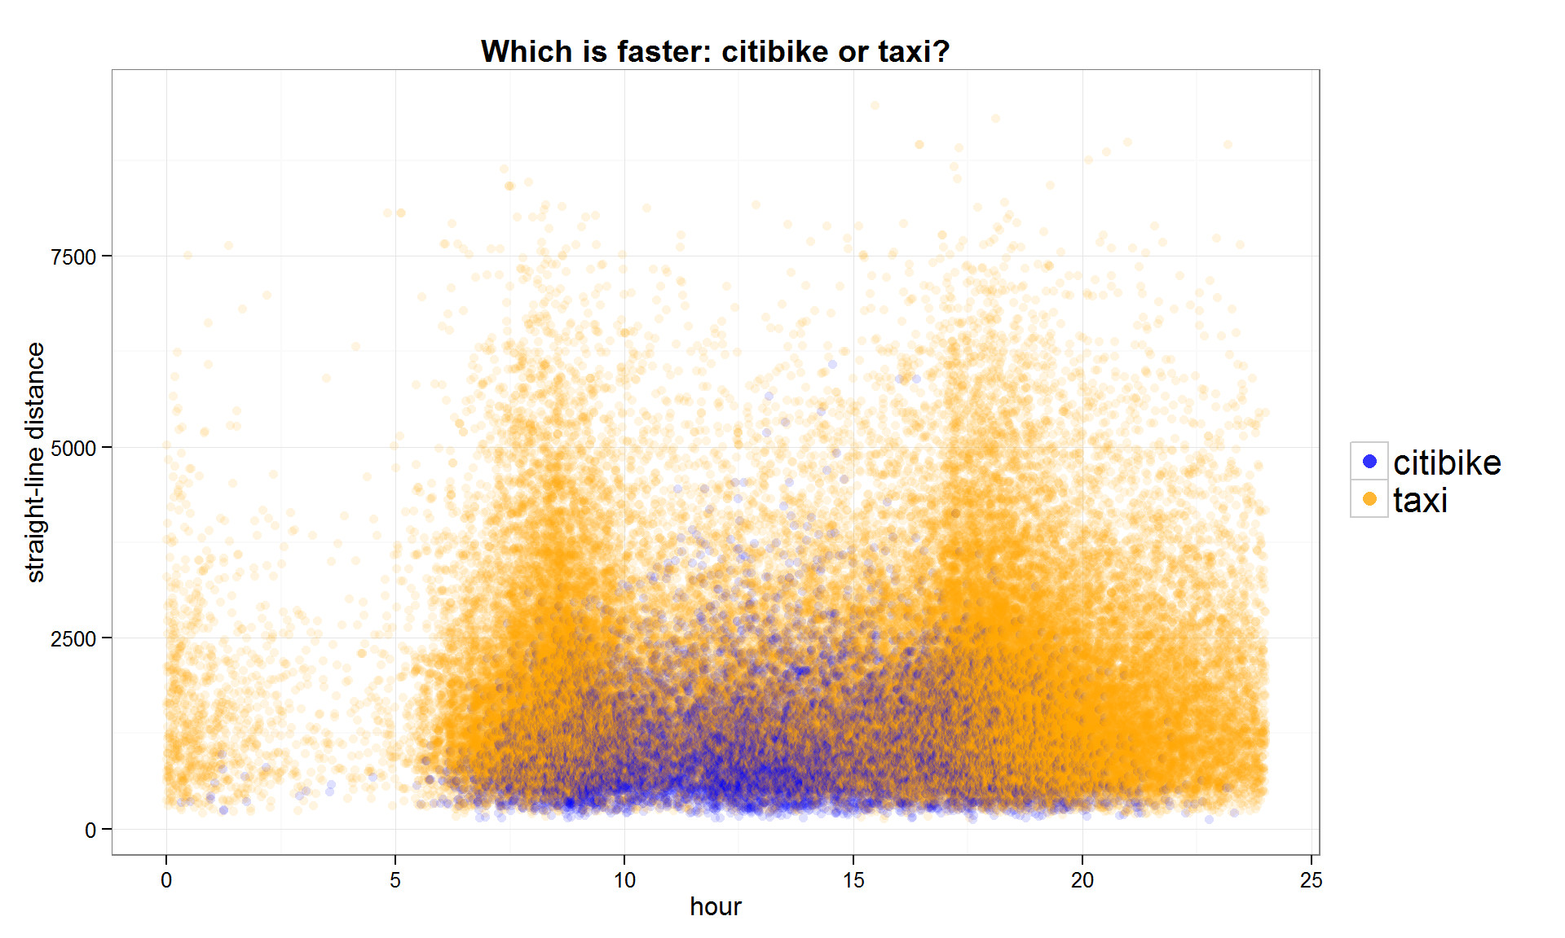
Which is faster: Citibikes or Taxis?

Slide 19
Modelling „which is faster“
10% test citibike data:
start time (hour+min/60)
straight-line distance
WhichIsFaster
Classification Tree Model
MODELLING
WhichIsFaster
Random Forest
Model

Slide 20
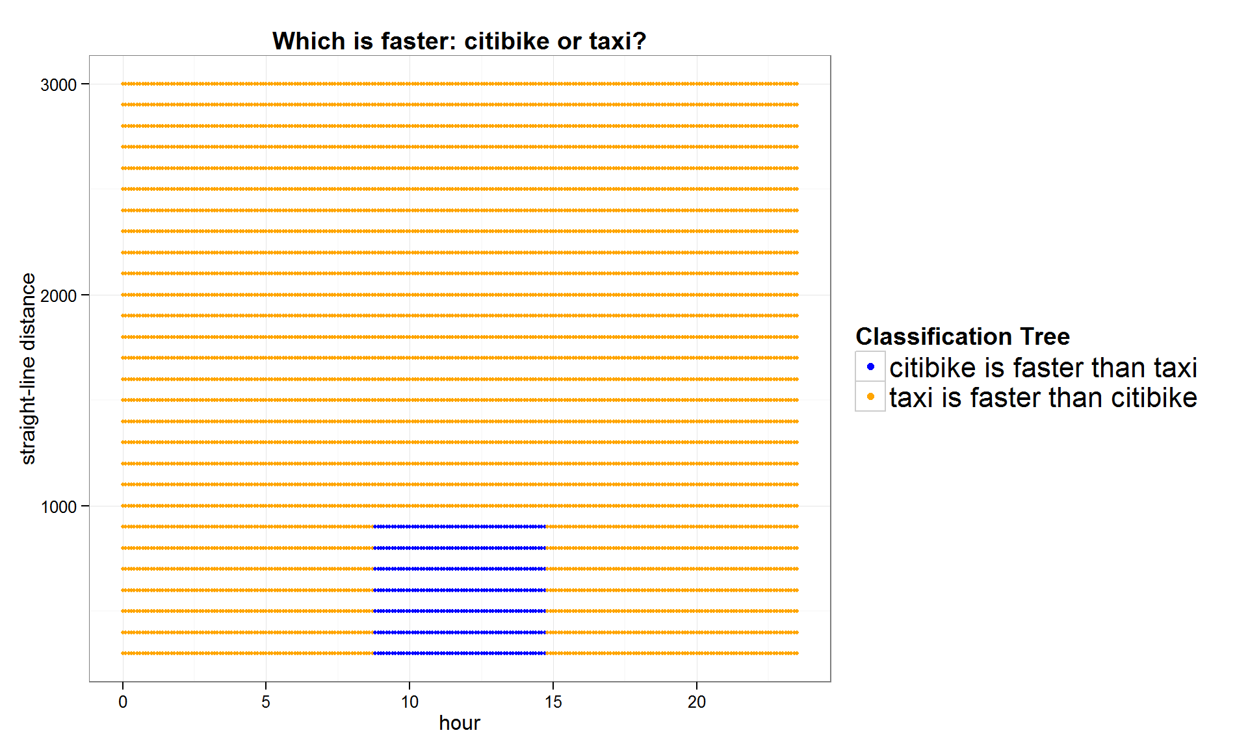
Which is faster: Citibikes or Taxis?

Slide 21

Which is faster: Citibikes or Taxis?

Slide 22
Answer
Citibikes faster than taxis
9 am - 15 pm during business days
short distances (straight-line distance < 1 km)

Slide 23
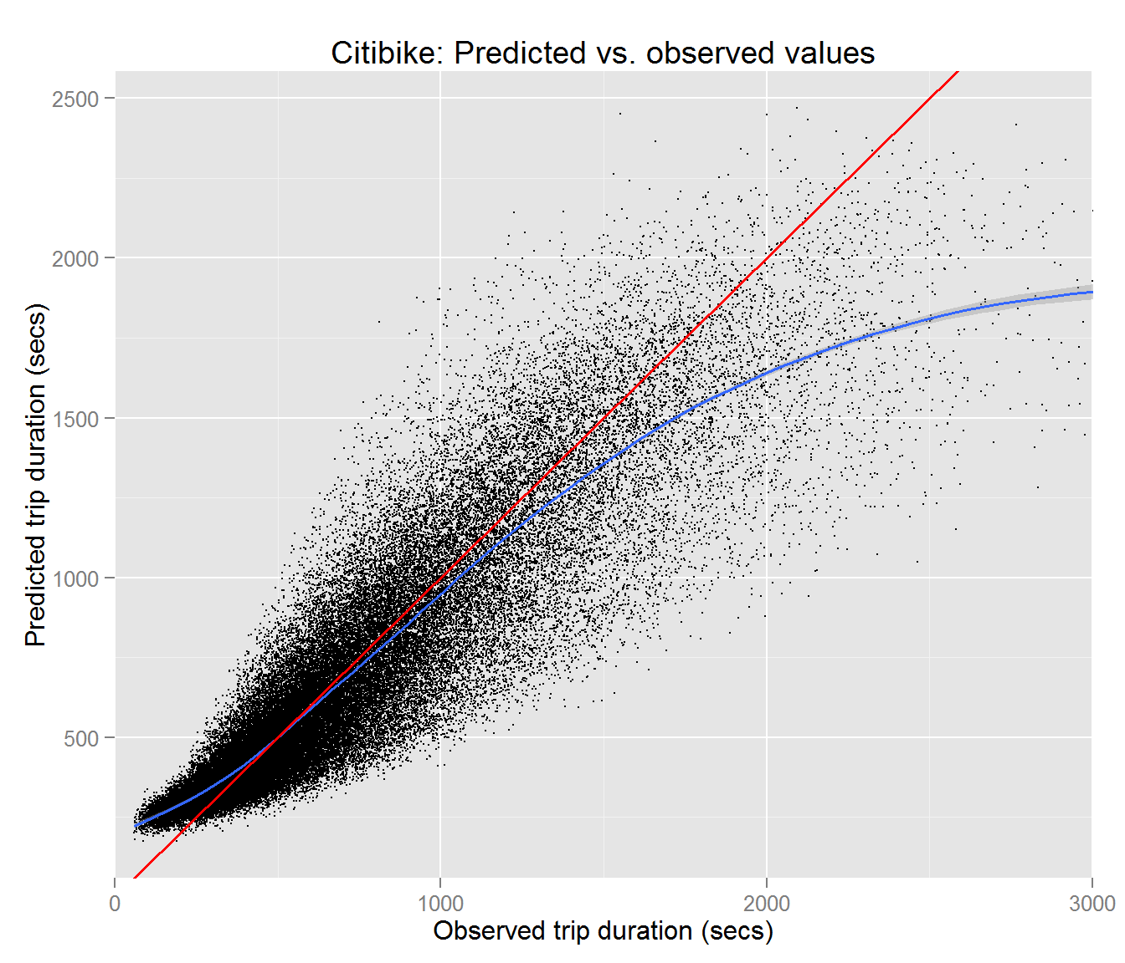
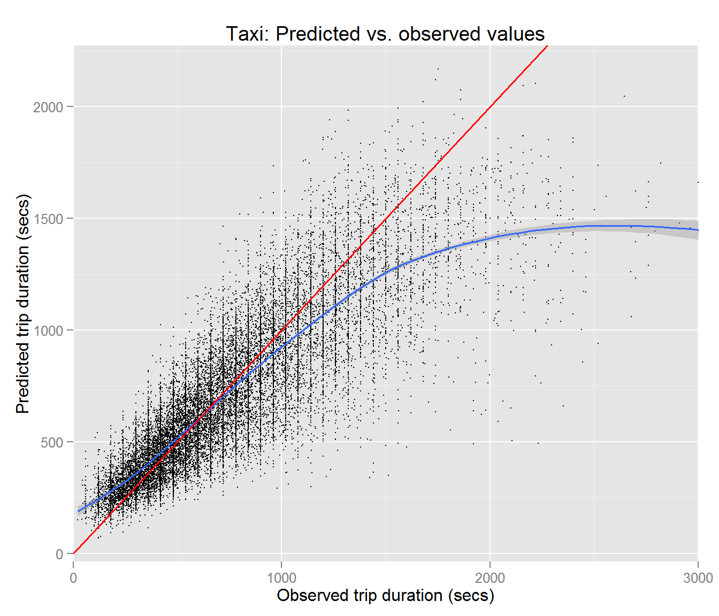
Improvements
Models for trip duration:
remove an observation if it differs considerably from the predicted value

