Slide 1
Data Mining Project
Predicting IPL Auction Rate
Submitted By-
Bhargav Thanki(U61740997)
Natasha Gandhi(U25537078)
Niroop Sadananda(U38061929)
Siddharth(U20004401)

Slide 2
Contents
Assumptions
DataSet Properties
Attributes and Output category
Visualizations and Insights in Tableau
Modelling in R
Sas E Miner Diagram
Variable Worth
Rapid-Miner Modelling
Interesting Insights

Slide 3
Assumptions
We are not considering the inflation
We have only considered data for international or top players
Converted currency from INR to USD for some years
Data for all rounders(10x) has been a avoided

Slide 4
DataSet Properties
Collected Data From Various sources
Players data was collected as per previous year’s performance
Number of Bowlers-96
Number of Batsman-93
Separated data for Bowlers and Batsmen
Tools Used: Excel,Sas E-Miner, R, Tableau,RapidMiner

Slide 5
Output Category
Sold Price | Category 1
Less than $250K | low
$250k-$500k | medium
$500k-750K | high
More than $750k | very high or vhigh
Sold Price | Category 3
Less than $200K | very low or vlow
$200k-$400k | low
$400k-$600K | medium
$600k-$800K | high
More than $800k | very high or vhigh
Sold Price | Category 2
Less than $350K | low
$350k-$700k | medium
More than $700k | high

Slide 6
Bowler Attributes
Category
Country
T20_Matches
T20 Catches
ODI_Matches
ODI Catches
T20_Over
T20_Runs_Given
T20_Wickets
T20_4_Wickets
T20_Bowling_Strike
T20_Economy
ODI_Over
ODI_Runs_Given
ODI_Wickets
ODI_4_Wickets
ODI_Bowling_Average
ODI_Bowling_Strike
ODI_Economy
T20_Bowling_Average

Slide 7
Batsman Attributes
Category
Country
T20_Matches
T20_Innings
T20_100s
T20_50s
Highest score_T20
Total Runs_T20
T20 Avg
T20 Strike Rate
T20 Catches
ODI_Matches
ODI_Innings
ODI_100s
ODI_50s
Highest score_ODI
Total Runs_ODI
ODI Avg
ODI Strike Rate
ODI Catches

Slide 8
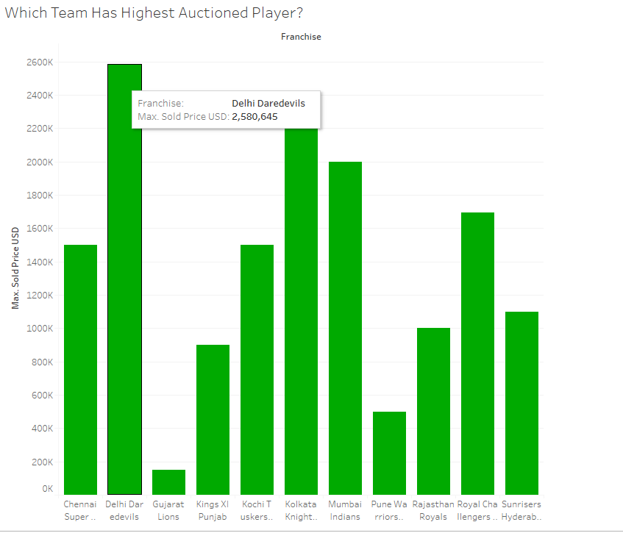
Which Team Has Highest Auctioned Batsman?

Slide 9
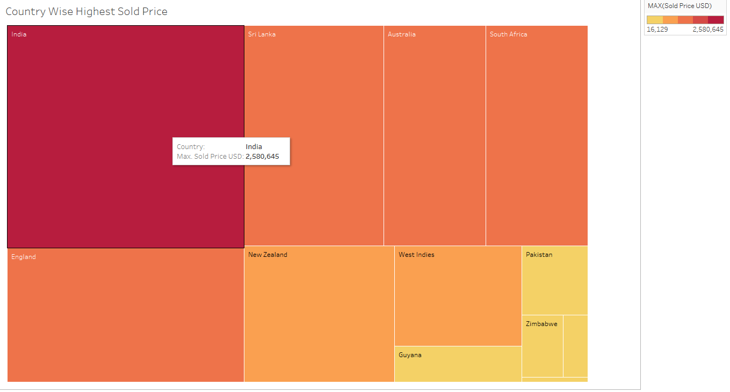
Which Country Has Highest Sold Price For Batsmen?

Slide 10
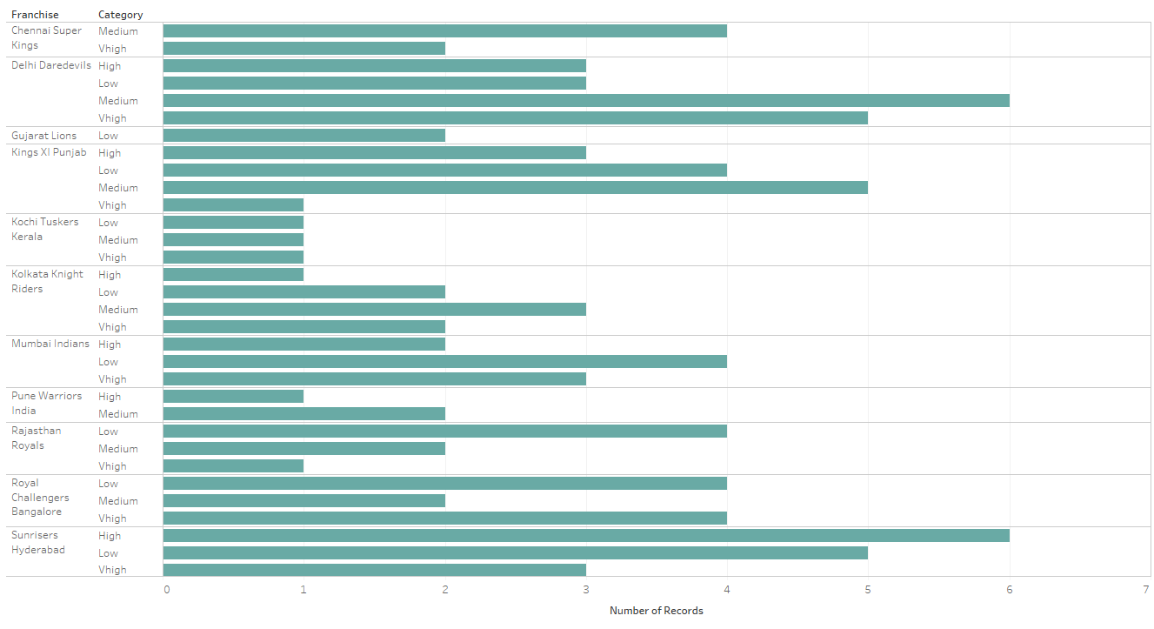
Category Wise Batsmen Count Per Team

Slide 11
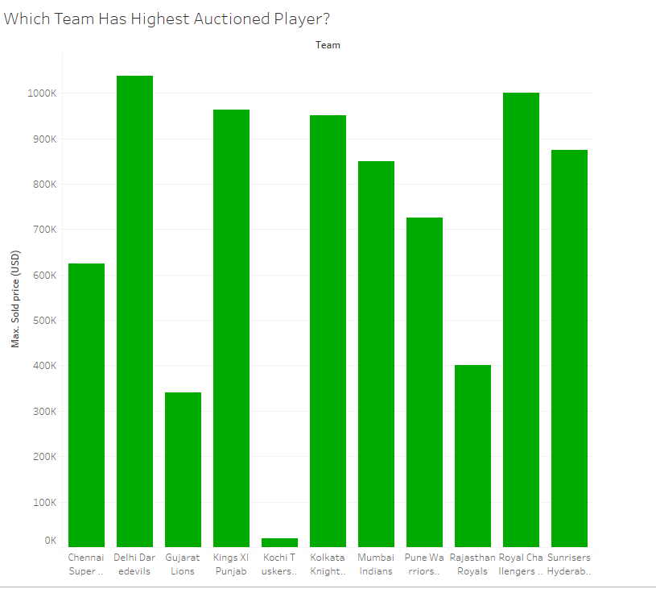
Which Team Has Highest Auctioned Bowler?

Slide 12
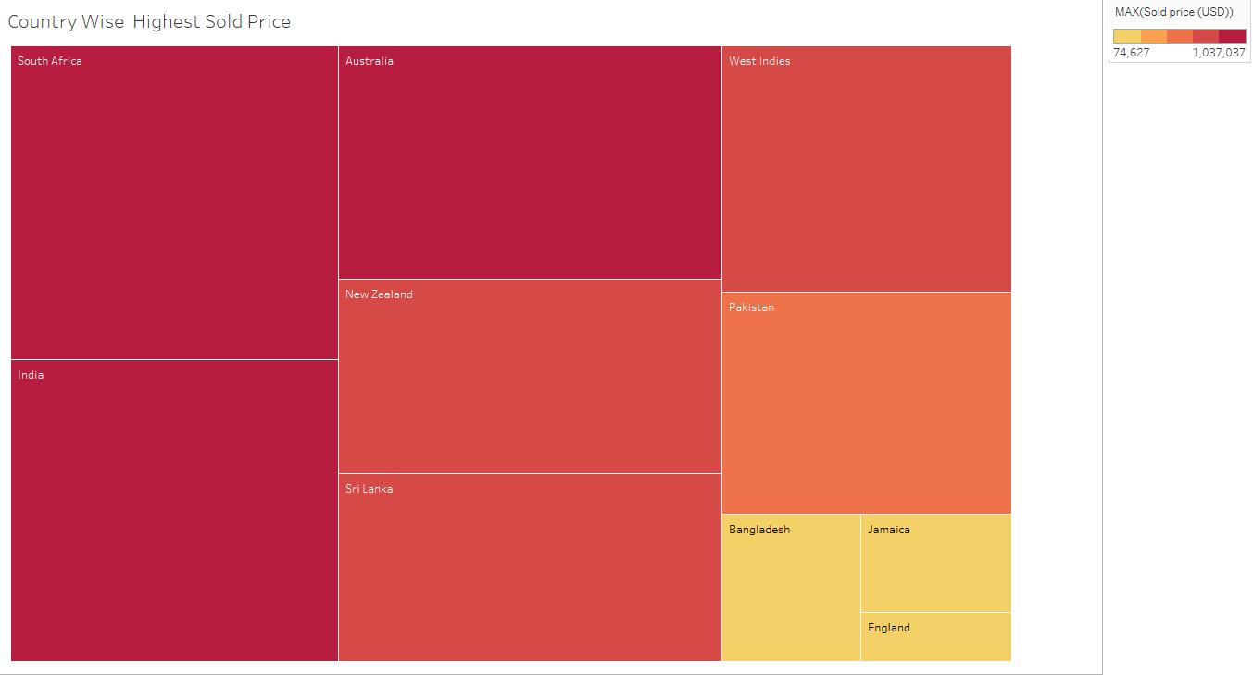
Which Country Has Highest Sold Price For Bowlers?

Slide 13
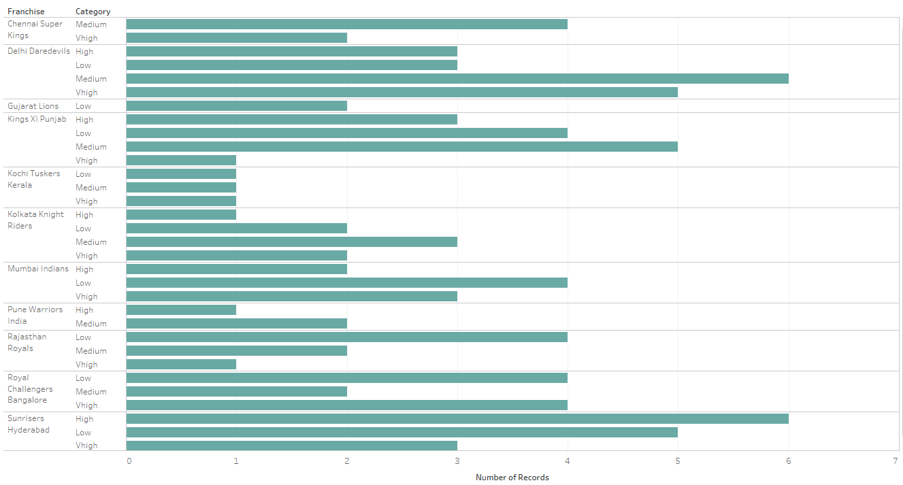
Category Wise Bowlers Count Per Team

Slide 14
R Bowlers
K fold validation -5
NaiveBayes
RandomForest
Category | Min | Max | Mean | Median
1 | 16 | 47 | 36 | 42
2 | 47 | 63 | 52 | 53
3 | 18 | 32 | 23 | 26
Category | Min | Max | Mean | Median
1 | 32 | 63 | 47 | 47
2 | 28 | 74 | 52 | 50
3 | 21 | 63 | 42 | 42
Notes:
databowler<-read.csv(file.choose())
#naiveBayes
outputData = 0
#Perform 5 fold cross validation
for(i in 1:5){
#Segement your data by fold using the which() function
folds <- cut(seq(1,nrow(databowler)),breaks=5,labels=FALSE)
testIndexes <- which(folds==i,arr.ind=TRUE)
testData <- databowler[testIndexes, ]
trainData <- databowler[-testIndexes, ]
classifier = naiveBayes(Category ~ ., data=trainData)
pred = predict(classifier, testData)
pred
misClassifyError = mean(pred != testData$Category)
Accuracy = 1-misClassifyError
Accuracy
outputData[i] = Accuracy
#Use the test and train data partitions however you desire...
}
summary(outputData)
#randomForest
#Perform 5 fold cross validation
for(i in 1:5){
#Segement your data by fold using the which() function
testIndexes <- which(folds==i,arr.ind=TRUE)
testData <- databowler[testIndexes, ]
trainData <- databowler[-testIndexes, ]
rf = randomForest(Category ~ . , data = trainData,na.action=na.exclude)
pred = predict(rf, testData)
pred
misClassifyError = mean(pred != testData$Category)
Accuracy = 1-misClassifyError
Accuracy
outputData[i] = Accuracy
#Use the test and train data partitions however you desire...
}
summary(outputData)

Slide 15
R Batsman
K fold validation -5
NaiveBayes
RandomForest
Category | Min | Max | Mean | Median
1 | 32 | 42 | 38 | 39
2 | 38 | 61 | 50 | 50
3 | 22 | 44 | 34 | 33
Category | Min | Max | Mean | Median
1 | 37 | 56 | 50 | 53
2 | 23 | 67 | 48 | 53
3 | 20 | 42 | 32 | 30
Notes:
databowler<-read.csv(file.choose())
#naiveBayes
outputData = 0
#Perform 5 fold cross validation
for(i in 1:5){
#Segement your data by fold using the which() function
folds <- cut(seq(1,nrow(databowler)),breaks=5,labels=FALSE)
testIndexes <- which(folds==i,arr.ind=TRUE)
testData <- databowler[testIndexes, ]
trainData <- databowler[-testIndexes, ]
classifier = naiveBayes(Category ~ ., data=trainData)
pred = predict(classifier, testData)
pred
misClassifyError = mean(pred != testData$Category)
Accuracy = 1-misClassifyError
Accuracy
outputData[i] = Accuracy
#Use the test and train data partitions however you desire...
}
summary(outputData)
#randomForest
#Perform 5 fold cross validation
for(i in 1:5){
#Segement your data by fold using the which() function
testIndexes <- which(folds==i,arr.ind=TRUE)
testData <- databowler[testIndexes, ]
trainData <- databowler[-testIndexes, ]
rf = randomForest(Category ~ . , data = trainData,na.action=na.exclude)
pred = predict(rf, testData)
pred
misClassifyError = mean(pred != testData$Category)
Accuracy = 1-misClassifyError
Accuracy
outputData[i] = Accuracy
#Use the test and train data partitions however you desire...
}
summary(outputData)

Slide 16
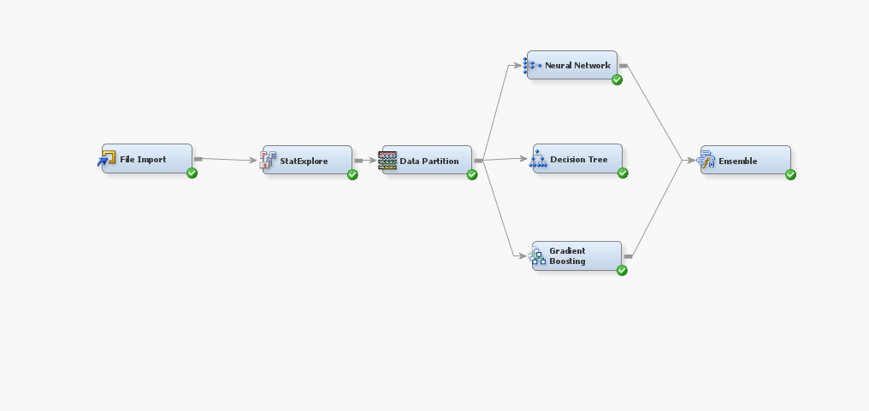
SAS Diagram

Slide 17
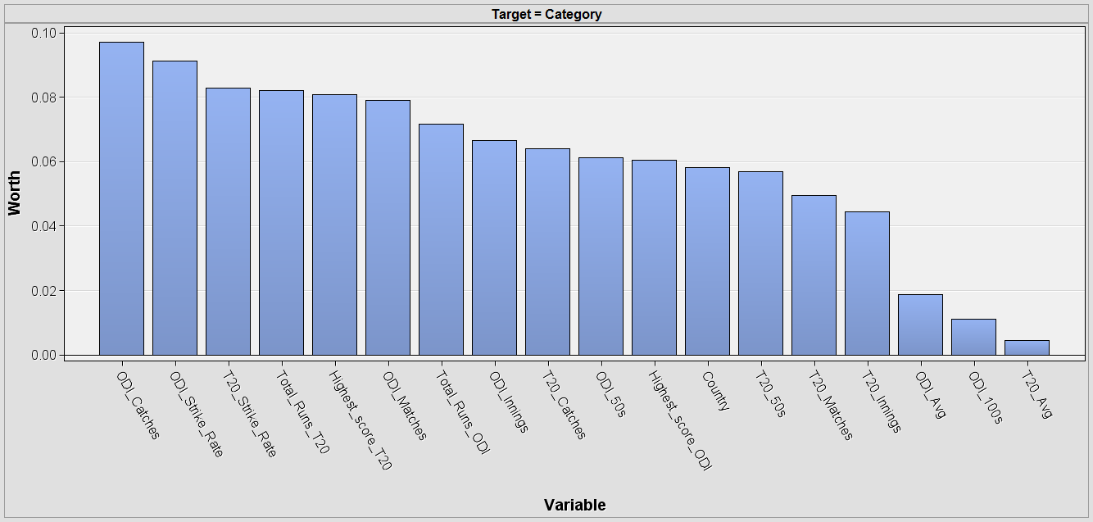
Batsman’s Variable Worth

Slide 18
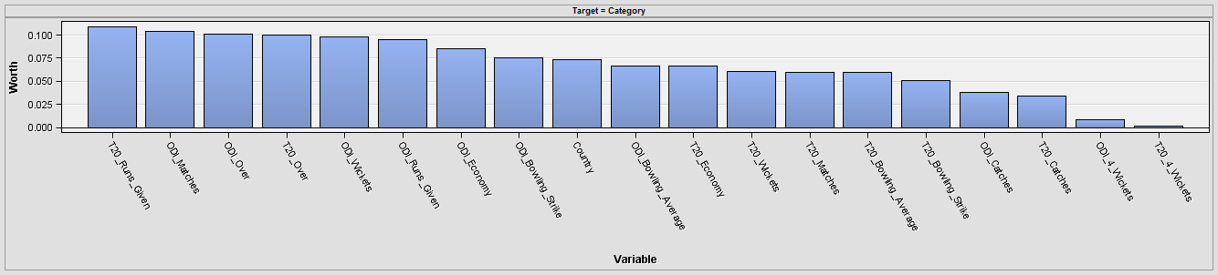
Bowler’s Variable Worth

Slide 19
SAS Enterprise
Train- 80 Test -20
Bowler
Batsman
Category | Neural Network | Gradient Boosting | Decision Tree
1 | 28 | 55 | 64
Category | Neural Net | Gradient Boosting | Decision Tree
1 | 31 | 35 | 22
Notes:
databowler<-read.csv(file.choose())
#naiveBayes
outputData = 0
#Perform 5 fold cross validation
for(i in 1:5){
#Segement your data by fold using the which() function
folds <- cut(seq(1,nrow(databowler)),breaks=5,labels=FALSE)
testIndexes <- which(folds==i,arr.ind=TRUE)
testData <- databowler[testIndexes, ]
trainData <- databowler[-testIndexes, ]
classifier = naiveBayes(Category ~ ., data=trainData)
pred = predict(classifier, testData)
pred
misClassifyError = mean(pred != testData$Category)
Accuracy = 1-misClassifyError
Accuracy
outputData[i] = Accuracy
#Use the test and train data partitions however you desire...
}
summary(outputData)
#randomForest
#Perform 5 fold cross validation
for(i in 1:5){
#Segement your data by fold using the which() function
testIndexes <- which(folds==i,arr.ind=TRUE)
testData <- databowler[testIndexes, ]
trainData <- databowler[-testIndexes, ]
rf = randomForest(Category ~ . , data = trainData,na.action=na.exclude)
pred = predict(rf, testData)
pred
misClassifyError = mean(pred != testData$Category)
Accuracy = 1-misClassifyError
Accuracy
outputData[i] = Accuracy
#Use the test and train data partitions however you desire...
}
summary(outputData)

Slide 20
Rapid Miner
Train- 70 Test-30
Bowler
Batsman
Naive Bayes | Random Forest(20) | Decision Tree
39 | 43 | 39
Naive Bayes | Random Forest(20) | Decision Tree
25 | 48 | 37
Notes:
databowler<-read.csv(file.choose())
#naiveBayes
outputData = 0
#Perform 5 fold cross validation
for(i in 1:5){
#Segement your data by fold using the which() function
folds <- cut(seq(1,nrow(databowler)),breaks=5,labels=FALSE)
testIndexes <- which(folds==i,arr.ind=TRUE)
testData <- databowler[testIndexes, ]
trainData <- databowler[-testIndexes, ]
classifier = naiveBayes(Category ~ ., data=trainData)
pred = predict(classifier, testData)
pred
misClassifyError = mean(pred != testData$Category)
Accuracy = 1-misClassifyError
Accuracy
outputData[i] = Accuracy
#Use the test and train data partitions however you desire...
}
summary(outputData)
#randomForest
#Perform 5 fold cross validation
for(i in 1:5){
#Segement your data by fold using the which() function
testIndexes <- which(folds==i,arr.ind=TRUE)
testData <- databowler[testIndexes, ]
trainData <- databowler[-testIndexes, ]
rf = randomForest(Category ~ . , data = trainData,na.action=na.exclude)
pred = predict(rf, testData)
pred
misClassifyError = mean(pred != testData$Category)
Accuracy = 1-misClassifyError
Accuracy
outputData[i] = Accuracy
#Use the test and train data partitions however you desire...
}
summary(outputData)

Slide 21
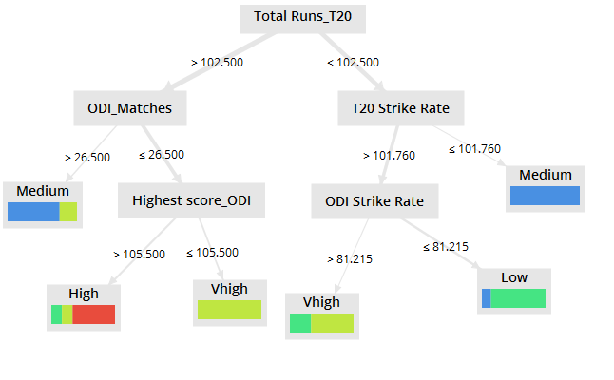
Decision Tree - Rapid Miner (Batsman)

Slide 22
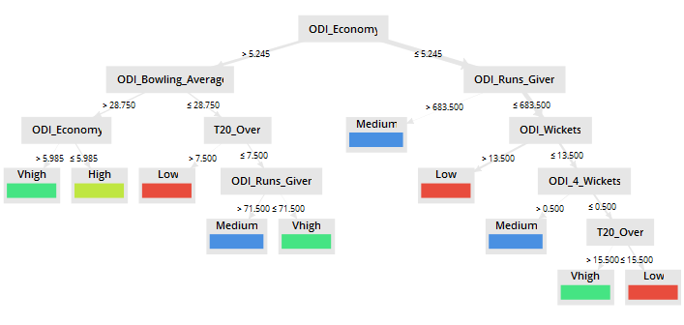
Decision Tree - Rapid Miner (Bowlers)

Slide 23
Total runs in the T20 was the most significant attribute.
ODI Economy Rate is the most significant attribute for bowlers.
T20 Average came out to be the least significant variable worth for batsmen.
Good batsmen tend to be good fielders.
Performance of the players is taken into account by the various franchise before the bidding.
Perhaps, for the next IPL season, data from other major cricket leagues, such as Big Bash and previous IPL performance of players could be integrated with this data to predict the auction rate.
Interesting Insights-

Slide 24
Thankyou!

