Slide 1
Crime and Housing Prices in Montgomery County, MD
Arash Asadabadi, Nibret Daba, Natasha Hurwitz, Ashley Turnbull
INST 737 – Dr. Seyed
December 8, 2016

Slide 2
Why are we interested?
To see:
If crime brings a meaningful influence upon neighborhood housing values
If there is any geographic pattern to crime
Is there any correlation between various crimes
What is the challenge in Montgomery County, MD (crime)

Slide 3
Process
Data Collection
Data Cleaning
Data Merging
Feature Development
Defining research Questions
Statically Analysis and Modeling

Slide 4
Data Sources
Crime_by_Zipcode -Montgomery County Open Data Portal
Zillow_MC (http://www.zillow.com/research/data/, ZHVI All Homes (SFR, Condo/Co-op) Time Series ($) by Zip Code)
Zip Codes - MC_Zip_Codes_IRS (http://www.zipcodestogo.com/Maryland/
Facilities_by_Zipcode – Data.gov
MC_House_Sales_by_Zipcode_2014 - http://planning.maryland.gov/msdc/sale_data/saledata.shtml

Slide 5
Data Preparation
Feature engineering
Crime types
Merging datasets
Removing less important data fields
Removing incomplete records (no zip codes, low listing)

Slide 6
Obtaining the Data and Preparation

Slide 7
Obtaining the Data
Long and Foster - Housing Data
It was not easy to obtain the home sales data, even though it was seemingly publicly available
A call to the data area of Long and Foster and we were able to reach Michael Bystry, Senior Market Research Analyst
One week later, he sent the dataset with 31 columns and over 10,000 records with documentation

Slide 8
Publicly Available Data
Datasets Combined on Zipcode
Zipcodestogo - to understand what zipcodes were in MoCo
Public Safety Data from Montgomery County on Crime (June 2013 – June 2014)
Community Facilities in Montgomery County
Maryland State Department of Planning
2014 means, medians and counts on housing sales
Some datasets were then summarized by zipcode
Datasets on publics schools were obtain and prepared, but ultimately discarded

Slide 9
Cleaning the Data
Missing data and ‘NA’s were examined and replaced or removed
Data with zipcodes that were not residential or were not in Montgomery County were examined and replaced or removed
The crime data was combined with other zipcode data
The housing dataset had several columns that were removed

Slide 10
Feature Creation
We found words in the crime data and created a spreadsheet with counts of crimes containing those words
23 crime categories were created
Each category was normalized by population to create a crime rate

Slide 11
Crime Data
Data is for all reported incidents from July 2013 to present
We only used 1-year period (July 2013 – July 2014) crime data, since housing prices belong to year 2014
Based on incident codes and report descriptions, we categorized the crimes (initially 68 types)
After aggregating the crime rates for different zip codes, some types were omitted or merged because of less frequency
The final data were the rate for 23 crime types among different zip codes in Montgomery County, which then were merged to main data

Slide 12
Descriptive Statistics

Slide 13
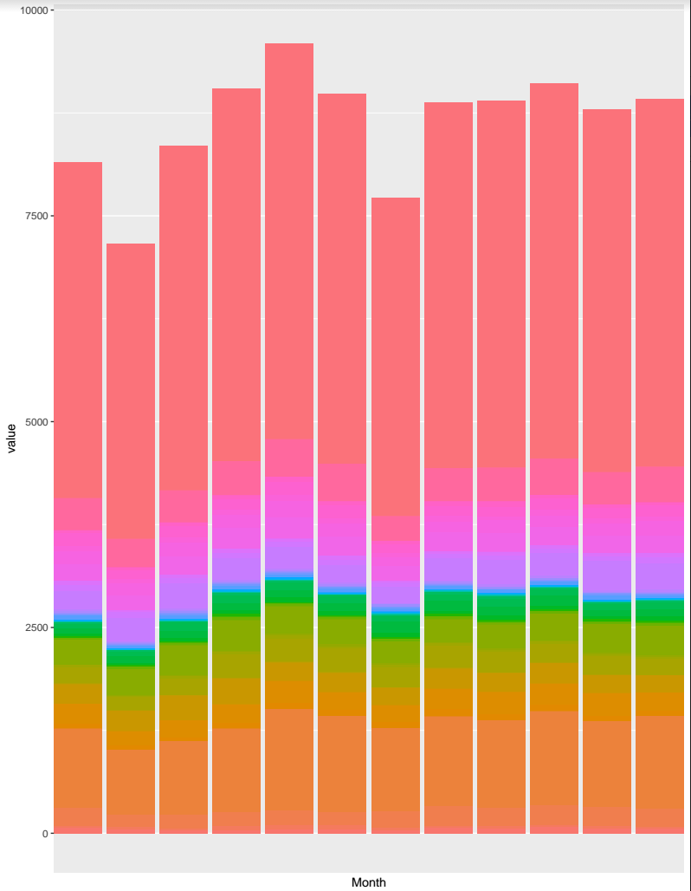
Crime Counts by Month

Slide 14
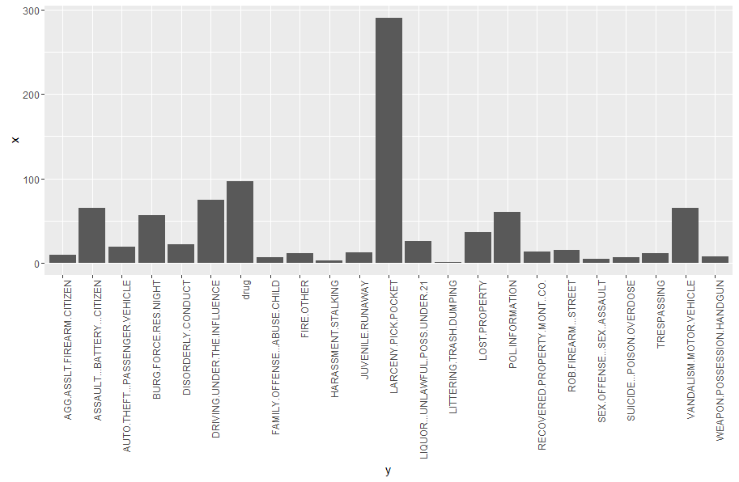
Crime by Category

Slide 15
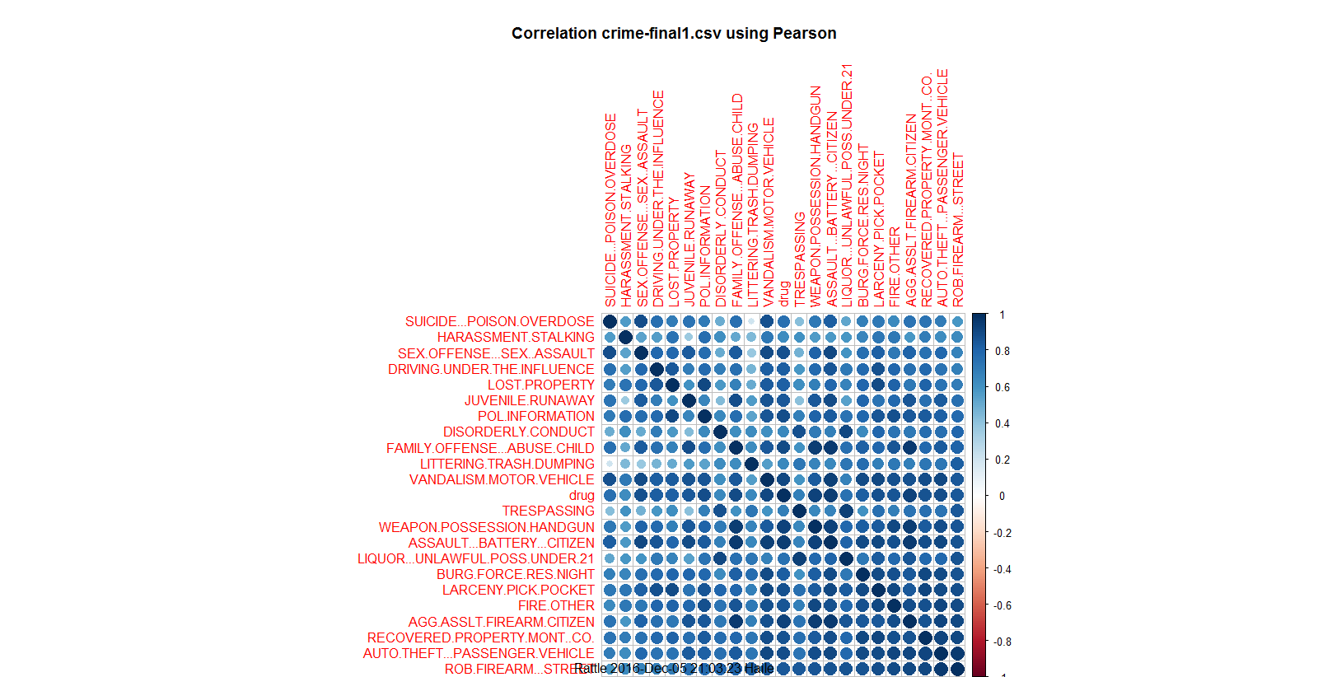
Correlation

Slide 16
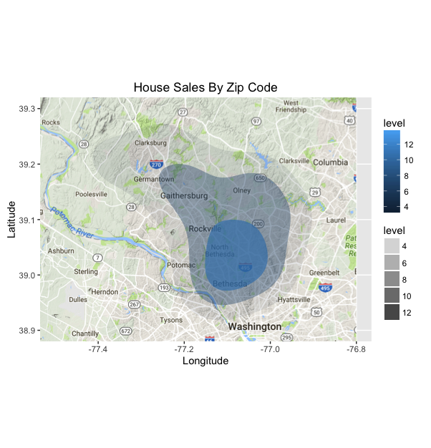

Slide 17
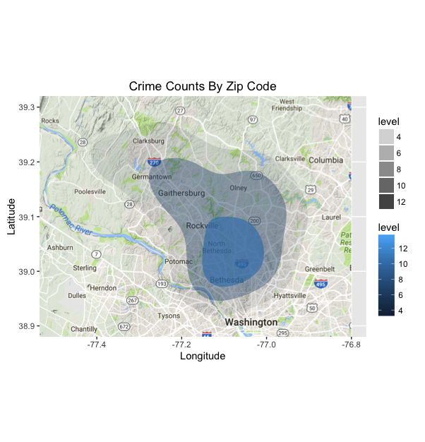

Slide 18
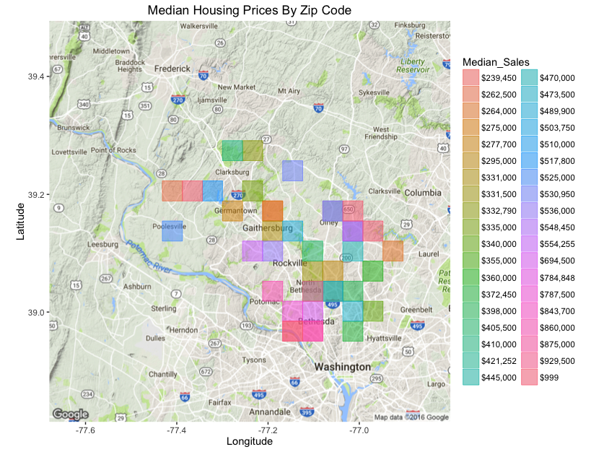

Slide 19
Linear Model and Principle Component Analysis (PCA)

Slide 20
Columns in Dataset
Numeric
Factor
By Zipcode
Crime Data (divided in 23 types)
Population
Community Facilities
Total Number of Home Sales
Total Number of Crimes
Median and Mean Selling Price
By Home
Sale Quarter
Days on Market
Number of Bedrooms
Number of Bathrooms
Square Footage
Zipcode
Legal Subdivision
Type (Townhouse, Detached)
Parking (off-street, garage)
Has Garage

Slide 21
Numeric Data Analysis
Only numeric data could be used for Principal Factor Analysis
Attempted to run the numeric data + factor data through stepwise AIC, but it took too much time
Only the numeric data was analyzed using these techniques

Slide 22
Linear Model with Stepwise AIC
This was the best linear model created with the numeric data
Close.Price ~ ROB.FIREARM...STREET + AGG.ASSLT.FIREARM.CITIZEN + LARCENY.PICK.POCKET + AUTO.THEFT...PASSENGER.VEHICLE + ASSAULT...BATTERY...CITIZEN + VANDALISM.MOTOR.VEHICLE + WEAPON.POSSESSION.HANDGUN + FAMILY.OFFENSE...ABUSE.CHILD + JUVENILE.RUNAWAY + LIQUOR...UNLAWFUL.POSS.UNDER.21 + DISORDERLY.CONDUCT + SUICIDE...POISON.OVERDOSE + LITTERING.TRASH.DUMPING + TRESPASSING + HARASSMENT.STALKING + FIRE.OTHER + LOST.PROPERTY + RECOVERED.PROPERTY.MONT..CO. + community_facilities_count + Number_of_Sales_2014 + Number_of_Crimes_2014 + List.Price + Original.List.Price + DOMM + DOMP + Baths.All + Bedrooms + median_sales_num + mean_sales_num

Slide 23
Everything Looked Significant
Because our dataset had 10,000+ records, nearly everything looked significant, and StepAIC created a model with most of the factors
Principal Component Analysis (PCA) was used to narrow down which crime factors would be most useful

Slide 24
Principle Component Analysis
1. ROB.FIREARM...STREET 2. FAMILY.OFFENSE...ABUSE.CHILD 3. BURG.FORCE.RES.NIGHT (which AIC isn't seeing as important) 4. AGG.ASSLT.FIREARM.CITIZEN
5. AUTO.THEFT...PASSENGER.VEHICLE 6. ASSAULT...BATTERY...CITIZEN 7. WEAPON.POSSESSION.HANDGUN 8. drug 9. RECOVERED.PROPERTY.MONT..CO. 10. JUVENILE.RUNAWAY 11. SEX.OFFENSE...SEX..ASSAULT (which AIC isn't seeing as important)

Slide 25
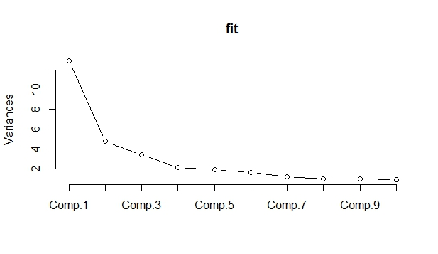
Principle Component Analysis

Slide 26
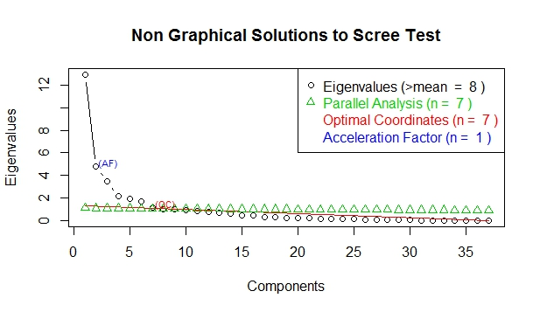
Principle Component Analysis

Slide 27
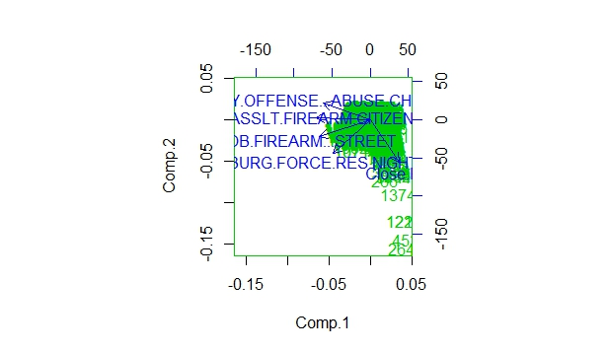
Principle Component Analysis

Slide 28
Including Some Factor Data
We had a problem running the factor data because it was very slow, but then identified 3 factors with fewer levels
Has Garage, Date.Quarter, Type of Home
Rob.Firearm, Child Abuse, Burglary, Assault.Firearm
This model had an improved AIC (229013)

Slide 29
Classification Models
Goal: Create a classifier which predicts the class of the houses.
Three classes based on price
Cheap: (0,300000), Medium(300000,650000), Expensive(65000,8650000)
Spectrum of housing prices:
Model: Class~ predictors
80% for training and 20% for test data set.
Lot-sqft: interestingly very low information gain! People reports it falesly
quantile | 0% | 25% | 50% | 75% | 100%
Price($) | 33000 | 305000 | 427000 | 650000 | 8650000

Slide 30
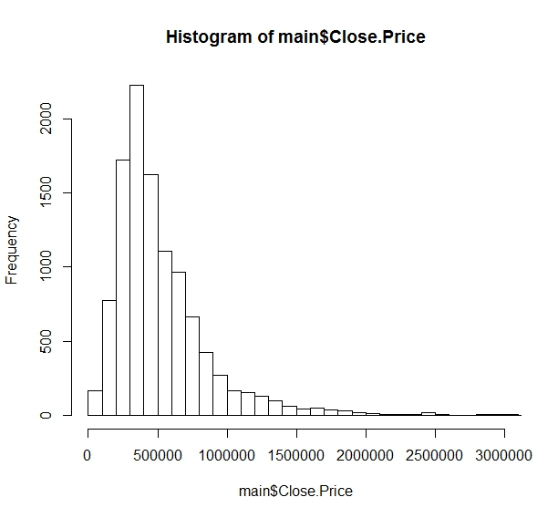

Slide 31
SVM
Which predictors to use? Feature Engineering
Predictor(s) | accuracy
number of bedrooms | .653
+ number of bathrooms | .683
+type of house | .709
+garage | 0.722
+total number of crimes | 0.722
+facilities of neighborhood | 0.786
+ all the crime variables(23) | .862

Slide 32
Error Analysis
Contingency table:
Most falsely predicted are near the boundaries
After shifting the boundaries these intervals still give the best accuracy
 | 1 | 2 | 3
1 | 415 | 56 | 0
2 | 97 | 976 | 100
3 | 0 | 63 | 462

Slide 33
Logistic regression
Three variables: Multinomial Logit
The same variables as in final SVM used
A sample of fitted model in the test data set:
With this criteria the final accuracy: 0.82
record | Class 1 | Class 2 | Class 3
8285 | 4.00e-05 | 0.999 | 1.096e-04
2055 | 0.867 | 0.132 | 3.19e-15
9930 | 0.431 | 0.563 | 0.15e-14

Slide 34

Result of logit model
Sample of result:
How to interpret? In MNL there is a based class( here is one)
ln($\frac{P (class=2)}{p (class=1)}$) = b₀₂ + b₁₂ * x1 + b₂₂ * x2 +…
 | Dependent Variable(Class)
Predictors | 2 | 3
ROB.FIREARM...STREET | -51.212***(0.00002) | 0.565***(0.00000)
BURG.FORCE.RES.NIGHT | 97.826***(0.0001) | 7.914*** (0.00000)
Baths.All | 1.236*** (0.067) | 3.603*** (0.048)
Bedrooms | 0.338*** (0.058) | -1.135***(0.031)

Slide 35
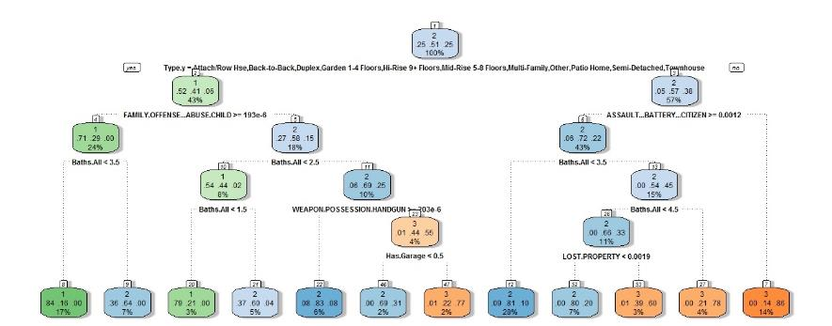
Decision Tree Model
Predict with same variables: Accuracy is 0.81

Slide 36
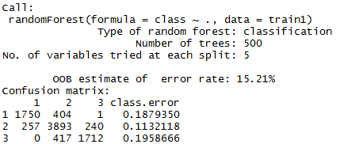
Random Forest
Creating 500 trees with random selection of 1-data, 2-variables
The accuracy increases to 0.87
 | 1 | 2 | 3
1 | 431 | 53 | 0
2 | 75 | 977 | 98
3 | 0 | 65 | 464

Slide 37
Comparison between models
Cross validation is used to average the accuracies for each method
Model | Accuracy
SVM | 0.86
Mulitnomial logit | 0.82
Decision Tree | 0.81
Random Forest | 0.87

Slide 38
Why the price decreases in the Market?
Original price versus Closing price
1847 stable,6847 reduction, 2148 increase
Regression model
Lm( log(price difference) ~ type+ log(original price)+ log(median-price)+…)

Slide 39
 | Estimate | t value
(Intercept) | 0.032 | 1.277
Date.Quarter2 | 0.014 | 6.923
Date.Quarter3 | 0.003 | 1.377
Date.Quarter4 | -0.007 | -3.208
Baths.All | -0.001 | -1.866
Bedrooms | -0.001 | -0.553
Type.yBack-to-Back | -0.022 | -1.552
Type.yDetached | -0.005 | -0.958
Type.yDuplex | -0.037 | -1.946
Type.yDwelling w/Rental | -0.122 | -2.846
Type.yGarden 1-4 Floors | -0.031 | -5.246
Type.yHi-Rise 9+ Floors | -0.037 | -6.077
Type.yHouse of Worship | 0.081 | 1.353
Type.yMid-Rise 5-8 Floors | -0.032 | -3.870
Type.yMulti-Family | 0.015 | 0.646
Type.yOther | -0.049 | -3.141
Type.yPatio Home | -0.010 | -0.808
Type.yQuad | -0.049 | -1.154
Type.ySemi-Detached | -0.002 | -0.166
Type.yTownhouse | -0.002 | -0.302
Has.GarageTRUE | 0.001 | 0.896
log(Original.List.Price) | -0.017 | -7.875
log(Median_Sales) | 0.013 | 5.375

Slide 40
How many days your house will be in the Market?
Variable DOMP :total days the house had been in the market before being sold
Can we predict it? Regression model
DOMP~ log(Original Price)+Type+ Bedrooms+ Bathrooms+ Parking+ Quarter

Slide 41
 | Estimate | t value
(Intercept) | -180.28 | -8.41
Type.yBack-to-Back | 17.69 | 1.24
Type.yDetached | 9.24 | 1.56
Type.yDuplex | 24.98 | 1.25
Type.yDwelling w/Rental | -9.28 | -0.20
Type.yGarden 1-4 Floors | 28.37 | 4.50
Type.yHi-Rise 9+ Floors | 32.65 | 5.03
Type.yHouse of Worship | -45.24 | -0.68
Type.yMid-Rise 5-8 Floors | 27.07 | 2.98
Type.yMulti-Family | -14.03 | -0.51
Type.yOther | 22.71 | 1.46
Type.yPatio Home | 14.42 | 1.21
Type.yPenthouse | 136.99 | 2.90
Type.yQuad | 20.92 | 0.44
Type.ySemi-Detached | 2.05 | 0.13
Type.yTownhouse | 7.82 | 1.31
Number_of_Crimes_2014 | 0.00 | 0.50
Has.GarageTRUE | 5.18 | 3.13
Bedrooms | 1.64 | 2.92
Date.Quarter2 | -20.95 | -9.55
Date.Quarter3 | -13.20 | -5.62
Date.Quarter4 | 1.16 | 0.48
log(Original.List.Price) | 16.65 | 10.16

