Slide 1
Qt C++/WPF Application
Explore Qt C++/WPF by creating your own App
https://github.com/natashaiwscope/emulator_v0

Slide 2
About Ethernet Bridge project
As developer we felt need to have device where we could write hello world application to interact with TTL UART/RS485/CAN/I2C/DAC and ADC bus.
Libraries provided with project are C++ DLL along with WPF wrapper.

Slide 3
Lets first start with QT How to write Qt application

Slide 4
Install QT 4.8.x (Windows) https://download.qt.io/official_releases/qt/4.8/4.8.7/qt-opensource-windows-x86-mingw482-4.8.7.exe (Please follow mingw32 compiler followed) Linux(Ubuntu) $ sudo apt-get install qt Windows WPF Frame Work Please search google with how to install WPF windows

Slide 5
Before you continue please test your framework by creating simple hello world application

Slide 6
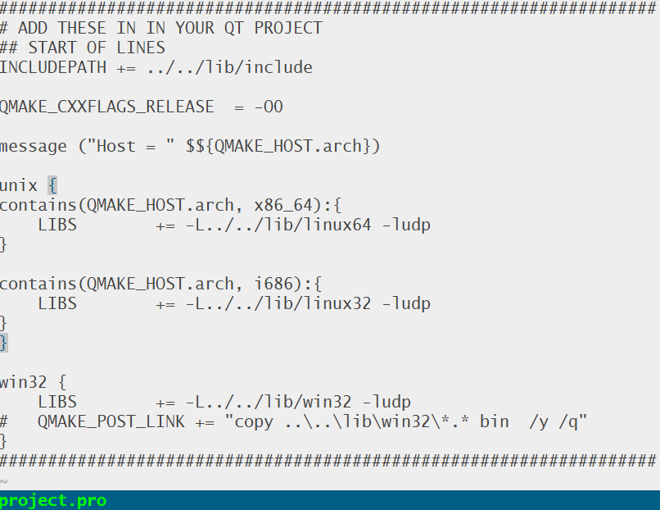
Add these LINES in QT Project file.➔
Edit Qt project file to include header and library
Please see supplied project for reference

Slide 7
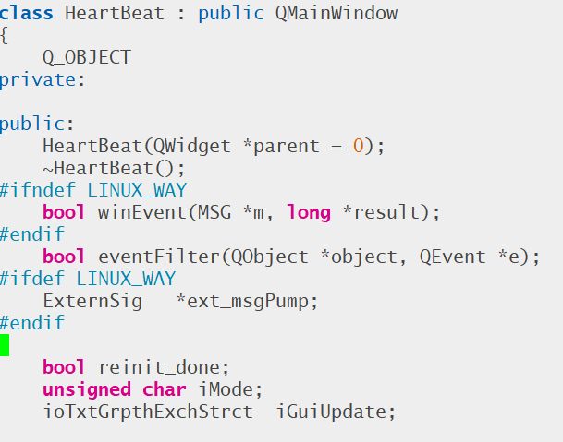
MODIFY Main Qt class (Please see examples)
Please see supplied project for reference
Handle message pumping (Windows)➔
Windows message will arrive when incomming data ready
Same message via SIGNAL in Linux➔

Slide 8
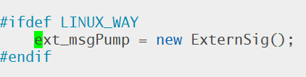
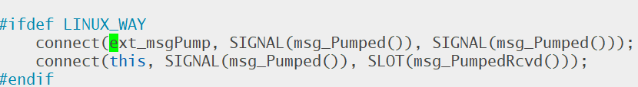
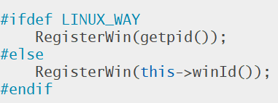
MODIFY Main Qt class (Please see examples)
Same message via SIGNAL in Linux➔
Windows platforms provides Handle for windows and Linux process ID

Slide 9
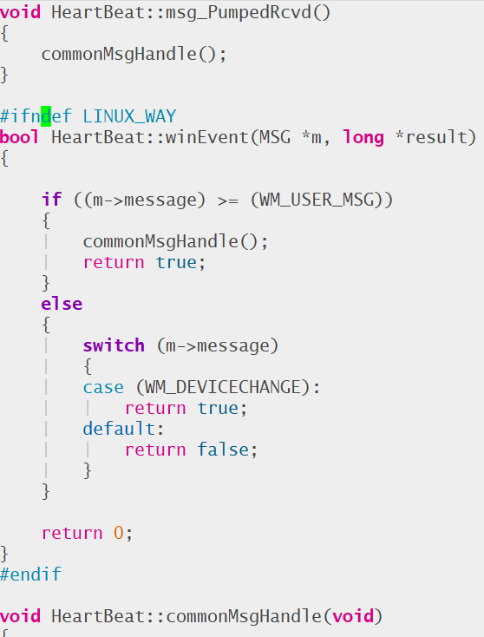
MODIFY Main Qt class (Please see examples)
Windows & Linux both Handles message
same way in commonMsgHandle

Slide 10
You Never need to poll for data, message post will inform if asyncronous if data available

Slide 11
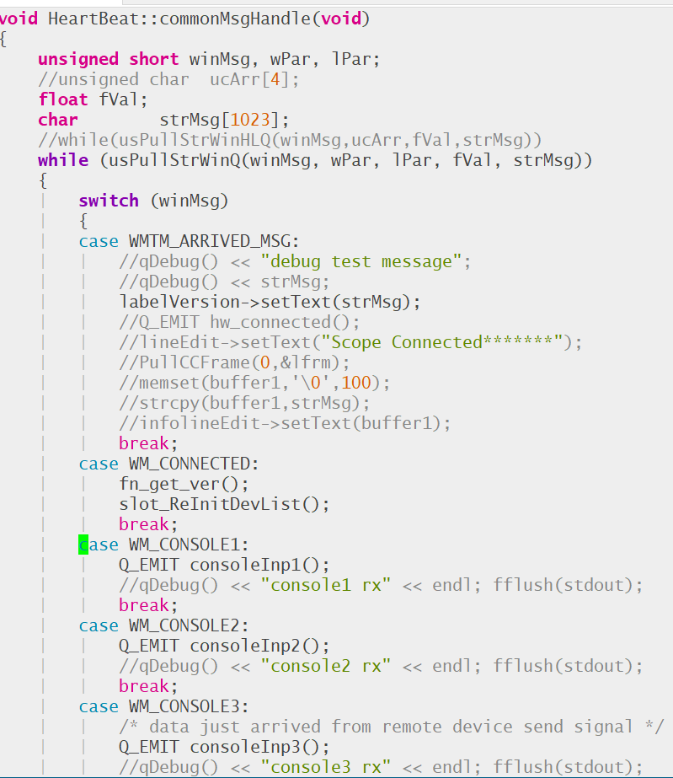
MODIFY Main Qt class (Please see examples)
Windows & Linux both Handles message
same way in commonMsgHandle
For example WM_CONSOLE3 message indicates
DATA READY on Ethernet hardware UART3 (MARKED on BOARD)

Slide 12
Now you got basic idea, please try to compile/build your self. Send email for any issue support@iwscope.com

Slide 13
Now microsoft WPF (windows presentation foundation) How to write WPF application

Slide 14
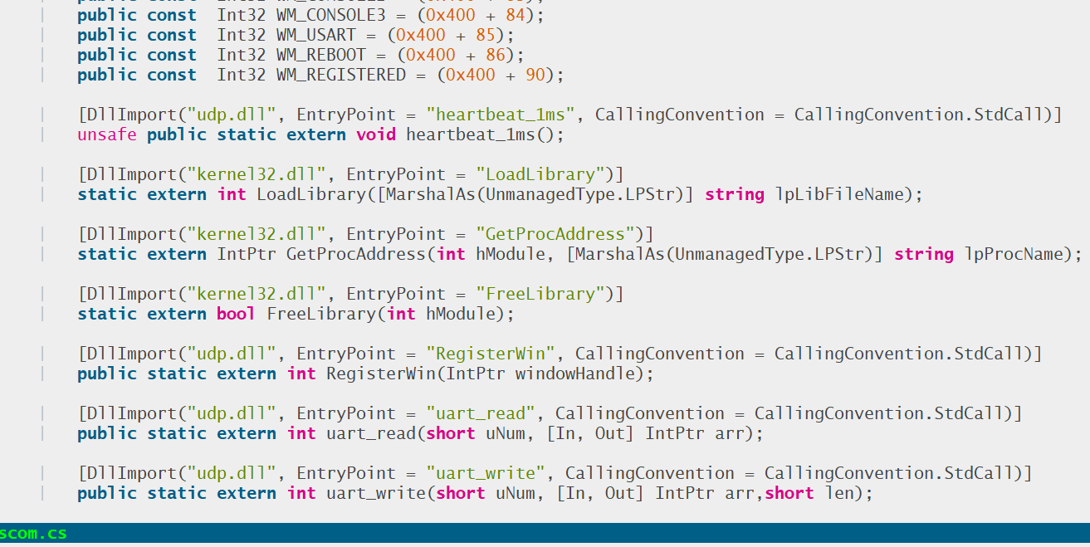
MODIFY Main Qt class (Please see examples)
There is .Net wrapper for C++ interface
User can register windows hadle
Getting windows hadle works different with WPF/.Net
Please see example code for terminal

Slide 15
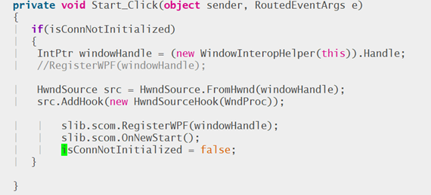
MODIFY Main Qt class (Please see examples)
Obtaining windows WPF handle

Slide 16
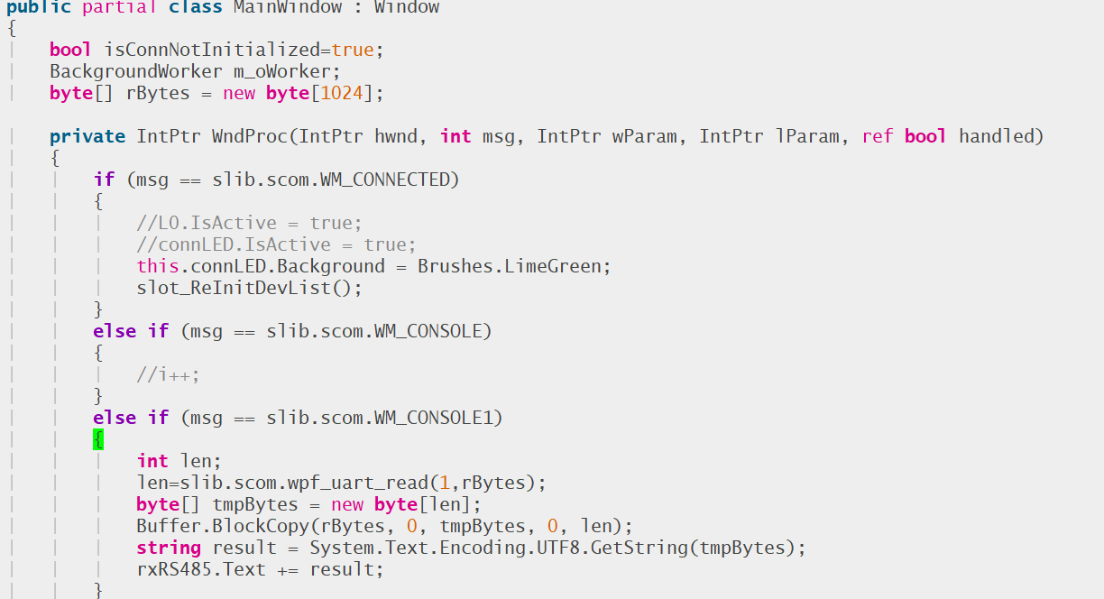
MODIFY Main Qt class (Please see examples)
How WPF Reads asynchronous incoming message pumping

Slide 17
Now you can create your own WPF Application with reference of supplied code please feel free to ask question

Slide 18
Library function reference

Slide 19
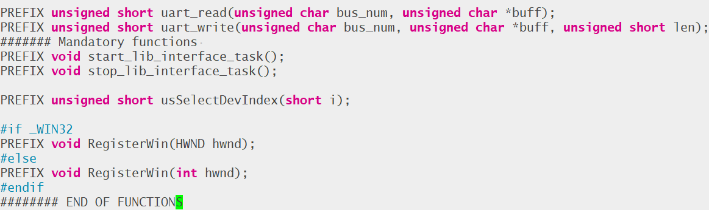
Library function
Start_lib_interface_task() is mandatory function which should be called, it may issue a stadanrad firewall warning on windows (first time), as it opens listening UDP socket and 5555 and 5683

Slide 20
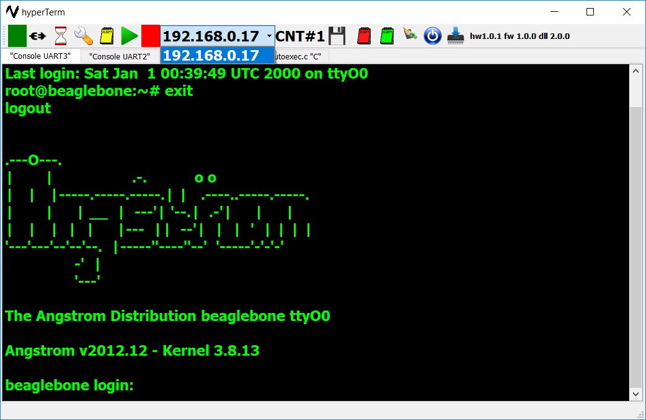
At one time user can access single device
User can select one Ethernet (if more then 1)
using usselectdevIndex(0)
uart_read or
uart_write will work currently selected device.
At a time only single device can be selected
Here is screen shot of QT app

Slide 21
All new Source code and latest documents GIT Repo https://github.com/natashaiwscope/emulator_v0

