Slide 1
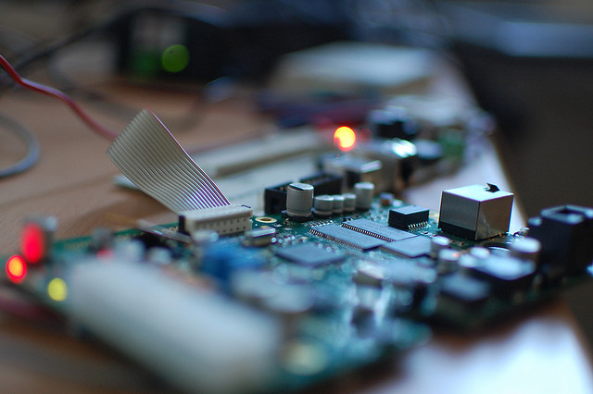
Wireless Central Buzzer
Low power remote buzzer

Slide 2
Agenda
Remote wireless buzzer,
How it works!
How to create simple test scenario

Slide 3
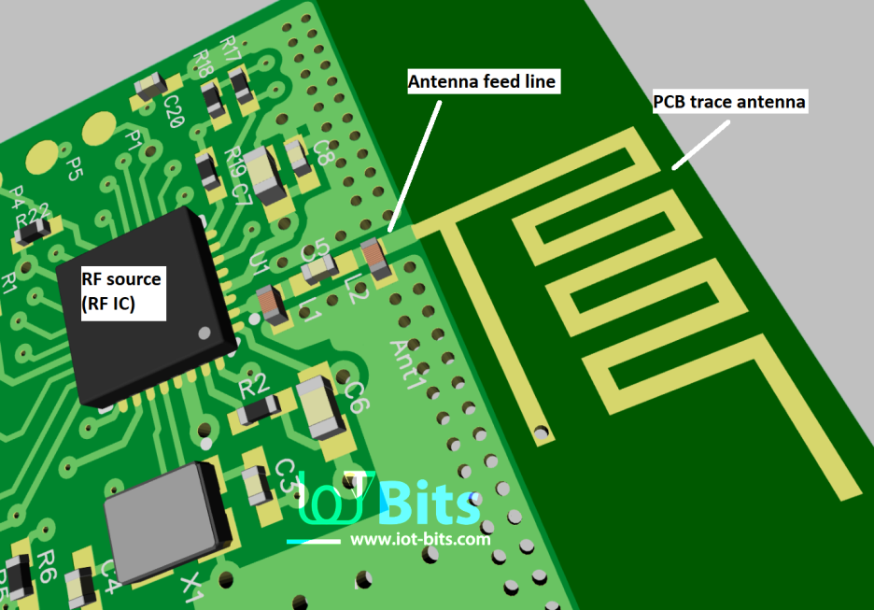
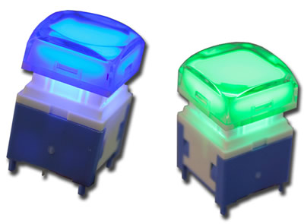
How it woks ?

Slide 4
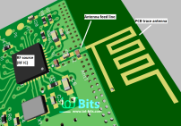




Multi node Wireless Remote buzzer
When any node pressed button operator hears a buzzing noise and flashing screen message on PC with node information.

Slide 5
Salient point
Any number of unlimited number of wireless nodes.
Maximum range is 800 meter(Long).(Two variants short and long)
Easy process to create Master/Slave (4 Mouse click).
2xAAA battery which lasts for many years.
Ideal for hospitals/hotels/restaurants and class room.

Slide 6
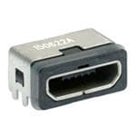
First time setup
1. Start PC Application
2. Connect Micro USB cable
3. Click “Make Master”
(Master button will hide after first use)
4. Connect next with USB “Make Slave”
5. Click “Make Slave”
Until all slave configured

