Slide 1
WiFi 802.1x/Ethernet I2C/UART/SPI/GPIO
WPF/Qt Open source Linux/Windows/Android(under progress)
Easy WiFi<>Serial Bridge<>I2C<>GPIO<>Analog

Slide 2
Features
1.WiFi Logging serial TTL UART data up to 6.12 Mega bits/Sec Speed
2.Easy configuration WiFi with reliable zUDP Communication built on top of UDP.
3.I2C/SPI/GPIO Communication.
4. Credit card size board (Raspberry PI Enclosure may be used)
5. Communication library for Linux32/64/Windows/Android platform.
6.Sample open-source Qt (Windows/Linux), WPF (Windows) and Android support (please note that only qt/wpf/android application is open source, not low level communication library)

Slide 3
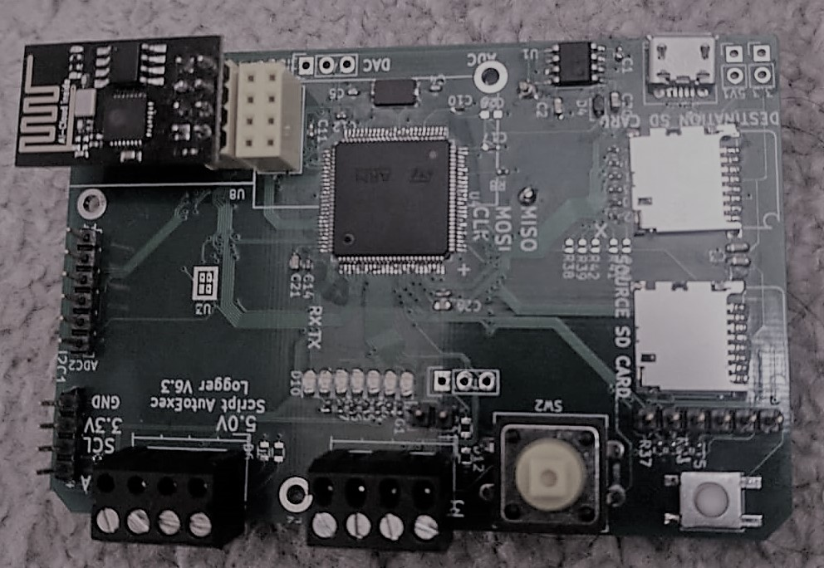
Credit card size 85x54mm

Slide 4
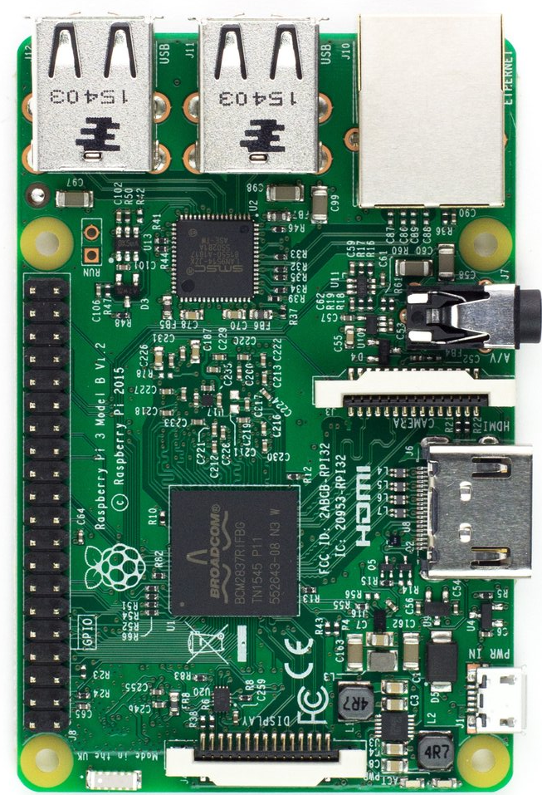
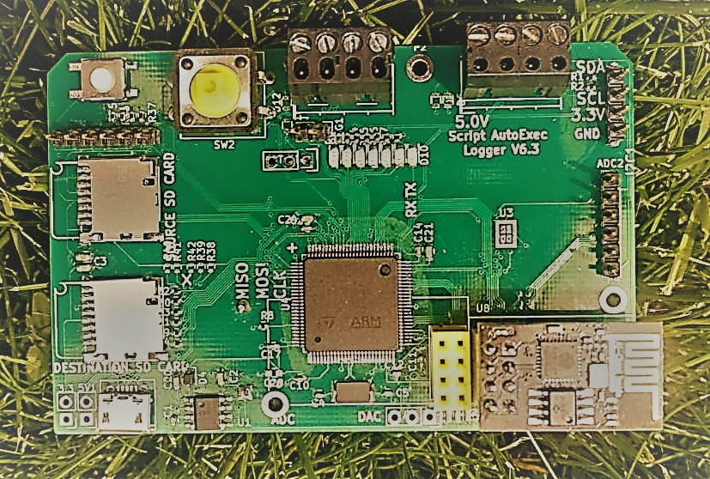
Credit card size 85x54mm (fits Raspberry Enclosure)
Just for size comparison

Slide 5

Connector
Credit card size board just like raspberry PI, it may be accommodated in raspberry PI enclosure. (Middle PIN Ground)
DAC Ch1/Ch2
Micro USB just for power supply
And CDC/HID Interface
802.1x esp8266 Wireless
nRF24L01 Header
4 Analog Channel
Or 4 Digital Input
Or 4 Digital Output
SD Card (Master)
LED Array
SD Card (Master)
RESET
I2C SDA
I2C SCL
Console UAR1 Qt
Console UAR2 Qt
Interrupt Switch

Slide 6
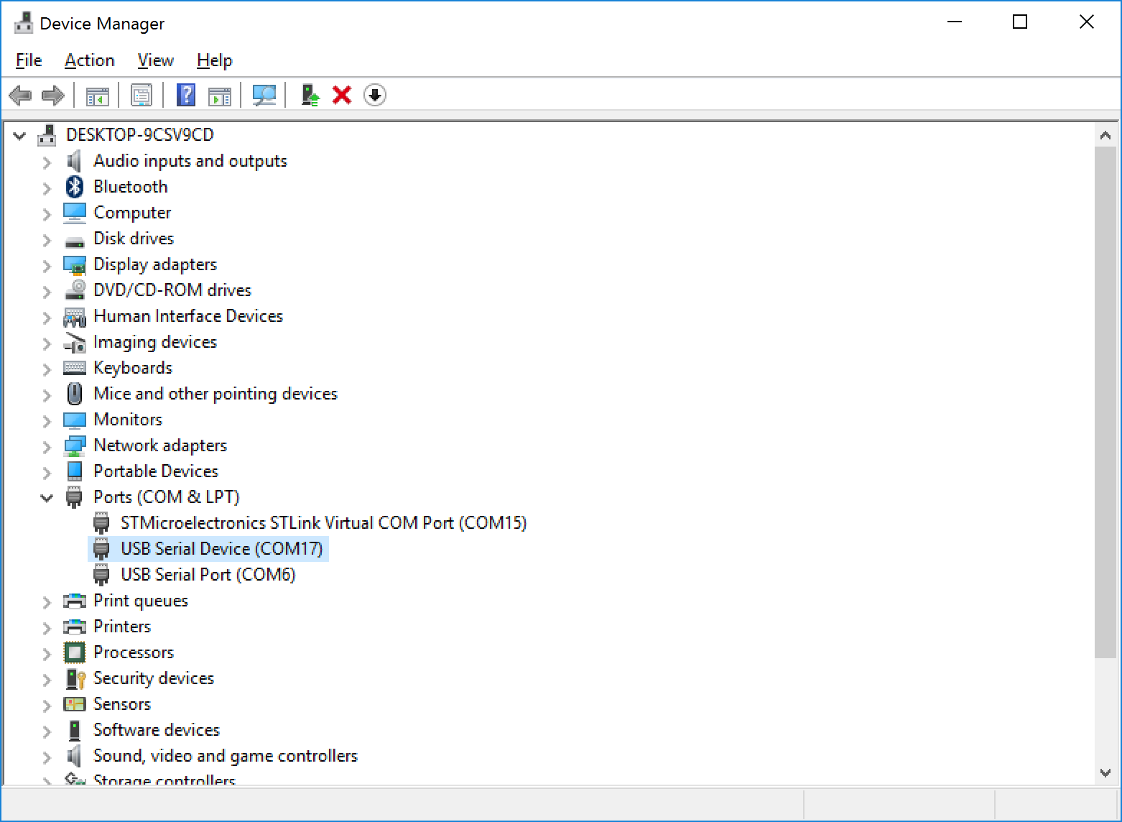
How to join WiFi Network (Windows Machine) ??
Connect USB cable to board and Windows PC, please make a note of new com port. (COM17), as you will need it for configuring wifi.

Slide 7
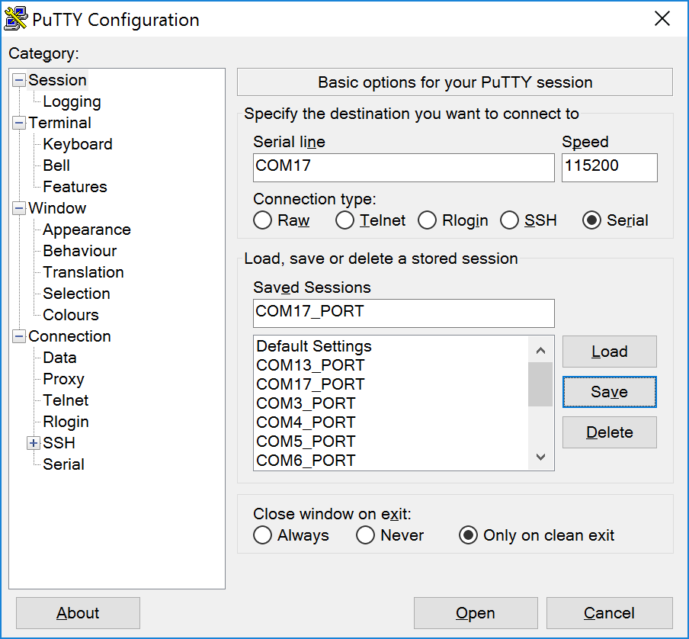
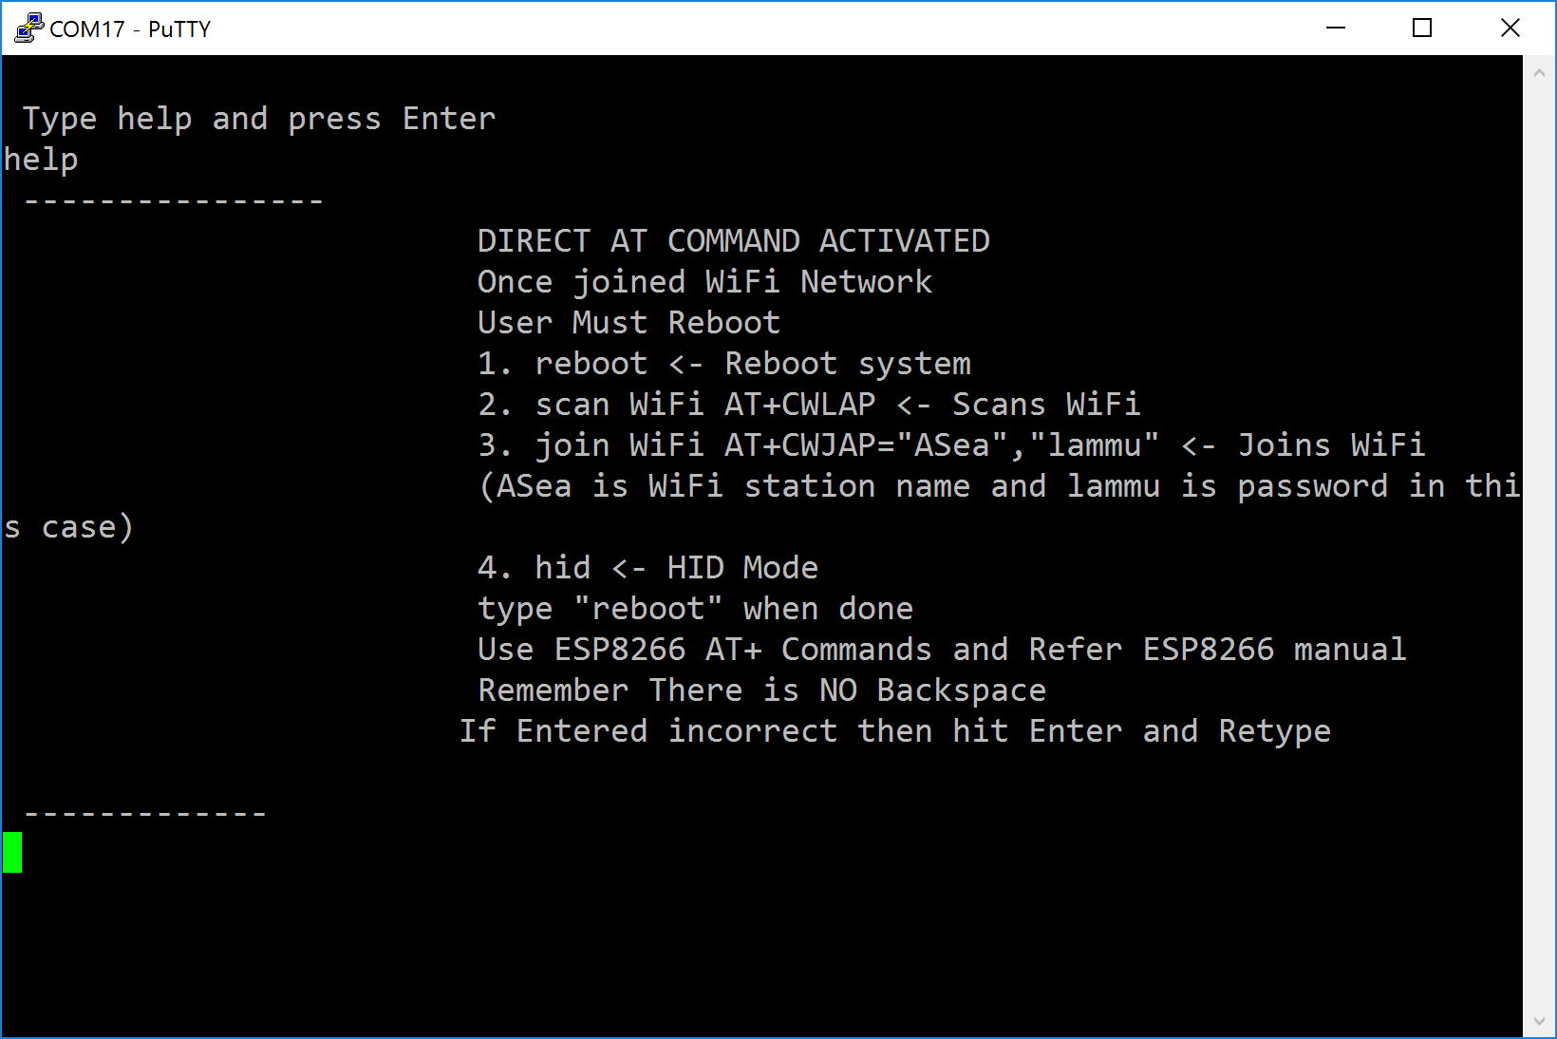
How to join WiFi Network (Windows Machine) ??
Use PUTTY.exe/HyperTerminal or TeraTerm to open this port, type help
Please refer for AT Commands https://www.espressif.com/sites/default/files/documentation/4a-esp8266_at_instruction_set_en.pdf

Slide 8
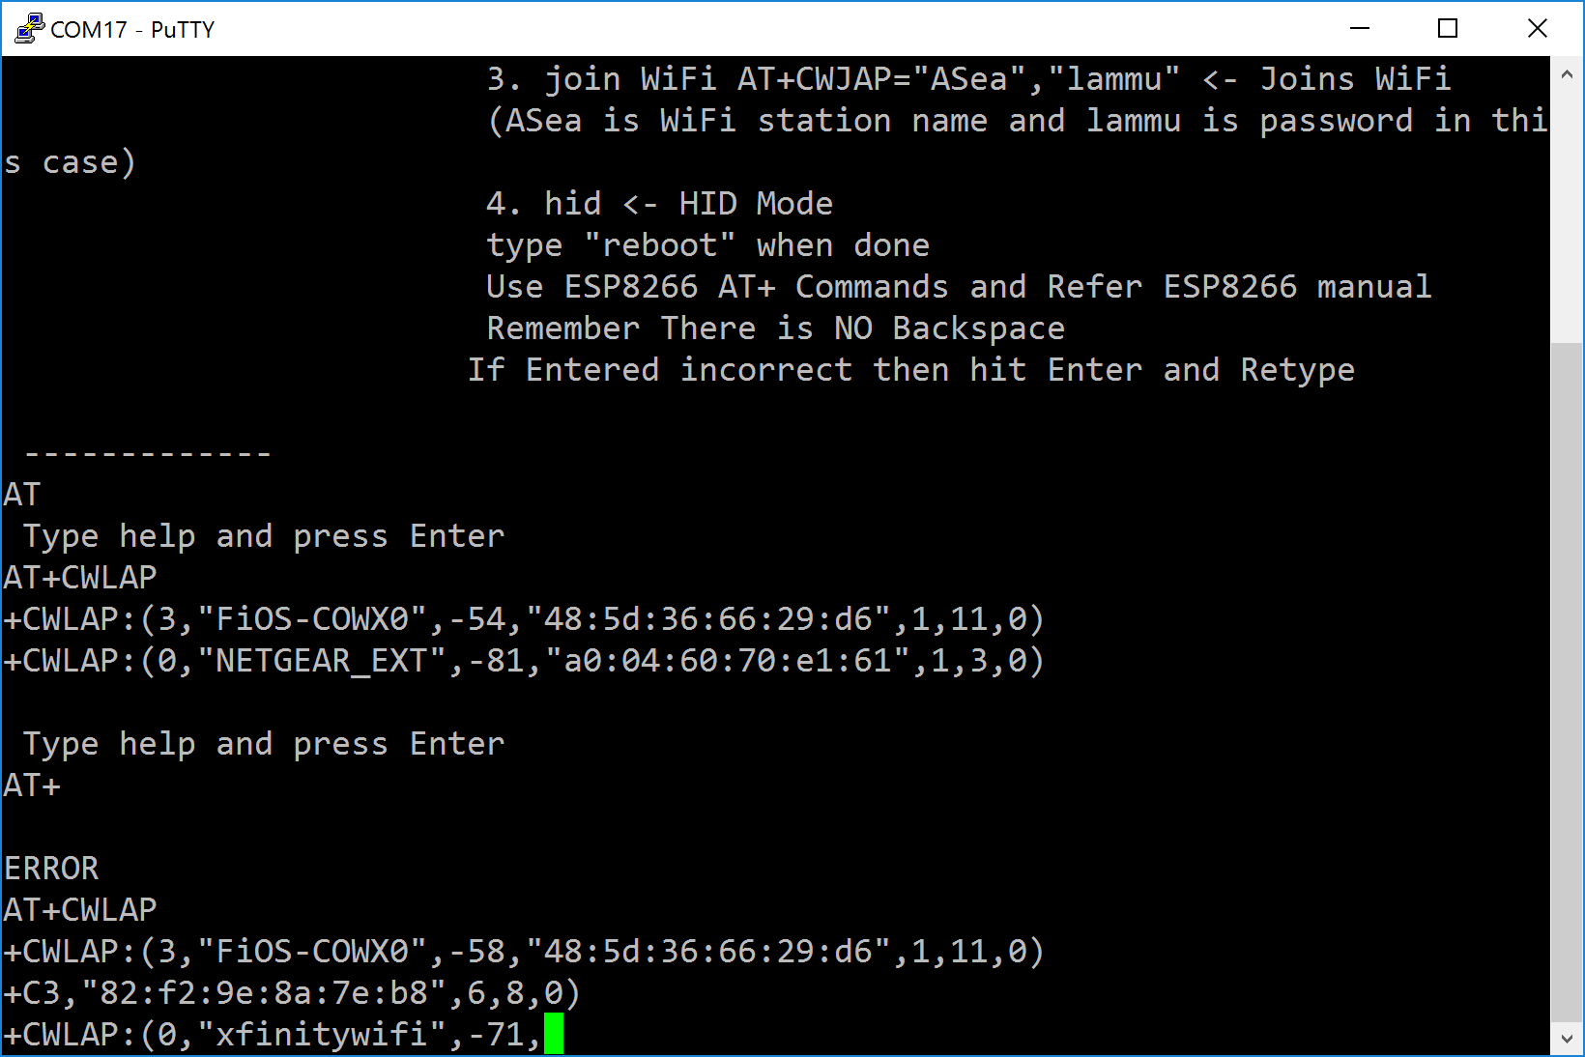
How to join WiFi Network (Windows Machine) ??
Use PUTTY.exe/HyperTerminal or TeraTerm to open this port, type help
For example AT+CWLAP command will scan all WiFi Network,
AT+CWJAP,”Asea”,”lammu” to join a network
where Asea is name of accesspoint and lammu is password. All AT commands run which are applicable to ESP8266, (Please do not change default baud rate or communication setting which is 115200 bps)

Slide 9
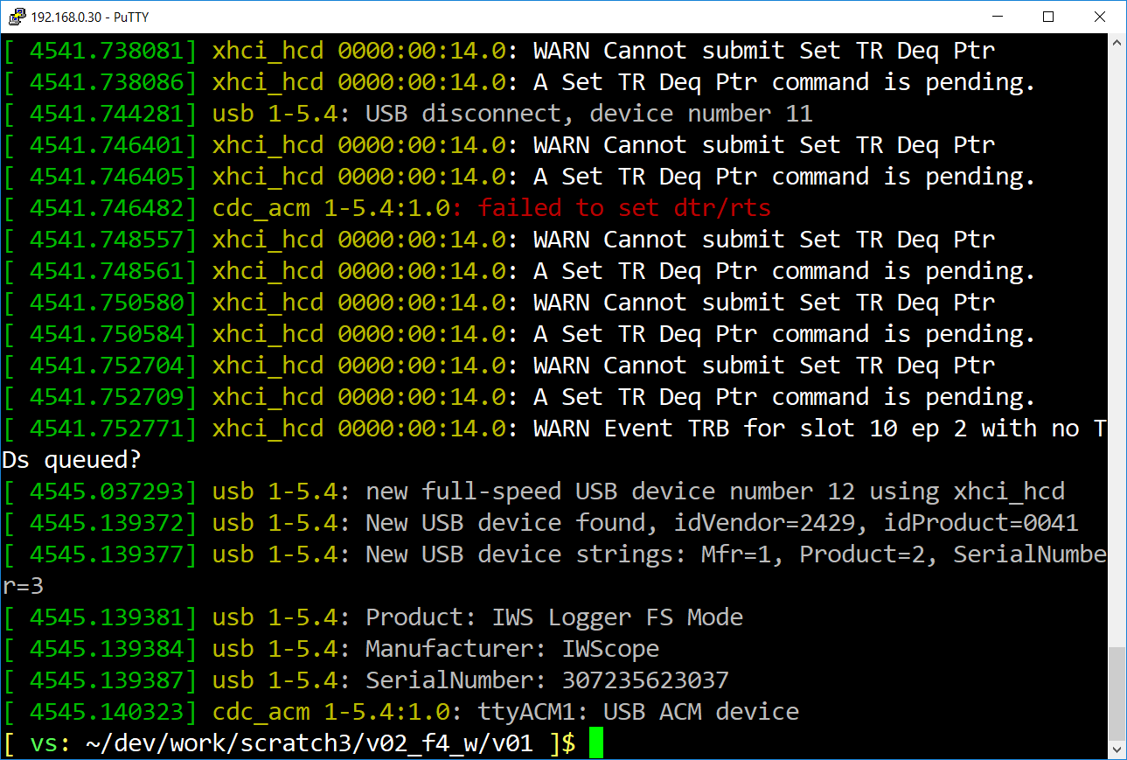
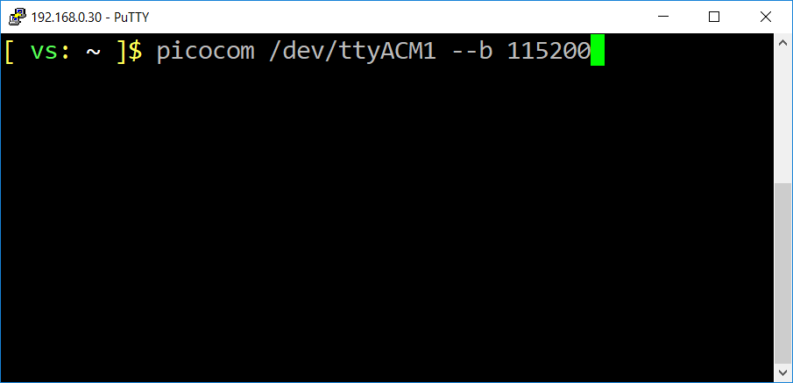
How to join WiFi Network (Linux Machine) ??
Open a Linux command prompt and connect board with micro USB cable, type dmesg on console prompt,as shown in pic below,

Slide 10
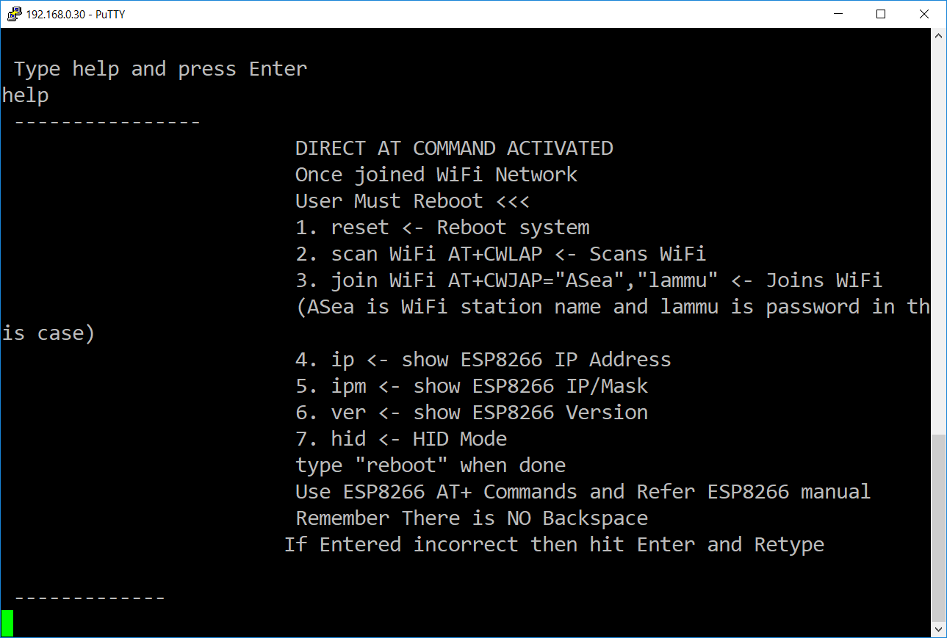
Type Help on console prompt

Slide 11
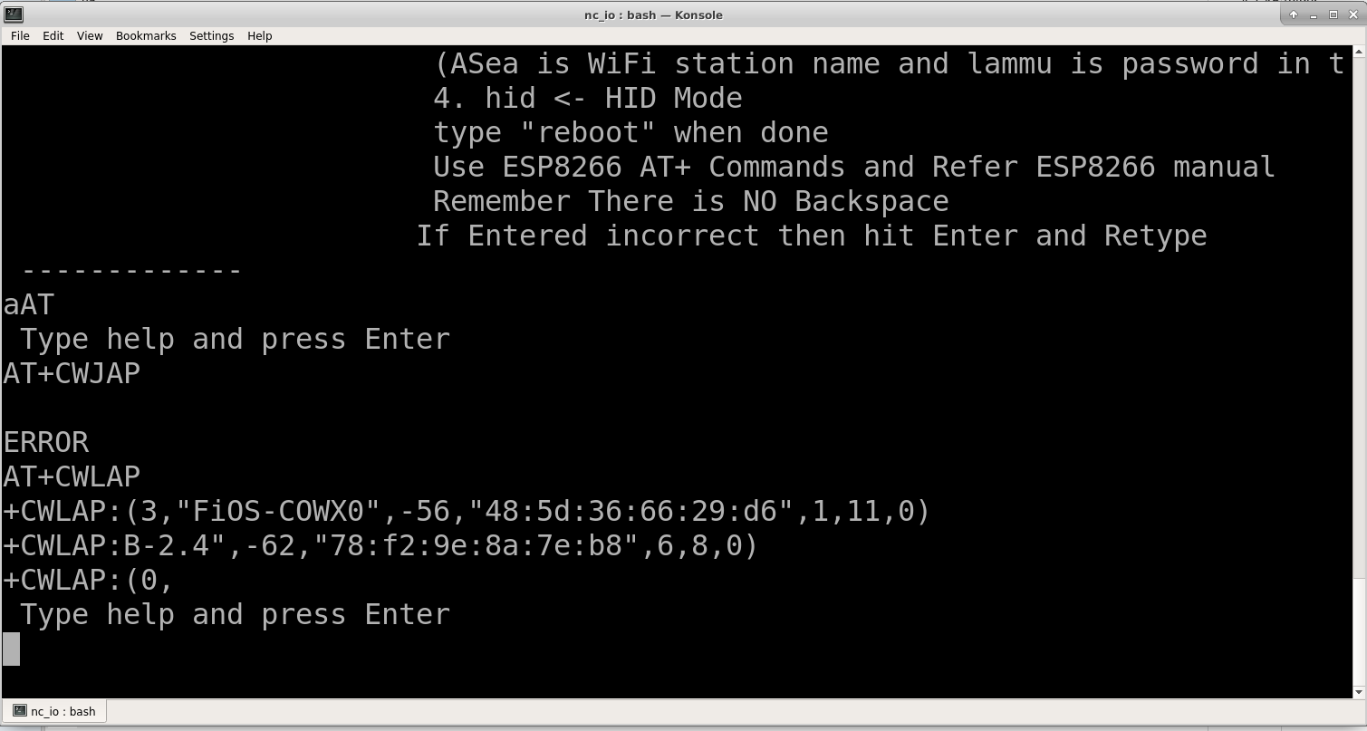
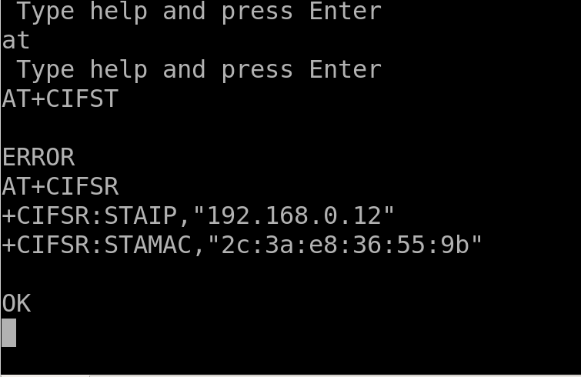
How to join WiFi Network (Linux Machine) ??
You can use picocom or other terminal picocom /dev/ttyACM1 --b 115200
AT+CIFSR lets you view ip address once you join network successfully.
For AT+ commands reference please refer esp8266 manual.

Slide 12
How to Learn if device connected ?
Once device joins WiFi user can see using AT+ command, BLUE LED will start blinking as firmware broadcasts IP Address every 5 seconds.
PC GUI/console Application locates wireless device using UDP broadcast.

Slide 13
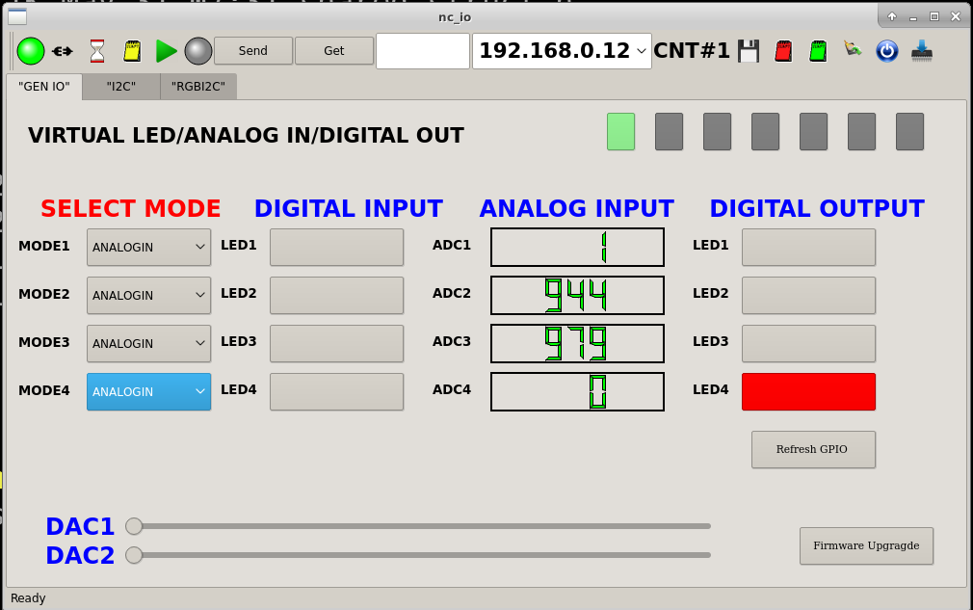
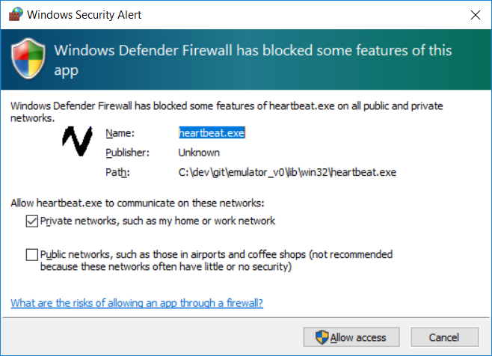
Windows/Linux app
When device connected it can be accessed by sample app or console app.First run
On windows os it shows a popup message, please unblock port 5555 and 5683
CoAP port.

Slide 14
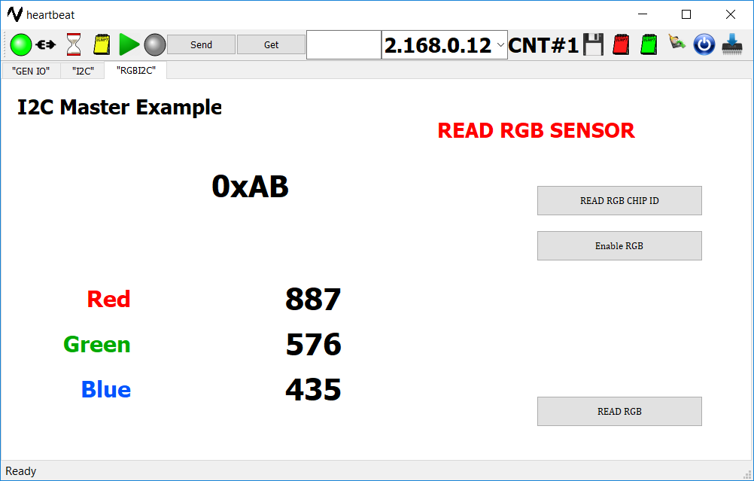
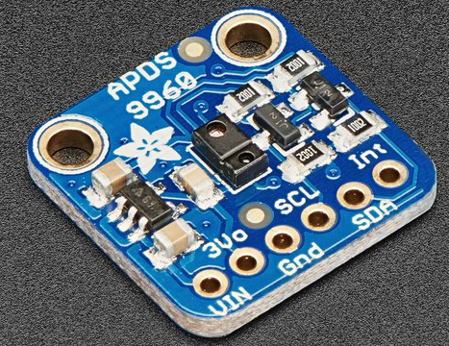
APDS9960 RGB Gesture/Sensor via Wireless

Slide 15
Samples Provided
1.Qt4.8 Serial Console with example serial terminal beagle bone black
2.Qt4.8 I2C Scanning and reading device.
3.Qt4.8 nRF2401 I2C/SPI Communication.
4. Virtual LED ( No Real Light Emitting Diode, PC Apps shows LED glowing) when VCC or GND asserted on PIN device.

Slide 16
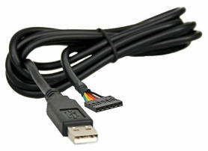
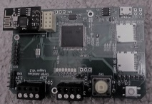
What is this Ethernet Serial Port
FTDI TTL 3.3 V Cable
FTDI TTL Cable | Parameter | Wireless Serial Port
Single comport | Number of ports | 2 TTL RS232 + 1 RS485
0.921600MBPS | Max Baud Rate | 6.5MBPS
No | Fractional baud rate | Yes
Full throttle Data | Yes | NO (Depends upon signal strength)
Close source | Windows Driver | (Qt/WPF open source sample app with library provided)
Open source | Linux Driver | (Qt open source sample app with Qt4 library provided for ARM/Intel Ubuntu)
N/A | Simultaneous port IO | Yes
N/A USB power | Power supply needed | Micro USB power

Slide 17
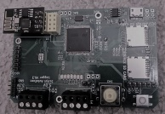
What is this Ethernet Serial Port
FTDI TTL Cable | Parameter | Ethernet Serial Port
Easy basic setup | Setup complexity | Easy basic setup Windows/Linux
Yes | Standard COM Port | No
USB Cable Length | Cable length | WiFi (No limit)
N/A | Recording of data into hardware | Can be dumped into SD card for analysis
--- | Field firmware upgrade | Yes
USB Cable | Physical size | Raspberry size board
Open licensed source GUI https://github.com/natashaiwscope/emulator_v0

Slide 18
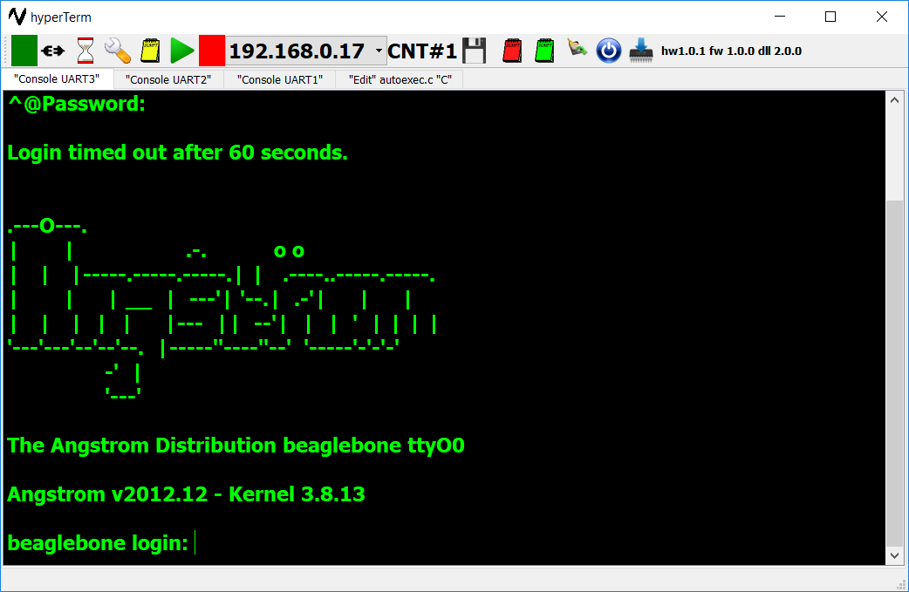
Serial Terminal Open BeagleBone Black FTDI)

Slide 19
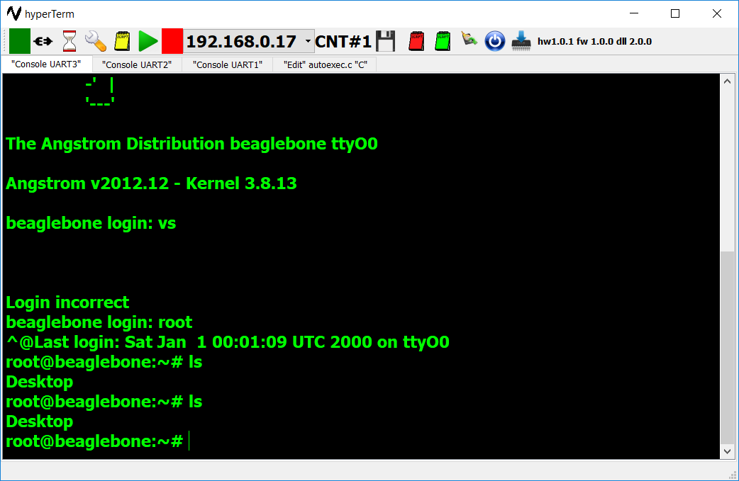
Serial Terminal (BBB FTDI)

Slide 20
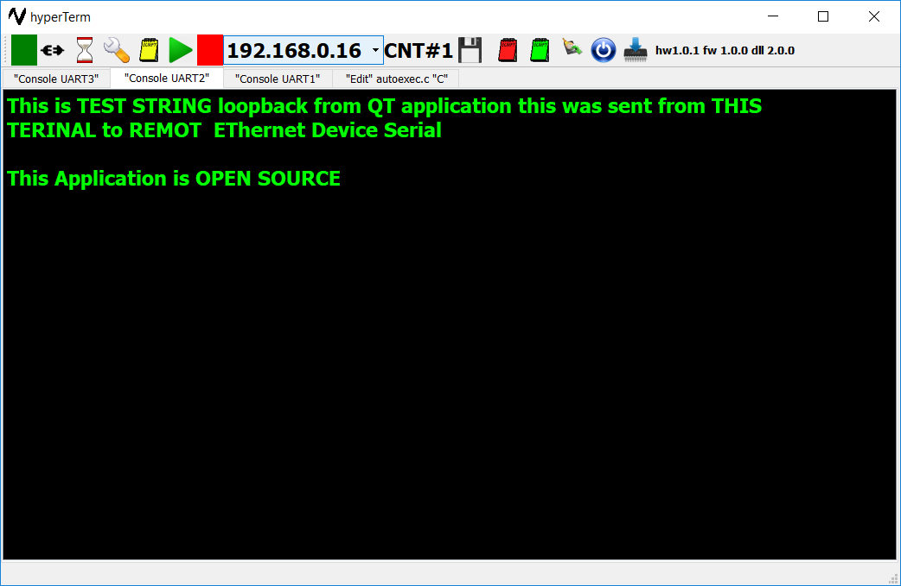
QT and “C” Console Sample (Open source)

Slide 21
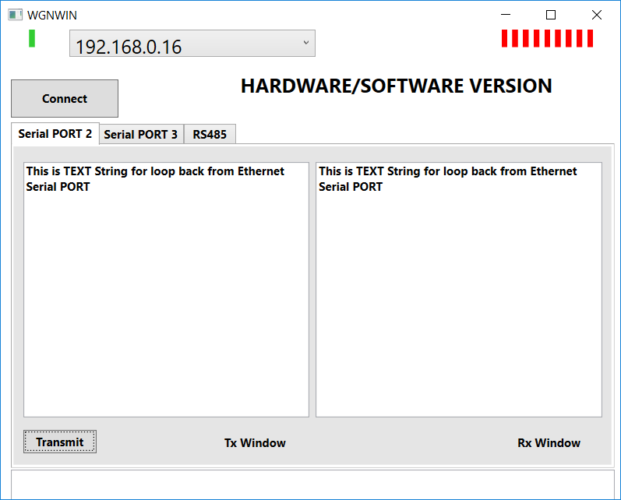
Open source WPF Sample (Serial loopback)

Slide 22
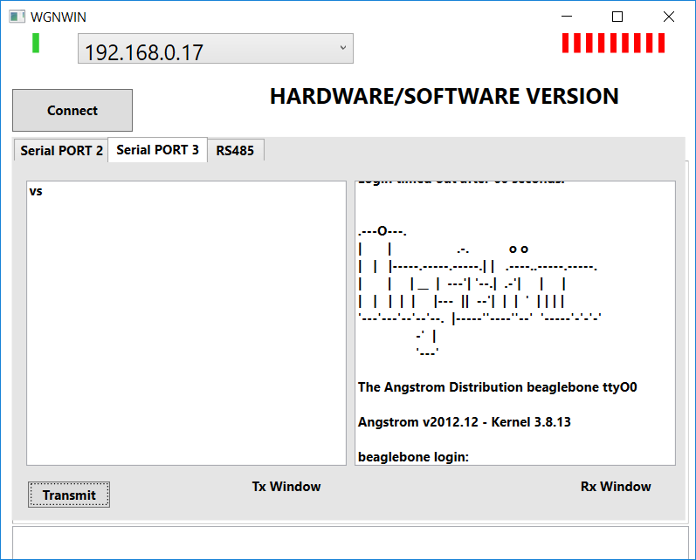
Open source WPF Sample (Serial loopback)

Slide 23
Prerequisites
Ethernet cable RJ45.
Micro USB power connector (Typical Android phone charger will work)
DHCP server where device can get iP address.
Network connected Linux/Windows computer with same DHCP server.
Few connection cable (some small cables are supplied)
Open box and connect to USB cable, one LED should turn On as soon as power is applied. Connect ethernet cable to router and hardware. Start Linux/Windows computer and launch following GUI application. Device broadcasts its IP address once every 5 seconds. PC application captures broadcast packet and autoconnect.

Slide 24
Major Milestones(Past 3 years)
Completed milestones
Hardware design and testing (Completed/Fully Tested Manufactured in small quantity)
Stable C++ DLL Library with .Net wrapper to be used anywhere.
Embedded TCP/IP firmware design. (Completed and testing/improvements)
PC Application fully complete (Enhancements and bug fix are under progress)
Bootloader for field firmware upgrade in place. (Bootloader so reliable it we prefer to use bootloader over programmer)
Risk and Challenges
Number of quantities board are contingent on ordered quantity ( Lead time may change schedule of delivery)
I2C/ADC/DAC and CAN library in progress.

