Slide 1


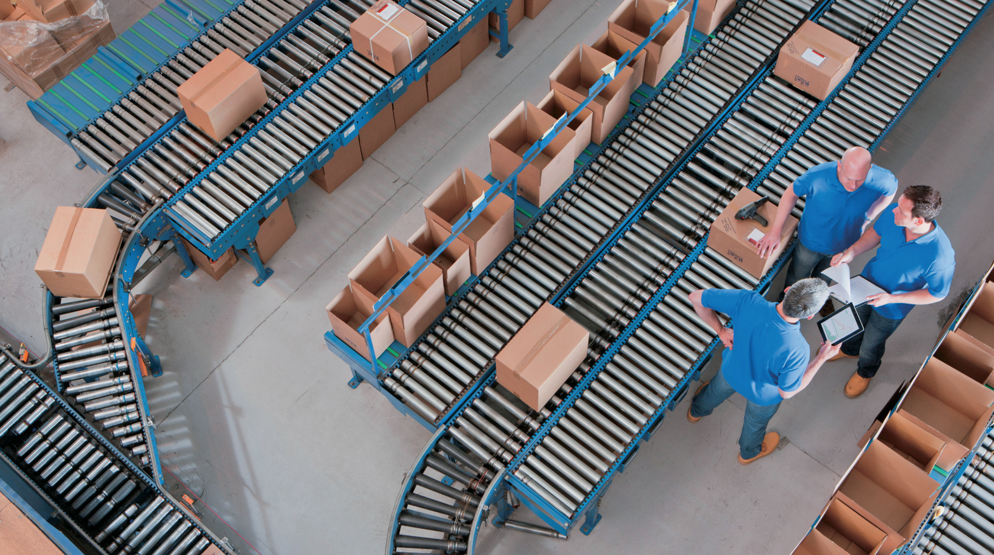
The Last Mile
Mestrado em Engenharia de Sistemas, 1º ano, 1º semestre
Logística
Group:
Caio Furtado
Célia Figueiredo
Daniel Sousa
José Machado

Slide 2
Abstract
The Last Mile
The market landscape
The consumer experience
A retailer’s perpective
The logistics landscape

Slide 3
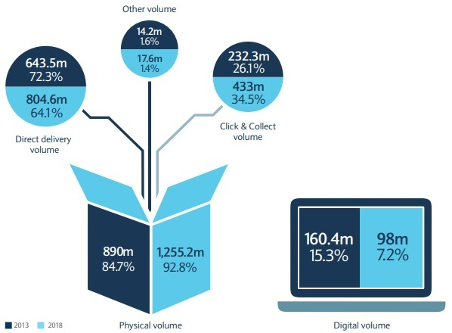
The market landscape
The Last Mile
In 2013, products ordered online generated one bilion deliveries, but this number is expected to grow 29% in 2018.
There are some deliveries methods:
-Direct Deliveries
-Click & Collect
-Digital Volume

Slide 4
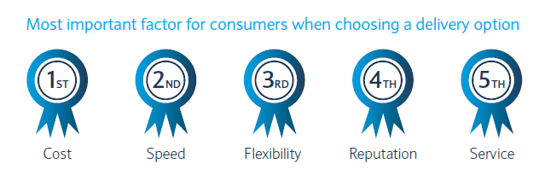
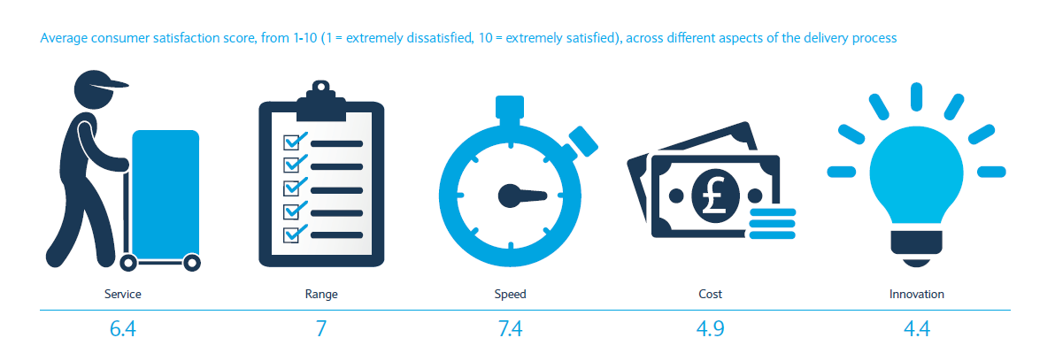
The Last Mile
The consumer experience
Online purchasing activity spikes at lunchtime and 5pm.
Activity hits its peak into the evening.
Cost and speed are the most important factors for consumers choice.
The satisfaction with delivery pricing remains low.
The consumers are satisfied with delivery quality and its speed.

Slide 5
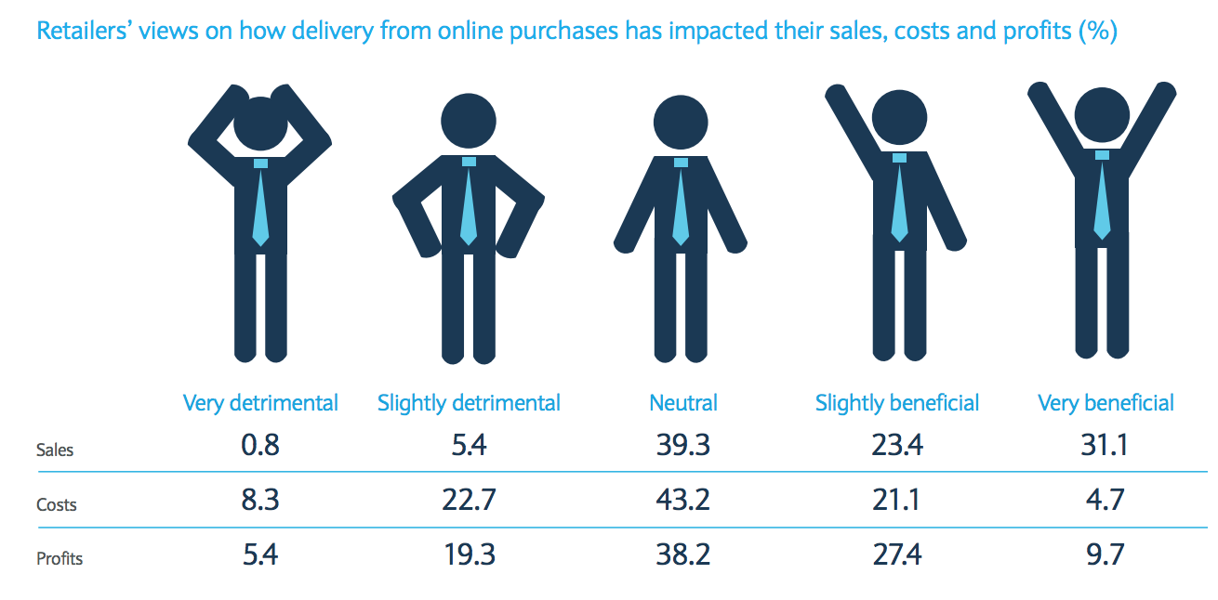
A retailer’s perspective
The Last Mile

Slide 6
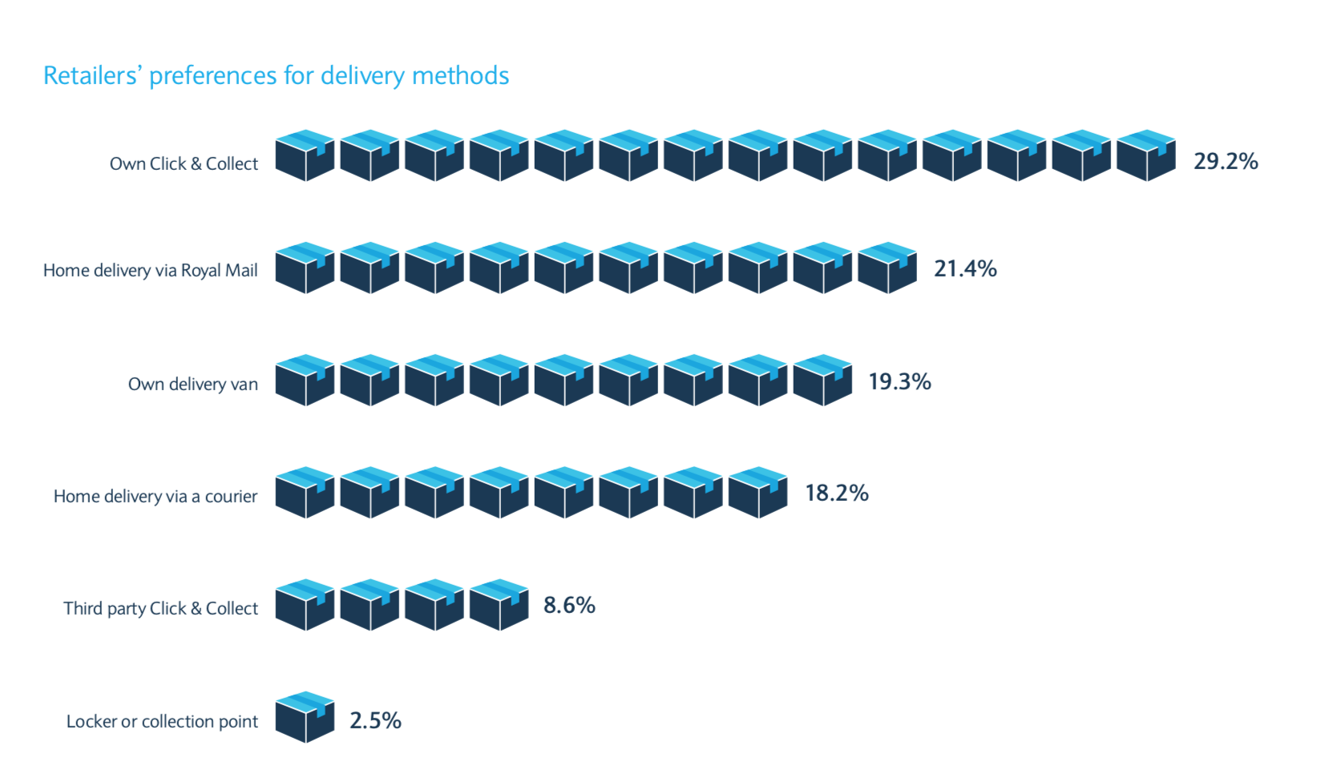
A retailer’s perspective
The Last Mile
Delivery preferences

Slide 7
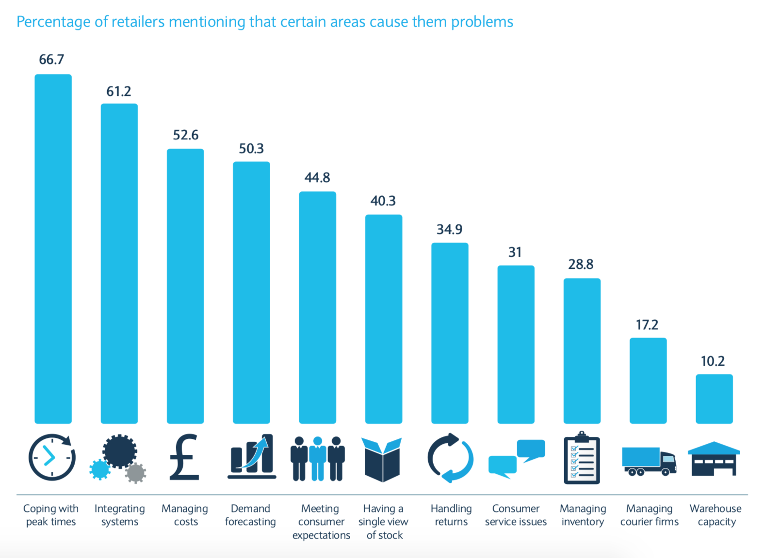
A retailer’s perspective
The Last Mile
Operational efficiency and return services

Slide 8
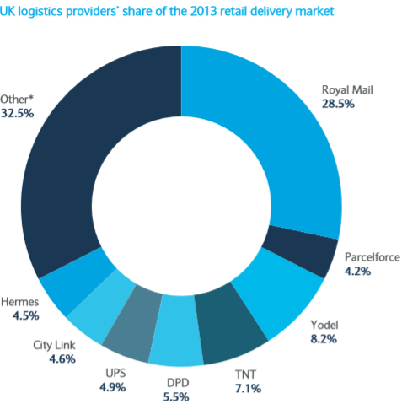
The logistics landscape
The Last Mile
During the past years, logistics providers have increased the variety of delivery options available to their customers.
This increase was maybe a result of:
more competition within the logistics market and
the consumers are becoming more vocal about their needs, with feedback tools

Slide 9
The logistics landscape
The Last Mile
Operational Effieciency
Future Development
Opportunities and Threats
Delivery the goods at right time
Keep deliveries fast in all seasons
Poorly packaged goods
Improving tracking and consumer notifications
Delivery on the weekends
Further delivery options
Increase flexibility in delivery options and introduction of more premium services
However, it's necessary deal with highest capacity requirements

Slide 10
The Last Mile
Mestrado em Engenharia de Sistemas, 1º ano, 1º semestre
Logística
Group:
Caio Furtado
Célia Figueiredo
Daniel Sousa
José Machado

