Slide 1
ECOSORT AI
Sorting household waste from a photo
A machine learning project, Version 1
A beginner project: I am still learning
cardboard
glass
metal
paper
plastic
trash
Presented by Nati | 16 October 2026

Slide 2
What EcoSort AI does
The goal
I am still learning
One photo
Model
One of 6 labels
This is my first complete machine learning project. I learned each step by doing it, so some of my choices may not be the best ones.
cardboard · glass · metal · paper · plastic · trash
Data: TrashNet (2,527 photos)
Version 1: software only
Tools: Python, PyCharm, PyTorch
2,525
4
photos in my split
models trained

Slide 3
The roadmap: 8 steps
1 Clean the data
2 Set up the tools
3 Load the images
4 Model 1: small CNN
5 Model 2: transfer learning
6 Experiments: Models 3 and 4
7 Final test, used once
8 Try my own photos
Each step has its own slide. After every step I checked the result before moving on.

Slide 4
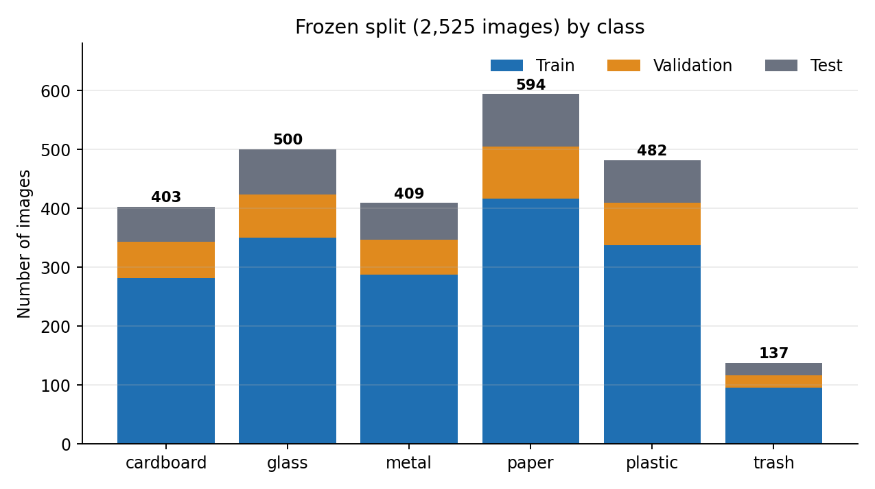
Step 1: Check and clean the data
What I checked | Result
Photos in the folder | 2,527
Rows in my split file | 2,525
Duplicates removed | 2
Extra file in __MACOSX | ignored
Split frozen: train 1,768 | validation 377 | test 380. A duplicate in two splits would let the model cheat, so I removed them.

Slide 5
Step 2: Set up the tools
Tool | Version
Python | 3.12.10
PyCharm | with .venv
PyTorch (CPU) | 2.14.1
torchvision | 0.29.1
pandas | 3.0.6
A problem I hit, and the fix
Error WinError 1114 (c10.dll) when importing torch
Fix Install Microsoft Visual C++ Redistributable, restart the PC
Result PyTorch 2.14.1 runs on my CPU
No graphics card: each model trained in 6 to 18 minutes on a normal laptop.

Slide 6
Step 3: Feed the photos to the model
Split file (CSV)
Open photo as RGB
Resize to 128 x 128
Tensor, values 0 to 1
Batches of 32
Split | Photos | Shape of one photo
train | 1,768 | 3 x 128 x 128
validation | 377 | 3 x 128 x 128
test | 380 | 3 x 128 x 128
Why this step?
The model needs numbers, not photo files. The 3 means three colour channels: red, green, blue.

Slide 7
Step 4: Model 1, a small CNN
Photo 3x128x128
Conv 16 + pool
Conv 32 + pool
Conv 64 + pool
Flatten + Linear 128
6 scores
2.1 million
From scratch
Adam
numbers the model can learn
starts with random numbers
adjusts the numbers to cut the loss
How it learns: guess, measure how wrong (loss), adjust, repeat for 10 epochs.

Slide 8
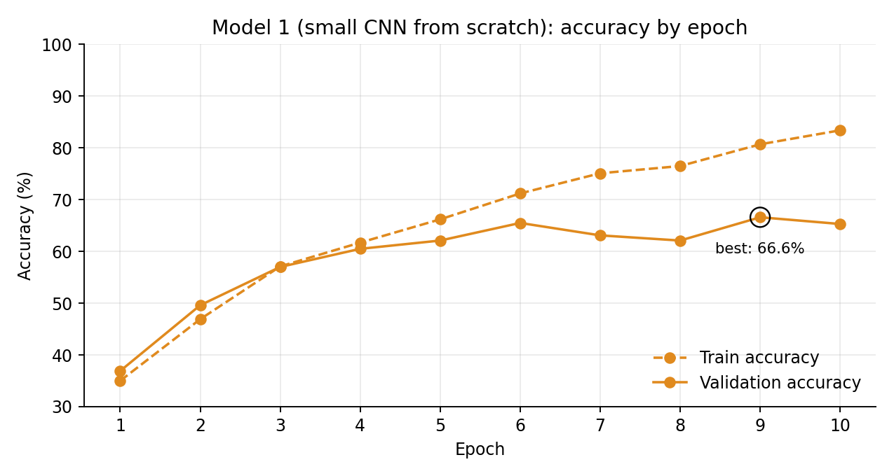
Step 5: Training Model 1
66.6%
best validation accuracy
83.4%
training accuracy, epoch 10
18 points
gap: overfitting starts
Random guessing would give about 17%. Training took 6 minutes.

Slide 9
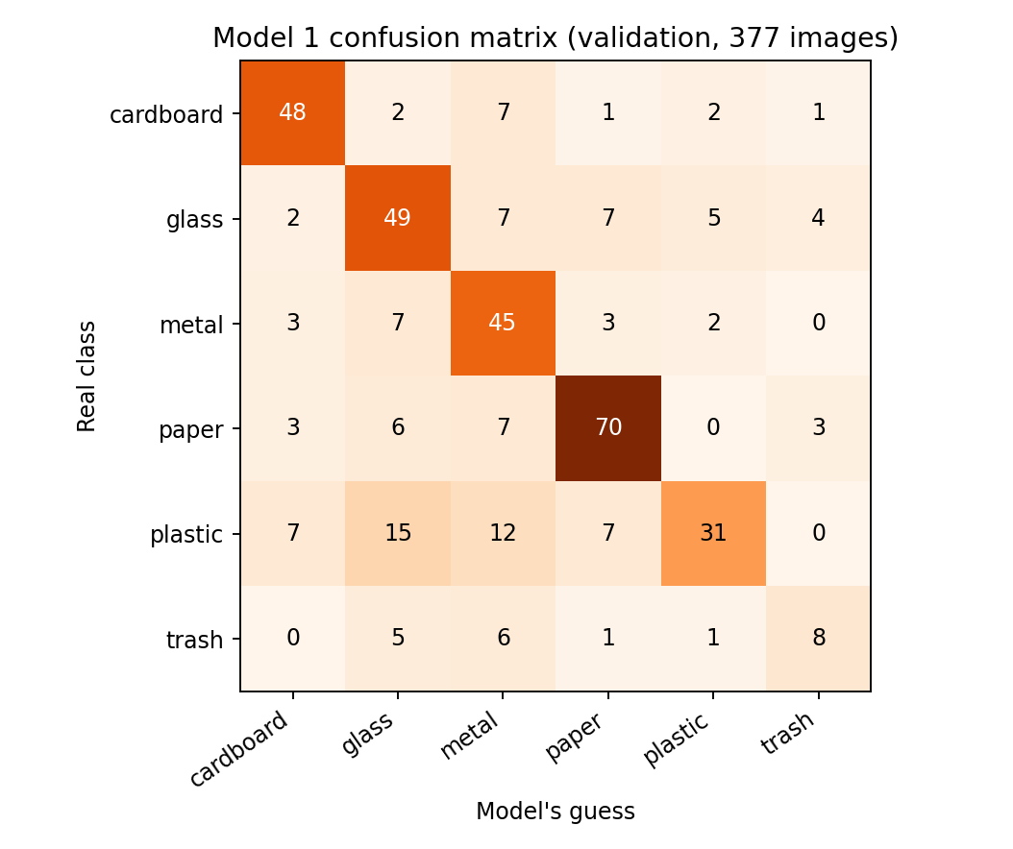
Step 6: Where Model 1 fails
Class | Recall
cardboard | 78.7%
glass | 66.2%
metal | 75.0%
paper | 78.7%
plastic | 43.1%
trash | 38.1%
Confusion matrix: rows are the real class, columns are the model's guess. Plastic and trash were the weakest.

Slide 10
Step 7: Transfer learning (Model 2)
Pretrained MobileNetV2 (frozen)
New last layer (trained)
6 labels
 | Model 1 | Model 2
Starts from | Random numbers | ImageNet knowledge
Photo size | 128 x 128 | 224 x 224
Numbers trained | 2,121,638 | 7,686
Training time | 6 min | 14 min
Best validation | 66.6% | 87.0%
+20 points
using the same photos
Several things changed at once, so I cannot say which one helped most.

Slide 11
Step 8: Two experiments
A: Class weights
B: Unfreeze the last 3 blocks
Idea: mistakes on trash count 3 times more
Result: 86.2%
Trash: 3 more found, but paper and glass lost 3 each
Verdict: no clear gain
Idea: let the model adapt to waste photos
Small learning rate, 6 epochs
Result: 90.7%, trash 14 of 21 found
Verdict: best model so far
Caution: B also trained for 6 more epochs, so unfreezing and extra training cannot be separated.

Slide 12
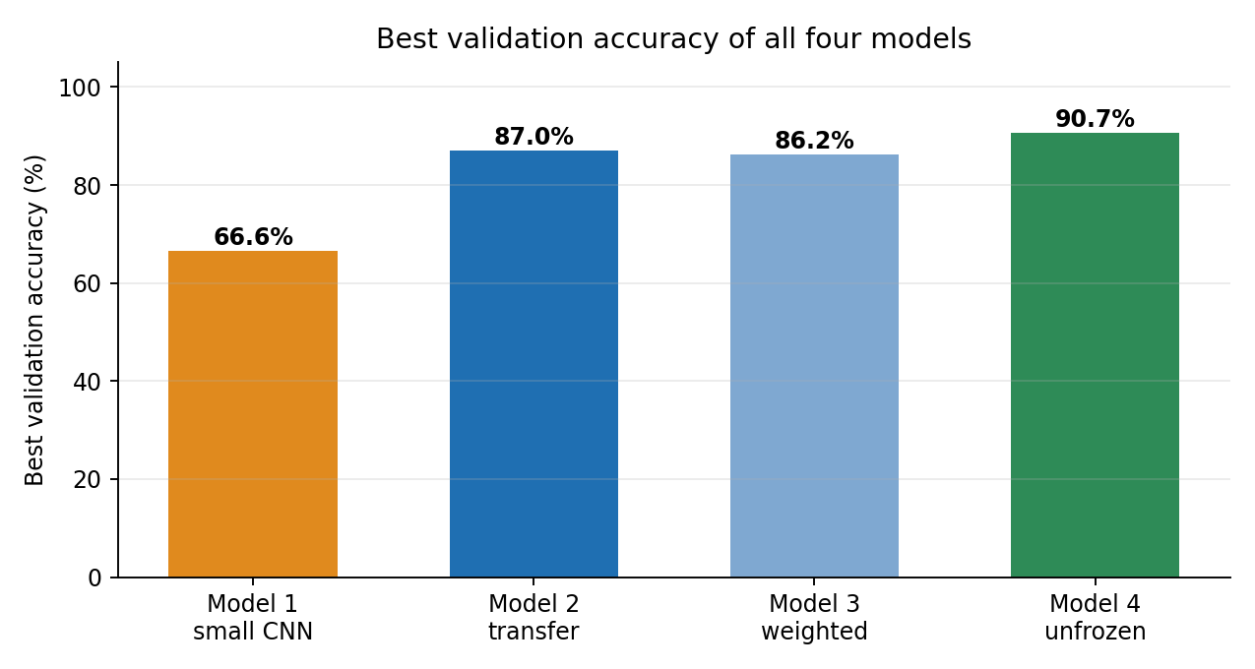
All four models compared
Model | Val. acc. | Trash recall | Time
1 Small CNN | 66.6% | 38.1% | 6 min
2 Transfer | 87.0% | 47.6% | 14 min
3 + weights | 86.2% | 61.9% | 17 min
4 Unfrozen | 90.7% | 66.7% | 18 min
These are validation scores. I used them to choose the model, so they are slightly optimistic.

Slide 13
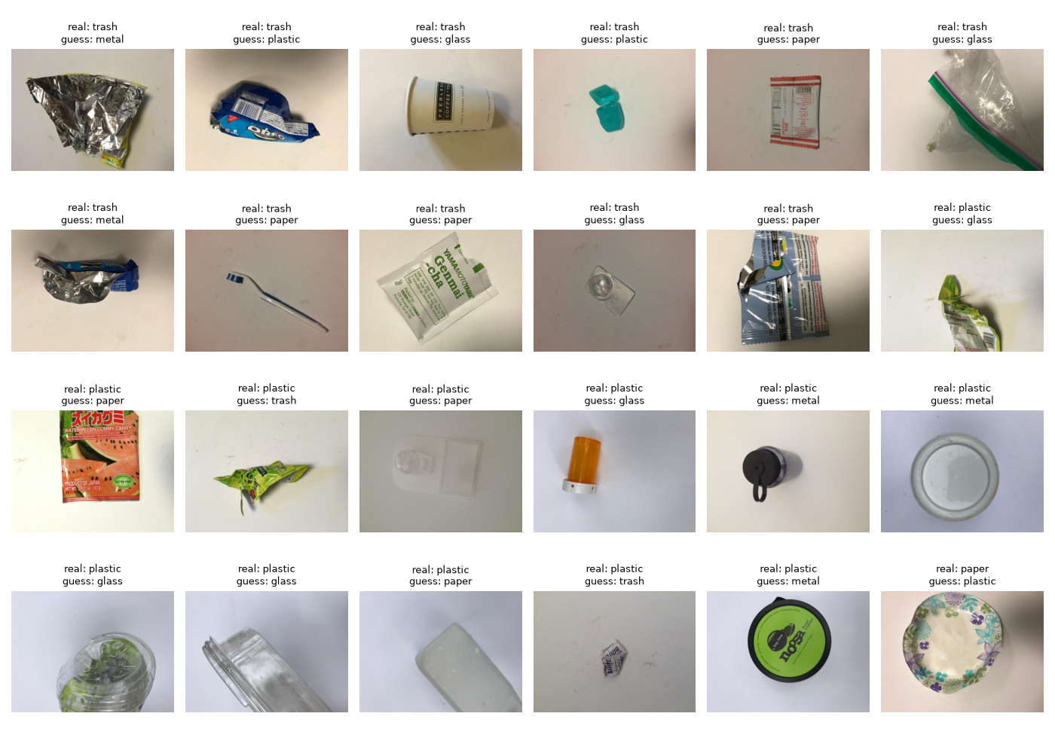
What the best model still gets wrong
Trash is a mixed group: wrappers, bags, small items
Clear or white plastic is called glass or paper
Crumpled wrappers look alike, even to me
Grid shows 24 of the 49 errors of Model 2

Slide 14
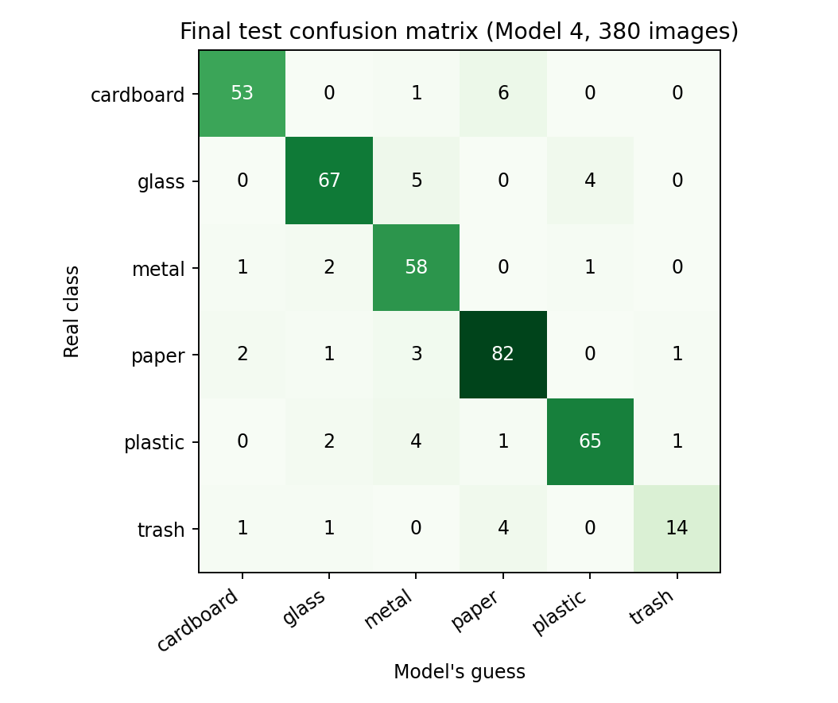
Final test: used only once
89.2%
339 of 380 unseen photos (validation was 90.7%)
87.8%
macro F1, all classes equal
70%
trash found: 14 of 20, weakest class

Slide 15
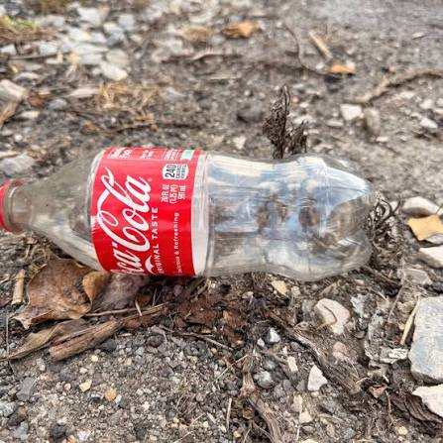
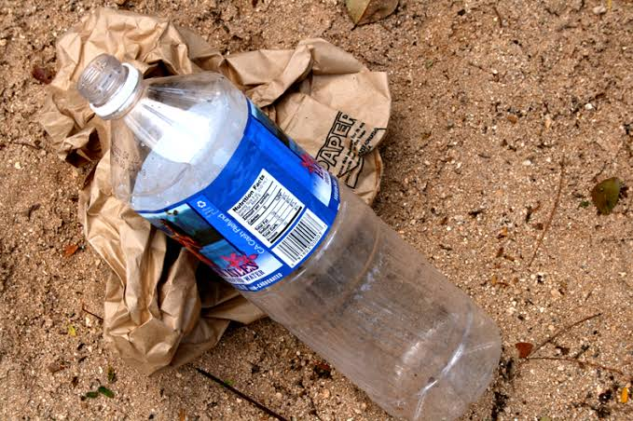
Trying my own photos
Photo | Model said | Conf.
Cardboard | cardboard ✓ | 98%
Metal can | metal ✓ | 100%
Paper | paper ✓ | 98%
Trash item | trash ✓ | 94%
Plastic bottle, paper bag | trash ✗ | 87%
Cola bottle, gravel | plastic ✓ | 47%
Cola bottle on gravel: plastic, only 47% sure
Bottle on a paper bag: called trash, 87% sure
5 of 6 correct, but this is an informal test, not an accurate score. It works best on one item on a plain background; messy scenes and mixed items confuse it.

Slide 16
Lessons, limits and next steps
What I learned
What I am still learning
Check the data before training
Compare with a baseline
Keep the test set locked
Read the mistakes, not only accuracy
Why models overfit, and how to stop it
Choosing settings without guessing
Testing on messy real photos
Building the upload page
Limits
Next steps
Clean TrashNet photos, one item each
Six fixed labels, no 'unknown'
Only 20 trash photos in the test set
89.2% has about 3 points of margin
Write the README
Build a simple upload page
Collect my own photos for a V2
Publish the code on GitHub

Slide 17
Thank you
Questions and advice are welcome: I am still learning.
89.2% test accuracy | 4 models | 6 classes | 2,525 photos

