Slide 1
1
Ice Sheet
Mothership
2
Mothership
Deploy
Mothership
3
Collect Data
Return

Slide 2
Ice Sheet
Mothership
Deploy
Return

Slide 3
Mothership

Slide 4
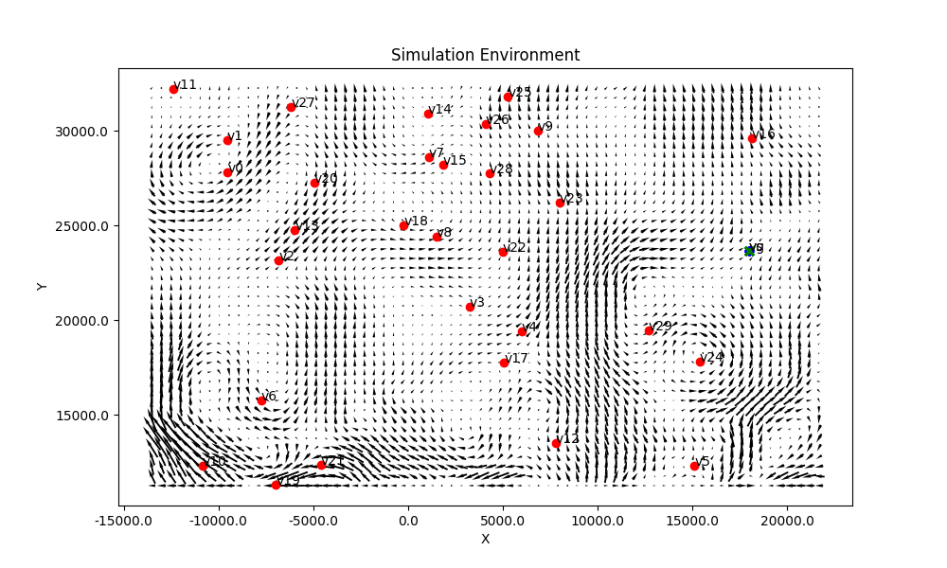
Mothership

Slide 5
Mothership

Slide 6
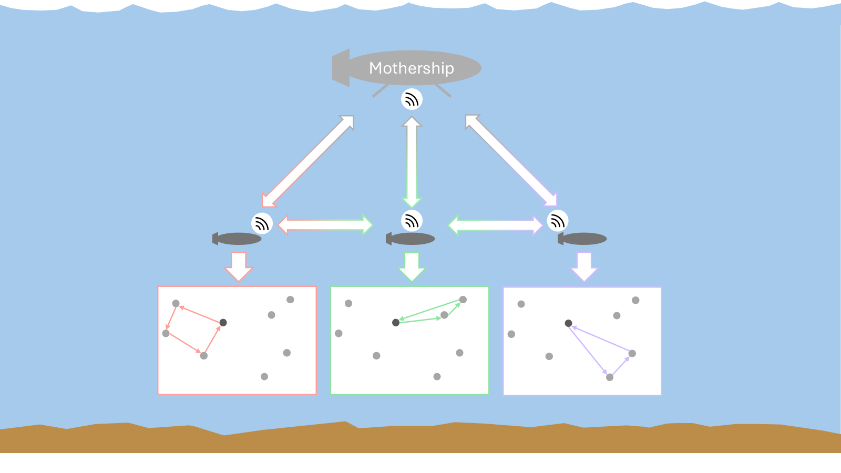
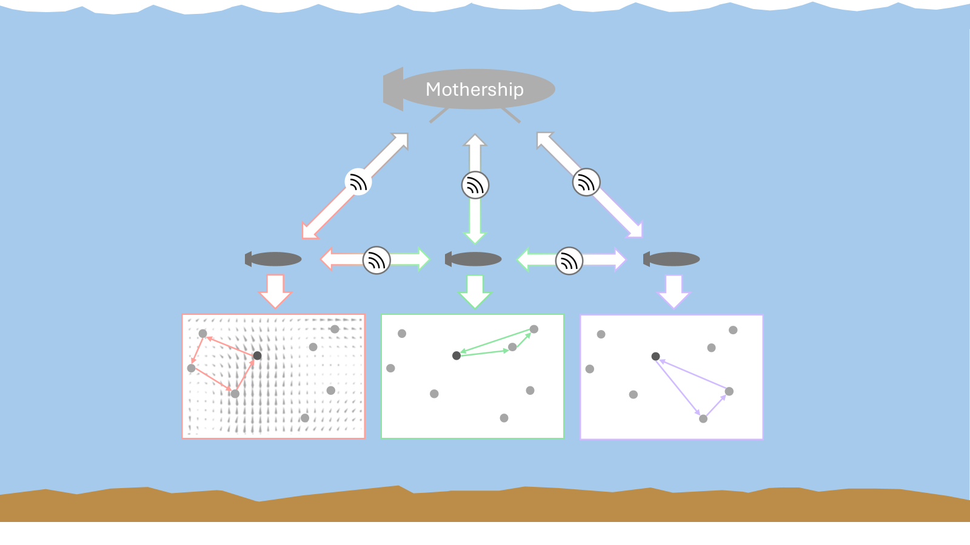
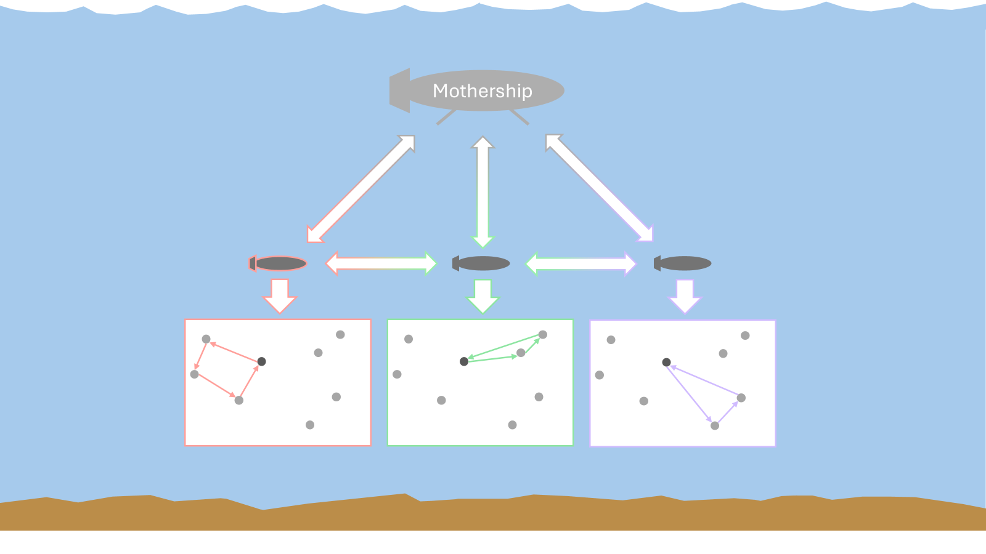

Slide 7
Ice Sheet

Slide 8
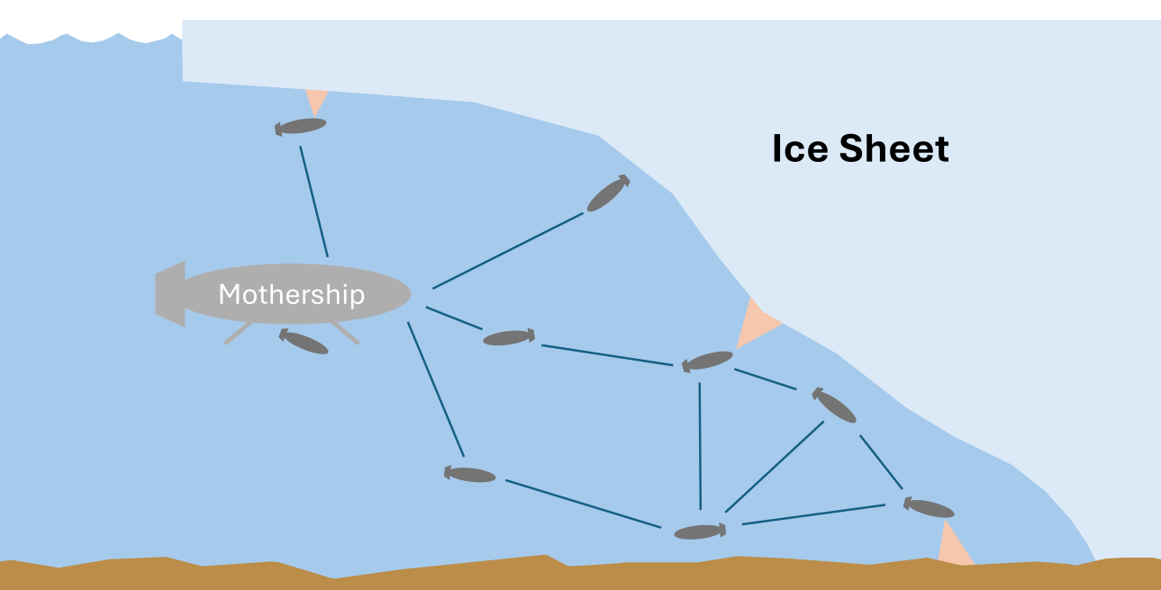
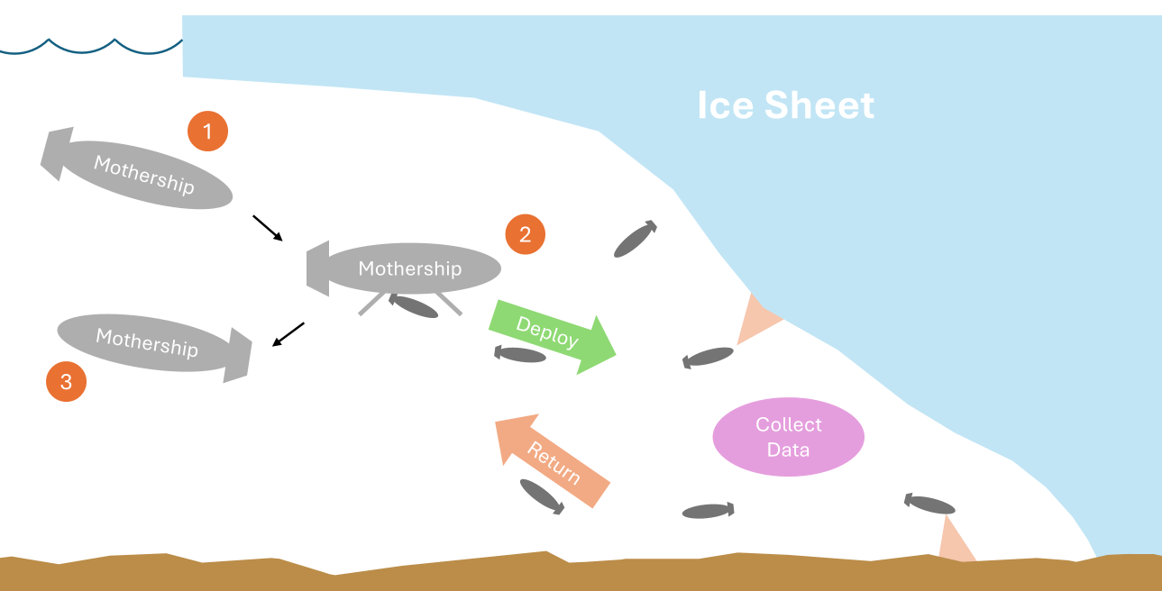
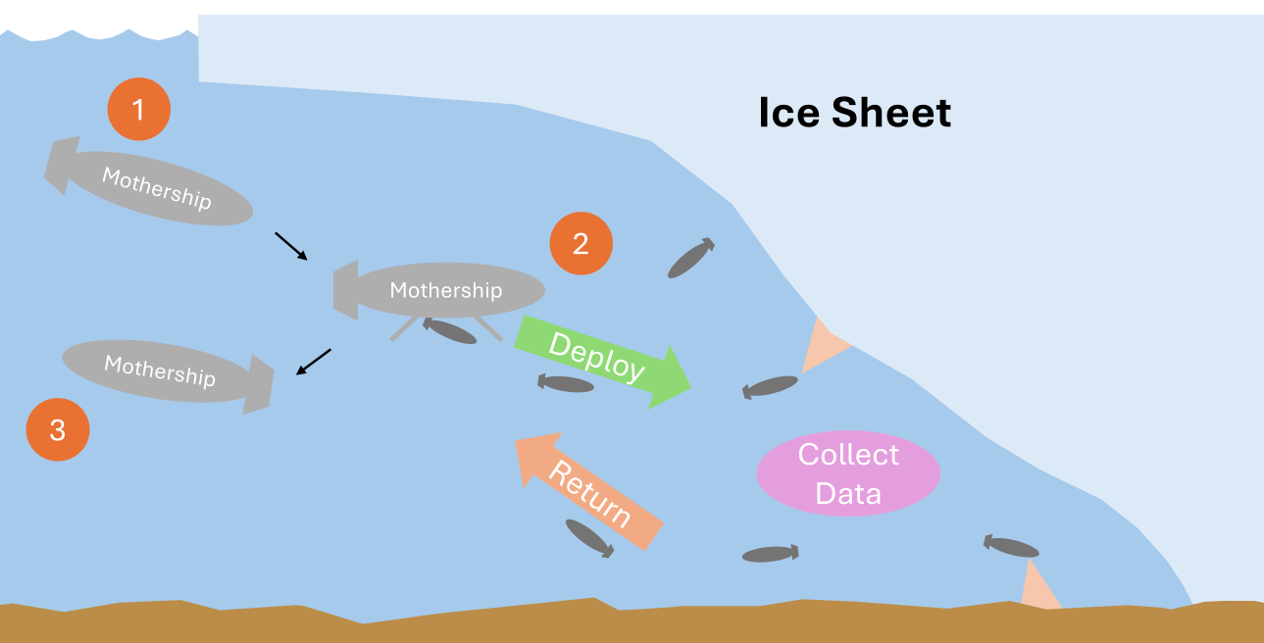
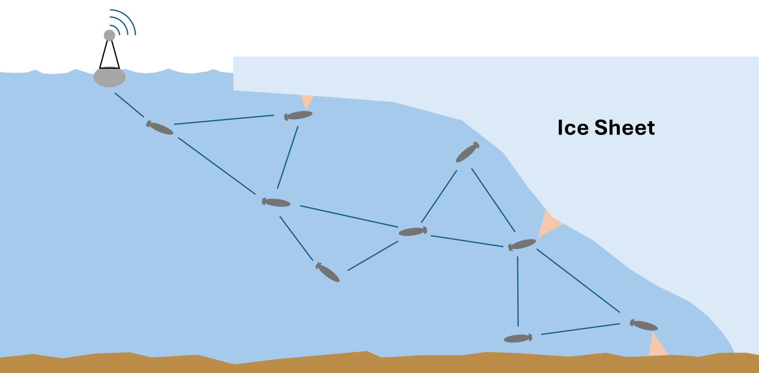

Slide 9
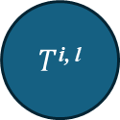
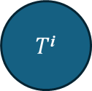
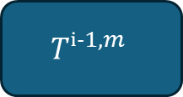
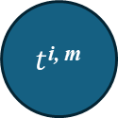
$$Tⁱ^{−1, m}$$
$T$^{i}
$T$^{i, l}
$t$^{i, m}
Passenger i
ti,m
Ti
SOP Solver
(MCTS)
Task Data
Neighboring Passengers
Task Data
Mothership
Schedule Selection Algorithm
STOP & SOP Solver
(Sim-BRVNS)
Passenger i Schedule Dist

Slide 10


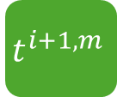


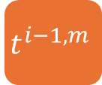
$$t^{i−1, m}$$
$$t^{i, m}$$
$$t^{i+1, m}$$
Passenger i
$$t^{i, m}$$
SOP Solver
(MCTS)
$$T^{i}$$
Mothership
Task Data
Task Data
Neighboring Passengers
STOP & SOP Solver
(Sim-BRVNS)
UpdateScheduleDists
$$θ^{i}$$

Slide 11
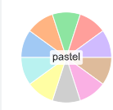







$$t_{i−1}^{m}$$
$$t_{i}^{m}$$
$$t_{i+1}^{m}$$
Passenger i
$$t_{i}^{m}$$
SOP Solver
(MCTS)
$$T_{i}$$
Mothership
Task Data
Task Data
Neighboring Passengers
STOP & SOP Solver
(Sim-BRVNS)
UpdateScheduleDists
$$θ^{i}$$

Slide 12
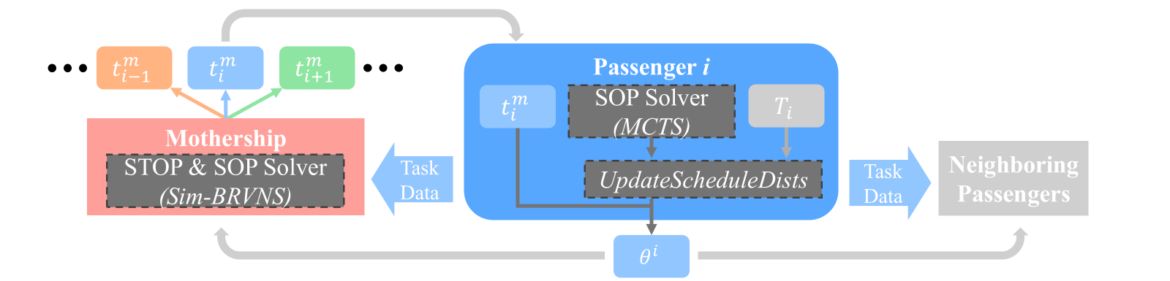
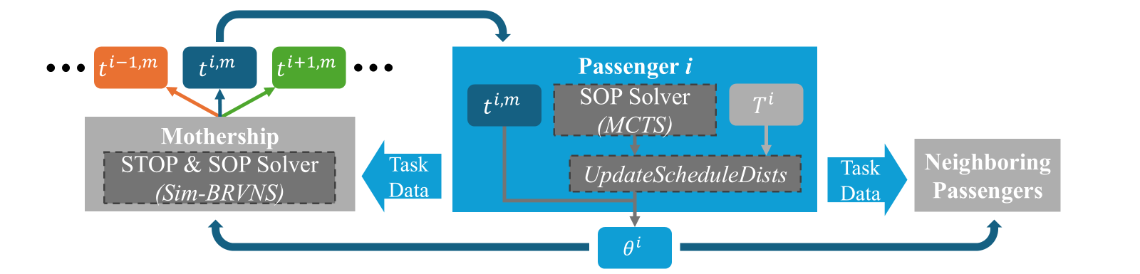

Slide 13
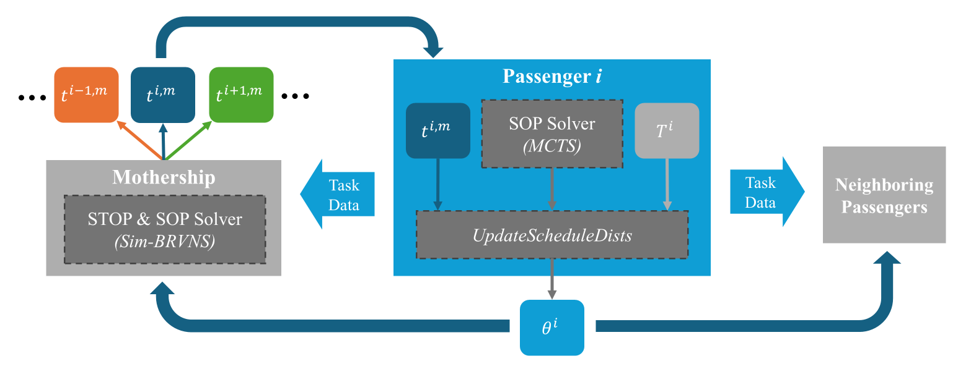

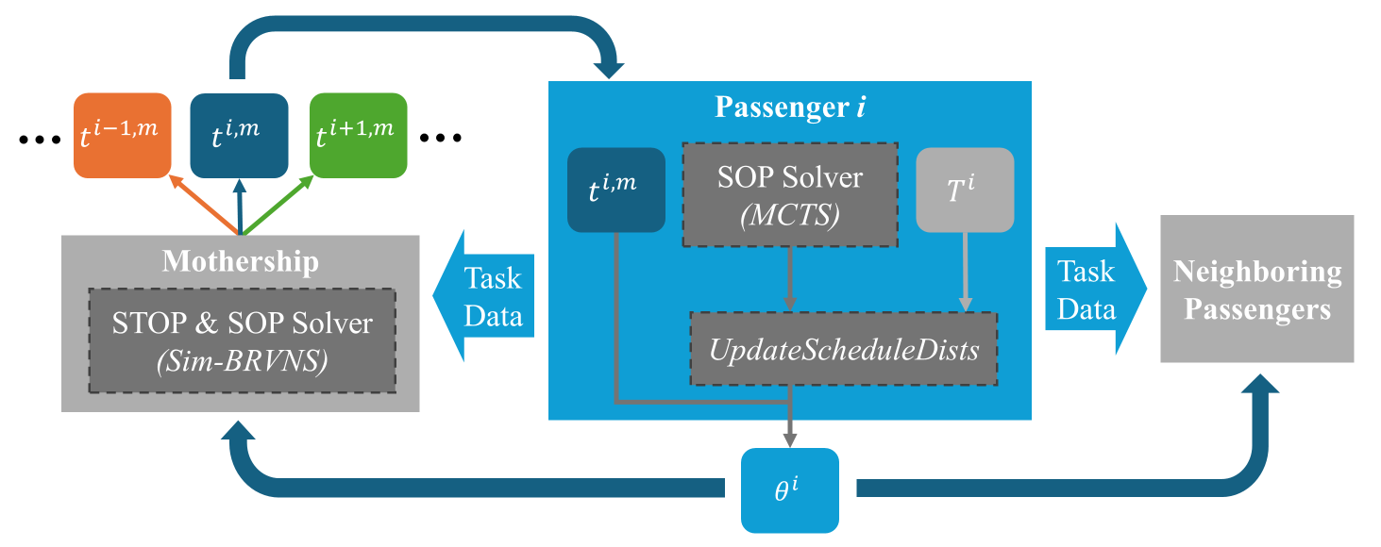
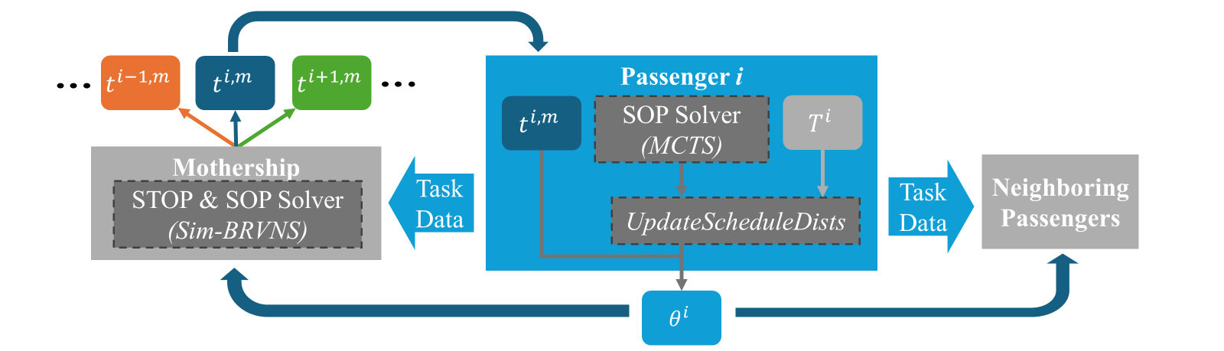

Slide 14
v
v
v
v
v
v
v
v
v
v
v
v
v
v
v
v
v
v
v
M
v
v
v
v
v
v
v
v
v
v
v

Slide 15
V
V
V
V
V
V
V
V
V
V
V
V
V
V
V
V
V
(meters)
V
M
V
V
V
V
V
V
V
V
V
V
V
(meters)

Slide 16
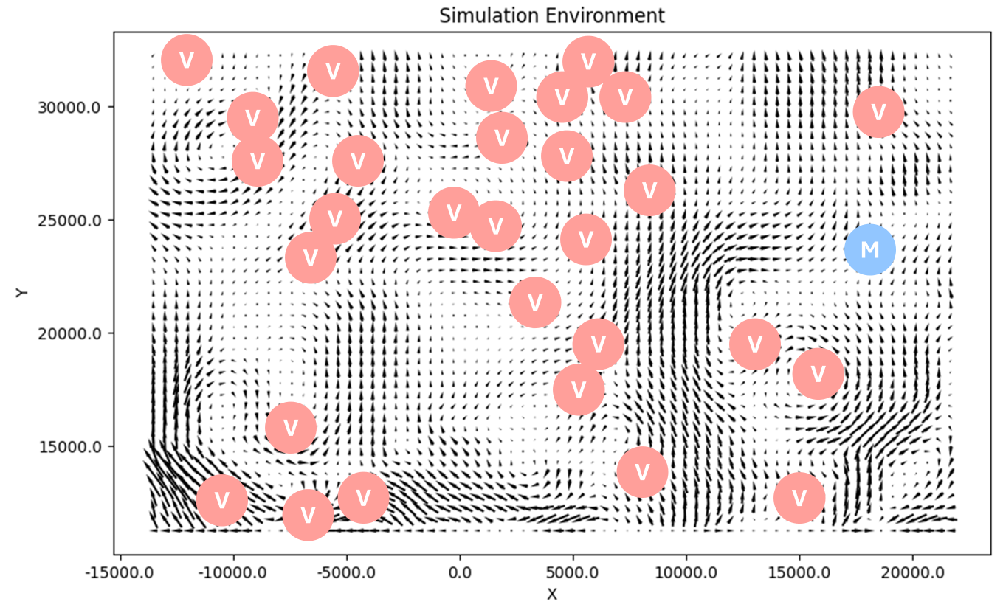
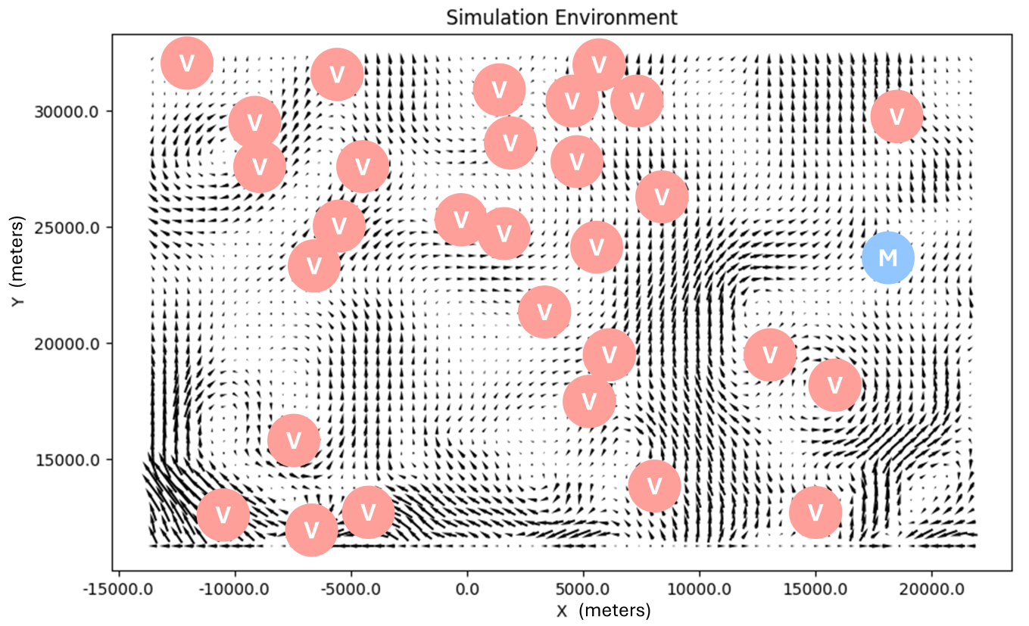
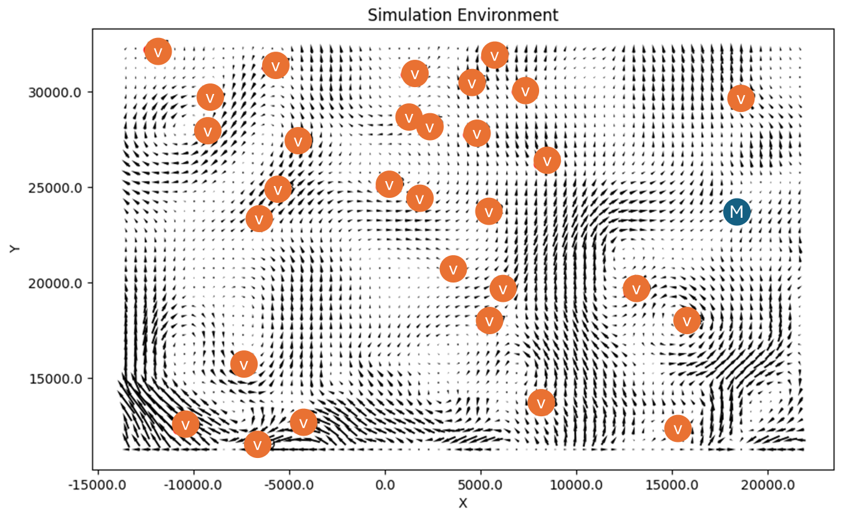
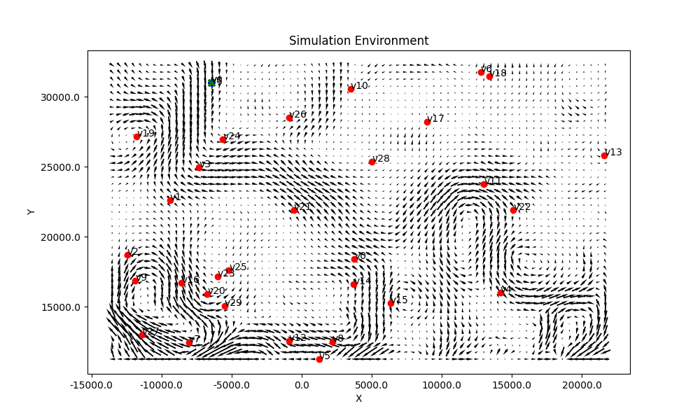

Slide 17
Algo. Variations
FE
D
FE+D
HybDO <- Added
FE+HybD
Should tell us about benefits from FE plan vs benefits from Hyb Dist solver

Slide 18
Displaying Results
% Total Reward
Baseline
2.5% Fail
5% Fail

